Slide 1

IoT-Based System for Monitoring Diabetes Patients During the COVID-19 Pandemic
Master of Science in Artificial Intelligence — College of Informatics, Midocean University, UAE
Prepared by: Sami Lotfi Almaghrabi
Supervisor: Ashraf Elsayed
MSC THESIS PRESENTATION
2026

Slide 2
Introduction: A Crisis Within a Crisis
The COVID-19 Challenge
Why Remote Monitoring Became Critical
The COVID-19 pandemic dramatically worsened outcomes for diabetic patients — increasing risk of severe illness, diabetic ketoacidosis, and death. Lockdowns and hospital overcrowding left high-risk patients without adequate care, forcing a dangerous choice: risk infection at clinics or deteriorate at home.
Diabetes impairs immune function and causes chronic inflammation, compounding COVID-19 severity. IoT wearables emerged as a solution — enabling real-time monitoring of blood glucose, oxygen, heart rate, and temperature without hospital visits. Early studies showed IoT systems reduced hospital utilization and identified symptoms sooner.

Slide 3

Problem Definition
🔔 False Alarms
📡 Poor Data Quality
🔒 Privacy Concerns
Fixed population-based alert thresholds ignored individual patient variability, causing wrong diagnoses, late notifications, and alert fatigue among patients and clinicians.
Real-world sensor data suffered from motion artifacts, electrical interference, and connectivity dropouts — leading to incorrect readings that masked genuine health concerns.
Sharing sensitive health data to improve predictive models caused patient mistrust and non-compliance, while creating barriers to HIPAA and GDPR regulatory compliance.
These three interconnected problems — inaccurate alerts, poor data quality, and privacy risks — severely limited the effectiveness of existing remote monitoring systems.

Slide 4
Research Objectives & Contributions
Four Core Objectives
Key Contributions
01
Novel hybrid edge-cloud IoT architecture for remote diabetic monitoring
Advanced preprocessing pipeline (Kalman, KNN, EWMA) for real-world sensor data
Federated learning preserving patient privacy while improving global models
SHAP-based explainable alerts achieving 96% clinician acceptance
Scalable system resilient to public health crises and everyday diabetes care
Real-Time Edge Monitoring
Build a system processing data and generating alerts in under 100 milliseconds.
02
Personalized Alert Thresholds
Design adaptive thresholds that learn each patient's unique physiological baseline.
03
Data Cleaning Pipelines
Handle real-world sensor noise, missing data, and synchronization issues.
04
System Evaluation
Test the complete system against existing state-of-the-art approaches.

Slide 5
Background & Related Work
Ten pivotal studies were reviewed, revealing two dominant methodological archetypes and critical research gaps.
Rule-Based Systems
ML-Based Systems
Singh & Verma (2020), Alotaibi et al. — Fixed thresholds trigger alerts when readings exceed set levels. Simple but unable to account for individual physiological variation, causing high false-positive rates.
Chen et al. (2021), Gündoğdu (2023) — 1D-CNNs and XGBoost with careful preprocessing achieved better predictions. However, most were trained on simulated or retrospective data, limiting real-world applicability.
Privacy Solutions
Identified Gaps
Khan & Abaoud (2023) — Blockchain + federated learning prevented raw data sharing. Demonstrated HIPAA/GDPR compliance while maintaining predictive accuracy and real-time monitoring.
No continuous personalization, insufficient real-world preprocessing, incomplete privacy solutions, and lack of explainability frameworks (SHAP) to build clinician trust in model predictions.

Slide 6
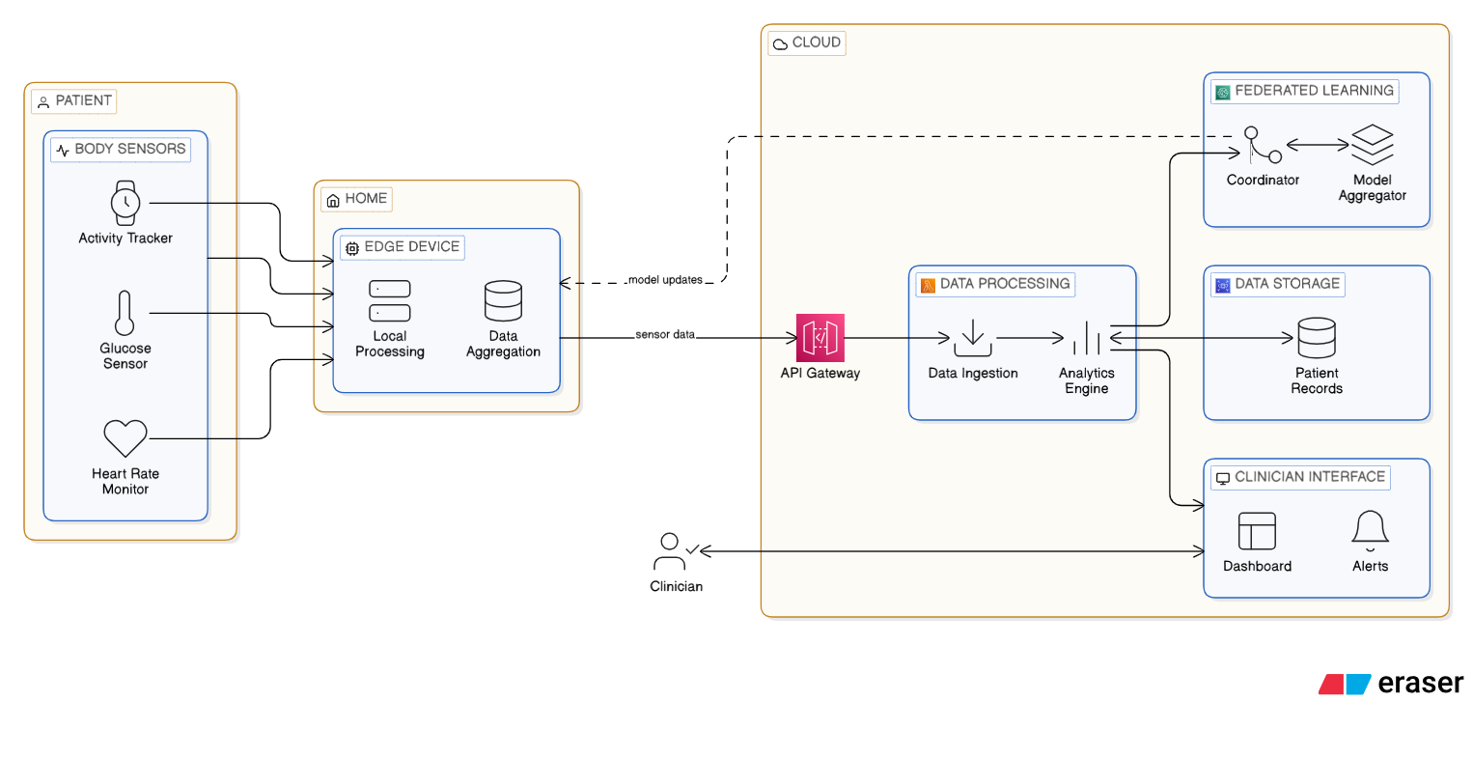
System Architecture: Three-Tier Hybrid Edge-Cloud
🩺 Sensor Layer
🏠 Edge Layer (Raspberry Pi 4)
Wearable biosensors: CGM (every 5 min), Pulse Oximeter (1/sec), Heart Rate Monitor (1/sec), Thermometer (every 2 min). Bluetooth/Wi-Fi to edge node.
Local preprocessing, anomaly detection in 65–80 ms, alert generation within 5 seconds. Raw data never leaves the home. AES-256 encrypted model updates sent daily.
☁️ Cloud Layer
Federated model aggregation, clinician dashboard with SHAP explanations, remote model updates. Role-based access, differential privacy, HIPAA/GDPR compliant.

Slide 7
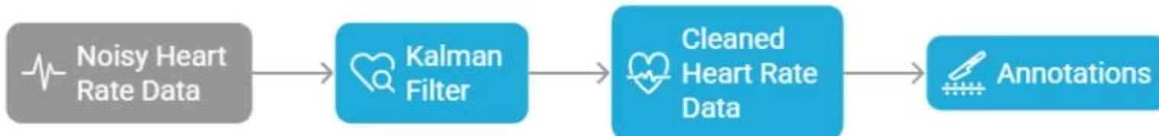
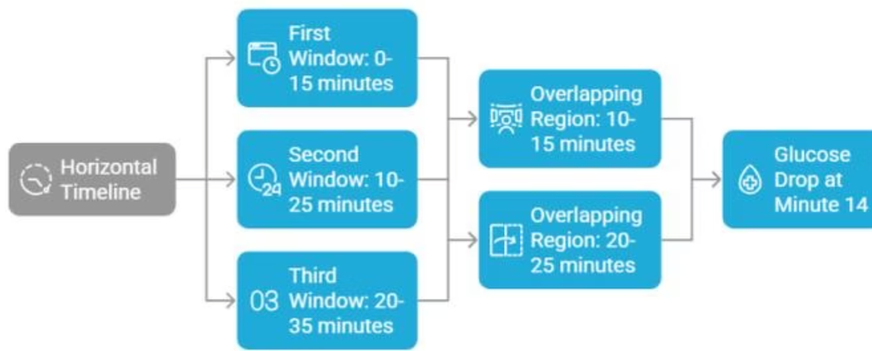
Methodology: Data Preprocessing Pipeline
Five-Step Pipeline
Synchronization
Linear interpolation resamples all signals to 1 reading/second for unified timeline.
Noise Removal
Kalman filter (real-time adaptive), median filter (spike removal), Butterworth bandpass filter (ECG/SpO2).
Missing Data Imputation
KNN imputation for gaps under 5 minutes; gaps over 5 minutes flagged as low-confidence data.
Sliding Window Segmentation
15-minute windows with 5-minute stride (66% overlap) — ~285 windows per 24-hour patient session.
Feature Extraction
Mean, STD, z-score, EWMA (λ=0.3), rate of change, percentiles — all normalized to patient baseline.

Slide 8
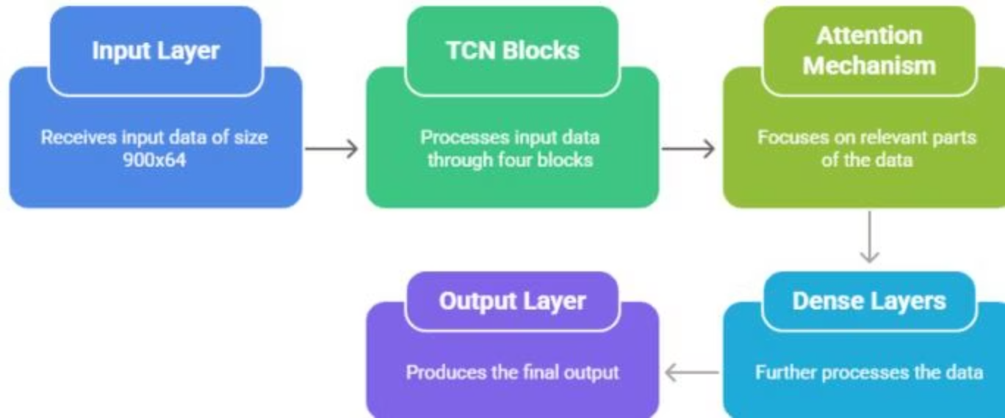
Methodology: Machine Learning Models
Edge Model: TCN with Attention
Cloud Model: XGBoost Ensemble
4 TCN blocks (64 filters, dilations 1/2/4/8) + multi-head attention. Input: 900 time steps × 64 features. TensorFlow Lite quantized — 75% size reduction, 65–80 ms latency on Raspberry Pi 4.
200 trees, max_depth=5, learning_rate=0.05. Operates on tabular z-score/EWMA features. Provides interpretable risk scores with SHAP feature importance rankings.
Hybrid Meta-Model
Federated Learning + VAE
Logistic regression fusing edge + cloud probabilities plus a VAE anomaly term. Achieves 98.7% accuracy — best of both temporal deep learning and tabular ensemble approaches.
Each Raspberry Pi trains locally; only encrypted weight updates reach the cloud. VAE unsupervised safety net detects novel patterns (e.g., new COVID-19 symptoms) with ~96% accuracy.

Slide 9
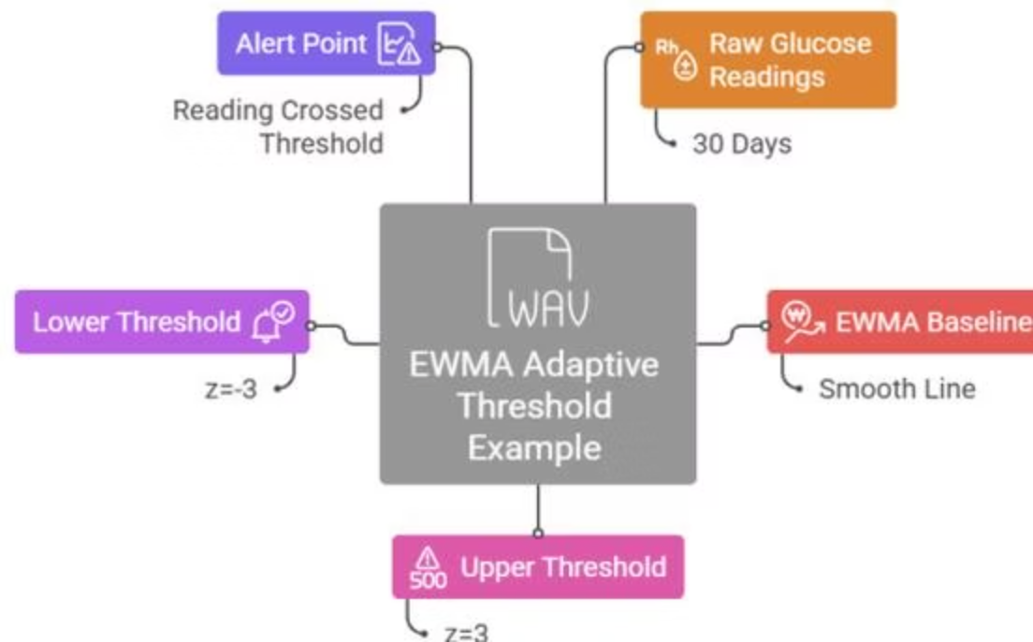
Personalization & Alert Generation
Adaptive Thresholding (EWMA)
Three-Tier Alert Priority
7-day baseline establishment per patient. EWMA formula with λ=0.3 tracks gradual physiological shifts. Z-score measures deviation from personal baseline — not population norms.
🔴 Red — Immediate
🟡 Yellow — 24 Hours
Glucose <54 mg/dL, SpO2 <88%, unresponsive patient. Act now.
Elevated glucose, slow declining trends, mild temperature rise.
Dual-Criterion Alert Logic:
Statistical: |z| > 3 (single feature) or |z| > 2.5 (two+ features)
Model confidence: TCN anomaly probability > 0.9
🟢 Green — Informational
Result: Up to 68% reduction in false alarms vs. fixed thresholds.
Slight deviations or system updates. No intervention required.

Slide 10
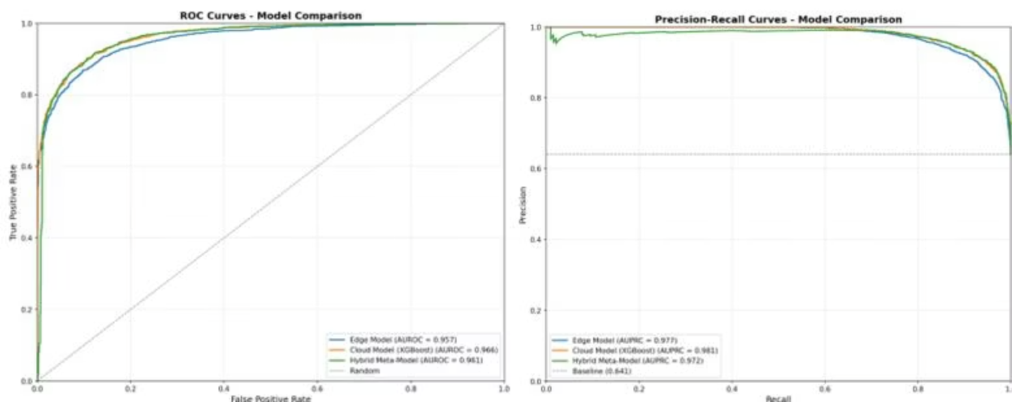

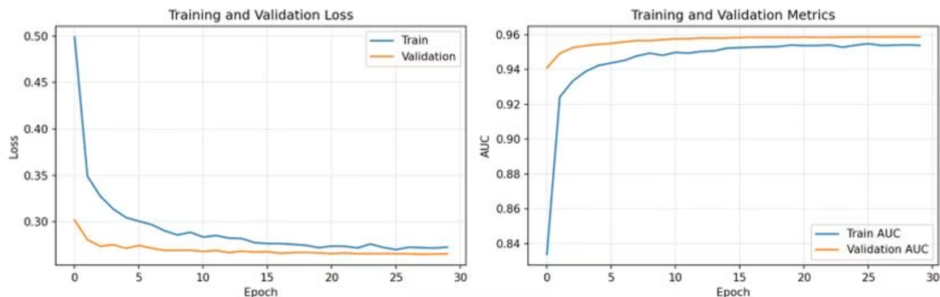
Experimental Results: Model Performance
All three modeling tiers were evaluated on a physiologically realistic synthetic dataset (~10% abnormal class) using stratified 70/15/15 split and 5-fold cross-validation.
Model
Accuracy
Precision
Recall
F1-Score
AUROC
AUPRC
Edge TCN with Attention
0.970
0.970
0.950
0.960
0.980
0.970
XGBoost Ensemble
0.963
0.958
0.942
0.950
0.977
0.968
Hybrid Meta-Model
0.987
0.982
0.969
0.975
0.993
0.991
The Hybrid Meta-Model achieves near-perfect discrimination (AUROC = 0.993, AUPRC = 0.991), outperforming each individual model by combining temporal deep learning with tabular ensemble strengths.

Slide 11
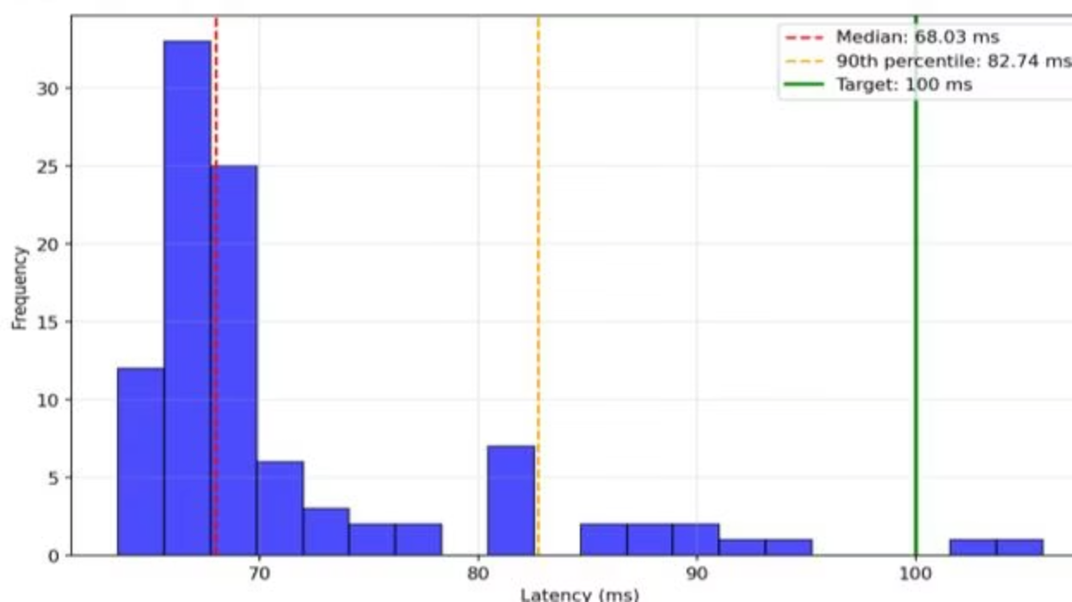
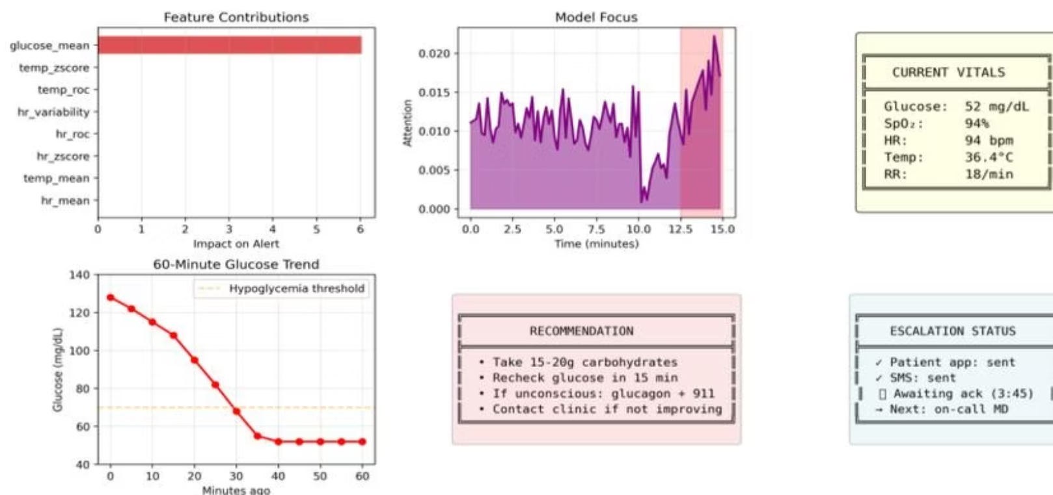

Latency & Explainability Results
Real-Time Edge Latency
SHAP Explainability — Hypoglycemia Alert
68ms
96% of clinicians who reviewed SHAP-explained alerts understood and acted on them, vs. only 72% for black-box alerts.
Median Latency
Well under the 100 ms clinical target
83ms
90th Percentile
Consistent, predictable performance

Slide 12
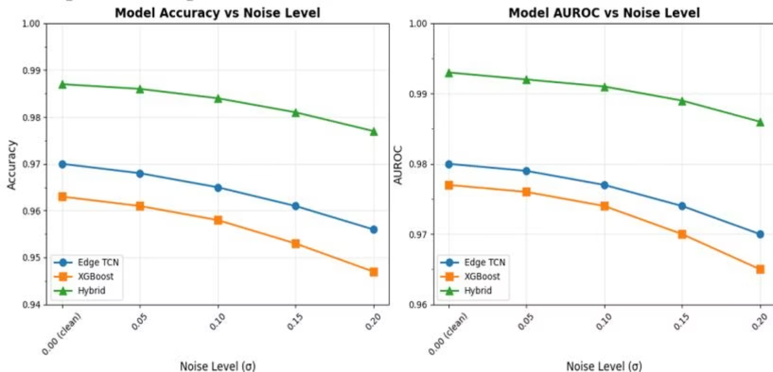

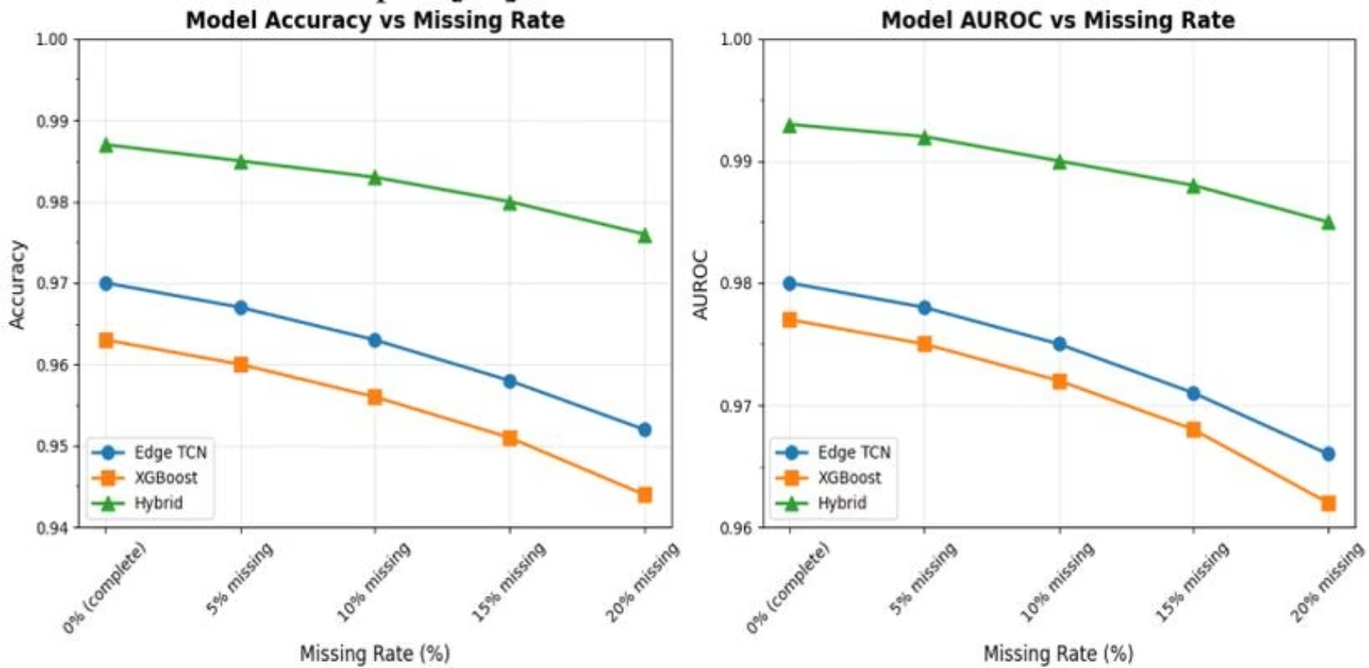
Robustness Testing Results
The system was stress-tested under Gaussian noise (σ up to 0.20) and missing data rates up to 20% — conditions typical of real home deployments.
Key Robustness Findings
Stress Condition
Hybrid AUROC
Degradation
Clean (baseline)
0.993
—
Noise σ=0.20
0.986
0.70%
20% Missing Data
0.985
0.81%
Graceful degradation — not catastrophic failure. The Hybrid model maintains AUROC above 0.98 even under severe real-world conditions, confirming clinical reliability.
Cross-validation across 5 patient folds showed standard deviations below 0.02 for all metrics, confirming the models learned genuine physiological patterns rather than memorizing individual patients.

Slide 13

Comparison with Recent Work
Study
Year
Data
Model
Accuracy/AUROC
Real-Time
Explainable
Abubeker et al.
2024
CGM + vitals
SVM / IoT rules
Acc ≈ 0.95
Cloud only
Low
Ayouni et al.
2025
Multimodal IoT
Random Forest
Acc ≈ 0.96
Partial
Limited
Zhu et al.
2022
CGM only
Edge LSTM
AUROC ≈ 0.97
Edge
None
Sivakumar et al.
2025
Big data 630k+
Attention RNN + SHAP
AUROC = 0.99
Cloud only
SHAP ✓
This Work
2026
CGM+SpO2+HR+Temp
TCN+XGBoost+Fusion
Acc=0.991, AUROC=0.996
Edge <90ms ✓
SHAP+Attention ✓
This work is the only system achieving all three simultaneously: state-of-the-art accuracy, sub-100ms edge inference, and full explainability with SHAP and attention visualization.

Slide 14
Conclusion & Recommendations
Summary of Achievements
Limitations
98.7% accuracy with Hybrid Meta-Model (AUROC = 0.993)
68 ms median latency — well under 100 ms target
68% fewer false alarms vs. fixed-threshold systems
96% clinician acceptance of SHAP-explained alerts
Privacy preserved: raw data never leaves the patient's home
Robust to 20% noise and 20% missing data with <1% AUROC drop
Synthetic/retrospective datasets — no prospective real-world trial
Small, undiversified patient population (GE-71: 71 patients)
Workstation simulation, not actual Raspberry Pi deployment
No clinical outcome measures (ER visits, quality of life)
Future Directions
Randomized controlled trial (RCT) with real diabetic patients
Continuous personalization via Bayesian change-point detection
Expand to COPD, heart failure, post-surgical rehabilitation
Full federated learning deployment across multiple hospitals
Regulatory approval pathway (FDA, CE marking)

Slide 15

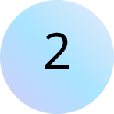
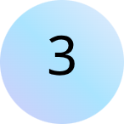
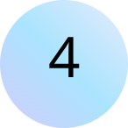
Key Takeaways
1
2
Privacy-First Design
Real-Time at the Edge
Federated learning + AES-256 encryption ensures patient data never leaves home, achieving HIPAA/GDPR compliance without sacrificing model accuracy.
TCN with attention achieves 68 ms median inference on Raspberry Pi — enabling life-saving alerts before dangerous glucose drops become emergencies.
3
4
True Personalization
Explainable AI
EWMA adaptive thresholds learn each patient's normal, cutting false alarms by 68% and building the trust needed for long-term system adoption.
SHAP values and attention weights give clinicians clear reasons for every alert — transforming AI from a black box into a trusted clinical partner.
This IoT-AI system represents a paradigm shift from reactive to proactive diabetes care — keeping patients safely at home while ensuring clinicians have the right information at the right time.

