Slide 1


Flutter & Dart Complete Guide
Prepared by Eng. Yousef Salah Kassem
DAFL 3
Architecture Pattern and Clean Code
Lecture 7

Slide 2
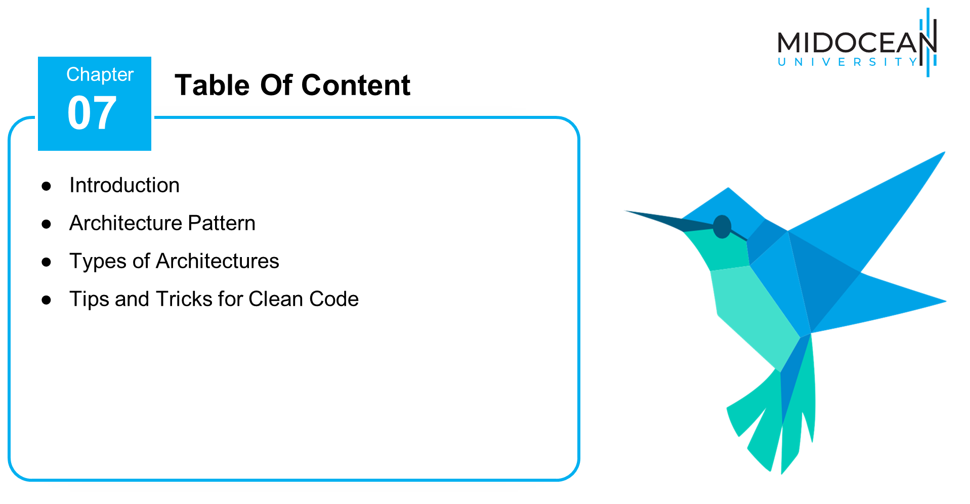

Slide 3



Slide 4
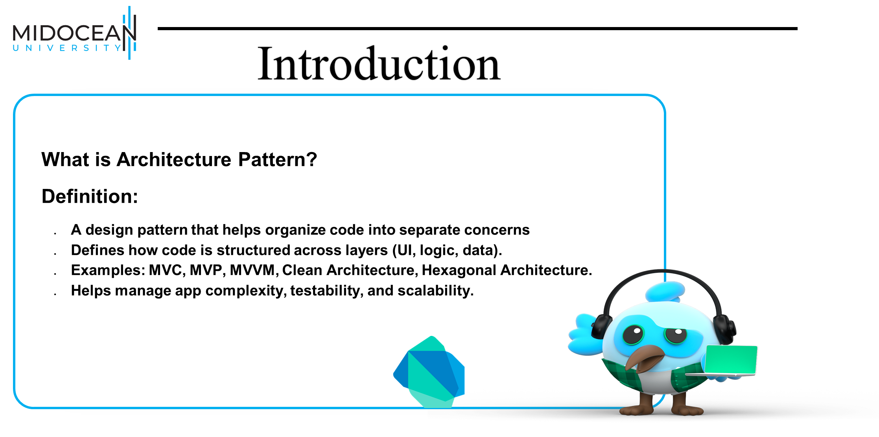

Slide 5
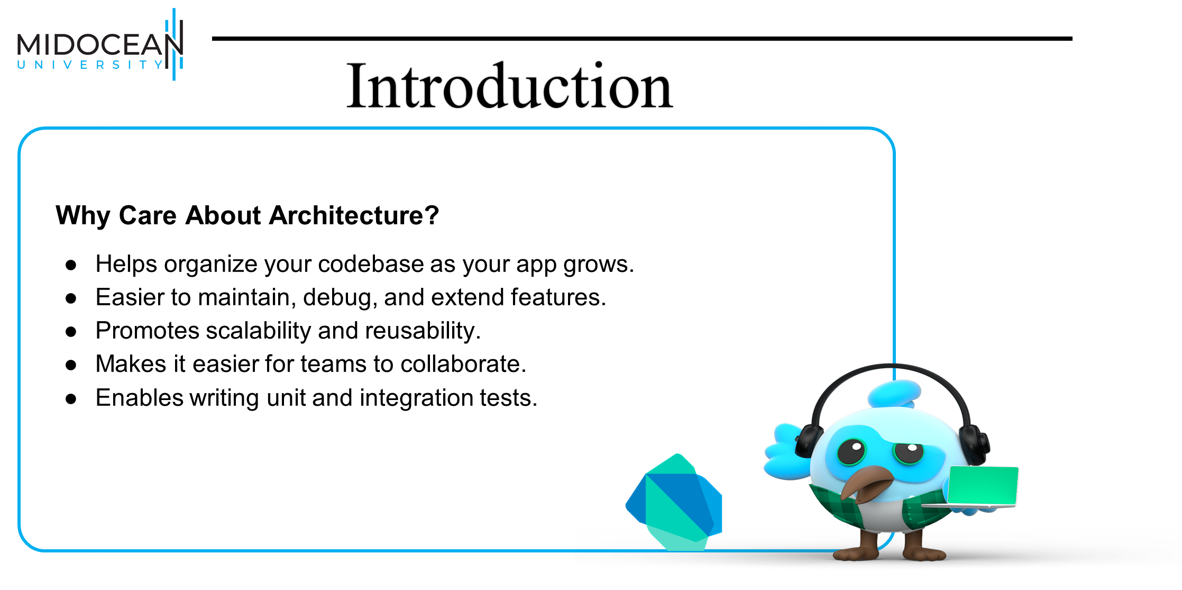

Slide 6
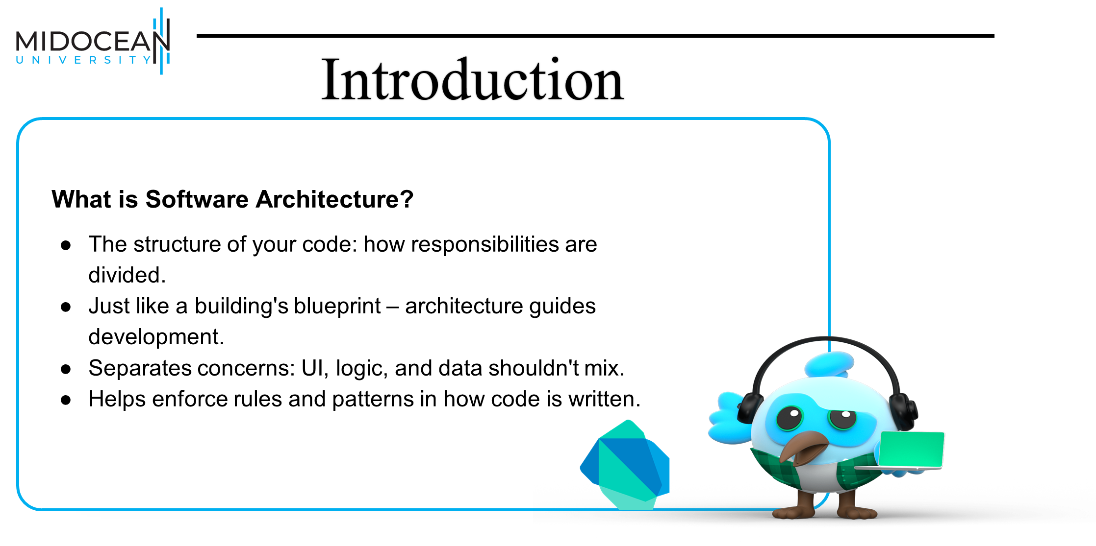

Slide 7


Slide 8
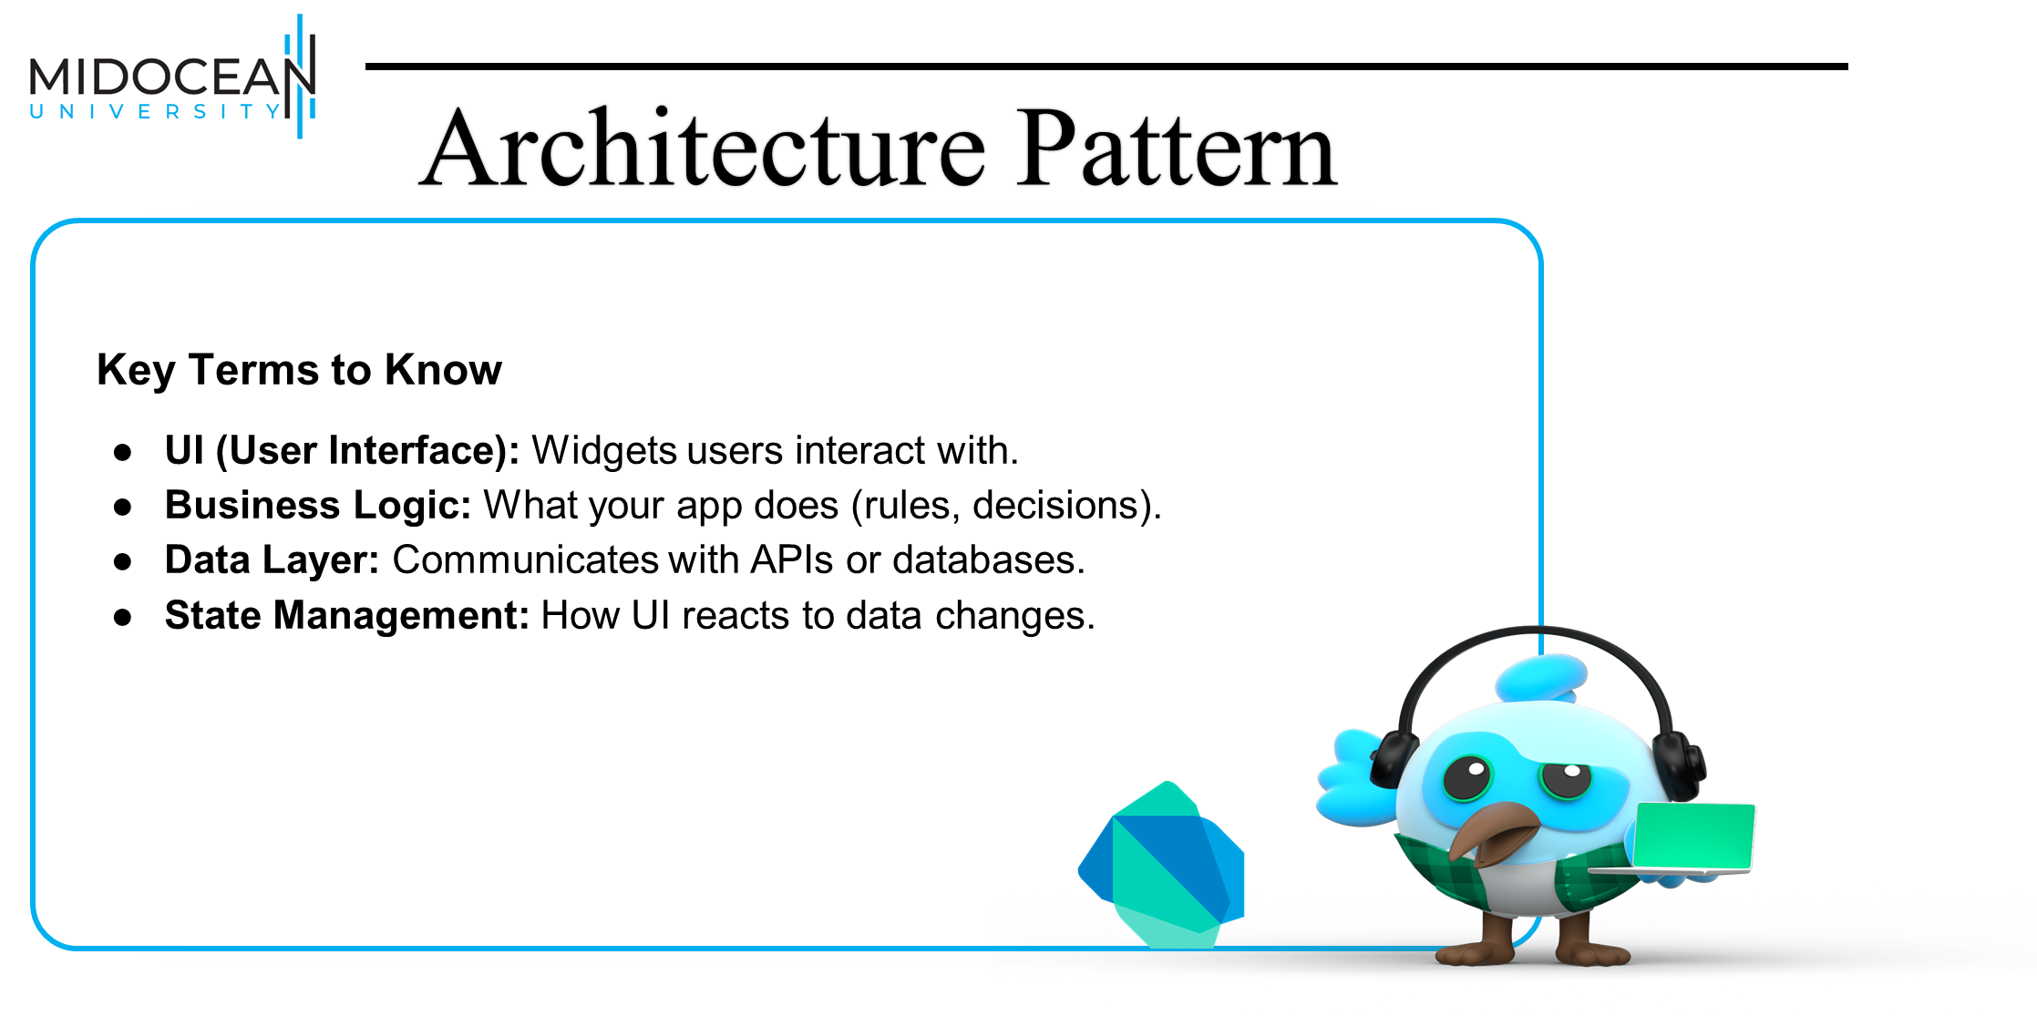

Slide 10
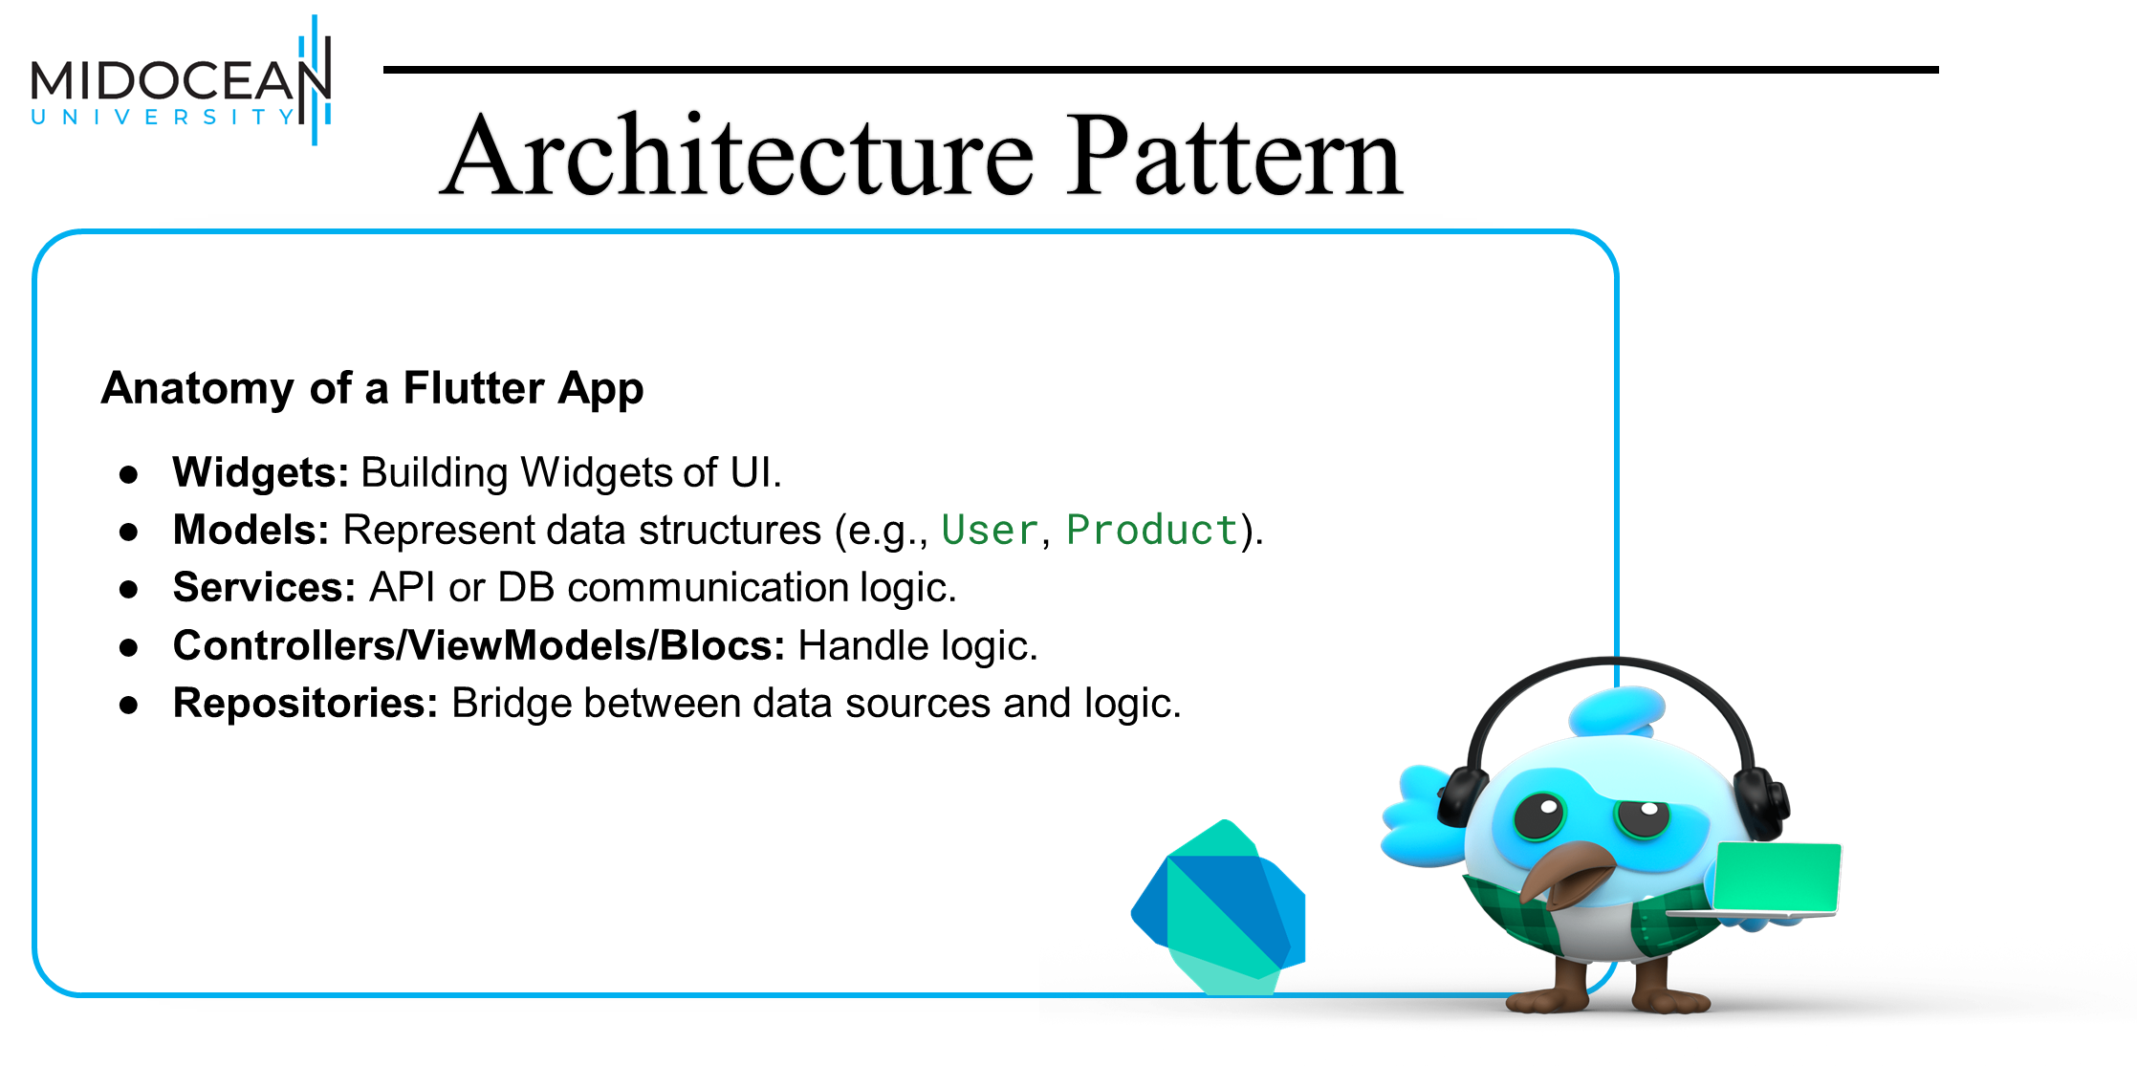

Slide 11


Slide 12
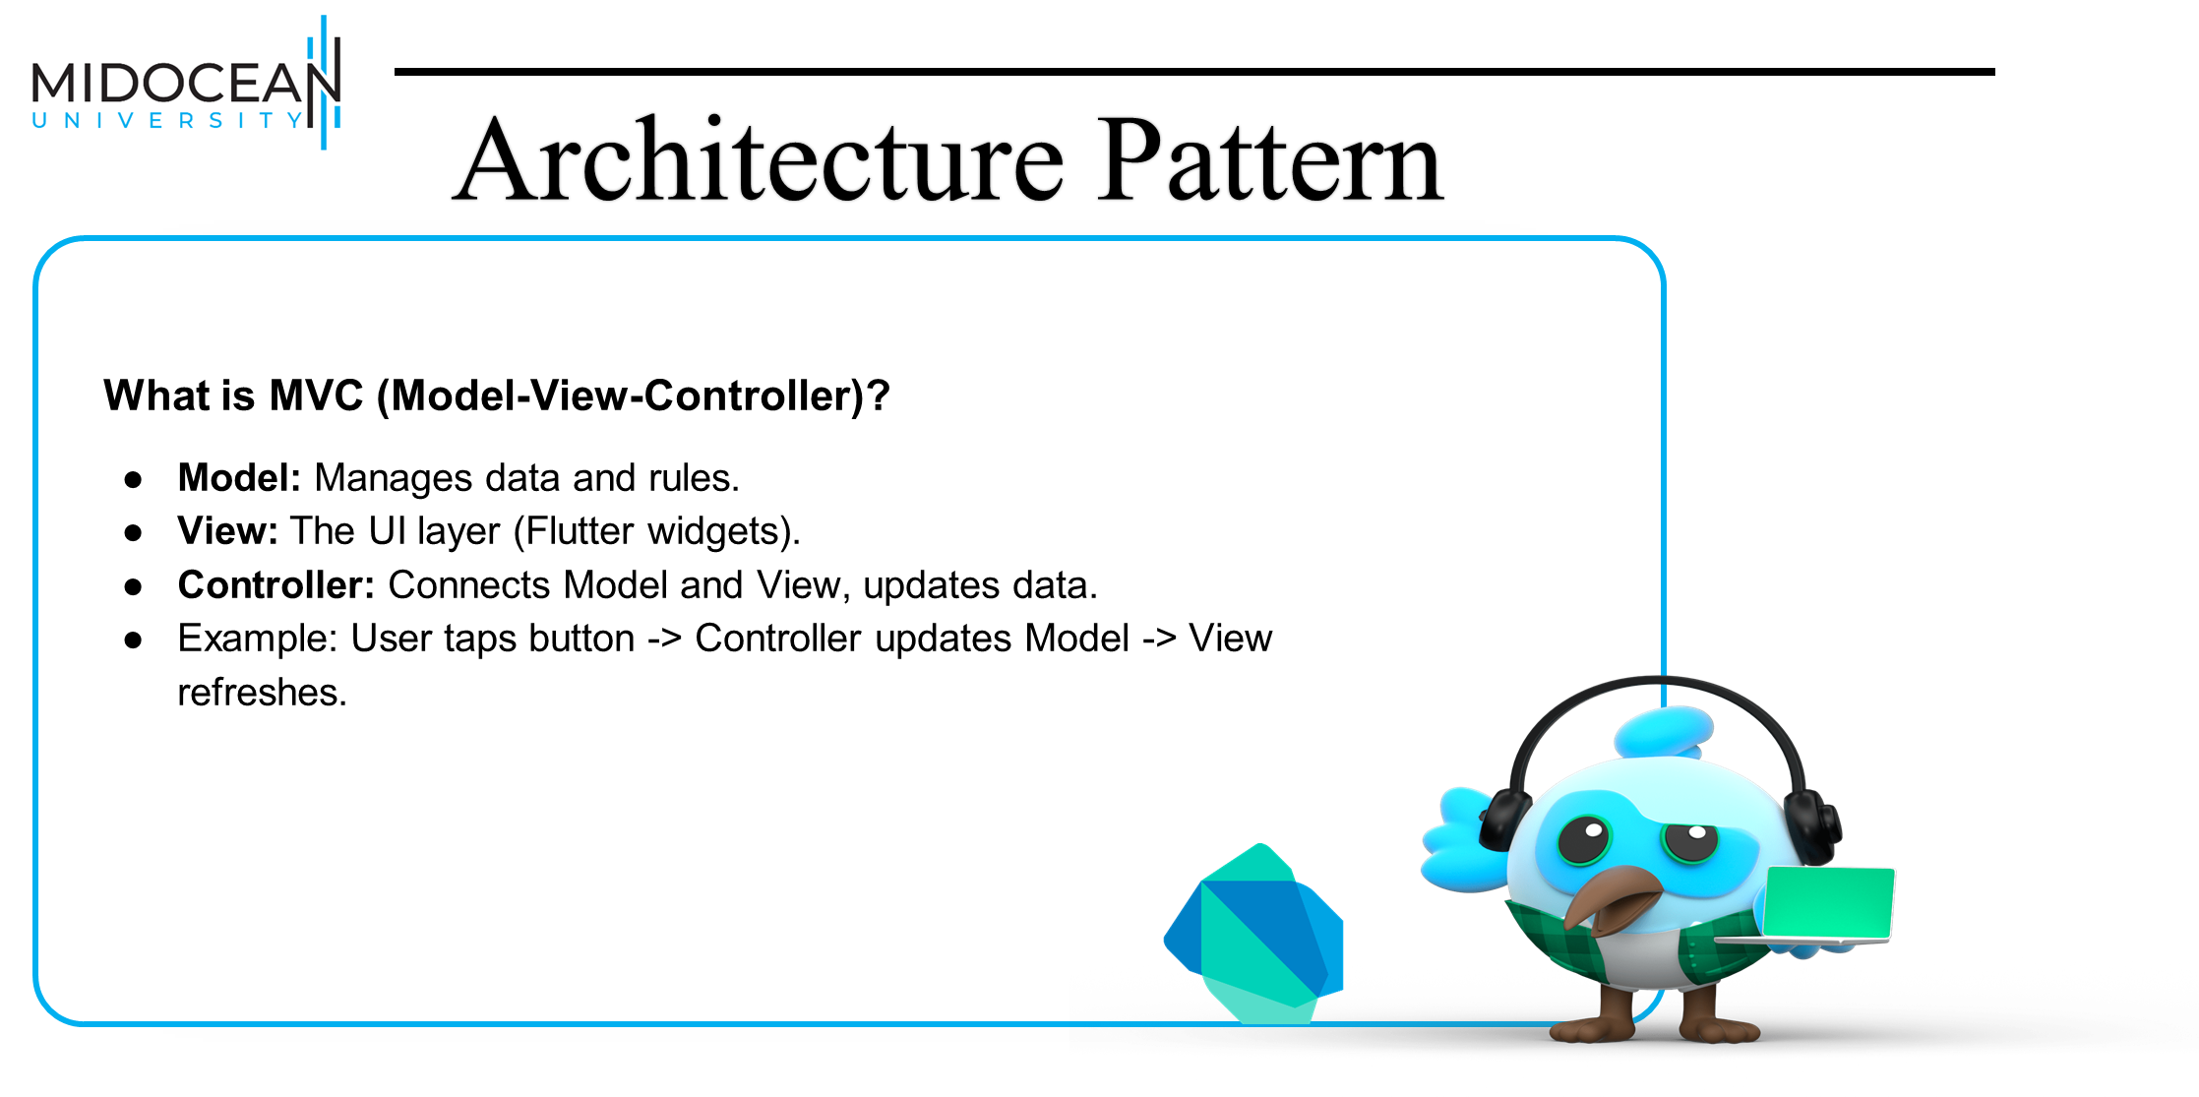

Slide 13
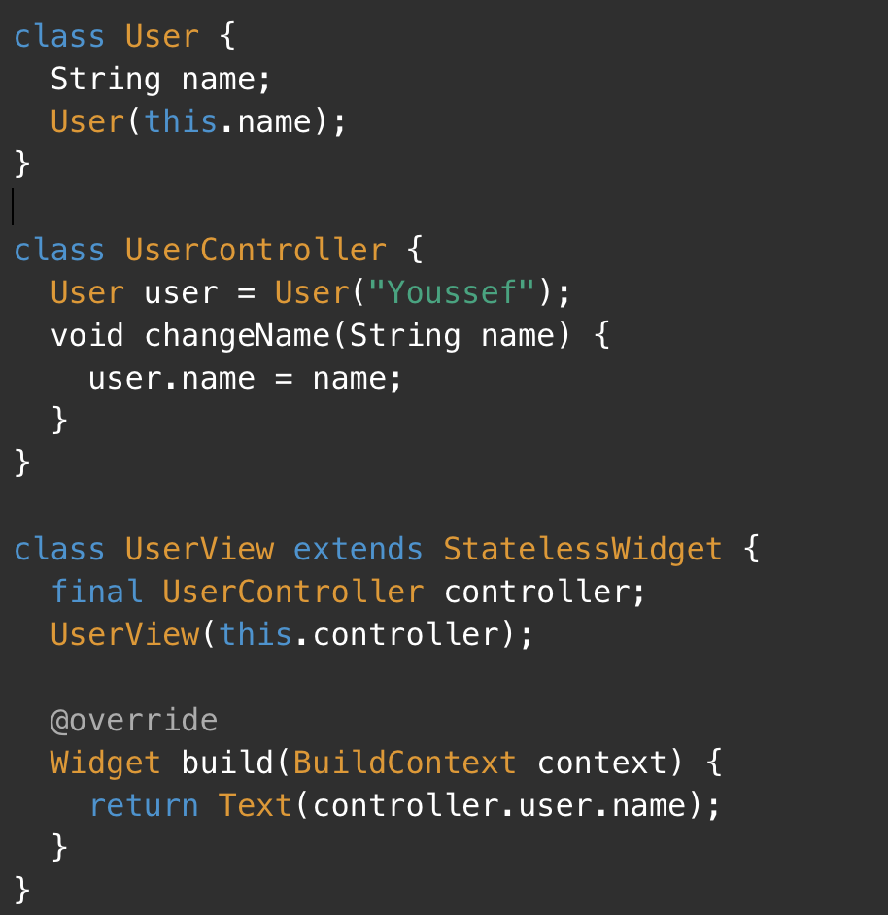

Slide 14
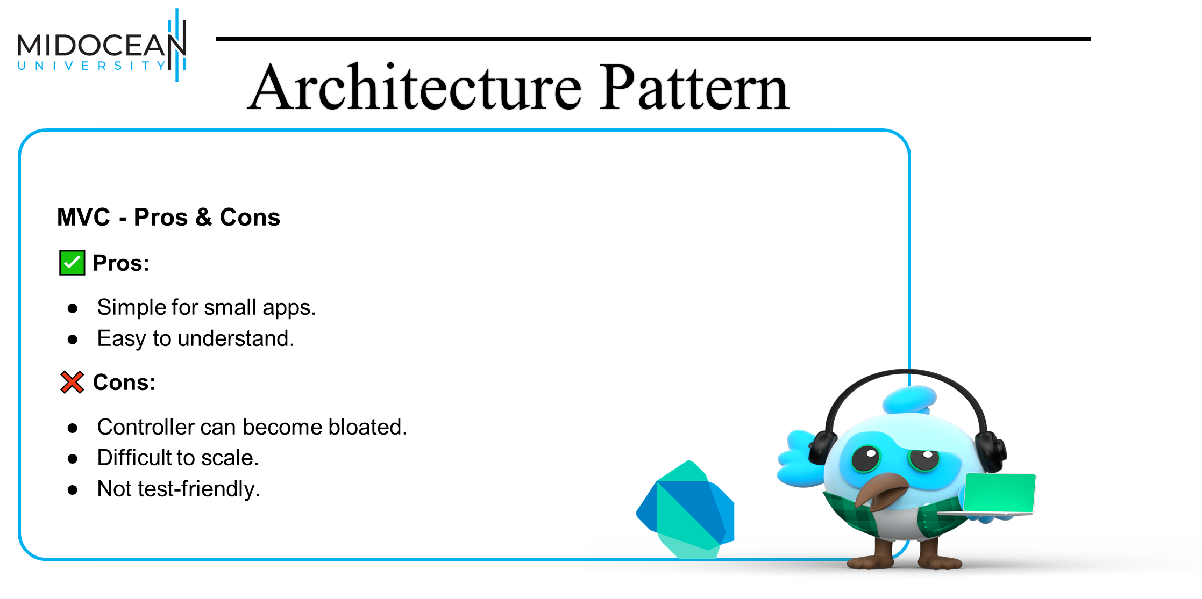

Slide 15
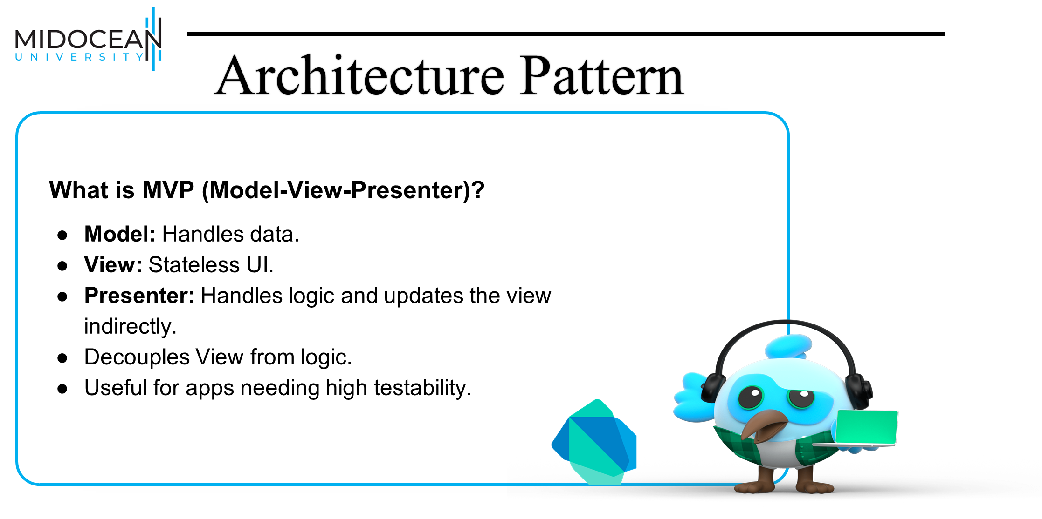

Slide 16
abstract class UserView {
void updateUserName(String name);
}
class UserPresenter {
final UserView view;
UserPresenter(this.view);
void loadUser() {
view.updateUserName("Ahmed");
}
}
class UserWidget extends StatelessWidget implements UserView {
String name = "";
late final presenter = UserPresenter(this);
@override
Widget build(BuildContext context) {
presenter.loadUser();
return Text(name);
}
@override
void updateUserName(String name) {
this.name = name;
}
}

Slide 17


Slide 18
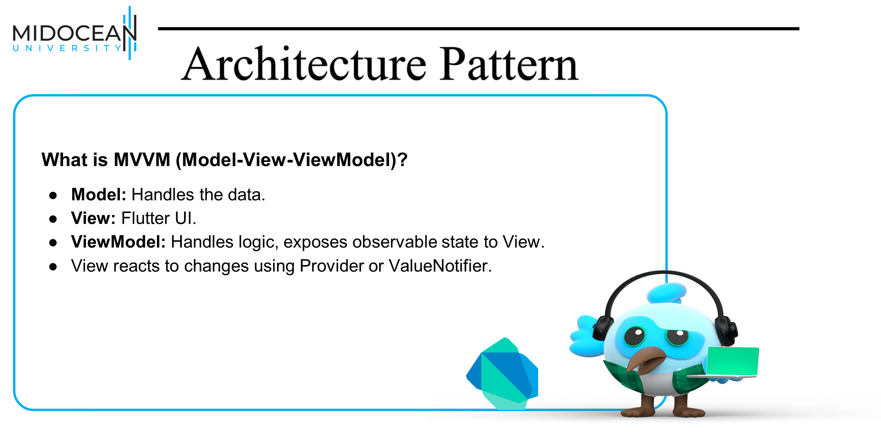

Slide 19
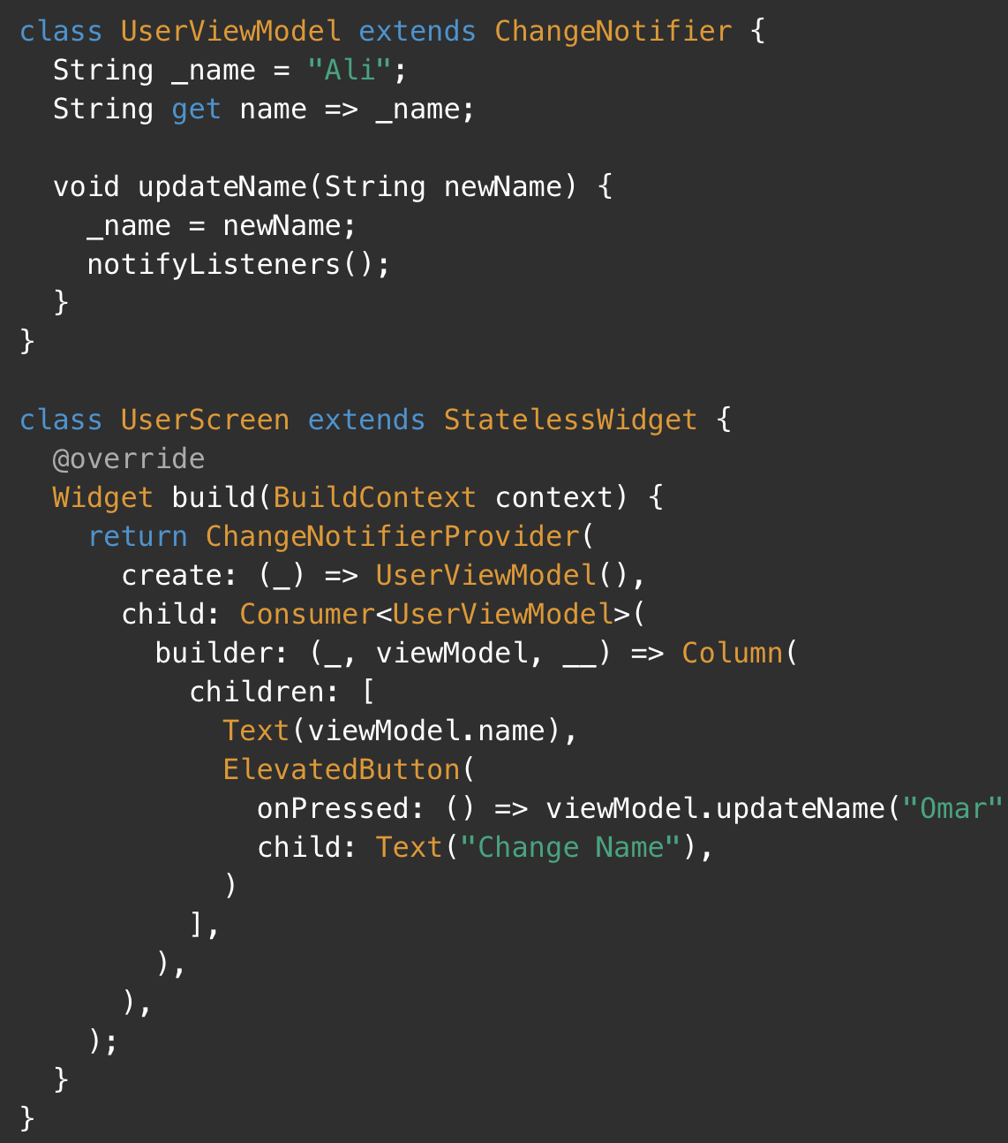

Slide 20
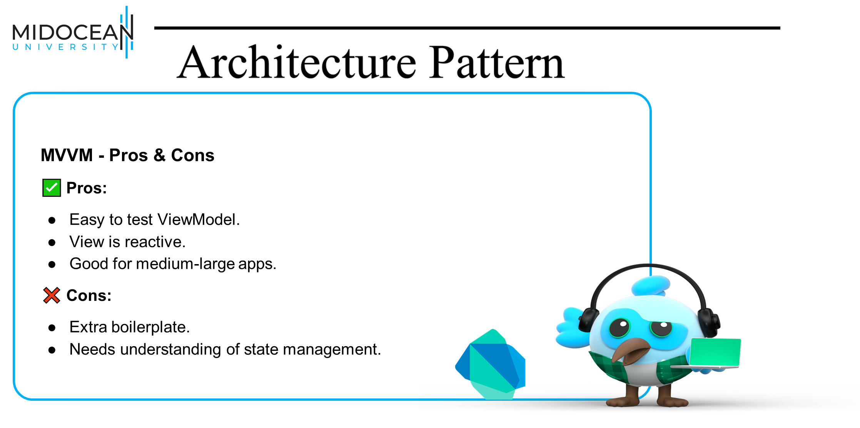

Slide 21
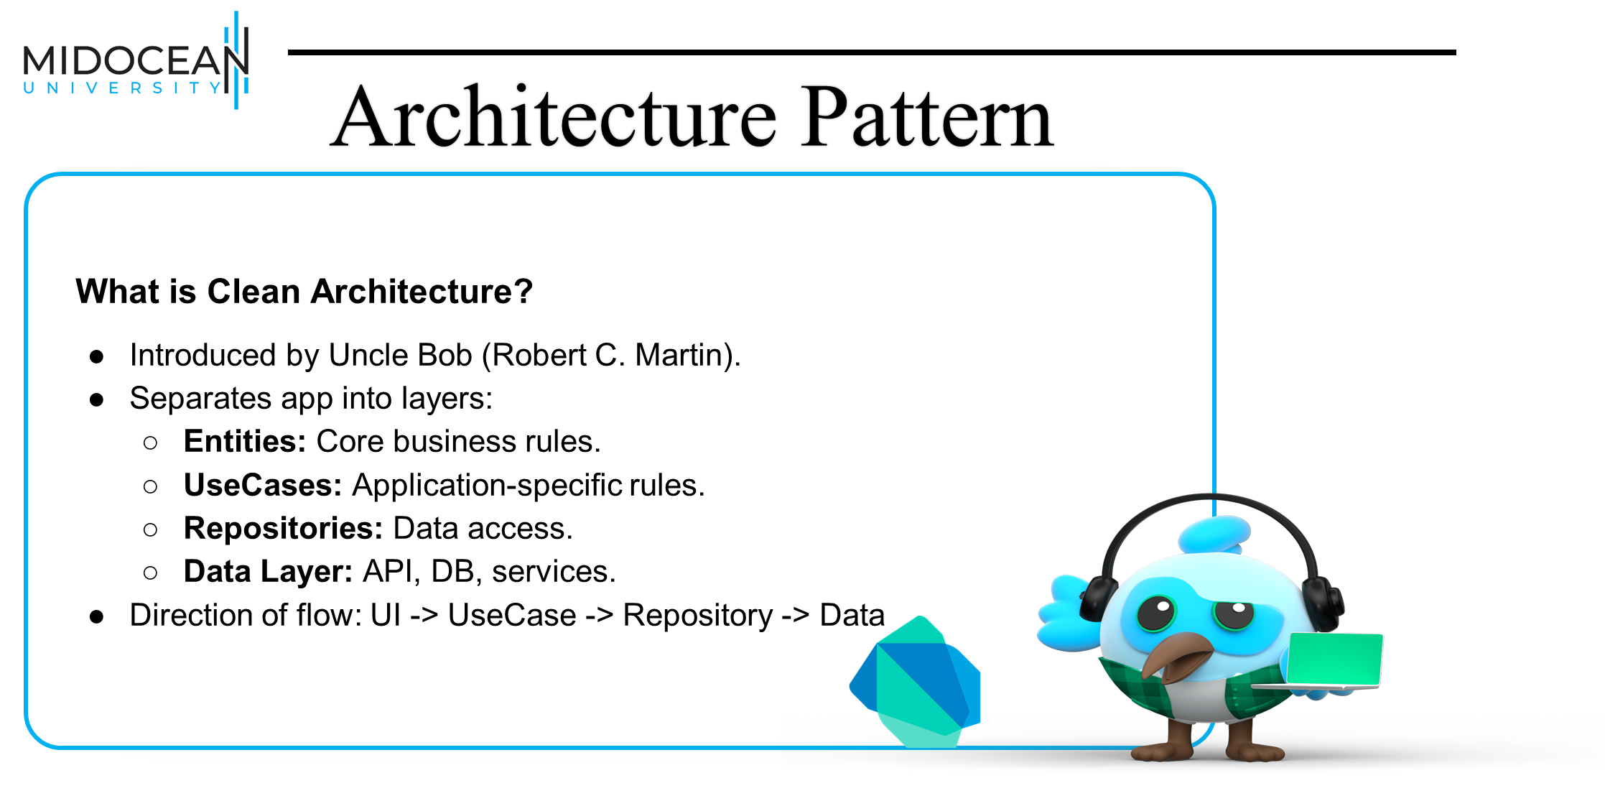

Slide 22
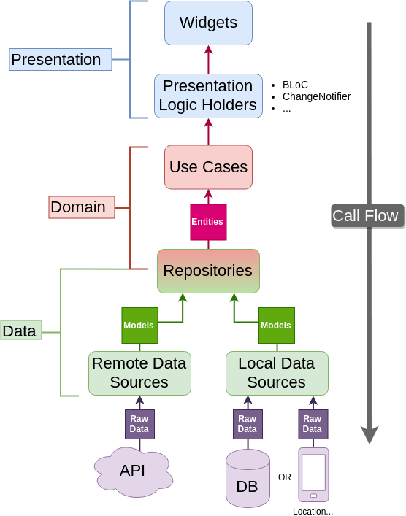

Slide 23
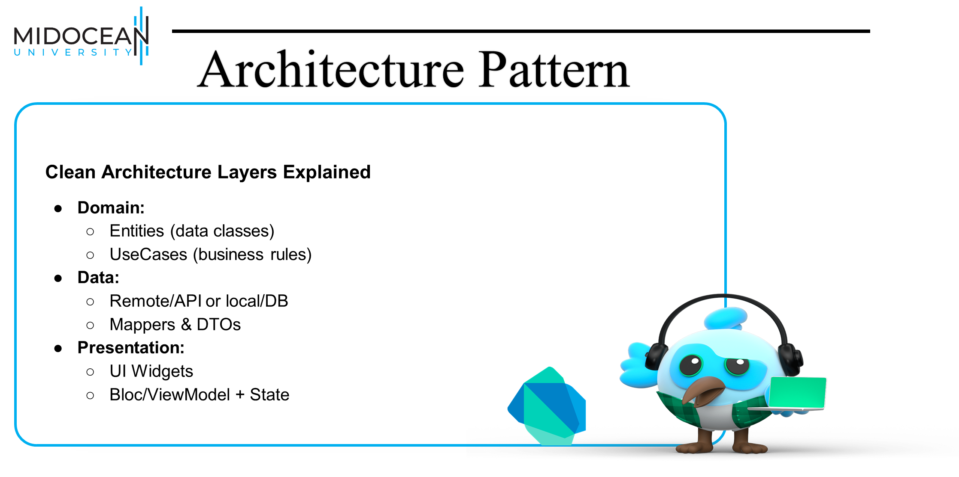

Slide 24
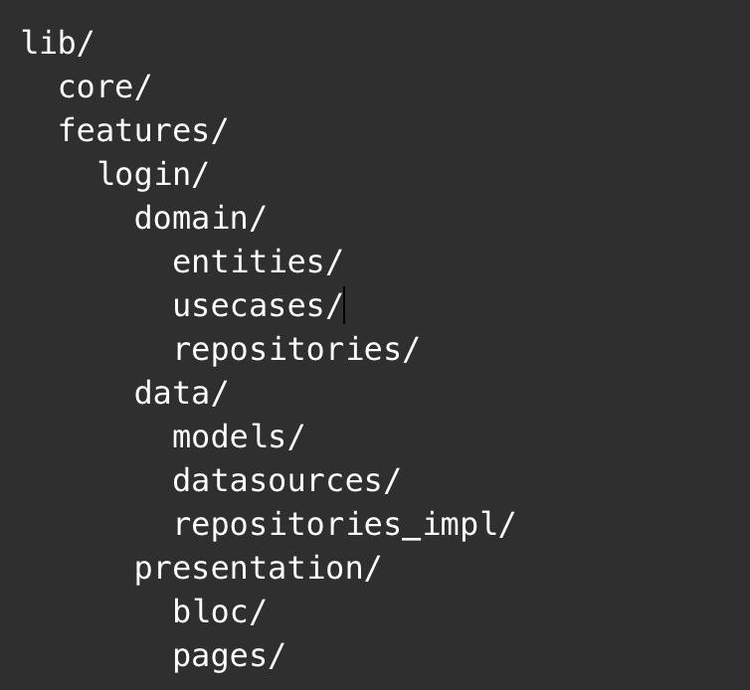

Architecture Pattern
Clean Architecture Folder
Structure

Slide 25
final loginProvider = Provider((ref) => LoginUseCase(ref.read(authRepoProvider)));
class LoginUseCase {
final AuthRepository repo;
LoginUseCase(this.repo);
Future<User> execute(String email, String pwd) {
return repo.login(email, pwd);
}
}

Slide 26
final loginNotifierProvider = StateNotifierProvider<LoginNotifier, AsyncValue<User>>((ref) {
final loginUseCase = ref.read(loginProvider);
return LoginNotifier(loginUseCase);
});
class LoginNotifier extends StateNotifier<AsyncValue<User>> {
final LoginUseCase useCase;
LoginNotifier(this.useCase) : super(const AsyncValue.data(User.empty()));
Future<void> login(String email, String pwd) async {
state = const AsyncValue.loading();
try {
final user = await useCase.execute(email, pwd);
state = AsyncValue.data(user);
} catch (e, st) {
state = AsyncValue.error(e, st);
}
}
}

Slide 27
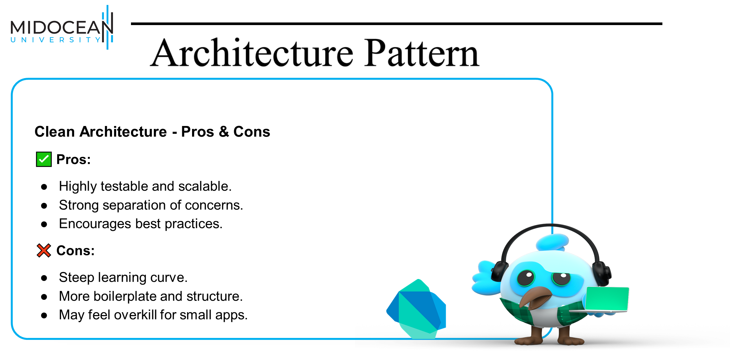

Slide 28


Slide 29
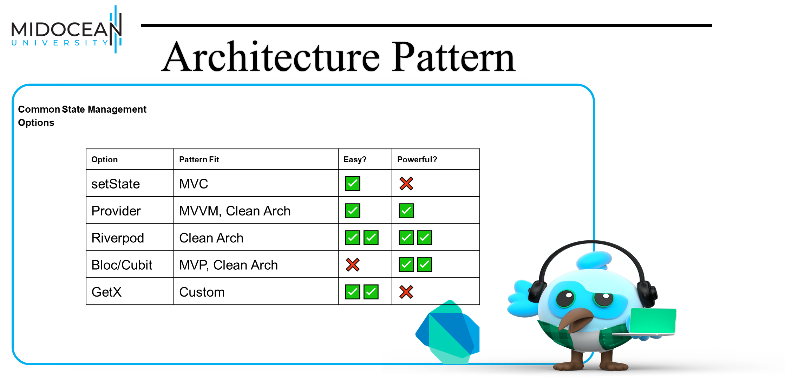

Slide 30
Using Provider in MVVM
final counterProvider = ChangeNotifierProvider((_) => CounterViewModel());
class CounterViewModel extends ChangeNotifier {
int count = 0;
void increment() {
count++;
notifyListeners();
}
}
class CounterView extends StatelessWidget {
@override
Widget build(BuildContext context) {
final vm = context.watch<CounterViewModel>();
return Column(
children: [
Text('${vm.count}'),
ElevatedButton(onPressed: vm.increment, child: Text('Add')),
],
);
}
}

Slide 31
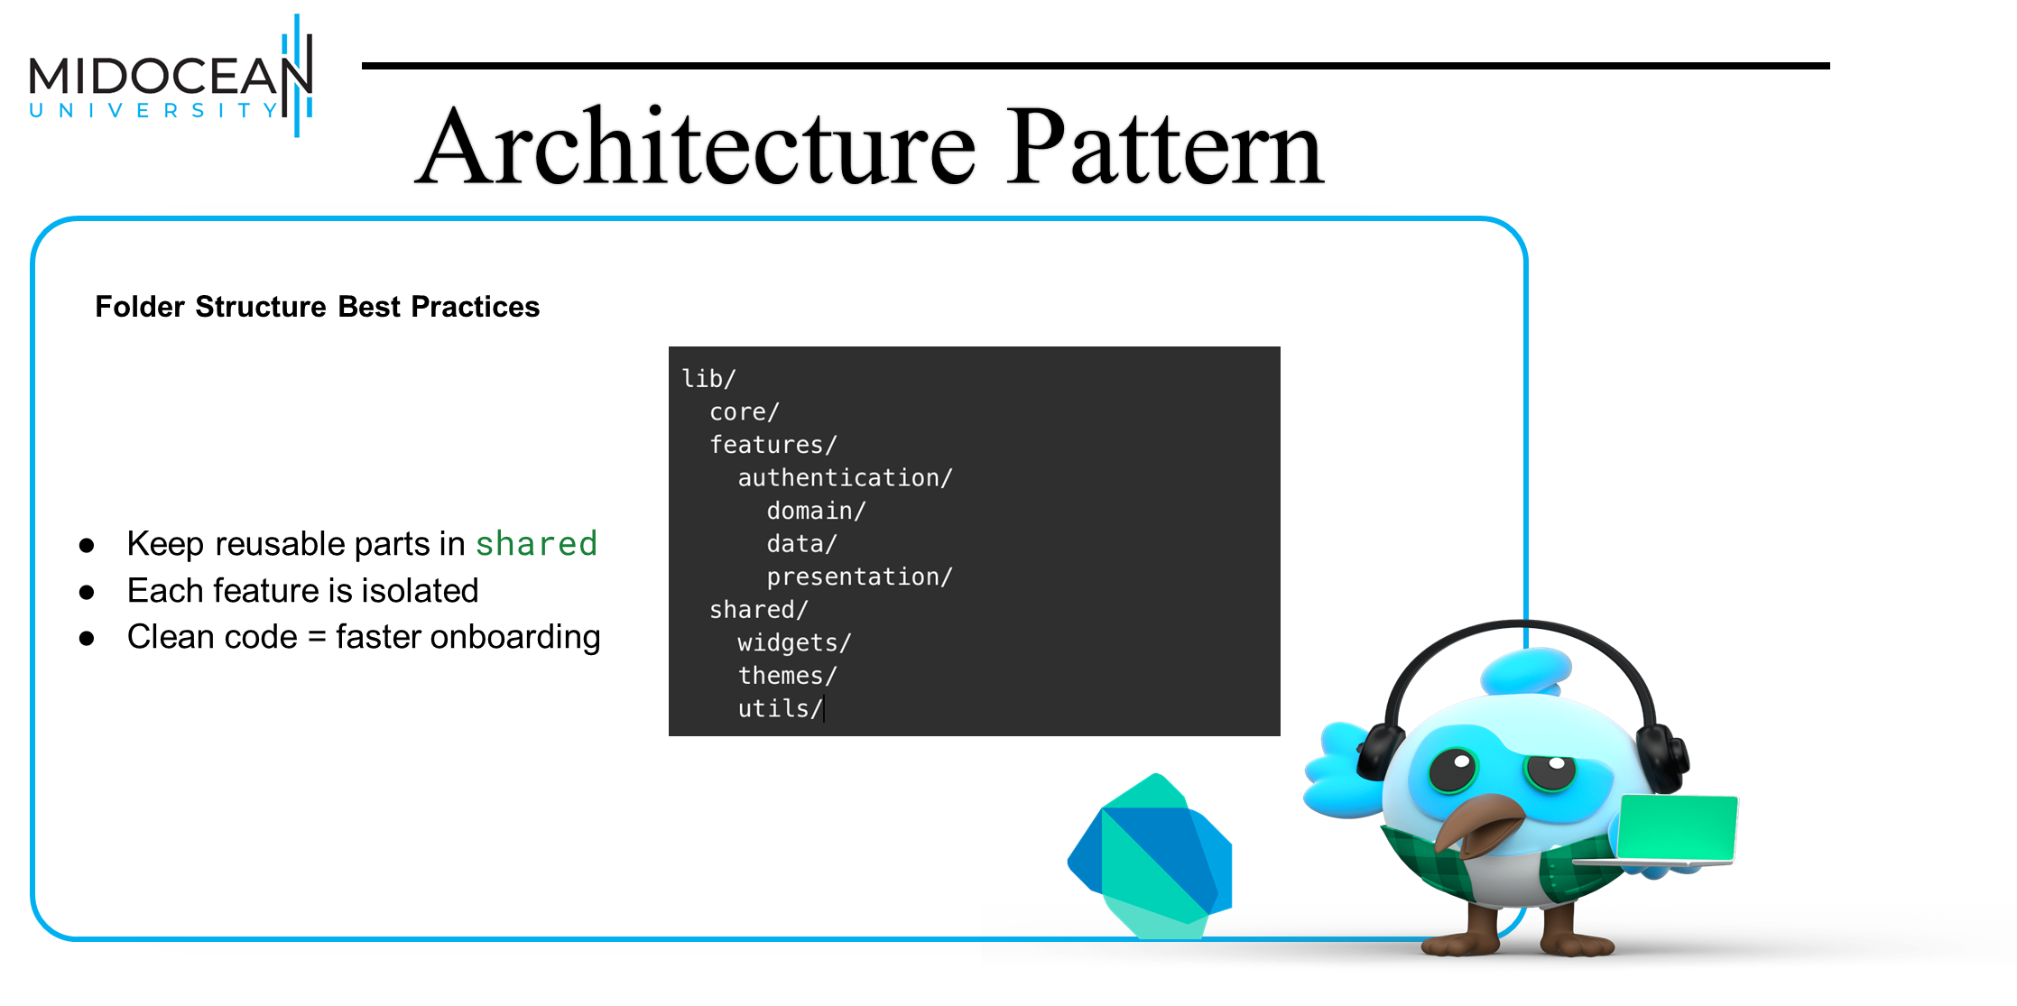

Slide 32
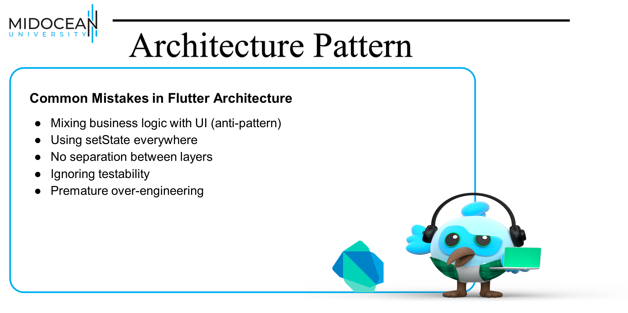

Slide 33
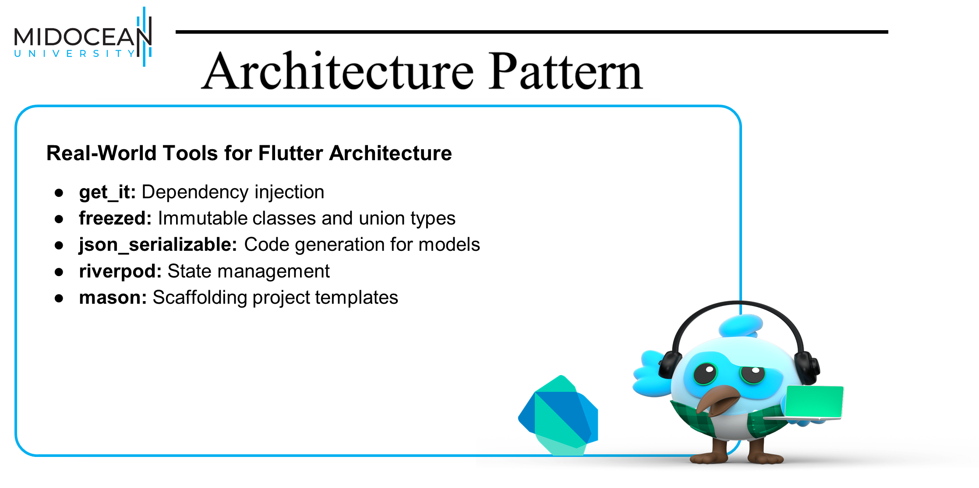

Slide 34


Slide 35
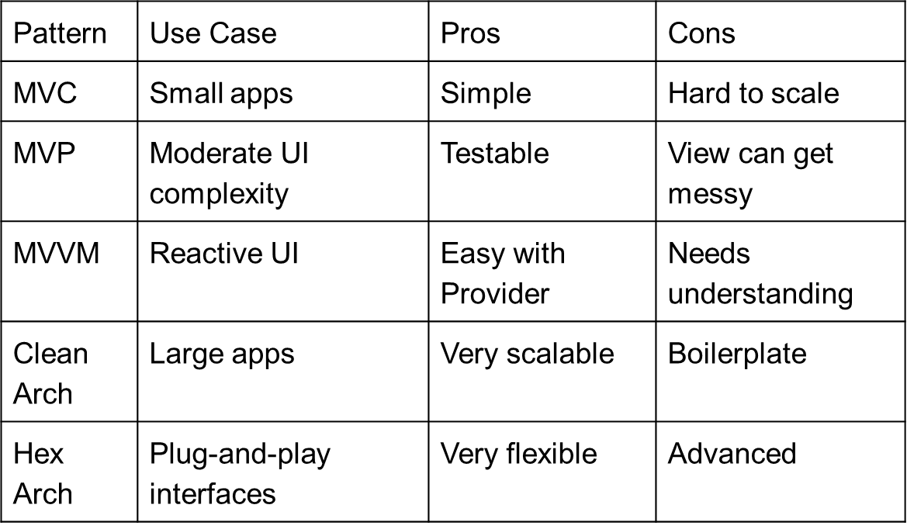

Architecture Pattern
Summary of Patterns

Slide 36
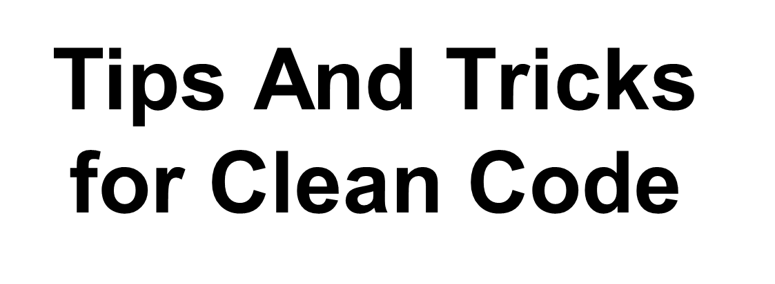

Slide 37
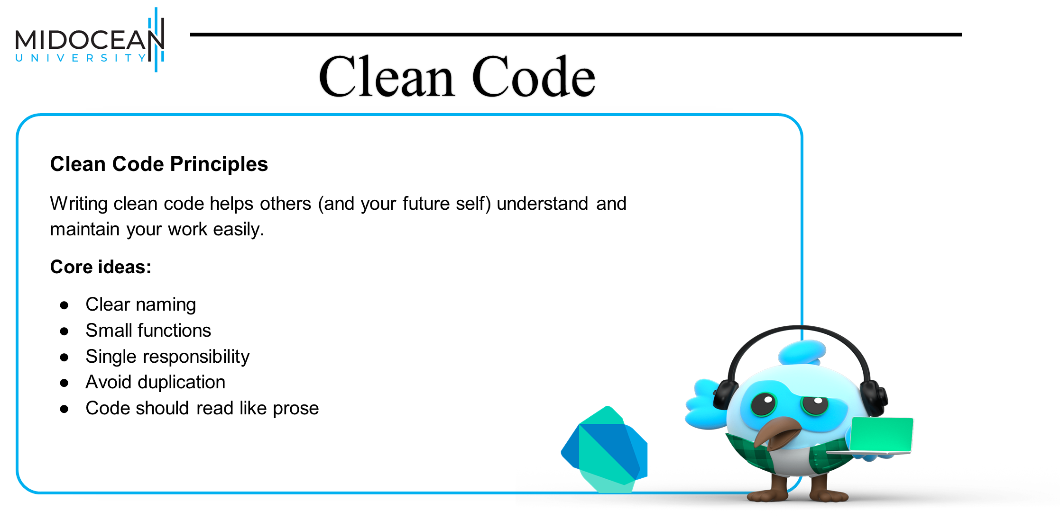

Slide 38
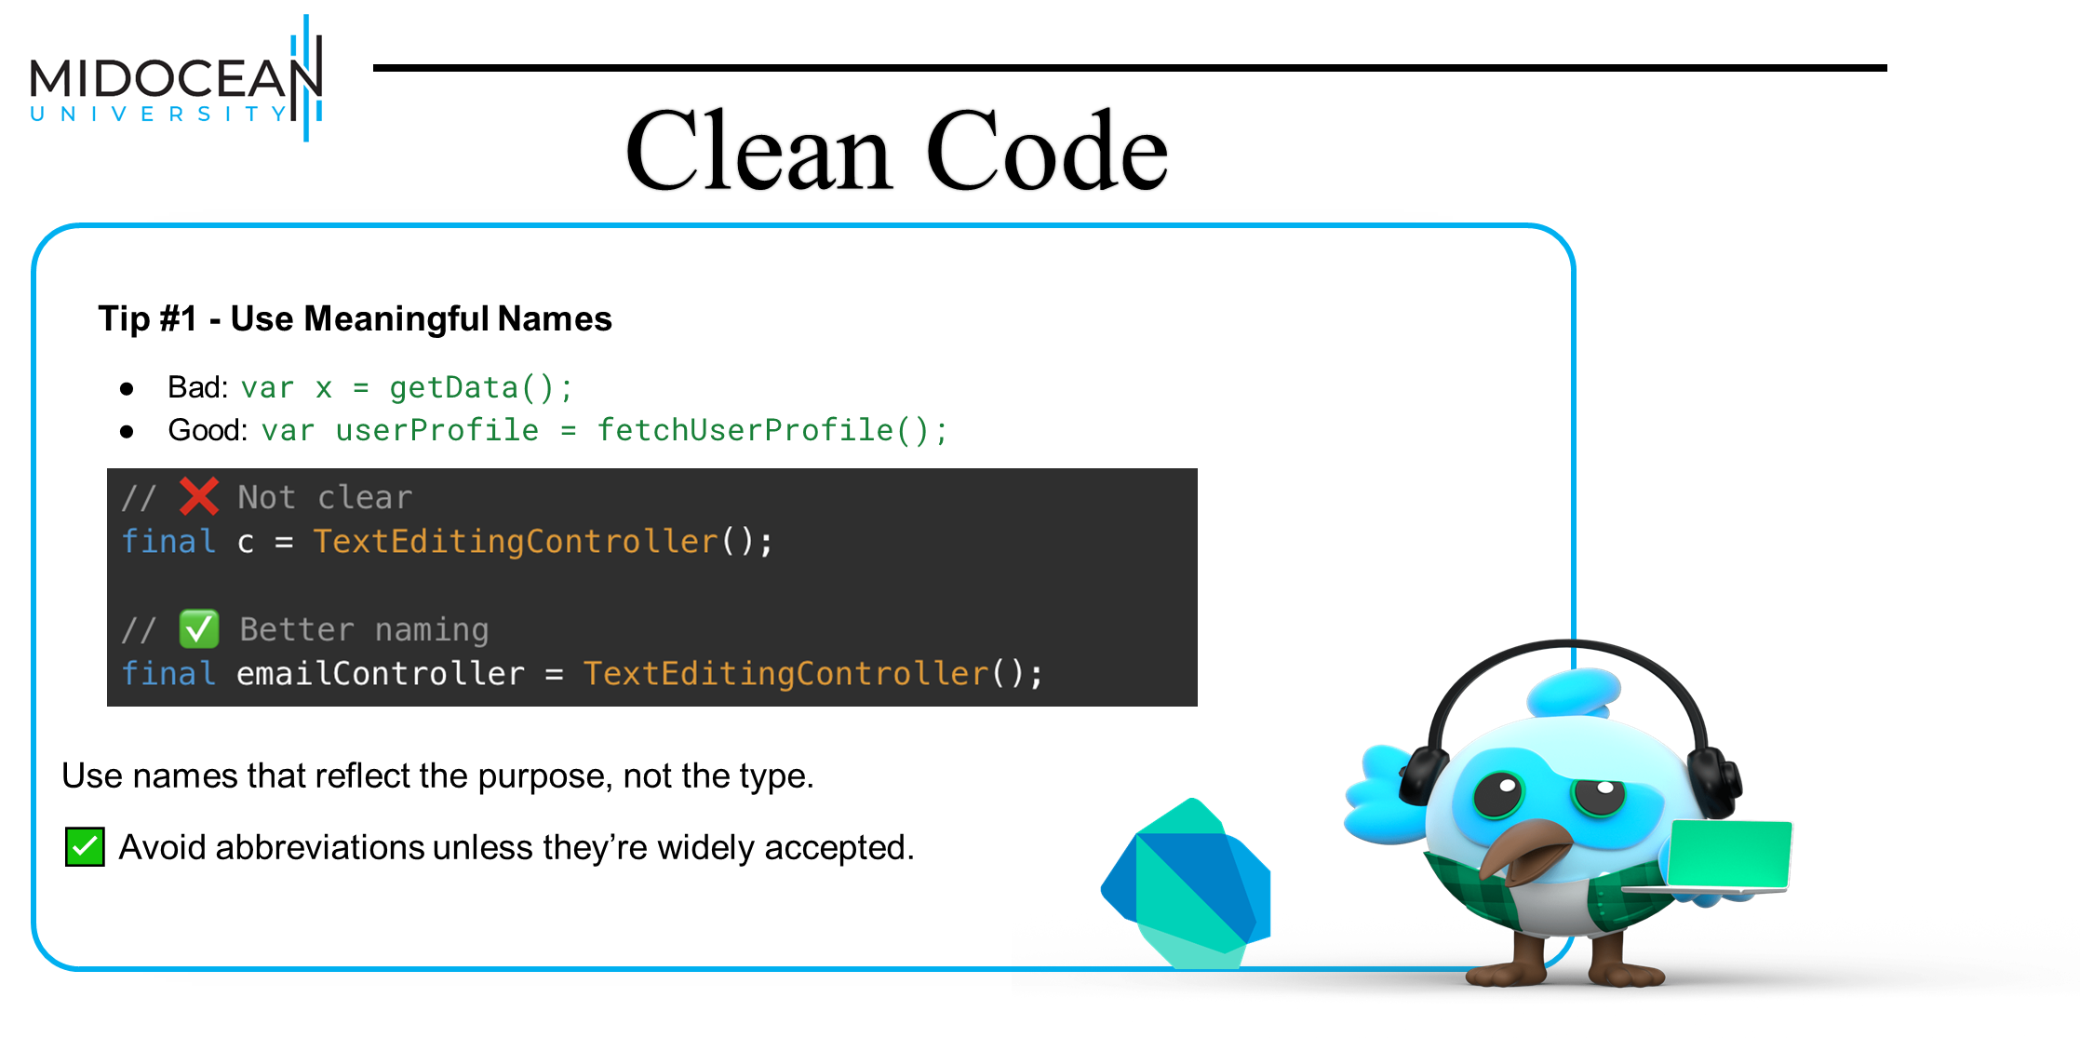

Slide 39
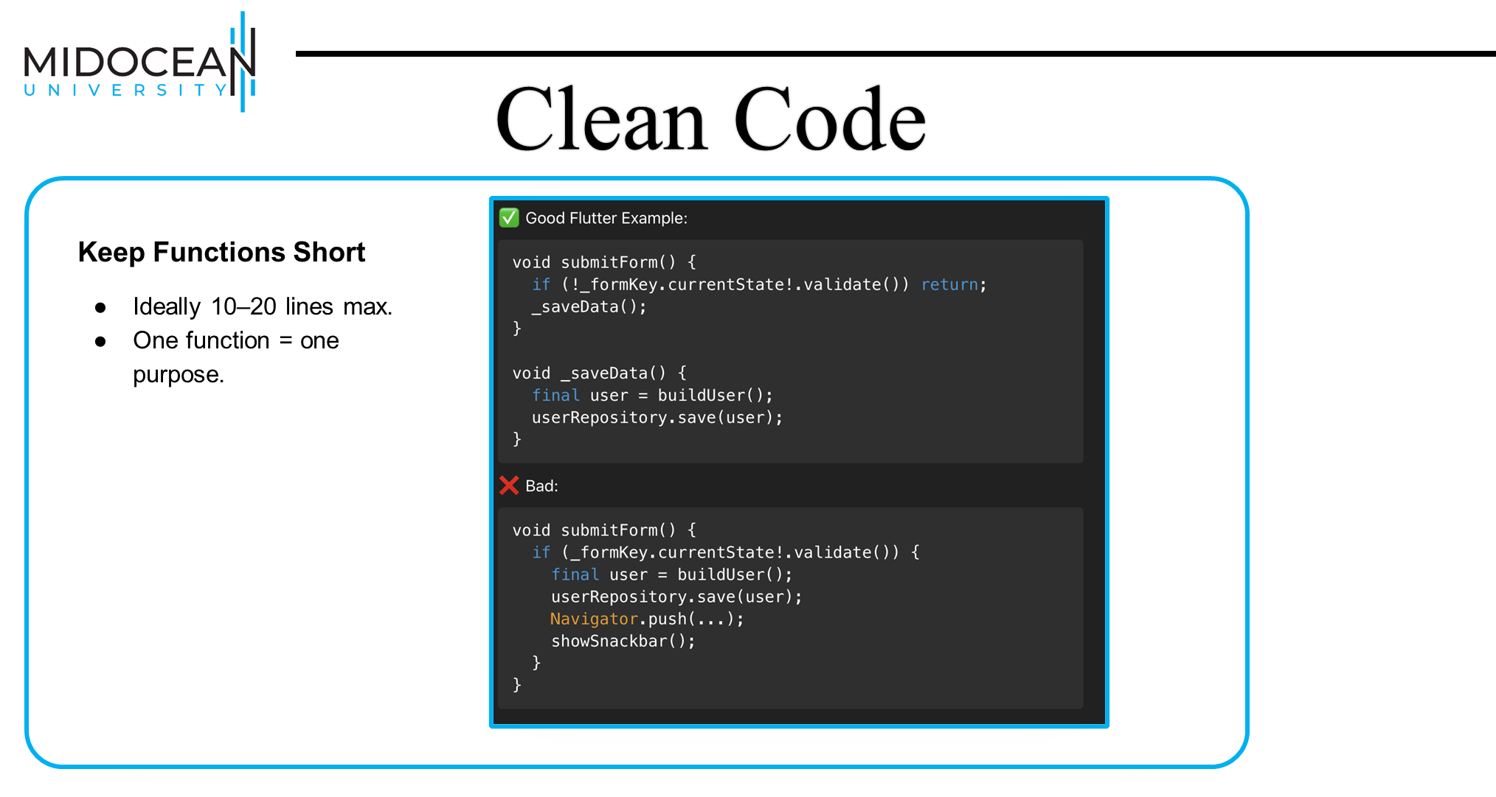

Slide 40
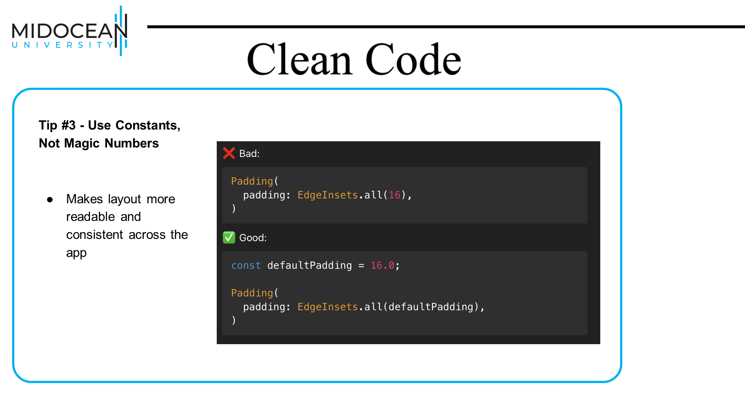

Slide 41
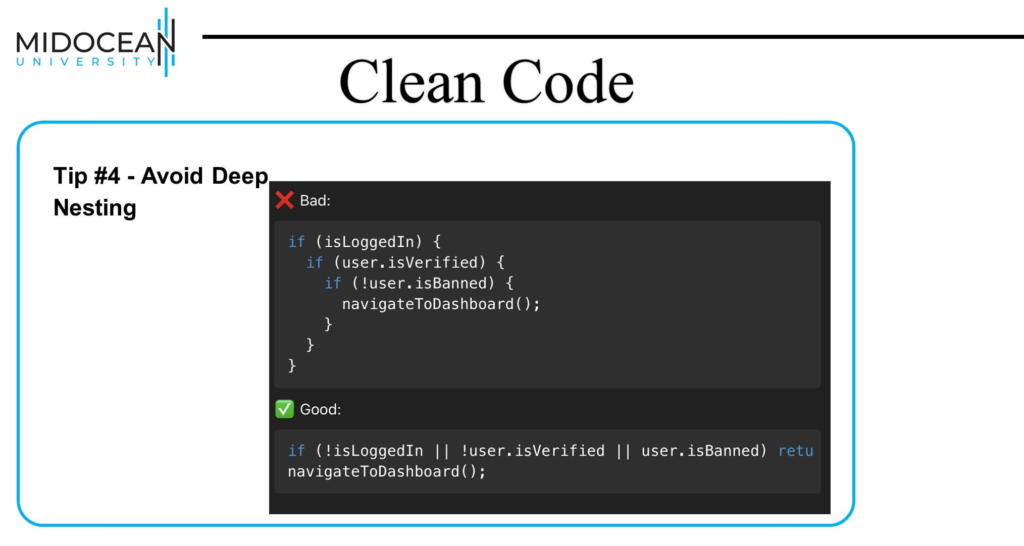

Slide 42
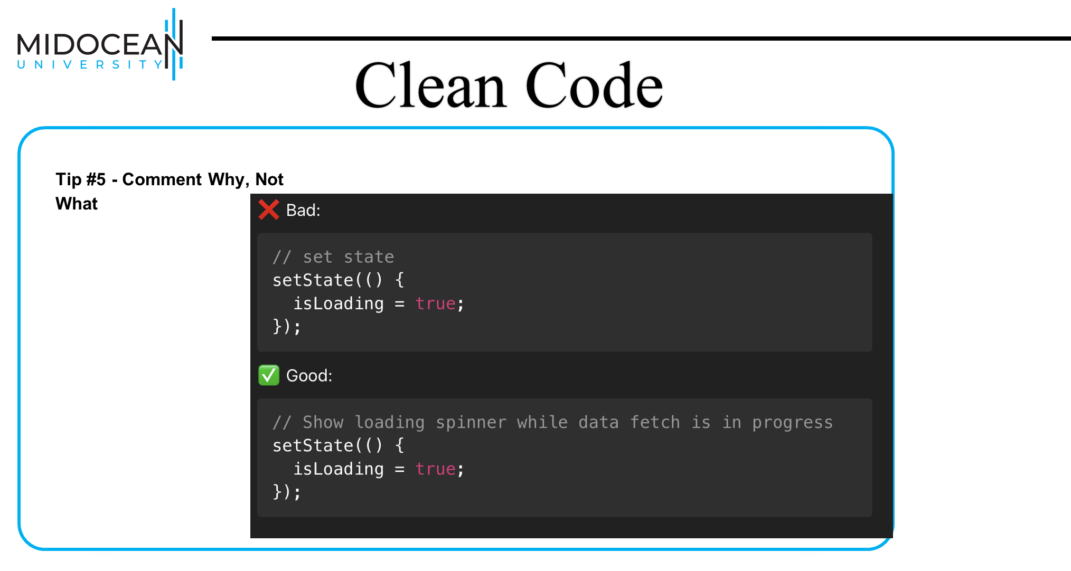

Slide 43
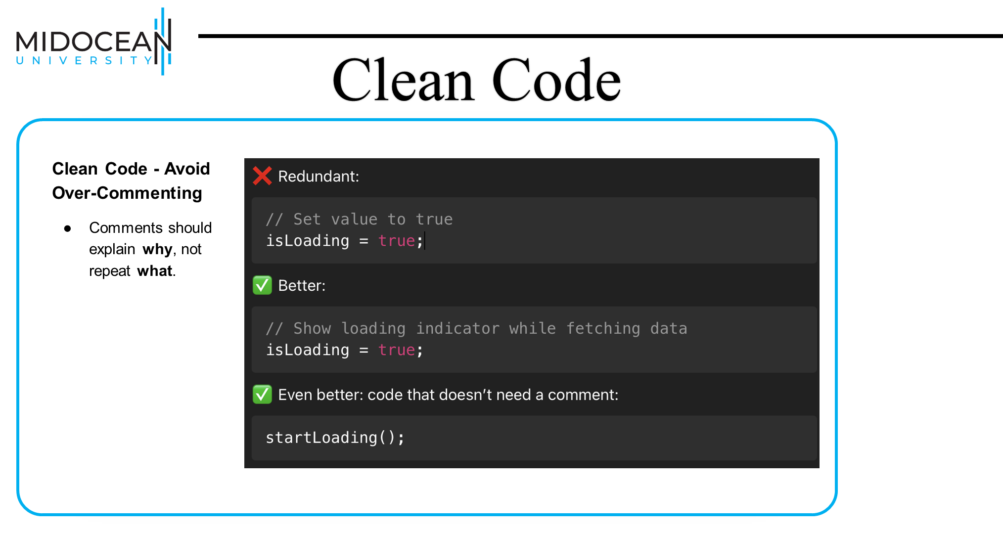

Slide 44
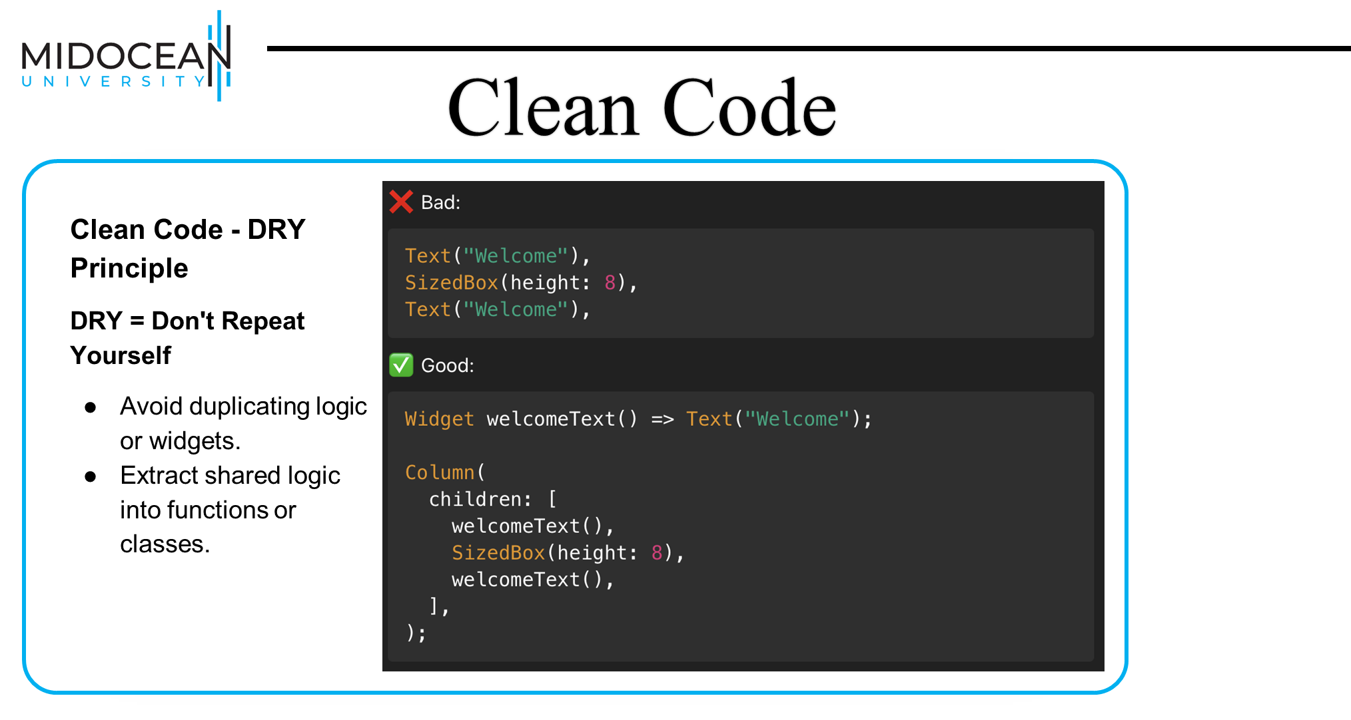

Slide 45
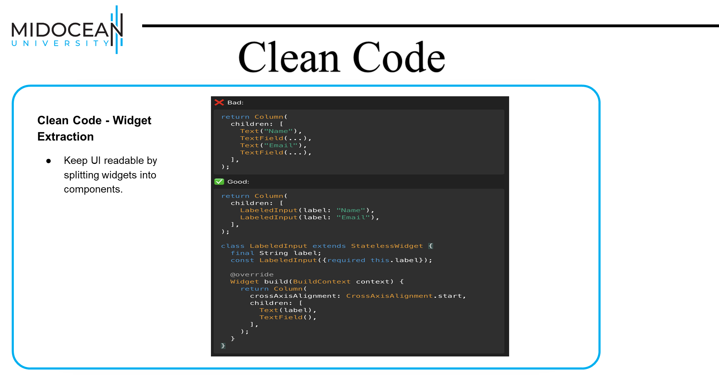

Slide 46
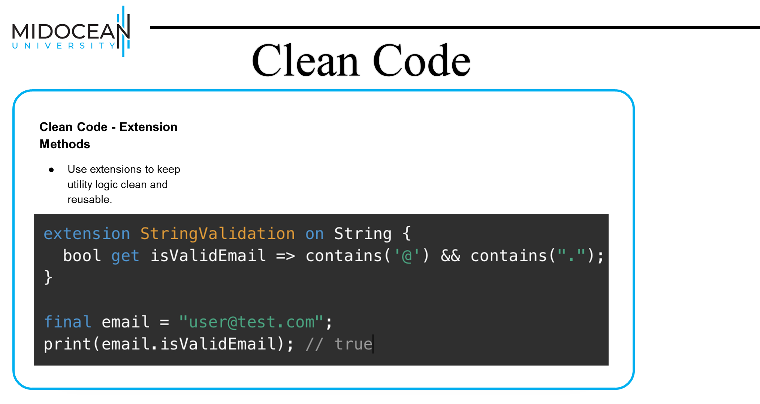

Slide 47


Slide 48



Thank You

