Slide 1




Mathematics 3 – MAT132
Mathematics 3
Lecture 9
MAT 132
Introduction to MATLAB
Prepared by
Dr. Israa Lewaa

Slide 2
Lecture Objectives
Lecture
05
Chapter Objectives
1 Introduction to MATLAB
2 How to Download MATLAB
3 Basic Features
4 MATLAB Session
5 Getting Started with MATLAB operations

Slide 3
Lecture Outline
Lecture
09
Lecture Outline
1 Introduction to MATLAB
2 How to Download MATLAB
3 Basic Features
4 MATLAB Session
5 Getting Started with MATLAB operations

Slide 4

1- Introduction to MATLAB
Lecture
08
1- Integration by parts

Slide 5
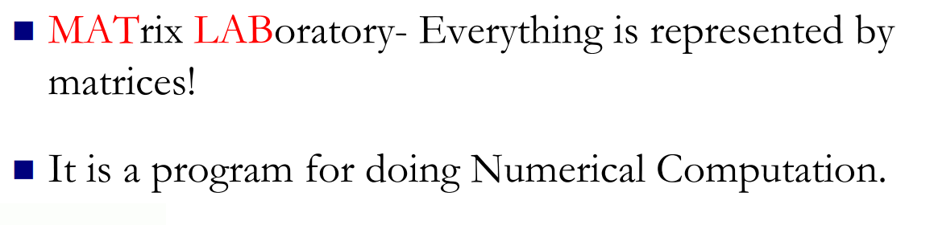
1- Introduction to MATLAB
Lecture
08
Example

Slide 6
1- Introduction to MATLAB
Lecture
08
Example

Slide 7
1- Introduction to MATLAB
Lecture
08
Example

Slide 8
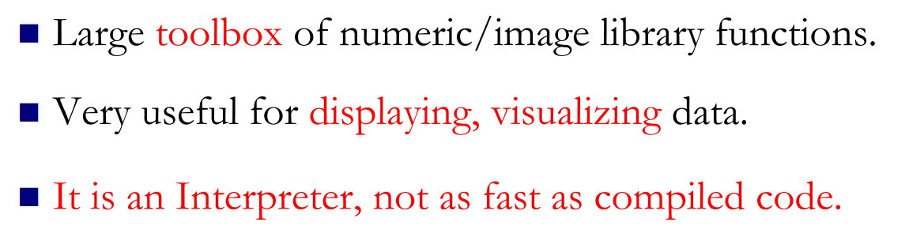
Why MATLAB ?
Lecture
08
** Revision – Fundamentals

Slide 9
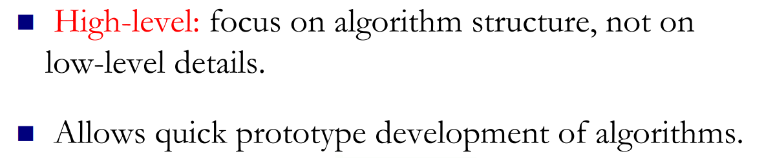
Why MATLAB ?
Lecture
08
Example

Slide 10
Download MATLAB
Lecture
08
Example
https://getintopc.com/softwares/maths/mathworks-matlab-r2021a-free-download-8853012/

Slide 11
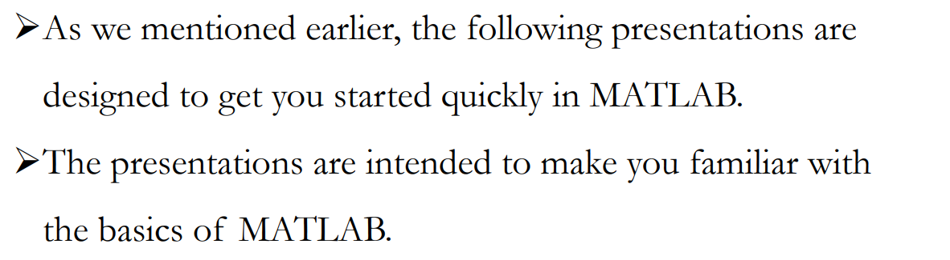
2- Basic Features
Lecture
08
Integration with initial Conditions

Slide 12
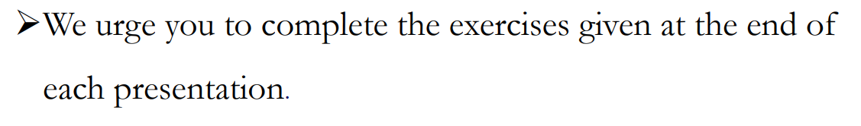
2- Basic Features
Lecture
08
Example

Slide 13
3- MATLAB Session
Lecture
08
Example
The goal of this minimum session (also called starting and exiting sessions) is to learn the first steps:
➢How to log on
➢Recall MATLAB
➢ Do a few simple calculations
➢How to quit MATLAB

Slide 14
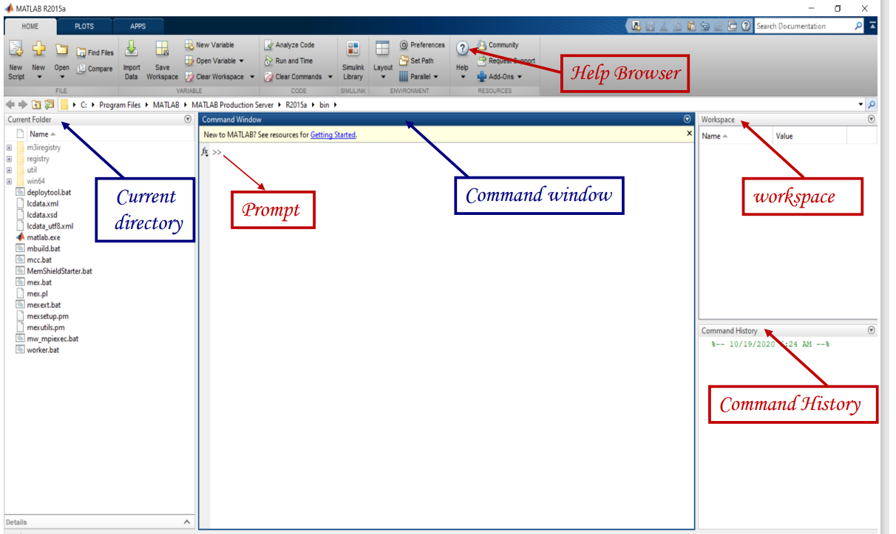
MATLAB Interface
Lecture
07
** EXTRA PRACTISE

Slide 15
MATLAB Environment
Lecture
07
** EXTRA PRACTISE
After logging into your account, you can enter MATLAB by double-clicking on the MATLAB shortcut icon (MATLAB R2015a) on your Windows desktop.
When you start MATLAB, a special window called the MATLAB desktop appears.
The desktop is a window that contains other windows.

Slide 16
MATLAB Environment
Lecture
07
** EXTRA PRACTISE
❖ The major tools within or accessible from the desktop are:
❑ The Command Window
❑ The Command History
❑ The Workspace
❑ The Current Directory
❑ The Help Browser
❑ The Start button

Slide 17
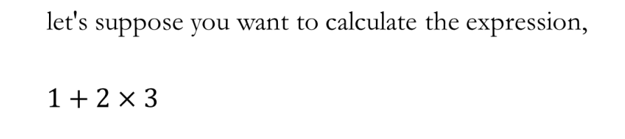
Extra Practice – Example 1
Lecture
08
Examples for different Methods of Integration
Hint: Use MATLAB

Slide 18
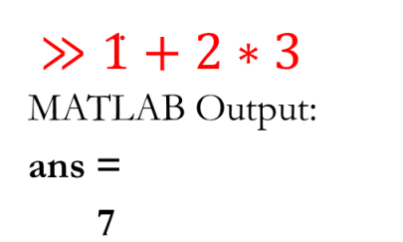
Extra Practice – Example 1 Solution
Lecture
08
Example

Slide 19
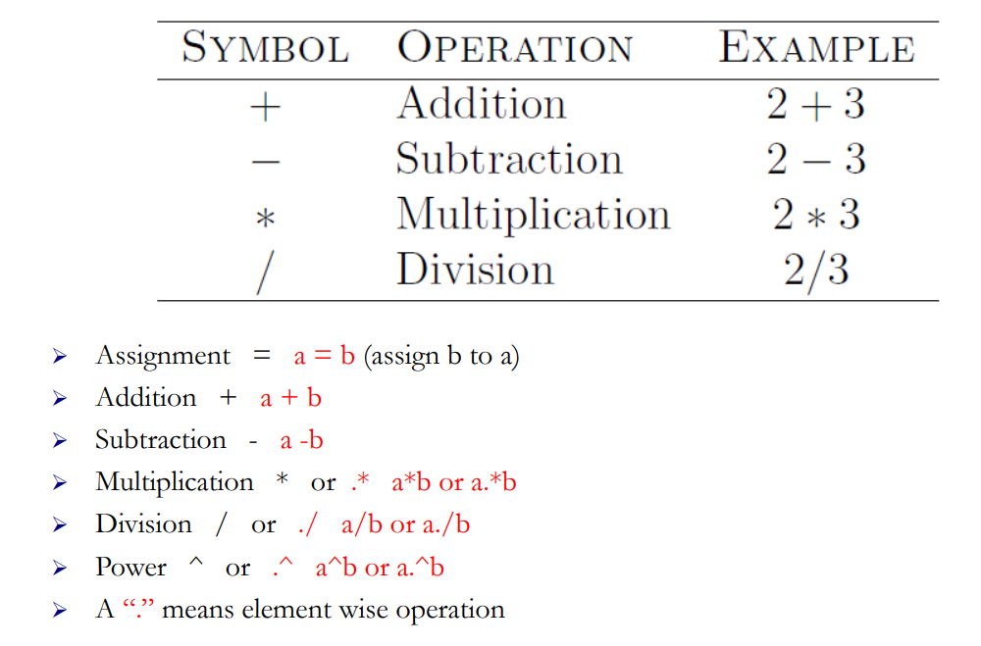
Operators
Lecture
08
Example

Slide 20
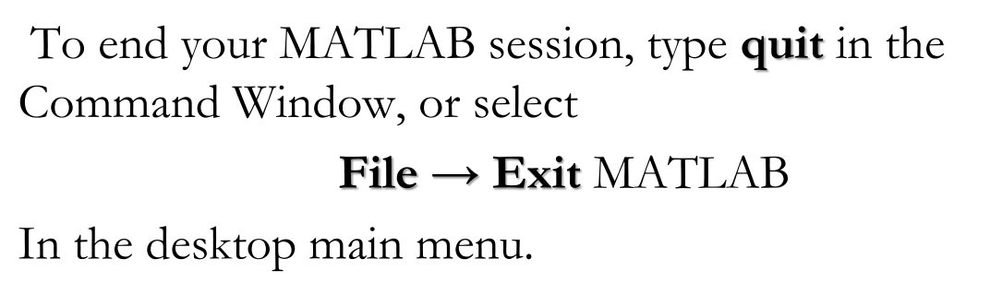
Quitting MATLAB
Lecture
08
The Definite Integral

Slide 21
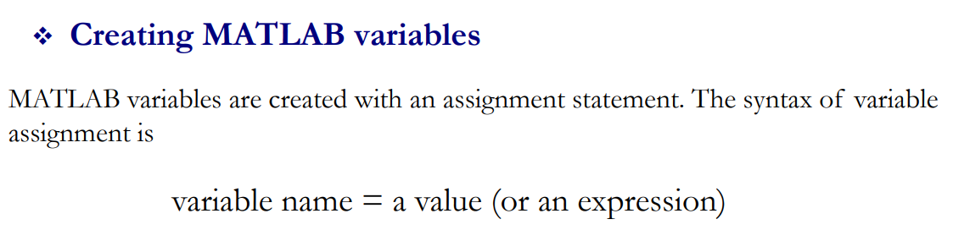
Creating MATLAB Variables
Lecture
08
The Definite Integral

Slide 22
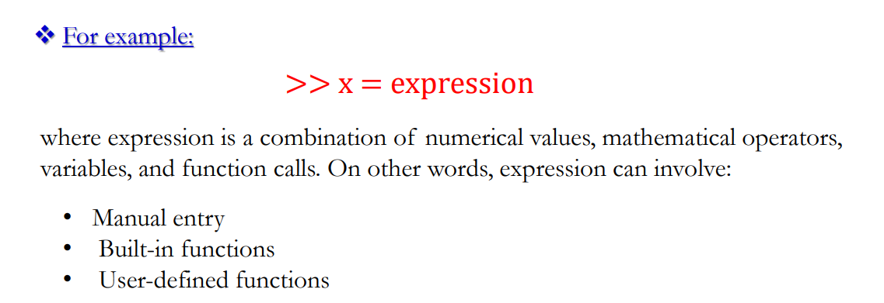
Expression Example
Lecture
08
Example

Slide 23
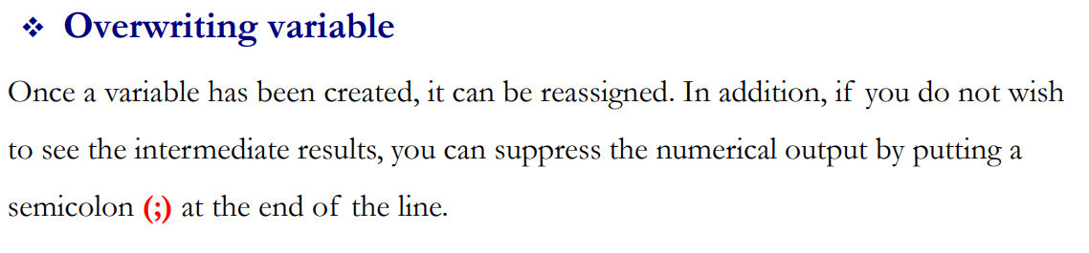
Overwriting variables
Lecture
08
The Definite Integral

Slide 24
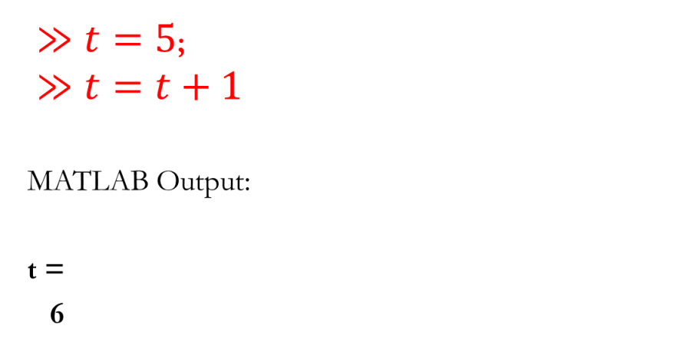
Overwriting Example
Lecture
08
Example

Slide 25
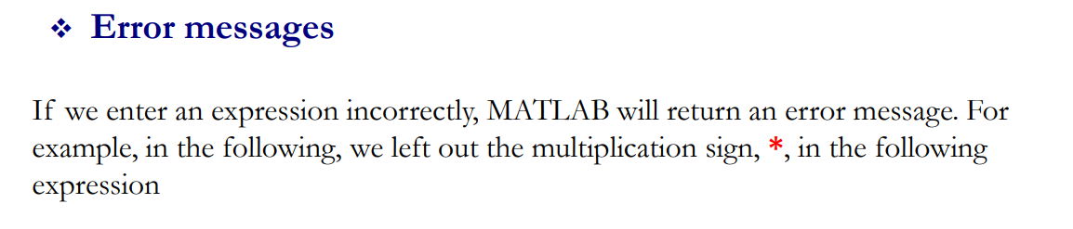
Error Massages
Lecture
08
The Definite Integral

Slide 26
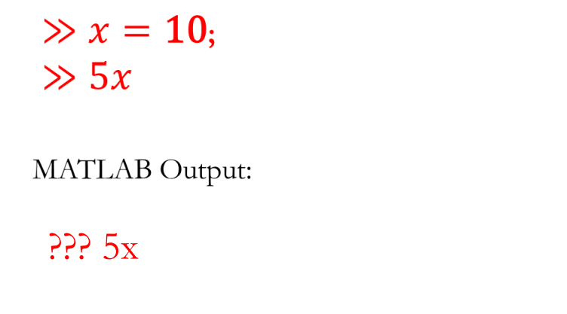
Error Messages Example
Lecture
08
Example

Slide 27
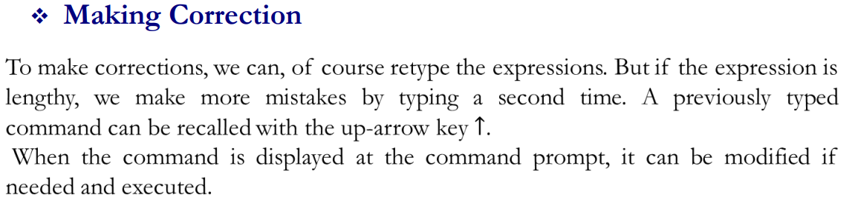
Making Correction
Lecture
08
The Definite Integral

Slide 28
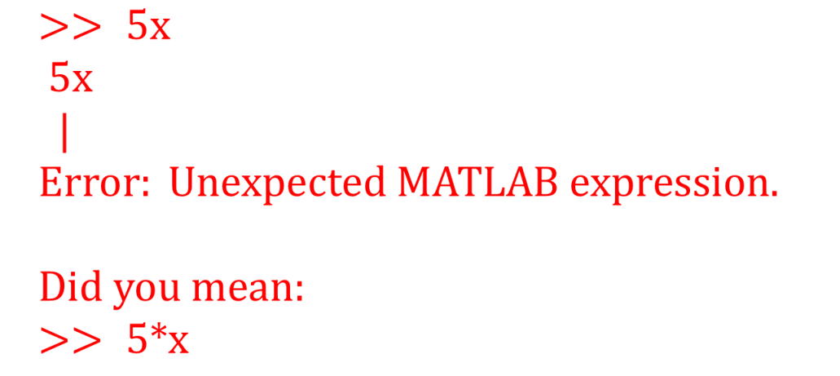
Extra Practice – Example 2
Lecture
08
Example

Slide 29
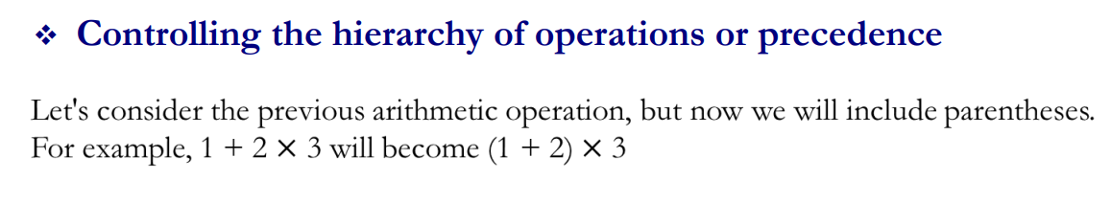
Controlling the hierarchy of operations or precedence
Lecture
08
The Definite Integral

Slide 30
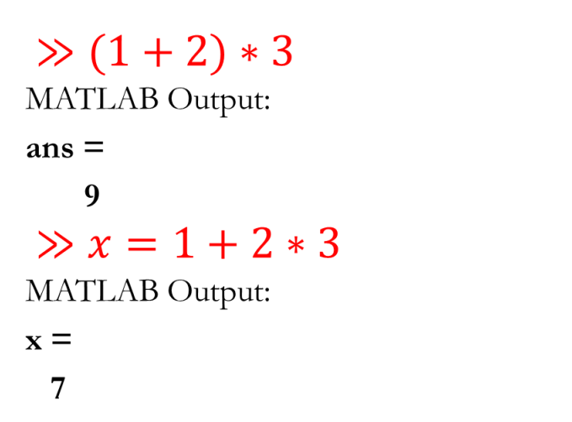
Example of Controlling the hierarchy
Lecture
08
Lecture
08
The Definite Integral
Example

Slide 31
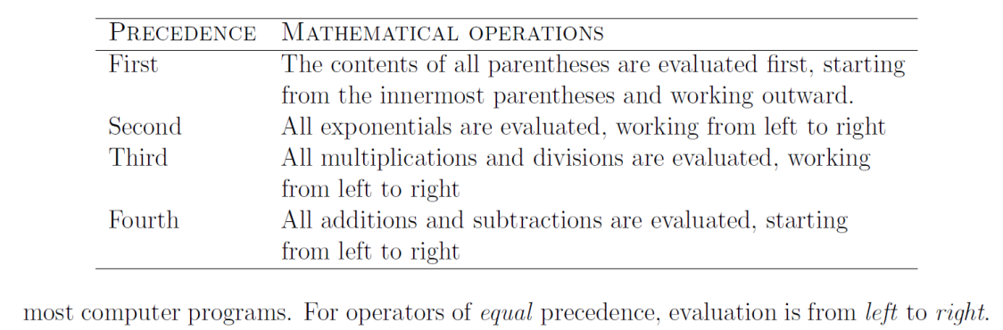
Lecture
08
MATLAB Rules
Lecture
08
The Definite Integral
The Definite Integral

Slide 32
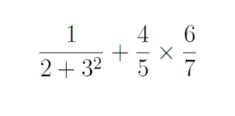
Extra Practice – Example 3
Lecture
08
Example
Solve the following expression on MATLAB:

Slide 33
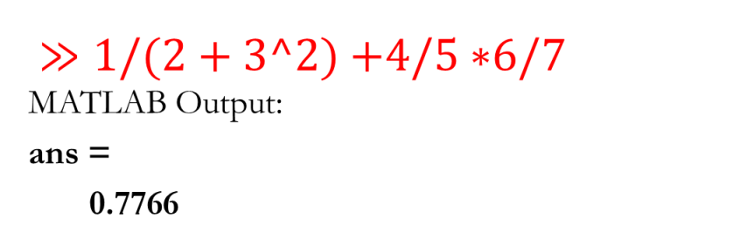
Extra Practice – Example 3 Solution
Lecture
08
The Definite Integral

Slide 34
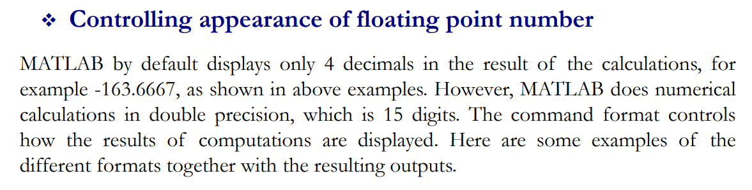
Lecture
08
Controlling the appearance of floating point number
Example

Slide 35
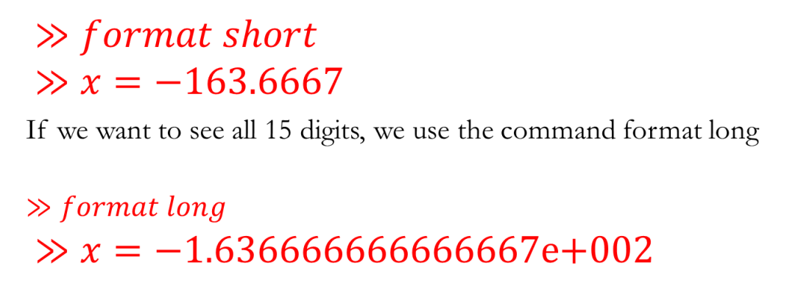
Example of Controlling the appearance
Lecture
08
Lecture
08
Example

Slide 36
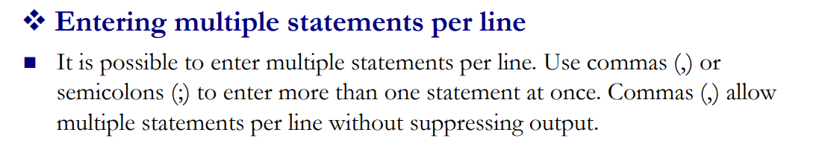
Entering multiple statements per line
Lecture
08
The Definite Integral

Slide 37
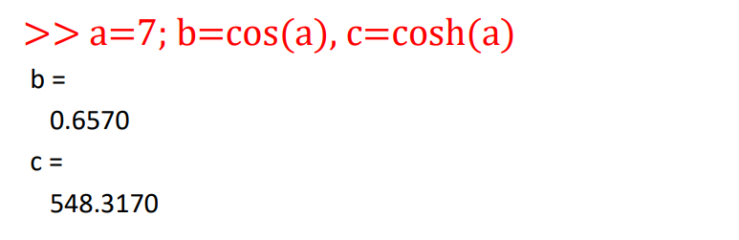
Example of entering multiple statements per line
Lecture
08
Example

Slide 38
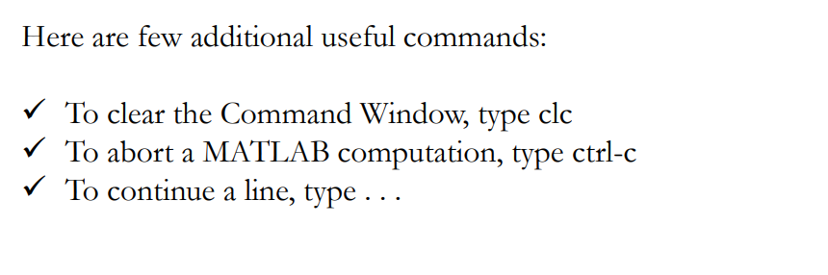
Entering multiple statements per line
Lecture
08
The Definite Integral

Slide 39
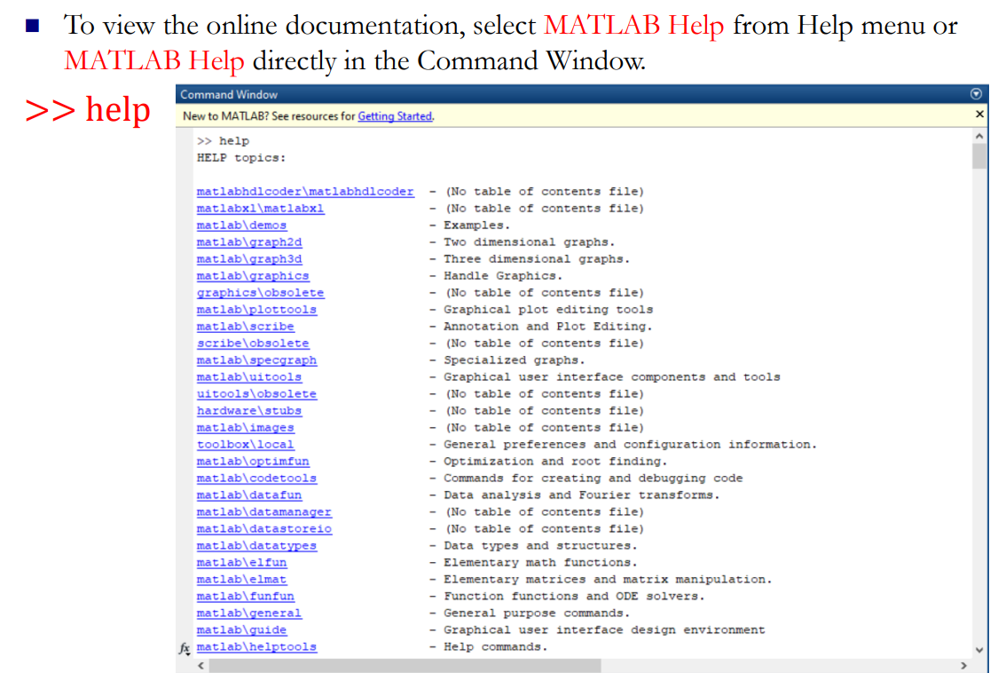
MATLAB Help
Lecture
08
Example

Slide 40
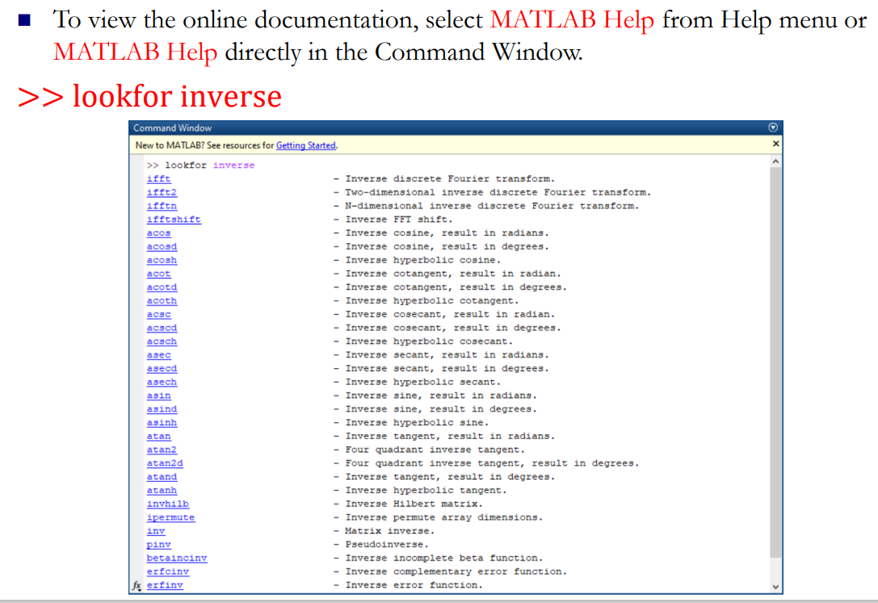
MATLAB Help
Lecture
08
The Definite Integral

Slide 41
Lecture Summary
Lecture
09
Lecture Summary
1 Introduction to MATLAB
2 How to Download MATLAB
3 Basic Features
4 MATLAB Session
5 Getting Started with MATLAB Operations

Slide 42



Thank You

