Slide 1



Cybersecurity Law, Policy, and Ethics
Dr. Kamal Alieyan
Master of Science in Cybersecurity
Orientation Show
عرض توجيهي

Slide 2

قوانين وسياسات وأخلاقيات الأمن السيبراني
Orientation Show
عرض توجيهي
Master of Science in Cybersecurity
Prepared by
Dr. Kamal Alieyan
www.midocean.ae

Slide 3
Who Am I?
Dr. Kamal Alieyan
  Assistant Professor in Cybersecurity
    Ph.D from USM, Malaysia, Jun. 2018.
    M.Sc from “University of Arab Academy for Banking and Financial Science”/ Jordan, Sep.2005.
    B.Sc from “Mu’tta University” / Jordan, Jun.2003.
www.midocean.ae

Slide 4



Who Am I?
  Office hours
  Discussion Time (Wednesday at 9:00 PM) every week
https://scholar.google.com/scholar?hl=en&as_sdt=0%2C5&q=Kamal+Alieyan&btnG=&oq=kama
https://www.scopus.com/authid/detail.uri?authorId=57000386100
https://orcid.org/0000-0002-9021-3151
www.midocean.ae

Slide 5
Primary Goal of This Course
This course provides an overview of the broad and constantly emerging field of cybersecurity ethics, governance, law, and compliance.
The importance of the role of security policy is discussed.
www.midocean.ae

Slide 6
Outline of Course
  Provide students with concepts of:-
  Introduction to Cyberethics
  Ethical Issues in Cybersecurity
  Cybersecurity Ethics: Cyberspace and Other Applications
  Introduction to Cyber laws
  Risks in Cybersecurity
  Introduction to Cybersecurity Policies
www.midocean.ae

Slide 7
The book of this course:
www.midocean.ae

Slide 8
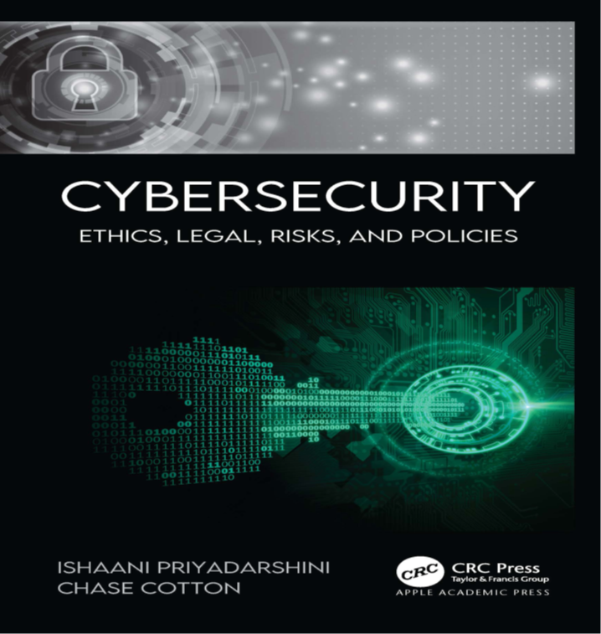
Learning Resources:
Credit Hours:
3 credit hours.
  Required Textbook:
  Apple Academic Press (2021). Cybersecurity Law Policy And Ethics. By Ishaani Priyadarshini, and Chase Cotton.
  Additional Reference:
  Springer (2020). The Ethics of Cybersecurity. By Markus Christen, Bert Gordijn, and Michele Loi.
www.midocean.ae

Slide 9
Units of Course Contents
Lecture Structure:
Module | Course Unit | No.of. Weeks | Contact Hours
1 | Lecture_1 Introduction to Cyberethics | 1st | 3
2 | Lecture_2 Introduction to Cyberethics (2) | 2nd | 3
2 | Lecture_3 Ethical Issues in Cybersecurity | 3 | 3
3 | Lecture_4 Cybersecurity Ethics: Cyberspace and Other Applications | 4 | 3
 | Lecture_5 Cybersecurity Ethics: Cyberspace and Other Applications (2) | 5 | 3
4 | Lecture_6 Introduction to Cyber laws | 6 | 3
5 | Lecture_7 Risks in Cybersecurity | 7 | 3
 | Lecture_8 Risks in Cybersecurity (2) | 8 | 3
6 | Lecture_9 Introduction to Cybersecurity Policies | 9 | 3
 | Lecture_10 Introduction to Cybersecurity Policies (2) | 10 | 3
www.midocean.ae

Slide 10
Course Information
Assessment Method:
Short Exam
  80% marks
    Count of short Exam 10 (Weekly)
    8 Marks for every each of short Exam.
  20% Final Examination
www.midocean.ae

Slide 11


Thank You

