Slide 1


Writing in
Organizations
Prepared by Dr. Magdy Alhaj
MGM 202
Lecture 6

Slide 2


Designing Successful Documents,
Visuals, and Websites.
Lecture 6
MGM 202
Prepared by
Dr. Magdy Alhaj
www.midocean.ae

Slide 3
Lecture 6
Course Outline
Lecture 1: Getting Started: Writing and Your Career.
Lecture 2: The Writing Process and Collaboration at Work.
Lecture 3: Writing Routine Business Correspondence.
Lecture 4: Writing Letters: Some Basics for Communicating with Audiences Worldwide.
Lecture 5: How to Get a Job: Searches, Dossiers, Portfolios, Résumés, Letters, and Interviews.
Lecture 6: Designing Successful Documents, Visuals, and Websites.
Lecture 7: Writing Instructions and Procedures.
Lecture 8: Writing Effective Short Reports.
Lecture 9: Writing Proposals.
Lecture 10: Writing Careful Long Reports.

Slide 4
Lecture 6
Lecture Outline
1- Characteristics of Effective Design.
2- Organizing Information Visually.
3- The ABCs of Print Document Design.
4- Successful Document Design: A Wrap-Up.
5 - The Purpose of Visuals.
6- Choosing Effective Visuals.
7- Generating Your Own Visuals
8- Inserting and Writing About Visuals: Some Guidelines.
9- Two Categories of Visuals: Tables and Figures.
10- Using Visuals Ethically.
11- Using Appropriate Visuals for International Audiences.
12- Writing for and Designing Websites.

Slide 5
Lecture 6
Designing Successful Documents, Visuals, and Websites
1- Characteristics of Effective Design:
In designing documents and websites, you need to project a positive, professional image of yourself, your company, and your product or service. A report or website filled with nothing but thick unbroken, long paragraphs crowded to the margins, with no visual clues to break them up or to make information stand out, is sure to intimidate readers and turn them away. They will conclude that your work is too complex and not worth their effort or time.

Slide 6
Lecture 6
Designing Successful Documents, Visuals, and Websites
Your company, too, will win or lose points because of your design choices. A visually appealing document or website will enhance a company’s reputation and improve its sales. A poorly designed one will not.
Make your documents look user-friendly—clear and logical—by signaling to your audience that your message is
■ easy to read
■ easy to follow and understand
■ easy to recall

Slide 7
Lecture 6
Designing Successful Documents, Visuals, and Websites
2- Organizing Information Visually:
Today’s web-based culture prizes visual thinking when you design all kinds of documents. The way you organize and visualize information can help readers move quickly and clearly through your document. design or layout plays a crucial role in an audience’s overall acceptance of your work.

Slide 8
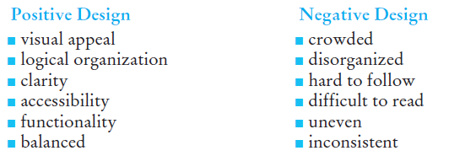
Lecture 6
Designing Successful Documents, Visuals, and Websites

Slide 9
Lecture 6
Designing Successful Documents, Visuals, and Websites
3- The ABCs of Print Document Design:
The basic elements of effective document design are
■ page layout
■ typography, or type design, including using color
■ graphics, or visuals

Slide 10
Lecture 6
Designing Successful Documents, Visuals, and Websites
Page Layout
Each of your pages needs to coordinate space and text pleasingly. To design an effective page layout, pay attention to the following elements.
1. White space. White space (blank space), which refers to open areas on a page such as margins and space around images, is free of text and visuals.
2. Margins. Use wide margins, usually 1 to 1 ½ inches, to “frame” your document with white space surrounding text and visuals.

Slide 11
Lecture 6
Designing Successful Documents, Visuals, and Websites
3. Line length. Most readers find a text line of 10 to 14 words, or 50 to 70 characters (depending on the type size you choose), comfortable and enjoyable to read.
4. Columns. Document text usually is organized in either single column or multicolumn formats.

Slide 12
Lecture 6
Designing Successful Documents, Visuals, and Websites
- Typography
Typography consists of font (also called typeface), font size, font styles, justification, heads and subheads, lists, and captions.
- Font
Readability of your text is crucial. Select a font, therefore, that ensures your text is
■ legible
■ attractive
■ functional
■ appropriate for your message
■ complementary with accompanying graphics

Slide 13
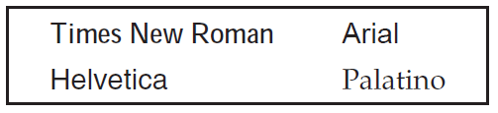
Lecture 6
Designing Successful Documents, Visuals, and Websites
The most familiar fonts are the following four.
- Font Size
Font size options are almost unlimited, depending on your software package and printer capabilities.
- Font Styles
Font styles include boldface, italics, shadow, underlining, small caps, and shading.

Slide 14
Lecture 6
Designing Successful Documents, Visuals, and Websites
- Justification
Sometimes referred to as alignment, justification consists of left, right, full, and center options.
- Heads and Subheads
Heads and subheads are brief descriptive words or phrases that signal starting points and major divisions in your document.
- Lists
Placing items in a list helps readers by dividing, organizing, and ranking information.

Slide 15
Lecture 6
Designing Successful Documents, Visuals, and Websites
- Captions
Used to accompany, explain, highlight, or reference pictures or other graphics (like charts and graphs), captions are titles that help a reader identify a visual and quickly explain the nature of the picture or other graphic.
- Using Color
Using color in workplace documents is a good way to enhance readability, break up long segments of text, and tie important ideas together.

Slide 16
Lecture 6
Designing Successful Documents, Visuals, and Websites
4- Successful Document Design: A Wrap-Up:
By following these three simple guidelines, you can design effective documents for your readers.
1. Keep it simple. Don’t try to impress your reader with visual effects—such as the overuse of italics or boldface (they will lose their purpose), fancy designs and scripts.
2. Make it clear. Make your message logical and easy to understand by including heads, bulleted lists, numbered steps, and the like.
3. Have it flow. Help your readers get through and understand your document easily and, if necessary, to go back and find information quickly.

Slide 17
Lecture 6
Designing Successful Documents, Visuals, and Websites
5 - The Purpose of Visuals:
Visuals are essential in the world of work. They are vital to the success of newsletters, reports, proposals, instructions, PowerPoint presentations, blogs, and, most certainly, websites. Even your company’s logo reveals a great deal about its image and mission. The reason visuals are so important is that they help readers understand your work.

Slide 18
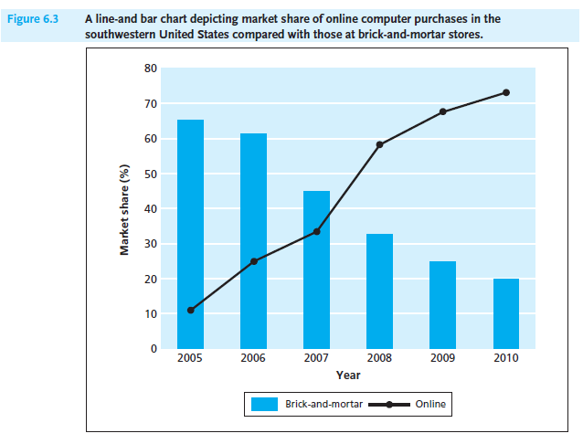
Lecture 6
Designing Successful Documents, Visuals, and Websites
through our sense of sight. Here are several reasons why visuals can improve your work:
each point is graphically reinforced in Figure 6.3 below.
1. Visuals arouse readers’ immediate interest.
2. Visuals increase readers’ understanding by simplifying concepts.
3. Visuals are especially important for non-native speakers of English and multicultural audiences.
4. Visuals emphasize key relationships.

Slide 19
Lecture 6
Designing Successful Documents, Visuals, and Websites
6- Choosing Effective Visuals:
Select your visuals carefully. You’ll find that many of the visuals you use will originate from the Internet or from a graphics program on your computer. But you can also scan hard-copy visuals and upload digital photographs. Regardless of the source of your visuals, the following suggestions will help you to choose them effectively:

Slide 20
Lecture 6
Designing Successful Documents, Visuals, and Websites
1. Include visuals only when they are relevant for your purpose and audience.
2. Use visuals in conjunction with—not as a substitute for—written work.
3. Experiment with several visuals.
4. Always use easy-to-read and relevant visuals.
5. Consider how your visuals will look on the page.
6. Be prepared to revise and edit your visuals.
7. Take advantage of scanners.

Slide 21
Lecture 6
Designing Successful Documents, Visuals, and Websites
7- Generating Your Own Visuals:
You can easily generate charts, graphs, or tables by using the templates available in your word processing software, such as Microsoft Word, and by selecting Insert Chart or Insert Table.
Spreadsheet programs, such as Microsoft Excel, also provide easy to-use templates for creating graphs and charts using the numerical data you have entered into your spreadsheet. When using these software programs, though, avoid the temptation to make your visuals too showy. Although dazzling graphics may attract your reader’s immediate attention, you don’t want them to take over the report. Computer-generated graphs and charts should work with your words, not overshadow them.

Slide 22
Lecture 6
Designing Successful Documents, Visuals, and Websites
8 - Inserting and Writing About Visuals: Some Guidelines.
Using a visual requires more of you as a writer than simply inserting it into your written work. You need to use visuals in conjunction with what you write. The following guidelines will help you to (1) identify, (2) cite, (3) insert, (4) introduce, and (5) interpret visuals for your readers.

Slide 23
Lecture 6
Designing Successful Documents, Visuals, and Websites
1 - Identify Your Visuals
Give each visual a number and caption (title) that indicates the subject or explains what the visual illustrates. An unidentified visual is meaningless. A caption helps your audience to interpret your visual—to see it with your purpose in mind.
2 - Cite the Source for Your Visuals
If you use a visual that is not your own work, give credit to your source (newspaper, magazine, textbook, company, federal agency, individual, or website).

Slide 24
Lecture 6
Designing Successful Documents, Visuals, and Websites
3 - Insert Your Visuals Appropriately
Since many of the images you use will come from outside sources, especially the Web, you have to incorporate them clearly and in appropriate places in your written work.
4 - Introduce Your Visuals
Refer to each visual by its number and, if necessary, mention the title as well.
5 - Interpret Your Visuals
Give readers help in understanding your visual and in knowing what to look for. Let them know what is most significant about the visual.

Slide 25
Lecture 6
Designing Successful Documents, Visuals, and Websites
9- Two Categories of Visuals: Tables and Figures:
Visuals can be divided into two categories—tables and figures. A table arranges information—numbers and/or words—in parallel columns or rows for easy comparison of data. Anything that is not a table is considered a figure. Figures include graphs, pie charts, bar charts, organizational charts, flow charts, pictographs, maps, photographs, and drawings. Expect to use both in your work.

Slide 26
Lecture 6
Designing Successful Documents, Visuals, and Websites
1. Tables
Tables are parallel columns or rows of information organized and arranged into categories to show changes in time, distance, cost, employment, or some other distinguishable or quantifiable variable. They allow readers to compare a great deal of information in a compact space.

Slide 27
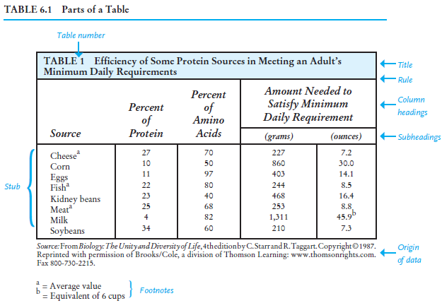
Lecture 6
Designing Successful Documents, Visuals, and Websites
- Parts of a Table
To use a table properly, you need to know the parts that constitute it. as you read the following:
■ The main column is “Amount Needed to Satisfy Minimum Daily Requirement,” and the sub columns are the protein sources for which the table gives data.
■ The stub refers to the first vertical column on the left side. The stub column heading is “Source.” The stub lists the foods for which information is broken down in the sub columns.
■ A rule (or line) across the top of the table separates the headings from the body of the table.

Slide 28
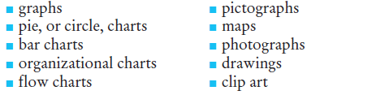
Lecture 6
Designing Successful Documents, Visuals, and Websites
2. Figures
As we saw, any visual that is not a table is classified as a figure. The types of figures are:

Slide 29
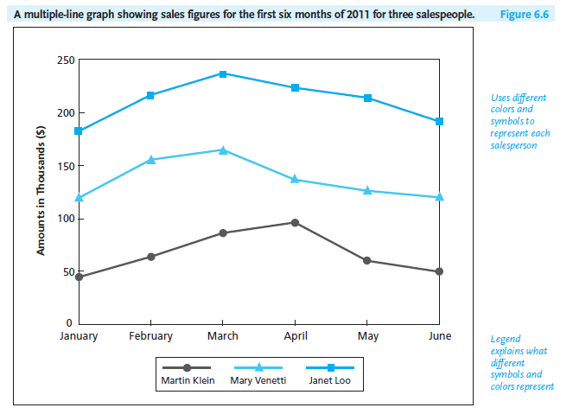
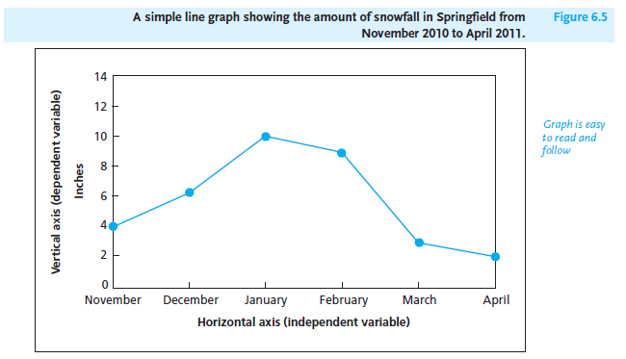
Lecture 6
Designing Successful Documents, Visuals, and Websites

Slide 30
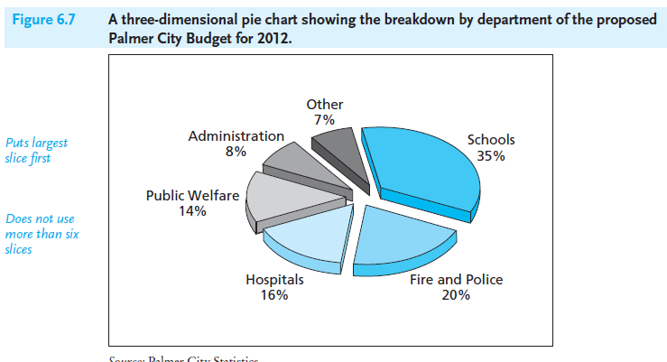
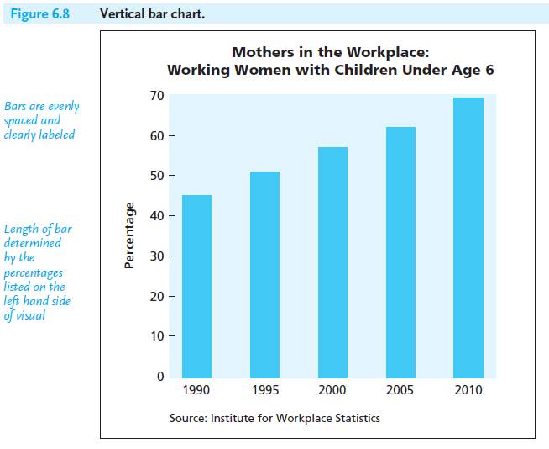
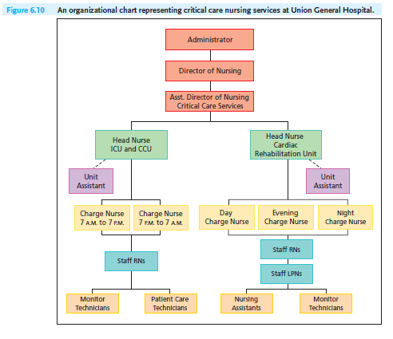
Lecture 6
Designing Successful Documents, Visuals, and Websites

Slide 31
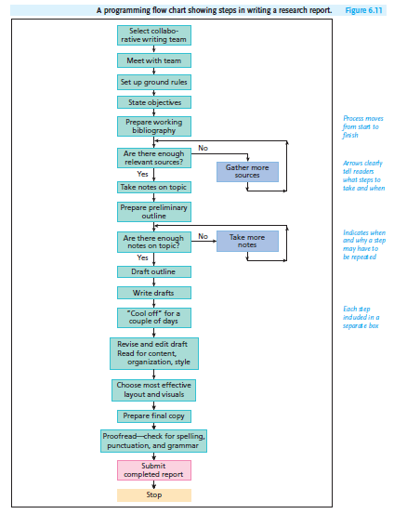
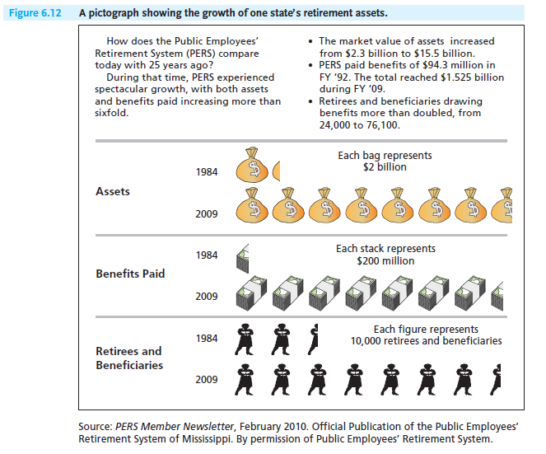
Lecture 6
Designing Successful Documents, Visuals, and Websites

Slide 32
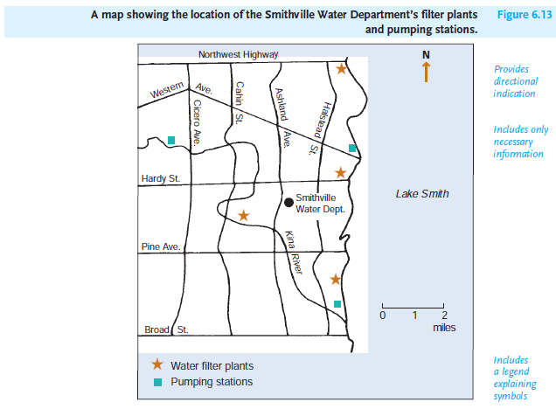
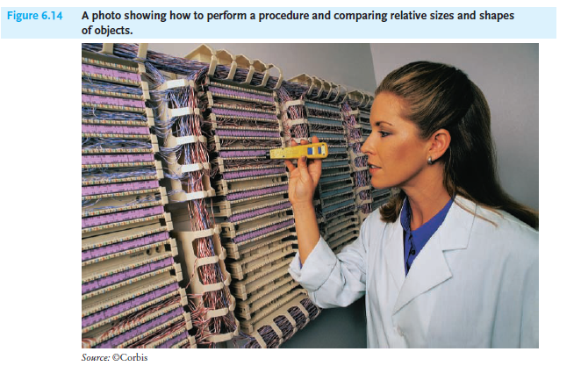
Lecture 6
Designing Successful Documents, Visuals, and Websites

Slide 33
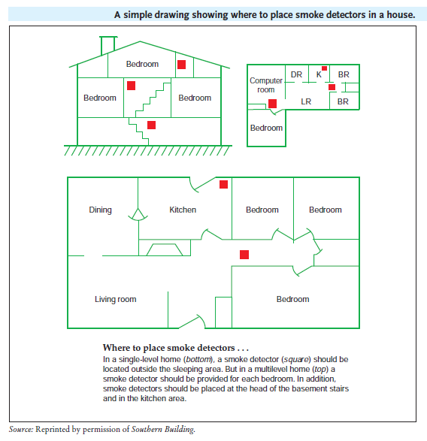
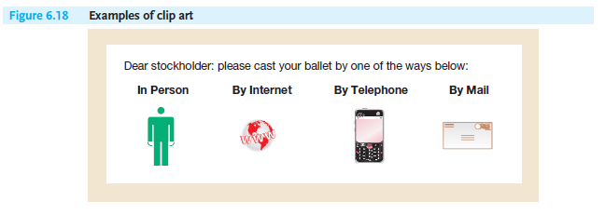
Lecture 6
Designing Successful Documents, Visuals, and Websites

Slide 34
Lecture 6
Designing Successful Documents, Visuals, and Websites
10- Using Visuals Ethically:
Make sure your visuals, whether you create or import them, are ethical. Like your words, your visuals should represent you, your company, and the data truthfully. Ethical visuals convey and interpret statistical information and other types of data, products and equipment, locations, and even individuals without misinterpretation. Your visuals should neither distort events and statistics nor mislead readers. Ethical visuals should be:

Slide 35
Lecture 6
Designing Successful Documents, Visuals, and Websites
■ accurate
■ honest, fair
■ complete
■ appropriate
■ easy to read
■ clearly labeled
■ uncluttered
■ consistent with conventions

Slide 36
Lecture 6
Designing Successful Documents, Visuals, and Websites
11- Using Appropriate Visuals for International Audiences:
Whether you are writing for an expanding international business community in South America, China, or for multicultural readers in the United States, you will have to prepare numerous documents that require visuals. These can range from instructions containing warning and caution statements to tables, graphs, charts, and photos for proposals, reports, and online presentations.

Slide 37
Lecture 6
Designing Successful Documents, Visuals, and Websites
- Guidelines for Using Visuals for International Audiences
To communicate appropriately and respectfully with international readers through visuals and other graphics, follow these guidelines:
1. Do not use any images that ethnically or racially stereotype your readers.
2. Be respectful of religious symbols and images.
3. Avoid using culturally insensitive or objectionable photographs.
4. Avoid any icons or clip art that international readers would misunderstand.

Slide 38
Lecture 6
Designing Successful Documents, Visuals, and Websites
5. Be cautious about importing images or photos with hand gestures in your work, especially in manuals or other instructional materials.
6. Don’t offend international readers by using colors that are culturally inappropriate.
7. Be careful using directional signs and shapes.
8. Avoid confusing an international audience with punctuation and other writing symbols used in the United States.

Slide 39
Lecture 6
Designing Successful Documents, Visuals, and Websites
12- Writing for and Designing Websites:
In today’s global marketplace, you can apply the skills you have just learned in designing documents and visuals to an online environment (websites, blogs, etc.). In fact, companies often ask their employees to write for and prepare visuals for a corporate website, and while you won’t be expected to construct such as website on your own, you will likely be part of a team of specialists in information technology, graphics, marketing, and engineering who are responsible for your firm’s web presence.

Slide 40
Lecture 6
Designing Successful Documents, Visuals, and Websites
To be a helpful member of this team, your employer will expect you to keep up with the latest features of website design and information on how your company can incorporate them. You may also be asked to critique a competitor’s website or to assist a client in preparing his/her website. This section of Chapter 6 stresses the principles and guidelines you need to follow to:

Slide 41
Lecture 6
Designing Successful Documents, Visuals, and Websites
■ help readers navigate your website quickly, moving from one part to another easily.
■ ensure that your site is current.
■ make your site user friendly (for global readers as well as English speaking audiences).
■ create a visually attractive site.
■ keep your design and content ethical.

Slide 42
Lecture 6
Designing Successful Documents, Visuals, and Websites
- Web Versus Paper Pages
Writing and designing a website requires the same emphasis on planning, drafting, formatting, and testing that printed business documents do. Just as with these paper documents, writers must take into account spatial, rhetorical, and visual considerations when they prepare work for a website. Yet, clearly, a website differs from a hard copy memo, letter, or report in the way content is organized and visually illustrated.

Slide 43
Lecture 6
Designing Successful Documents, Visuals, and Websites
- Web Versus Print Readers
To help design and write for the web, you need to recognize how webpages are read differently from the way print documents are.
1. Readers do not generally go through a website word for word hunting for information, carefully studying each sentence.
2. Web readers want articles, news stories, and features to be more condensed, and more strategically arranged.
3. A web audience will not necessarily read your entire website.
4. Text on the Web needs to be shorter because of the size of the screen.
5. Web readers will expect navigational cues that readers of a print source do not have.

Slide 44
Lecture 6
Designing Successful Documents, Visuals, and Websites
- Designing and Writing for the Web: Eight Guidelines
Designing and writing for a website requires you to follow many of the rules By adhering to the following eight guidelines:
1. Make your site easy to find.
2. Make your site easy to download and navigate.
3. Make your site informative.

Slide 45
Lecture 6
Designing Successful Documents, Visuals, and Websites
4. Make your site easy to read for both native English speakers and international readers.
5. Keep your site updated.
6. Use images and icons effectively.
7. Encourage visitor interaction by soliciting feedback.
8. Make sure your website is ethical.

Slide 46



References:
Successful Writing at Work, Concise Third Edition,
By: Philip C. Kolin
University of Southern Mississippi
Chapter 6
Thank You

