Slide 1


Probability and
Statistics
Prepared by Dr. Alfaisal Hasan
STA 201
Probability and Statistics
Lecture NO 5

Slide 2



Probability and
Statistics
Lecture NO 5
STA 201
Probability and Statistics
Prepared by
Dr. Alfaisal Hasan
www.midocean.ae

Slide 3

Chapter
Topics
Chapter 1: Introduction To Statistics
Chapter 2: Descriptive Statistics
Chapter 3: Probability
Chapter 4: Discrete Probability Distributions
Chapter 5: Normal Probability Distributions
Chapter 6: Confidence Intervals
Chapter 7: Hypothesis Testing with One Sample
Chapter 8: Hypothesis Testing with Two Samples
Chapter 9: Correlation And Regression
Chapter 10: Chi-Square Tests and The F-Distribution
www.midocean.ae

Slide 4
Chapter
Normal Probability Distribution
5.1 Introduction to Normal Distributions and the Standard Normal Distribution
5.2 Normal Distributions: Finding Probabilities
5.3 Normal Distributions: Finding Values
5.4 Sampling Distributions and the Central Limit Theorem
5.5 Normal Approximations to Binomial Distributions
www.midocean.ae

Slide 5
Chapter
Introduction to Normal Distribution
Continuous random variable
Has an infinite number of possible values that can be represented by an interval on the number line.
Continuous probability distribution
The probability distribution of a continuous random variable.
Hours spent studying in a day
The time spent studying can be any number between 0 and 24.
0
3
6
9
12
15
18
21
24
www.midocean.ae

Slide 6
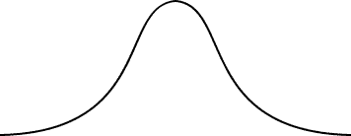
Chapter
Properties of Normal Distribution
Normal distribution
A continuous probability distribution for a random variable, x.
The most important continuous probability distribution in statistics.
The graph of a normal distribution is called the normal curve.
μ
x
www.midocean.ae

Slide 7
Chapter
Properties of Normal Distribution
The mean, median, and mode are equal.
The normal curve is bell-shaped and symmetric about the mean.
The total area under the curve is equal to one.
The normal curve approaches, but never touches the x-axis as it extends farther and farther away from the mean.
Total area = 1
μ
x
www.midocean.ae

Slide 8
Chapter
Properties of Normal Distribution
Between μ – σ and μ + σ (in the center of the curve), the graph curves downward. The graph curves upward to the left of μ – σ and to the right of μ + σ. The points at which the curve changes from curving upward to curving downward are called the inflection points.
Inflection points
x
μ − 3σ
μ − 2σ
μ − σ
μ
μ + σ
μ + 2σ
μ + 3σ
www.midocean.ae

Slide 9

Chapter
Means and standard deviations
A normal distribution can have any mean and any positive standard deviation.
The mean gives the location of the line of symmetry.
The standard deviation describes the spread of the data.
μ = 3.5
σ = 1.5
μ = 3.5
σ = 0.7
μ = 1.5
σ = 0.7
www.midocean.ae

Slide 10

Chapter
Example
Which curve has the greater mean?
Which curve has the greater standard deviation?
Solution:
Curve A has the greater mean (The line of symmetry of curve A occurs at x = 15. The line of symmetry of curve B occurs at x = 12)
Curve B has the greater standard deviation (Curve B is more spread out than curve A.)
www.midocean.ae

Slide 11

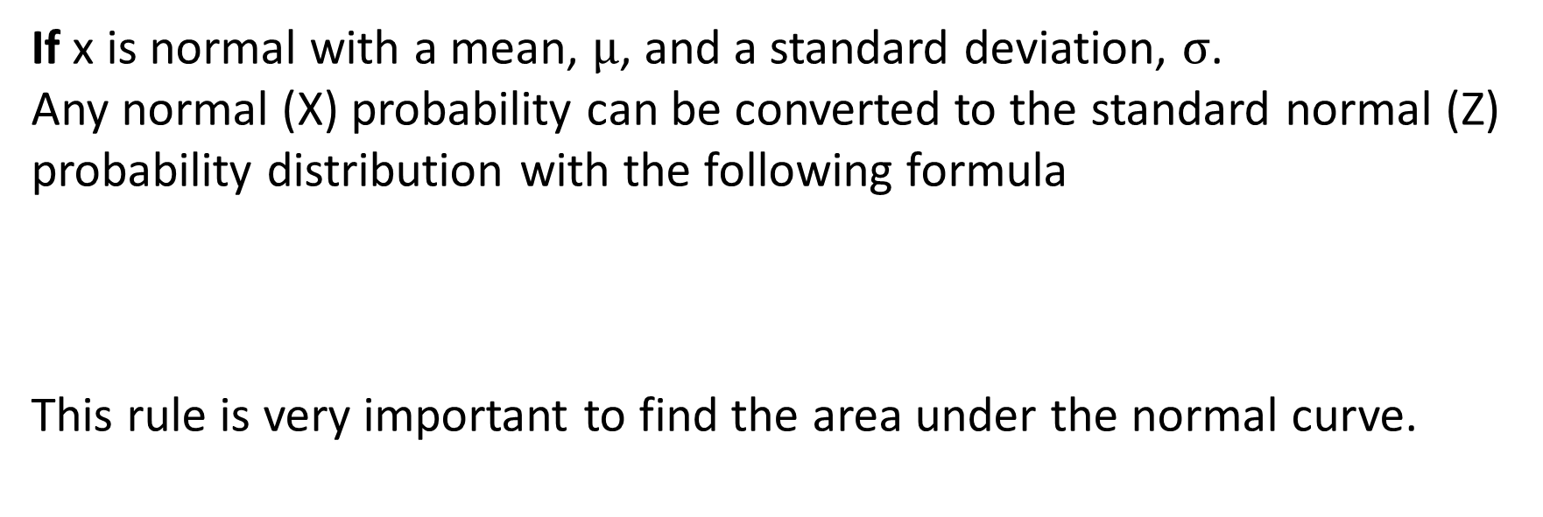
Chapter
Convert from normal to standard normal
If x is normal with a mean, $\text{μ}$, and a standard deviation, $\text{σ}$.
Any normal (X) probability can be converted to the standard normal (Z) probability distribution with the following formula
This rule is very important to find the area under the normal curve.
www.midocean.ae

Slide 12
Chapter
The Standard Normal Distribution
Standard normal distribution
A normal distribution with a mean of 0 and a standard deviation of 1.
Area = 1
z
−3
−2
−1
0
1
2
3
Any x-value can be transformed into a z-score by using the formula
www.midocean.ae

Slide 13
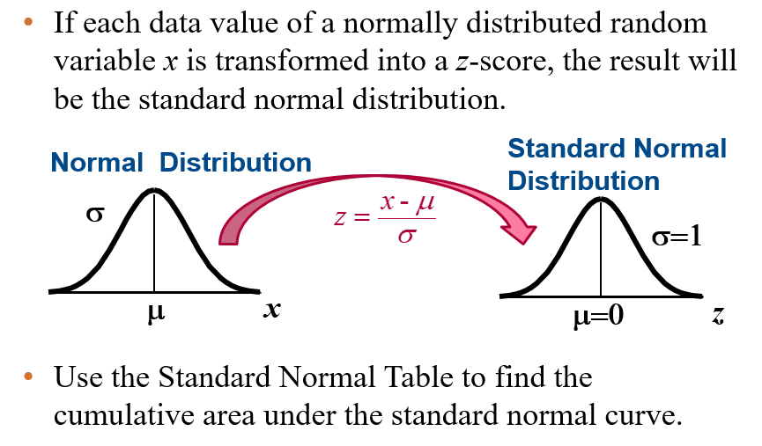
The Standard Normal Distribution
Chapter
www.midocean.ae

Slide 14
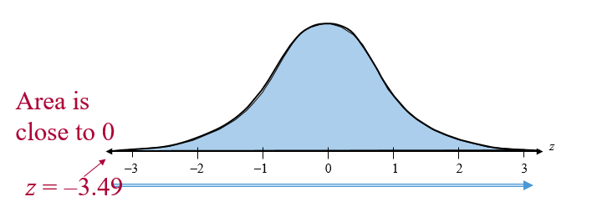
Chapter
Properties of the Standard Normal Distribution
The cumulative area is close to 0 for z-scores close to z = −3.49.
The cumulative area increases as the z-scores increase.
www.midocean.ae

Slide 15
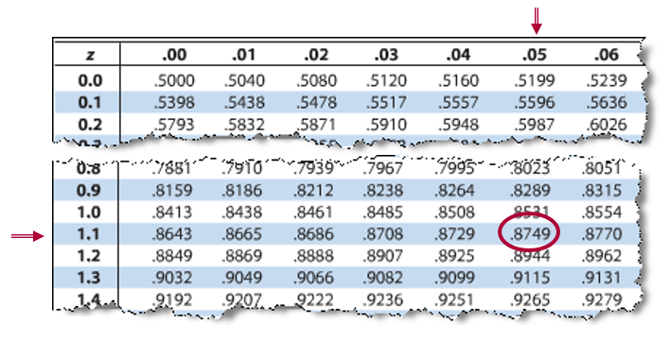
Example: Using The Standard Normal Table
Chapter
Find the cumulative area that corresponds to a z-score of 1.15.
The area to the left of z = 1.15 is 0.8749.
www.midocean.ae

Slide 16
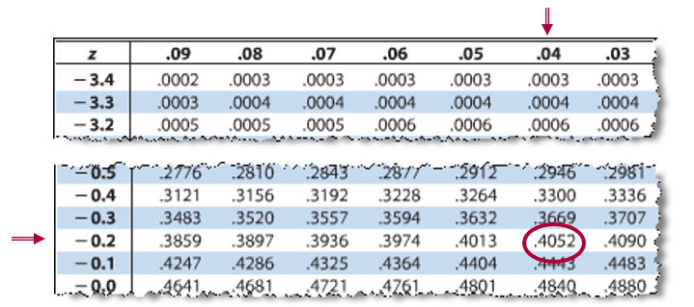
Example: Using The Standard Normal Table
Chapter
Find the cumulative area that corresponds to a z-score of -0.24.
The area to the left of z = -0.24 is 0.4052.
www.midocean.ae

Slide 17
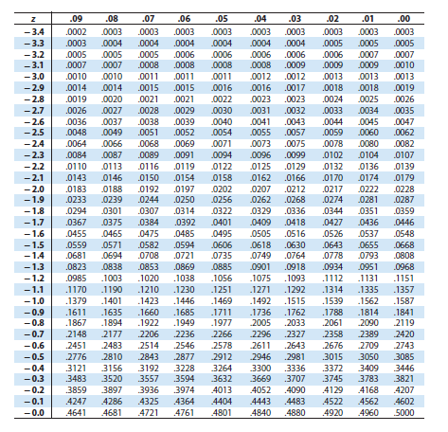
The Standard Normal Table
Chapter
www.midocean.ae

Slide 18
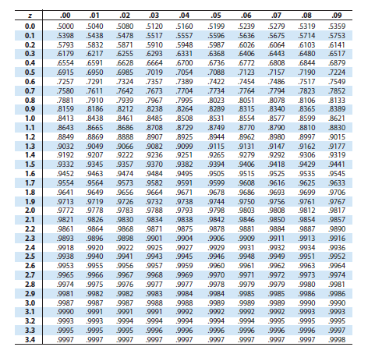
The Standard Normal Table
Chapter
www.midocean.ae

Slide 19
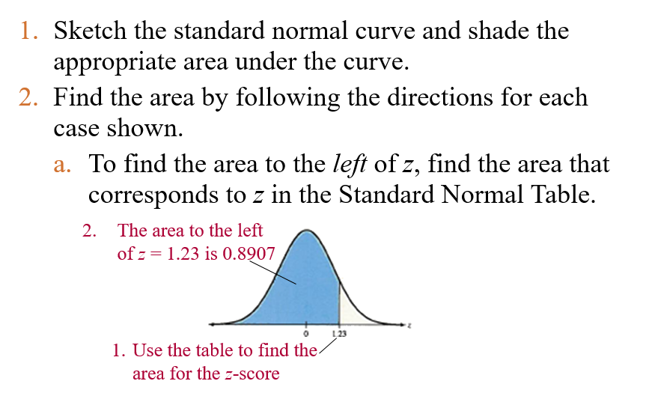
Finding Areas Under the Standard Normal Curve
Chapter
www.midocean.ae

Slide 20
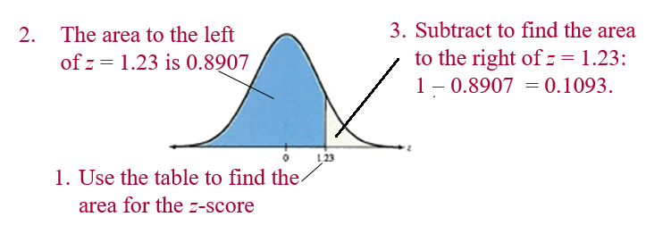
Finding Areas Under the Standard Normal Curve
Chapter
  To find the area to the right of z, use the Standard Normal Table to find the area that corresponds to z. Then subtract the area from 1.
www.midocean.ae

Slide 21
Normal Distributions: Finding Probabilities
Chapter
If X value equal to 600, we have to transform this value to standard value by the rule to be able to use the table:
www.midocean.ae

Slide 22

Example: Finding Probabilities for Normal Distributions
Chapter
A survey indicates that people use their computers an average of 2.4 years before upgrading to a new machine. The standard deviation is 0.5 year. A computer owner is selected at random. Find the probability that he or she will use it for fewer than 2 years before upgrading. Assume that the variable x is normally distributed.
Solution:
We need to find P(x < 2)
www.midocean.ae

Slide 23
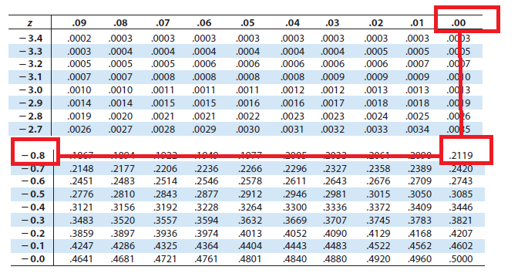
Example: Finding Probabilities for Normal Distributions
Chapter
P(z < -0.80)
0.2119
z
-0.80
0
P(x < 2) = P(z < -0.80) = 0.2119
www.midocean.ae

Slide 24
Example: Finding Probabilities for Normal Distributions
Chapter
A survey indicates that for each trip to the supermarket, a shopper spends an average of 45 minutes with a standard deviation of 12 minutes in the store. The length of time spent in the store is normally distributed and is represented by the variable x. A shopper enters the store. Find the probability that the shopper will be in the store for between 24 and 54 minutes.
Solution:
We need to find P(24< x < 54)
www.midocean.ae

Slide 25
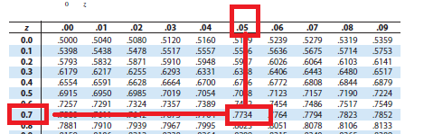
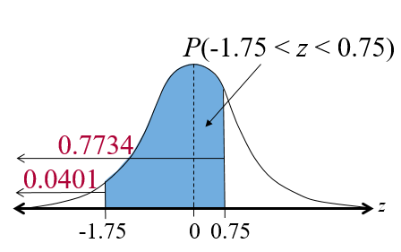
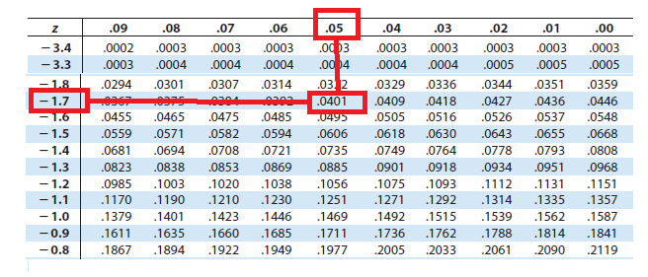
Example: Finding Probabilities for Normal Distributions
Chapter
P(24 < x < 54) = P(-1.75 < z < 0.75) = 0.7734 – 0.0401 = 0.7333
www.midocean.ae

Slide 26
Example: Finding Probabilities for Normal Distributions
Chapter
Find the probability that the shopper will be in the store more than 39 minutes. (Recall μ = 45 minutes and σ = 12 minutes)
Solution:
We need to get P(x > 39)
www.midocean.ae

Slide 27
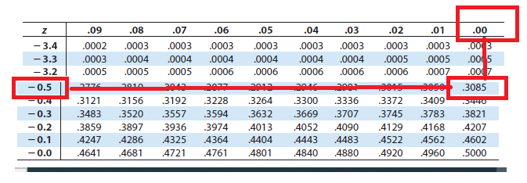
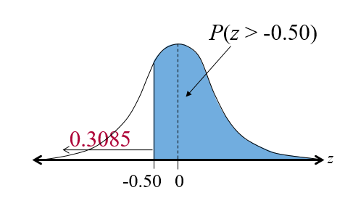
Example: Finding Probabilities for Normal Distributions
Chapter
P(x > 39) = P(z > -0.50) = 1– 0.3085 = 0.6915
www.midocean.ae

Slide 28
5.3 Normal Distributions: Finding Values
Chapter
Find a z-score given the area under the normal curve
Transform a z-score to an x-value
Find a specific data value of a normal distribution given the probability
www.midocean.ae

Slide 29
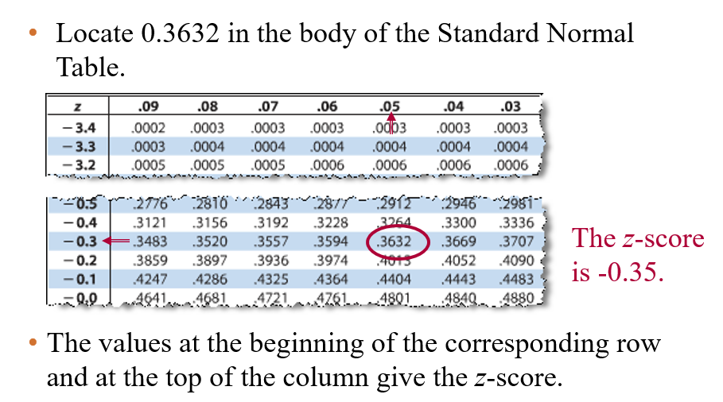
Example: Finding a z-Score Given an Area
Chapter
Find the z-score that corresponds to a cumulative area of 0.3632.
www.midocean.ae

Slide 30
Transforming a z-Score to an x-Score
Chapter
To transform a standard z-score to a data value x in a given population, use the formula
x = μ + zσ
www.midocean.ae

Slide 31
Example: Finding an x-Value
Chapter
The speeds of vehicles along a stretch of highway are normally distributed, with a mean of 67 miles per hour and a standard deviation of 4 miles per hour. Find the speeds x corresponding to z-sores of 1.96, -2.33, and 0
Solution: Use the formula x = μ + zσ
z = 1.96: x = 67 + 1.96(4) = 74.84 miles per hour
z = -2.33: x = 67 + (-2.33)(4) = 57.68 miles per hour
z = 0: x = 67 + 0(4) = 67 miles per hour
www.midocean.ae

Slide 32
Sampling Distributions and the Central Limit Theorem
Chapter
Find sampling distributions and verify their properties
Interpret the Central Limit Theorem
Apply the Central Limit Theorem to find the probability of a sample mean
www.midocean.ae

Slide 33
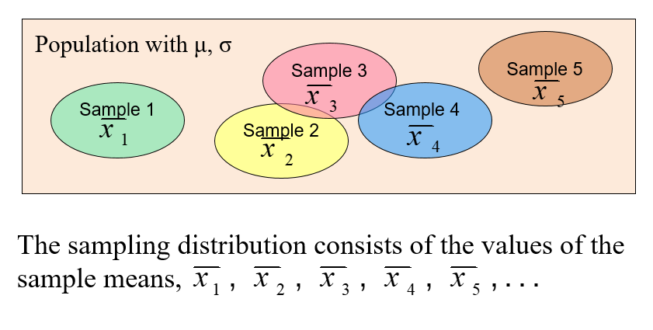
Sampling distribution of sample mean
Chapter
www.midocean.ae

Slide 34
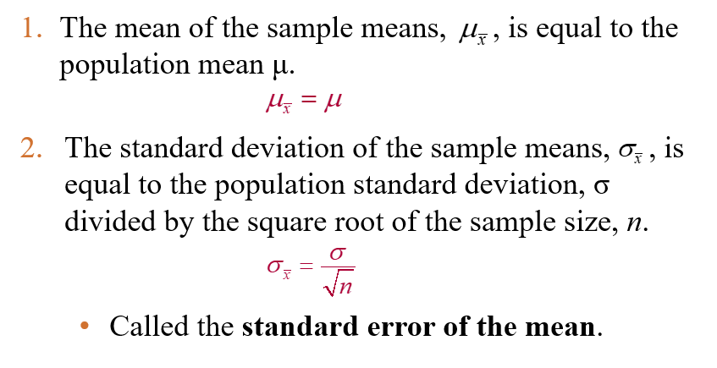
Properties of Sampling distribution of sample mean
Chapter
www.midocean.ae

Slide 35
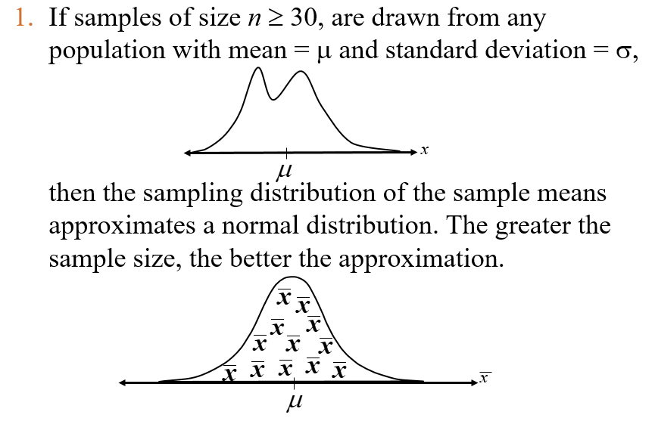
Central Limit Theorem
Chapter
www.midocean.ae

Slide 36
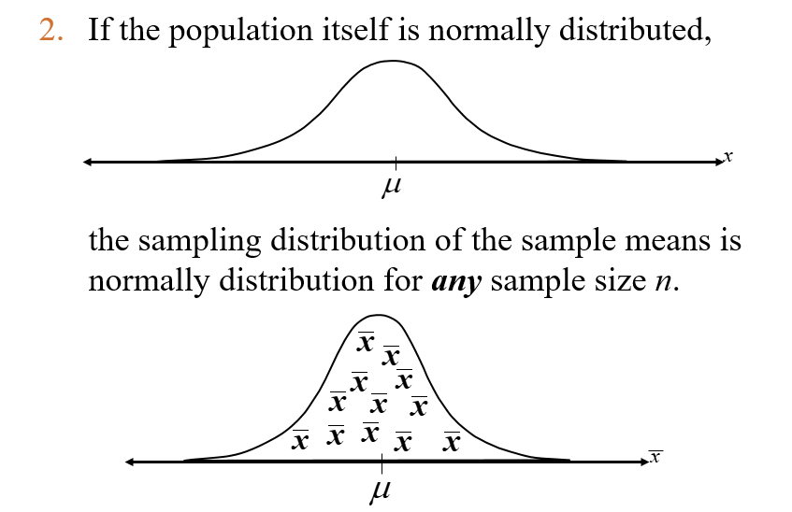
Central Limit Theorem
Chapter
www.midocean.ae

Slide 37
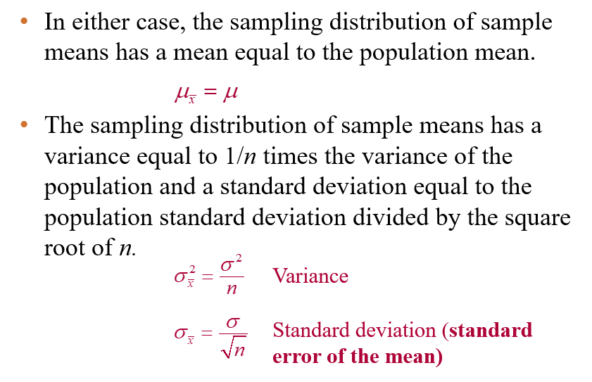
Central Limit Theorem
Chapter
www.midocean.ae

Slide 38
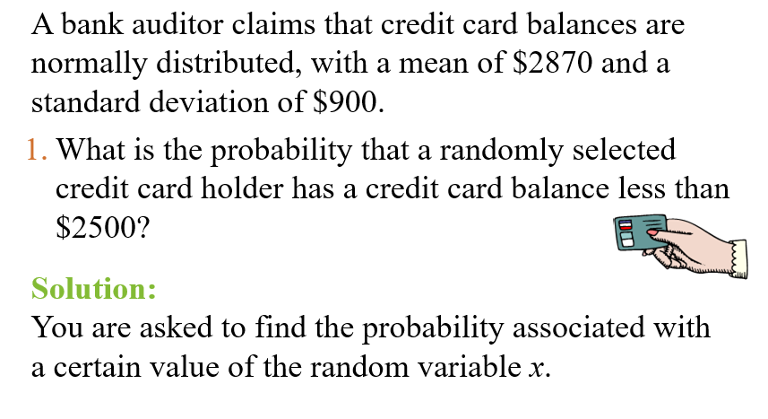

Example: Probabilities for x and $\overline{x}$
Chapter
www.midocean.ae

Slide 39
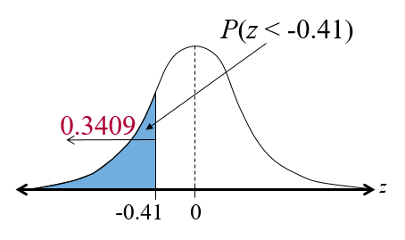

Solution: Probabilities for x and $\overline{x}$
Chapter
  P( x < 2500) = P(z < -0.41) = 0.3409
www.midocean.ae

Slide 40
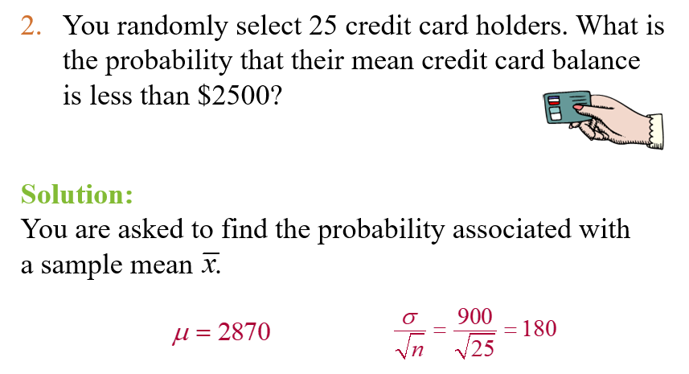
Example: Probabilities for x and $\overline{x}$
Chapter
www.midocean.ae

Slide 41
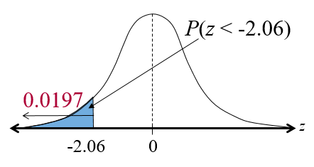
Example: Probabilities for x and $\overline{x}$
Chapter
P( x < 2500) = P(z < -2.06) = 0.0197
www.midocean.ae

Slide 42
5.5 Normal Approximations to Binomial Distributions
Chapter
Determine when the normal distribution can approximate the binomial distribution
Use the normal distribution to approximate binomial probabilities
www.midocean.ae

Slide 43
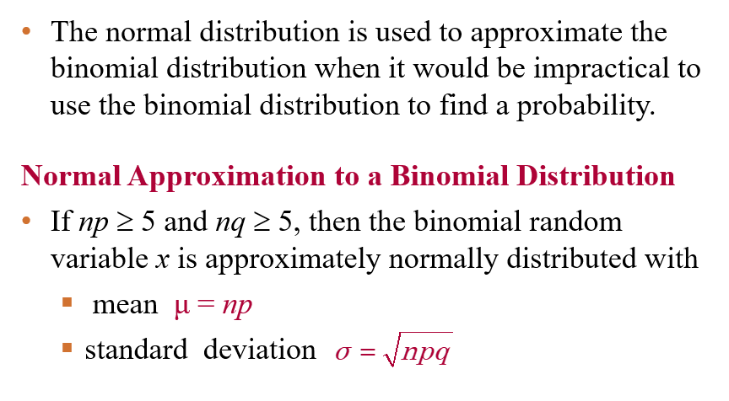
Normal Approximation to a Binomial
Chapter
www.midocean.ae

Slide 44
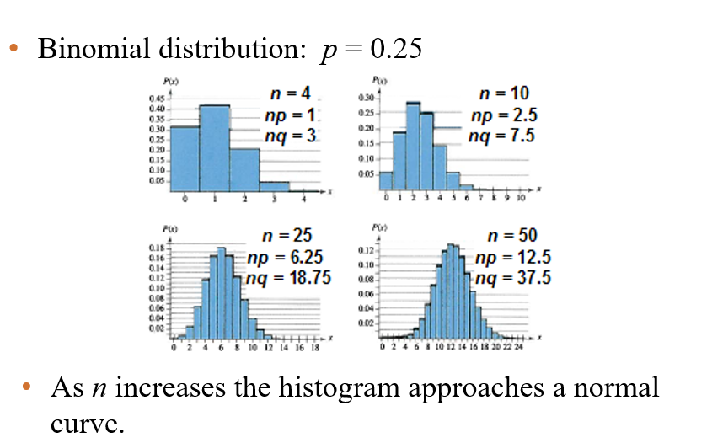
Normal Approximation to a Binomial
Chapter
www.midocean.ae

Slide 45
Normal Approximation to a Binomial
Chapter
www.midocean.ae

Slide 46
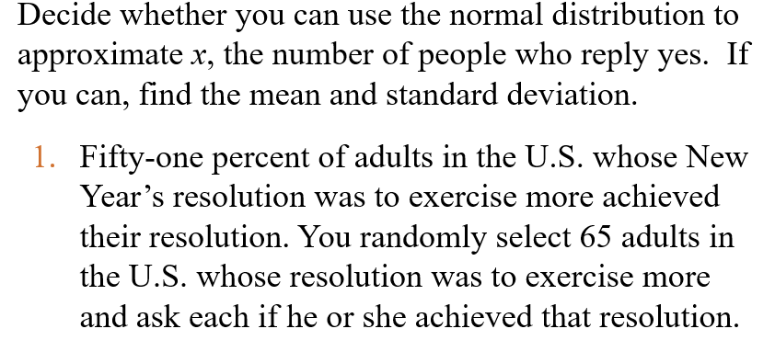
Approximating the Binomial
Chapter
www.midocean.ae

Slide 47
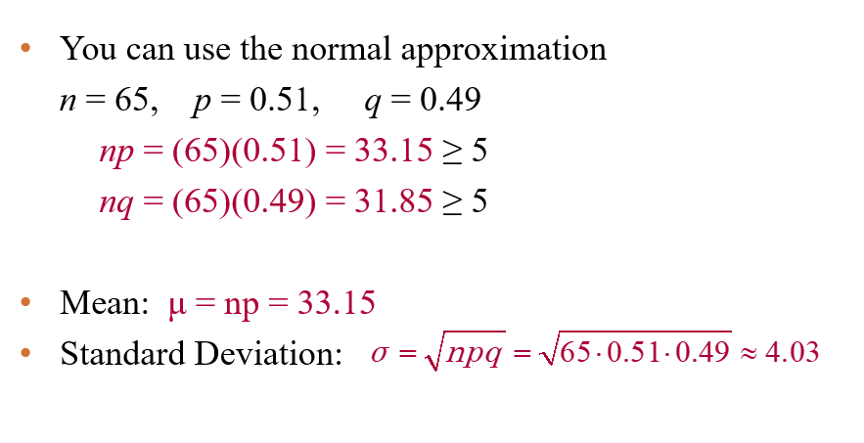
Solution: Approximating the Binomial
Chapter
www.midocean.ae

Slide 48
Chapter Summary
Chapter
Found probabilities for normally distributed
Found a z-score given the area under the normal curve
Transformed a z-score to an x-value
Interpreted the Central Limit Theorem
Used the normal distribution to approximate binomial probabilities
www.midocean.ae

Slide 49
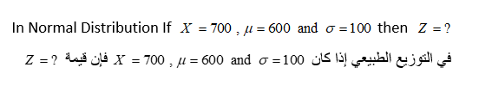
Un Solved Examples
Chapter
www.midocean.ae

Slide 50
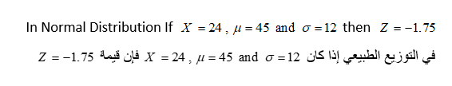
Un Solved Examples
Chapter
www.midocean.ae

Slide 51
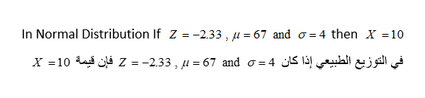
Un Solved Examples
Chapter
www.midocean.ae

Slide 52

Un Solved Examples
Chapter
www.midocean.ae

Slide 53


Thank You

