Slide 1



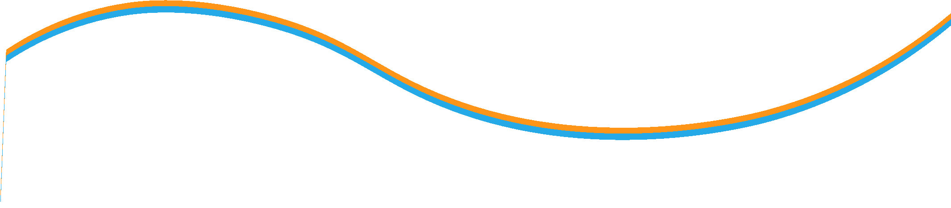

Equity Valuation
Lecture 5
Prepared by Dr. Walaa Mohamed
MGM 237
Introduction to Finance

Slide 2
LEARNING OBJECTIVES
After studying this chapter, you should be able to do the following:
LO 10.1 Top-down approach & Bottom-up approach.
LO 10.2 Present value models
LO 10.3 Risk in Stock Valuation
LO 10.4 Valuation and the Financial Environment.
LO 10.5 Industry and Competition

Slide 3















































Slide 4
A. Evaluate whether a security, given its current market price and a value estimate, is overvalued, fairly valued, or undervalued by the market
This reading introduces equity valuation models used to estimate the intrinsic value (synonym: fundamental value) of a security; intrinsic value is based on an analysis of investment fundamentals and characteristics. The fundamentals to be considered depend on the analyst’s approach to valuation.
intrinsic value the maximum price we should be willing to pay for an asset; the best estimate of the true economic value of an asset based upon a forecast of future cash ﬂows and an estimate of the appropriate discount rate.
In a top-down approach, an analyst examines the economic environment, identifies sectors that are expected to prosper in that environment, and analyzes securities of companies from previously identified attractive sectors
In a bottom-up approach, an analyst typically follows an industry or industries and forecasts fundamentals for the companies in those industries in order to determine valuation
Analysts use valuation models to estimate the intrinsic values of stocks and compare them to the stocks’ market prices to determine whether individual stocks are overvalued, undervalued, or fairly valued. In doing valuation analysis for stocks, analysts are assuming that some stocks’ prices deviate significantly from their intrinsic values

Slide 5
There are things to consider when executing the valuation models:
The larger the percentage difference between market prices and estimated values, the more likely the investor is to take a position based on the estimate of intrinsic value
The more confident the investor is about the appropriateness of the valuation model used, the more likely the investor is to take an investment position in the stock
The more confident the investor is about the estimated inputs used in the valuation model, the more likely the investor is to take an investment position in a stock that is identified as overvalued or undervalued. Analysts must also consider the sensitivity of a model value to each of its inputs in deciding whether to act on a difference between model values and market prices
Even if we assume that market prices sometimes deviate from intrinsic values, market prices must be treated as fairly reliable indications of intrinsic value. Investors must consider why a stock is mispriced in the market
Finally, to take a position in a stock identified as mispriced in the market, an investor must believe that the market price will actually move toward its estimated intrinsic value

Slide 6
b: Describe major categories of equity valuation models.
One of major categories of equity valuation models are:
Present value models (synonym: discounted cash flow models). These models estimate the intrinsic value of a security as the present value of the future benefits expected to be received from the security. In present value models, benefits are often defined in terms of cash expected to be distributed to shareholders (dividend discount models) or in terms of cash flows available to be distributed to shareholders after meeting capital expenditure and working capital needs (free-cash- flow-to- equity models). Many models fall within this category

Slide 7
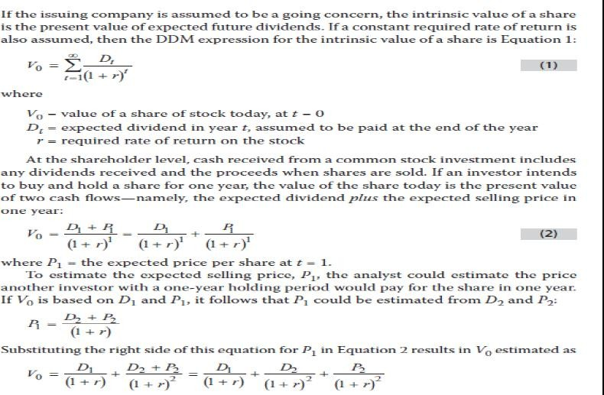
c. Explain the rationale for using present value models to value equity and describe the dividend discount and free-cash-flow-to- equity models.
The Dividend Discount Model: Description

Slide 8
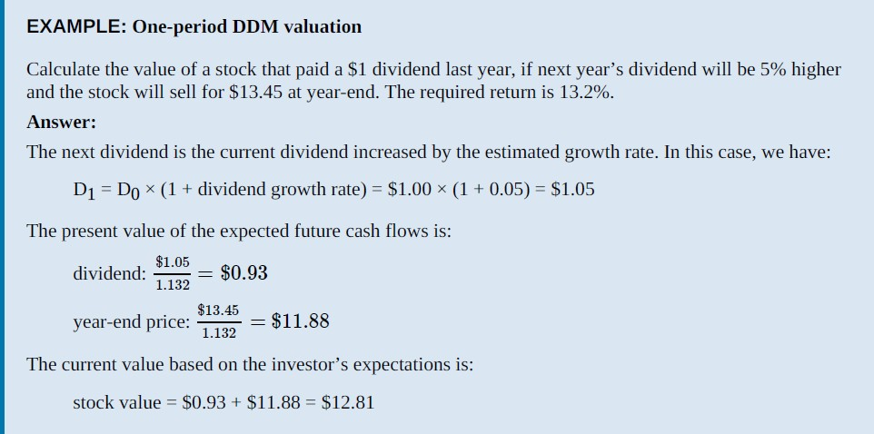

Slide 9
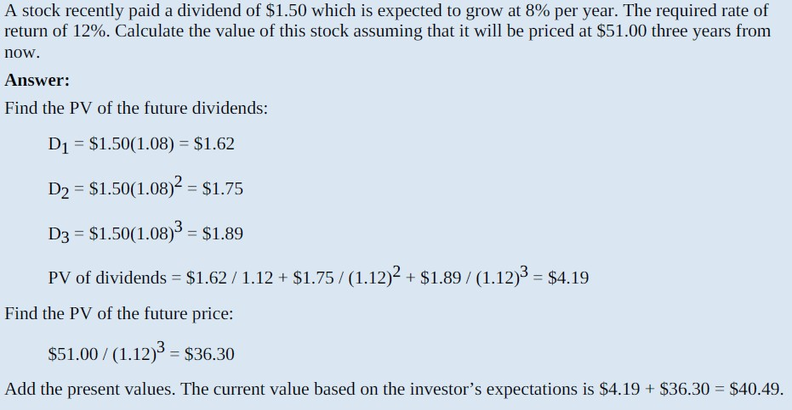

Slide 10
Free cash flow to equity (FCFE) is often used in discounted cash flow models instead of dividends because it represents the potential amount of cash that could be paid out to common shareholders. That is, FCFE reflects the firm’s capacity to pay dividends. FCFE is also useful for firms that do not currently pay dividends
FCFE is defined as the cash remaining after a firm meets all of its debt obligations and provides for the capital expenditures necessary to maintain existing assets and to purchase the new assets needed to support the assumed growth of the firm. In other words, it is the cash available to the firm’s equity holders after a firm meets all of its other obligations. FCFE for a period is often calculated as:
FCFE = net income + depreciation − increase in working capital − fixed capital investment (FCInv) − debt principal repayments + new debt issues
FCFE can also be calculated as:
FCFE = cash flow from operations − FCInv + net borrowing

Slide 11
What Is Working Capital?
Working capital, also known as net working capital (NWC), is the difference between a company’s current assets—such as cash, accounts receivable/customers’ unpaid bills, and inventories of raw materials and finished goods—and its current liabilities, such as accounts payable and debts. It's a commonly used measurement to gauge the short-term health of an organization.
Working capital, also called net working capital, represents the difference between a company’s current assets and current liabilities.
Working capital is a measure of a company’s liquidity and short-term financial health.
A company has negative working if its ratio of current assets to liabilities is less than one (or if it has more current liabilities than current assets).
Positive working capital indicates that a company can fund its current operations and invest in future activities and growth.
High working capital isn’t always a good thing. It might indicate that the business has too much inventory, not investing its excess cash, or not capitalizing on low-expense debt opportunities.

Slide 12
Estimating the Required Return for Equity
The capital asset pricing model (CAPM) provides an estimate of the required rate of return (ki) for security i as a function of its systematic risk (βi), the risk-free rate (Rf), and the expected return on the market
[E(Rmkt)] as: R = Rf + β [E(Rmkt) − Rf]
There is some controversy over whether the CAPM is the best model to calculate the required return on equity. Also, different analysts will likely use different inputs, so there is no single number that is correct.
Beta is a concept that measures the expected move in a stock relative to movements in the overall market. A beta greater than 1.0 suggests that the stock is more volatile than the broader market, and a beta less than 1.0 indicates a stock with lower volatility.

Slide 13

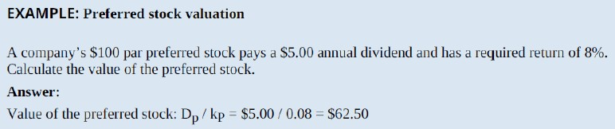
E: Calculate the intrinsic value of a non-callable, non-convertible preferred stock.
Preferred stock pays a dividend that is usually fixed and usually has an indefinite maturity. When the dividend is fixed and the stream of dividends is infinite, the infinite period dividend discount model reduces to a simple ratio:
•

Slide 14


The Gordon growth model (or constant growth model) assumes the annual growth rate of dividends, g, is constant. Hence, next period’s dividend, D1, is D0(1 + g), the second year’s dividend, D2, is D0(1 + g), and so on. The extended equation using this assumption gives the present value of the expected future dividends (V0) as:
f: Calculate and interpret the intrinsic value of an equity security based on the Gordon (constant) growth dividend discount model or a two-stage dividend discount model, as appropriate
When the growth rate of dividends is constant, this equation simplifies to the
Gordon (constant) growth model:
The assumptions of the Gordon growth model are:
Dividends are the appropriate measure of shareholder wealth
The constant dividend growth rate, g, and required return on stock, r, are never expected to change
r must be greater than g. If not, the math will not work.

Slide 15
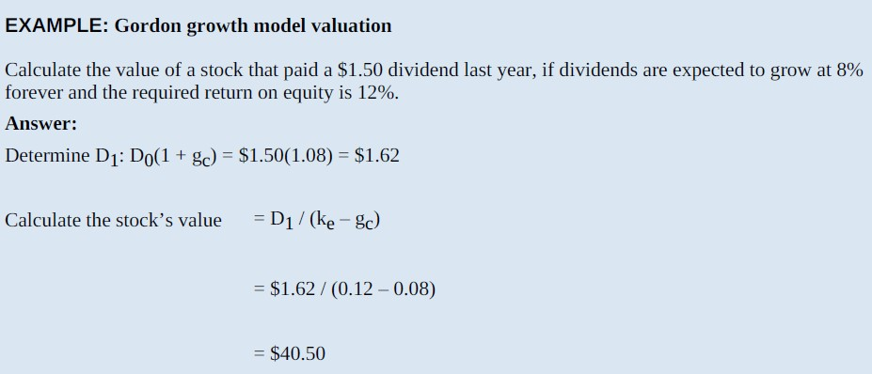

Slide 16
This example demonstrates that the stock’s value is determined by the relationship
between the investor’s required rate of return on equity, r, and the projected growth rate of dividends, g:
As the difference between r and g widens, the value of the stock falls
As the difference narrows, the value of the stock rises
Small changes in the difference between r and g can cause large changes in the stock’s value
Because the estimated stock value is very sensitive to the denominator, an analyst should calculate several different value estimates using a range of required returns and growth rates.

Slide 17
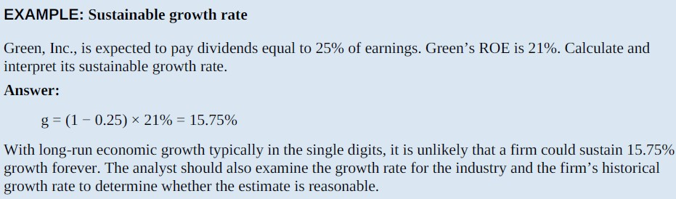
Estimating the growth rate in dividends
To estimate the growth rate in dividends, the analyst can use three methods:
Use the historical growth in dividends for the firm.
Use the median industry dividend growth rate.
Estimate the sustainable growth rate
Sustainable Growth Rate; is the rate at which equity, earnings, and dividends can continue to grow indefinitely assuming that ROE is constant, the dividend payout ratio is constant, and no new equity is sold.

Slide 18
h: Identify characteristics of companies for which the constant growth or a multistage dividend discount model is appropriate
The Gordon growth model uses a single constant growth rate of dividends and is most appropriate for valuing stable and mature, non-cyclical, dividend-paying firms
For dividend-paying firms with dividends that are expected to grow rapidly, slowly, or erratically over some period, followed by constant dividend growth, some form of the multistage growth model should be employed
One variant of a multistage growth model assumes that the firm has three stages of dividend growth, not just two. These three stages can be categorized as growth, transition, and maturity. A 3-stage model would be suitable for firms with an initial high growth rate, followed by a lower growth rate during a second, transitional period, followed by the constant growth rate in the long run, such as a young firm still in the high growth phase
When a firm does not pay dividends, estimates of dividend payments some years in the future are highly speculative. In this case, and in any case where future dividends cannot be estimated with much confidence, valuation based on FCFE is appropriate as long as growth rates of earnings can be estimated. In other cases, valuation based on price multiples may be more appropriate

Slide 19
Risk in Stock Valuation
Investors in common stocks face a number of risks that bondholders do not. This additional risk leads them to require a higher rate of return on a ﬁrm’s stock than on its debt securities. For example, in the event of corporate failure, the claims of stockholders have lower priority than those of bondholders. So, stockholders face a greater risk of loss than bondholders. Dividends can be variable and omitted, whereas bond cash ﬂows have a legal obligation to be met.
Poor ethical decisions and poor management are another source of risk for stock investors in that such decisions can lower future cash ﬂows and raise the required rate of return demanded by future investors. Accounting gimmickry and decisions by self-serving managers can hurt stock prices

Slide 20
If the general level of interest rates rises, investors will demand a higher rate of return on stocks to maintain their risk premium diﬀerential over debt securities. This will force stock prices downward. Therefore, stockholders risk losses from any general upward movement of market interest rates.
Also, future dividends, or dividend growth rates, are not known with certainty at the time stock is purchased. If poor corporate performance or adverse general economic conditions lead investors to lower their expectations about future dividend payments, this will lower the present value of shares of the stock, leaving the stockholder with the risk of capital loss. Stock analysts systematically review economic, industry, and ﬁrm conditions in great detail to gain insight into corporate growth prospects and the appropriate level of return that an investor should require of a stock.

Slide 21
Valuation and the Financial Environment
The price of an asset is the present value of future cash ﬂows; the discount rate used in the present value calculation is the required rate of return on the investment. Future cash ﬂows of ﬁrms and the required returns of investors are aﬀected by the global and domestic economic environments and the competition faced by ﬁrms. Slower sales or higher expenses can harm a ﬁrm’s ability to pay its bond interest or dividends or to reinvest in its future growth. Besides aﬀecting cash ﬂows, these can aﬀect investors’ required rates of return by increasing risk premiums or credit spreads. Inﬂation pressures and capital market changes inﬂuence the level of interest rates and required returns.

Slide 22
Domestic Economic Influences
Individuals can spend only what they have (income and savings) or what their future earning capacity will allow them to borrow. Consumption spending (spending by individuals for items such as food, cars, clothes, computers, and so forth) comprises about two-thirds of gross domestic product (GDP) in the United States. Generally, higher disposable incomes (that is, income after taxes) lead to higher levels of consumption spending. Higher levels of spending mean inventories are reduced and companies need to produce more and hire additional workers to meet sales demand. Corporations will spend to obtain supplies and workers based upon expectations of future demand. Similarly, they will invest in additional plant and equipment based upon expected future sales and income. Economic growth results in higher levels of consumer spending and corporate investment, which in turn stimulates job growth and additional demand. Slow or negative growth can lead to layoﬀs, pessimistic expectations, and reduced consumer and corporate spending. These eﬀects will directly inﬂuence company proﬁts and cash ﬂows.

Slide 23
Economic conditions aﬀect required returns, too. Investors will be more optimistic in good economic times and more willing to accept lower-risk premiums on bond and stock investments. In poor economic times, credit spreads will rise as investors want to place their funds in safer investments.
Governments shape the domestic economy by ﬁscal policy (government spending and taxation decisions) and monetary policy. These decisions may aﬀect consumer disposable income (ﬁscal policy) and the level of interest rates as well as inﬂation expectations, (monetary policy) and, therefore, aﬀect the valuation of the bond and stock markets.
Some industry sectors are sensitive to changes in consumer spending. Sales by auto manufacturers, computer ﬁrms, and other manufacturers of high-priced items will rise and fall by greater amounts over the business cycle than will food or pharmaceutical ﬁrms. Changes in interest rates aﬀect some industries more than others, too; banks and the housing industry (and sellers of large household appliances) are sensitive to changes in interest rates more than, say, book and music publishers or restaurants.

Slide 24
Industry and Competition
A ﬁrm’s proﬁts are determined by its sales revenues, expenses, and taxes. We have mentioned taxes and some inﬂuences on sales and expenses in our discussion of global and domestic economies, but industry competition and the ﬁrm’s position within the industry will have a large impact on its ability to generate proﬁts over time. Tight competition means it will be diﬃcult to raise prices to increase sales revenue or proﬁtability. Nonprice forms of competition, such as customer service, product innovation, and the use of technology to the fullest extent in the manufacturing and sales processes may hurt proﬁts by increasing expenses if the features do not generate suﬃcient sales. Changes in the cost and availability of raw materials, labor, and energy can adversely aﬀect a ﬁrm’s competitive place in the market.
The inﬂuences of competition and supply ultimately aﬀect a ﬁrm’s proﬁtability and investors’ perceptions of the ﬁrm’s risk. This, in turn, will aﬀect its bond and stock prices. The most attractive ﬁrms for investing in will be those with a competitive advantage over their rivals. They may oﬀer a high-quality product, be the low-cost producer, be innovators in the use of technology, or oﬀer the best customer support. Whatever the source of the ﬁrm’s advantage is, if it can build and maintain this advantage over time it will reap above-normal proﬁts and be an attractive investment.

