Slide 1


Procurement and Supply Chain Management
Prepared by Dr. Tarek Mohamed
MGM 431
Lecture 2

Slide 2


Understanding logistics and supply chain
Lecture 2
MGM 431
Prepared by
Dr. Tarek Mohamed
www.midocean.km

Slide 3

Course Agenda
Chapter
1-Understanding both supply chain and logistics management.
2-Analyze the increased importance of logistics.
3-Provide a brief overview of activities in the logistics channel.
4-Discuss the role of warehousing in a logistics system.
5-Describe several types of transportation specialists.
6-Describe reverse logistics and sustainability dimensions for a supply chain.
www.midocean.km

Slide 4
Supply Chain Defined
The supply chain itself is a system of organizations, people, activities, information, and resources involved in the planning, moving or storage of a product or service from supplier to customer (actually more like a “web” than a “chain”).
Supply chain activities transform natural resources, raw materials, and components into a finished product that is delivered to the end customer.
www.midocean.km

Slide 5
Supply Chain Functions
Depending on one’s view, some of the functions below may be included within the supply chain & logistics organization:
Procurement - The acquisition of goods or services from an outside external source.
Demand forecasting - Estimating the quantity of a product or service that customers will purchase.
Customer service and order management - Tasks associated with fulfilling an order for goods or services placed by a customer.
Inventory – Planning and management.
Transportation – For hire and private.
Warehousing – Public and private.
Materials handling and packaging - Movement, protection, storage and control of materials and products using manual, semi-automated and automated equipment.
Facility network – Location decision in an organization’s supply chain network.
www.midocean.km

Slide 6
VALUE CHAIN
Inbound logistics—Receiving, warehousing, and inventory control of input materials.
Operations—Transforming inputs into the final product or service to create value.
Outbound logistics—Actions that get the final product to the customer, including warehousing and order fulfillment.
Marketing and sales—Activities related to buyers purchasing the product, including advertising, pricing, distribution channel selection, and the like.
Service—Activities that maintain and improve a product’s value, including customer support, repair, warranty service, and the like.
www.midocean.km

Slide 7
VALUE CHAIN
There are also support activities identified by Porter that can add value to an organization:
Procurement—Purchasing raw materials and other inputs that are used in value-creating activities.
Technology development—Research and development, process automation, and similar activities that support value chain activities.
Human resource management—Recruiting, training, development, and compensation of employees.
Firm infrastructure—Finance, legal, quality control, etc.
www.midocean.km

Slide 8
Supply Chain Strategy for a Competitive Advantage
Cost Strategy – Focuses on delivering a product or service to the customer at the lowest possible cost without sacrificing quality. Walmart has been the low-cost leader in retail by operating an efficient supply chain.
Time Strategy – This strategy can be in terms of speed of delivery, response time or even product development time. Dell has been a prime example of a manufacturer that has excelled at response time by assembling, testing and shipping computers in as little as a few days. FedEx is known for fast, on-time deliveries of small packages.
Quality Strategy – Consistent, high-quality goods or services require a reliable, safe supply chain to deliver on this promise. If Sony had an inferior supply chain with high damage levels, it wouldn’t matter to the customer that their electronics are of the highest quality.
Flexibility Strategy – Can come in various forms such as volume, variety and customization. Many of today’s e-commerce businesses such as Amazon offer a great deal of flexibility in many of these categories.

Slide 9
Segmenting the supply chain
Product complexity based
Supply chain risk based
Manufacturing process and technology based
Customer service needs based
Market driven
www.midocean.km

Slide 10
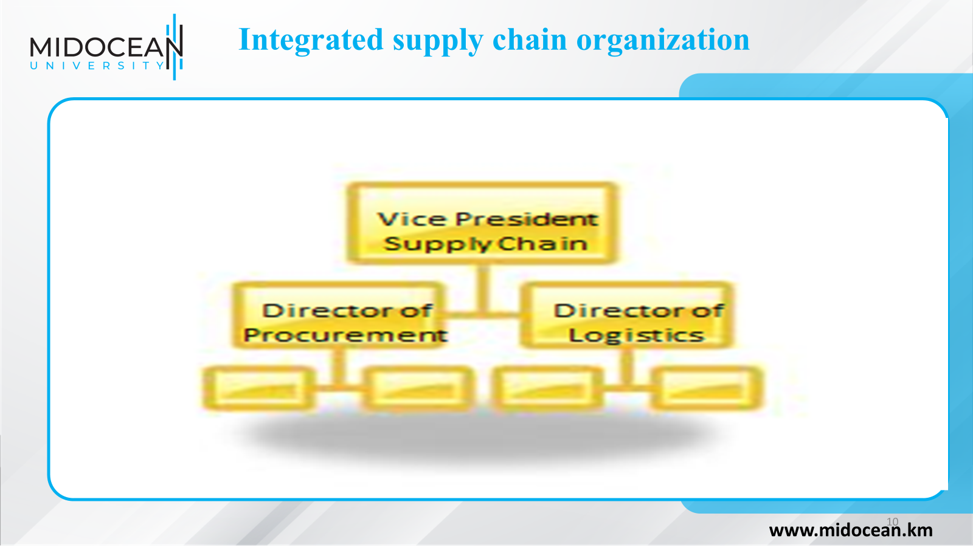

Slide 11
VALUE AS A UTILITY
Form Utility – Performed by the manufacturers (as well as third party logistics companies or “3PL’s” that perform value added activities such as kitting and display assembly) making the products useful.
Time Utility – Having products available when needed.
Place Utility – Having items available where people want them.
Possession Utility – Transfer ownership to the customer as easily as possible, including the extension of credit.
Information Utility – Opening two-way flows between parties (i.e. customer and manufacturer).
Service Utility - Providing fast, friendly service during and after the sale and teaching customers how to best use products. This is becoming one of the most important utilities offered by retailers, which in many ways are part of the supply chain.
www.midocean.km

Slide 12
Overview of Logistics
Council of Logistics Management definition:
  “Logistics is that part of the supply chain process that plans, implements, and controls the efficient, effective forward and reverse flow and storage of goods, services, and related information between the point of origin and the point of consumption in order to meet customers’ requirements.”
www.midocean.km

Slide 13
The Increased Importance of Logistics
A Reduction in Economic Regulation
Changes in Consumer Behavior
Technological Advances
The Growing Power of Retailers
Globalization of Trade
www.midocean.km

Slide 14
Logistical Relationships within the Firm
Marketing
  Place Decisions
  Price Decisions
    Landed costs
  Product Decisions
    Stockouts
    Sustainable products
  Promotion Decisions
www.midocean.km

Slide 15
Marketing Channels
“Set of institutions necessary to transfer the title to goods and to move goods from the point of production to the point of consumption and, as such, which consists of all the institutions and all the marketing activities in the marketing process.”
Channel members
    Manufacturers
    Wholesalers
    Retailers
www.midocean.km

Slide 16
Marketing Channels
Ownership channel
  Covers movement of the title to the goods
Negotiations channel
  Buy and sell agreements are reached
Financing channel
  Payments for goods
Promotions channel
  Promoting a new or existing product
Logistics channel
  Moving and storing product throughout the channel
www.midocean.km

Slide 17
Channel Intermediaries/Facilitators
Ownership channel
  Banks, finance companies
Negotiations channel
  Brokers
Financing channel
  Banks, insurance companies, finance companies
Promotions channel
  Advertising agencies, public relations agencies
Logistics channel
  Freight forwarders
www.midocean.km

Slide 18
Activities in the Logistical Channel
Customer service
Facility location decisions
Inventory management
Order management
Procurement
Transportation management
Demand forecasting
International logistics
Materials handling
Packaging
Reverse logistics
Warehousing management
www.midocean.km

Slide 19
The Role of Warehousing in a Logistics System
General warehouse – This type of facility is primarily for the storage and protection of goods, with the need to minimize handling and movement.
Distribution warehouse (or distribution center) – In these facilities goods are received in large volumes. The goods are then sorted, stored and then consolidated into customer orders for fulfillment. This type of facility is more concerned with throughput.
www.midocean.km

Slide 20
The Role of Warehousing in a Logistics System
Warehousing
Refers to “that part of the firm’s logistics system that stores products (raw materials, part, good-in-process, finished goods) between points of origin and point of consumption.”
Warehousing Management
Warehousing and transportation are substitutes for each other, with warehousing having been referred to as “transportation at zero miles per hour.”
www.midocean.km

Slide 21
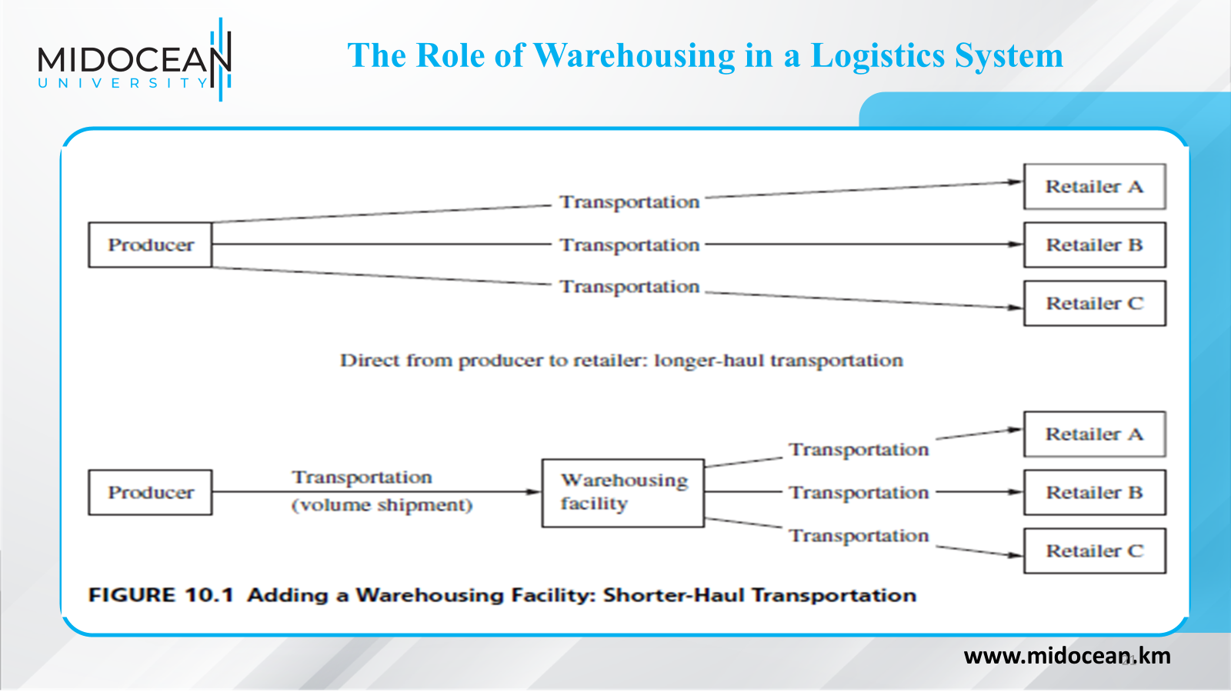

Slide 22
The Role of Warehousing in a Logistics System
Key reason for warehousing
Because patterns of production and consumption do not coincide
Warehousing
Serves to match different rates or volumes of flow when patterns of
production and consumption do not coincide
Warehousing facilitates the regrouping function in a supply chain
Involves rearranging the quantities and assortment of products as they
move through the supply chain
www.midocean.km

Slide 23
The Role of Warehousing in a Logistics System
Warehousing facilitates the regrouping function in a supply chain – can take place in four forms
  Accumulating (bulk making)
    Involves bringing together similar stocks from different sources
  Allocating (bulk breaking)
    Involves breaking larger quantities into smaller quantities
  Assorting
    Refers to building up a variety of different products for resale to particular customers
  Sorting out
    “Separating products into grades and qualities desired by different target markets”
www.midocean.km

Slide 24
The Role of Warehousing in a Logistics System
Warehousing can be provided by
  Warehouses
    Emphasize the storage of products
    Primary purpose is to maximize the usage of available storage space
  Distribution centers
    Emphasize rapid movement of products through the facility
    Attempt to maximize throughput
      Throughput is defined as the amount of product entering and leaving a facility in a given time period
www.midocean.km

Slide 25
The Role of Warehousing in a Logistics System
Warehousing can be provided by
  Cross-docking facilities
    Has grown due to the increased emphasis on time reduction in supply chains
    Defined as “the process of receiving product and shipping it out the same day or overnight without putting it into storage”
    Key benefits include improved service by allowing products to reach their destinations more quickly as well as reduced inventory carrying costs from less stock because of faster product delivery
www.midocean.km

Slide 26
The Role of Warehousing in a Logistics System
Warehousing can be provided by
  Cross-docking facilities
    Is differentiated from distribution centers by the length of time a product is in a facility (24 hours or less for cross-docking facility)
    Design of the facility is an important consideration to facilitate quick movement of product
      Should be designed with a minimal amount of storage space and truck doors on two or more sides
      Some designs include “H”, “I”, “T”, “U” and “E” configurations
www.midocean.km

Slide 27
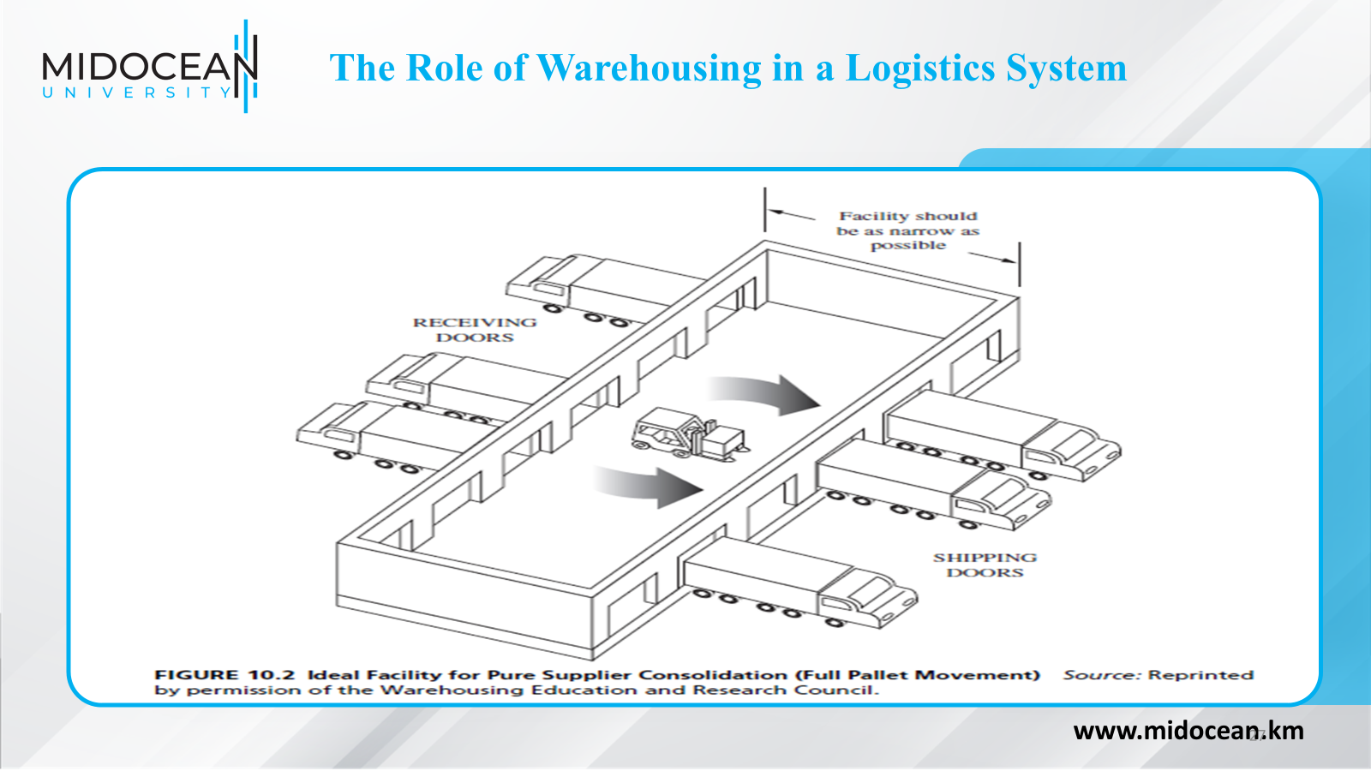

Slide 28
Transportation
Transportation
  The actual, physical movement of goods and people between two points
  Transportation is a significant component of the costs incurred by most supply chains.
Transportation influences or is influenced by the following logistics activities:
  Transportation costs are affected by node location
  Inventory requirements are influenced by mode
  Packaging requirements are dictated by mode
  Carrier classification rules dictate package choice
www.midocean.km

Slide 29
Transportation
Transportation influences or is influenced by the following logistics activities:
  Materials handling equipment and design of the docks are dictated by mode
  Maximum consolidation of loads achieved with order-management technology reduces costs
  Customer service goals influence the type and quality of carrier
  Customer service goals influence carrier choice
www.midocean.km

Slide 30
Transportation Modes
The attractiveness of a particular mode depends on the following attributes:
Cost
Speed
Reliability
Capability
Capacity
Flexibility
www.midocean.km

Slide 31
Transportation Specialists
Freight forwarders
  Two types of domestic freight forwarders
    Surface
    Air
  Exists by offering a service to shippers that must use LTL rates because they do not generate enough volume to use TL rates
  Typically offers pickup and delivery service but does not perform the line-haul service (done by motor carriers or railroads)
www.midocean.km

Slide 32
Transportation Specialists
Freight forwarders
  Give volume discounts to customers shipping large quantities of freight at one time
  TL rates < LTL rates because
    Shipper loads the goods and the consignee unloads trailer
    The load goes directly from shipper to consignee without passing through terminals
    Paperwork, billing, and other administrative costs are little more for a 25,000 lb shipment than for 250 lb shipment
www.midocean.km

Slide 33
Transportation Specialists
Air forwarders
  Consolidate shipments
  Tender to airlines in containers ready for loading
  Forwarders provide retailing function
  Airline provides wholesaling function
Shipper’s associations
  Similar to air and freight forwarders but are not-for-profit organizations
  Primarily focused on achieving the lowest rates for members
www.midocean.km

Slide 34
Transportation Specialists
Brokers
  Companies that look to match a shipper’s freight with a carrier to transport it
  May consolidate LTL shipments and then give to motor carriers, freight forwarders, or shippers’ associations
Third party logistics companies (3PLs)
  Find clients with complimentary transportation needs to maximize equipment utilization
Fourth party logistics companies (4PLs)
  Logistics manager arranges transportation separately with third-party logistics providers.
www.midocean.km

Slide 35
Transportation Specialists
Parcel carriers
  Parcels are packages weighing up to 150 pounds
  Parcel carriers are companies that specialize in transporting parcels
  Parcel carriers include:
    USPS
    UPS
    FedEx Express
    Greyhound Package Express
www.midocean.km

Slide 36
Reverse Logistics and Sustainability
“A complete supply chain dedicated to the reverse flow of products and materials for the purpose of returns, repair, remanufacture, and/or recycling.”
Can represent major costs to a company
Amount of goods returned
-up to 50% in the publishing industry
-90% of automotive starter motors or alternators
Companies are taking responsibility of the return of packaging materials
www.midocean.km

Slide 37
Reverse Logistics - Information
Goods are returned to supplier
Information is also needed
  reason / approval for the return
  credit information
www.midocean.km

Slide 38
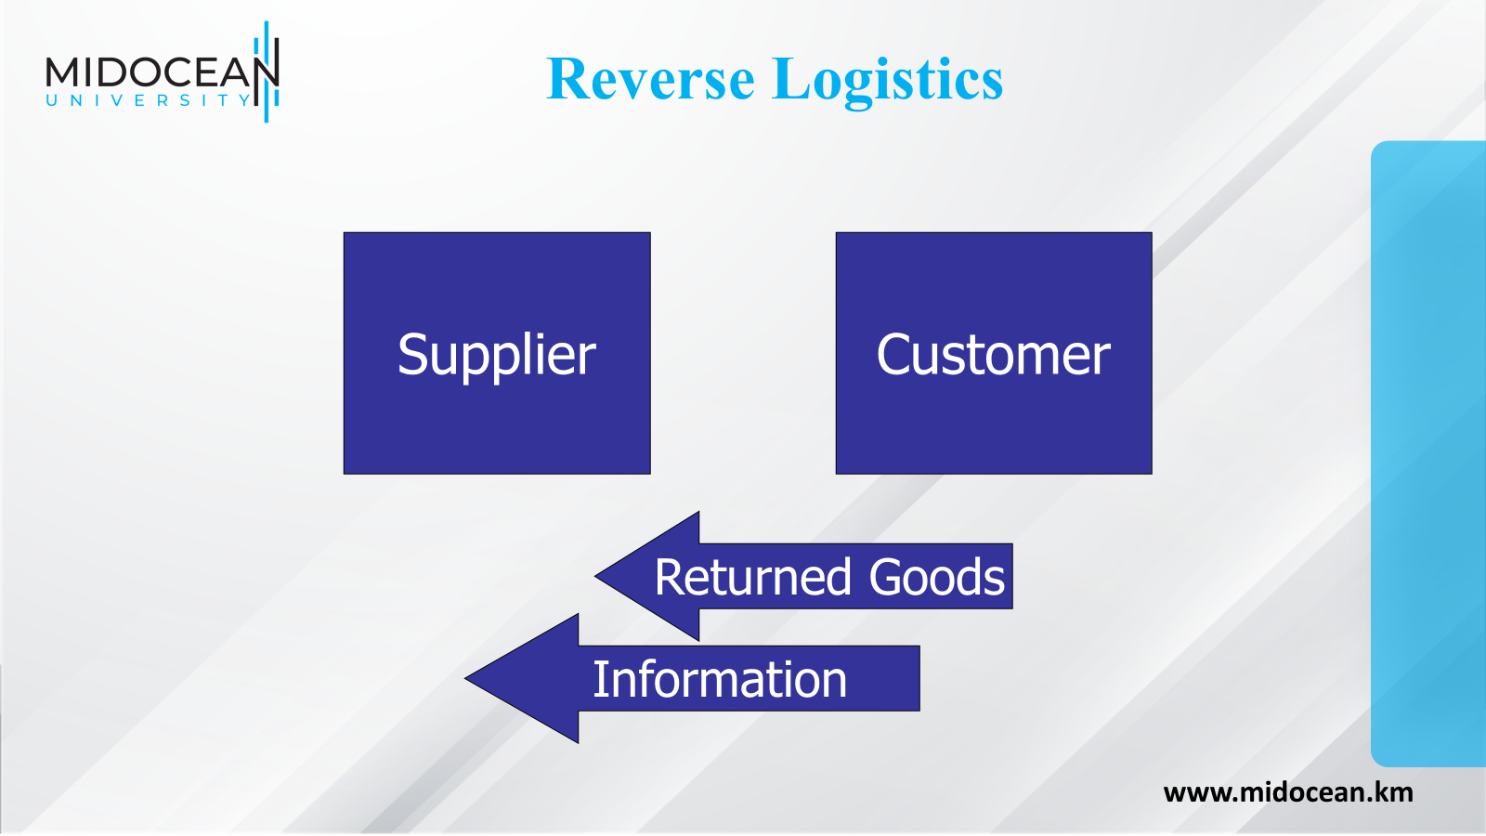

Slide 39
Green Logistics
Return and disposal of packaging materials
Return and disposal of environmentally sensitive materials
  heavy metals
  solvents
Use of reusable (returnable) packaging
www.midocean.km

Slide 40
Returned Goods
Quality demands by customers
Damage or defects
Excessive inventories
Seasonal inventories
Out-of-date inventories
Remanufacturing or refurbishment
www.midocean.km

Slide 41
Returned Goods - Disposition
Returned to inventory
Refurbished for resale
Sold into alternate markets
Disassembled to retrieve components
Sorted for material recovery
Value
www.midocean.km

Slide 42
Summary of Learning Objectives
1-Understanding both supply chain and logistics management.
2-Analyze the increased importance of logistics.
3-Provide a brief overview of activities in the logistics channel.
4-Discuss the role of warehousing in a logistics system.
5-Describe several types of transportation specialists.
6-Describe reverse logistics and sustainability dimensions for a supply chain.
www.midocean.km

Slide 43
Essential Reference
Chopra, S., & Meindl, P. (2016). Global Edition. Pearson Education Limited
Lysons, K., & Farrington, B. (2020). Procurement and supply chain management. Pearson UK.
Morris, P. W., & Pinto, J. K. (Eds.). (2007). The Wiley guide to project technology, supply chain, and procurement management (Vol. 4). John Wiley & Sons.
Schwalbe, K. (2015). Information technology project management. Cengage Learning.
Supply Chain Council
www.midocean.km

Slide 44


Thank You

