Slide 1

Fraud Detection in Financial Industries Using Machine Learning as a Tool
Authors:
  ELSEDEEG MOHAMED ELBASHER
  MOHAMED ABDELSATAR
Supervisor:
Dr. Khaled Eskaf | Midocean / Master of Science in Artificial Intelligence

Slide 2

Agenda
Motivation & Problem
Dataset & Preprocessing Pipeline
Models & Training Strategy
Metrics & Results
100% Accuracy: Reliability Caveat
Explainability: SHAP & LIME
Governance & Deployment Concept
Limitations, Future Work, Conclusion
Key Message: We follow the same flow as the pipeline: data → models → explainability → deployment readiness.

Slide 3
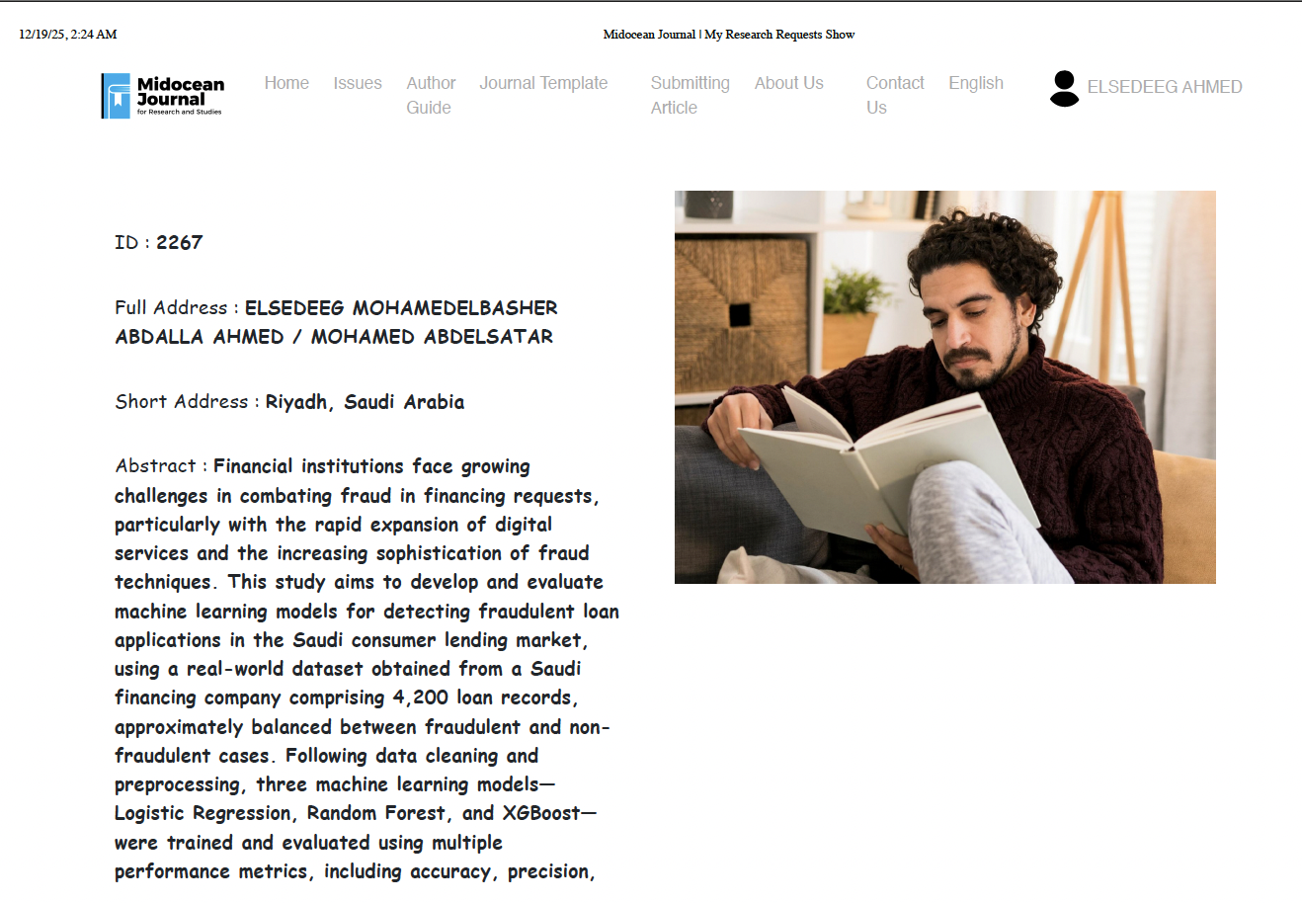

Motivation: Why Fraud Detection Matters Now?
Digital lending scale increases fraud attempts and complexity.
Rule-based/manual checks struggle with evolving, non-linear fraud patterns.
Fraud impacts losses, customer trust, and operational workload.
Financial AI must be accurate, explainable, and governance-ready.
Key Message: In financial services, decisions must be defensible and auditable—not just accurate.

Slide 4
Problem Statement (What We Solve)
Objective: Detect fraudulent loan applications in a digital financing workflow.
Challenge: Balance fraud blocking with customer experience and operational cost.
Requirement: Provide traceable explanations for audit/compliance and review.
Output: Fraud Score + Decision + Explanation + Logs.
Key Message: We treat fraud detection as a decision system, not a standalone classifier.

Slide 5
Research Objectives & Key Contributions
Build an end-to-end, reproducible ML pipeline for loan-application fraud detection (data → preprocessing → training → evaluation).
Benchmark Logistic Regression, Random Forest, and XGBoost under a unified pipeline to ensure fair comparison.
Evaluate with multi-metric evidence (F1, ROC-AUC, PR-AUC) to reflect operational fraud trade-offs beyond accuracy.
Integrate explainability (SHAP/LIME) to enable traceability, audit readiness, and governance reporting.
Frame deployment considerations: threshold policy, logging, monitoring, and generalization/perfect-score risks
Key Message: A reproducible, comparable, and audit-ready pipeline that links model performance to governance and real fraud operations
.

Slide 6

Emkan Finance Company Management interview
Sultan Alqahtani - Chief Information Technology Officer Emkan
LinkedIn Profile
Sultan Almutairi - Vice president Anti Fraud Department
LinkedIn Profile
Key Message: To confirm the legality of the Data and the value of building this Model and the impact to Financial industry

Slide 7
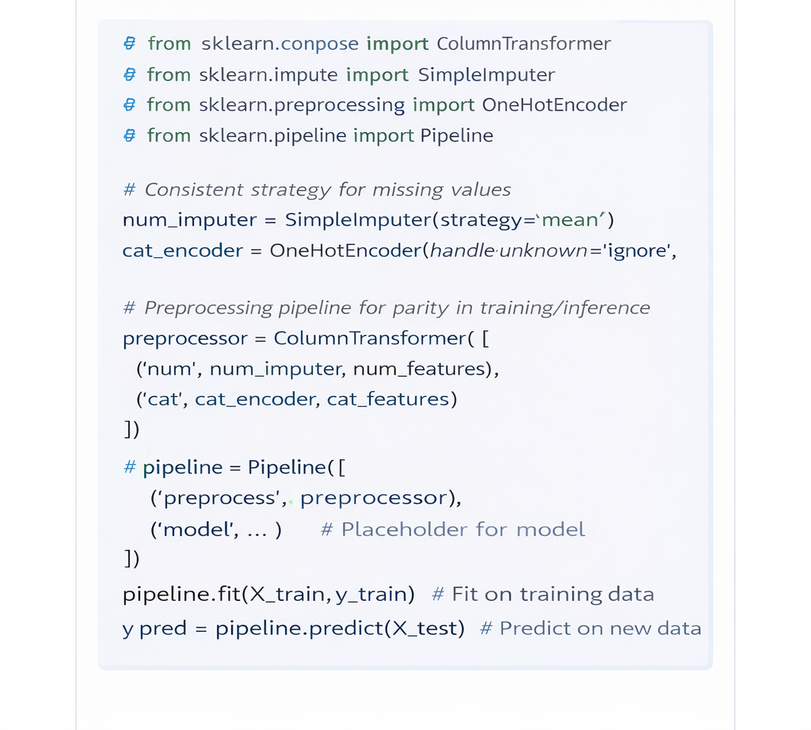
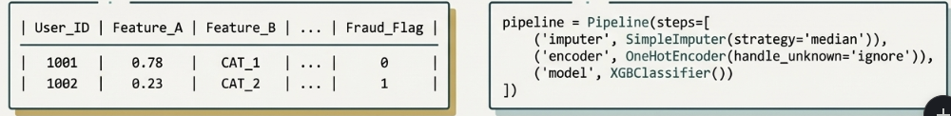
Data Quality & Preprocessing and overview
Real digital financing dataset (Saudi context)
Size: 4,400 records
Target: Fraud_Flag (1/0)
Reflects operational patterns
Missing values handled via consistent imputation strategy.
Categorical variables encoded for model compatibility.
Transformations executed inside a pipeline for training/inference parity.
Pipeline design reduces leakage risk and supports repeatable inference.

Slide 8
Model Selection Rationale
Logistic Regression: interpretable baseline (fast and transparent).
Random Forest: robust non-linear ensemble (handles mixed features well).
XGBoost: boosting power for complex interactions and higher accuracy potential.
Selection covers a spectrum: interpretability ↔ complexity ↔ performance.
Key Message: A controlled comparison requires diverse model classes.

Slide 9
Training & Tuning Strategy
Train/Test split (stratified by target) 80% 20%
Hyperparameter tuning via stratified CV Randomized Search (RF/XGB) to balance rigor and runtime.
Same preprocessing pipeline applied across all models.
Model selection based on F1, ROC-AUC, PR-AUC (not accuracy only).
Key Message: Fair benchmarking requires consistent preprocessing and comparable tuning effort across models.

Slide 10
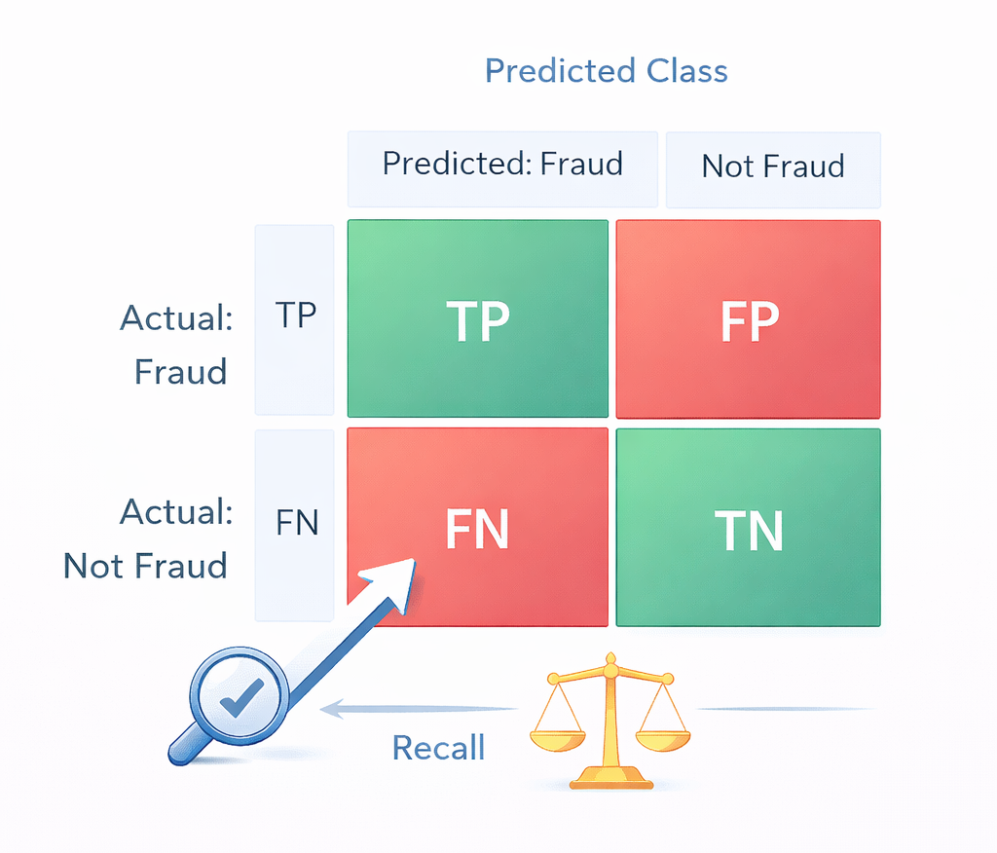
Evaluation Metrics (Fraud-Appropriate)
Confusion Matrix: TP/TN/FP/FN (error types matter in fraud).
Precision: how many flagged cases are truly fraud.
Recall: how much fraud we successfully catch.
F1-score: balance between precision and recall.
ROC-AUC: ranking performance across thresholds.
PR-AUC: informative under fraud prevalence changes.
Key Message: In fraud, choosing the right metric is as important as choosing the model.

Slide 11
Model Performance at a Glance (Head-to-Head Comparison)
Benchmarks: LR, RF, and XGBoost — evaluated under one unified pipeline and consistent metrics (F1, ROC-AUC, PR-AUC)
Feature | Logistic Regression (Baseline) | Random Forest (Recommended) | XGBoost (Under Verification)
F1-Score | 91.6% | 95.0% | 100%
Accuracy | 92% | 95% | 100%
Precision | 91% | 96% | 1.00
Recall | 92% | 95% | 1.00
Key Strength | High interpretability | Balanced performance & robustness | Perfect separation (experimental upper bound)
Key Weakness | Misses non-linear patterns | More complex than LR | Requires leakage & out-of-time validation
Verdict | Benchmark baseline established | Ready for pilot | Verification required
All scores are from the held-out 20% stratified test set using the same preprocessing pipeline and CV-based tuning protocol
Key Message: Head-to-head benchmarking shows that the most deployable model balances performance with reliability—not just peak scores.

Slide 12
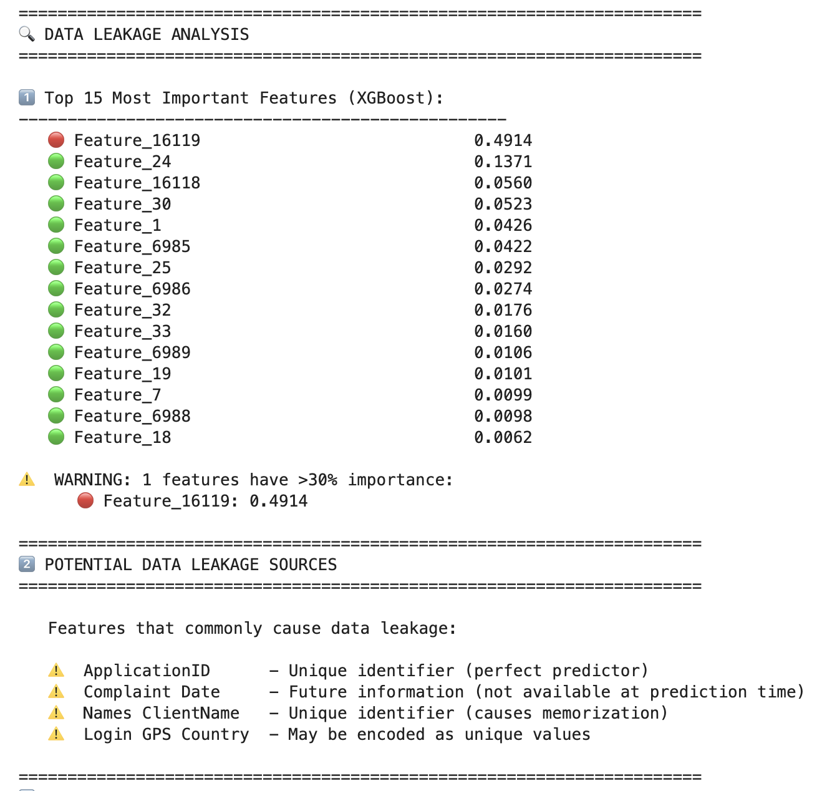
XGBoost 100% Result: Leakage & Generalization Verification
Investigation Plan
Step 1: Confirm feature availability at prediction time (no future information).
Step 2: Run Out-of-Time split (train on earlier, test on later).
Step 3: Perform Leakage probes (ID-like fields, duplicates, target proxies).
Step 4: Ablation test: remove dominant feature(s) and re-train.
Step 5: Re-evaluate stability (PR-AUC/F1) + monitor drift assumptions.
Evidence Snapshot: XGBoost feature-importance dominance (model-side signal)
Key Observation
    One feature shows unusually high dominance in importance (~0.49).
    This may indicate a proxy/leakage signal or a strong shortcut pattern.
Next: neutralize it and re-test generalization.
Note: Importance ≠ causality; requires leakage validation
Key Message: Perfect scores are accepted only after leakage is ruled out and out-of-time generalization is confirmed.

Slide 13
Generalization & Validation Plan
Time-based validation: test on a later month/quarter.
External validation: different segment/region/channel (if available).
Stress testing: simulate distribution shift and fraud-pattern drift.
Continuous monitoring: drift detection, recalibration, retraining policy.
Key Message: Generalization is demonstrated through structured validation—not a single split.

Slide 14
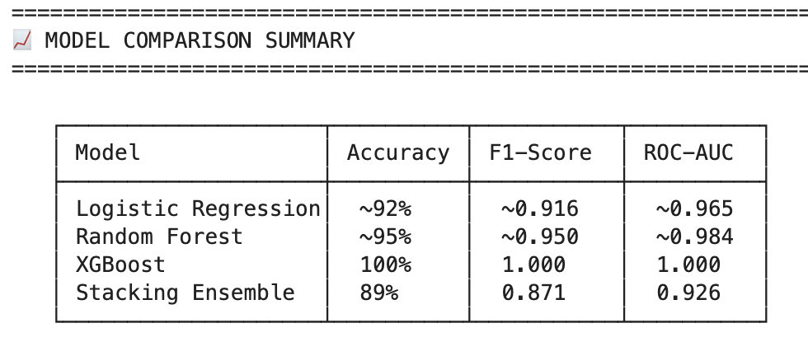
ROC Curves (Model Ranking Across Thresholds)
ROC curves compare TPR vs FPR across thresholds.
ROC-AUC summarizes ranking quality independent of one chosen threshold.
Useful for selecting operating points under changing risk policy.
Key Message: ROC explains model behavior across operating points—not just one threshold.

Slide 15
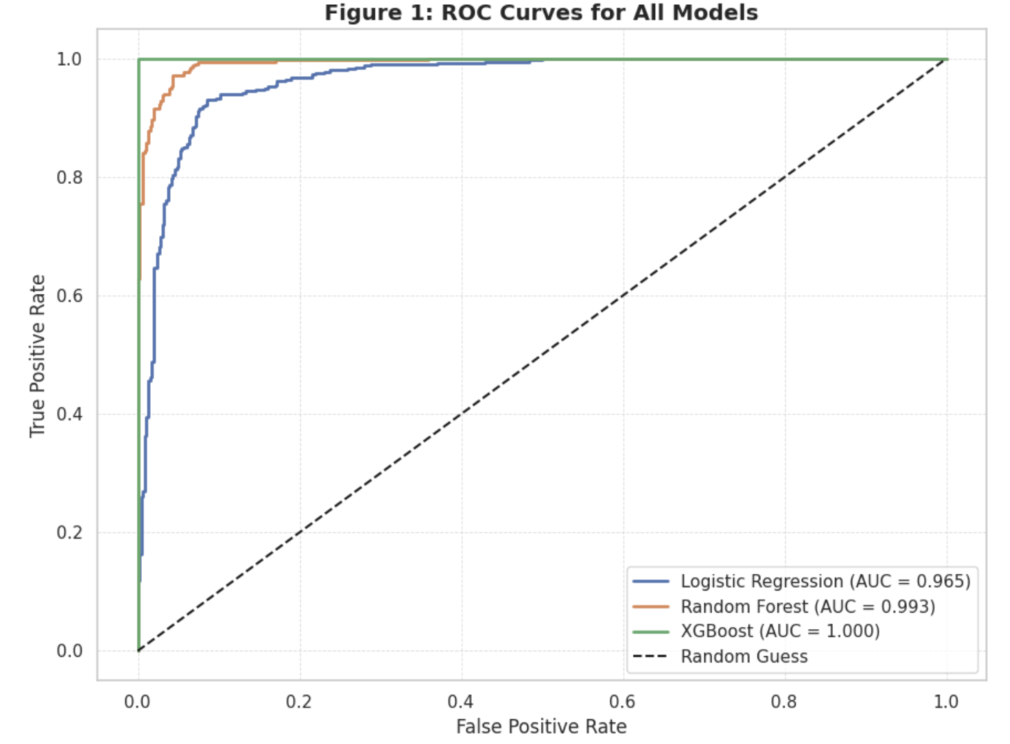
ROC Curves (Overall Separability View)
ROC curves summarize the trade-off between True Positive Rate (TPR) and False Positive Rate (FPR) across all thresholds.
ROC-AUC measures overall class separability; values closer to 1.0 indicate stronger discrimination.
For fraud operations, the selected operating point should prioritize low FPR to reduce unnecessary investigations and customer friction.
Threshold selection must be cost-aware and aligned with risk appetite and policy constraints.
Key Message: ROC provides a threshold-independent view of discrimination, helping select a cost- and policy-aligned operating point.

Slide 16
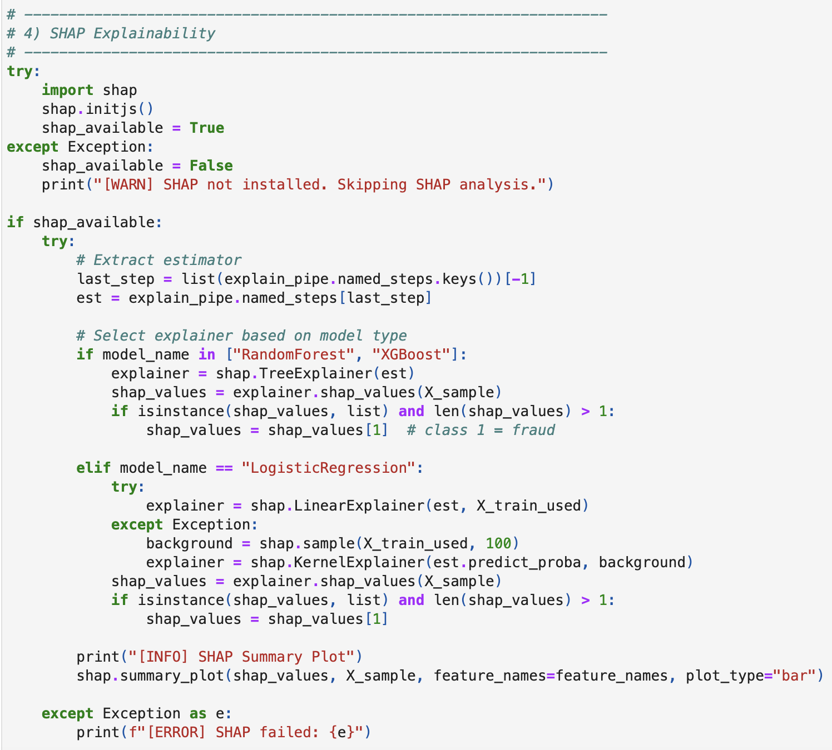
Explainability (XAI): From Prediction to Audit Evidence
Financial decisions require traceability, justification, and audit readiness.
XAI reduces black-box risk and supports compliance and governance.
SHAP (Global): identifies dataset-level drivers and directional impact.
LIME (Local): explains individual decisions for case review and disputes.
Key Message: XAI turns model scores into traceable, audit-ready evidence.

Slide 17
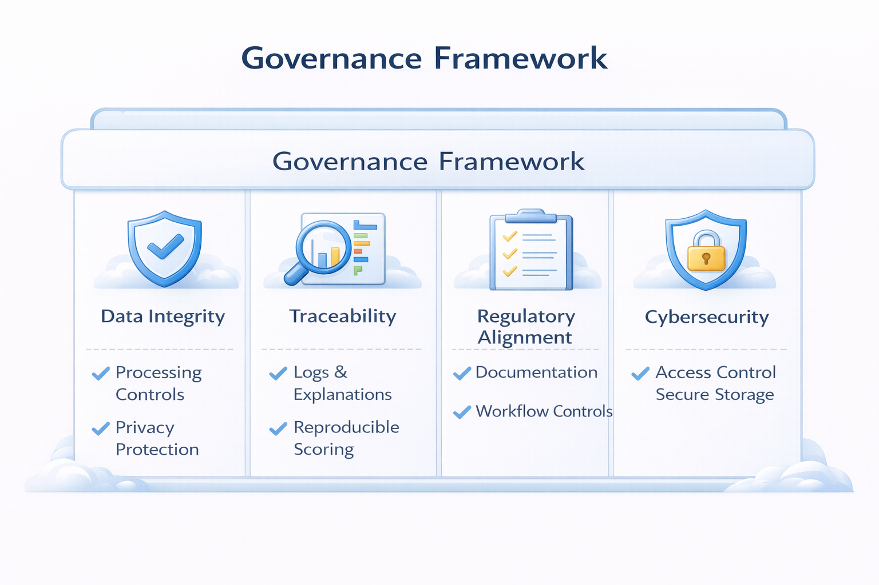
Governance: Decisions to Deployment Readiness
Traceability: logs + explanations + reproducible scoring for audit readiness.
Regulatory alignment: documentation, controls, and review workflow (human-in-the-loop).
Data & security controls: privacy-aware processing, access control, secure storage, segregation of duties.
Data Intake
(CRM/Mobile)
Feature Service
(Preprocessing)
Scoring API
(Model)
Explanation Bundle
(SHAP/LIME)
Audit & Monitoring
(Logs/Drift)
Key Message: Governance makes ML decisions auditable, controllable, and safe for financial operations.

Slide 18
Limitations and Future Directions
To address limited generalization, we will conduct time-based and external validation across new periods and segments.
To de-risk the 100% test result, we will re-run experiments using stricter splits (group/time) and validate on independent data before any production §claim.
To maintain long-term reliability, we will implement drift monitoring with a controlled retraining/recalibration policy.
To minimize total business risk, we will apply cost-aware threshold optimization and explore cost-sensitive learning to balance FP vs FN.
Key Message: Validate, explain, and govern before production.

Slide 19
Model review
This model showing the practical example of applying to loan to Emkan Portal and the model will validate the provided information earthier Fraud or Normal

Slide 20
Thank you
Thank you very much for your kind attention,
and we eagerly look forward to your guidance and suggestions

