Slide 1


System Administration (2)
IT401
Prepared by
Dr. Ahmed El-Douh
Lecture 10

Slide 2



System Administration 2
Lecture 10
IT401
Installing and updating software packages
Prepared by
Dr. Ahmed El-Douh

Slide 3
Objectives
Upon completion of this lecture, you will be able to:
  ▪ Understand software package management in RHEL using RPM, YUM, and DNF.
  ▪ Install, update, and manage individual packages and package groups.
  ▪ Search and manage repositories and package information using YUM.
  ▪ Configure and validate a local RHEL ISO repository for offline updates.

Slide 4
Chapter
Outlines
10
Installing and updating software packages
  What is a Package?
  Install vs Upgrade Packages
  Installing a package from a remote location
  Searching for software packages
  Updating software packages

Slide 5


Installing and updating software packages

Slide 6
Installing and updating software packages
What is a Package?
In RHEL and CentOS, software is organized and distributed using packages.
A package is a compressed archive that contains all files related to a specific software.
It includes binaries, libraries, metadata, and installation instructions.
Packages also define software dependencies required for correct operation.
RHEL and CentOS use the RPM package format developed by Red Hat.

Slide 7
Installing and updating software packages
RPM: The Red Hat Package Manager and yum
To ease the management of rpm packages, the rpm package manager was created.
Although very powerful, it is focused on single packages, so it is not able to resolve dependencies.
To manage the relationships between packages, and avoid the infamous dependency hell, first yum package manager (Yellow Updater Modified) and then its evolution.

Slide 8
Installing and updating software packages
Installing a package with rpm
One of the most basic operations we can perform with rpm is the installation of a package.
As said before, this will work only if the package has no external dependencies, since rpm is not able to manage it.
There are basically three ways we can install a package with rpm: they correspond respectively to the -i, -U and -F options.
To install a new package, we can run rpm with the -i option (short for --install).

Slide 9
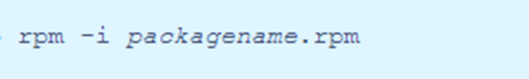
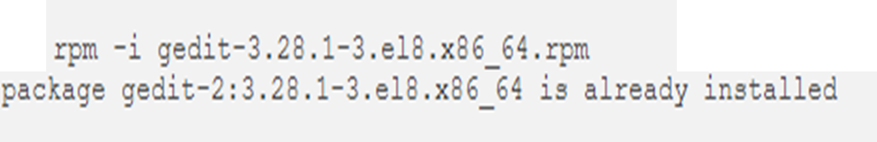
Installing and updating software packages
The syntax is very simple:
When we run the command above, the specified package is installed only if not already installed on the system. If we try to install an already installed package (gedit in this case), we receive an error:

Slide 10
Install vs Upgrade Packages

Slide 11
Installing and updating software packages
Install vs Upgrade Packages
  The term same package means the same exact version.
  Installing a new package version keeps the older versions installed.
  This method is recommended when installing a new kernel.
  Multiple kernel versions can coexist to provide a fallback option.
  Using the -U option performs an upgrade operation.
  If the package is not installed, it will be installed.
  If an older version exists, it will be replaced by the newer one.
  After upgrading, older package versions are removed.

Slide 12
Installing and updating software packages
Upgrade Warnings and Freshen Option
  Upgrading critical software like the kernel in place is discouraged.
  Older kernel versions should be kept until the new one is fully tested.
  Removing old kernels too early can cause system instability.
  The -F option is short for freshen.
  The freshen option updates only existing packages.
  Packages that do not already exist on the system are not installed.

Slide 13
Installing and updating software packages
Installing a package from a remote location
With rpm is also possible to install a package which is not on our local filesystem.
Say for example we want to install a package accessible via the ftp protocol; the command to run would be the following:
It is also possible to provide a username and a password if authentication is required, including such information in the address:

Slide 14
Installing and updating software packages
Application Streams
  RHEL 8 introduces the concept of Application Streams.
  Multiple versions of user-space applications are delivered separately from the core OS.
  Application Streams are updated more frequently than core system packages.
  This approach provides greater flexibility without affecting system stability.
  Application Stream components can be delivered as modules or RPM packages.
  Application Streams are provided through the AppStream repository in RHEL 8.
  Each Application Stream has its own life cycle, which may be shorter than RHEL 8.

Slide 15
Installing and updating software packages
Modules and Module Streams
  A module is a collection of related packages forming a logical unit.
  A module can represent an application, language stack, database, or tools set.
  All packages in a module are built, tested, and released together.
  Module streams represent different versions of the same module.
  Example: PostgreSQL module provides multiple streams such as PostgreSQL 10 and PostgreSQL 9.6.
  Only one module stream can be installed on a system at a time.
  Different module versions can run in separate containers.

Slide 16
Installing and updating software packages
Searching for software packages
yum allows you to perform a complete set of operations with software packages.
The following section describes how to use yum to:
  Search for packages.
  List packages.
  List repositories.
  Display information about the packages.
  List package groups.
  Specify global expressions in yum input.

Slide 17


Installing and updating software packages
1. Searching packages with YUM:
Use the following procedure to find a package providing a particular application or other content.
Procedure
To search for a package, use:
Replace term with a term related to the package.
Note that yum search command returns term matches within the name and summary of the packages. This makes the search faster and enables you to search for packages you do not know the name of, but for which you know a related term.
To include term matches within package descriptions, use:
Replace term with a term you want to search for in a package name, summary, or description.
Note that yum search --all enables a more exhaustive but slower search.

Slide 18



Installing and updating software packages
2. Listing packages with YUM
Use the following procedure to list installed and available packages.
Procedure
To list information on all installed and available packages, use:
To list all packages installed on your system, use:
To list all packages in all enabled repositories that are available to install, use:

Slide 19
Installing and updating software packages
3. Listing repositories with YUM:
Use the following procedure to list enabled and disabled repositories.
Procedure
  To list all enabled repositories on your system, use: # yum repolist
  To list all disabled repositories on your system, use: # yum repolist --disabled
  To list both enabled and disabled repositories, use: # yum repolist --all

Slide 20
Installing and updating software packages
4. Displaying package information with YUM
You can display various types of information about a package using YUM, for example version, release, size, loaded plugins, and more.’
Procedure
To display information about one or more packages, use:
Replace package-name with the name of the package.

Slide 21

Installing and updating software packages
5. Listing package groups with YUM
Use yum to view installed package groups and filter the listing results.
Procedure
To view the number of installed and available groups, use:
To list all installed and available groups, use:
Note that you can filter the results by appending command line options for the yum group list command (--hidden, --available). For more available options see the man pages.

Slide 22
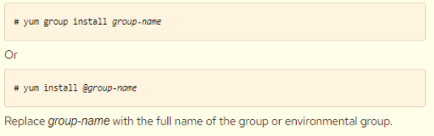
Installing and updating software packages
To list mandatory and optional packages contained in a particular group, use:
Replace group-name with the name of the group.
Installing a package group with YUM
The following procedure describes how to install a package group by a group name or by a groupID using yum.
To install a package group by a group name, use:

Slide 23
Installing and updating software packages
6. Specifying a package name in YUM input
To optimize the installation and removal process, you can append -n, -na, or -nevra suffixes to yum install and yum remove commands to explicitly define how to parse an argument:
To install a package using its exact name, use: # yum install-n name
  Replace name with the exact name of the package.
To install a package using its exact name and architecture, use: # yum install-na name.architecture
  Replace name and architecture with the exact name and architecture of the package.
To install a package using its exact name, epoch, version, release, and architecture, use:
# yum install-nevra name-epoch:version-release.architecture
  Replace name, epoch, version, release, and architecture with the exact name, epoch, version, release, and architecture of the package.

Slide 24
Updating Software Packages

Slide 25
Installing and updating software packages
Updating software packages
yum allows you to check if your system has any pending updates. You can list packages that need updating and choose to update a single package, multiple packages, or all packages at once.
If any of the packages you choose to update have dependencies, they are updated as well.
The following section describes how to use yum to:
  Check for updates.
  Update a single package.
  Update a package group.
  Update all packages and their dependencies.

Slide 26
Installing and updating software packages
1. Checking for updates with YUM
The following procedure describes how to check the available updates for packages installed on your system using yum.
Procedure
To see which packages installed on your system have available updates, use:
# yum check-update
The output returns the list of packages and their dependencies that have an update available.

Slide 27
Installing and updating software packages
2. Updating a single package with YUM
Use the following procedure to update a single package and its dependencies using yum.
To update a package, use:
# yum update package-name
Replace package-name with the name of the package.
→Important
When applying updates to kernel, yum always installs a new kernel regardless of whether you are using the yum update or yum install command.

Slide 28
Installing and updating software packages
3. Updating a package group with YUM
Use the following procedure to update a group of packages and their dependencies using yum.
Procedure
  To update a package group, use:
    # yum group update group-name
Replace group-name with the name of the package group.

Slide 29
Installing and updating software packages
4. Updating all packages and their dependencies with YUM
Use the following procedure to update all packages and their dependencies using yum.
Procedure
To update all packages and their dependencies, use:
# yum update

Slide 30
Installing and updating software packages
Installing Packages on RHEL 8 Locally Using ISO
Benefits of Using RHEL 8 ISO as a Local Repository
  Allows you to apply offline patches.
  You can update your server in critical cases where you don’t have an internet connection.
  Using local repo, you can create an ultra-secure RHEL 8 environment that will never be connected to the internet and still be updated with the most frequent packages.
  You can also upgrade the server from RHEL 8.x to RHEL 8.y.

Slide 31
Installing and updating software packages
Often, when we want to have a local repository for our RHEL 8 system to install packages without internet access for extra safety and using RHEL 8 ISO is the easiest way to do that.
In this guide, we will be showing you how you can configure and use locally downloaded RHEL 8 ISO images as a repository for installing packages in RHEL 8 Linux.
[ You might also like: How to Create Local RHEL 9 Repository ]
But before that, let’s have a look at what are the advantages of using RHEL 8 ISO as a local repository.

Slide 32
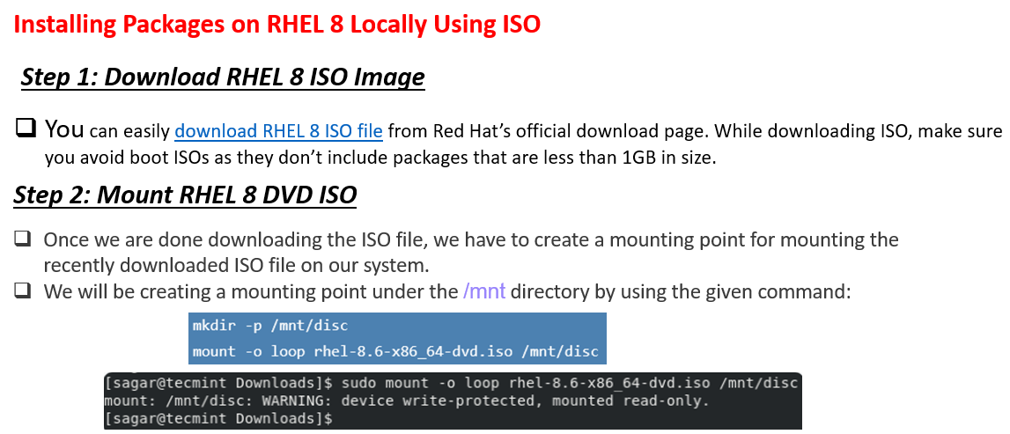
Installing and updating software packages

Slide 33
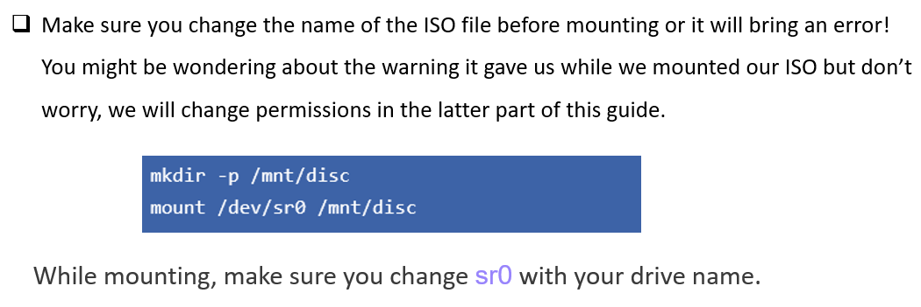
Installing and updating software packages

Slide 34
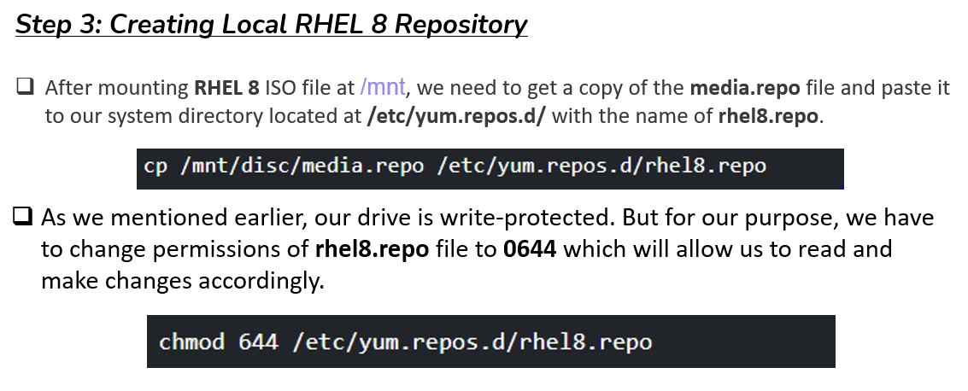
Installing and updating software packages

Slide 35
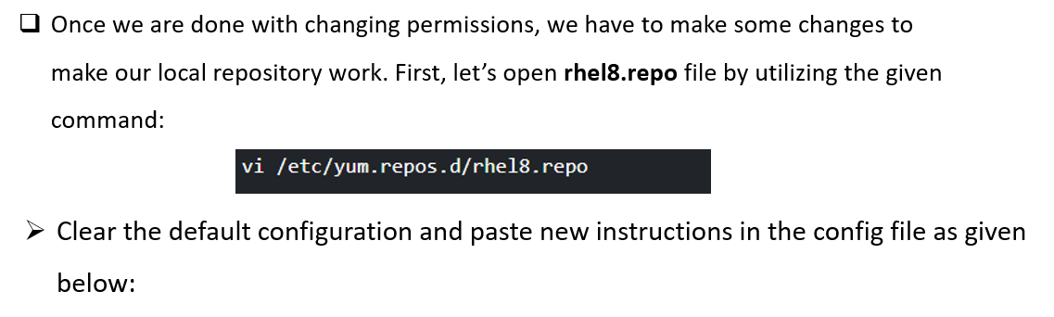
Installing and updating software packages

Slide 36
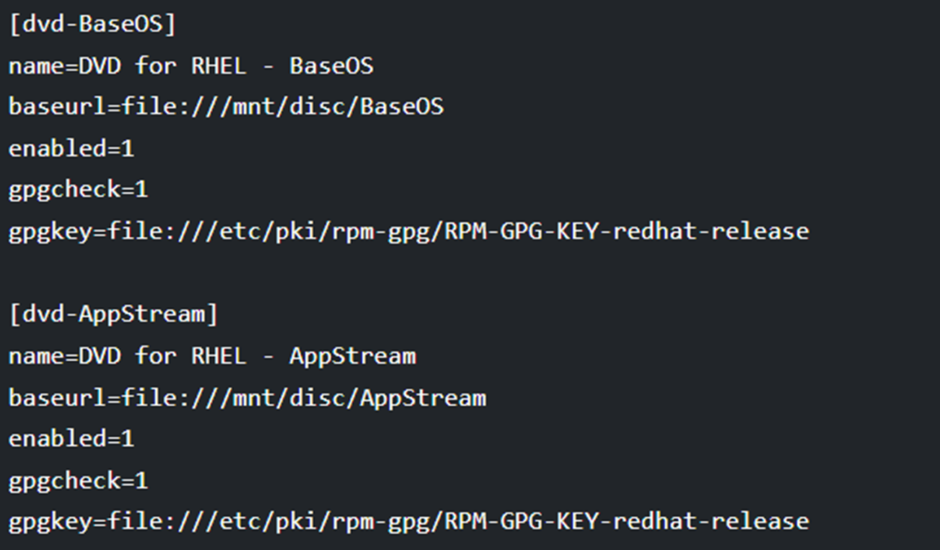

Slide 37
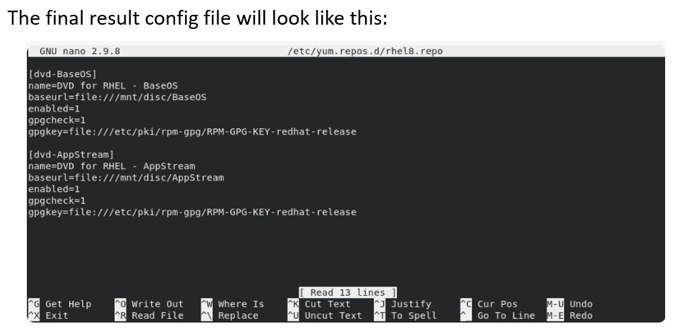
Installing and updating software packages

Slide 38
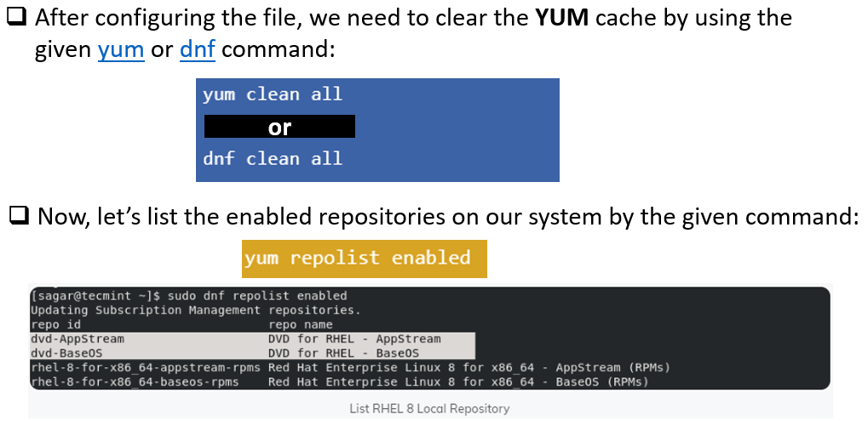
Installing and updating software packages

Slide 39
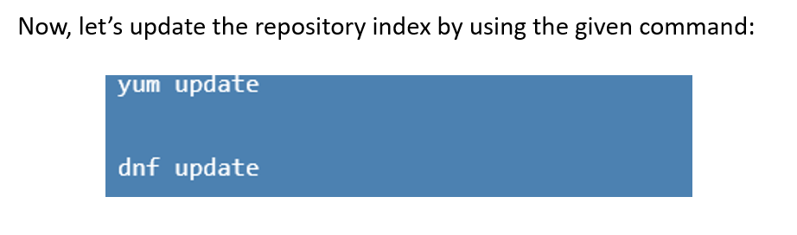
Installing and updating software packages

Slide 40
Summary
Understand the concept of software packages and RPM-based package management.
Use RPM, YUM, and DNF to install, upgrade, and manage software packages.
Search for packages, repositories, and package information using YUM.
Manage package dependencies, updates, and package groups effectively.
Check for available software updates and apply updates using YUM.
Update individual packages, package groups, or the entire system.
Understand Application Streams and modular package management in RHEL 8.
Configure and use a local RHEL 8 ISO repository for offline and secure updates.

Slide 41
Summary
Understand the concept of software packages and RPM-based package management.
Use RPM, YUM, and DNF to install, upgrade, and manage software packages.
Search for packages, repositories, and package information using YUM.
Manage package dependencies, updates, and package groups effectively.
Check for available software updates and apply updates using YUM.
Update individual packages, package groups, or the entire system.
Understand Application Streams and modular package management in RHEL 8.
Configure and use a local RHEL 8 ISO repository for offline and secure updates.

Slide 42


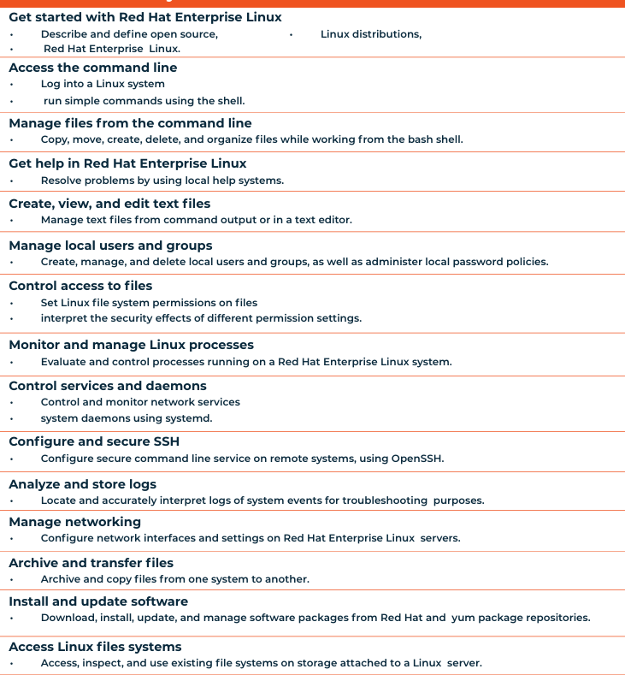

Thank You

