Slide 1


Supply Chain Management
Prepared by Dr. Tarek Mohamed
MGM 660
Lecture 3

Slide 2


Supply Chain Drivers and Metrics
Lecture 3
MGM 660
Prepared by
Dr. Tarek Mohamed

Slide 3

Course Agenda
Chapter
01
1- Identify the major drivers of supply chain performance.
2- Discuss the role of each driver in creating a strategic fit
between the supply chain strategy and the competitive strategy.
3- Define the key metrics that track the performance of the
supply chain in terms of each driver.

Slide 4
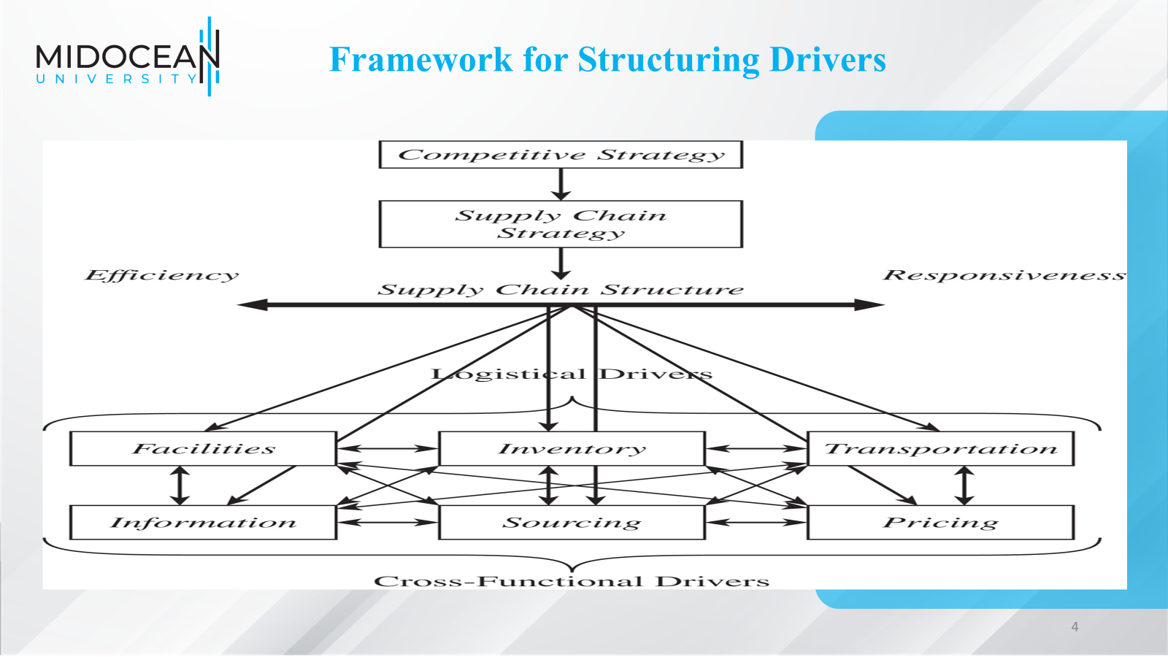

Slide 5
Common Supply Chain Trade-Offs
A trade-off in supply chain management is the balance between two competing objectives, where improving one objective may worsen another.
Common Supply Chain Trade-Offs
Responsiveness vs. Efficiency
Responsiveness: Ability to react quickly to customer demand.
Efficiency: Ability to operate at low cost.
Example: Holding large inventories improves responsiveness but increases costs.
2.Inventory vs. Transportation
Keeping more inventory in multiple locations reduces delivery time.
However, it increases inventory holding costs.
Keeping less inventory lowers inventory costs but may require more expensive transportation.

Slide 6
Examples for Structuring Drivers
3.Transportation Cost vs. Delivery Speed
Air freight is fast but expensive.
Sea freight is cheaper but slower.
4. Facilities Cost vs. Customer Service
More warehouses improve customer service and reduce delivery times.
Fewer warehouses reduce facility costs but may increase delivery times.
Example
A company can:
Store products in many warehouses → Faster delivery, higher costs.
Store products in one central warehouse → Lower costs, slower delivery.
Thus, supply chain managers must choose the right balance between cost efficiency and customer responsiveness to achieve the company's competitive strategy.

Slide 7
The trade-offs within each driver
Driver | More Responsive | More Efficient
Facilities | Multiple Plants Flexible Plants | Single Plant Dedicated Plant
Inventory | Higher Inventory | Lower Inventory
Transportation | Higher Speed | Lower Speed
Information | Accurate Real Time Transmission | Less Accurate Batched Transmission
Sourcing | Responsive supplier | Efficient supplier
Pricing | Differential Pricing | Everyday Low Pricing

Slide 8
Drivers of Supply Chain Performance
Supply Chain Drivers are the key factors that determine the performance of a supply chain in terms of responsiveness and efficiency.
The structural (or logistical) supply chain drivers are:
Facilities – The physical locations where products are manufactured, assembled, stored, or sold (such as factories, warehouses, and distribution centers).
Inventory – All raw materials, work-in-process items, and finished goods held throughout the supply chain.
Transportation – The movement of products between different stages of the supply chain, including shipping by truck, rail, air, sea, or pipeline.
These drivers are called structural drivers because they involve the physical design and operation of the supply chain network.

Slide 9
Drivers of Supply Chain Performance
In many supply chain frameworks, the other drivers are Information, Sourcing, and Pricing, which are often referred to as cross-functional drivers.
Information
  Data and analysis concerning facilities, inventory, transportation, costs, prices, and customers throughout the supply chain
Sourcing
  Who will perform a particular supply chain activity?
Pricing
  How much a firm will charge for the goods and services that it makes available in the supply chain
Structural (Logistical) Drivers: Facilities, Inventory, Transportation.
Cross-Functional Drivers: Information, Sourcing, Pricing.

Slide 10
Facilities
Role in the supply chain
  Increase responsiveness by increasing the number of facilities, making them more flexible, or increasing capacity.
  For example,
  Amazon increased the number of warehousing facilities located close to customers to improve its responsiveness.
  In contrast, Best Buy tried to improve its efficiency by shutting down retail facilities even though it reduced responsiveness.

Slide 11
Facilities
Role in the supply chain
  Tradeoffs between facility, inventory, and transportation costs.
  Increasing the number of facilities increases facility and inventory costs, decreases transportation costs and reduces response time
  Increasing the flexibility or capacity of a facility increases facility costs but decreases inventory costs and response time.
  For example, IKEA has become profitable by opening a few hundred large stores (no more than one or two per city) to grow efficiency,
  Seven- Eleven Japan has grown profitability by opening a highly dense network of stores (often hundreds per city) to provide responsiveness.
  Both companies are successful because the facility decisions are aligned with the supply chain strategy.

Slide 12
Facilities
Components of facilities decisions
  Capacity
    A facility’s capacity to perform its intended function or functions
    Excess capacity – responsive, costly
    Little excess capacity – more efficient, less responsive

Slide 13
Facilities
Components of facilities decisions
Facility-related metrics
Capacity (measures the maximum amount a facility can process).
Utilization (measures the fraction of capacity that is currently being used in the facility).
Processing/setup/down/idle time (measures the fraction of time that the facility was processing units, being set up to process units, unavailable because it was down, or idle because it had no units to process.
Production cost per unit (measures the average cost to produce a unit of output )
Quality losses (measure the fraction of production lost as a result of defects)
Theoretical flow/cycle time of production (measures the time required to process a unit if there are absolutely no delays at any stage
Actual average flow/cycle time (measures the average actual time taken for all units processed over a specified duration, such as a week or a month.

Slide 14
Facilities
Components of facilities decisions
Facility-related metrics
  Flow time efficiency (is the ratio of the theoretical flow time to the actual average flow time. Low values for flow time efficiency indicate that a large fraction of time is spent waiting ).
  Product variety (measures the number of products or product families processed in a facility)
  Volume contribution of top 20 percent SKU's and customers (measures the fraction of total volume processed by a facility that comes from the top 20 percent of SKUs or customers).
  Average production batch size (measures the average amount produced in each production batch)
  Production service level (measures the fraction of production orders completed on time and in full.

Slide 15
Inventory
Role in the Supply Chain
  Mismatch between supply and demand
  Exploit economies of scale
  Reduce costs
  Improve product availability
  Affects assets, costs, responsiveness, material flow time

Slide 16
Inventory
Overall trade-off
Increasing inventory generally makes the supply chain more responsive
A higher level of inventory facilitates a reduction in production and transportation costs because of improved economies of scale
Inventory holding costs increase

Slide 17
Components of Inventory Decisions
Cycle inventory
  Average amount of inventory used to satisfy demand between supplier shipments
  Function of lot size decisions
Safety inventory
  Inventory held in case demand exceeds expectations
  Costs of carrying too much inventory versus cost of losing sales

Slide 18
Components of Inventory Decisions
Seasonal inventory
  Inventory built up to counter predictable variability in demand.
  Cost of carrying additional inventory versus cost of flexible production.
Level of product availability
  The fraction of demand that is served on time from product held in inventory.
  Trade off between customer service and cost.

Slide 19
Components of Inventory Decisions
Inventory-related metrics
C2C cycle time (is a high-level metric that includes inventories, accounts payable, and receivables).
Average inventory (measures the average amount of inventory carried. Average inventory should be measured in units, days of demand, and financial value )
Inventory turns (measure the number of times inventory turns over in a year )
Products with more than a specified number of days of inventory (identifies the products for which the firm is carrying a high level of inventory)
Average replenishment batch size (measures the average amount in each replenishment order. The batch size should be measured by SKU in terms of both units and days of demand )

Slide 20
Transportation
Role in the Supply Chain
Moves the product between stages in the supply chain
Affects responsiveness and efficiency
Faster transportation allows greater responsiveness but lower efficiency
Also affects inventory and facilities
Allows a firm to adjust the location of its facilities and inventory to find the right balance between responsiveness and efficiency

Slide 21
Transportation
Components of Transportation Decisions
Design of transportation network
  Modes, locations, and routes
  Direct or with intermediate consolidation points
  One or multiple supply or demand points in a single run

Slide 22
Transportation
Components of Transportation Decisions
Choice of transportation mode
Air, truck, rail, sea, and pipeline
Information goods via the Internet
Different speed, size of shipments, cost of shipping, and flexibility

Slide 23
Transportation
Transportation-related metrics
Average inbound transportation cost (typically measures the cost of bringing product into a facility )
Average income shipment size (measures the average number of units or dollars in each incoming shipment at a facility)
Average inbound transportation cost per shipment (measures the average transportation cost of each incoming delivery).
Average outbound transportation cost (measures the cost of sending product out of a facility to the customer)
Average outbound shipment size (measures the average number of units or dollars on each outbound shipment at a facility)
Average outbound transportation cost per shipment (measures the average transportation cost of each outgoing delivery)
Fraction transported by mode (measures the fraction of transportation (in units or dollars) using each mode of transportation

Slide 24
Transportation
Overall trade-off: Responsiveness versus efficiency
  The cost of transporting a given product (efficiency) and the speed with which that product is transported (responsiveness)
  Using fast modes of transport raises responsiveness and transportation cost but lowers the inventory holding cost

Slide 25
Information
Role in the Supply Chain
  Improve the utilization of supply chain assets and the coordination of supply chain flows to increase responsiveness and reduce cost
  Information is a key driver that can be used to provide higher responsiveness while simultaneously improving efficiency

Slide 26
Information
Role in the Competitive Strategy
Improves visibility of transactions and coordination of decisions across the supply chain
Right information can help a supply chain better meet customer needs at lower cost
More information increases complexity and cost of both infrastructure and analysis exponentially while marginal value diminishes
Share the minimum amount of information required to achieve coordination

Slide 27
Information
Overall trade-off: Responsiveness versus efficiency
  The cost of transporting a given product (efficiency) and the speed with which that product is transported (responsiveness)
  Using fast modes of transport raises responsiveness and transportation cost but lowers the inventory holding cost

Slide 28
Components of Information Decisions
Push versus Pull
  Different information requirements and uses
Coordination and information sharing
  Supply chain coordination, all stages of a supply chain work toward the objective of maximizing total supply chain profitability based on shared information
Sales and operations planning (S&OP)
  The process of creating an overall supply plan (production and inventories) to meet the anticipated level of demand (sales)

Slide 29
Components of Information Decisions
Enabling technologies
  Electronic data interchange (EDI)
  The Internet
  Enterprise resource planning (ERP) systems
  Supply chain management (SCM) software
  Radio frequency identification (RFID)

Slide 30
Components of Information Decisions
Information-related metrics
Forecast horizon (identifies how far in advance of the actual event a forecast is made )
Frequency of update (identifies how frequently each forecast is updated)
Forecast error (measures the difference between the forecast and actual demand )
Seasonal factors (measure the extent to which the average demand in a season is above or below the average in the year )
Variance from plan (identifies the difference between the planned production/inventories and the actual values )
Ratio of demand variability to order variability (measures the standard deviation of incoming demand and supply orders placed )

Slide 31
Sourcing
Role in the Supply Chain
Set of business processes required to purchase goods and services
Will tasks be performed by a source internal to the company or a third party
Increase the size of the total surplus to be shared across the supply chain

Slide 32
Sourcing
Role in the Competitive Strategy
Sourcing decisions are crucial because they affect the level of efficiency and responsiveness in a supply chain
Outsource to responsive third parties if it is too expensive to develop their own
Keep responsive process in-house to maintain control

Slide 33
Components of Sourcing Decisions
In-house or outsource
  Perform a task in-house or outsource it to a third party
  Outsource if it raises the supply chain surplus more than the firm can on its own
  Keep function in-house if the third party cannot increase the supply chain surplus or if the outsourcing risk is significant

Slide 34
Components of Sourcing Decisions
Supplier selection
  Number of suppliers, criteria for evaluation and selection
Procurement
  Obtain goods and service within a supply chain
  Goal is to increase supply chain surplus

Slide 35
Components of Sourcing Decisions
Sourcing-related metrics
  Days payable outstanding (measures the number of days between when a supplier performed a supply chain task and when it was paid for)
  Supply quality (measures the quality of product supplied)
  Supply lead time (measures the average time between when an order is placed and when the product arrives)
  Percentage of on-time deliveries (measures the fraction of deliveries from the supplier that were on time)
  Supplier reliability (measures the variability of the supplier’s lead time as well as the delivered quantity relative to plan)

Slide 36
Pricing
Role in the Supply Chain
Pricing determines the amount to charge customers for goods and services
Affects the supply chain level of responsiveness required and the demand profile the supply chain attempts to serve
Pricing strategies can be used to match demand and supply
Objective should be to increase firm profit

Slide 37
Components of Pricing Decisions
Pricing and economies of scale
  The provider of the activity must decide how to price it appropriately to reflect economies of scale
Everyday low pricing versus high-low pricing
  Different pricing strategies lead to different demand profiles that the supply chain must serve

Slide 38
Components of Pricing Decisions
Fixed price versus menu pricing
If marginal supply chain costs or the value to the customer vary significantly along some attribute, it is often effective to have a pricing menu
Can lead to customer behavior that has a negative impact on profits

Slide 39
Components of Pricing Decisions
Pricing-related metrics
Profit margin (measures profit as a percentage of revenue)
Days sales outstanding (measures the average time between when a sale is made and when the cash is collected)
Incremental fixed cost per order ( measures the incremental costs that are independent of the size of the order)
Incremental variable cost per unit (measures the incremental costs that vary with the size of the order)
Average sale price (measures the average price at which a supply chain activity was performed in a given period)
Average order size (measures the average quantity per order)
Range of sale price (measures the maximum and the minimum of sale price per unit over a specified time horizon)
Range of periodic sales (measures the maximum and minimum of the quantity sold per period (day/week/month) during a specified time horizon)

Slide 40
Summary of Learning Objectives
Chapter
01
1- Identify the major drivers of supply chain performance.
2- Discuss the role of each driver in creating a strategic fit
between the supply chain strategy and the competitive strategy.
3- Define the key metrics that track the performance of the
supply chain in terms of each driver.

Slide 41
Essential Reference
Chopra, S., & Meindl, P. (2016). Global Edition. Pearson Education Limited
Chapter 3.
Lysons, K., & Farrington, B. (2020). Procurement and supply chain management. Pearson UK.
Morris, P. W., & Pinto, J. K. (Eds.). (2007). The Wiley guide to project technology, supply chain, and procurement management (Vol. 4). John Wiley & Sons.
Schwalbe, K. (2015). Information technology project management. Cengage Learning.
Supply Chain Council

Slide 42

Thank You

