Slide 1

Interaction Design (DGM 729)
Prepared by
Dr. Mohamed Owies
Lecture 3
Interaction Design (DGM 729)

Slide 2
Chapter 3
Advocating for UX Within Organizations
Interaction Design

Slide 3
Lecture 3
Content
lecture 3 includes the following points:
Principles over Process
Dealing with People Issues
Dealing with Organizational Issues
Responses to Common Objections
If You Only Do One Thing

Slide 4

Lecture 3
Principles over Process
One team of one I spoke with said, “We don’t have the process in place that we need to have. In the next year, I’m going to push for that.” This desire for more process is common. But too much emphasis on process can be a distraction that takes your energy and attention away from relationships, which are more important—particularly when UX is still trying to establish itself in an organization and as a field.
You can have all the processes in the world, but if people don’t participate or support them, they’re a fruitless exercise. And processes may need to change—often right in the middle of them—but principles can keep the work anchored. Principles are deceptively simple; they’re just statements, really.

Slide 5
Lecture 3
Principles over Process
They are a way for you to articulate a vision for what your user-centered approach should ultimately entail. Principles can apply to not just what you make, but also how you work.
Think of the following principles as core tenets for how to work as a team of one. With startling consistency, the most happy and successful teams of one explain that it’s their mindset, not just their methods, that keep them going. This mindset is embodied by the following principles of engagement

Slide 6
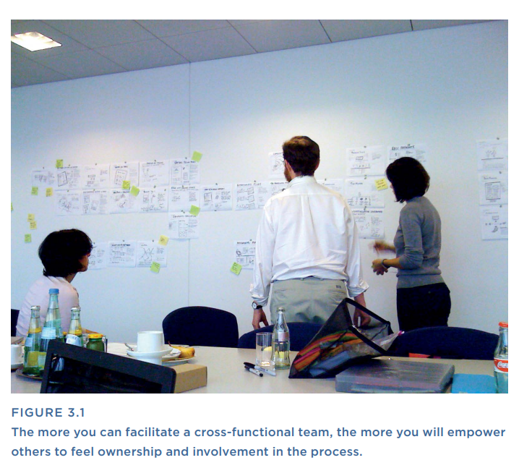

Lecture 3
Principles over Process
1 - Invite People In
Overworked teams of one can sometimes spend more time at their desks than in conversations with colleagues. You think you’re getting lots of work done and surely people will recognize and applaud your efforts, but it can have the unintended effect of making you seem inaccessible and unfriendly.
In bringing people over to your cause, openness and friendliness can go a long way. Every day is an opportunity to invite your non-UX colleagues into the world of UX (see Figure 3.1). In fact, your coworkers may already think of themselves as savvy UX supporters.

Slide 7
Lecture 3
Principles over Process
1 - Invite People In
Even though you may see missed opportunities or on-gain/off-again support, you can still cultivate advocates for UX. Invite them into the conversation and the community, and treat them as partners in the ongoing project of making your products as user-friendly as possible.

Slide 8
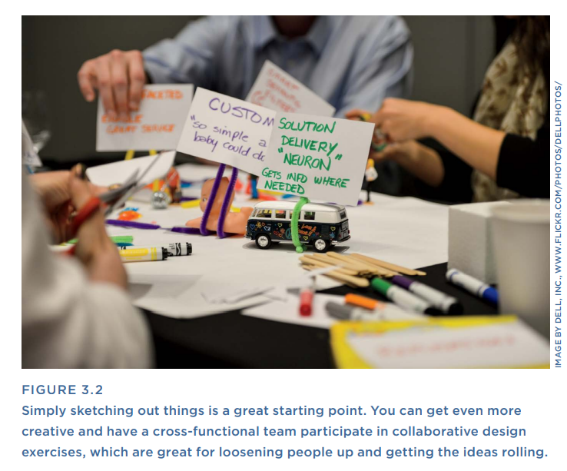
Lecture 3
Principles over Process
2 - Make Things Together
User experience work (and who are we kidding, work in general) can often be adversarial. Even though everyone on the team is presumably working toward the same goal, often how to accomplish that goal can become a battlefield of differing opinions, each informed by the professional experience and expertise of their owners.
Meetings are one culprit here. Unstructured conversations are another. The two in conjunction create fertile soil for endless discussions back and forth that can get mired in all the bad habits of interpersonal communication.

Slide 9
Lecture 3
Principles over Process
2 - Make Things Together
But you don’t want that. And odds are good that your colleagues don’t want it either. Happily, you have a very important tool at your disposal: the ability to make ideas tangible, and then to use that tangibility as a tool for further discussing and refining those ideas.
Simply put, if you can quickly make examples of what you and your colleagues are talking about (even the sketchiest, most rudimentary examples), you can break the conversational cycle and instead help foster a constructive evolution of shared vision. How do you do this? Take a look at Figure 3.2. Model good behaviors like sketching, white boarding, and in-the-moment willingness to say “Can we draw that out?”

Slide 10
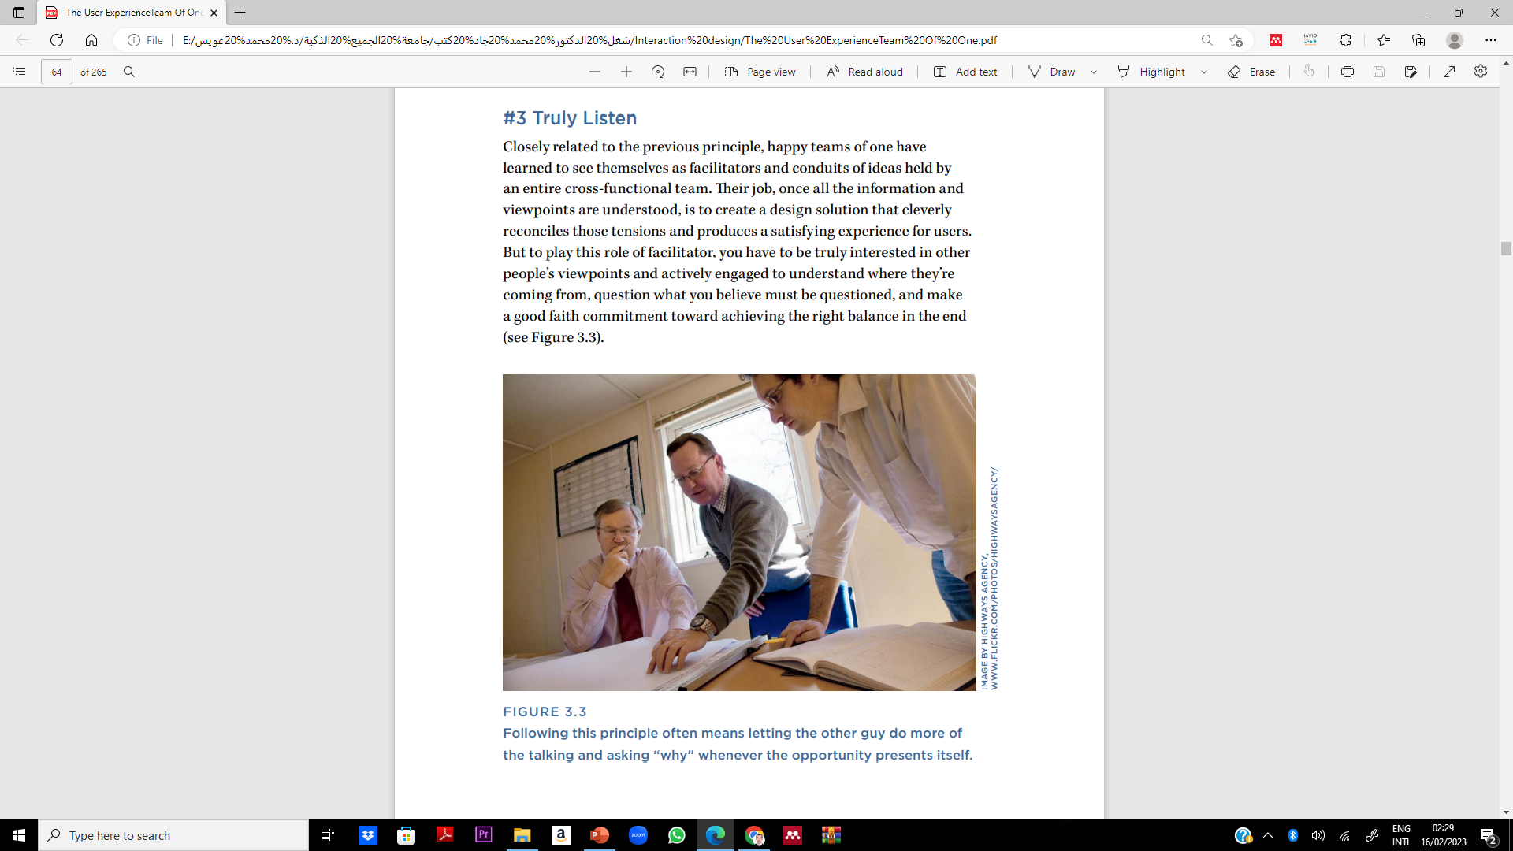
Lecture 3
Principles over Process
3 - Truly Listen
Closely related to the previous principle, happy teams of one have learned to see themselves as facilitators and conduits of ideas held by an entire cross-functional team. Their job, once all the information and viewpoints are understood, is to create a design solution that cleverly reconciles those tensions and produces a satisfying experience for users.
But to play this role of facilitator, you have to be truly interested in other people’s viewpoints and actively engaged to understand where they’re coming from, question what you believe must be questioned, and make a good faith commitment toward achieving the right balance in the end (see Figure 3.3).

Slide 11
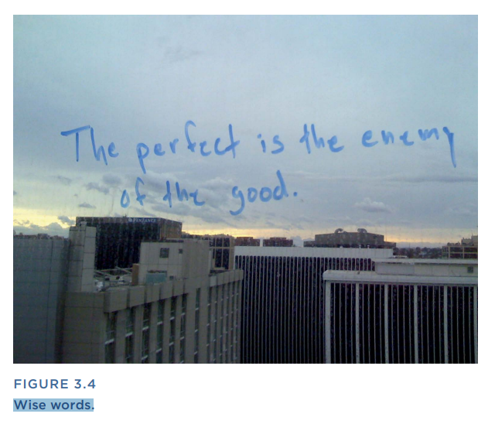
Lecture 3
Principles over Process
4- Know When It’s Good Enough
Finishing a UX project is like sweeping a floor. You get the big pile fairly easily, but those last few specks of dust are impossible to ever really clean up. You just keep cutting the dirt pile in half until finally you’re left with an acceptable amount of grime to put the broom away and get on with the next thing. Suffice it to say, the work is never really done.
Having an ongoing conversation with your non-UX colleagues about what’s most important to get right and taking a “let’s show the sausage being made” attitude can turn that problem into a compelling way to get others involved.

Slide 12
Lecture 3
Principles over Process
4- Know When It’s Good Enough
By committing yourself to the idea that it will be imperfect and that others will have good ideas for how to improve it, you start to get a feel for what “good enough” looks like (see Figure 3.4). Good enough to convey the basic idea. Good enough to have a conversation about it.
Good enough to get started writing code You will see all four of these principles in action in the two main challenges that are addressed next: dealing with people issues and dealing with organizational issues.

Slide 13

Lecture 3
Dealing with People Issues
Relationships are one of the most important means by which you can establish a foundation for UX. And yet, in a complex organization, it can sometimes be difficult to engage without getting sucked into interpersonal politics. Those people whom I’ve known to be most successful in this area seem to make themselves present and available, but without soiling their reputations or impartiality.
They seem to assume that everyone has good intentions, and they try to see the situation from other people’s perspectives, rather than just their own. That may sound warm and squishy, but it speaks to one of the supreme paradoxes of our work: it’s frustrating when our efforts are impeded by others, but it’s only by working with others that we build unofficial and official support for UX. Here are some techniques that will help.

Slide 14
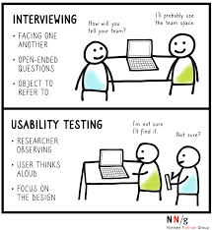
Lecture 3
Dealing with People Issues
1- Interview the team about how they want to engage with UX.
One thing I learned in consulting is that you must work with the
resources that are available. People are resources, too. You can assess what sort of environment you’re stepping into with a “Listening Tour” (Chapter 5, “Planning and Discovery Methods”).
These “tours” involve one-on-one meetings with key people that quickly educate you as to their perspectives on the project, organizational norms, how they like to work, and how receptive they are to the idea of your involvement.

Slide 15
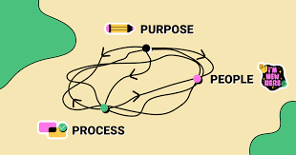
Lecture 3
Dealing with People Issues
2- Build an informal UX network.
In larger organizations, it’s actually possible that there are a lot of other people who also think of themselves as user-savvy advocates. Develop communities of practice or lunchtime brown bags to pull the UX enthusiasts out of the woodwork and promote broader UX uptake within the company.
Create a “Peer-to-Peer Learning Community” (see Chapter 9, “Evangelism Methods”) to create an informal community of support for UX and to educate others.

Slide 16

Lecture 3
Dealing with People Issues
3- Ask others to participate.
Fluctuating support suggests that managers and colleagues need to better understand the value of UX. Invite them into your process and yourself into theirs so they get a better sense of what UX means and what value it provides. When conducting user research, invite your non-UX colleagues to come along. Offer to facilitate a “Strategy Workshop” (Chapter 5), where a cross-functional team can openly discuss opportunities to improve the user experience of your products.
Also, hone your sketching skills so you can turn any meeting into a design session (see Chapter 7, “Design Methods”) and invite your colleagues to sketch as well. People love it when ideas start to become tangible, and it’s a way for you to demonstrate your leadership and help guide a conversation if it seems to be spinning. Host “Sketch board” sessions (Chapter 7). These are generative design workshops that give your non-designer colleagues an opportunity to contribute to the design process.

Slide 17
Lecture 3
Dealing with People Issues
4- Arrange pre-meetings to avoid the “big reveal.
I was on a project once with a manager who set up pre-meetings with all of her senior executives prior to the formal share-out of proposed designs. At the time, it seemed to me like a lot of unnecessary conversations, but it had a magical effect on the big meeting. When we pulled out the designs and started explaining our logic, the senior execs smiled knowingly and nodded their heads in the affirmative.
There were none of the puzzled “I’m thinking about it” expressions that I was used to in such presentations. Pre-meetings help you get people to commit their support for your approach prior to going in for the big reveal, and they give your colleagues a very important gift: the time and space to really think about proposed designs and establish their own point of view.

Slide 18
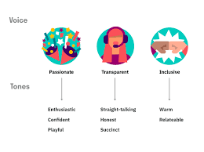
Lecture 3
Dealing with People Issues
5- Use relatable language.
UX is rife with jargon that can be off-putting to people from other fields. Find plain-English ways to describe what you’re attempting to do, and speak to the outcome, not just the process.

Slide 19

Lecture 3
Dealing with Organizational Issues
User experience practitioners, due to their focus on both user needs and business needs, can provide a holistic view that can actually be rare within an organization. That’s particularly true if your business is siloed or heavily segmented by department.
If you find that your vantage point is restricting you from looking beyond one piece of the system or process, you are ultimately hampered in your ability to consider and design for user experiences that are fluid. You may need to find novel ways to gain access and visibility across departments, deal with conflicting priorities, and make the most of insufficient or unclear resources. Here are some ideas.

Slide 20
Lecture 3
Dealing with Organizational Issues
User experience practitioners, due to their focus on both user needs and business needs, can provide a holistic view that can actually be rare within an organization. That’s particularly true if your business is siloed or heavily segmented by department.
If you find that your vantage point is restricting you from looking beyond one piece of the system or process, you are ultimately hampered in your ability to consider and design for user experiences that are fluid. You may need to find novel ways to gain access and visibility across departments, deal with conflicting priorities, and make the most of insufficient or unclear resources. Here are some ideas.

Slide 21
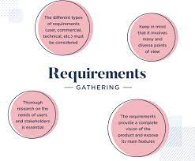
Lecture 3
Dealing with Organizational Issues
Offer to visualize requirements:
Early on in the process, offer to be the design hands to help others visually convey what they have in mind and tease out their ideas. If you know that preliminary product strategy conversations are taking place, or that use cases and requirements are being written prior to UX involvement, this is
the perfect moment to offer your services and suggest in a friendly fashion that the user experience of the product often benefits down the road from having UX involved in early-stage efforts. By offering yourself in the capacity of early-stage visualizer and prototypist, you can make a place for yourself in strategic conversations that establish the fundamentals of the product or service.

Slide 22
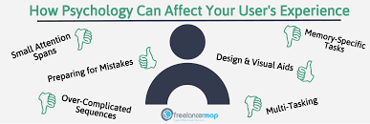
Lecture 3
Dealing with Organizational Issues
- Help others see how UX impacts the process:
Make it clear how UX changes the established process. Show a “UX Project Plan” (Chapter 5) to give everyone (including yourself) a realistic understanding of the time and resources needed to work UX into the process. It can also give you a better idea of the resources and support you’ll need to do your work well. To address concerns about the amount of time or effort that may be required, create one version that shows the project timeline with UX, and one that shows it without.
This also gives you a tangible way to talk about trade-offs and compromises: where you could shorten your process, where there are dependencies, and what the team will be giving up if UX is not involved.

Slide 23
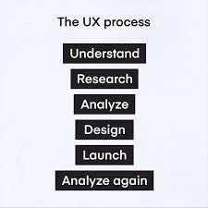
Lecture 3
Dealing with Organizational Issues
Play nicely with vendors:
You may find yourself having to work with vendors or outside agencies from time to time. These can be analytics vendors or development vendors or, really, any kind of vendors. When it’s UX vendors, it hurts a little.
If you’ve been struggling to establish a robust UX practice, having someone from outside the organization come in with the freedom and the support to do all the most interesting work can be a little frustrating. But this is a great opportunity, actually, and you don’t want to waste it sucking on sour grapes.
Here are a few tips.

Slide 24
Lecture 3
Dealing with Organizational Issues
Get invited to their meetings. Position yourself as someone who can share internal knowledge and bring the work they generate back in-house.
See it as an opportunity to learn. They might have some tricks/ techniques you can add to your own arsenal.
Work with them rather than against them. A positive attitude will reflect well on you, and it shows maturity and understanding of the organization.
Know that outside vendors never really do all the work. Often, they set a direction, but due to a limited statement of work, much work will remain to be done to extend that vision through the product. Stay actively involved so you can own and direct how the work gets executed.

Slide 25

Lecture 3
Dealing with Organizational Issues
Turn the rubber stamp into an opportunity:
One common problem for teams of one is getting called in only near the end of development to do a quick usability review—in others words, to rubber stamp a product. This can be frustrating and makes it very hard to suggest anything beyond the most surface changes. But you can treat this as a teachable moment to expose others to what user-centered design really entails. Do “Guerilla User Research” (see Chapter 6, “Research Methods”) to give the team an understanding of what needs to be improved that is based on first-hand observation.

Slide 26

Lecture 3
Dealing with Organizational Issues
Develop case studies:
Often, people don’t really know what you do, even after you’ve done it. Wrap up past projects into a tidy story. People love stories. Instead of talking about the deliverables that you produce or UX concepts in the abstract, case studies and stories give people a memorable narrative that they can envision themselves in. This is also good because it makes it easier for you to remember what you did, so you can tell your stories confidently and on the fly. Develop a collection of “Mini-Case Studies” (Chapter 9) that you can call on or conjure up whenever you have an opportunity.

Slide 27
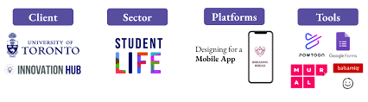
Lecture 3
Dealing with Organizational Issues
Break bread.
Turn lunch into relationship-building time. Shared experiences (even minor ones) turn co-workers into allies. Getting out of the office and trying to relate on a personal level can change the dynamics of your relationship for the better.

Slide 28
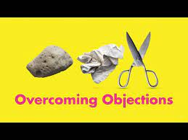
Lecture 3
Responses to Common Objections
Talking about UX often leads to questions, and in some cases objections. But any seasoned salesperson will tell you that objections are an opportunity, not a threat. Think of an objection as an invitation to a more direct and honest conversation, where you can really probe about what’s driving someone else’s point of view. The following is a cheat sheet of the most common questions that UX professionals face and some good ways to answer them.

Slide 29
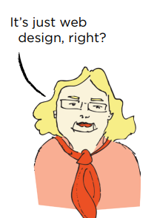
Lecture 3
Responses to Common Objections
Objection: It’s just Web design, right?
Answer: Researching user needs can impact the product at many levels: what features and functions are included, how content is written and presented, how support works, and how well it integrates with other touch points like mobile, desktop, and print. Limiting the scope of responsibility and involvement that the UX designer has to merely the Web or interface level limits its potential impact and effectiveness.
Many UX designers never even touch the Web. (They might go by more specialized titles like a mobile designer or tablet designer, but they’re practicing UX, too.) UX is a role that should span product development from start to finish and at all major product decisions.

Slide 30
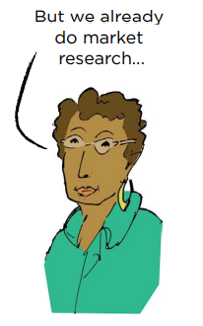
Lecture 3
Responses to Common Objections
Objection: But we already do market research.
Answer: User-centered research is, fundamentally, design research. Design research differs from market research in approach and intent. They are complementary but different. Market research is about identifying what people want, whereas design research is about identifying how best to achieve what people want, i.e., what versus how. In design research, you look for evidence of habits, biases, needs, and native worldviews.
The goal in design research is to develop empathy and insight into why people do what they do and to spark inspiring ideas for how products can meet unmet needs and enhance their lives. What you learn through design research can help you develop tools like “Proto-Personas” (see Chapter 6, “Research Methods,” for more information).

Slide 31
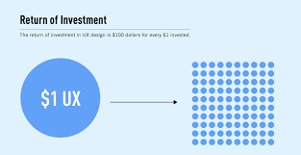
Lecture 3
Responses to Common Objections
The ROI of Design Research
To help companies determine whether design research and persona development is worth the investment.
The market research firm Forrester developed an ROI model to measure the benefit of personas to the companies that undertake them. They discovered that a redesign effort with personas can provide a return of up to four times more than a redesign without personas. (From the Forrester Report “The ROI of Personas.”)

Slide 32
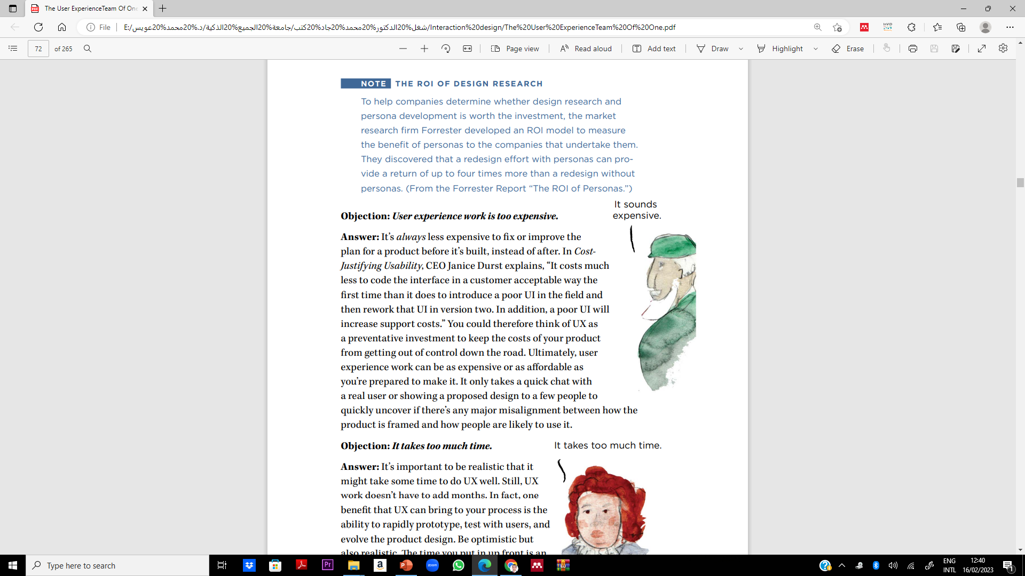
Lecture 3
Responses to Common Objections
Objection: User experience work is too expensive:
Answer: It’s always less expensive to fix or improve the plan for a product before it’s built, instead of after. In Cost Justifying Usability, CEO Janice Durst explains, “It costs much less to code the interface in a customer-acceptable way the first time than it does to introduce a poor UI in the field and then rework that UI in version two. In addition, a poor UI will increase support costs.” You could therefore think of UX as a preventative investment to keep the costs of your product from getting out of control down the road.
Ultimately, user experience work can be as expensive or as affordable as you’re prepared to make it. It only takes a quick chat with a real user or showing a proposed design to a few people to quickly uncover if there’s any major misalignment between how the product is framed and how people are likely to use it.

Slide 33
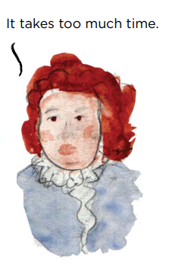
Lecture 3
Responses to Common Objections
Objection: It takes too much time:
Answer: It’s important to be realistic that it might take some time to do UX well. Still, UX work doesn’t have to add months. In fact, one benefit that UX can bring to your process is the ability to rapidly prototype, test with users, and evolve the product design. Be optimistic but also realistic.
The time you put in upfront is an investment that defrays other, more burdensome, costs down the road. And whether your organization realizes it or not, UX is probably already in your process in some surprising forms. It currently shows up in places like time in the call center providing support, or extended time up front for sales, or time in QA testing, or time in maintenance and bug fixes. Ultimately, formalized UX can save you time by taking less time up front to address usability and experience issues that could become a lot costlier to fix once built.

Slide 34
Lecture 3
Responses to Common Objections
The Cost of Not Doing User-Centered Design In Software Engineering, A Practitioner’s Approach, Roger Pressman presents a compelling return on investment for focusing on user needs early in the product development lifecycle. For every dollar spent to resolve problems during product design, Pressman shows it would cost $10 to address the same problem during product development, and $100 or more to solve the problem after the product is released.

Slide 35
Lecture 3
Responses to Common Objections
Objection: But UX research isn’t statistically significant:
Answer: To be statistically significant means that a result has been determined by statistical methods to be unlikely to have occurred by chance.
Statistical significance creates confidence about the linkage between cause and effect. With quantitative research (for example, research conducted with large numbers of people), it is easier to prove statistical significance.
In qualitative research (for example, research focused on gathering in-depth understanding of behavior, but often based on relatively small sample sizes), and statistical significance is pretty hard to prove..

Slide 36
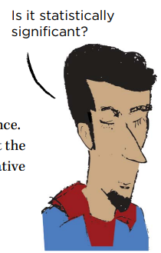
Lecture 3
Responses to Common Objections
Objection: But UX research isn’t statistically significant:
User-centered research typically errs on the side of the qualitative, which means small sample sizes, usually somewhere between six and a dozen people. The main reason for this is that you spend more time with each participant one-on-one—a lot more—and thus a larger sample is prohibitive in terms of time and cost.
The other big reason is that you don’t really need to do it. With even just a small sample size, you can get a sense of the big trends. Sometimes, seeing just one or two users experience the same problem can clue you into a major opportunity for improvement. You can also get some pretty fascinating and rich detail, and that ultimately is the main goal of design research.
But in particularly numerate environments, people sometimes object that what you find with design research is not statistically significant. David Gilmore writing in Interactions magazine called this studying “large numbers shallowly [vs.] small numbers in depth.”

Slide 37
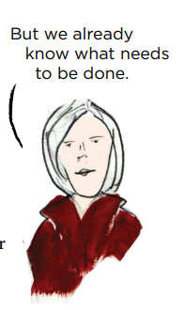
Lecture 3
Responses to Common Objections
Objection: But we already know what needs to be done:
Answer: UX tells you not just what’s wrong, but also why and how to fix it. It also gives you an opportunity to validate that you got it right. Sometimes, things that seem pretty straightforward or that users may even have asked for explicitly really come from a deeper need that you can only discover by getting out of the office and into people’s lives. And, in the long run, observing real people using your products (or their preferred alternatives) may teach the team some things they didn’t know before.

Slide 38
Lecture 3
Responses to Common Objections
Objection: That’s [marketing’s/engineering’s/ product management’s] job.
Answer: In product development, there are a lot of people who are thinking about the product from various angles.
Engineers think about how to write code that’s efficient and reliable. Marketers think about how to connect to and engage the target market for the product. Quality assurance folks think about whether people can use the product to complete the intended use cases.
UX is, in some respects, the glue that binds these considerations together, ensuring that the actual experience of using the product is, from moment to moment, clear, fluid, and even a little bit delightful.

Slide 39
Lecture 3
Responses to Common Objections
A 2005 article from IEEE called “Why Software Fails” listed the top 12 reasons why software projects are unsuccessful. Of the 12, three were directly connected to issues that user experience practitioners can help with:
Badly defined system requirements
Poor communication among customers, developers, and users
Stakeholder politics
While UX isn’t a silver bullet for all the complexities of product development, much of a user experience practitioner’s work is about making sure that what is being built is relevant to both customers’ goals and business goals. A user experience practitioner can help the team ensure that system requirements and product designs are aligned with what’s usable and desirable for users.

Slide 40
Lecture 3
The Role of Artificial Intelligence in Enhancing User Experience (UX)
Artificial Intelligence (AI) is revolutionizing how organizations interact with users.
User Experience (UX) focuses on usability, accessibility, and satisfaction in product or service interactions.
AI-powered tools such as chatbots, recommendation engines, and personalization systems are shaping seamless digital experiences.

Slide 41
Lecture 3
How Organizations Use AI to Improve UX
Chatbots & Virtual Assistants: Provide 24/7 customer support and reduce response time.
Personalized Content: AI algorithms analyze user behavior to tailor experiences.
Predictive Analytics: Forecast user needs and suggest solutions in real time.
UX Design Optimization: AI tools test UI designs and optimize layouts based on user data.

Slide 42
Lecture 3
Benefits and Challenges of Integrating AI in UX
Benefits:
Enhanced user satisfaction and engagement.
Increased operational efficiency.
Better decision-making through data analysis.
Challenges:
Data privacy and ethical concerns.
Over-reliance on automation may reduce the human touch.
Need for skilled workforce to manage AI tools.

Slide 43
Lecture 3
If You Only Do One Thing…
In UX, designing great products is only half the work. The other half is handling all the “people stuff” that goes along with it: building support, ferreting out lingering objections and concerns, untangling a knot of competing agendas, and rallying your colleagues around a new direction.
This chapter encourages you to address those challenges and objections head on. Having the right attitude matters. Be vigilant against feelings of defensiveness or combativeness in yourself. Rather, cultivate a collaborative, curious, and respectful mindset. So if you do nothing else from this chapter, be sure to think about the principles at the start: invite non-UX people into your process.
Listen with genuine curiosity. Make ideas tangible. And, above all else, be patient with yourself and others, remembering that design is an iterative process that takes time to get right.

Slide 44
Lecture 3
Thank You

