Slide 1

Social Media Management (DGM 721)
Prepared by
Dr. Mahitab ELrafii
Lecture No.3
Social Media Management (DGM721)

Slide 2

Sources of Knowledge
Social media management
Dr. Mahitab ELrafii

Slide 3
Content of lecture
The Content of lecture 3 Includes the following:
Introduction to Online Advertising
content network
categories for online advertising
Pricing Models for Online Advertising
The actors involved in online advertising
The use of dynamic keywords
Viral Campaigns
Success Stories of Viral Campaigns
The main advantages and disadvantages of viral campaigns

Slide 4


Introduction to Online Advertising
One possibility for a social media strategy is to consider online advertising. Many online advertisements (ads) appear nowadays on websites, social media tools, or search engine results from pages. The space for (paid) ads is usually indicated with a special icon or a title such as “Ads” or “Sponsored links” which is a disclosure of the relationship to inform the Internet user that its content differs from regular web content and that it may influence the reader’s behavior

Slide 5

Introduction to Online Advertising
Online ads can take many sizes, ranging from very small to very large. Some ads have a lot of text, while others are represented by text with a picture or a moving object and possibly with music. Some ads appear on a website or a social media tool that the Internet user visits and still allow him/her to browse the web content. Nonetheless, an increasing number of blocking ads appear which oblige Internet users to look at their content (e.g., with a message such as “Your video will play in 5 s”) or even to act (e.g., with a button such as “Go to the website”).

Slide 6
Introduction to Online Advertising
Ads are not only present on individual websites. Also, search engines (e.g., Google™, Bing™, or Yahoo!™) frequently sell space for ads to organizations.
Ads may or may not be linked to the web page’s content. Similarly, search engine results pages mostly show ads that depend on the keyword in the search query of a particular Internet user.

Slide 7
Introduction to Online Advertising
For instance, if a user looks for information about a certain keyword (e.g., “smartphone”), then the ads are usually linked to that keyword (e.g., shops that sell smartphones). Such ads that are shown on relevant web pages or alongside relevant search results are called “personalized,” “contextual,” or “targeted” ads. Hence, online advertising can offer a more personalized way of advertising compared to traditional (i.e., offline) ads.

Slide 8
content network
ads can also be sponsored in a “content network.” This means that webmasters can collaborate and simultaneously offer their ad space to organizations. An organization’s ad may then appear on multiple websites. A content network thus refers to a collection of websites or web content (e.g., an online newspaper or a blog) which frequently display targeted ads, namely, ads that are to some degree related to the content of that web page or to the interests of the website visitor.

Slide 9
content network
This type of advertising differs from strict search ads (i.e., ads on search engine results pages) in the sense that Internet users do not necessarily look for information by means of inserting a keyword in a search query. A content network is usually coordinated by an intermediate actor or a so-called ad server vendor.

Slide 10

targeted ads can be considered positive for the Internet user (including a higher probability of getting more relevant or interesting ads) and the organization (with a higher probability that people who see the ad will also click on the ad and thus reach the corporate website). Nonetheless, personal information is needed for some types of targeting (besides looking at the actual web page content) revealed by browser cookies, by collecting personal information on different social media tools through social engineering, or by profiling in social network

Slide 11
Defining Online Advertising
Paid marketing initiatives on the Internet or social media
Higher efficiency is expected, because of:
• Fast dissemination of information possible
• Interaction possible (e.g., input fields in the ad)
• Niche audience possible (e.g., customized by geography, demography, hobby, etc.)

Slide 12

In general, different forms of customization or targeting exist for online advertising, such as::
Targeting related to the web page that shows ads (e.g., contextual or content-related targeting, prime-time targeting.)
Targeting related to personal social media profiles or data from the computer of the Internet user who visits a web page that shows ads (e.g., sociodemographic targeting, geographic or get targeting, behavioral targeting.)

Slide 13
categories for online advertising
Text ads:: Textual ads are frequently based on the user’s search keywords in search engines or on the content of a specific web page.
Display ads or banner ads:: Ads that combine text with graphical images (e.g., using pop-ups, buttons, or screen savers) and which are possibly like traditional ads.
Classified ads:: Small text ads presented by product category (e.g., classified postings in newspapers or magazines).

Slide 14

Rich media ads:: Ads that look like television commercials (e.g., with audio, video, or other animation or interaction).
Sponsorship ads:: If an organization sponsors a third-party website, it can usually show its ads on the sponsored site too.
Email ads:: Ads that appear in direct electronic messages (and which inherently differ from social media ads).

Slide 15

Pricing Models for Online Advertising
As advertising should serve specific business objectives, organizations can spend a certain amount of money on online ads. The price organizations are willing to pay usually depends on their total budget and on the relevance of the corresponding business objective.

Slide 16
Pricing Models for Online Advertising
Although some online ads can be free, the majority are paid ads. It is important to know that online advertising prices are not stable and usually depend on a bidding process. Like an auction, space for ads is rather sold to the best bidder. In other words, organizations usually can’t buy ad space, but they can only bid.

Slide 17
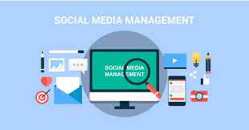
Demand for ad space:: If many organizations wish to show an ad at the same time, then the price per ad is likely to increase.
Reach of ad space:: The more visitors, users, or accounts a publisher has (e.g., a search engine, blog, or other social media tools), the higher the requested price for online advertising. For instance, in 2012, Facebook™ changed the personal email address of its users into a new Facebook™ address (i.e., ending with @facebook.com) in order to stimulate its users to visit the tool more frequently and thus to boost advertising sales (BBC 2012b).

Slide 18
Keywords:: The price per ad can also increase if many ads are linked to the same keyword (e.g., if many competing ads use “smartphone” as a keyword). Choosing the right keywords is particularly important for targeted (e.g., contextual) ads.

Slide 19
Location on a web page:: Eye cam research has investigated how people generally look at a web page. It turned out that people tend to look more at the upper part of a web page and particularly the upper left corner (Lee 2005). This most viewed area is thus the ultimate space for ads and therefore more expensive.

Slide 20
The most common pricing models are::
Pay-per-view:: An advertiser pays for each unique user view of the ad (i.e., per appearance or per impression). Alternatively, an advertiser can pay per 1000 impressions of the ad .
Pay-per-click:: An advertiser pays each time a user clicks on the ad and is redirected to the corporate website.
Pay-per-action (or pay-per-performance):: An advertiser pays each time a user clicks on the ad and completes a transaction or business action (e.g., ordering products, completing a form, registering for a newsletter, etc.).

Slide 21
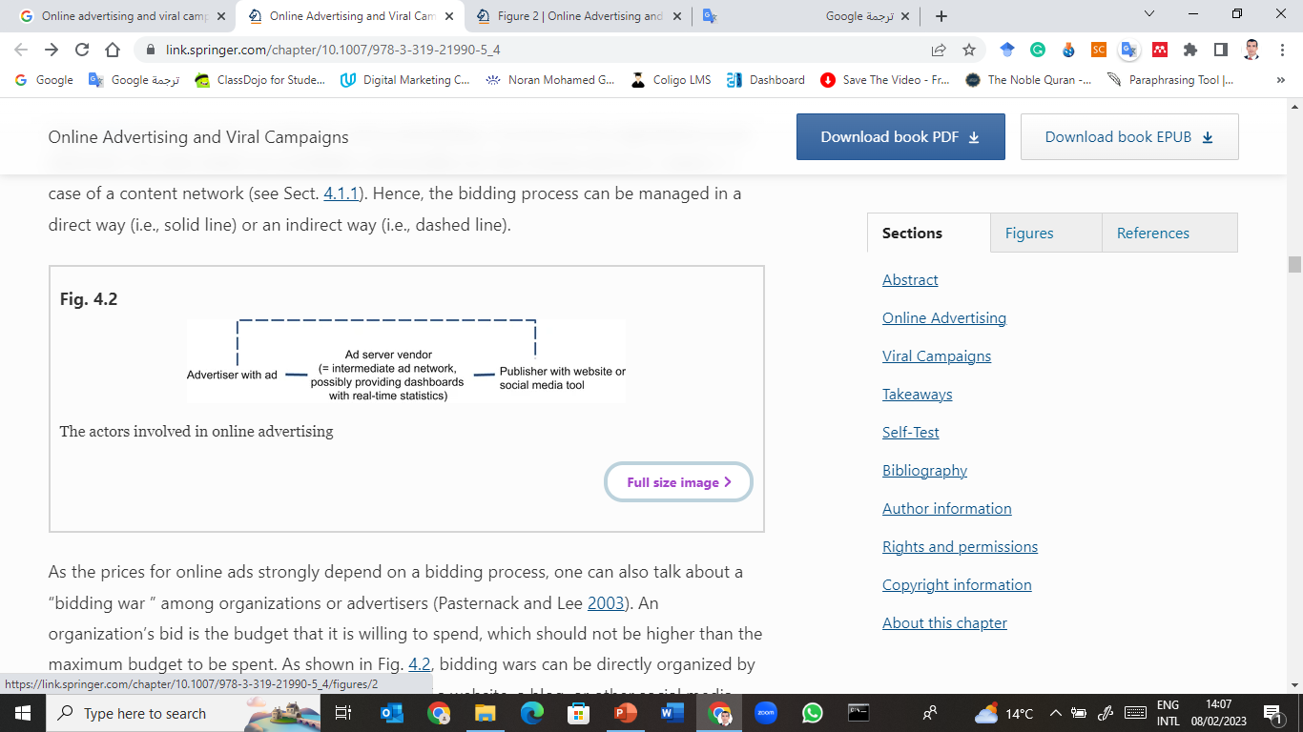
The actors involved in online advertising

Slide 22
Starting Online Advertising
Determine an online advertising strategy:: The purpose is to promote an organization, its products, or services, and this by considering the needs of the target audience. Hence, an organization should strategically think through the content of its ad and where it will appear.
Fill out the online parameters for the ad::A publisher or ad server vendor will probably ask the organization to fill out some parameters for the ad, depending on the determined needs and location of the ad. For instance, Google™ AdWords.

Slide 23
Starting Online Advertising
Determine your target audience and its needs:: Like offline marketing, an organization should understand its target audience. This understanding can deal with demographic and geographic questions (e.g., which type of persons are part of the target audience and where they live) but also lifestyle (e.g., how they live), their future needs, etc.

Slide 24
Determine relevant keywords:: Keywords are relevant to characterize the ad and allow targeting. Internet users typically choose keywords depending on their phase of purchase. Particularly, Table 4.2 shows that Internet users will rather use generic keywords for raising awareness and brand keywords for more complex searches when considering buying a specific product or service.

Slide 25

Generic keywords :: Many Internet users tend to look for generic keywords, but rather for raising awareness than for buying a specific product or service.
Nonbrand product or service keywords::When the user is looking for a specific product or service, but not yet for a specific brand. Especially in this phase, ads may play an important role to drive website traffic.
Branded product or service keywords:: When the user is looking for a specific brand and considers buying one or another product or service of that brand.
Core brand keywords::When the user is aware of and considers buying a specific product or service of a specific brand.

Slide 26
The use of dynamic keywords
No capitalization, all words are in lower case.
Every word is capitalized.
Every letter in the first word is capitalized.
Every letter in the first word and the first letter of the other word(s) are capitalized.
Every letter is capitalized.

Slide 27
Viral Campaigns
A viral marketing campaign relies on unsolicited (i.e., not upon request), mouth-to-mouth communication through the Internet, and social media. However, in contrast to traditional mouth-to-mouth communication, a viral campaign is inherently created by an organization to promote itself as an employer (e.g., for e-recruitment ), its brand (e.g., for brand recognition), or its products and services (e.g., for product awareness, higher sales, etc.). Particularly, a viral campaign can help create awareness, trigger interest, and generate sales or product/service adoption

Slide 28
Once a viral campaign is launched, the receivers become new senders, and the message continues to spread, independent of the organization (e.g., mouth-to-mouth communication). In other words, while the original source of a marketing campaign is inherently an organization, people can start sharing the campaign.

Slide 29
The literature compares the intention of a viral campaign with an “echo,” a “virus,” or a “viral infection” that can spread exponentially and create a buzz or contagious talk. The term “viral” is the adjective of the noun “virus” (i.e., derived from the Latin, where the word refers to “poison”), but has been adopted for online content that rapidly becomes popular or well known. Hence, define a viral marking campaign as “electronic word-of-mouth whereby some form of marketing message related to a company, brand, or product is transmitted in an exponentially growing way—often through the use of social media applications”.

Slide 30
The way a successful viral campaign works is an illustration of the “social ripple effect ”. Particularly, illustrates how a viral campaign typically works. it starts with an organization (otherwise it would concern customer conversations or criticism instead of a campaign; . When people receive the message, they can share it in their network.

Slide 31
As such, the receivers become new senders. When those people also start sharing the content, a social ripple effect is created. Like an “echo,” a “virus,” or a “viral infection,” the message can reach an increasing number of people as it exponentially moves to the right. This characteristic implies that the success of a viral campaign strongly depends on how many times the corporate message is shared .

Slide 32
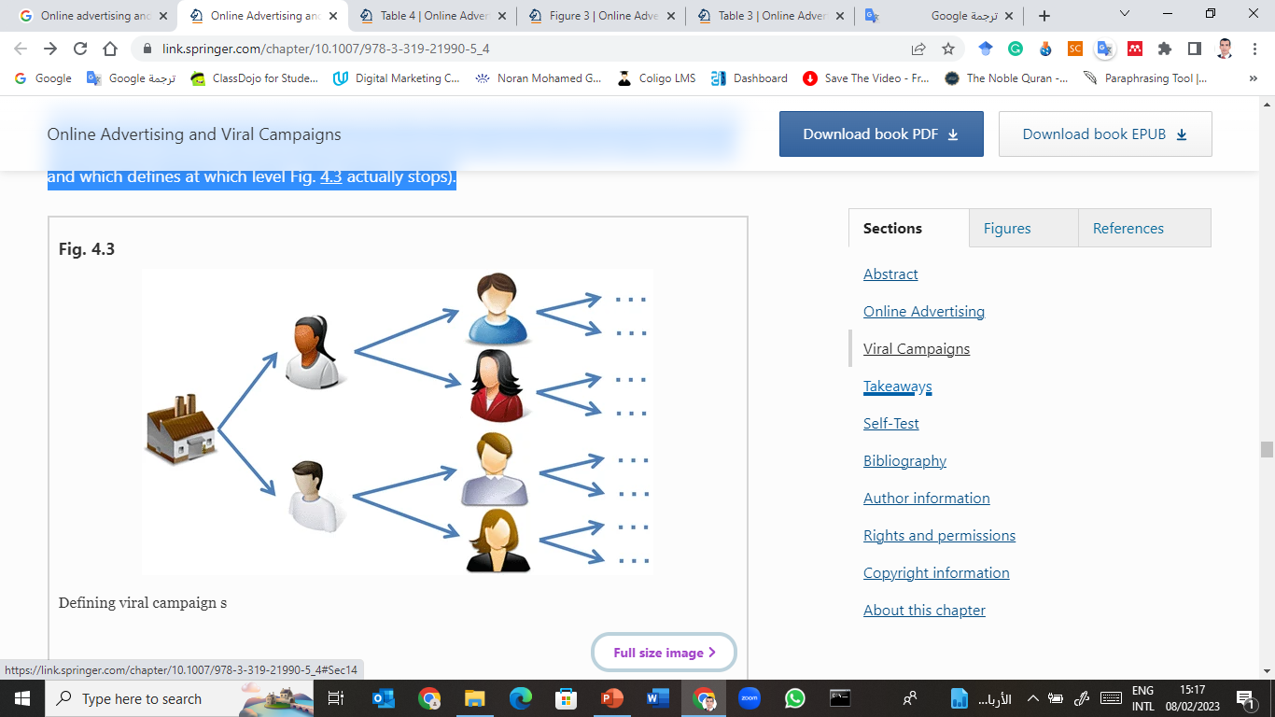
Defining viral campaigns

Slide 33
Success Stories of Viral Campaigns
Hotmail™ launch (1996):: One of the first viral campaigns was launched by the electronic mail service Hotmail™ in the 1990s, namely, during the upcoming use of the Internet. In order to obtain more email accounts, Hotmail™ automatically added a short message at the bottom of every outgoing mail: “PS: Get your private, free email from Hotmail™ at http://www.hotmail.com.”

Slide 34
Success Stories of Viral Campaigns
The message was an invitation for the mail recipient to join Hotmail™ too. The campaign can be called a success as 12 million users signed in within 18 months. Only recently, in 2013, Hotmail™ stopped existing and sold its mail service to Microsoft's outlook.com.

Slide 35
Burger King™ (2004). viral campaigns can also be more interactive than video sharing. One example is a game developed by Burger King™ in 2004. To promote a chicken sandwich, Burger King™ introduced the slogan: “Get chicken just the way you like it.” Besides the traditional commercials, a web page was created called “The subservient chicken.” On that page, a man in a chicken suit performed a range of actions based on the user’s input.

Slide 36
In other words, an Internet user could type a word, and the chicken would perform a specific action linked to that word. For instance, when someone asked, “Do you like hamburgers,” the chicken would rub its belly. Although all actions were prerecorded, the game seemed like an interactive webcam.

Slide 37
Tips and Tricks for Viral Campaigns
Goal 1:: Create content that people are eager to share (e.g., video clips, interactive games, e-books, images, text messages, etc.).
Goal 2:: Focus on trendsetters, namely, people who can influence others and who can start the sharing process.

Slide 38
The main advantages and disadvantages of viral campaigns
Advantages::
Higher efficiency is expected, because of:
• Lower costs than (online) advertising as people (customers) voluntarily spread the message.
• Many people can be reached in a short period of time.
• Possible integration with other campaigns.
• Viral campaigns never stop.
• ROI can be monitored online.

Slide 39
Disadvantages::
• Low control over content and timing
• Sharing strongly depends on the goodwill of people
• Possible miscommunication between cultures (e.g., humor)

Slide 40
Thank you

