Slide 1



Market Entry: Developing the Go-to-Market Strategy
Prepared by Dr. Mohamed Soliman
ENT624
Entrepreneurial Strategy
Lecture 6

Slide 2



Learning Objectives
Learn how to develop your value solution based on your overall strategy.
2. Understand the key drivers that are integral to buyers' demands and expectations within your industry.
3. Know how your own value solution is matched and compared against these drivers within your marketplace .
4. Learn the value of the perceptual map and how the map is used to maintain and exceed your competition in your industry.
5. Learn how to develop and gain an appreciation for a “Go-to-Market” strategy that is based on your value solution, the drivers in the industry, and your competitive positioning.

Slide 3
Designing Your Firm's Value Solution(s)
Prior to putting together any type of messaging regarding how the entrepreneur will deliver on the strategy, it is necessary to establish the firm's unique selling point—otherwise known as the value solution. This is directly related to developing the firm's strategy as presented in advance.
Previously, you had the opportunity to learn the benefits that win customers and how to sustain your competitive advantage.
Now, begin defining your value solution along the similar categories of value and cost-benefits of customer convenience, price, productivity, simplicity, convenience, and image.
Under these categories, think about how your company, your service, and/or product is different from anyone else’s.

Slide 4
Designing Your Firm's Value Solution(s) (Cont.)
To further perceive and develop your value solution, begin by considering the following:
What solution or need does your product/service fill in the eyes of your customers? Why would they want your product/service? How does the solution improve the lives of your potential customers? Go ahead and develop a full list based on these questions and then also consider:
Would you buy this product? Why or why not? If not, this may give you an insight into potential weaknesses, areas that you need to improve and enhance before placing your product/service in the marketplace. Essentially, you could reverse these weaknesses and turn them into a value solution that makes a difference in how customers perceive and buy your product/service.
From there, you can then start to determine who will most benefit from your product and/or service. All this information can then be mapped out using Table1.

Slide 5
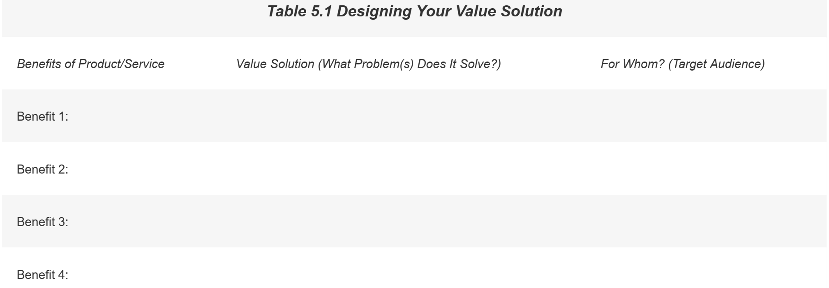

Slide 6
If you are having difficulty in listing the benefits, examine further how the categories of customer convenience, price, productivity, simplicity, and image can then be differentiated from the competition. For example:
• For customer convenience, who within your firm's industry is emphasizing customer convenience?
Where are there gaps? How does your primary market currently go about buying existing products or services of this type? How can your new venture create a solution or solutions to offer customer convenience?
• For price, how does your pricing strategy compare to others in the industry? Is pricing a major buying criterion for your customers? If so, how can you make price a key differentiator (while keeping your
viability and business expenses in mind)?
• For productivity, how does your product/service improve or enhance the productivity and efficiency of your market? How can you make sure that efficiency is perceived as a key marketing or selling point of what your firm offers or how it conducts business?

Slide 7
• For simplicity, how does your product or service meet some of the basic needs and solve the current problems of your customers?
• For image, how do your potential or current customers perceive the benefits of your business? What are their sources of information? Word of mouth? Trade publications? The Internet? How can you build or improve the image of your product/service solutions?
By answering these questions, you can then further develop your value solution(s) and refine it to communicate your message directly to where your market would look and find information related to your business.

Slide 8
Market-to-Market Creative Connections
This tool, in which creative connections are forged between the intended market and an unrelated market, will help the entrepreneur to generate ideas for:
-- positioning the new venture,
-- promoting its products and services, and
-- developing and extending the value solution.
1. Business description
Write the nature of the business in a word or a short phrase.
2. Attribution list
List all the features, (e.g., characteristics, services, products, promotion methods, value offered) that you associate with this business in a column on your paper.
*If the business is not yet in existence, list your intended features.
**If it is an already established business, list the features it already provides.

Slide 9
3. Select a different type of business
Pick an industry or business type that is distinctly different from yours or the one you are considering and write the name of it at the top of the next column on the page.
4. Attribution list for different business
List all the features, (e.g., characteristics, services, products, promotion methods, value offered, etc.) that you associate with this different business. Write as much as you know about what this different business does or could provide.

Slide 10
5. Make creative connections
• What do the attributes of the “different business or industry” suggest for your business or industry? For your value solution?
• What could you put in place in your business that has been successful or a competitive advantage in the different business? How can information from a different industry partner assist you in developing your value solution(s)?
• What opportunities did you discover for marketing your product/service? How can these opportunities be integrated into how you market your value solution?

Slide 11
The Key Drivers Integral to Buyers' Demands and Expectations within Your Industry
Once you have defined your firm's value solution(s), you will find that you will need to revisit and adapt your strategy based on the conditions and context of your industry and marketplace.
As customers' needs and preferences change, your firm will need to take a proactive approach in understanding how these changes influence the overall operations and efficiencies of your business.
One of the ways to stay ahead and meet the expectations of your customers is to understand the key drivers of your venture within the industry.
The categories above are helpful in considering your firm's value solution(s) at the initial launch of your business. However, over time, you will want to adapt these categories to the needs and expectations that drive your customer buying decisions on a daily basis.

Slide 12
Matching and Refining the Value Solution(S) to Marketplace Drivers Over Time
Once the entrepreneur has determined the industry's key drivers over time, those drivers can be assessed based on how well they meet your firm's strategy and value solution(s).
Using the grid in Table 2, determine how well the strategy and solutions are matched against the key drivers in the market.

Slide 13
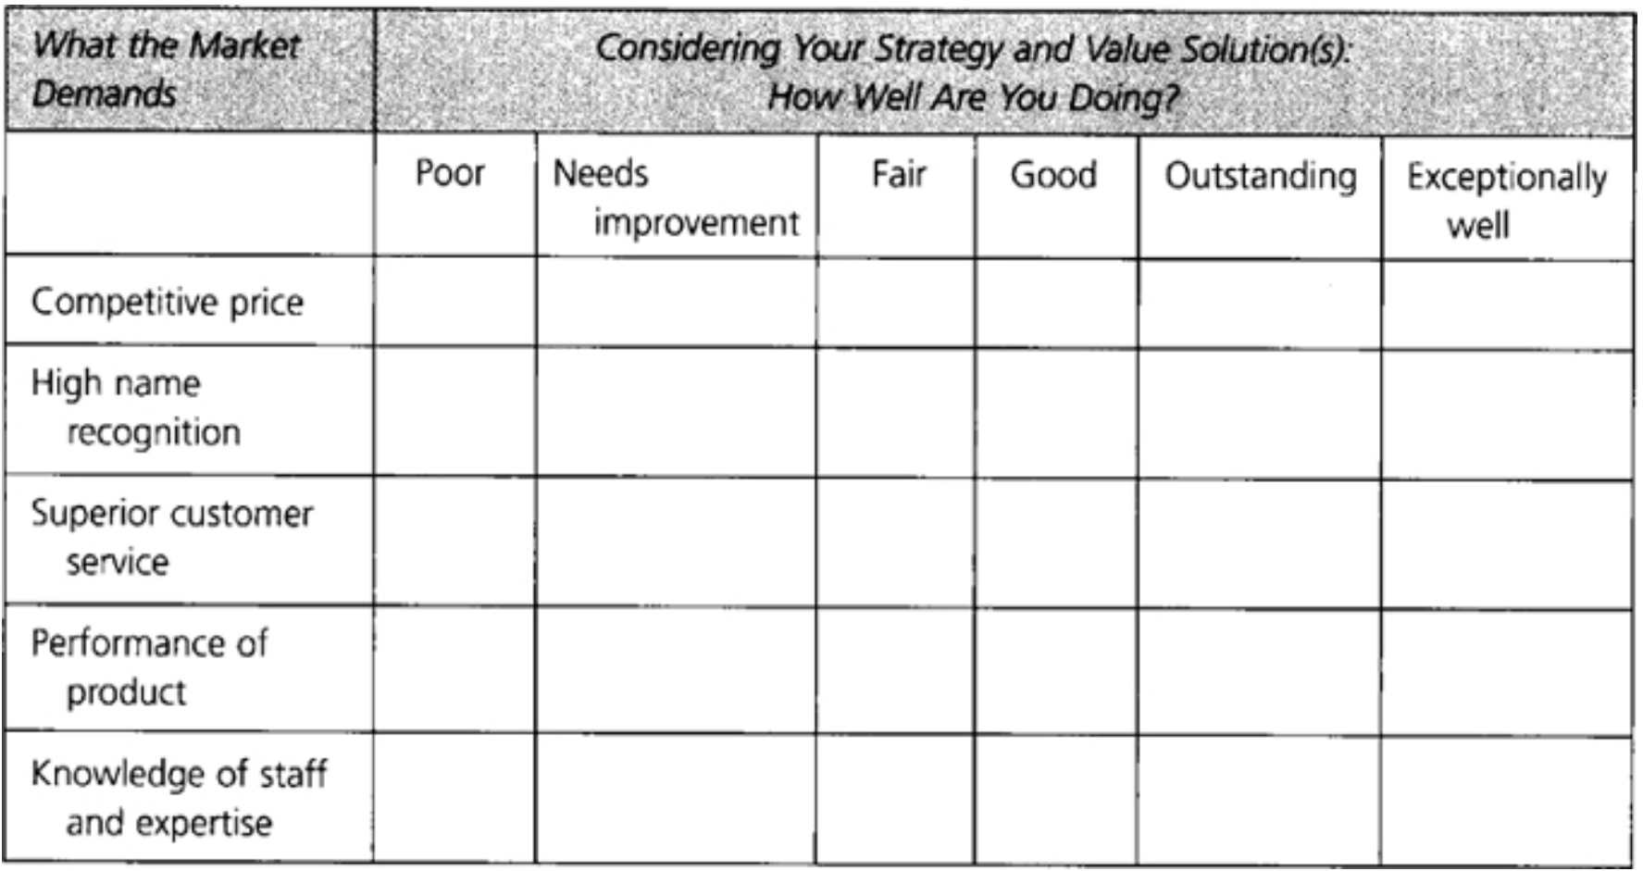
Table 2 Matching Strategy, Solutions, and Market Drivers

Slide 14
Table 2 assists you in benchmarking areas where your firm requires attention or where you lack the internal capabilities and resources to meet the needs of the marketplace.
Knowing these weaknesses will help you craft a revised strategy that focuses on those drivers and positions you for the next new innovation (perhaps coming from your organization).
While partnering and strategic alliances will be discussed later, the idea of developing a relationship with an outside firm may assist you in finding the key resources to fulfill your strategy and meet or exceed the needs of your customers.
In finding a partner to assist with building your resources and capabilities, consider the following three questions:
1. What capabilities do you need to achieve the value solution and key drivers in the industry, and which ones do you lack? (Refer to the second column of Table 2)
2. Which companies have those missing capabilities?
3.Based on cost, quality, and speed, should you acquire those companies or partner with them?

Slide 15
While “how to” partner and build a strategic alliance will be discussed later, discovering what kinds of resources and capabilities you need to implement your value solution and strategy is the first step in the process of building and growing a sustainable, profitable venture.
Our next focus will be on how others, including your competition, view your strategy and your operational effectiveness and performance. We will learn the value of the perceptual map and how the map is used to maintain and exceed your competition in your industry.

Slide 16
Matrix Comparisons: Perceptual Map
Developing your solution and its match with the key drivers in the industry assesses your internal strengths and weaknesses; also, it is important to look outside, in terms of how others in your market space are performing.
Competitive positioning reveals where your company stands in the eyes of any given group of people through the use of matrices.
By creating a simple 2×2 matrix diagram, you can easily map out the position of your firm in relationship to its competitors, or its relationship to a firm in a different business or industry.
Matrices give us a great way to visualize many of the different types of comparisons mentioned in this chapter.
Simply take two characteristics of a business and align them on the vertical and horizontal axis. In Table 3, we compare expertise and name recognition.

Slide 17
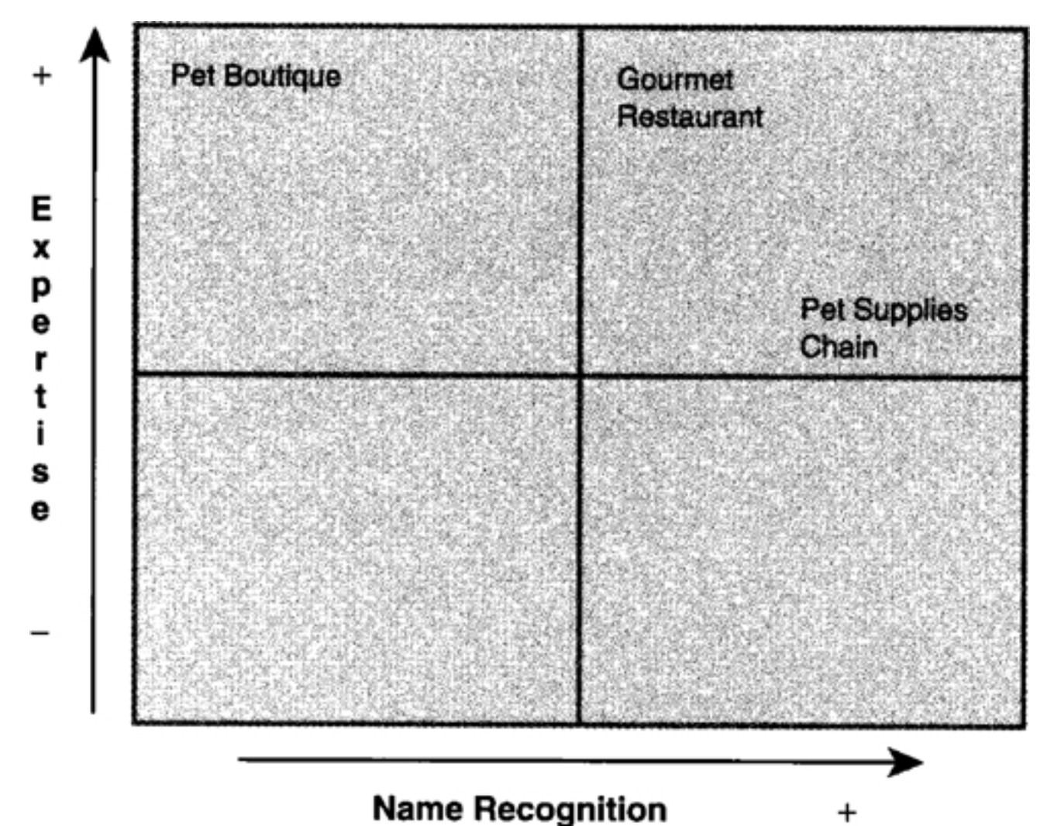
Table 3 Strategic Positioning of the Firm

Slide 18
Let us consider the example of an entrepreneur who owns a pet accessories boutique.
Pet products and services are one of the hottest new ideas: The American Pet Products Manufacturers Association Inc. estimates that $35.9 billion was spent on pets in the United States in 2005, up from $34.4 billion in 2004 (Pennington, 2005).
In this case, the boutique is renowned in its neighborhood, with a steady and loyal clientele.
If the entrepreneur wants to compare how her business fares against competing national pet supplies chain in these two categories, she would place her business low on the name recognition scale but higher on the expertise scale.
The pet boutique owner may choose to look at the techniques the large chain uses to excel in these areas.

Slide 19
Assessing a Competitor's Will
Even the strongest competitor can be overcome if it is not committed to the market needs.
Similarly, a weak competitor can cause massive damage if it is obsessively committed.
It is crucial to assess competitors' strength of will or commitment.
This requires going beyond objectives (what do they want?) to assess the intensity with which they approach the task (how badly do they want it?).
Most competitions involve several key times when each competitor has the choice of backing down or continuing the fight.
When assessing the likelihood that a competitor will continue to fight (an act that sometimes is not rational from a profit perspective), one should assess the following factors:

Slide 20
1. How crucial is this product to the firm? The more crucial the product is in terms of sales and profits, number of employees, or strategic thrust, the more committed most companies will be to it. This helps explain why efforts to unseat a market leader by attacking the heart of the market provoke violent reactions, whereas a strategy that nibbles away at secondary markets is more likely to go matchless. For example, eBay's key product is its on-line auction. Attempts by http://Amazon.com and others to develop similar auctions are considered to be a strong threat to eBay's viability and are met with increased promotions and advertising, as well as expansion in the number of auction categories.
2. How visible is the commitment to the market? It may be difficult for companies to admit they are wrong once they are publicly committed. A good example of this is Exxon's Office Systems Division, which was clearly in trouble for a long time before it was sold in 1985. Also, Coca-Cola held on to New Coke and repositioned it several times, even though it did not sell well.

Slide 21
3. How aggressive are the managers? Personality differences exist, and some individuals are more combative than others.
This aspect of management may not be detected in the management analysis.
Only by knowing how badly a competitor “wants it” can one successfully approach the next task: predicting future strategies.

Slide 22
Developing the Go-to-Market Strategy (GTM)
It has been said, “If you don't know where you are going, any road can take you there.”
To eliminate such disorientation and provide direction, an entrepreneur should begin with the vision and create the “Go-to-Market” (GTM) strategy for what will be the firm's launch.
A full GTM strategy includes channels that a company uses to connect with its customers and organizational processes it develops to guide customer interactions from initial contact through fulfillment.
The right GTM strategy has a significant impact on a company's ability to cost-effectively deliver its value solution to each of its target segments.
Companies are becoming increasingly focused and sophisticated in the way in which they compete to create superior customer value.
As companies tailor their value solutions to better address customer needs beyond product specifications and to better align their cost of sales and fulfillment relative to those needs, GTM strategy plays a central role.

Slide 23
A powerful vision should continually stretch the corporation's capabilities.
For many companies, therefore, the overarching vision is captured in an ambitious aspiration, the time frame of which may be ill-defined and distant.
In the 1920s, Ford wanted to put “a car in every home”; in the 1980s, Apple looked toward the future and saw “a computer in every home.” By the 1990s, Bill Gates had gone further yet: “a computer on every desk, and in every home, running on Microsoft software.” By the end of that decade, this vision had grown to include the Internet.
Each of these simple expressions offers a compelling statement that challenges and motivates employees by providing meaning and fulfillment to their work.

Slide 24
Your Go-to-Market Strategy
As you become operational, and to focus on solutions rather than specific products, you can now organize your strategic efforts around annual GTM campaigns.
A GTM strategy focuses your business on short-term strategic challenges and provides consistent strategic marketing approaches for your products and services.
Strategic partners or allies can align their products or services with your GTM strategies to benefit from these campaigns.
However, while GTM strategies are intended to make your message to the marketplace more focused and coherent, their short-term focus and vagueness mean partners should take time to understand their benefits.
GTM campaigns can be designed using the matrix in Table 3, completing each of the cells and offering solutions for your marketplace.

Slide 25
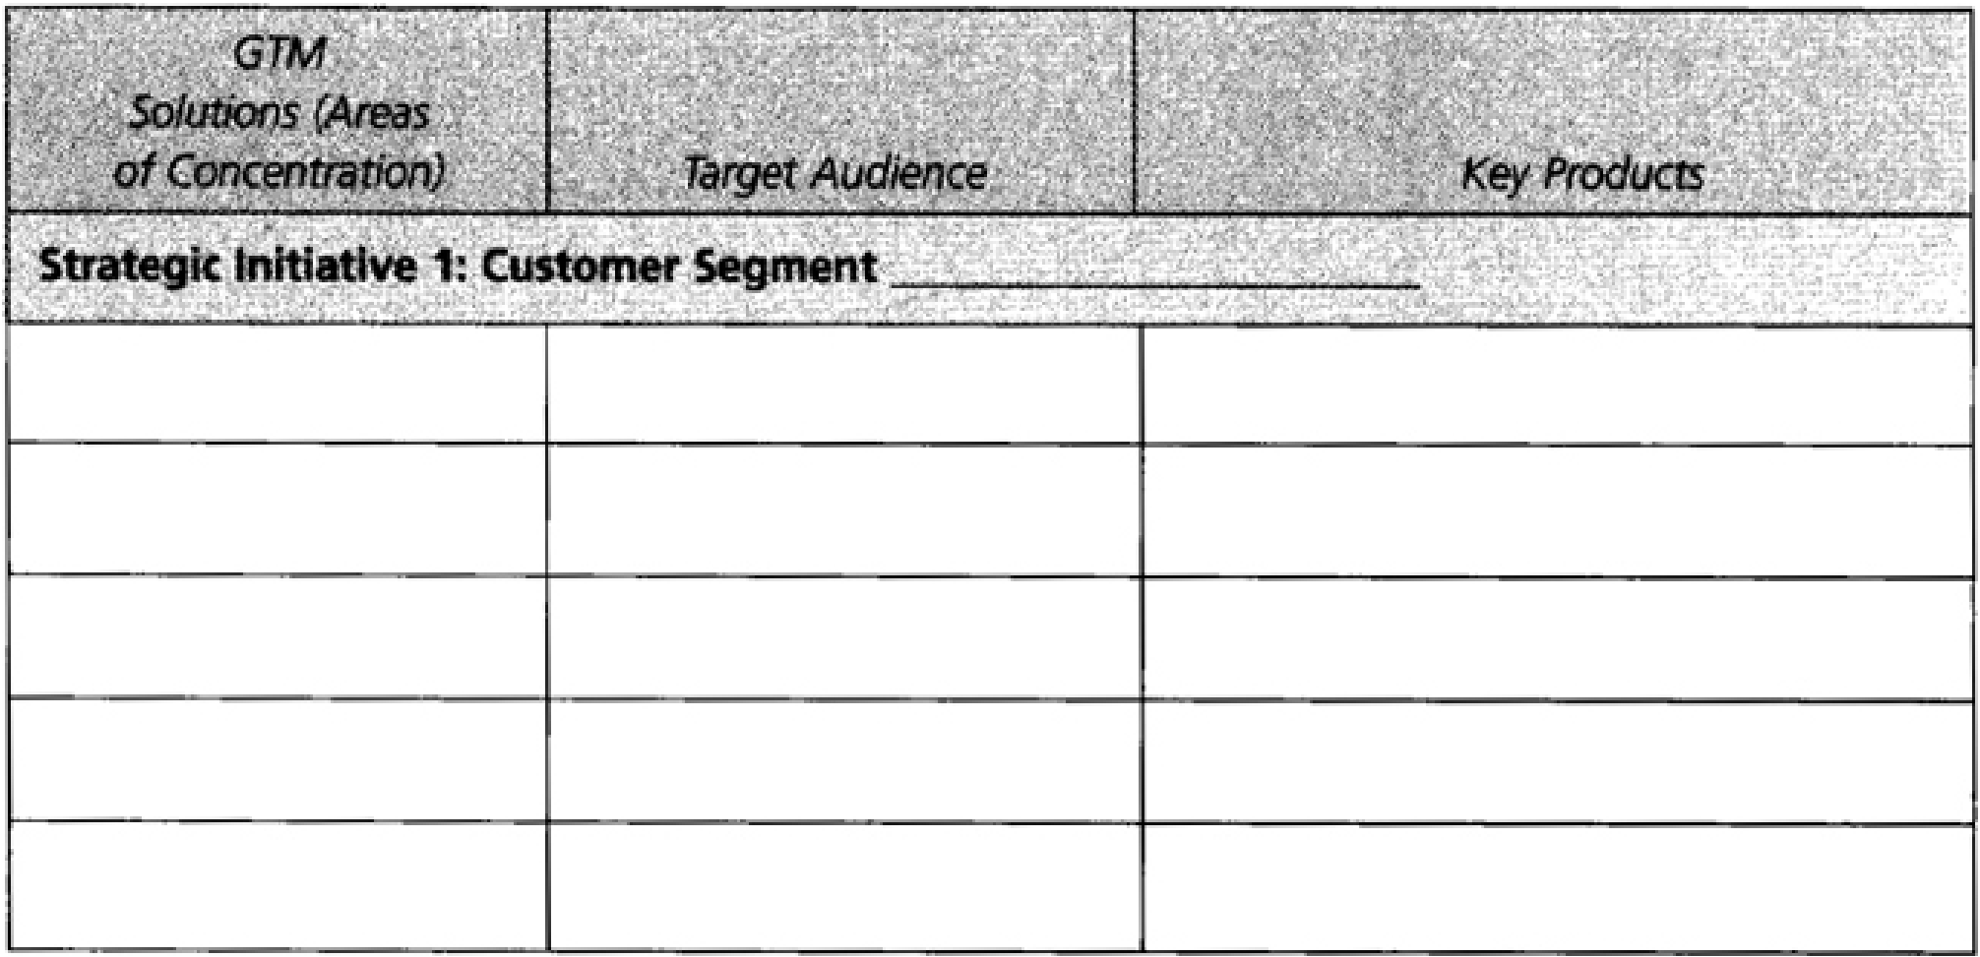
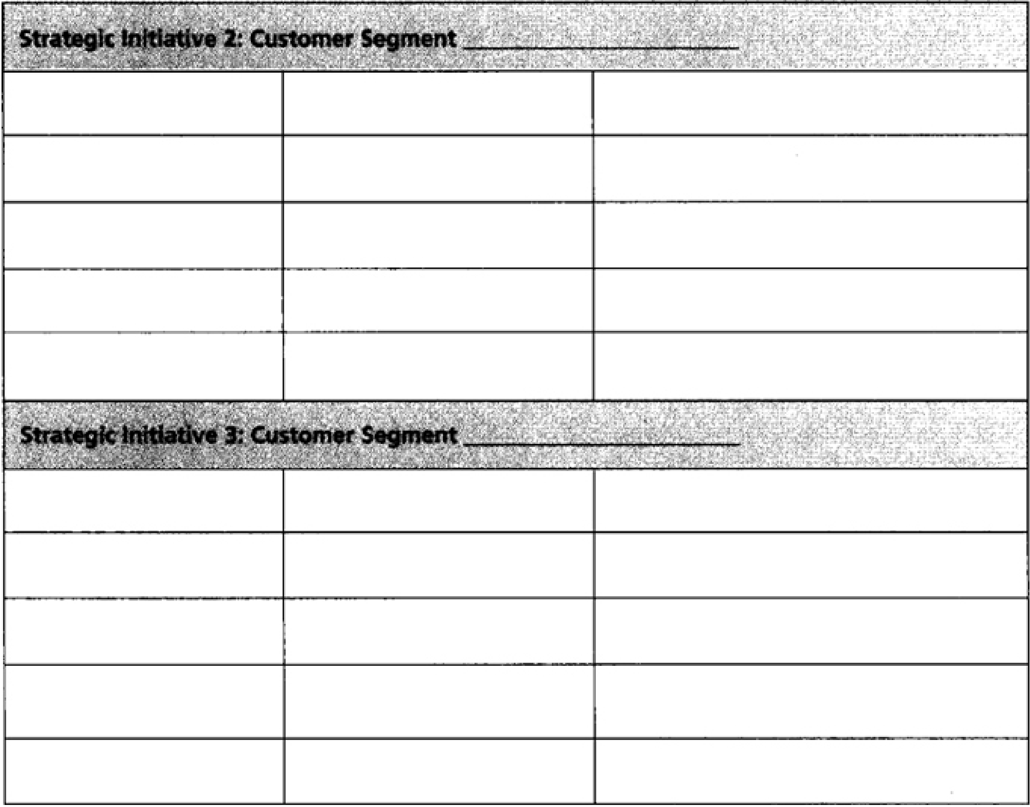

Slide 26
Pioneers and Followers—Competitive Tactics, Environment, and Firm Growth
A form of corporate entrepreneurship called market pioneering occurs when a firm is first to offer a new product/service on the market.
The connection between market pioneering and firm performance focused primarily on:
(1) pioneering as an environment specific phenomenon, and
(2) firm's performance
(3) fit between a firm's pioneer/follower status and its competitive tactics.
These phenomena are explored, emphasizing how they are manifested in different industry environments and what pioneers and followers do differently to promote their performance.
A theory that describes how specific competitive tactics relate to firm sales growth rate among market pioneers and market followers is developed in two distinct environmental settings: hostile and benign.

Slide 27
To test two proposed hypotheses, data is collected from senior managers of 103 independent, non-diversified manufacturing firms in 75 industries.
The main analytical techniques used to assess the data are: cluster analysis, ANOVA, and correlational analysis. The findings suggest that market pioneers grow at the same rate as market followers.
In hostile environments, pioneering may enable firms to break out of the dominant price-based mode of competition and grow despite charging high prices.
Pioneers in hostile environments are better served than followers from a wide geographical distribution of their products.
It is recommended that followers in hostile environments reduce their cost structures in order to maintain low price strategies.
The results also suggest that, in benign environments, offering products with warranties superior to those of competitors may have positive effects on sales growth, more so among pioneers than followers.

Slide 28
Recap
Value solution
Key drivers that are integral to buyers' demands
Market –to-Market connection tool
Perceptual Map
Assessing a Competitor's Will
Go-to-market strategy
Pioneering market
Pioneering firms
Followers firms

Slide 29
Summary
1. Learn how to develop your value solution based on your overall strategy
• Consider defining your value solution along the similar categories of value and cost-benefits of customer productivity, simplicity, convenience, price, and image.
• You can then further develop your value solution and identify ways you can locate and communicate with your customers, as well as where your market would look to find information related to your business.
2. Understand the key drivers that are integral to buyers' demands and expectations within your industry
• As customers' needs and preferences change, your firm will need to take a proactive approach in understanding how these changes influence the overall operations and efficiencies of your business.
• To uncover and reveal the most important drivers within your industry, you need to engage in questioning and research that not only reveals the important key drivers but also identifies how well your product or service responds to these key drivers over a period of time.

Slide 30
Summary
3. Know how your own value solution is matched and compared against these drivers within your marketplace
• Once the entrepreneur has determined the industry's key drivers, those driver can be assessed based on how well they meet the strategy and unique value solution.
• Table 2 assists you in benchmarking areas where your firm requires attention or where you lack the internal capabilities and resources to meet the needs of the marketplace.
• Knowing these weaknesses will help you craft a revised strategy that focuses on those drivers and that positions you for the next new innovation (perhaps coming from your organization).
4. Learn the value of the perceptual map and how the map is used to maintain and exceed your competition in your industry
• Competitive positioning reveals where your company stands in the eyes of any given group of people through the use of perceptual maps.
• Perceptual maps are useful whenever a business decision requires knowledge of how people perceive issues and when the success of company policy or action requires a desired response.

Slide 31
Summary
5. Learn how to develop and gain an appreciation for a “go-to-market” strategy that is based on your value solution, the drivers in the industry, and your competitive positioning
• A full “go-to-market” strategy encompasses the channels that a company uses to connect
with its customers and the organizational processes it develops to guide customer interactions from initial contact through fulfillment.
• The right go-to-market strategy has a significant impact on a company's ability to cost-effectively deliver its value solution to each of its target segments.
• As companies tailor their value solutions to better address customer needs beyond product specifications and to better align their cost of sales and fulfillment relative to those needs, go-to-market strategy plays a central role.

Slide 32



Thank You

