Slide 1


DIGITAL MEDIA ETHICS
DGM 723
Prepared by:
Dr. Sherihan Mohamed
Lecture 5

Slide 2



DMG 723
DIGITAL MEDIA ETHICS
Chapter 3
Copying and Distributing via Digital Media
Prepared by:
Dr. Sherihan Mohamed

Slide 3

Lecture 4
Remember:
** Introduction
** What Do You Know About Copying & Distributing?
** How Copyrighting Works.
** The Ethics Of Copying.
** Ai's Impact On Copyright.

Slide 4
Lecture 5
Outlines:
** What do we mean with copyleft?
- Copyleft and open sources.
- What is the Public copyright?
** Other Copyleft Applications:
- Creative commons.
- Public domain.

Slide 5

Lecture 5
What do we mean with Copyleft?

Slide 6
What do we mean with Copyleft?
Lecture 5
To understand Copyleft we have to know first about Open Source:
Let's examine what open source means. All open source licenses, by the Open Source Initiative's definition must, among other things, allow distribution in source form. Anyone who receives open source software has the right to inspect and modify the code.

Slide 7
Open source components have changed the way we develop software.
Ready-made libraries from the open source community enable busy developers to focus on creating the secret sauce needed to release the new and exciting software products of tomorrow, today.

Slide 8
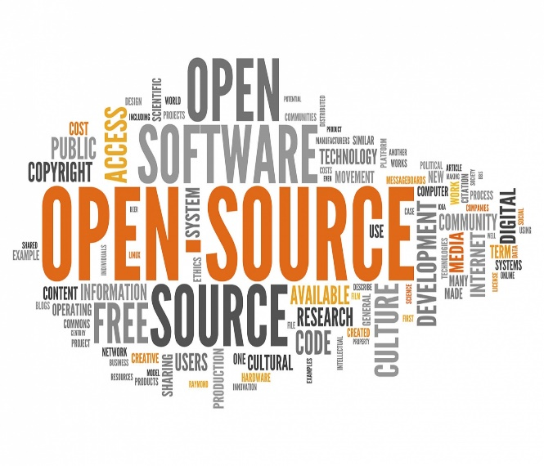
What do we mean with Copyleft?
Lecture 5
Downloading An Open Source Component DOESN’T require your credit card number, BUT the open source license attached to the component does demand you abide by certain terms and conditions. Especially when it’s an open source copyleft license.

Slide 9

In answer to the current copyright challenges, open licensing movements have risen in recent years, with a significant impulse from the open software communities.
So, What Is The Public Copyright?

Slide 10
What do we mean with Copyleft?
Lecture 5
A public license or public copyright license is a license by which a copyright holder as licensor can grant additional copyright permissions to any and all persons in the general public as licensees.
Open licenses are a novel use of existing copyright law to ensure a work remains freely available fostering openness and the free circulation of knowledge.

Slide 11
An open license is a license agreement that describes the conditions under which the holder of the intellectual property grants the users to perform a variety of uses for his intellectual or artistic works.
Through open licences, authors grant permission for users to reproduce, adapt, or distribute the work, with the accompanying requirement that any resulting copies or adaptations are also bound by the same licensing agreement.

Slide 12
What do we mean with Copyleft?
Lecture 5
Examples of such licences include the GNU General Public License – the first and most widely used software ‘copyleft’ license – and Creative Commons Licenses.
In 1989, Richard Stallman wrote the first version of the GNU-GPL license, unifying similar licenses he used for earlier versions of his programs. Nowadays the GNU-GPL licence is adopted by a large number of projects and it is at the heart of the free software movement.

Slide 13
Wide adoption of this licence is partly due to historical reasons (it’s the licence created by Richard Stallman, the founder of the Free Software Movement) but also to practical reasons:
* the engineering of this license favoured for the spreading of free software.
* In fact, the GNU-GPL provides that the user is allowed to modify and redistribute software licensed under this licence provided that the modified version is in turn licensed under the terms of the same licence.

Slide 14
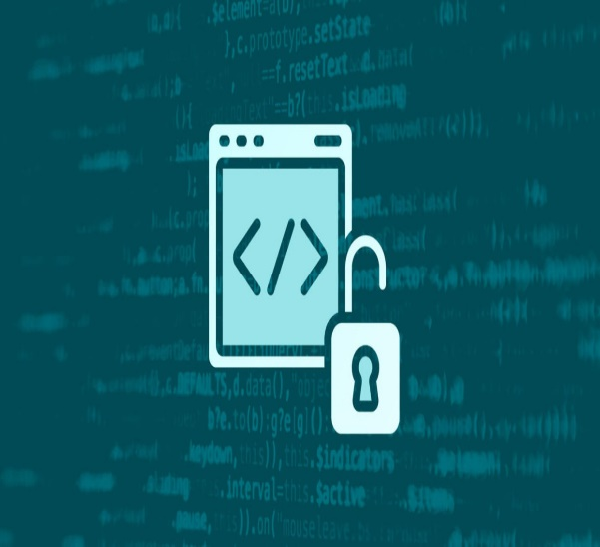
What do we mean with Copyleft?
Lecture 5
To put it briefly, open licences foster sharing: whoever wants to modify the content and distribute it (or, sometimes, allow its remote use) can do so provided that he in turn gives the users the same freedoms that were granted to him.

Slide 15
Lecture 5
Other Copyleft Application

Slide 16
Common practice for using copyleft is to codify the copying terms for a work with a license. Any such license typically includes all the provisions and principles of copyleft inside the license's terms.
This includes the freedom to use the work, study the work, copy and share the work with others, modify the work, and distribute exact or modified versions of that work, with or without a fee.

Slide 17
Other Copyleft Application
Lecture 5
Unlike similar permissive licenses that also grant these freedoms, copyleft licenses also ensure that any modified versions of a work covered by a copyleft license must also grant these freedoms.
Thus, copyleft licenses have conditions: that modifications of any work licensed under a copyleft license must be distributed under a compatible copyleft scheme and that the distributed modified work must include a means of modifying the work.

Slide 18
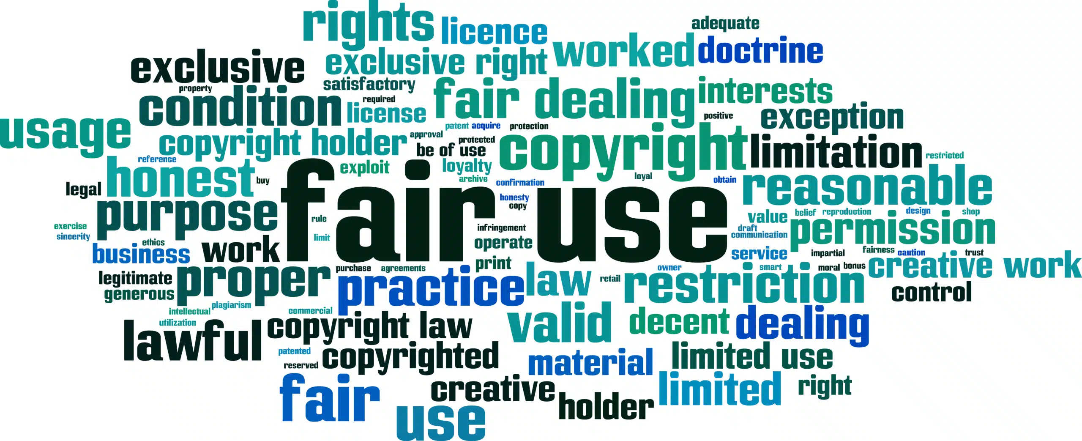
Under fair use, however, copyleft licenses may be superseded, just like regular copyrights. Therefore, any person utilizing a source licensed under a copyleft license for works they invent is free to choose any other license (or none at all) provided they meet the fair use standard.

Slide 19
Other Copyleft Application
Lecture 5
Copyleft licenses necessarily make creative use of relevant rules and laws to enforce their provisions.
For example, when using copyright law, those who contribute to a work under copyleft usually must gain, defer, or assign copyright holder status.
By submitting the copyright of their contributions under a copyleft license, they deliberately give up some of the rights that normally follow from copyright, including the right to be the unique distributor of copies of the work.

Slide 20
Some laws used for copyleft licenses vary from one country to another, and may also be granted in terms that vary from country to country.
For example, in some countries, it is acceptable to sell a software product without warranty, in standard GNU General Public License style, while in most European countries it is not permitted for a software distributor to waive all warranties regarding a sold product.

Slide 21
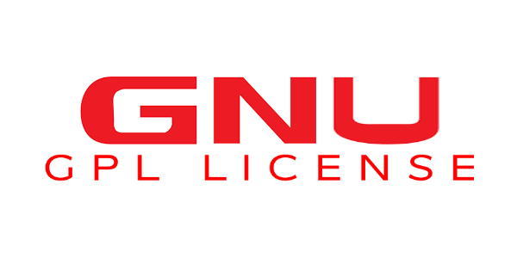
Other Copyleft Application
Lecture 5
For this reason, the extent of such warranties is specified in most European copyleft licenses, for example, the European Union Public Licence (EUPL), or the CeCILL license, a license that allows one to use GNU GPL in combination with a limited warranty.

Slide 22
Creative Commons (CC): is a project building a new and more flexible paradigm for copyright.
CC develops standardised copyright licences and other (optional) technical tools to assist authors wanting to share some of their rights with users and fellow authors in a way that is easy, flexible and legally rigorous.
Creative Commons licences were originally designed for sharing creative works. They may apply to all types of works (scientific or not).

Slide 23
Other Copyleft Application
Lecture 5
CC licences protect the people who use or redistribute an author’s work from concerns of copyright infringement as long as they abide by the conditions that are specified in the licence by which the author distributes the work.
Such licences all grant the ‘baseline rights’, such as the right to distribute the copyrighted work worldwide for non-commercial purposes, and without modification.

Slide 24
There are different CC licences, some more permissive than others. Some types of licences are particularly broad: the public domain dedication mark such as CC0 (‘No Rights Reserved’) or PDM (‘No Known Copyright’), the licence CC-BY (‘Attribution’) or the licence CC-BY-SA (‘Attribution/ShareAlike’).

Slide 25
Other Copyleft Application
Lecture 5
Public Domain: ‘The term public domain refers to creative materials that are not protected by intellectual property laws such as copyright, trademark, or patent laws.
The public owns these works, not an individual author or artist. Anyone can use a public domain work without obtaining permission, but no one can ever own it (Stim 2010)

Slide 26
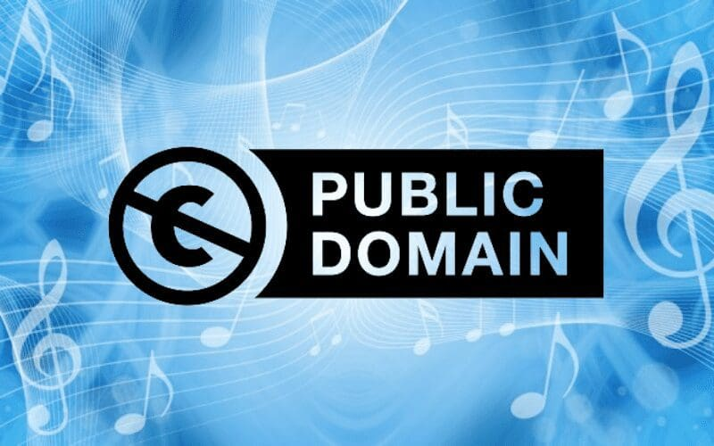
Eventually all original works enter the Public Domain at some point, namely when their copyright protection expires, but it tends to take a long time – in most jurisdictions this happens at least 70 years after the author’s death!

Slide 27

Other Copyleft Application
Lecture 5
The public domain consists of elements that are not protected by themselves, whatever the circumstances of their use. The public domain, by its nature, can be used freely because it is based on the principle that there is no exclusive right in it.

Slide 28
The Public Domain Mark (PDM), developed by Creative Commons, is a symbol used to indicate that a work is free of known copyright restrictions and therefore in the public domain.
The PDM is intended for use with old works that are free of copyright restrictions around the world, or works that have been affirmatively placed in the worldwide public domain prior to the expiration of copyright by the rights’ holder. It should not be used to mark works that are in the public domain in some jurisdictions while known to be restricted by copyright in others.

Slide 29

Other Copyleft Application
Lecture 5
Nonetheless, copyright holders might want to dedicate their works to the public domain at any point. In order to do so, they need to explicitly state that they do not wish to reserve any of their intellectual property rights over a given work, something that can be done for instance, by making use of the CC0 tool.

Slide 30
Using CC0, you can waive all copyrights and related or neighbouring rights that you may have in all jurisdictions worldwide, such as your moral rights (to the extent waivable), your publicity or privacy rights, rights you have protecting against unfair competition, and database rights and rights protecting the extraction, dissemination and reuse of data.

Slide 31

Other Copyleft Application
Lecture 5
‘In contrast to CC’s licenses that allow copyright holders to choose from a range of permissions while retaining their copyright, CC0 empowers yet another choice altogether – the choice to opt out of copyright and database protection, and the exclusive rights automatically granted to creators – the ‘no rights reserved’ alternative to our licenses’.

Slide 32
For instance, you may find datasets contributed by researchers to the worldwide Public Domain at Figshare.
Another example is PixaBay; a repository of high quality photographs and illustrations that only contains public domain content released under CC0. While users can give credit, and even donations, to the authors of content, this is not required.

Slide 33

Other Copyleft Application
Lecture 5
Rather than thinking of open and closed as binary concepts, it is more appropriate to see them as the two ends of a wide continuum that can include different levels of openness (or closedness).
That is, resources can be more or less open depending on the rights reserved by their authors, being Public Domain is the most open possible option.

Slide 34
Territorial public domain: The status of an intellectual resource depends on the law applicable to it. National laws provide a rule for determining the applicable law in the field of copyright, that the enjoyment and exercise of copyright is “not linked to the existence of protection in the country of origin of the work” and that “the scope of protection as well as the remedies are exclusively governed by the laws of the country in which protection is sought.” guaranteed to the author to protect his rights”

Slide 35

Other Copyleft Application
Lecture 5
Where there is subject matter to which these agreements apply, the law applicable to the existence of copyright is the law of the place of protection. This rule of applicable law, inherent to the fundamental principle of territoriality in copyright.

Slide 36

Idea/expression or existential public domain: A major dividing line between the subject matter of copyright and the public domain lies in the so-called principle of separation of idea and expression. This principle means that only forms of creative expression deserve protection, leaving everyone free to benefit from the same ideas or information

Slide 37
Other Copyleft Application
Lecture 5
Ideas can still be protected by confidentiality and non-disclosure but “as soon as an author discloses his work to the public, any ideas contained in the work are thus relinquished to the public domain, and the author must be content to retain only control over the form in which he initially expressed these ideas.”
Such control, more than a boundary separating the protected copyright domain from the unprotected public domain, is also a criterion for identifying potential copyright infringement, given that copying only an expression, not copying an idea, constitutes copyright infringement.

Slide 38
The political public domain: The public domain is also enriched by elements that are expressly excluded from the field of protection. These exclusions relate to intellectual creations that ostensibly may be eligible for copyright protection, but the legislator has decided to strip them of their eligibility for protection for reasons of public or public interest. These exclusions constitute what might be called the political public domain.

Slide 39
Other Copyleft Application
Lecture 5
Official editors: In the field of copyright, a traditional exclusion from protection concerns official texts of a legislative, administrative or legal nature, as well as official translations of these texts.
Daily News: The second exclusion, this time mandatory, relates to "daily news or miscellaneous facts that are merely press information items.“ Information, abstract facts and news are not, by their very nature, worthy of protection by copyright, thus relegating them to the existential public domain.

Slide 40

Other Copyleft Application
Lecture 5
Other exclusions: Other countries consider that works whose authors pass away without heirs are in the public domain.
There are countries that place works confiscated by the state in the public domain, unless the law specifies a beneficiary to enjoy protection in these works.
Others exclude from copyright protection works that contain material plagiarized from other authors.

Slide 41
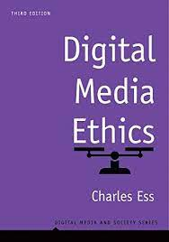

Digital Media Ethics (Digital Media and Society Series), 3rd Edition, by Charles Ess
Intro
Recommended Reference

Slide 42
Lecture 5
Outlines:
** What do we mean with copyleft?
- Copyleft and open sources.
- What is the Public copyright?
** Other Copyleft Applications:
- Creative commons.
- Public domain.

Slide 43



Thank You

Slide 44
DIGITAL MEDIA ETHICS
Lecture 5
DMG 723
Prepared by:
Dr. Sherihan Mohamed

