Slide 1


Project Leadership
Prepared by Dr. Ehab Mahmoud

Slide 2



Project Leadership
Lecture 5
Prioritization: The Core of Project Leadership
PMG 511
Master in Project Management
Prepared by
Dr. Ehab Mahmoud
www.midocean.ae

Slide 3

Chapter
Learning Outcomes
05
Why is Prioritization So Essential?
Estimation Methods
Estimates vs. Commitments
Accuracy and Precision
Project Scheduling
Project Tracking
Prioritizing Stakeholders
Summary and Conclusion
www.midocean.ae

Slide 4
Chapter
What is a Project Prioritization?
05
Project prioritization is the foundation for successfully implementing projects. It's where you align your projects to strategy. It's where you win executive sponsorship and support. It's where you identify and eliminate waste.
Poor prioritization leads to project failure and, ultimately, missed business goals.
Done well, a good project prioritization process will allow the leader to strategically align resource allocation and decisions while delivering more successful projects.
www.midocean.ae

Slide 5

Chapter
What is Prioritization?
05
Prioritization is a process where you work out which projects are the most important so that you can focus your resources on successfully delivering those value-added projects.
www.midocean.ae

Slide 6
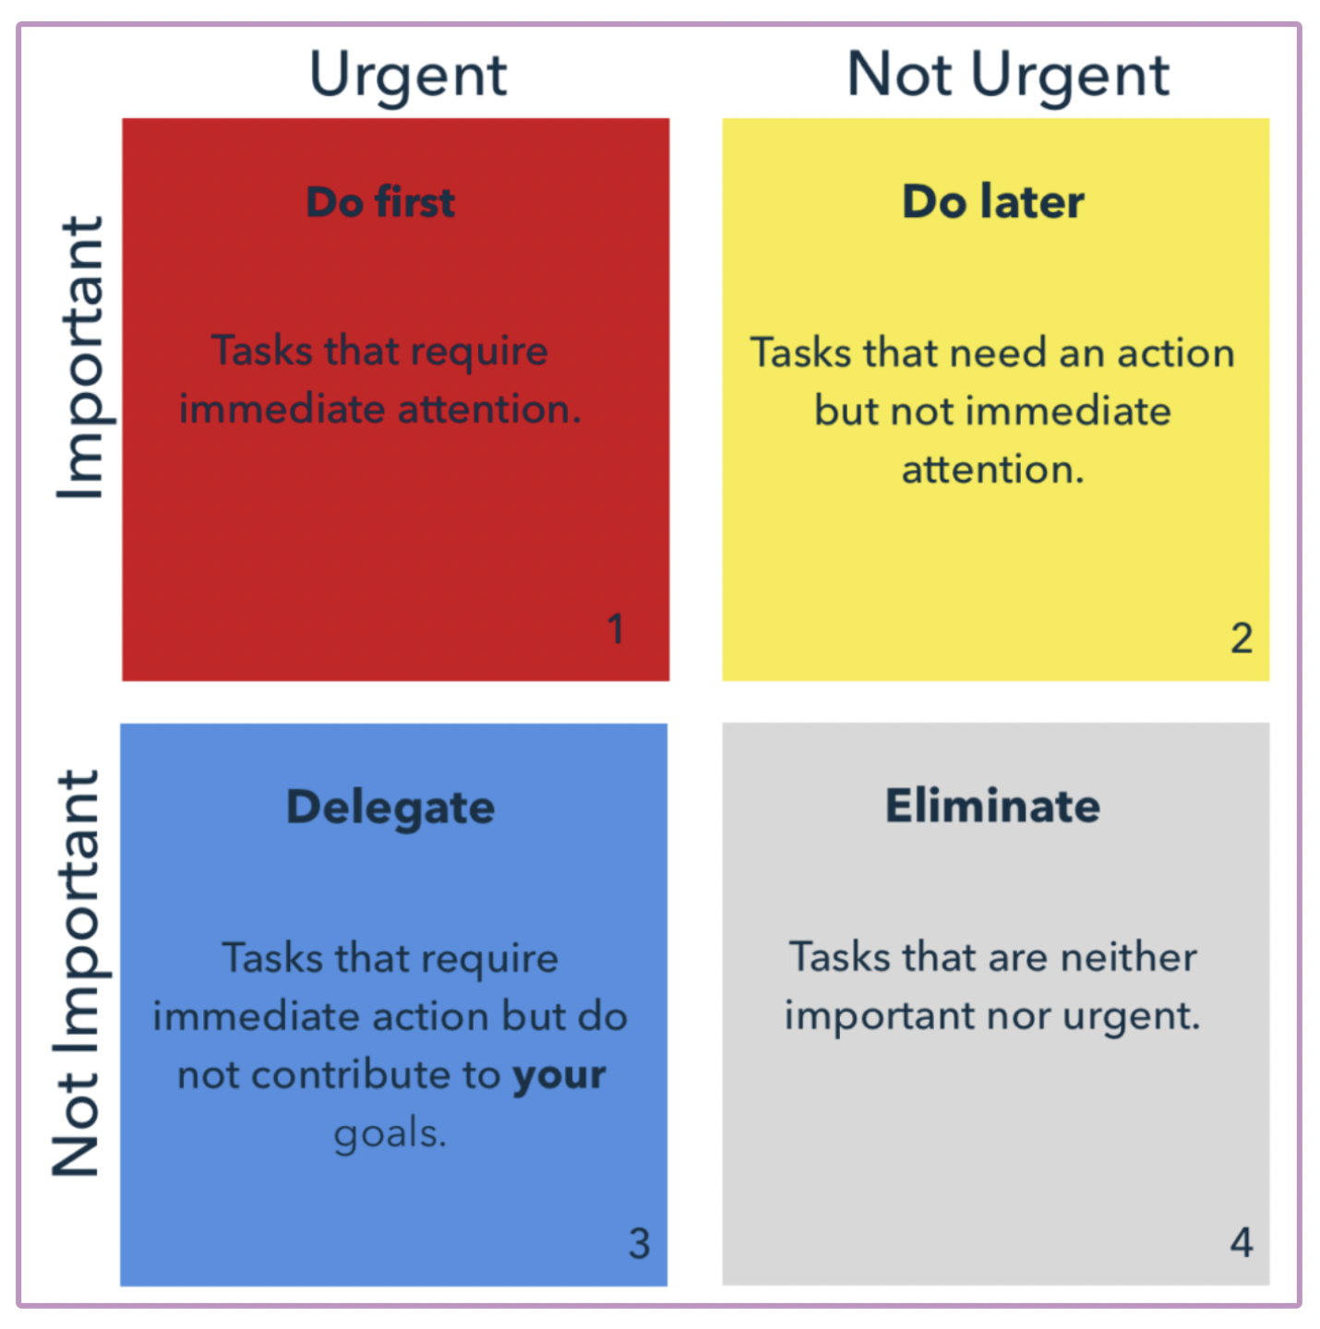
Chapter
The Eisenhower Matrix
05
www.midocean.ae

Slide 7

Chapter
05
When thinking about prioritization it is important to address these six aspects:
1. Who wants the work to be done?
2. When do they want the delivery of the work?
3. Why does it fit there?
4. What do they want to be done?
5. Where does the work fit in the schedule?
6. How will this work impact the deadlines for other work?
www.midocean.ae

Slide 8

Chapter
05
Think about that (to Prioritize your project work):
Grab your pen and paper and think about projects you need to prioritize their work.
www.midocean.ae

Slide 9
Chapter
Reasons to Prioritize a Project
05
Effort concentration:
Focus on time and resource.
Costs:
- The right investment in the adequate product/service.
- Better financial management.
Strategy:
- Direct link to the strategic plan.
- Increase in strategic alignment (business objective).
www.midocean.ae

Slide 10
Chapter
Leadership Priorities
05
What are the strategic initiatives today, this year and next year?
- Smart leaders understand that their job requires, choosing what not to do as much as what to do.
- leaders often turn to rank ordering their priorities; it is natural and easy to make a list.
www.midocean.ae

Slide 11
Chapter
05
Three interdependent variables that are essential for project prioritization:
Timing
Cost
Resources
www.midocean.ae

Slide 12

Chapter
05
Once a leader decides what resources will be allocated to achieve which objectives over what periods of time, he has no more need for ranking; he will be forced to acknowledging three kinds of priorities: critical, important, and desirable..
www.midocean.ae

Slide 13
Chapter
Planning and Prioritizing Project Work
05
Before work can be completed, three basic steps must take place:
  Planning takes place early in the project, and determines objectives to be completed, resources available, etc.
  Estimating is the process of determining how long or how many resources each planned element will take
  Scheduling is the ‘calendarization’ of estimated work
Once the work begins (execution of plans):
  Tracking must occur, comparing actual results with plans, estimates, and schedules
  If changes occur or results vary from plans, repeat the steps
www.midocean.ae

Slide 14
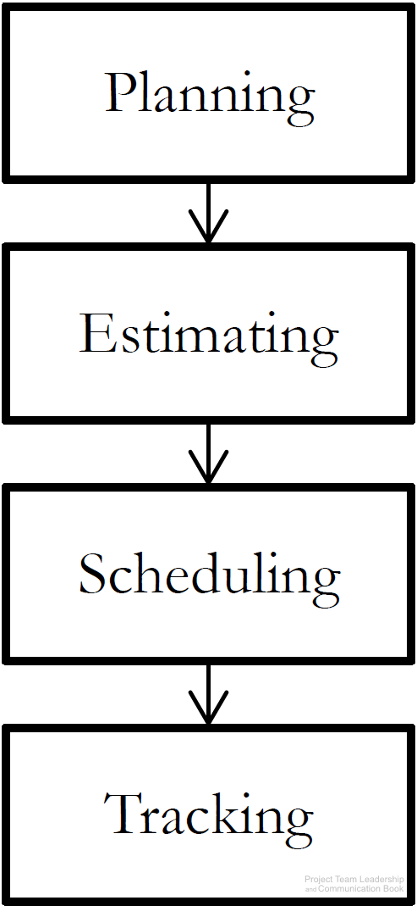
Chapter
Planning Project Work
05
Is devising and maintaining a workable scheme to accomplish the business need via using a formal, approved documents used to guide both project execution and project
www.midocean.ae

Slide 15
Chapter
Elements of a Project Planning Work
05
Interrelates all tasks on a common time scale like:
– Names of the tasks and work packages listed in the WBS (work breakdown structure).
– Names of the persons responsible for each task.
– Expected duration of each task.
– Due date of each task.
www.midocean.ae

Slide 16

Chapter
Estimation Methods
05
Why project leaders need to estimate the scope of work?
Estimating a project’s scope of work means laying out what tasks, deliverables, and dependencies are all built into the project.
This covers all aspects of the project from technical development to catch-ups and calls.
To be more accurate: estimating what the project will actually involve will help you better predict how much it will cost, how long it will take, and what potential roadblocks may slow things down.
www.midocean.ae

Slide 17
Chapter
What is Estimating Project Work?
05
Project estimation means looking through all available data to propose the time, cost, and resources needed to complete a project.
The deliverables of project estimation include:
- Project Timeline.
- Resource Overview.
- Cost Estimates.
- Risks
www.midocean.ae

Slide 18
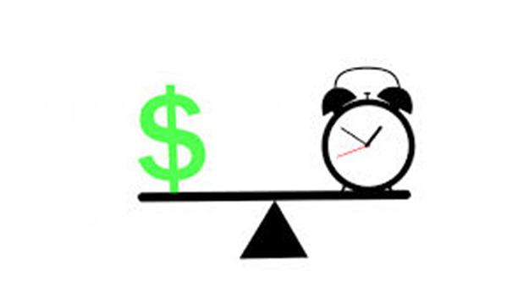
Why Project Leaders Need To Estimate the Project Timeline?
Chapter
05
To find a straightforward timeline covering all aspects of the project and the scope of work.
This should show when different parts of the project start and finish, which parts depend on other parts, and when each milestone will be finished.
www.midocean.ae

Slide 19

Why Project Leaders Need To Estimate the Resource Overview?
Chapter
05
Having a clear scope of work and a timeline will allow you to understand exactly what the project requires when it comes to resources.
A good project estimation will make it clear who will be involved in the project (staff, contractors, vendors, or suppliers), what technical or other resources you will need (manufacturing, printing, shipping, etc.) and how these relate to the overall project.
www.midocean.ae

Slide 20

Why Project Leaders Need To Estimate the Project Cost?
Chapter
05
Looking at the scope of work, timeline, and resource requirements will allow you to accurately forecast the project cost. With all key elements of the project mapped out, you’ll be able to clearly estimate the overall cost range.
Review all historical data related to past project costs. Dig into previous projects for similar clients to compare and adjust as needed. The more accurate data you have, the closer project estimates will be.
www.midocean.ae

Slide 21

Why Project Leaders Need To Estimate the Risk Factors?
Chapter
05
After gaining a complete overview of the project, it’s time to identify the risk factors and potential roadblocks.
This step should cover all aspects of the project including potential roadblocks with resourcing, scope of work difficulties, and budget constraints.
www.midocean.ae

Slide 22
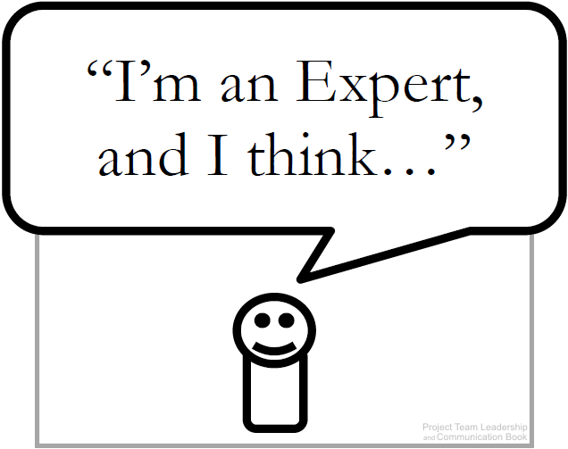

Chapter
Estimation Techniques (1 of 3)
05
1- Expert Judgement: experience is used to estimate
The basis for all other techniques.
Strengths: expert lends credibility to estimate.
Weaknesses: one person’s ‘expertise’ may fail.
2- Group Consensus: various techniques are used to poll the group and reach consensus.
Strengths: group participation and ‘buy-in’.
Weaknesses: bias and cultural issues manifest.
www.midocean.ae

Slide 23
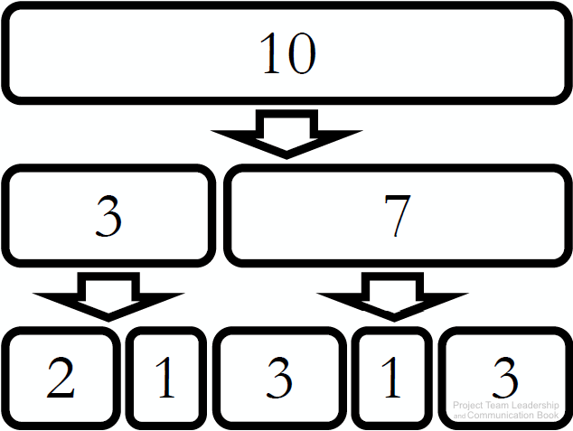
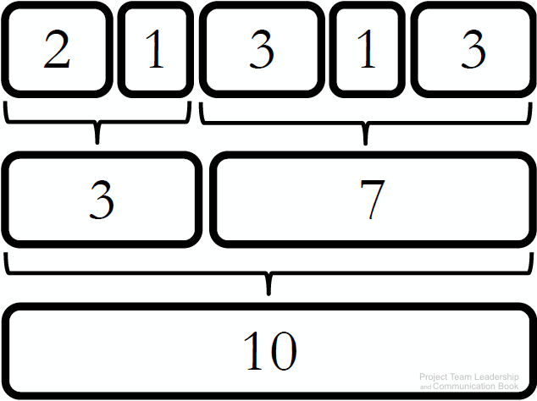
Chapter
Estimation Techniques (2 of 3)
05
3- Top-Down: large units estimated then divided up.
Strengths: usable when less detail is known.
Weaknesses: inaccurate if major sections of the project aren’t considered.
4- Bottom-Up: small units estimated then added together.
Strengths: can be quite precise if used properly.
Weaknesses: more time consuming than other techniques, changes to items can impact greatly.
www.midocean.ae

Slide 24

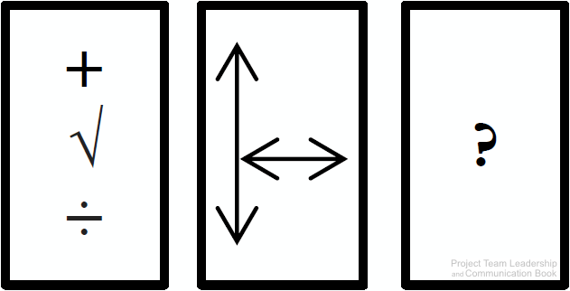
Chapter
Estimation Techniques (3 of 3)
05
5- Comparison or Analogy: projects (or components) are compared to previous work.
Strengths: based on actual results, increasing credibility and potentially accuracy.
Weaknesses: all projects are unique, may be difficult to find comparisons, data may not exist.
Other Methods: mathematical/statistical models, focusing on size rather than time, or industry-specific methods.
www.midocean.ae

Slide 25
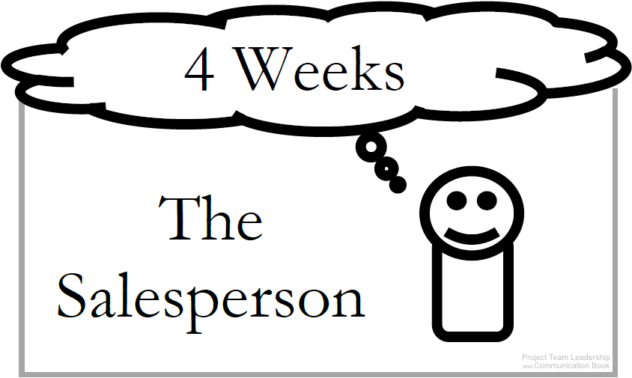
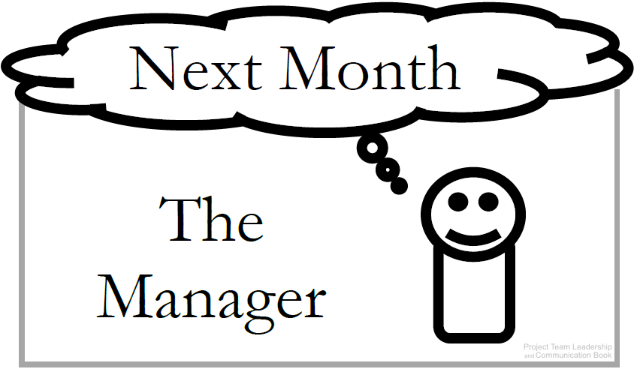
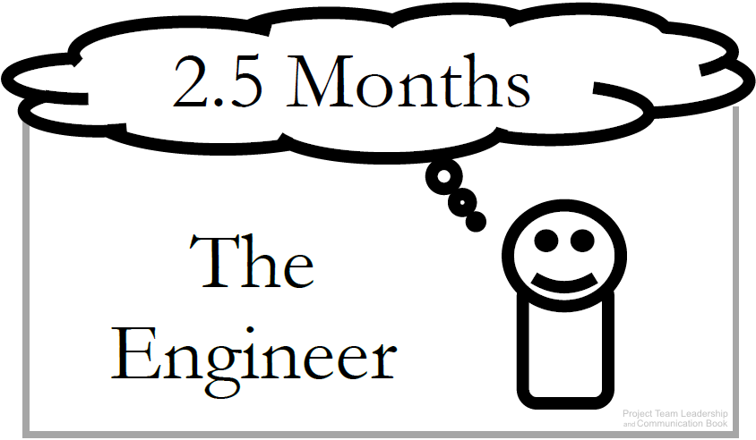
Chapter
Estimates vs. Commitments
05
All parties must be careful not to confuse estimates with commitments
Commitments: Are deadlines ‘real’ or arbitrary?
Estimates: Presentation can be important: Ranges (6-8 Months), plus/minus qualifiers (7 Weeks +/– 1 Week), and Confidence factors (4 weeks: 30% chance, 5 weeks: 50% chance) can be helpful.
Don’t confuse estimation with scheduling, which sets actual dates
www.midocean.ae

Slide 26
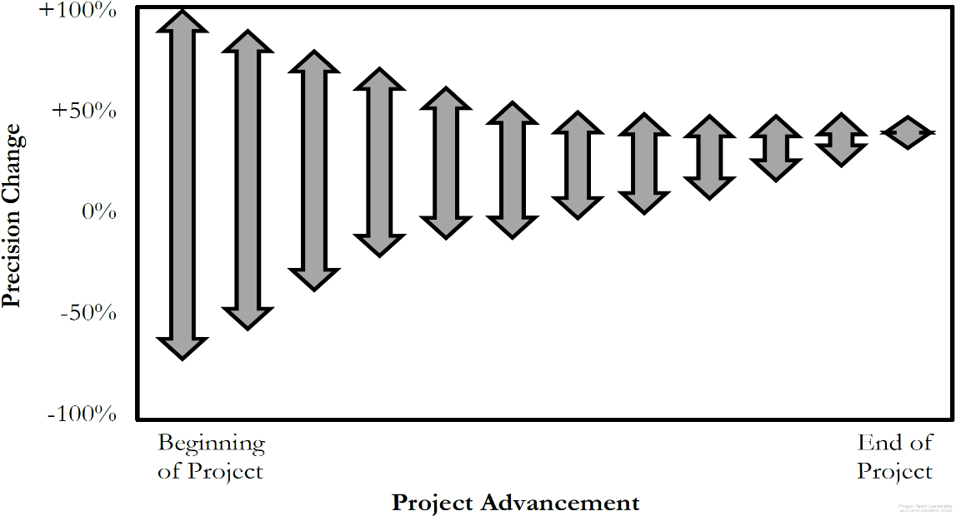
Chapter
Accuracy vs. Precision
05
Accuracy is how true a value is
  ‘4-6’ is accurate if the actual # is 5.5
Precision is how exact a value is
  ‘4-6’ is less precise than ‘4.5-5.5’
Within a project communications
should always be as accurate as
possible (especially in estimating)
Because uncertainty is high at the beginning of a project, the only way to be accurate is to be less precise.
As the project progresses, we can be more precise while remaining accurate (ranges get smaller and smaller)
www.midocean.ae

Slide 27
Chapter
Project Scheduling
05
In project management, a schedule is a listing of a project milestone activities, and deliverables, usually intended start and finish dates.
www.midocean.ae

Slide 28
Organizing Tasks: The Work Breakdown Structure (WBS)
Chapter
05
A Work Breakdown Structure (WBS) is a deliverable-oriented hierarchical decomposition of the work to be executed by the project team to accomplish the project objectives and create the required deliverables.
A WBS is the cornerstone of effective project planning, execution, controlling, monitoring, and reporting.
www.midocean.ae

Slide 29
Chapter
The Work Breakdown Structure (WBS)
05
A good WBS should exhibit the following characteristics:
Definable—can be described and easily understood by project participants.
Manageable—a meaningful unit of work where specific responsibility and authority can be assigned to a responsible individual.
Estimateable—duration can be estimated in time required to complete, and cost can be estimated in resources required to complete.
Independent—minimum interface with or dependence on other ongoing elements (i.e., assignable to a single control account, and clearly distinguishable from other work packages).
Integratable—integrates with other project work elements and with higher level cost estimates and schedules to include the entire project.
Measurable—can be used to measure progress; has start and completion dates and measurable interim milestones.
Adaptable—sufficiently flexible so the addition/elimination of work scope can be readily accommodated in the WBS framework.
www.midocean.ae

Slide 30
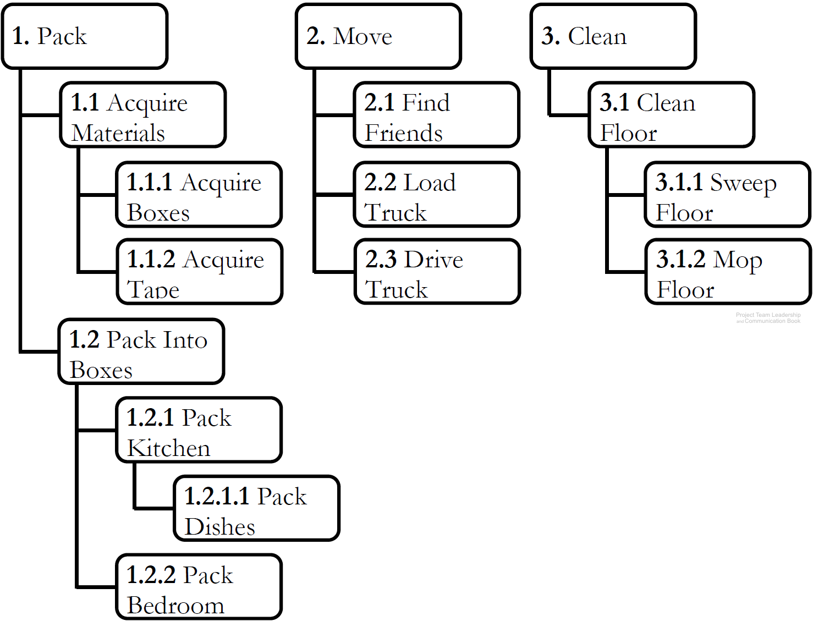
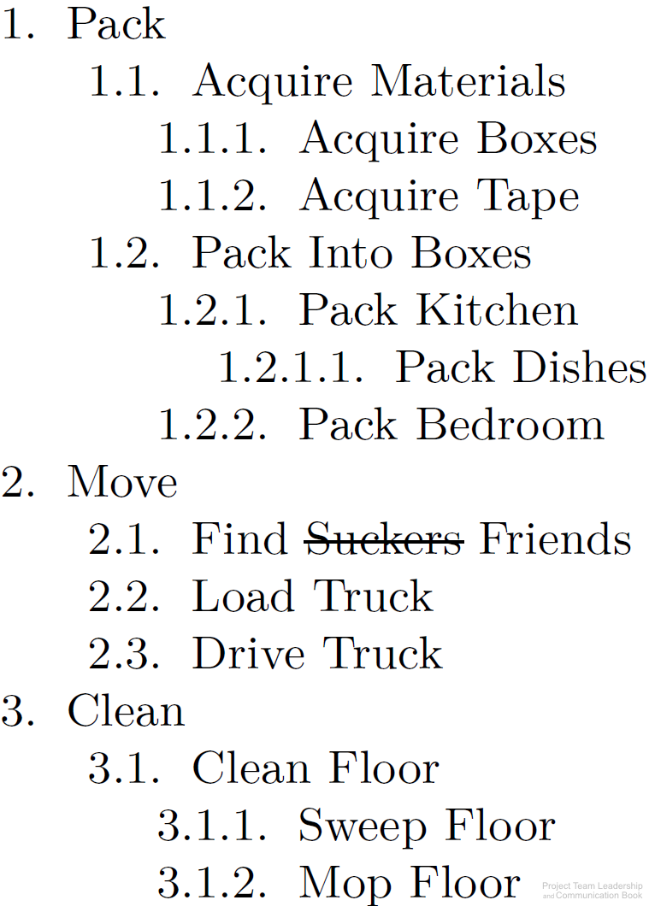
Chapter
The Work Breakdown Structure (WBS)
05
Organizes elements with ‘sub-
numbers.’ 1.2.3 is part of 1.2
Two types: product & process
  Product divides by components
  Process divides by activities/tasks
Can be built ‘top down,’
‘bottom-up,’ or ‘rolling-wave’
A good way to organize brain-
storming efforts early in the project
Sequencing of tasks or components
isn’t needed until later in scheduling efforts
www.midocean.ae

Slide 31
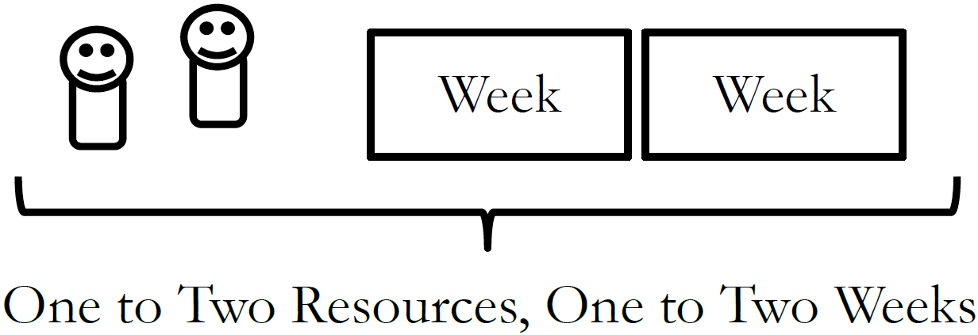
Chapter
The One-to-Two Rule
05
How do you know when you’ve divided tasks into small enough ‘chunks’?
If tasks are too large, it becomes difficult to track progress
If tasks are too small, time is wasted micromanaging the project
Optimize with ‘The One-to-Two Rule,’
which states that tasks have been
divided enough when each requires
1-2 resources 1-2 weeks to complete it
www.midocean.ae

Slide 32
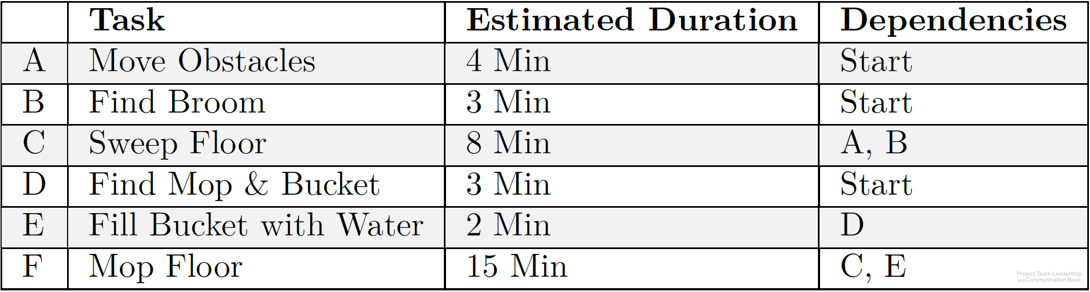
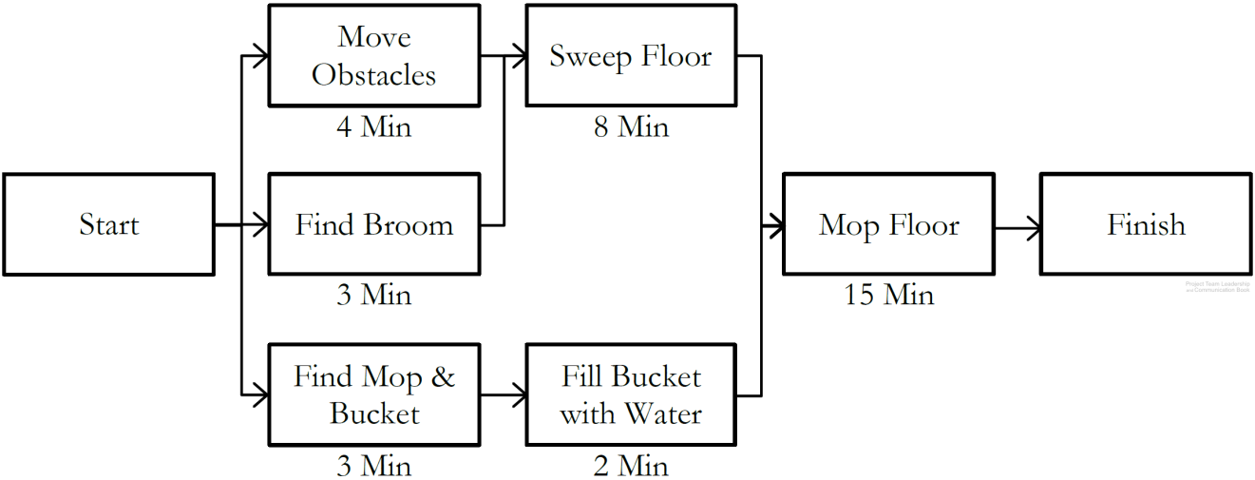
Chapter
Sequencing and Scheduling Tasks
05
Predecessors or dependencies are determined for all tasks
Using this information, a precedence diagram is created
  The longest path, called the critical path, determines project length.
  Slack time, the ability to delay starting without impacting the schedule, is available to some tasks which are not on the critical path
Tasks are then ‘calendarized,’ with actual dates based on resources available.
www.midocean.ae

Slide 33
Chapter
Activity – Organizing and Sequencing Tasks
05
Consider the following scenario:
One of your best friends is graduating from college and you’ve decided to throw her a big party. Her parents have volunteered to let you decorate and hold the event at their house, the food is to be catered, and you would like to invite as many of her friends and family as you can.
Create a basic work breakdown structure, listing 15 planning activities that must take place
After determining which activities must occur before others, create a precedence diagram with the activities and tasks outlined in your work breakdown structure
www.midocean.ae

Slide 34
Chapter
Project Tracking
05
A combination of cost and time tracking will let you finish tasks earlier, delay non-critical tasks for the same of keeping to the project baseline, and find ways for reducing costs and the project scope.
www.midocean.ae

Slide 35

Chapter
Project Tracking
05
To succeed in delivering your project, you will need to get an understanding of how to track your project and what items need to be monitored.
Track time and cost
Track human resources
Track team progress and efficiency
Track risks, changes, issues
Track project health
www.midocean.ae

Slide 36
Chapter
Tracking Progress
05
A main concern of project tracking is visibility. Often, the team isn’t aware of how far along they are due to long phases
Project Visibility is often only achieved when phases are started or completed
www.midocean.ae

Slide 37
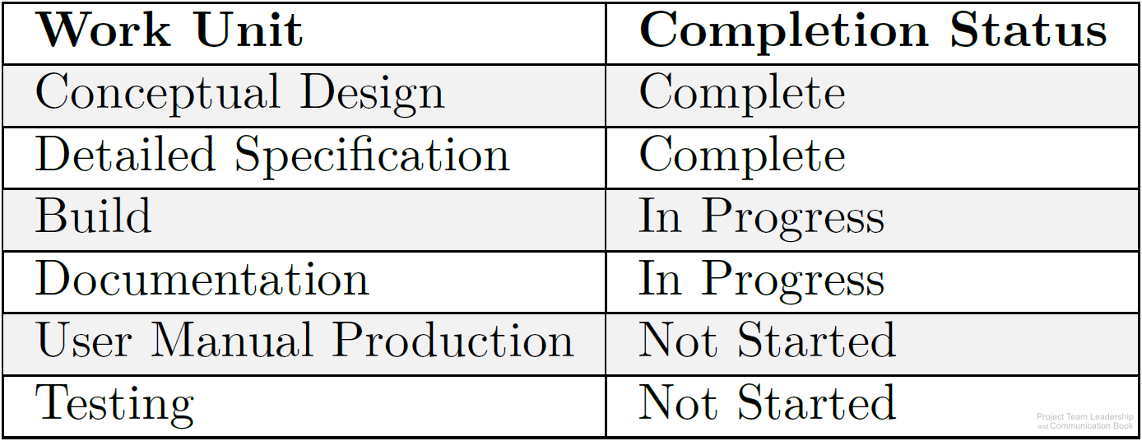
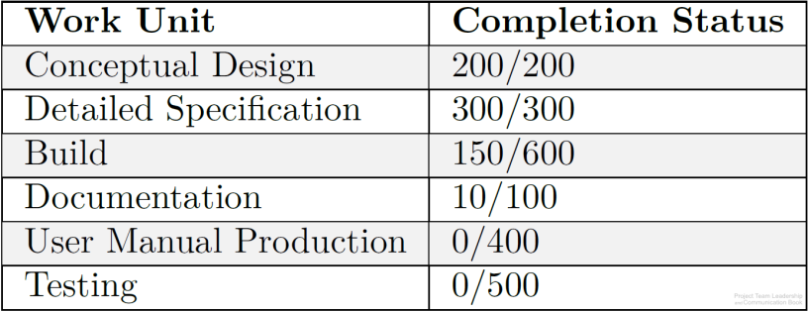
Chapter
Tracking Earned Value
05
Tasks or groups of tasks are often tracked with little granularity (large chunks instead of small) and simple not-started / started / complete progress reporting
By giving each task a relative weight and assigning earned value to sub-tasks, the percentage of progress can be calculated (example: 660/2100=31% complete)
Calculated earned value can be compared to the time or resources expended
www.midocean.ae

Slide 38
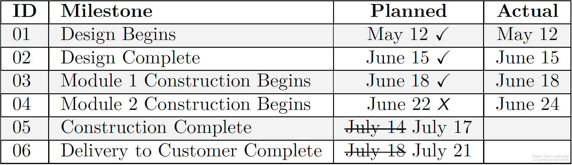
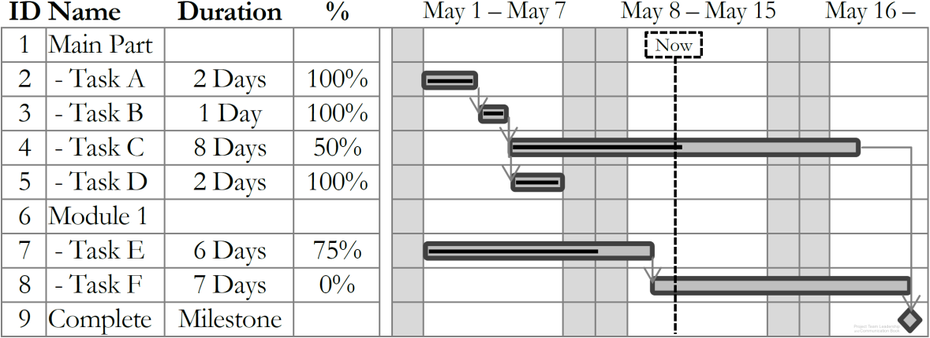
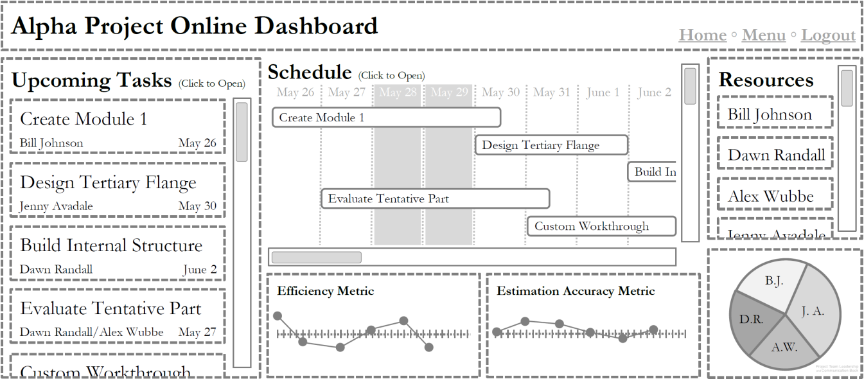
Chapter
Scheduling/Tracking Tools and Visualizations
05
Milestone Charts list major points in time, or milestones, such as phases ending
Gantt Charts provide an easy-to-understand visualization of the schedule and progress
Many software packages and online tools are specifically designed for managing projects
www.midocean.ae

Slide 39
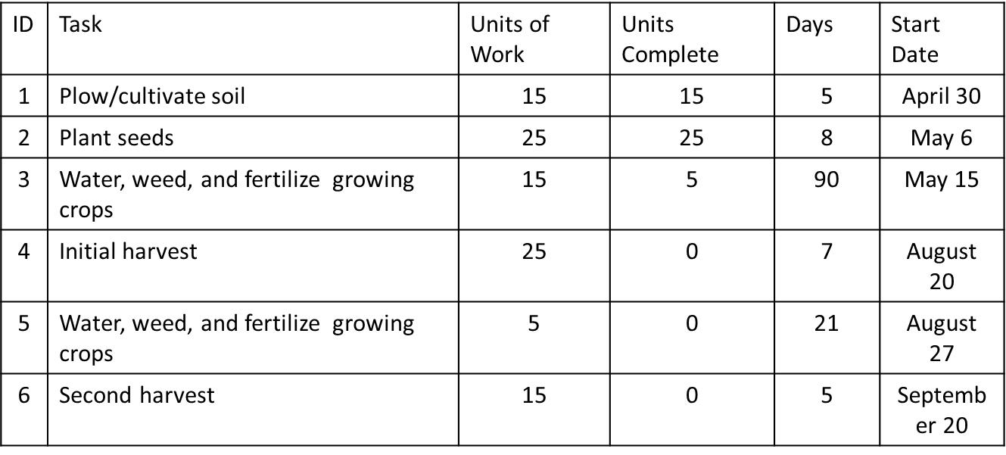
Chapter
Activity – Tracking Project Progress
05
Examine the following project status information:
Calculate the percentage complete, or earned value
Using a whiteboard or application, create a basic Gantt chart. Estimate the total time elapsed for the project
www.midocean.ae

Slide 40
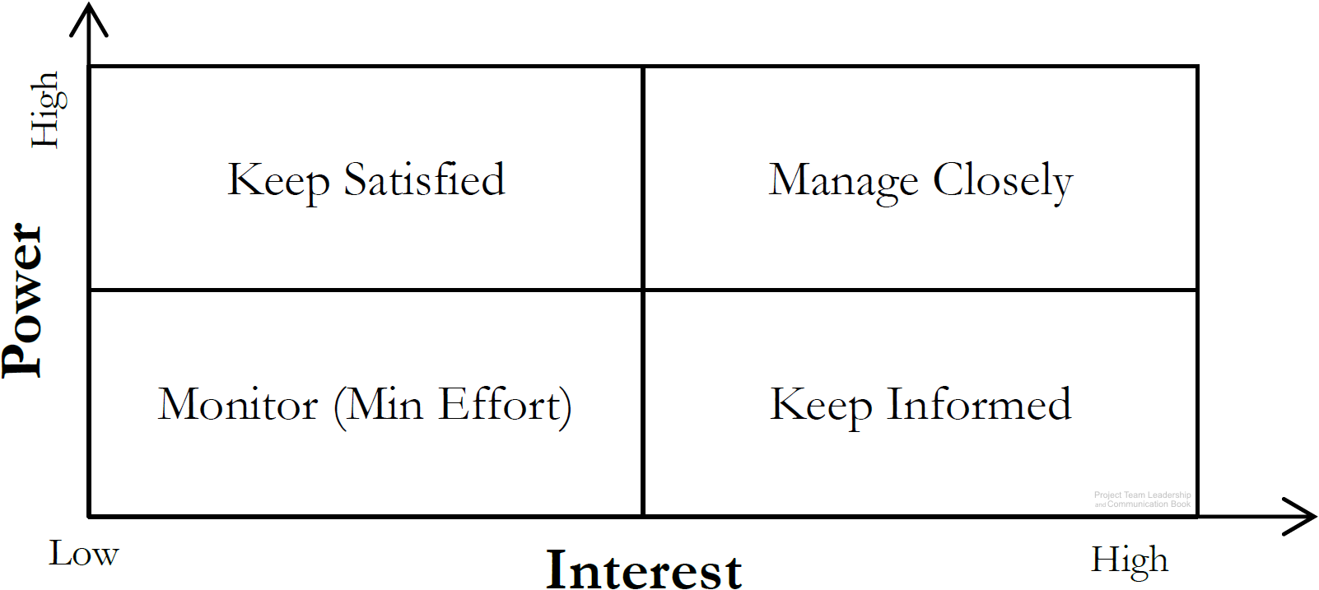
Chapter
Prioritizing Stakeholders
05
Stakeholders are people who can affect or are affected by the execution or outcome of a project. Everyone should be involved in identifying them
  Stakeholders can be groups
Once identified, they should be analyzed
  High or low power, or ability to affect the project
  High or low interest, or how they’re affected by
  the projects positive or negative outcome
www.midocean.ae

Slide 41
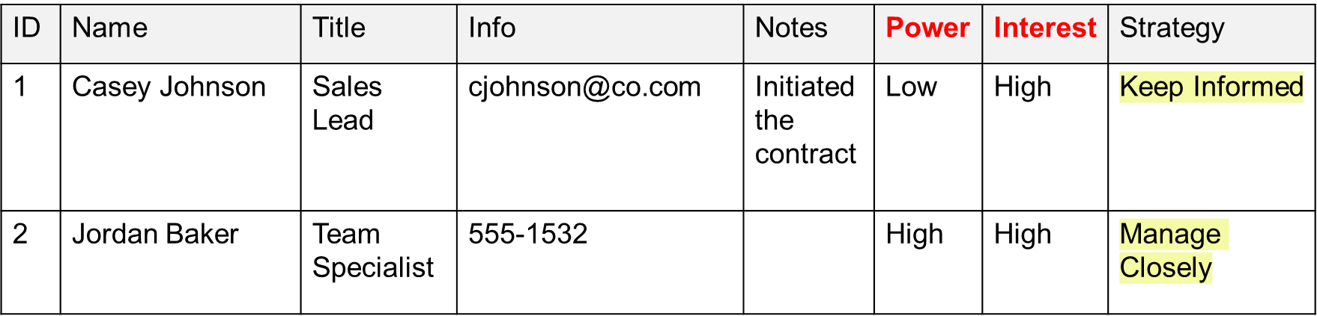
Chapter
Prioritizing Stakeholders
05
All information should be recorded/tracked in a stakeholder register.
www.midocean.ae

Slide 42
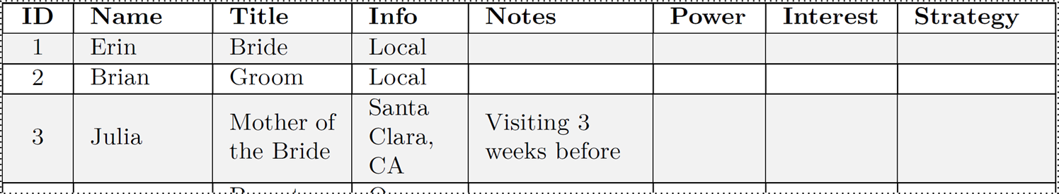
Chapter
Activity – Finding and Analyzing Stakeholders
05
Consider the stakeholders in a typical wedding. Remember that stakeholders with a similar stake can be listed as groups.
list 15 stakeholders/stakeholder groups on a whiteboard.
For each, analyze their level of interest and power as it pertains to the planning and execution.
Determine each stakeholder’s management strategy (monitor, keep informed, etc.)
www.midocean.ae

Slide 43
Chapter
Summary and Conclusions
05
Project work requires planning, estimating, scheduling, and tracking.
Estimating judges how long project work will take:
  There are several techniques (top-down, bottom-up, analogy, etc.)
  Teams must provide clarity between and estimate and a commitment
  Early estimations should be imprecise (ranges, etc.) to remain accurate
In order to properly schedule tasks, they must first be sequenced
  Work Breakdown Structures assist in dividing work into smaller, estimate-able tasks
  Tasks have dependencies/precedence which must be accounted for in final schedule
  Use visualizations and tools such as milestone charts, Gantt charts, and precedence diagrams
Tracking after the project begins is what makes scheduling efforts ‘worth it’
Stakeholder prioritization starts with identification, then analyzes and formulates strategies
www.midocean.ae

Slide 44



Thank You

Slide 45

Reference

