Slide 1




Mathematics 3 – MAT132
Dr. Israa Lewaa
Lecture 5 – Calculus for Fourier Series

Slide 2



Lecture Objective
Lecture
05
Chapter Objectives
Revision for some integration Rules
Integration of Basic Trigonometric Functions
Integration for other functions with Trigonometric Functions
definite Integration
Extra Practice
Lecture 5 Dr. Israa Lewaa Mathematics 3

Slide 3
Basic Rules in Integration
Lecture
05
Chapter Objectives
Revising some main rules in the integration
Lecture 5 Dr. Israa Lewaa Mathematics 3

Slide 4
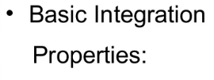
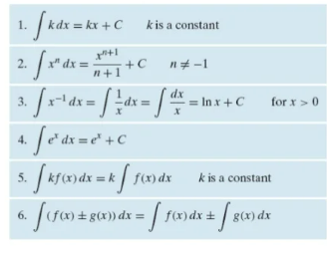
Rules of Integration
Lecture
07
2- Rules of Integration

Slide 5
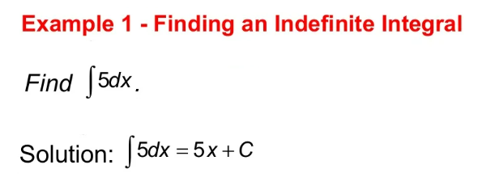
Example
Lecture
04
Example
Lecture 5 Dr. Israa Lewaa Mathematics 3

Slide 6
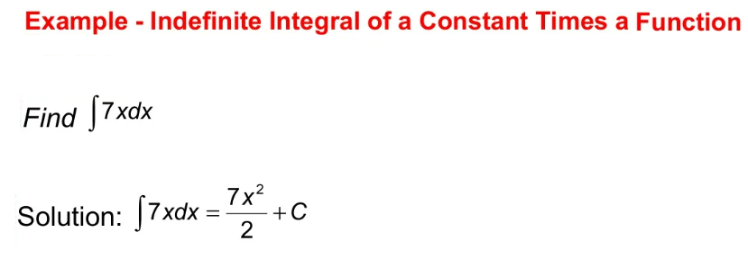
Example
Lecture
07
Example
Lecture 5 Dr. Israa Lewaa Mathematics 3

Slide 7
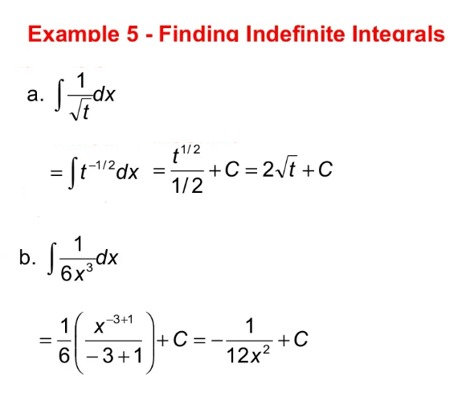
Example
Lecture
07
Example

Slide 8
Basic Rules in Integration
Lecture
05
Chapter Objectives
Important Notes for Trigonometric Functions
Lecture 5 Dr. Israa Lewaa Mathematics 3

Slide 9
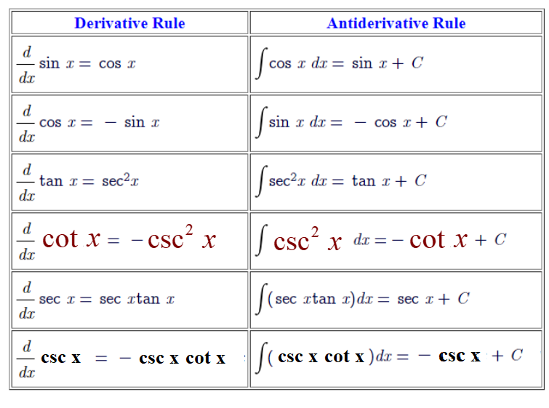
Important Notes
Lecture
05
Chapter Objectives

Slide 10
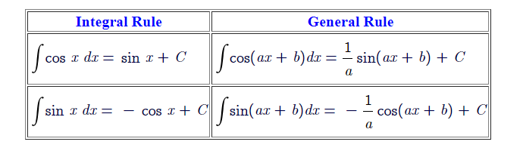
Important Notes
Lecture
05
Chapter Objectives
Lecture 5 Dr. Israa Lewaa Mathematics 3

Slide 11
Extra Practice
Lecture
05
Chapter Objectives
Extra Practice for different ideas in Integration !!!!!
Lecture 5 Dr. Israa Lewaa Mathematics 3

Slide 12
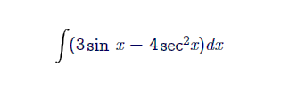
Extra Practice – Example 1
Lecture
05
Chapter Objectives
Integrate the following function:
Lecture 5 Dr. Israa Lewaa Mathematics 3

Slide 13
Example 1 Solution
Lecture
05
Chapter Objectives
Lecture 5 Dr. Israa Lewaa Mathematics 3

Slide 14
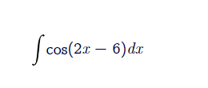
Extra Practice – Example 2
Lecture
05
Chapter Objectives
Integrate the following function:
Lecture 5 Dr. Israa Lewaa Mathematics 3

Slide 15
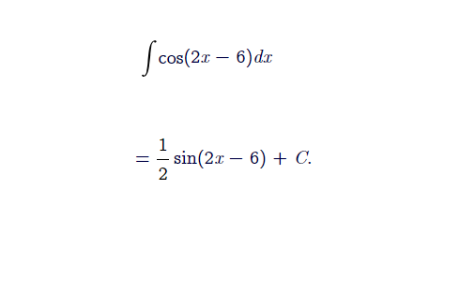
Example 2 Solution
Lecture
05
Chapter Objectives
Lecture 5 Dr. Israa Lewaa Mathematics 3

Slide 16
Extra Practice – Example 3
Lecture
05
Chapter Objectives
Integrate the following function:
Lecture 5 Dr. Israa Lewaa Mathematics 3

Slide 17
Example 3 Solution
Lecture
05
Chapter Objectives
Lecture 5 Dr. Israa Lewaa Mathematics 3

Slide 18
Extra Practice – Example 4
Lecture
05
Chapter Objectives
Integrate the following function:
Lecture 5 Dr. Israa Lewaa Mathematics 3

Slide 19
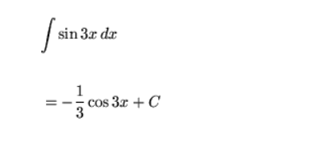
Example 4 Solution
Lecture
05
Chapter Objectives
Lecture 5 Dr. Israa Lewaa Mathematics 3

Slide 20

Extra Practice – Example 5
Lecture
05
Chapter Objectives
Integrate the following function:
Lecture 5 Dr. Israa Lewaa Mathematics 3

Slide 21
Example 5 Solution
Lecture
05
Chapter Objectives
Lecture 5 Dr. Israa Lewaa Mathematics 3

Slide 22
Extra Practice – Example 6
Lecture
05
Chapter Objectives
Integrate the following function:
Lecture 5 Dr. Israa Lewaa Mathematics 3

Slide 23
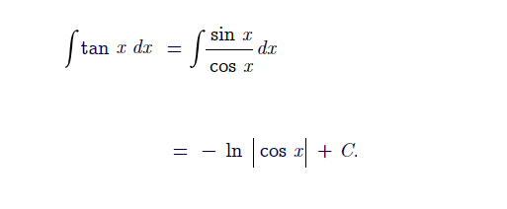
Example 6 Solution
Lecture
05
Chapter Objectives
Lecture 5 Dr. Israa Lewaa Mathematics 3

Slide 24

Extra Practice – Example 7
Lecture
05
Chapter Objectives
Integrate the following function:
Lecture 5 Dr. Israa Lewaa Mathematics 3

Slide 25
Example 7 Solution
Lecture
05
Chapter Objectives
Lecture 5 Dr. Israa Lewaa Mathematics 3

Slide 26
Extra Practice – Example 8
Lecture
05
Chapter Objectives
Integrate the following function:
Lecture 5 Dr. Israa Lewaa Mathematics 3

Slide 27
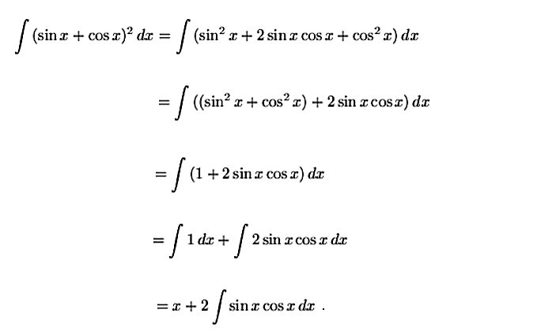
Example 8 Solution
Lecture
05
Chapter Objectives
Lecture 5 Dr. Israa Lewaa Mathematics 3

Slide 28
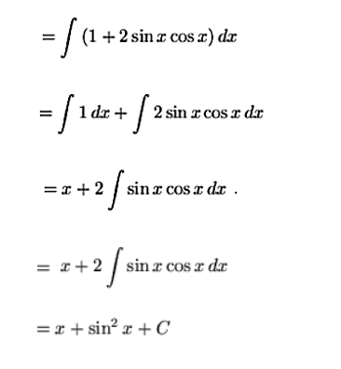
Example 8 Solution
Lecture
05
Chapter Objectives
Lecture 5 Dr. Israa Lewaa Mathematics 3

Slide 29

Extra Practice – Example 9
Lecture
05
Chapter Objectives
Integrate the following function:
Lecture 5 Dr. Israa Lewaa Mathematics 3

Slide 30
Example 9 Solution
Lecture
05
Chapter Objectives
Lecture 5 Dr. Israa Lewaa Mathematics 3

Slide 31
Example 9 Solution
Lecture
05
Chapter Objectives
Lecture 5 Dr. Israa Lewaa Mathematics 3

Slide 32

Extra Practice – Example 10
Lecture
05
Chapter Objectives
Integrate the following function:
Lecture 5 Dr. Israa Lewaa Mathematics 3

Slide 33

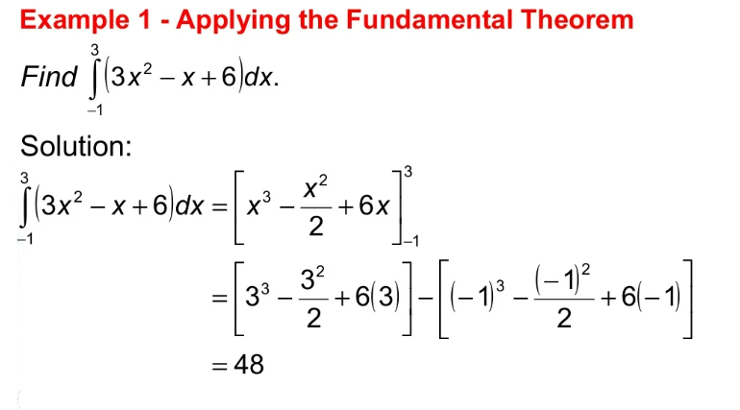
Example 10 Solution
Lecture
07
Example
Lecture 5 Dr. Israa Lewaa Mathematics 3

Slide 34

Extra Practice – Example 11
Lecture
08
Example 1 - Definite Integration
Integrate the following function:

Slide 35
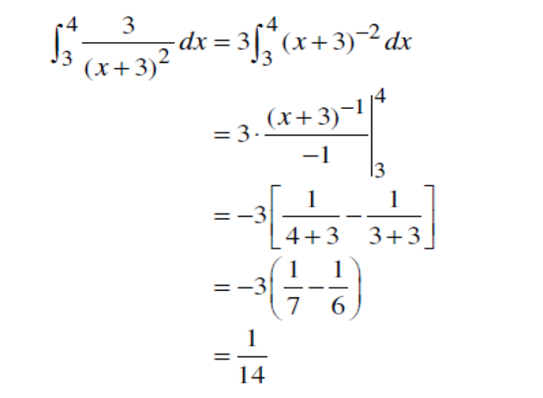
Example 11 Solution
Lecture
08
Example 1 Solution
Lecture 5 Dr. Israa Lewaa Mathematics 3

Slide 36
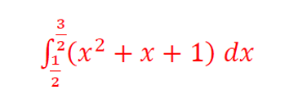
Extra Practice – Example 12
Lecture
08
Example
Integrate the following function:

Slide 37
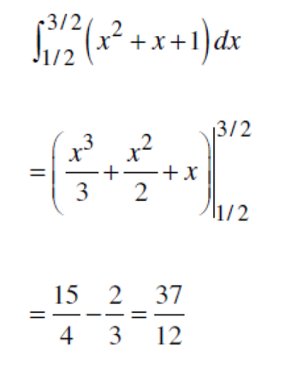
Example 12 Solution
Lecture
08
Example
Lecture 5 Dr. Israa Lewaa Mathematics 3

Slide 38

Extra Practice – Example 13
Lecture
08
** EXTRA PRACTISE
Integrate the following function:

Slide 39
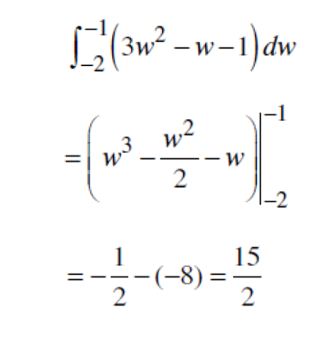
Example 13 Solution
Lecture
08
** EXTRA PRACTISE
Lecture 5 Dr. Israa Lewaa Mathematics 3

Slide 40
Lecture Summary
Lecture
05
Chapter Objectives
Revision for some integration Rules
Integration of Basic Trigonometric Functions
Integration for other functions with Trigonometric Functions
Definite Integration
Extra Practice
Lecture 5 Dr. Israa Lewaa Mathematics 3

