Slide 1



Lecture 10
FNT 628
Blockchain and Cryptocurrencies
Prepared by Dr. Yara Ibrahim
www.midocean.ae

Slide 2
Technical Analysis &Cryptocurrency

Slide 3
Introduction
Market analysis is broadly categorized into two main methods, the first one is fundamental analysis and the second one is technical analysis.
In fundamental analysis an analyst needs to look at the financial statements of a company, its business model, overall macroeconomic scenarios, management capabilities and many more things for coming to a specific fair value of a company.
On the contrary the discipline of technical analysis is not at all concerned with this detailed study of fundamental factors.
On the contrary, a technical analyst only looks at price of a stock derived as a result of supply-demand interaction.
For a technical analysts’ price is supreme and he or she sees price as manifestation of every fundamental reality.
Hence, they look only at two main aspects in the market. Price -over -time and volume.

Slide 4
Introduction
The entire discipline of technical analysis is based on these two data points, price over time and volume. All patterns, indicators, concepts are derived from these two basic data points.
Technical analysis is a very interesting subject.
This is not a definitive science, rather a probabilistic discipline. In simple terms, it is more of an art than science.
There are well known chart patterns or indicators in the market. But nothing works 100% of time. We still follow them because they work more number of times than they fail.
Hence emerged the concept of probability, the number of times anything works among the number of times that occur.
This ratio is different in different stocks in different phases.
That is why it is called an art. With experience, a chartist is able to form an opinion of his or her own so that he has some extra edge on the market assessment than someone having just bookish knowledge of technical analysis.
This book on technical analysis is your stepping stone towards the journey to become a seasoned technical analyst. We request you to go through the concept slowly one at a time and keep observing charts on regular basis.
Look at old charts and also look at contemporary live charts. Once you find a pattern or some indicator try to predict the future move and note down your prediction. Then as time flows try to match the price action with your prediction.
Then analyze why it worked or not worked.

Slide 5
Types of Charts
Charts are two-dimensional representation of price over time.
There are many types of charts available. But most popular and widely used among them are Line Charts, Bar Charts and the Candlestick Charts.
The X axis, i.e. the time axis is crucial. The unit can be month, week, day, hour, 5 min or few seconds.
The shorter the time period, more detailed the chart becomes.
The beauty of time in technical analysis is that the same concepts apply to charts irrespective of time-frame of observation.
However, the success rate of individual patterns or indicators-based decisions may vary across time frames.
Generally higher the time frame of chart, relatively higher is the probability of any concept in market.

Slide 6
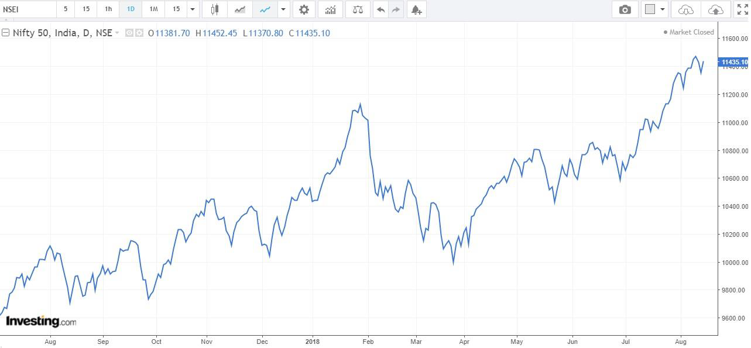
Line Charts
In line chart each and every price point is represented as a dot.
The X axis represents the time scale and the Y axis represents the price.
Each dot or point represents the closing price at the end of a unit of time. These points are then joined to form a line. This is the simplest form of chart.
But this is quite good if we want to plot 3-4 similarly priced stocks in a single chart and compare.
Moreover, the line chart gives the clearest idea about price direction of a stock.

Slide 7
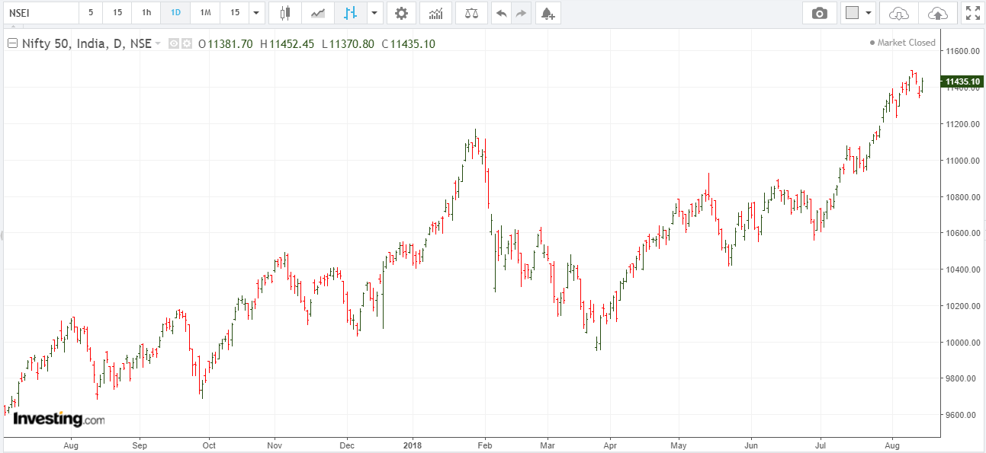
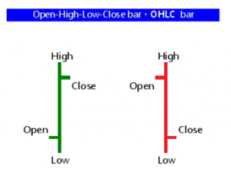
Bar Charts
A bar chart is comprised of a series of bars. Every bar has four important price points - open close high and low.
The bars are represented in green or blue color when close is higher than open and red color when close is lower than open.
The bar charts are more detailed than the line chart and are good for demonstrating or spotting the classical price patterns.
We will discuss about the classical chart patterns in appropriate time.

Slide 8
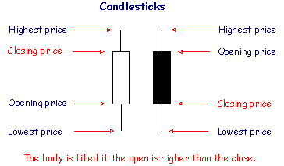
Candlestick Charts
The concept of candlestick charts came from Japan. That is why they are often referred to as Japanese candlestick charts.
These charts are the most versatile and popular form of chart representation.
Price behavior during each time unit is represented in the form of a candle.
If the closing price of a stock is higher than open price during a particular time period, then the candle is green, if the close price is below the open price then the candle is red.
Each candle has a body and two wicks.
The distance between open to close is represented by the body of a candle and the upper and lower wicks represent the highs and lows of a candle.

Slide 9
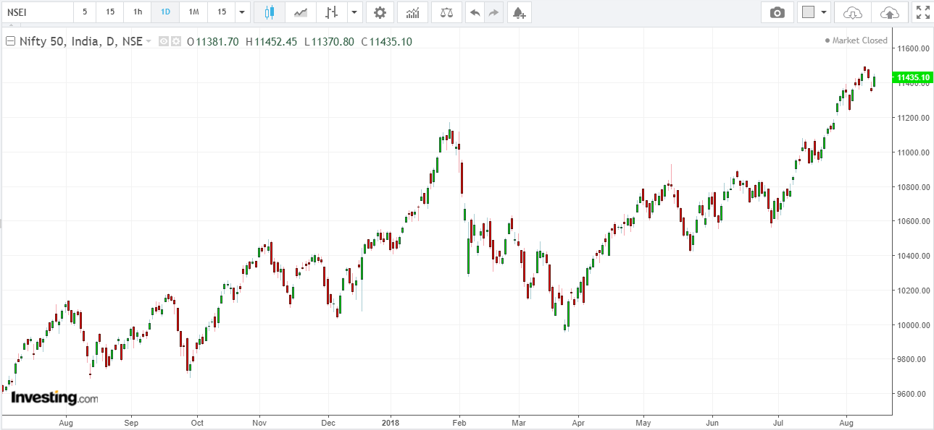
Candlestick Charts
Candlestick chart is special not only because it adds a special visual clarity about the price action, but also because often a single candle stick or two or three consecutive candlesticks together form a pattern that indicate reversal of a prior move or give conviction on continuation of the ongoing move.
These are called candlestick patterns.
We will discuss about them in due course of time. After getting introduced to the concept of charting we will discuss about the concept of trend.

Slide 10
Market Trends
Often market movements happen in the form of trends. A price trend is a continuous or a directional price movement in upward or downward direction. We call them up -trend and down -trend respectively.
Now if we look at price action in market through charts, we will find that no price movement happens in a straight line.
Suppose we are looking at a broader uptrend represented as primary move, we may find intermediate corrections represented as secondary trend and minor counter moves among the secondary moves represented as minor trend.
This is how the market behaves generally in both the up and the down trends.
Often an up- trend is represented in the form of a sequence of higher highs and higher lows.
Similarly a downtrend is represented as a sequence of lower lows and lower highs. A trend is said to reverse when the sequence is broken.

Slide 11
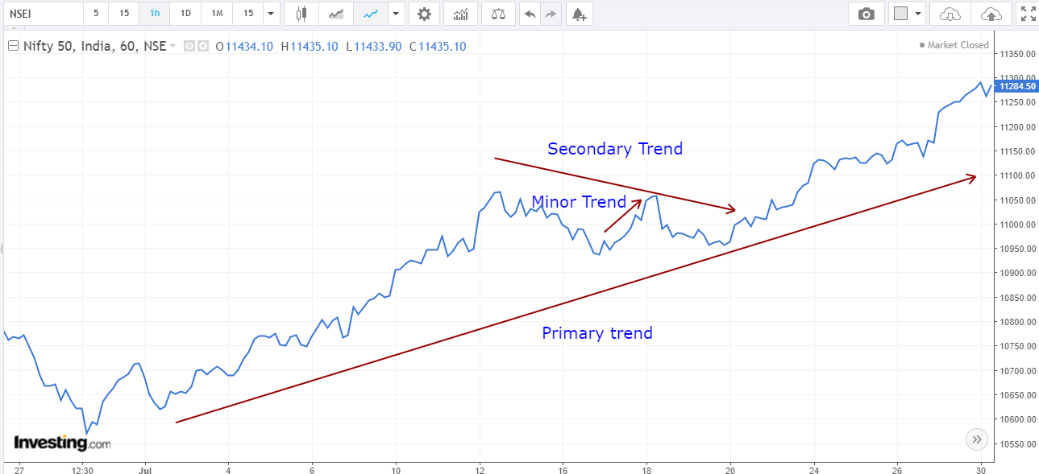
Market Trends

Slide 12
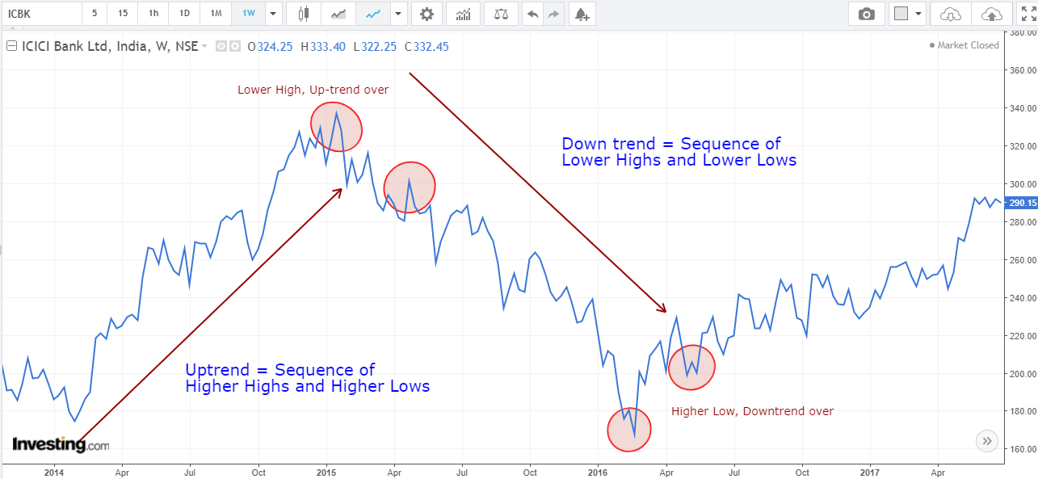
Trend Reversal

Slide 13
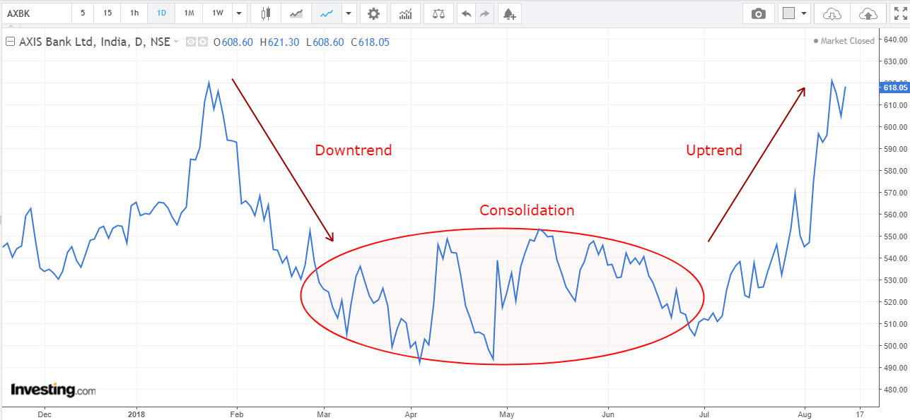
Market Trends
We should remember a simple point that market is not trending all the time.
Often the market consolidates within a small range and goes nowhere.
Then suddenly it can break on the upside or downside.

Slide 14
Trendlines & Channels
Trendline and Channels are one of the most simple and useful tools in the market.
During an uptrend, a trendline is formed by joining lowest points of periodic pull-backs, defined as secondary moves in the previous section.
The up-trend line has positive slope. To be precise we need two lows to join to form a trendline during an up-move.
This line is then extended in the upward direction; the third move towards the trend-line is used to validate the trend line. If the trend line is not broken in the pull back, then it is called trend-line validation. It is often observed that price pulls back towards the trend line and moves higher.
In an uptrending market it is often easier to make money if one buys near the trend line and sells higher. The more number of time the trend-line is validated, more important it becomes. An upward trend line is said to be the area of support.
The selling pressure meets the buying pressure here and eventually overtime when buying pressure is higher than selling pressure price sees an upward bounce. Now when one buys he or she is looking for the prices to move higher.
But this may or may not happen.
Hence the investor should maintain a stop loss point below which he-or she should cut his position, i.e. book loss.
When a trend line is broken, either the market may reverse the trend, continue the uptrend with little less force or just go sideways.

Slide 15
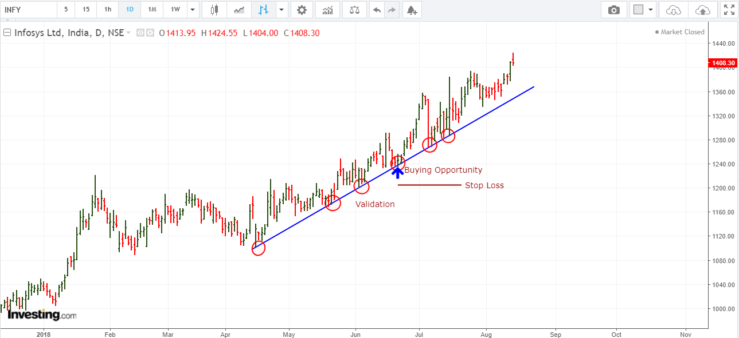
Uptrend

Slide 16
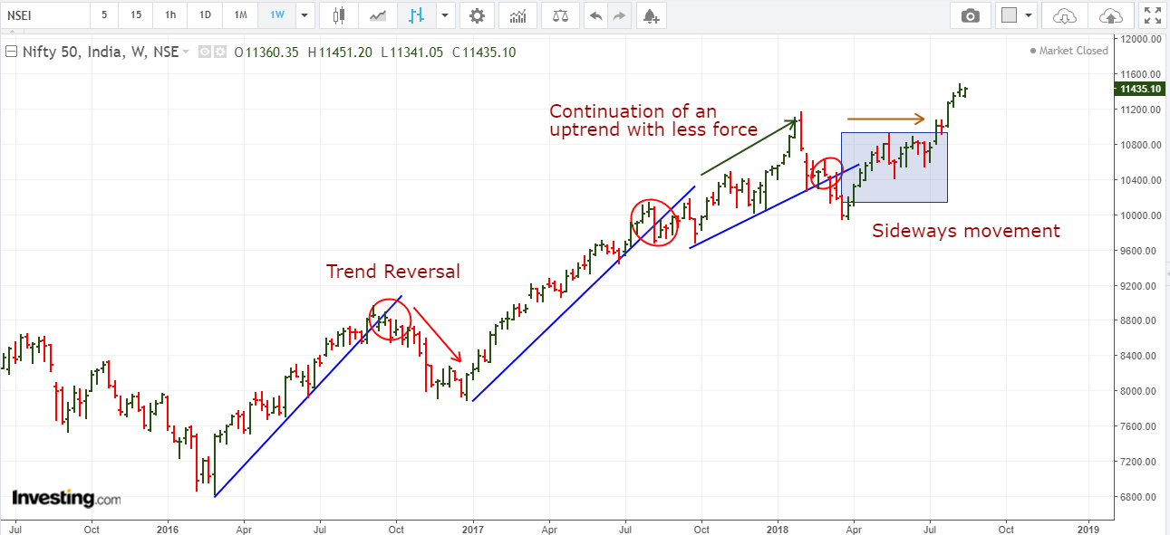
Uptrend Reversal

Slide 17
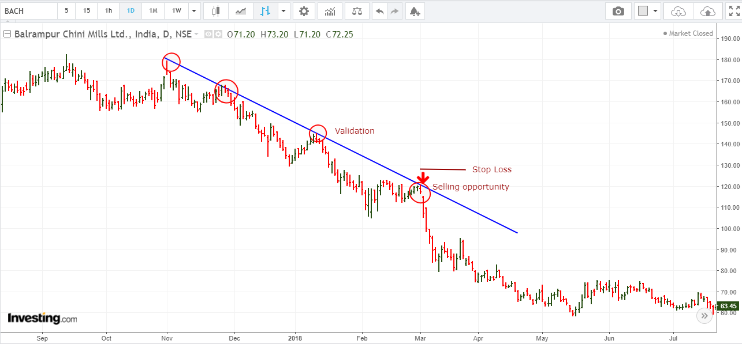
Downtrend
Similarly, during a down-trend: a trendline is formed by joining pull-back highs. They slope downwards.
Just like an up-trend line a down-trend line is formed by joining two points and then extended in downward direction. Pull backs towards the trend-lines are low risk points for short selling with a stop loss little above the trend line.
More number of times the line is validated, more it grows in importance.
Similar to an uptrend-line, when a down trending trend line is broken the trend may continue with less pace, or reverse or may go side-ways.
A downward trend line is said to be area of resistance.
The selling pressure meets the buying pressure here and eventually overtime when selling pressure is higher than buying pressure price sees a decline.

Slide 18
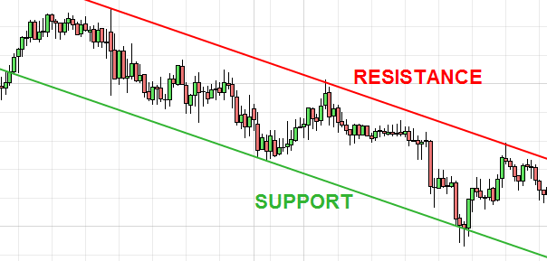
Resistance and Support

Slide 19
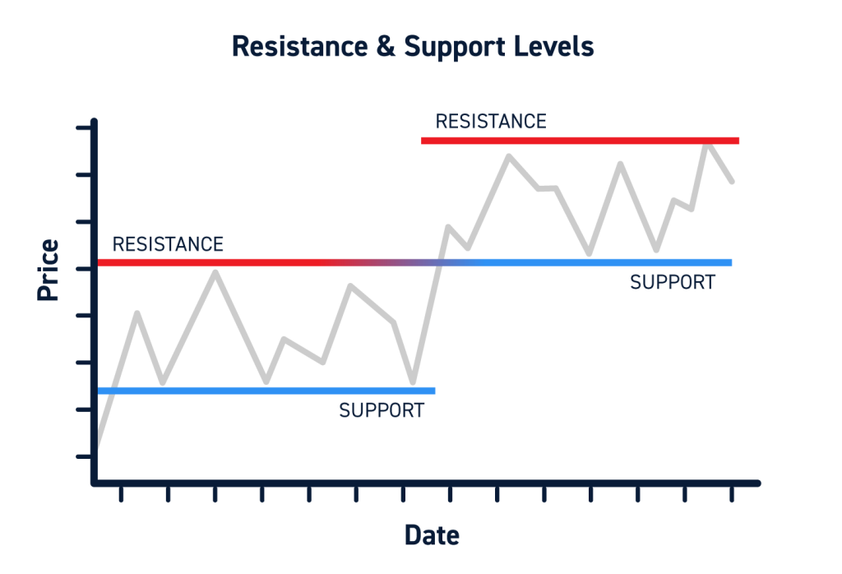
Role Reversal
Once a trendline support or resistance is broken, its role is reversed. If the price falls below a support line, that line will become resistance.
If the price rises above a resistance line, it will often become support.
As the price moves past a line of support or resistance, it is considered that supply and demand have shifted, causing the breached line to reverse its role.
For a true reversal to occur, however, it is important that the prices make a strong move through either the support or resistance line.

Slide 20
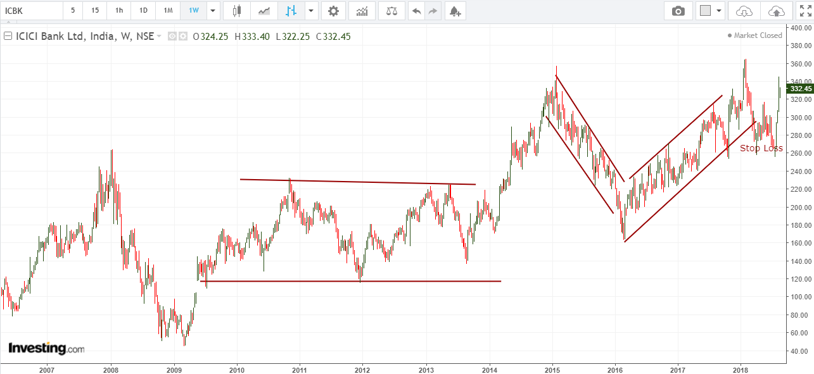
Channels
The concept of channel is much similar to trend lines. When in an uptrend or in a down trend or in a consolidation, we see rhythmic movement in form of parallelogram, we can draw channels.
The channel boundaries are good points for reversal trades with small stop losses.
Once price is out of the channel, the trend or range of the stock is broken.

Slide 21
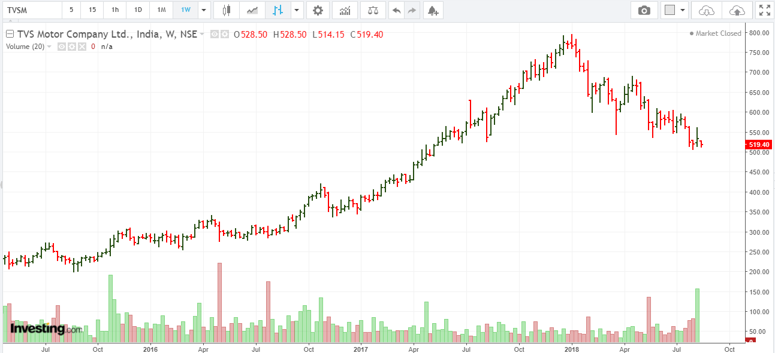
Volume
In this section we introduce the second aspect of charting.
This is called volume. Traded volume is the number of quantity of stocks which change hand.
The volume is shown as a sub graph in the price-time chart, below the price window.
Higher the volume in any particular move, the greater is the conviction in that move to continue greater distance in that direction.
However, if volume is on the lower side during a move, the stock is generally bound to lose momentum.
Generally, during range bound phases, the volume is low.

Slide 22
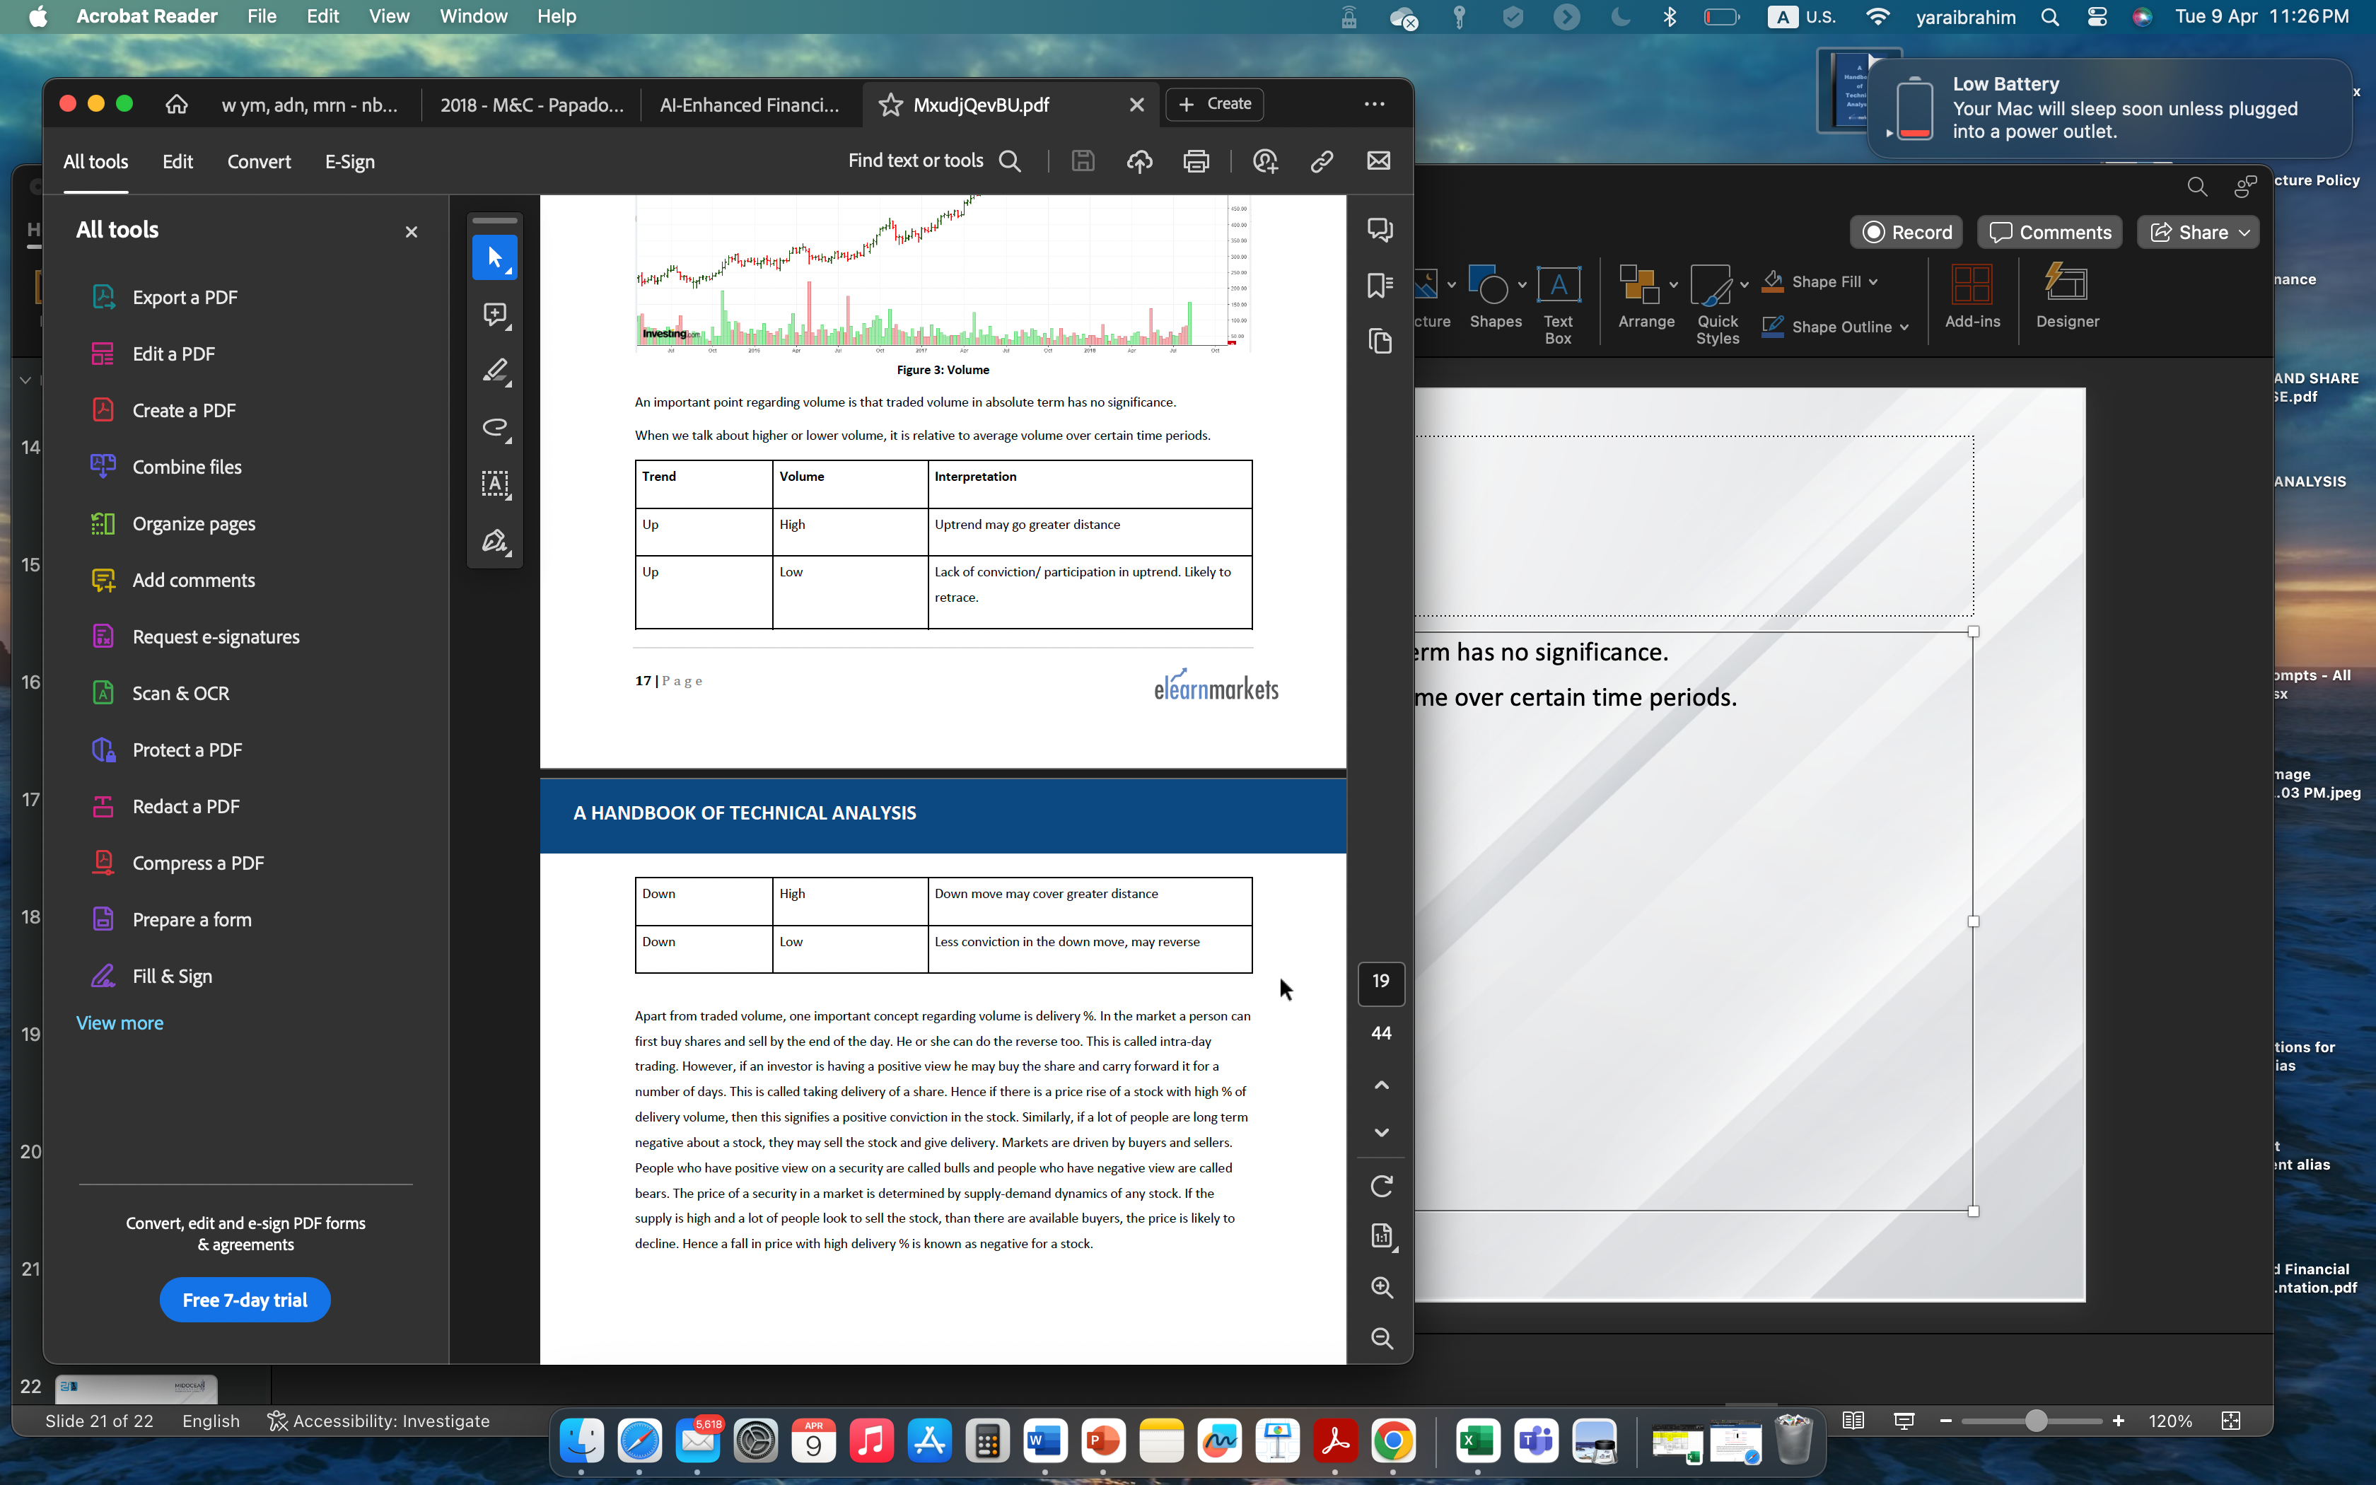
Volume
An important point regarding volume is that traded volume in absolute term has no significance.
When we talk about higher or lower volume, it is relative to average volume over certain time periods.

Slide 23
Volume
Apart from traded volume, one important concept regarding volume is delivery %. In the market a person can first buy shares and sell by the end of the day. He or she can do the reverse too.
This is called intra-day trading. However, if an investor is having a positive view he may buy the share and carry forward it for a number of days. This is called taking delivery of a share.
Hence if there is a price rise of a stock with high % of delivery volume, then this signifies a positive conviction in the stock.
Similarly, if a lot of people are long term negative about a stock, they may sell the stock and give delivery. Markets are driven by buyers and sellers.
People who have positive view on a security are called bulls and people who have negative view are called bears. The price of a security in a market is determined by supply-demand dynamics of any stock.
If the supply is high and a lot of people look to sell the stock, than there are available buyers, the price is likely to decline.
Hence a fall in price with high delivery % is known as negative for a stock.

Slide 24
Chart Patterns
As we have discussed in the previous section, that market can be either in trending phase or in a range-bound phase.
No trend generally lasts forever in the market.
After prolonged or medium or shorter duration up and downtrend, the market often reverses and a move starts in the opposite direction of the prior move.
Often we find that well defined geometrical patterns are formed in the chart which provides good indication of price reversals.
These patterns are called reversal classical chart patterns. When they are formed as a bullish reversal pattern they are said to be part of accumulation.
On the other hand if they are formed at the top of a price move just before bearish reversal, then they are part of distribution.
However, a geometrically shaped consolidation does not necessarily mean price reversal. Often price resumes the erstwhile trend post the consolidation move. These are called continuation classical chart pattern.

Slide 25
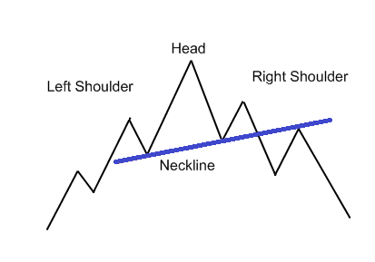
Head and Shoulder & Inverse Head & Shoulder
Head and Shoulder pattern is a bearish reversal pattern.
This pattern appears after an uptrend. This pattern is formed with three consecutive tops with middle one being higher than the other two.
The middle top is called the head and the two side peaks are called the shoulders.
On joining the intermediate troughs, we get the neck-line. On ultimate break below the neckline, usually a short trade is taken with a stop-loss above the top of the nearest shoulder.
The target is usually considered as the distance between the neckline and head, projected from the point of break.
If the volume in the down leg of the right shoulder is on the higher side and break happens with high volume, the conviction is on the higher side for the reversal.
An Inverse Head and Shoulder is just mirror image of the Head and Shoulder pattern.
This should appear after a sustained down trend, the rule of stop loss and target are similar. This often acts as a very effective bullish reversal pattern.

Slide 26
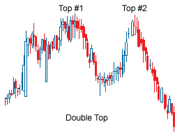
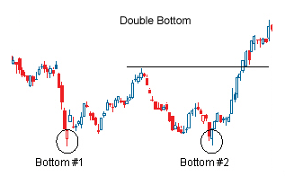
Double Tops and Bottoms
These chart patterns are well-known patterns that signal a trend reversal – these are considered to be one of the most reliable patterns and are commonly used.
These patterns are formed after a sustained trend and signal to chartists that the trend is about to reverse.
These patterns are created when price movement tests support or resistance levels twice and is unable to break through.
These patterns are often used to signal intermediate and long-term trend reversals.

Slide 27
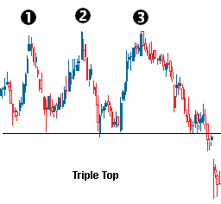
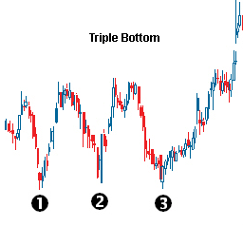
Triple Tops and Bottoms
These are another set of reversal chart patterns in chart analysis. These are not as prevalent in charts as Head and Shoulders and Double Tops and Bottoms, but they act in a similar fashion.
These two chart patterns are formed when the price movement tests a level of support or resistance three times and is unable to break through.
They signal a reversal of the prior trend.
A trade entry is initiated at the break of a neckline with a small stop-loss and the target is measured as the distance between peaks/troughs and the neckline.

Slide 28
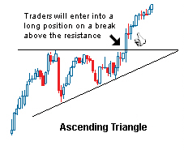
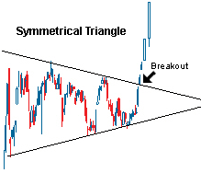
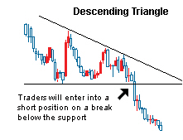
Triangles
Triangles are one of the most well-known chart patterns used in technical analysis.
The three most common types of triangles, which vary in construction and implications, are Symmetrical Triangle, Ascending Triangle and Descending Triangle.
These chart patterns are considered to last anywhere from a couple of weeks (ideally more than 12 weeks) to several months.
These are areas of consolidations after a trending move and are generally continuation patterns, i.e. the erstwhile trends resumes after the breakout.
However, in certain cases they act as reversal patterns. They can appear both in up-trend and down-trend.

Slide 29
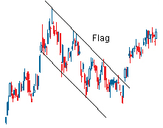
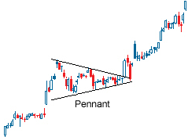
Flag and Pennant
These two short-term chart patterns are continuation patterns that are formed when there is a sharp price movement followed by a generally sideways price movement.
The patterns are generally thought to last from one to three weeks (Can last from 1 to 12 week but ideally they should last between 1 and 4 weeks).
They can appear both in up-trend and down-trend.

Slide 30
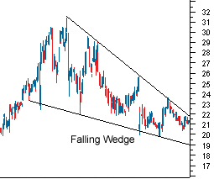
Wedge
The Wedge chart pattern can be either a continuation or reversal pattern.
It is similar to a Symmetrical Triangle except that the Wedge Pattern slants in an upward or downward direction, while the symmetrical triangle generally shows a sideways movement.
The other difference is that Wedges tend to form over longer periods, usually between three and six months.
The fact that Wedges are classified as both continuation and reversal patterns, can make reading signals confusing.
However, at the most basic level, a falling wedge in an uptrend is bullish and a rising wedge in a downtrend is considered bearish.

Slide 31
Candlestick Reversal Patterns
When we had discussed about the candlestick charts, we had said that they have an edge over many other types of charts representation due to recognizable chart patterns which are easy to define and which work beautifully in the market.
In this section we will discuss about few chart popular candlestick patterns.
Candlestick patterns provide entry and stop-loss criteria, but there are no target setup as available in classical chart patterns.

Slide 32
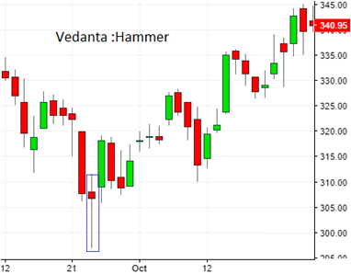
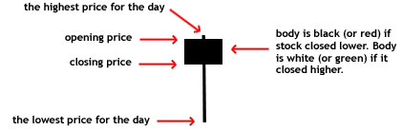
Hammer
Hammer is a single candlestick bullish reversal pattern. This occurs after a prolonged down trend. Ideally there should be a gap down opening and bears should be able to push the price lower as a continuation of a down-move.
At this point, bulls should overpower bears and push price higher and make close near to the opening price. The candle formed in this process should be having a small body, a big lower shadow and a negligibly small upper shadow.
Ideally the lower shadow should be at least twice the length of the body.
The color of the body can be either green or red, but if the body color is green, then the hammer is considered a little more bullish, as the bulls were strong enough to close the price higher than the open price.
The next day or in next two three days, ideally there should be a gap up opening or price should move above the high of the hammer candle.
This is called confirmation or validation of the pattern.
A hammer like candle, without validation has no real significance. If price moves above the high of the hammer a buy trade can be taken with a stop loss below the low of the candle.

Slide 33
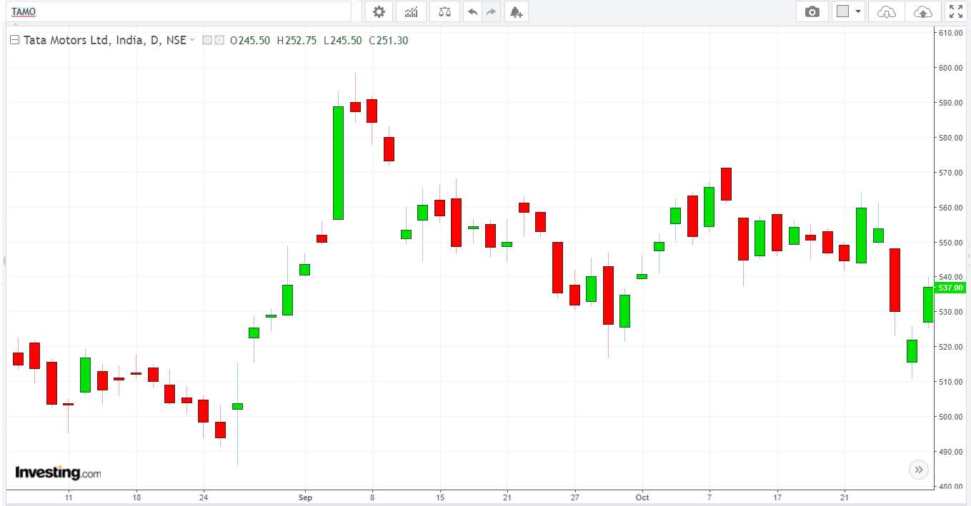
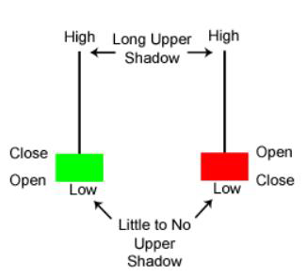
Shooting Star
A shooting star is just like a mirror image of a hammer candle. First there should be a sustained up trend and then there has to be a gap up opening.
The bulls should push price higher in the initial part of the day. Then, later in the day bears should take in the control of the stock and push prices down.
Eventually the closing price should be very close to the opening price, resulting in a candle with a small green or red body, a big upper shadow and a small or negligible lower shadow. The upper shadow of the candle should be at least twice the length of the body.
Now a confirmation of the shooting star pattern comes if price moves below the low of the candle within next 2-3 candles.
On confirmation, a short trade should be taken with stop loss above the high of the high of the candle. A shooting star pattern with a red body is considered slightly more bearish than one with a green body.
It is often observed that shooting star candlestick pattern acts as bearish reversal pattern and triggers a down move after an uptrend.

Slide 34
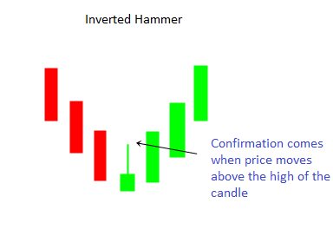
Inverted-Hammer
An inverted hammer is a single candlestick bullish reversal pattern. The pattern appears after a sustained down-trend.
At the beginning of the day there should be a gap-down opening.
However, bulls should push the price higher during the course of the day. Eventually the bears should push the price lower during the course of the day and close near the open price.
The resulting candle should have a small body, red or green, the upper wick should be at least twice the body of the candle and the lower shadow should be quite small or negligible in size.
If the body is green it is relatively bullish than if it is red. This looks like an inverted hammer as the name suggests.
The philosophy is that bears were not able to push the price below the opening price during the course of the day.
This pattern, however, is considered to be little less bullish than the hammer itself, because in hammer bulls are able to force a higher close by the end of the day. The confirmation of the pattern comes once the price moves above the high of the candle.
On confirmation a buy trade can be initiated with a stop loss below the low of the candle. Inverted hammer occurs little less frequently in market as compared to hammer pattern.

Slide 35
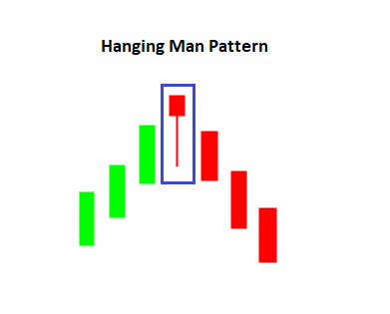
Hanging Man
Hanging Man is a single candlestick bearish reversal pattern. This appears after a sustained up-move. The candle looks like a hammer; only difference is that it appears at the end of an up-trend.
The candle should have a small body at the top (red/green) and a lower shadow at least twice the length of the body.
There should be very small or no upper shadow.
A red colored body of hanging man pattern is more bearish than a hanging man pattern with green body.
The confirmation of the pattern happens when price moves below the low of the candle. On confirmation a trader may take short trade with stop-loss above the high of the candle.
The hanging man pattern is bearish counterpart of Bullish inverted hammer.
However this appears much less frequently than shooting star which is another bearish reversal pattern.

Slide 36
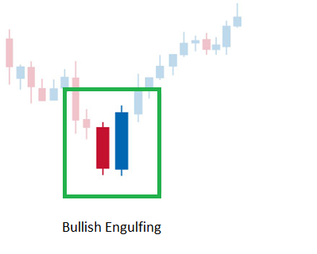
Bullish Engulfing Pattern
Bullish candlestick pattern is a two-candlestick bullish reversal pattern. First there should be a downtrend.
Then we should have a red candle followed by a green candle.
The body of the green candle should engulf the body of the first red candle.
The idea is in the second candle that constitutes the pattern, the day started below the previous day’s close on a bearish note.
However, as the day progresses, the bulls take-over the charge and eventually succeed to close above previous day’s high.
In such a scenario, if the highest point of these two candlesticks is breached on the upside within next 2-3 candles, the bearish engulfing pattern is said to be confirmed.
A buy trade can be initiated upon confirmation with stop-loss below the low of the two candlestick patterns.

Slide 37
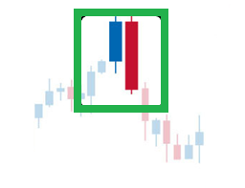
Bearish Engulfing Pattern
Bearish Engulfing pattern is just mirror image of bullish engulfing pattern with bearish implication.
First, we should be having an up-trend. Then we should have a green candle as continuation.
The next day should see a gap up above the close of previous day.
The 2nd day candle should eventually close red with its body totally engulfing the body of the first candle.
The confirmation comes when within next 2-3 candles the price moves below the low of the two candles forming the Bearish Engulfing pattern.
On confirmation a trader may take a short trade with stop loss above the top of the two candlestick patterns.
Larger the 2nd candle, more bearish is the pattern.

Slide 38
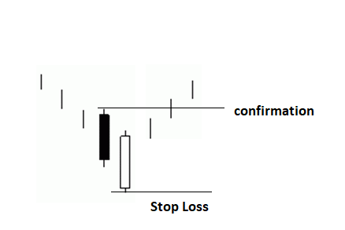
Piercing Pattern
The piercing pattern is just similar to the bullish engulfing pattern; only thing is that the 2nd candle in the two candlestick pattern does not close engulfing the body of the first candle.
Instead it closes crossing the halfway mark of the body of the first candle.
A confirmation comes when price crosses the high of the two candlestick patterns within next 2-3 candles.
On confirmation one may take a buy trade with stop loss below the low of the candle.

Slide 39
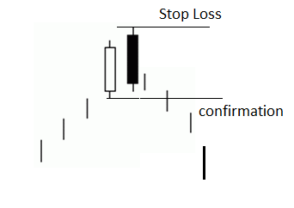
Dark Cloud Cover
The Dark cloud cover is a two candlestick bearish reversal pattern and much similar to the bearish engulfing pattern.
In this pattern, the second candle, unlike the bearish engulfing pattern falls short of engulfing the first candle, instead it crosses 50% the body of the first candle.
The confirmation comes when a candle breaches the bottom of the pattern.
On confirmation a short trade can be taken with stop loss above the high of the candle.

Slide 40
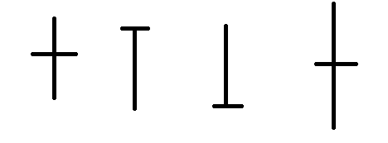
Doji
The Doji is a single candlestick pattern.
The Doji assumes significance, when it appears after a trending move, be it up or down.
The Doji symbolizes indecision and after a Doji the incumbent trend can reverse, go sideways or continue uptrend.
However, appearance of a Doji is a signal of caution that the probability is high that the erstwhile trend may be coming to an end. Doji is a candle which has open and close almost at similar level.
There can be upper shadows and lower shadows of various proportions.

Slide 41
Indicators
Indicators are tools to aid decision making in the market.
There are various types of indicators which measures or indicate the trend, the momentum, the volatility and various other aspects in the market.
There are thousands of indicators which are derived out of the price and volume data over time.
Here we introduce you with four very useful indicators.

Slide 42
Simple Moving Average
Simple Moving Average or SMA is a moving average which is calculated by adding the closing price of security prices for the last n-periods and dividing it by the total number of time periods.
For example, suppose we want to calculate the 9 periods SMA of a security price.
First, we will add the last 9 Days Closing Price of the security and then it will be divided by the 9 periods.
Calculation for 9 periods SMA: (P9+P8+P7+P6…. +P1)/9 Where, P=Price P9= Closing Price 9 days ago
SMA is a Technical indicator which is represented by a line and it is directly plotted on the security price. As per the choice of the trader, the periods can be changed in the SMA indicator.
For shorter-term SMA, we can use 5,8,13 etc.
For Medium term 20, 34, 50 and
for longer term 100,200 can be used.

Slide 43
Simple Moving Average
If a medium term moving average is having a positive slope, the trend is considered to be positive in medium term and vice versa.
Price breaching a particular moving average from down to up is considered a bullish sign.
Similarly, price breaching a particular moving average from upside and closing below is considered bearish.
If we find a shorter term moving average crossing a medium term moving average from below, often this is called bullish crossover.
On the other hand if a shorter term moving average crosses a medium term moving average from upside to below that is called a bearish crossover and often considered a signal of bearishness.

Slide 44
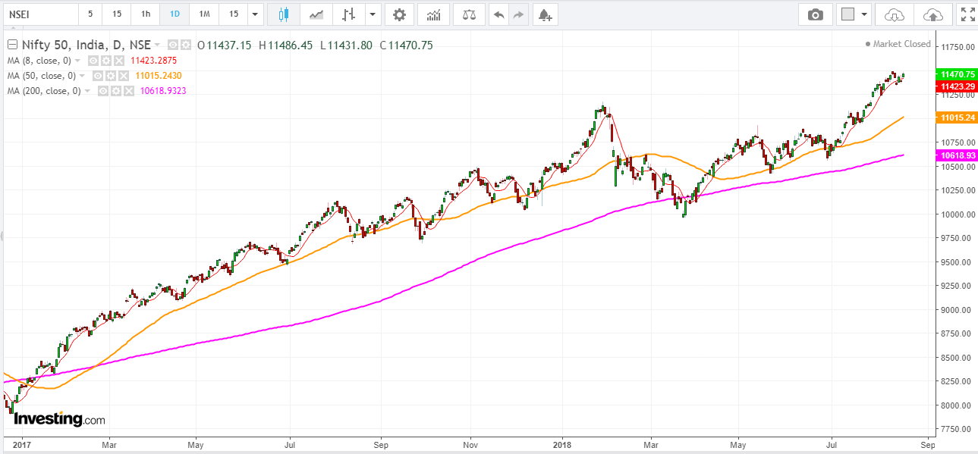
Simple Moving Average

Slide 45
Relative Strength Index (RSI)
Relative Strength Index (RSI) is a momentum oscillator, developed by J. Welles Wilder, which measures the speed and velocity of price movement of trading instruments (stocks, commodity futures, bonds, forex etc.) over a specified period of time.
The objective of RSI indicator is to measure the change in price momentum.
It is a leading indicator and is widely used by Technical Analysts over the globe.
RSI can be used to spot a general trend.
It is considered overbought when it goes above 70 and oversold when it goes below 30. 30-70 region of RSI is considered to be normal zone.

Slide 46
Calculations
The formula for calculating Relative Strength Index is as follows
RSI = 100 – 100 / (1 + RS) RS = Average Gain over specified period/ Average loss over the same period
The default setting for Relative Strength Index is 14, but you may change this value to decrease or increase sensitivity based on your requirement.

Slide 47
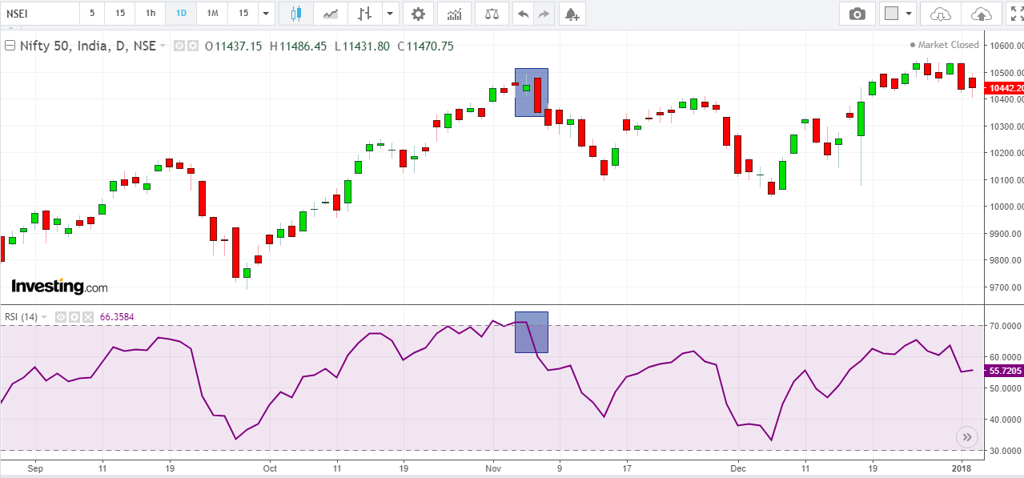
Usage
There are many kinds of usage of RSI.
However most popularly, if we find that, RSI breaching the 70 level and at the same time we spot a bearish reversal pattern, then there is opportunity to take short trade with stop loss.
Similarly if RSI breaches 30 from below and we observe a bullish reversal pattern, there is opportunity to take long trade with stop loss.

Slide 48
Conclusion
Ideally traders combine indicators and price patterns to form their trading strategies.
Very rarely professional traders just rely on a single indicator or a price pattern. We are about to end our short journey of introducing you with the concept of basic charting.
Hope this gives you enough clarity and generates great interest in your mind to apply those concepts in live charts.
Technical analysis is a discipline in which a practitioner improves and learns with time and practice.

Slide 49
Reference
Handbook of Technical Analysis, Elearn Markets.

Slide 50

Thank You

