Slide 1

Probability and Statistics
Prepared by Dr.Israa Lewaa
Lecture 5
STA 201
Normal Probability Distributions

Slide 2

Chapter
05
Normal Probability Distributions
5.1 Introduction to Normal Distributions and the Standard Normal Distribution
5.2 Normal Distributions: Finding Probabilities
5.3 Normal Distributions: Finding Values
5.4 Sampling Distributions and the Central Limit Theorem
5.5 Normal Approximations to Binomial Distributions

Slide 3
Chapter
05
Introduction to Normal Distributions
Continuous random variable
Has an infinite number of possible values that can be represented by an interval on the number line.
Continuous probability distribution
The probability distribution of a continuous random variable.
Hours spent studying in a day
The time spent studying can be any number between 0 and 24.
0
3
6
9
12
15
18
21
24

Slide 4
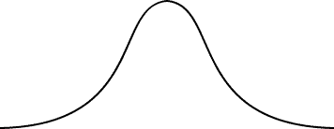
Chapter
05
Properties of a Normal Distribution
Normal distribution
A continuous probability distribution for a random variable, x.
The most important continuous probability distribution in statistics.
The graph of a normal distribution is called the normal curve.
μ
x

Slide 5
Chapter
05
Properties of a Normal Distribution
The mean, median, and mode are equal.
The normal curve is bell-shaped and symmetric about the mean.
The total area under the curve is equal to one.
The normal curve approaches, but never touches the x-axis as it extends farther and farther away from the mean.
Total area = 1
μ
x

Slide 6
Chapter
05
Properties of a Normal Distribution
Between μ – σ and μ + σ (in the center of the curve), the graph curves downward. The graph curves upward to the left of μ – σ and to the right of μ + σ. The points at which the curve changes from curving upward to curving downward are called the inflection points.
Inflection points
x
μ − 3σ
μ − 2σ
μ − σ
μ
μ + σ
μ + 2σ
μ + 3σ

Slide 7

Chapter
05
Means and standard deviations
A normal distribution can have any mean and any positive standard deviation.
The mean gives the location of the line of symmetry.
The standard deviation describes the spread of the data.
μ = 3.5
σ = 1.5
μ = 3.5
σ = 0.7
μ = 1.5
σ = 0.7

Slide 8

Chapter
05
Example
Which curve has the greater mean?
Which curve has the greater standard deviation?
Solution:
Curve A has the greater mean (The line of symmetry of curve A occurs at x = 15. The line of symmetry of curve B occurs at x = 12)
Curve B has the greater standard deviation (Curve B is more spread out than curve A.)

Slide 9

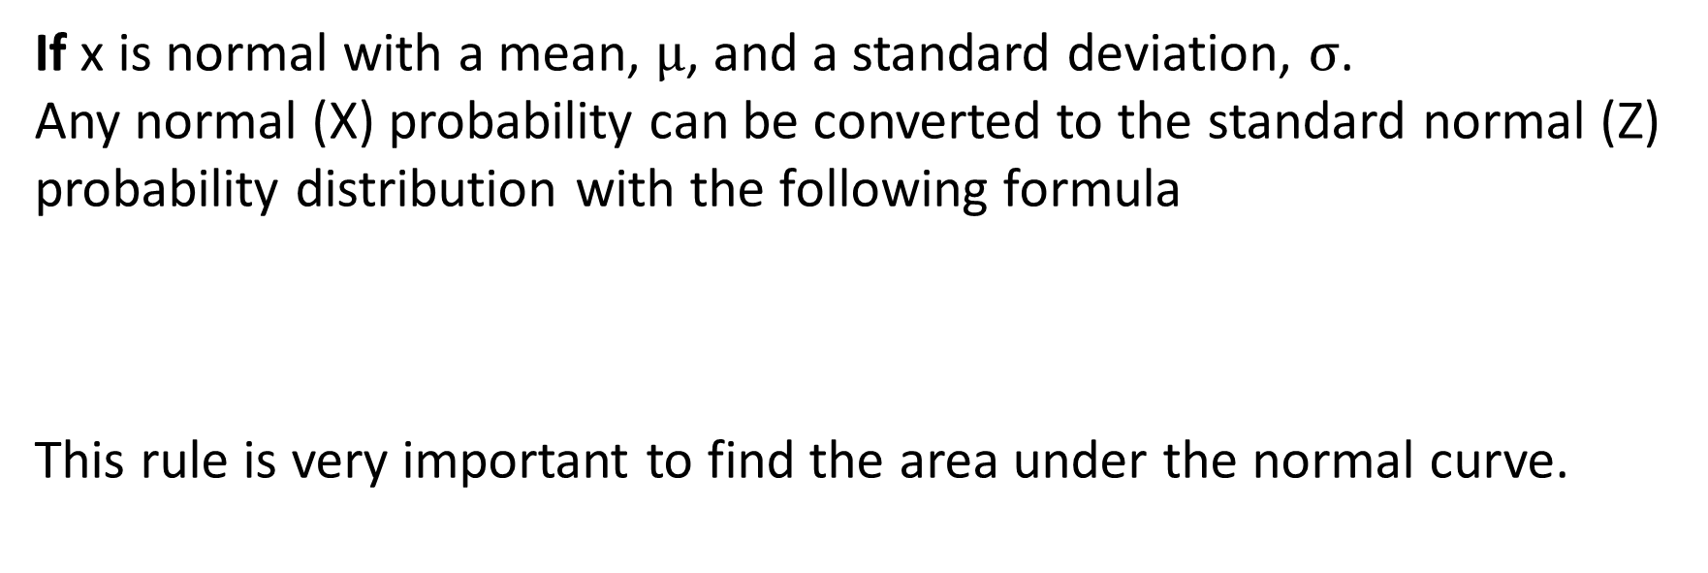
Chapter
05
Convert from normal to standard normal
If x is normal with a mean, $\text{μ}$, and a standard deviation, $\text{σ}$.
Any normal (X) probability can be converted to the standard normal (Z) probability distribution with the following formula
This rule is very important to find the area under the normal curve.

Slide 10
Chapter
05
The Standard Normal Distribution
Standard normal distribution
A normal distribution with a mean of 0 and a standard deviation of 1.
Area = 1
z
−3
−2
−1
0
1
2
3
Any x-value can be transformed into a z-score by using the formula

Slide 11
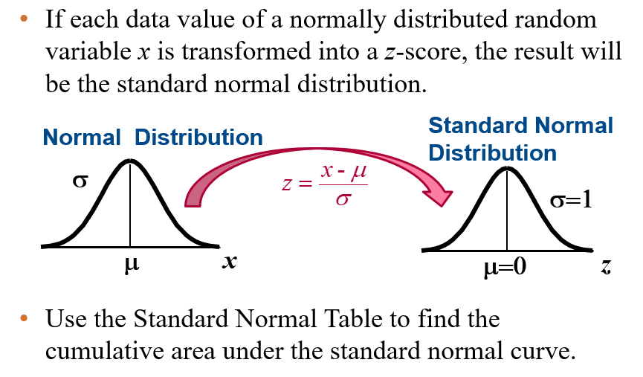
Chapter
05
The Standard Normal Distribution

Slide 12
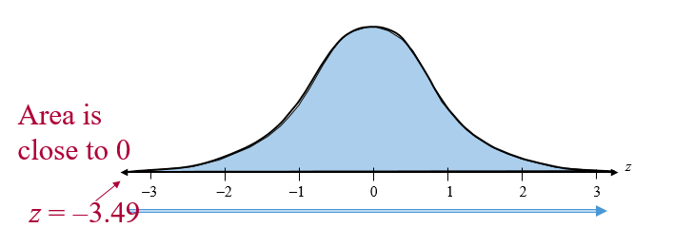
Chapter
05
Properties of the Standard Normal Distribution
The cumulative area is close to 0 for z-scores close to z = −3.49.
The cumulative area increases as the z-scores increase.

Slide 13
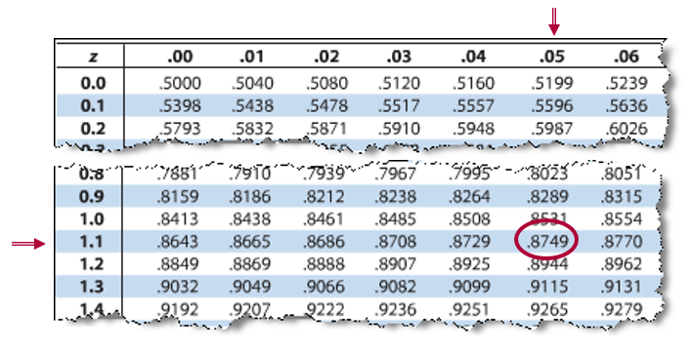
Chapter
05
Example: Using The Standard Normal Table
Find the cumulative area that corresponds to a z-score of 1.15.
The area to the left of z = 1.15 is 0.8749.

Slide 14
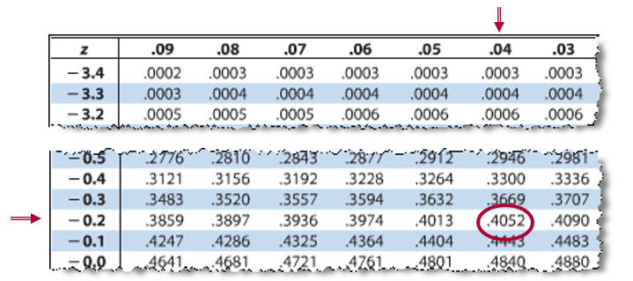
Chapter
05
Example: Using The Standard Normal Table
Find the cumulative area that corresponds to a z-score of -0.24.
The area to the left of z = -0.24 is 0.4052.

Slide 15
Chapter
05
Example: Using The Standard Normal Table
Find the cumulative area that corresponds to a z-score of -0.24.
The area to the left of z = -0.24 is 0.4052.

Slide 16
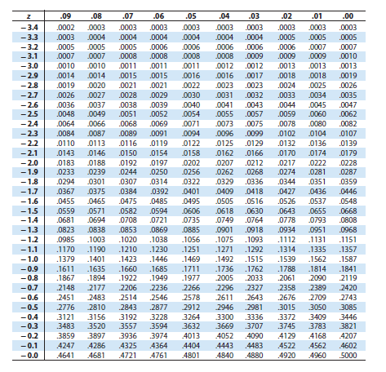
Chapter
05
The Standard Normal Table

Slide 17
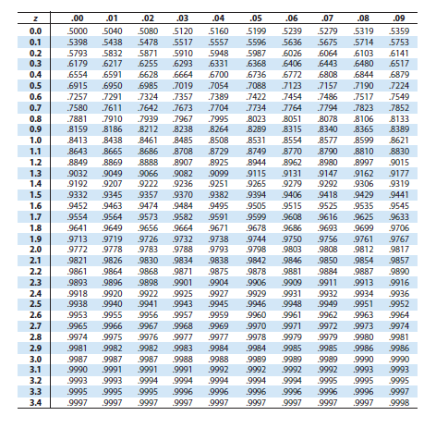
Chapter
05
The Standard Normal Table

Slide 18
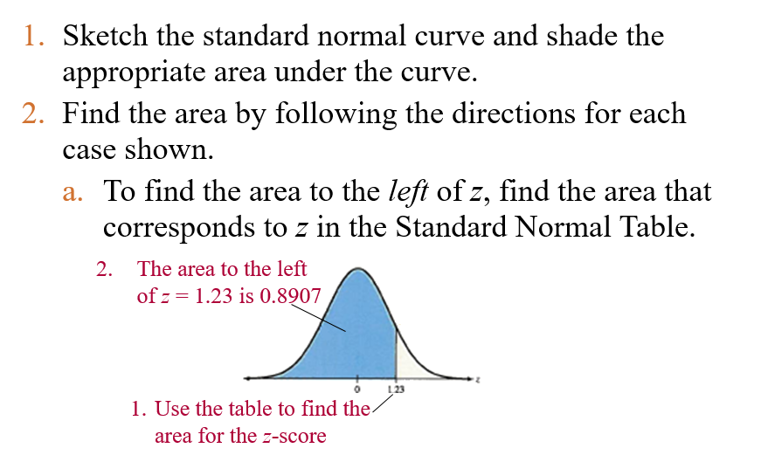
Chapter
05
Finding Areas Under the Standard Normal Curve

Slide 19
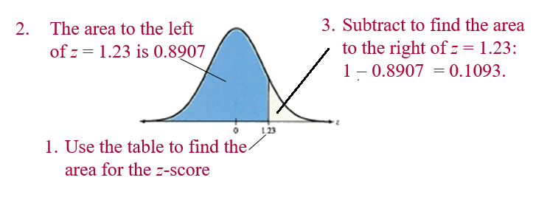
Chapter
05
Finding Areas Under the Standard Normal Curve
  To find the area to the right of z, use the Standard Normal Table to find the area that corresponds to z. Then subtract the area from 1.

Slide 20
Chapter
05
Normal Distributions: Finding Probabilities
If X value equal to 600, we have to transform this value to standard value by the rule to be able to use the table:

Slide 21

Chapter
05
Example: Finding Probabilities for Normal Distributions
A survey indicates that people use their computers an average of 2.4 years before upgrading to a new machine. The standard deviation is 0.5 year. A computer owner is selected at random. Find the probability that he or she will use it for fewer than 2 years before upgrading. Assume that the variable x is normally distributed.
Solution:
We need to find P(x < 2)

Slide 22
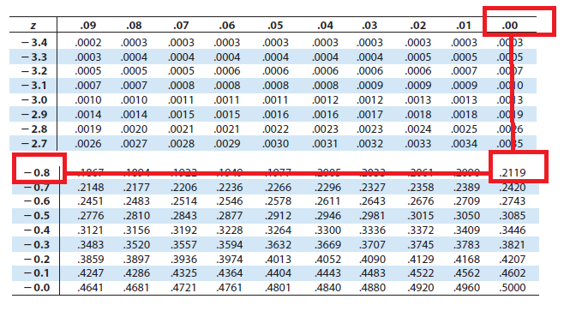
Chapter
05
Solution: Finding Probabilities for Normal Distributions
P(z < -0.80)
0.2119
z
-0.80
0
P(x < 2) = P(z < -0.80) = 0.2119

Slide 23
Chapter
05
Example: Finding Probabilities for Normal Distributions
A survey indicates that for each trip to the supermarket, a shopper spends an average of 45 minutes with a standard deviation of 12 minutes in the store. The length of time spent in the store is normally distributed and is represented by the variable x. A shopper enters the store. Find the probability that the shopper will be in the store for between 24 and 54 minutes.
Solution:
We need to find P(24< x < 54)

Slide 24
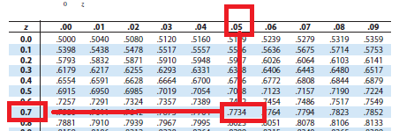
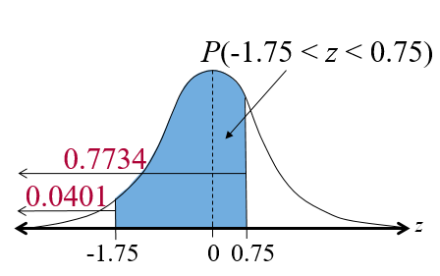
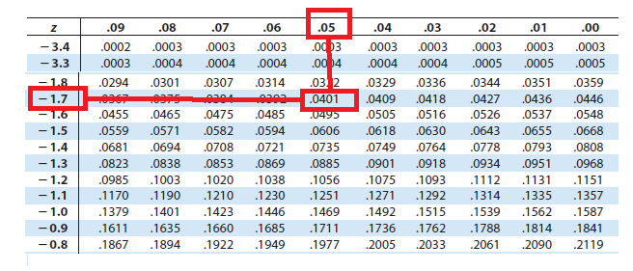
Chapter
05
Solution: Finding Probabilities for Normal Distributions
P(24 < x < 54) = P(-1.75 < z < 0.75) = 0.7734 – 0.0401 = 0.7333

Slide 25
Chapter
05
Example: Finding Probabilities for Normal Distributions
Find the probability that the shopper will be in the store more than 39 minutes. (Recall μ = 45 minutes and σ = 12 minutes)
Solution:
We need to get P(x > 39)

Slide 26
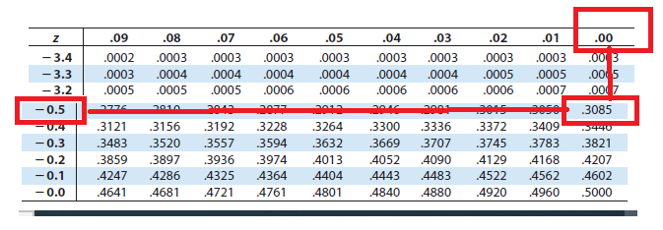
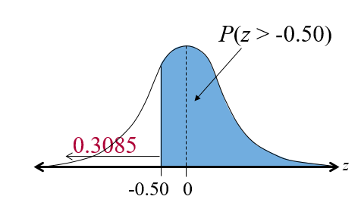
Chapter
05
Solution: Finding Probabilities for Normal Distributions
P(x > 39) = P(z > -0.50) = 1– 0.3085 = 0.6915

Slide 27
Chapter
05
5.3 Normal Distributions: Finding Values
Find a z-score given the area under the normal curve
Transform a z-score to an x-value
Find a specific data value of a normal distribution given the probability

Slide 28
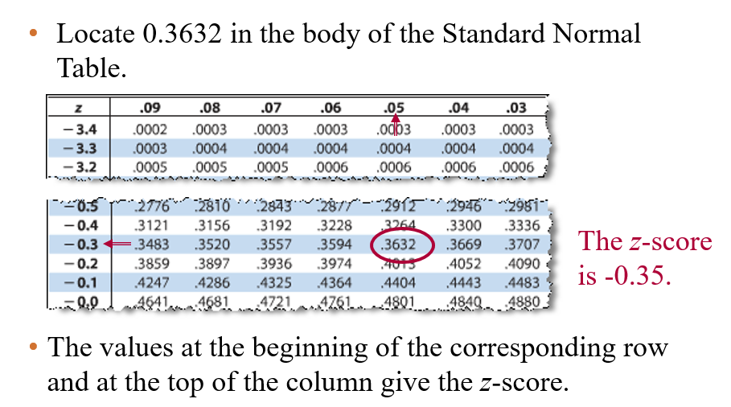
Chapter
05
Example: Finding a z-Score Given an Area
Find the z-score that corresponds to a cumulative area of 0.3632.

Slide 29
Chapter
05
Transforming a z-Score to an x-Score
To transform a standard z-score to a data value x in a given population, use the formula
x = μ + zσ

Slide 30
Chapter
05
Example: Finding an x-Value
The speeds of vehicles along a stretch of highway are normally distributed, with a mean of 67 miles per hour and a standard deviation of 4 miles per hour. Find the speeds x corresponding to z-sores of 1.96, -2.33, and 0
Solution: Use the formula x = μ + zσ
z = 1.96: x = 67 + 1.96(4) = 74.84 miles per hour
z = -2.33: x = 67 + (-2.33)(4) = 57.68 miles per hour
z = 0: x = 67 + 0(4) = 67 miles per hour

Slide 31
Chapter
05
Sampling Distributions and the Central Limit Theorem
Find sampling distributions and verify their properties
Interpret the Central Limit Theorem
Apply the Central Limit Theorem to find the probability of a sample mean

Slide 32
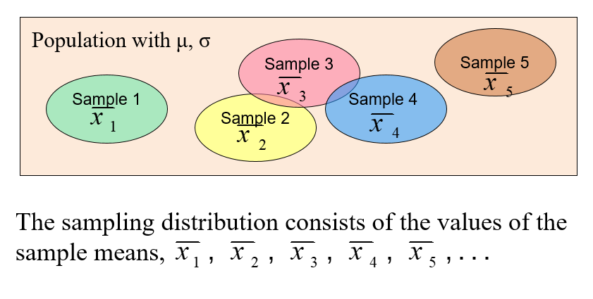
Chapter
05
Sampling distribution of sample mean

Slide 33
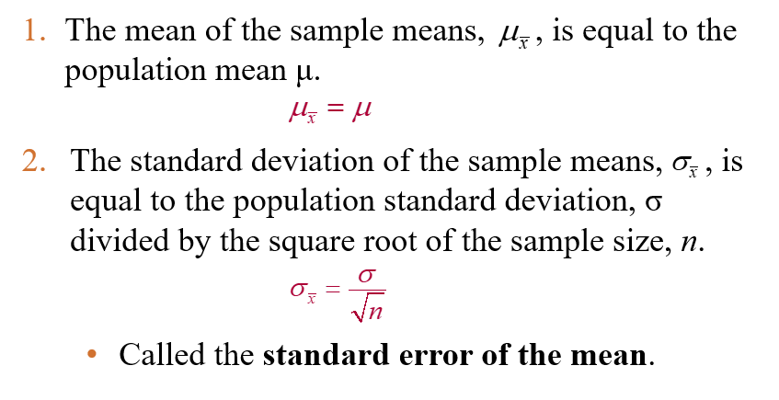
Chapter
05
Properties of Sampling distribution of sample mean

Slide 34
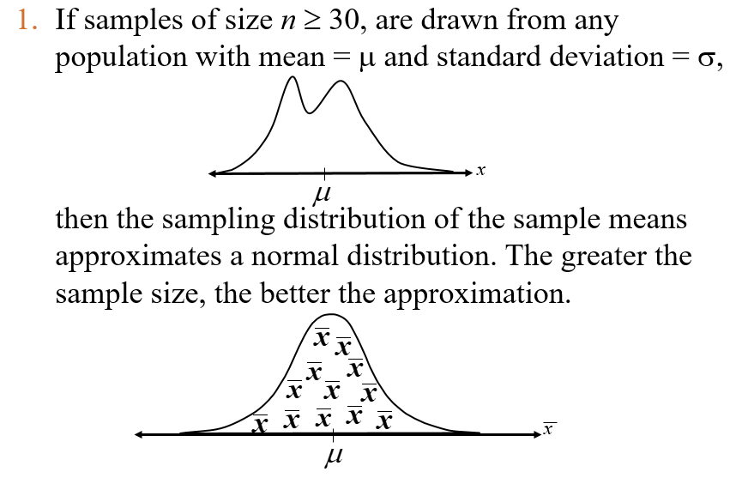
Chapter
05
Central Limit Theorem

Slide 35
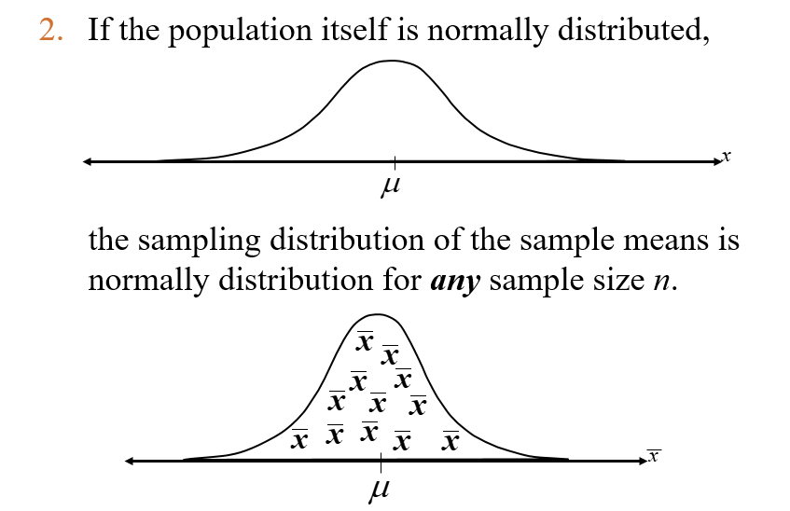
Chapter
05
Central Limit Theorem

Slide 36
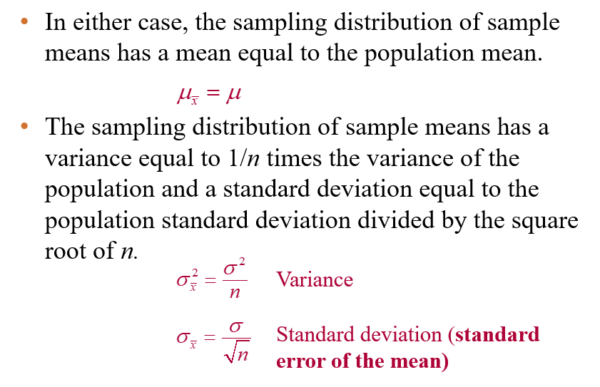
Chapter
05
Central Limit Theorem

Slide 37
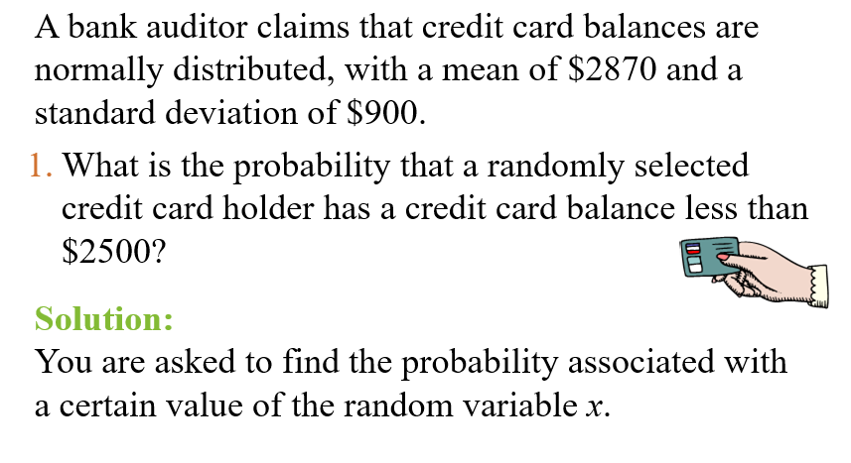

Chapter
05
Example: Probabilities for x and $\overline{x}$

Slide 38
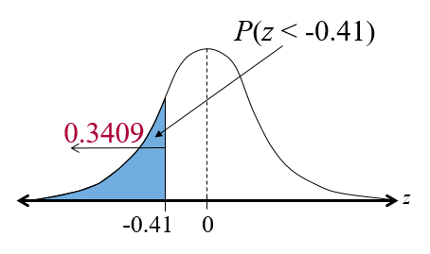

Chapter
05
Solution: Probabilities for x and $\overline{x}$
  P( x < 2500) = P(z < -0.41) = 0.3409

Slide 39
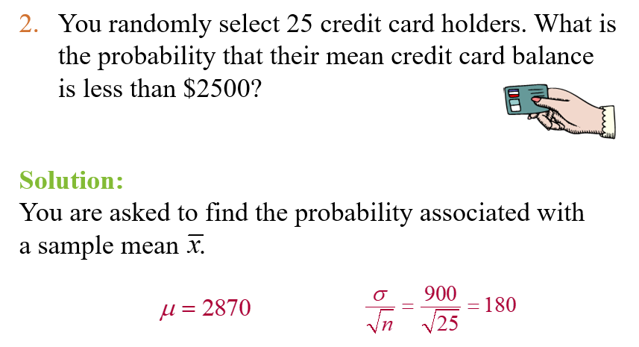

Chapter
05
Example: Probabilities for x and $\overline{x}$

Slide 40
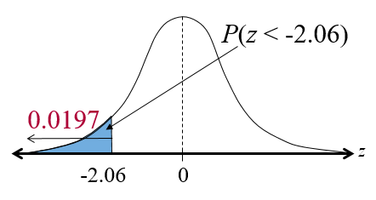

Chapter
05
Example: Probabilities for x and $\overline{x}$
P( x < 2500) = P(z < -2.06) = 0.0197

Slide 41
Chapter
05
5.5 Normal Approximations to Binomial Distributions
Determine when the normal distribution can approximate the binomial distribution
Use the normal distribution to approximate binomial probabilities

Slide 42
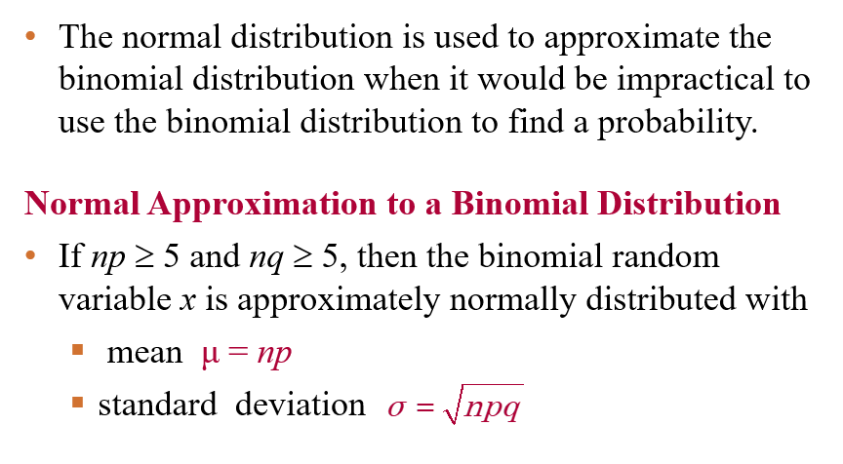
Chapter
04
Normal Approximation to a Binomial

Slide 43
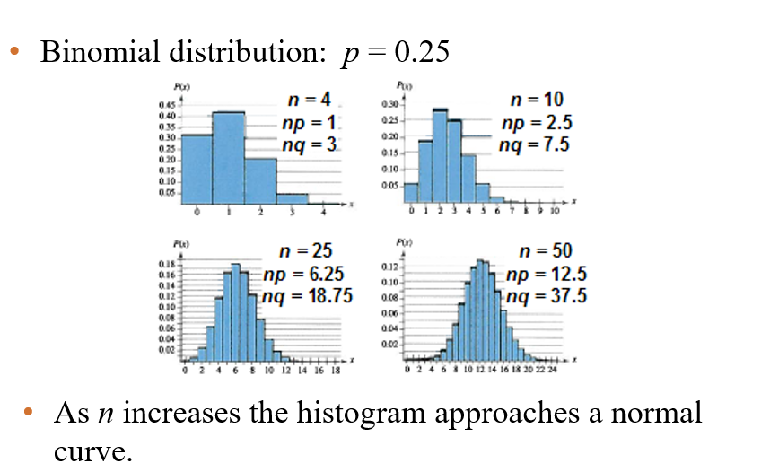
Chapter
05
Normal Approximation to a Binomial

Slide 44
Chapter
05
Normal Approximation to a Binomial

Slide 45
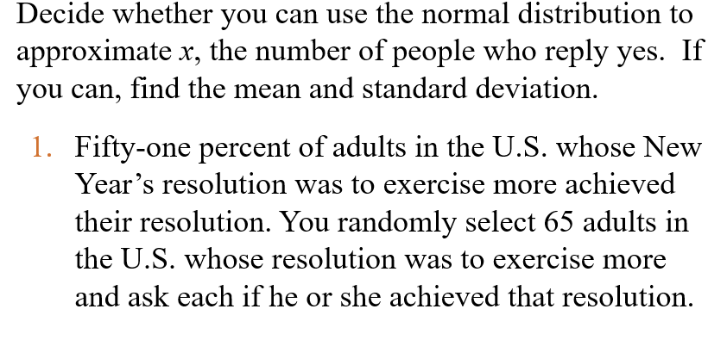
Chapter
05
Approximating the Binomial

Slide 46
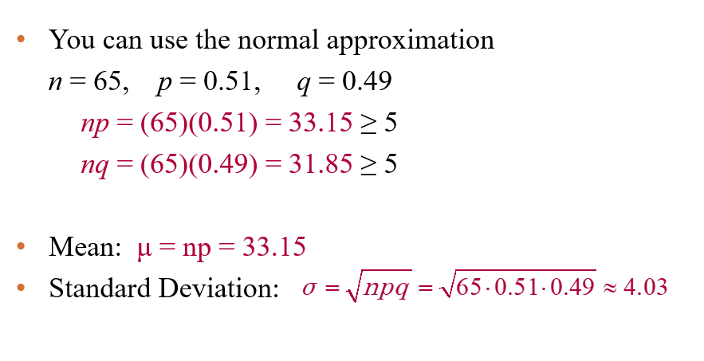
Chapter
05
Solution: Approximating the Binomial

Slide 47
Chapter
05
Chapter Summary
Found probabilities for normally distributed
Found a z-score given the area under the normal curve
Transformed a z-score to an x-value
Interpreted the Central Limit Theorem
Used the normal distribution to approximate binomial probabilities

