Slide 1

Supply chain Management
Prepared by Dr. Badur elgasim
Lecture 10
PMG 660
Transportation in a Supply Chain

Slide 2

Learning Objectives
After reading this chapter, you will be able to:
1. Understand the role of transportation in a supply chain.
2. Evaluate the strengths and weaknesses of different modes of transportation.
3. Discuss the role of infrastructure and policies in transportation.
4. Identify the relative strengths and weaknesses of various transportation network design options.
5. Identify trade-offs that shippers must consider when designing a transportation network.

Slide 3
The role of transportation in a supply chain
Transportation refers to the movement of product from one location to another as it makes its way from the beginning of a supply chain to the customer.
Transportation is an important supply chain driver because products are rarely produced and consumed in the same location.
Transportation is a significant component of the costs incurred by most supply chains.. Transportation-related jobs employed nearly .

Slide 4
Cont.
The role of transportation is even more significant in global supply chains. Dell currently has suppliers worldwide and sells to customers all over the world from just a few plants. Transportation allows products to move across Dell's global network.
Similarly, global transportation allows Wal-Mart to sell products manufactured all over the world in the United States.

Slide 5
Cont.
Any supply chain's success is closely linked to the appropriate use of transportation. IKEA, the Scandinavian home furnishings retailer, has built a global network with about 180 stores in 23 countries primarily on the basis of effective transportation. IKEA's sales for the year ending August 2004 reached 12.8 billion euros.
IKEA's strategy is built around providing good-quality products at low prices. Their goal is to cut prices by 2 to 3 percent each year.

Slide 6
Cont.
As a result, IKEA works hard to find the most inexpensive global source for each of its products. Modular design of its furniture allows IKEA to transport its goods worldwide much more cost effectively than a traditional furniture manufacturer.
The large size of IKEA stores and shipments allows inexpensive transportation of home furnishings all the way to the retail store. Effective sourcing and inexpensive transportation allow IKEA to provide high-quality home furnishings at low prices globally.

Slide 7
Cont.
Supply chains also use responsive transportation to centralize inventories and operate with fewer facilities.
For example, Amazon.com relies on package carriers and the postal system to deliver customer orders from centralized warehouses. Dell manufactures in a few locations in the United States and uses responsive transportation provided by package carriers to provide customers with highly customized products at a reasonable price.

Slide 8
Cont.
To understand transportation in a supply chain it is important to consider the perspective of all four parties. (carriers, infrastructure owners and operators, transportation policy makers, and shippers) A carrier makes investment decisions regarding the transportation equipment (locomotives, trucks, airplanes, etc.) and in some cases infrastructure (rail), and then makes operating decisions to try to maximize the return from these assets.
A shipper, in contrast, uses transportation to minimize the total cost (transportation, inventory, information, sourcing, and facility) while providing an appropriate level of responsiveness to the customer.

Slide 9
Cont.
We can think of a transportation network as a collection of nodes and links. Transportation originates and ends at nodes and travels on links. For most modes of transportation, infrastructure such as ports, roads, waterways, and airports is required both at the nodes and links. Most transportation infrastructure is owned and managed as a public good throughout the world.
It is very important that infrastructure be managed in such a way that monies are available for maintenance and investment in further capacity as needed..

Slide 10

Cont.
Transportation policy sets direction for the amount of national resources that go into improving transportation infrastructure.
Transportation policy also aims to prevent abuse of monopoly power, promote fair competition, and balance environmental, energy, and social concerns in transportation

Slide 11
Modes of transportation and their performance characteristics
Supply chains use a combination of the following modes of transportation:
• Air
• Package carriers
• Truck
• Rail
• Water
• Pipeline
• Intermodal

Slide 12
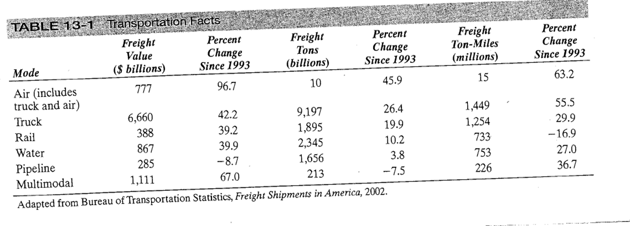
Cont.
Commercial freight activity in the United States by mode in 2002 is summarized in Table 13-1.

Slide 13
Cont.
The effectiveness of any mode of transport is affected by equipment investments and operating decisions by the carrier as well as the available infrastructure and transportation policies. The carrier's primary objective is to ensure good utilization of its assets while providing customers with an acceptable level of service.
Carrier decisions are affected by equipment cost, fixed operating cost, variable operating costs, the responsiveness the carrier seeks to provide its target segment, and the prices that the market will bear.

Slide 14
Transportation infrastructure and policies
Roads, seaports, airports, rail, and canals are some of the major infrastructural elements that exist along nodes and links of a transportation network. In almost all countries, the government has either taken full responsibility or played a significant role in building and managing these infrastructure elements.
Even in the United States, where a lot of the rail infrastructure was built by private capital under a charter, the cost was subsidized through land grants from the government.

Slide 15
Cont.
Improved infrastructure has played a significant role in the development of transportation and the resulting growth of trade.
The role of the railroads and canals in the economic development of the United States is well documented.
More recently, the impact of improved road, air, and port infrastructure on the development of China is very visible.

Slide 16
Design options for a transportation network
The design of a transportation network affects the performance of a supply chain by establishing the infrastructure within which operational transportation decisions regarding scheduling and routing are made.
A well-designed transportation network allows a supply chain to achieve the desired degree of responsiveness at a low cost.

Slide 17
Design options for a transportation network
We discuss a variety of design options for transportation networks and the strengths and weaknesses for each option in the context of a buyer with multiple locations sourcing from several suppliers.
These design options may be implemented between any two stages of a supply chain.

Slide 18
Direct shipment network
With the direct shipment network option, the buyer structures his transportation network so that all shipments come directly from each supplier to each buyer location, as shown in Figure 13-2.
With a direct shipment network, the routing of each shipment is specified and the supply chain manager only needs to decide on the quantity to ship and the mode of transportation to use.

Slide 19
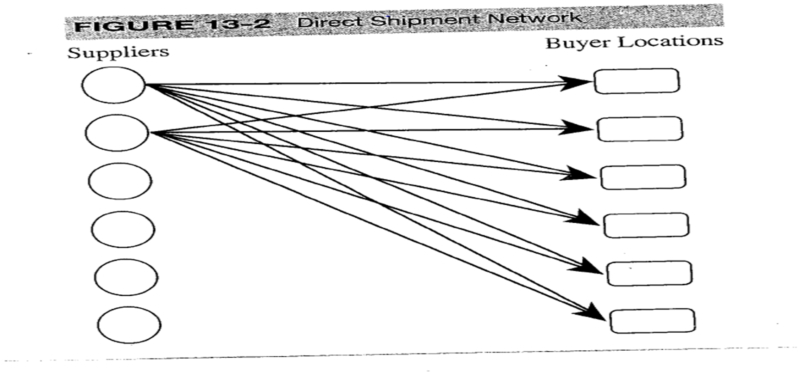
Cont.

Slide 20
Cont.
The major advantage of a direct shipment transportation network is the elimination of intermediate warehouses and its simplicity of operation and coordination.
The shipment decision is completely local, and the decision made for one shipment does not influence others.
The transportation time from supplier to buyer location is short because each shipment goes direct.

Slide 21
Cont.
A direct shipment network is justified if demand at buyer locations is large enough that optimal replenishment lot sizes are close to a TL (truckload) from each supplier to each location. With small buyer locations, however, a direct shipment network tends to have high costs.
If a TL carrier is used for transportation, the high fixed cost of each truck results in large lots moving from suppliers to each buyer location, resulting in high supply chain inventories.

Slide 22
Cont.
If a LTL (less-than truckload) carrier is used, the transportation cost and the delivery time increase, though inventories are lower.
If package carriers(transportation companies that carry packages , usually small) are used, transportation costs are very high. With direct deliveries from each supplier, receiving costs are high because each supplier must make a separate delivery.

Slide 23
Direct shipping with milk runs
A milk run is a route on which a truck either delivers product from a single supplier to multiple retailers or goes from multiple suppliers to a single buyer location,(adelivery method used to transport mixed loads from various suppliers to one customer) as shown in Figure 13-3. In direct shipping with milk runs, a supplier delivers directly to multiple buyer locations on a truck or a truck picks up deliveries destined for the same buyer location from many suppliers. When using this option, a supply chain manager has to decide on the routing of each milk run.

Slide 24
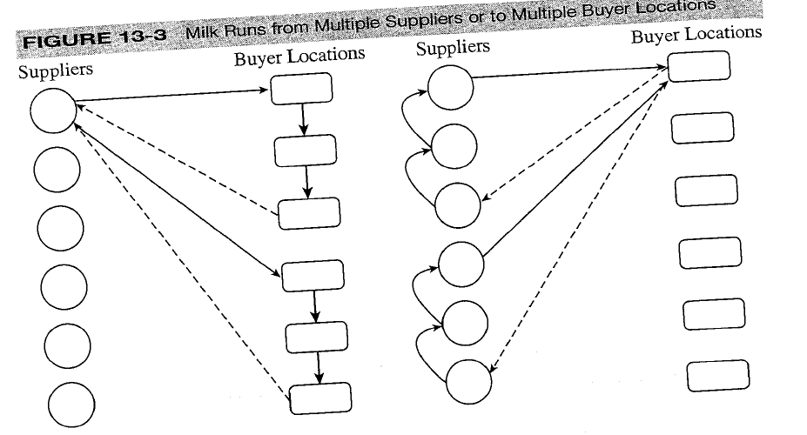
Cont.

Slide 25
Cont.
Direct shipping provides the benefit of eliminating intermediate warehouses, whereas milk runs lower transportation cost by consolidating shipments to multiple locations on a single truck.
For example, the replenishment lot size for each buyer location may be small and require LTL shipping if sent directly. The use of milk runs allows deliveries to multiple locations to be consolidated on a single truck, resulting in better utilization of the truck and somewhat lower costs.

Slide 26
Cont.
Companies such as, Toyota uses milk runs from suppliers to support its JIT manufacturing system in both Japan and the United States.
In Japan, Toyota has many assembly plants located close together and thus uses milk runs from a single supplier to many plants. In the United States, however, Toyota uses milk runs from many suppliers to each assembly plant.

Slide 27
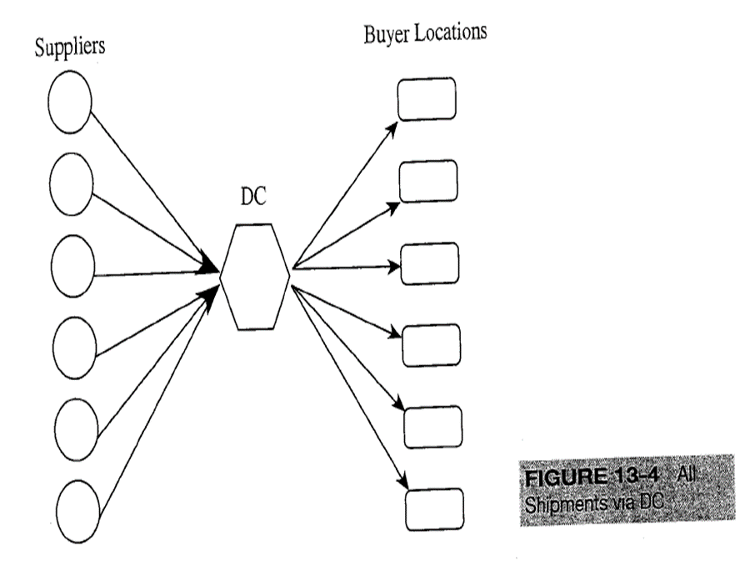
All shipments via central DC
Under this option, suppliers do not send shipments directly to buyer locations. The buyer divides locations by geographic region and a DC is built for each region. Suppliers send their shipments to the DC and the DC then forwards appropriate shipments to each buyer location, as shown in Figure 13-4.

Slide 28
Cont.
The DC is an extra layer between suppliers and buyer locations and can play two different roles. One is to store inventory and the other is to serve as a transfer location. In either case, the presence of DCs can help:
reduce supply chain costs when suppliers are located far from the buyer locations and transportation costs are high.
allows a supply chain to achieve economies of scale for inbound transportation to a point close to the final destination, because each supplier sends a large shipment to the DC that contains product for all locations the DC serves . Because DCs serve locations nearby, the outbound transportation cost is not very large. For example, W.W. Grainger has its suppliers ship products to one of nine DCs, which in turn replenish their almost 400 branches

Slide 29
Cont.
If transportation economies require very large shipments on the inbound side DCs hold inventory and send product to buyer locations in smaller replenishment lots. For example, when Wal-Mart sources from an overseas supplier, the product is held in inventory at the DC because the lot size on the inbound side is much larger than the sum of the lot sizes for the stores served by the DC.
If replenishment lots for the buyer locations served by a DC are large enough to achieve economies of scale on inbound transportation, the DC does not need to hold inventory.

Slide 30
Trade-offs in transportation design
All transportation decisions made by shippers in a supply chain network must take into account their impact on inventory costs, facility and processing costs, the cost of coordinating operations, as well as the level of responsiveness provided to customers. The cost of coordinating operations is generally hard to quantify. Shippers should evaluate different transportation options in terms of various costs as well as revenues and then rank them according to coordination complexity. A manager can then make the appropriate transportation decision. Managers must consider the following tradeoffs when making transportation decisions:
• Transportation and inventory cost trade-off
• Transportation cost and customer responsiveness trade-off

Slide 31
Cont.
TRANSPORTATION AND INVENTORY COST TRADE-OFF
The trade-off between transportation and inventory costs is significant when designing a supply chain network.
Two fundamental supply chain decisions involving this trade off are
• Choice of transportation mode
• Inventory aggregation
1- Choice of Transportation Mode:
Selecting a transportation mode is both a planning and an operational decision in a supply chain. The decision regarding carriers with which a company contracts is a planning decision, whereas the choice of transportation mode for a particular shipment is an operational decision

Slide 32
Cont.
For both decisions, a shipper must balance transportation and inventory costs. The mode of transportation that results in the lowest transportation cost does not necessarily lower total costs for a supply chain. Cheaper modes of transport typically have longer lead times and larger minimum shipment quantities, both of which result in higher levels of inventory in the supply chain. Modes that allow for shipping in small quantities lower inventory levels but tend to be more expensive

Slide 33
Cont.
Dell, for example, airfreights several of its components from Asia. This choice cannot be justified on the basis of transportation cost alone. It can only be justified because the use of a faster mode of transportation for shipping valuable components allows Dell to carry low levels of inventory .
The impact of using different modes of transportation on inventories, response time, and costs in the supply chain. Each transportation mode is ranked along various dimensions.

Slide 34
Cont.
Faster modes of transportation are preferred for products with a high value-to weight ratio, for which reducing inventories is important, whereas cheaper modes are preferred for products with a small value-to-weight ratio, for which reducing transportation cost is important.
The choice of transportation mode should take into account cycle, safety, and in-transit inventory costs besides the cost of transportation. Ignoring inventory costs when making transportation decisions can result in choices that worsen the performance of a supply chain

Slide 35

Cont.
2- Inventory Aggregation
Firms can significantly reduce the safety inventory they require by physically aggregating inventories in one location. Most e-businesses use this technique to gain advantage over firms with facilities in many locations. For example, Amazon.com has focused on decreasing its facility and inventory costs by holding inventory in a few warehouses, whereas booksellers such as Borders and Barnes & Noble have to hold inventory in many retail stores.

Slide 36
Cont.
Inventory aggregation is a good idea when inventory and facility costs form a large fraction of a supply chain's total costs. Inventory aggregation is useful for products with a large value-to-weight ratio and for products with high demand uncertainty. For example, inventory aggregation is very valuable for new products in the PC industry, because PCs have a large value-to-weight ratio and demand for new products is uncertain. Inventory aggregation is also a good idea if customer orders are large enough to ensure sufficient economies of scale on outbound transportation.

Slide 37
TRADE-OFF BETWEEN TRANSPORTATION COST AND CUSTOMER RESPONSIVENESS
The transportation cost a supply chain incurs is closely linked to the degree of responsiveness the supply chain aims to provide. If a firm has high responsiveness and ships all orders within a day of receipt from the customer, it will have small outbound shipments resulting in a high transportation cost. If it decreases its responsiveness and aggregates orders over a longer time horizon before shipping them out, it will be able to exploit economies of scale and incur a lower transportation cost because of larger shipments. Temporal aggregation is the process of combining orders across time. Temporal aggregation decreases a firm's responsiveness because of shipping delay but also decreases transportation costs because of economies of scale that result from larger shipments. Thus, a firm must consider the trade-off between responsiveness and transportation cost when designing its transportation network

Slide 38
Tailored transportation
Tailored transportation is the use of different transportation networks and modes based on customer and product characteristics. Most firms sell a variety of products and serve many different customer segments. For example, W.W. Grainger sells over 200,000 MRO supply products to both small contractors and very large firms.
Products vary in size and value and customers vary in the quantity purchased, responsiveness required, uncertainty of the orders, and distance from W.W. A firm can meet customer needs at a lower cost by using tailored transportation to provide the appropriate transportation choice based on customer and product characteristics

Slide 39
The role of IT in transportation
The complexity and scale of transportation makes it an excellent area within the supply chain for the use of IT systems. The use of software to determine transportation routes has been the most common IT application in transportation. This software takes the location of customers, shipment size, desired delivery times, information on the transportation infrastructure (such as distances between points), and vehicle capacity as inputs.
These inputs are formulated into an optimization problem whose solution is a set of routings and a packing list for each vehicle that minimize costs while meeting delivery constraints.

Slide 40
Cont.
Along with routing, vehicle packing software helps improve fleet utilization. By accounting for the size of the container and the size and sequence of each delivery, this software develops a plan to pack the vehicle efficiently while allowing for the greatest ease of unloading and/or loading along the route.
Synchronization between the packing and routing software is important because how much is packed on a truck affects the routing, while the routing obviously affects what is packed on a truck.

Slide 41
Risk management in transportation
There are three main types of risk to consider when transporting a shipment between two nodes on the network:
1. The risk that the shipment is delayed
2. The risk that the shipment does not reach its destination because intermediate nodes or links are disrupted by external forces
3. The risk of hazardous material

Slide 42
Making transportation decisions in practice
Align transportation strategy with competitive strategy.
Managers should ensure that a firm's transportation strategy supports its competitive strategy. They should design functional incentives that help achieve this goal.
Historically, the transportation function within firms has been evaluated based on the extent to which it can lower transportation costs.

Slide 43
Cont.
2. Consider both in-house and outsourced transportation.
Managers should consider an appropriate combination of company-owned and outsourced transportation to meet their needs.
This decision should be based on a firm's ability to handle transportation profitably as well as the strategic importance of transportation to the success of the firm.

Slide 44
Cont.
3. Use technology to improve transportation performance.
Managers must use information technology to decrease costs and improve responsiveness in their transportation networks. Software helps managers do transportation planning, modal selection, and build delivery routes and schedules.
Available technology allows carriers to identify the precise location of each vehicle as well as the shipments the vehicle carries.

Slide 45
Cont.
4. Design flexibility into the transportation network.
When designing transportation networks, managers should take into account uncertainty in demand as well as availability of transportation.
Ignoring uncertainty encourages a greater use of inexpensive and inflexible transportation modes that perform well when everything goes as planned . Such networks, however, perform very poorly when plans change.

Slide 46
Reference
Supply chain management
Strategy, Planning, and Operation
By: Sunil Chopra,.-3rd ed.
Chapter 13

