Slide 1


Data Structures and Algorithms
Prepared by Prof. Shereen Taie
IT251
Information Technology Department
Lecture 10

Slide 2




Data Structures and
Algorithms
Lecture 10
IT251
Information Technology Department
Prepared by
Prof. Shereen Taie
www.midocean.ae

Slide 3
Learning Objectives:
Single-Source Shortest Path
Dijkstra's algorithm Applications
Problem Dijkstra's algorithm
  Idea
  Dijkstra by example
  Pseudocode
  Dijkstra's algorithm - steps
Dijkstra Animated Example
Dijkstra’s algorithm running time
Chapter
04
www.midocean.ae

Slide 4
Dijkstra’s Algorithm
Chapter
04
www.midocean.ae

Slide 5
Dijkstra's algorithm Applications:
1. Digital Mapping Services in Google Maps: Many times we have tried to find the distance in G-Maps, from one city to another, or from your location to the nearest desired location.
  There encounters the Shortest Path Algorithm, as there are various routes/paths connecting them but it has to show the minimum distance, so Dijkstra’s Algorithm is used to find the minimum distance between two locations along the path.
2. Social Networking Applications: In many applications you might have seen the app suggests the list of friends that a particular user may know. How do you think many social media companies implement this feature efficiently, especially when the system has over a billion users.
  The standard Dijkstra algorithm can be applied using the shortest path between users measured through handshakes or connections among them.
04
www.midocean.ae

Slide 6
Dijkstra's algorithm Applications:
3. Telephone Network: As we know, in a telephone network, each line has a bandwidth, ‘b’. Bandwidth represents the amount of information that can be transmitted by the line. If we imagine a city to be a graph, the vertices represent the switching stations, and the edges represent the transmission lines and the weight of the edges represents ‘b’. It fall into the category of shortest distance problem, for which the Dijkstra is can be used.
4. IP routing to find Open shortest Path First: Open Shortest Path First (OSPF) is a link-state routing protocol that is used to find the best path between the source and the destination router using its own Shortest Path First.
  Dijkstra’s algorithm provides the shortest cost path from the source router to other routers in the network.
04
www.midocean.ae

Slide 7
Dijkstra's algorithm Applications:
5. Flighting Agenda: The agent has access to a database with all airports and flights. Specifically, the agent wants to determine the earliest arrival time for the destination given an origin airport and start time.
  Dijkstra’s algorithm comes into use.
6. Designate file server: To designate a file server in a LAN(local area network), Dijkstra’s algorithm can be used.
  To minimize the number of “hops” from the file server to every other computer on the network the idea is to use Dijkstra’s algorithm to minimize the shortest path between the networks resulting in the minimum number of hops.
04
www.midocean.ae

Slide 8
DIJKSTRA’S ALGORITHM
Single-source shortest paths for weighted graphs
(non-negative edges)
04
www.midocean.ae

Slide 9
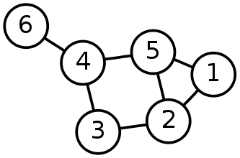
Single-Source Shortest Path Problem
Single-Source Shortest Path Problem - The problem of finding shortest paths from a source vertex v to all other vertices in the graph.
04
www.midocean.ae

Slide 10
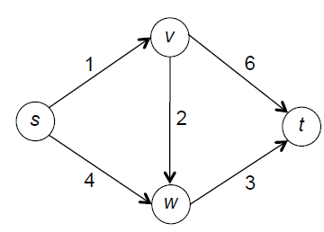
Exercise 1:
Consider the following input to the single-source shortest path problem, with starting vertex s and with each edge labeled with its length:
What are the shortest-path distances to s, v, w, and t, respectively?
a) 0, 1, 2, 3
b) 0, 1, 3, 6
c) 0, 1, 4, 6
d) 0, 1, 4, 7
04
www.midocean.ae

Slide 11
Single-Source Shortest path problem
What is the shortest path between u and v in a weighted graph?
  the cost of a path is the sum of the weights along that path
  The shortest path is the one with the minimum cost.
The distance d(u,v) between two vertices u and v is the cost of the shortest path between u and v.
For this lecture all graphs are directed, but to save on notation I’m just going to draw undirected edges.
This path from s to t has cost 25.
3
20
2
s
1
t
2
1
This path is shorter, it has cost 5.
1
04
=
www.midocean.ae

Slide 12
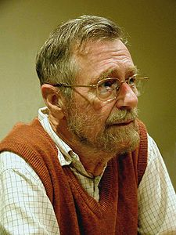
Edsger Wybe Dijkstra
- May 11, 1930 – August 6, 2002
- Received the 1972 A. M. Turing Award, widely considered the most prestigious award in computer science.
- The Schlumberger Centennial Chair of Computer Sciences at The University of Texas at Austin from 1984 until 2000
- Made a strong case against use of the GOTO statement in programming languages and helped lead to its deprecation.
- Known for his many essays on programming.
04
www.midocean.ae

Slide 13
Dijkstra's algorithm
Dijkstra's algorithm - is a solution to the single-source shortest path problem in graph theory.
Works on both directed and undirected graphs. However,
All edges must have nonnegative weights.
Approach: Greedy
Input: Weighted graph G={E,V} and source vertex v ∈V, such that all edge weights are nonnegative
Output: Lengths of shortest paths (or the shortest paths themselves) from a given source vertex v ∈V to all other vertices
04
www.midocean.ae

Slide 14
Dijkstra's algorithm - Idea
Source node is s.
For each node v, store an over-estimate of d(s, v).
These over-estimates start off as ∞, and we’ll iteratively work to make these over-estimates tighter and tighter, until they reach the true distance.
Each iteration of its main loop processes one new vertex.
The algorithm’s sophistication lies in its clever rule for selecting which vertex to process next: the not-yet-processed vertex that appears to be closest to the starting vertex.
For demonstration purposes, we’ll use three colors again to keep track of the state of each node:
unsure node
04
current node
sure node
www.midocean.ae

Slide 15
DIJKSTRA BY EXAMPLE
Suppose our single source node is Gates.
Caltrain
unsure node
12
4
Gates
Stadium
current node
3
2
15
sure node
Memchu
2
21
Wilbur Dining
Chipotle
10
1
The Dish
Old Union
15
04
www.midocean.ae

Slide 16
DIJKSTRA BY EXAMPLE
∞
∞
Caltrain
unsure node
12
4
∞
∞
Gates
∞
current node
Stadium
3
2
15
sure node
Memchu
∞
∞
∞
2
Wilbur Dining
∞
21
Chipotle
∞
10
∞
1
We initialize all our overestimates:
d[v] = ∞
for all vertices v.
∞
∞
Old Union
The Dish
∞
15
∞
04
www.midocean.ae

Slide 17
DIJKSTRA BY EXAMPLE
∞
∞
Caltrain
unsure node
12
4
∞
0
Gates
∞
current node
Stadium
3
2
15
sure node
Memchu
∞
∞
∞
2
Wilbur Dining
∞
21
Chipotle
∞
10
∞
1
∞
∞
Old Union
Since Gates is our source, first set
d[Gates] = 0
The Dish
∞
15
∞
04
www.midocean.ae

Slide 18
DIJKSTRA BY EXAMPLE
∞
∞
Caltrain
unsure node
12
4
∞
0
Gates
Stadium
∞
current node
3
2
15
sure node
Memchu
∞
∞
∞
2
Wilbur Dining
∞
21
Chipotle
∞
10
∞
1
∞
∞
Old Union
Now pick the node with the smallest d[v]. That’s obviously Gates.
Call this node u.
The Dish
∞
15
∞
04
www.midocean.ae

Slide 19
DIJKSTRA BY EXAMPLE
∞
Caltrain
unsure node
12
4
0
Gates
Stadium
∞
current node
3
2
15
sure node
Memchu
2
∞
∞
21
Wilbur Dining
Chipotle
∞
10
1
∞
Old Union
Update each of u’s neighbors v as follows:
d[v] = min(d[v], d[u] + w(u, v))
=min(∞,0+12)=min(∞,12)=12
Min(∞,0+3)=3
=min(∞,0+2)=2
=min(∞,0+21)=21
The Dish
15
∞
04
www.midocean.ae

Slide 20
DIJKSTRA BY EXAMPLE
12
Caltrain
unsure node
12
4
0
Gates
Stadium
3
current node
3
2
15
sure node
Memchu
2
∞
∞
21
Wilbur Dining
Chipotle
2
10
1
21
Old Union
Update each of u’s neighbors v as follows:
d[v] = min(d[v], d[u] + w(u, v))
The Dish
15
∞
04
www.midocean.ae

Slide 21
DIJKSTRA BY EXAMPLE
12
Caltrain
unsure node
12
4
0
Gates
Stadium
3
current node
3
2
15
sure node
Memchu
2
∞
∞
21
Wilbur Dining
Chipotle
2
10
1
21
Old Union
Mark current node u as sure.
The Dish
15
∞
04
www.midocean.ae

Slide 22
DIJKSTRA BY EXAMPLE
12
Caltrain
unsure node
12
4
0
Gates
Stadium
3
current node
3
2
15
sure node
Memchu
2
∞
∞
21
Wilbur Dining
Chipotle
2
10
1
21
Old Union
Now pick the next node with the smallest d[v]. That’s MemChu.
(we’ll call this node u now).
The Dish
15
∞
04
www.midocean.ae

Slide 23
DIJKSTRA BY EXAMPLE
12
Caltrain
unsure node
12
4
0
Gates
Stadium
3
current node
3
2
15
sure node
Memchu
2
∞
∞
21
Wilbur Dining
Chipotle
2
10
1
21
Old Union
Update each of u’s unsure neighbors v as follows:
d[v] = min(d[v], d[u] + w(u, v))
=min(∞,2+2)=4
The Dish
15
∞
04
www.midocean.ae

Slide 24
DIJKSTRA BY EXAMPLE
12
Caltrain
unsure node
12
4
0
Gates
Stadium
3
current node
3
2
15
sure node
Memchu
2
4
∞
21
Wilbur Dining
Chipotle
2
10
1
21
Old Union
Update each of u’s unsure neighbors v as follows:
d[v] = min(d[v], d[u] + w(u, v))
The Dish
15
∞
04
www.midocean.ae

Slide 25
DIJKSTRA BY EXAMPLE
12
Caltrain
unsure node
12
4
0
Gates
Stadium
3
current node
3
2
15
sure node
Memchu
2
4
∞
21
Wilbur Dining
Chipotle
2
10
1
21
Old Union
Mark current node u as sure.
The Dish
15
∞
04
www.midocean.ae

Slide 26
DIJKSTRA BY EXAMPLE
12
Caltrain
unsure node
12
4
0
Gates
Stadium
3
current node
3
2
15
sure node
Memchu
2
4
∞
21
Wilbur Dining
Chipotle
2
10
1
21
Old Union
Now pick the next node with the smallest d[v]. That’s Stadium.
(we’ll call this node u now).
The Dish
15
∞
04
www.midocean.ae

Slide 27
DIJKSTRA BY EXAMPLE
12
Caltrain
unsure node
12
4
0
Gates
Stadium
3
current node
3
2
15
sure node
Memchu
2
4
∞
21
Wilbur Dining
Chipotle
2
10
1
21
Old Union
Update each of u’s unsure neighbors v as follows:
d[v] = min(d[v], d[u] + w(u, v))
Min(12,3+4)=min(12,7)=7
Min(∞, 3+15)=min(∞, 18)=18
The Dish
15
∞
04
www.midocean.ae

Slide 28
DIJKSTRA BY EXAMPLE
7
Caltrain
unsure node
12
4
0
Gates
Stadium
3
current node
3
2
15
sure node
Memchu
2
4
18
21
Wilbur Dining
Chipotle
2
10
1
21
Old Union
Update each of u’s unsure neighbors v as follows:
d[v] = min(d[v], d[u] + w(u, v))
The Dish
15
∞
04
www.midocean.ae

Slide 29
DIJKSTRA BY EXAMPLE
7
Caltrain
unsure node
12
4
0
Gates
Stadium
3
current node
3
2
15
sure node
Memchu
2
4
18
21
Wilbur Dining
Chipotle
2
10
1
21
Old Union
Mark current node u as sure.
The Dish
15
∞
04
www.midocean.ae

Slide 30
DIJKSTRA BY EXAMPLE
7
Caltrain
unsure node
12
4
0
Gates
Stadium
3
current node
3
2
15
sure node
Memchu
2
4
18
21
Wilbur Dining
Chipotle
2
10
1
21
Old Union
Now pick the next node with the smallest d[v]. That’s Wilbur Dining.
(we’ll call this node u now).
The Dish
15
∞
04
www.midocean.ae

Slide 31
DIJKSTRA BY EXAMPLE
7
Caltrain
unsure node
12
4
0
Gates
Stadium
3
current node
3
2
15
sure node
Memchu
2
4
18
21
Wilbur Dining
Chipotle
2
10
1
21
Old Union
Update each of u’s unsure neighbors v as follows:
d[v] = min(d[v], d[u] + w(u, v))
Min(18,4+10)=14
Min(∞, 4+1)=5
The Dish
15
∞
04
www.midocean.ae

Slide 32
DIJKSTRA BY EXAMPLE
7
Caltrain
unsure node
12
4
0
Gates
Stadium
3
current node
3
2
15
sure node
Memchu
2
4
14
21
Wilbur Dining
Chipotle
2
10
1
21
Old Union
Update each of u’s unsure neighbors v as follows:
d[v] = min(d[v], d[u] + w(u, v))
The Dish
15
5
04
www.midocean.ae

Slide 33
DIJKSTRA BY EXAMPLE
7
Caltrain
unsure node
12
4
0
Gates
Stadium
3
current node
3
2
15
sure node
Memchu
2
4
14
21
Wilbur Dining
Chipotle
2
10
1
21
Old Union
Mark current node u as sure.
The Dish
15
5
04
www.midocean.ae

Slide 34
DIJKSTRA BY EXAMPLE
7
Caltrain
unsure node
12
4
0
Gates
Stadium
3
current node
3
2
15
sure node
Memchu
2
4
14
21
Wilbur Dining
Chipotle
2
10
1
21
Old Union
Now pick the next node with the smallest d[v]. That’s Old Union.
(we’ll call this node u now).
The Dish
15
5
04
www.midocean.ae

Slide 35
DIJKSTRA BY EXAMPLE
7
Caltrain
unsure node
12
4
0
Gates
Stadium
3
current node
3
2
15
sure node
Memchu
2
4
14
21
Wilbur Dining
Chipotle
2
10
1
21
Old Union
Update each of u’s unsure neighbors v as follows:
d[v] = min(d[v], d[u] + w(u, v))
Min(21,5+15)=20
The Dish
15
5
04
www.midocean.ae

Slide 36
DIJKSTRA BY EXAMPLE
7
Caltrain
unsure node
12
4
0
Gates
Stadium
3
current node
3
2
15
sure node
Memchu
2
4
14
21
Wilbur Dining
Chipotle
2
10
1
20
Old Union
Update each of u’s unsure neighbors v as follows:
d[v] = min(d[v], d[u] + w(u, v))
The Dish
15
5
04
www.midocean.ae

Slide 37
DIJKSTRA BY EXAMPLE
7
Caltrain
unsure node
12
4
0
Gates
Stadium
3
current node
3
2
15
sure node
Memchu
2
4
14
21
Wilbur Dining
Chipotle
2
10
1
20
Old Union
Mark current node u as sure.
The Dish
15
5
04
www.midocean.ae

Slide 38
DIJKSTRA BY EXAMPLE
7
Caltrain
unsure node
12
4
0
Gates
Stadium
3
current node
3
2
15
sure node
Memchu
2
4
14
21
Wilbur Dining
Chipotle
2
10
1
20
Old Union
Now pick the next node with the smallest d[v]. That’s Caltrain.
(we’ll call this node u now).
The Dish
15
5
04
www.midocean.ae

Slide 39
DIJKSTRA BY EXAMPLE
7
Caltrain
unsure node
12
4
0
Gates
Stadium
3
current node
3
2
15
sure node
Memchu
2
4
14
21
Wilbur Dining
Chipotle
2
10
1
20
Old Union
We’d update each of u’s unsure neighbors v,
but looks like u doesn’t have any unsure neighbors.
Just mark u as sure.
The Dish
15
5
04
www.midocean.ae

Slide 40
DIJKSTRA BY EXAMPLE
7
Caltrain
unsure node
12
4
0
Gates
Stadium
3
current node
3
2
15
sure node
Memchu
2
4
14
21
Wilbur Dining
Chipotle
2
10
1
20
Old Union
Now pick the next node with the smallest d[v]. That’s Chipotle.
(we’ll call this node u now).
The Dish
15
5
04
www.midocean.ae

Slide 41
DIJKSTRA BY EXAMPLE
7
Caltrain
unsure node
12
4
0
Gates
Stadium
3
current node
3
2
15
sure node
Memchu
2
4
14
21
Wilbur Dining
Chipotle
2
10
1
20
Old Union
We’d update each of u’s unsure neighbors v,
but looks like u doesn’t have any unsure neighbors.
Just mark u as sure.
The Dish
15
5
04
www.midocean.ae

Slide 42
DIJKSTRA BY EXAMPLE
7
Caltrain
unsure node
12
4
0
Gates
Stadium
3
current node
3
2
15
sure node
Memchu
2
4
14
21
Wilbur Dining
Chipotle
2
10
1
20
Old Union
Now pick the next node with the smallest d[v]. That’s The Dish.
(we’ll call this node u now).
The Dish
15
5
04
www.midocean.ae

Slide 43
DIJKSTRA BY EXAMPLE
7
Caltrain
unsure node
12
4
0
Gates
Stadium
3
current node
3
2
15
sure node
Memchu
2
4
14
21
Wilbur Dining
Chipotle
2
10
1
20
Old Union
We’d update each of u’s unsure neighbors v,
but looks like u doesn’t have any unsure neighbors.
Just mark u as sure.
The Dish
15
5
04
www.midocean.ae

Slide 44
DIJKSTRA BY EXAMPLE
7
Caltrain
unsure node
12
4
0
Gates
Stadium
3
current node
3
2
15
sure node
Memchu
2
4
14
21
Wilbur Dining
Chipotle
2
10
1
20
Old Union
There are no more unsure nodes!
We’re done, and all d[v] = d(s,v)!
(Check for yourself)
The Dish
15
5
04
www.midocean.ae

Slide 45

Chapter
04
DIJKSTRA PSUEDOCODE
www.midocean.ae

Slide 46
DIJKSTRA PSUEDOCODE
DIJKSTRA(G,s):
Set all vertices to not-sure.
d[v] = ∞ for all v in V
d[s] = 0
while there are not-sure nodes:
pick the not-sure node u with smallest estimate d[u]
for v in u.neighbors:
d[v] ← min(d[v], d[u] + w(u,v)) // update step
mark u as sure
now all d[v] indeed equals the true distance d(s,v)
04
www.midocean.ae

Slide 47
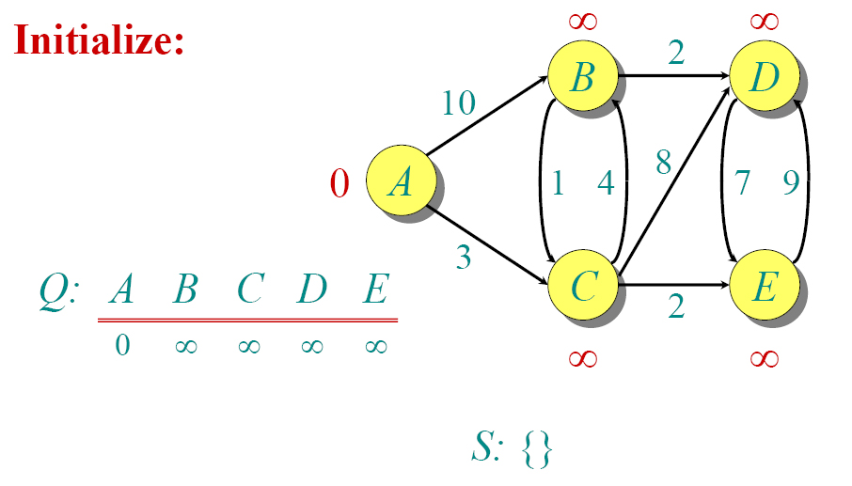
Dijkstra Animated Example 1
04
www.midocean.ae

Slide 48
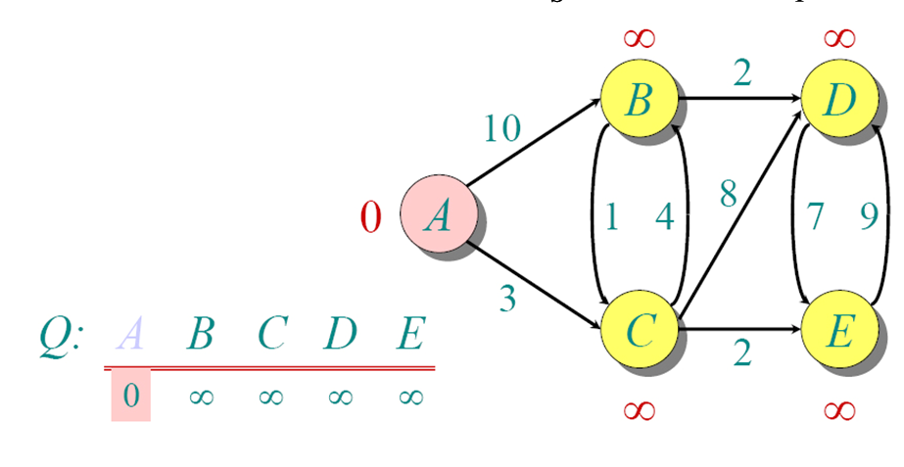
Dijkstra Animated Example 1
04
www.midocean.ae

Slide 49
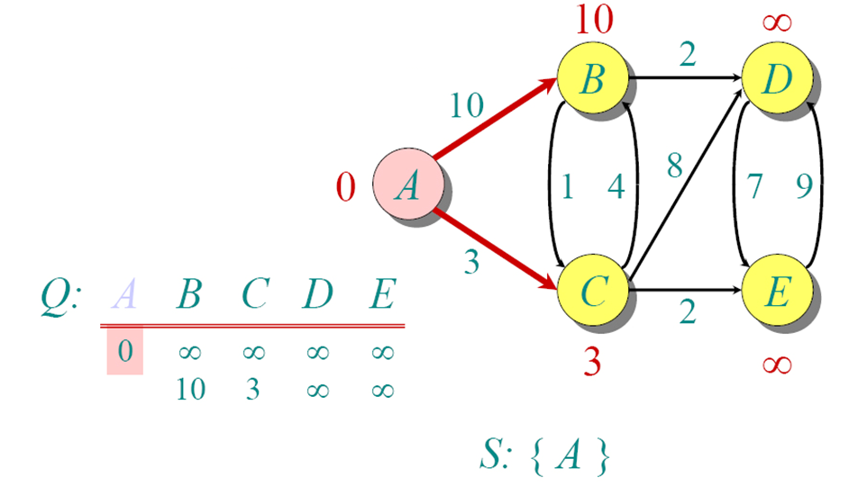
Dijkstra Animated Example 1
04
www.midocean.ae

Slide 50
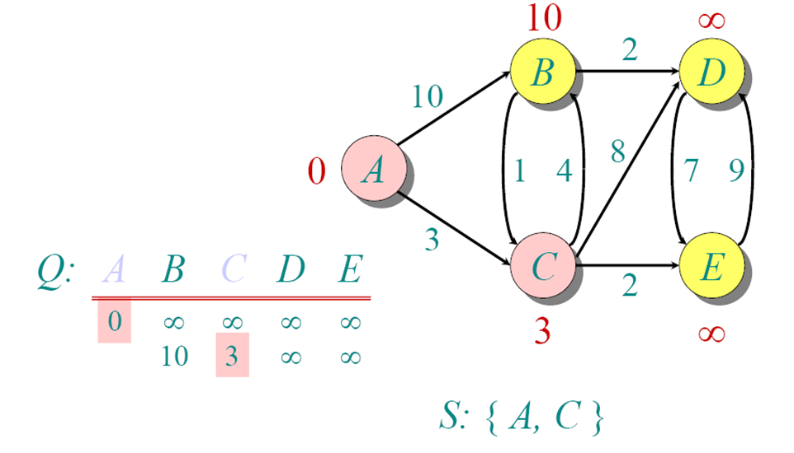
Dijkstra Animated Example 1
04
www.midocean.ae

Slide 51
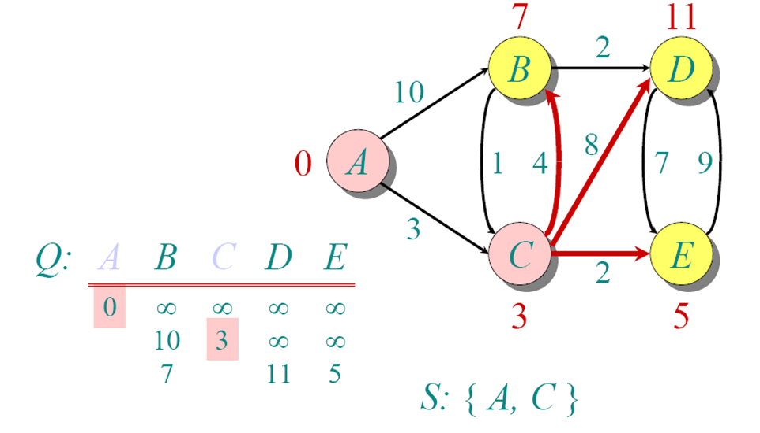
Dijkstra Animated Example 1
04
www.midocean.ae

Slide 52
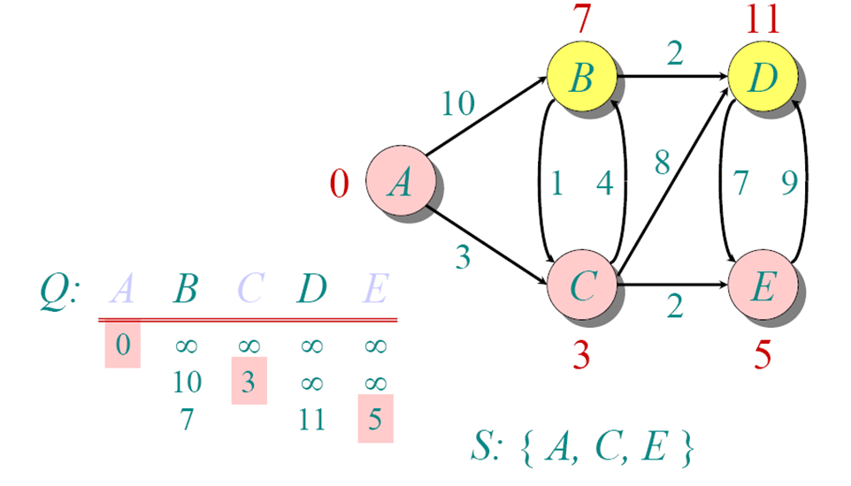
Dijkstra Animated Example 1
04
www.midocean.ae

Slide 53
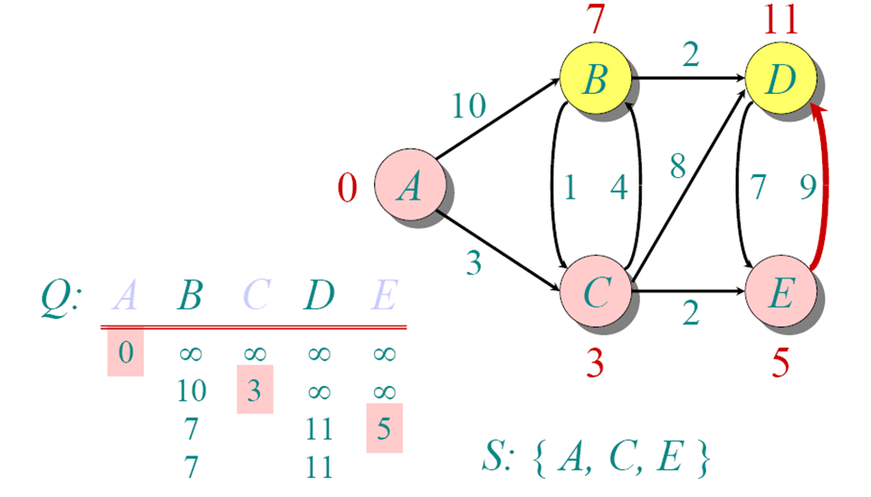
Dijkstra Animated Example 1
04
www.midocean.ae

Slide 54
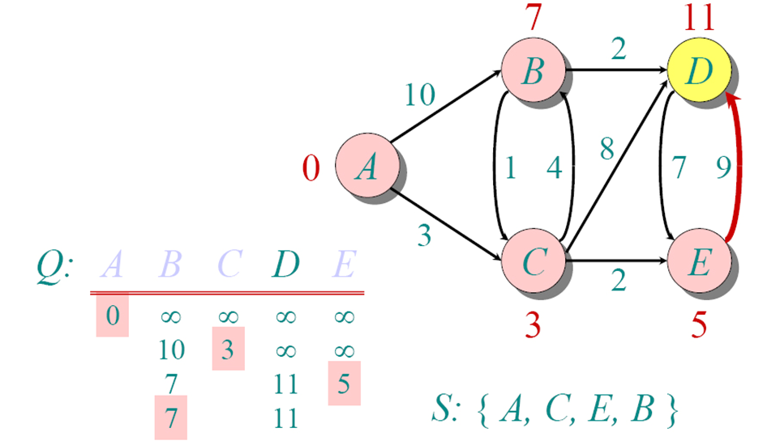
Dijkstra Animated Example 1
04
www.midocean.ae

Slide 55
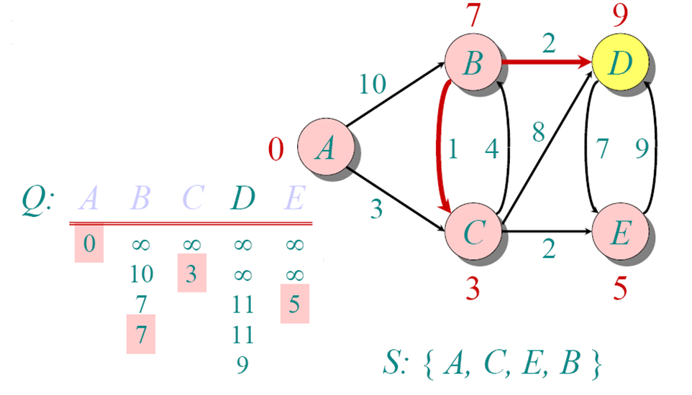
Dijkstra Animated Example 1
04
www.midocean.ae

Slide 56
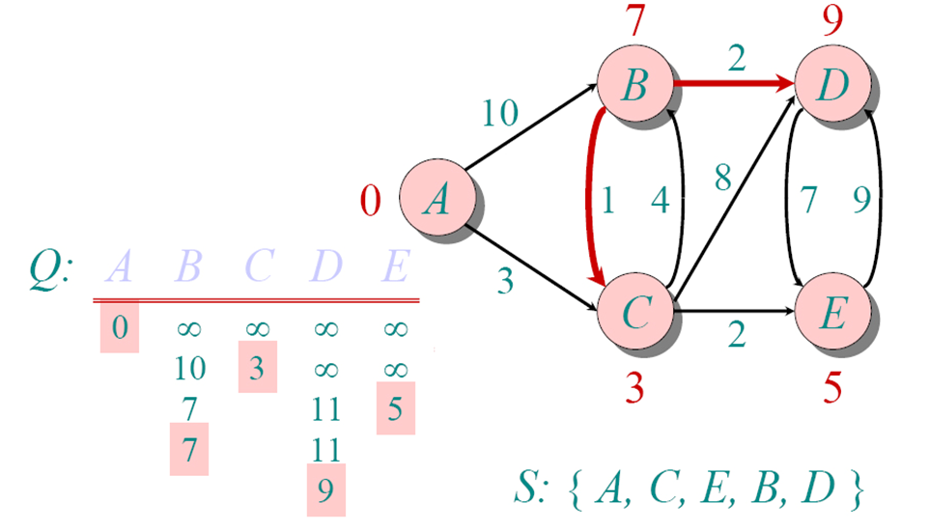
Dijkstra Animated Example 1
Vertex | Shortest distance from start | Previous vertex
A | 0
C | 3 | A
E | 5 | C
B | 7 | C
D | 9 | B
04
www.midocean.ae

Slide 57
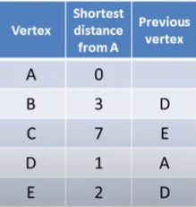
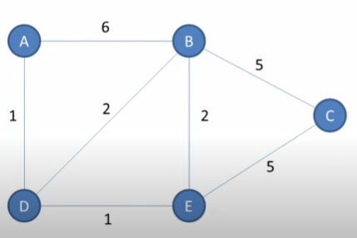
Dijkstra Example 2
Find the shortest distance from A to each vertex in the graph
Find the shortest path from A to each vertex in the graph
04
www.midocean.ae

Slide 58
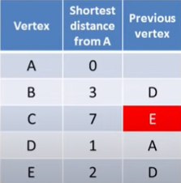
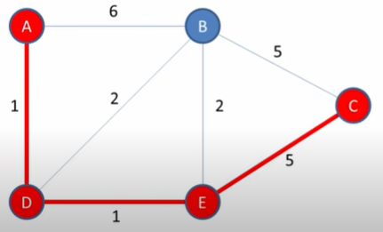
Dijkstra Example 2
Ex: Find the shortest path from A to C
04
www.midocean.ae

Slide 59
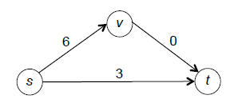
Dijkstra's algorithm
You might be wondering why it matters whether or not edges have negative edge lengths. Can’t we just force all the edge lengths to be nonnegative by adding a big number to every edge’s length?
The problem is that different paths from one vertex to another might not have the same number of edges.
If we add some number to the length of each edge, then the lengths of different paths can increase by different amounts, and a shortest path in the new graph might be different than in the original graph.
04
www.midocean.ae

Slide 60
Dijkstra's algorithm
There are two paths from s to t: the direct path (which has length -2) and the two-hop path s → v → t (which has length 1 + (-5) = -4).
The latter has the smaller (that is, more negative) length, and is the shortest s-t path.
To force the graph to have nonnegative edge lengths, we could add 5 to every edge’s length:
The shortest path from s to t has switched, and is now the direct s-t edge (which has length 3, better than the alternative of 6).
Running a shortest-path algorithm on the transformed graph would not produce a correct answer for the original graph.
04
www.midocean.ae

Slide 61
Exercise 2:
Which of the following running times best describes a straightforward implementation of Dijkstra’s algorithm for graphs in adjacency-list representation? As usual, n and m denote the number of vertices and edges, respectively, of the input graph.
a) O(m + n)
b) O(mlog n)
c) O(n2)
d) O(mn)
04
Correct answer: (d).
www.midocean.ae

Slide 62
Dijkstra’s algorithm running time
The number of iterations is O(n) and each takes time O(m).
The overall running time is O(mn).
04
www.midocean.ae

Slide 63
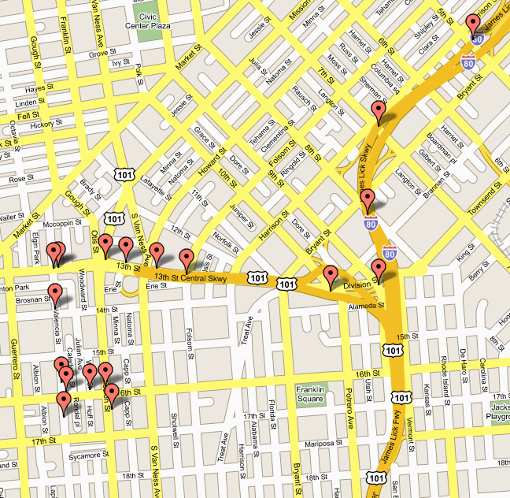
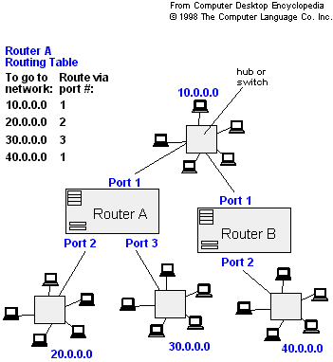
Applications of Dijkstra's Algorithm
- Traffic Information Systems are most prominent use
- Mapping (Map Quest, Google Maps)
- Routing Systems
04
www.midocean.ae

Slide 64
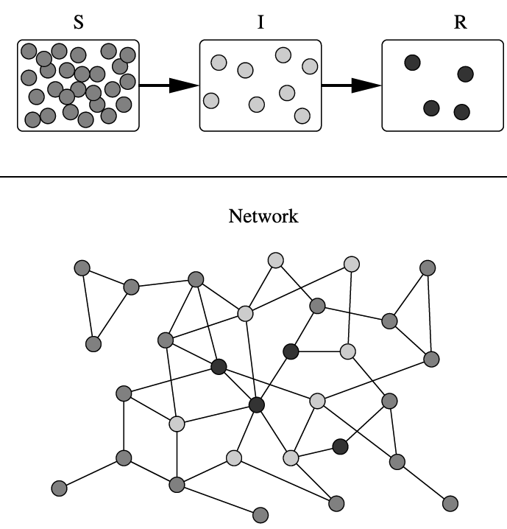
Applications of Dijkstra's Algorithm
One particularly relevant this : epidemiology
Prof. Lauren Meyers (Biology Dept.) uses networks to model the spread of infectious diseases and design prevention and response strategies.
Vertices represent individuals, and edges their possible contacts. It is useful to calculate how a particular individual is connected to others.
Knowing the shortest path lengths to other individuals can be a relevant indicator of the potential of a particular individual to infect others.
04
www.midocean.ae

Slide 65




Thank You

