Slide 1
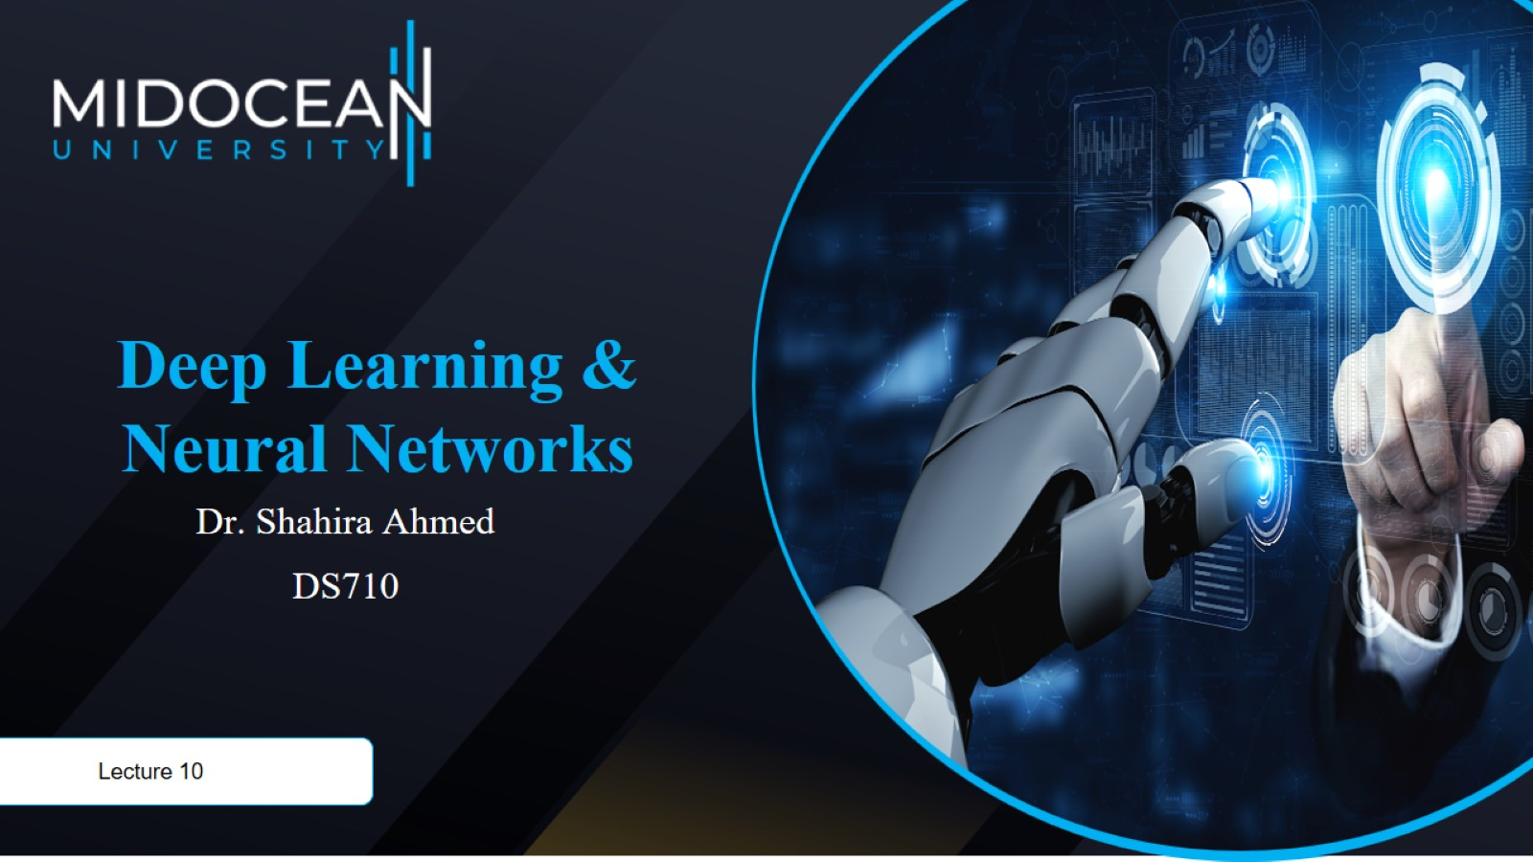

Slide 2


Slide 3
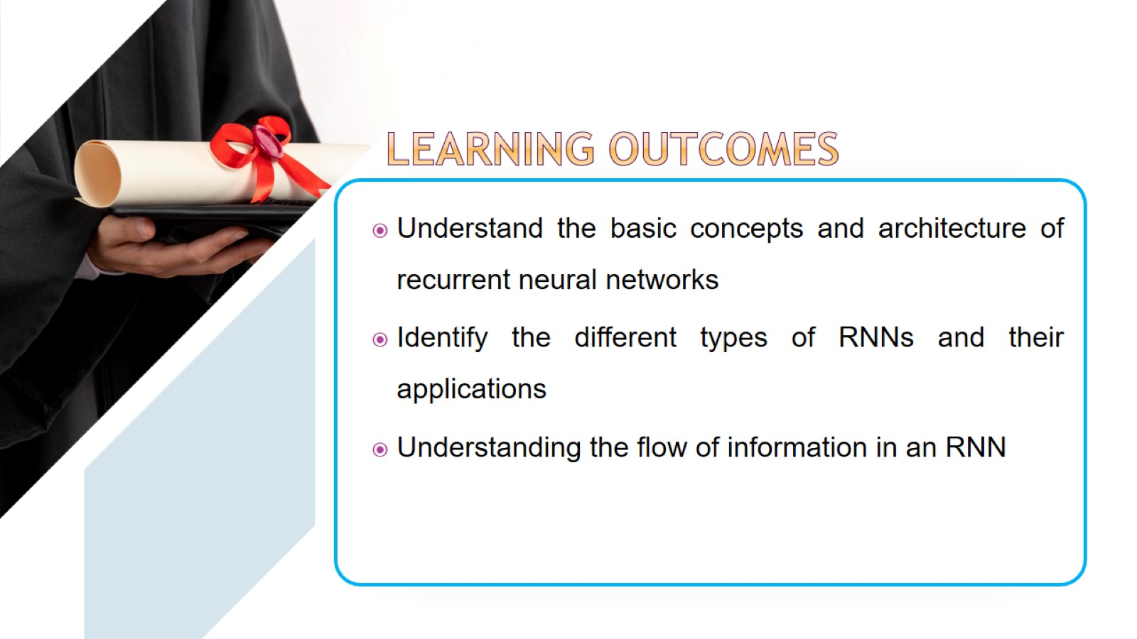

Slide 4
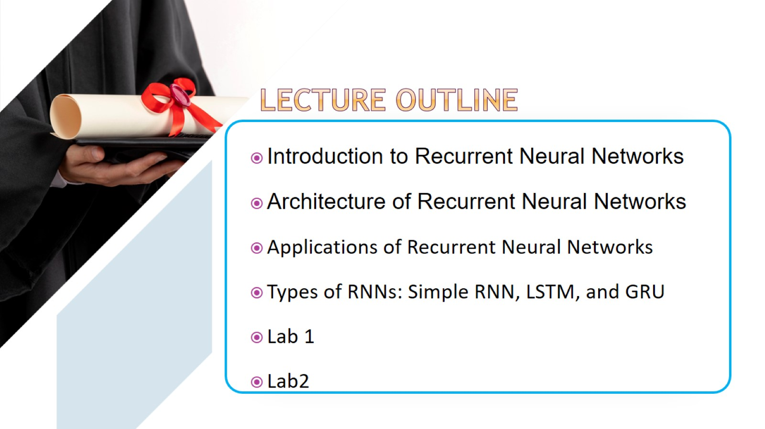

Slide 5
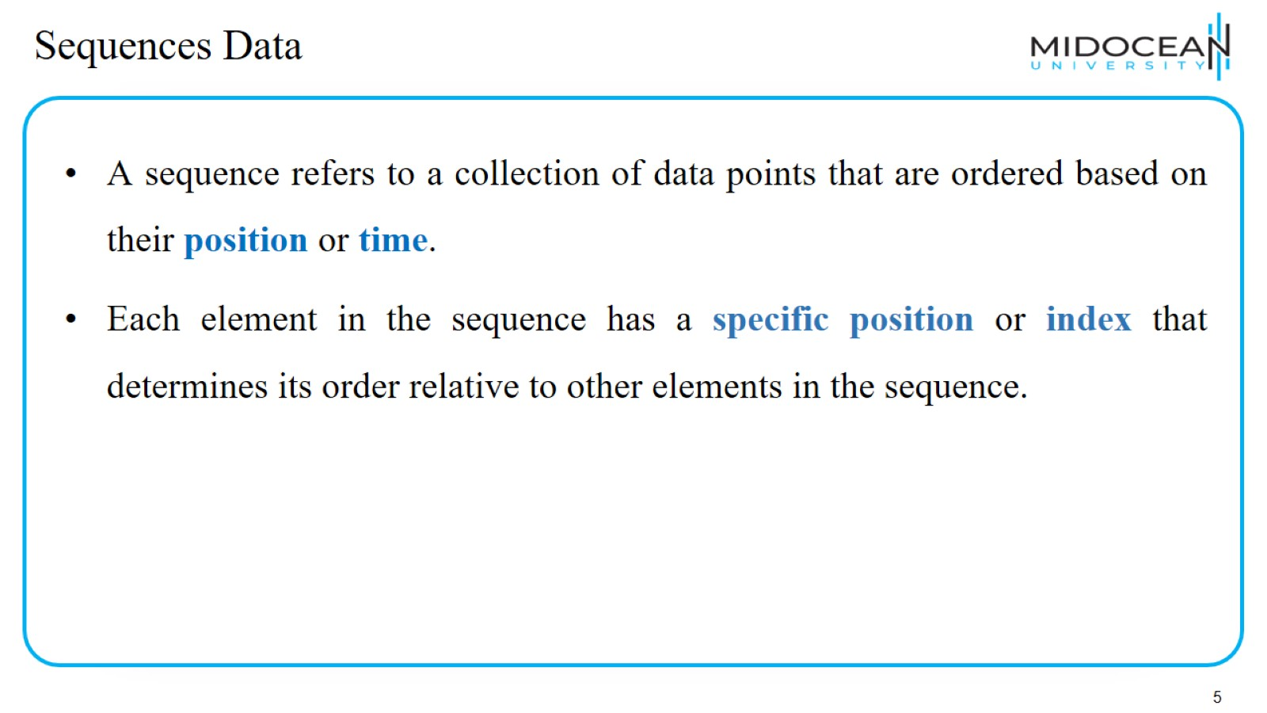
Sequences Data

Slide 6
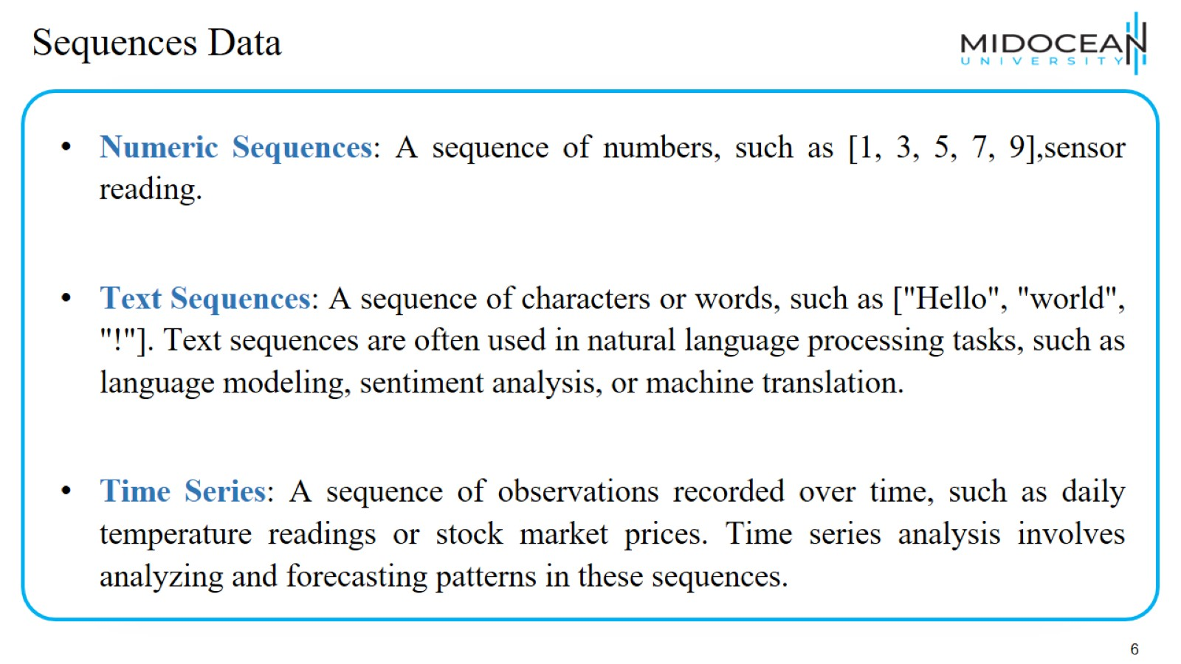
Sequences Data

Slide 7
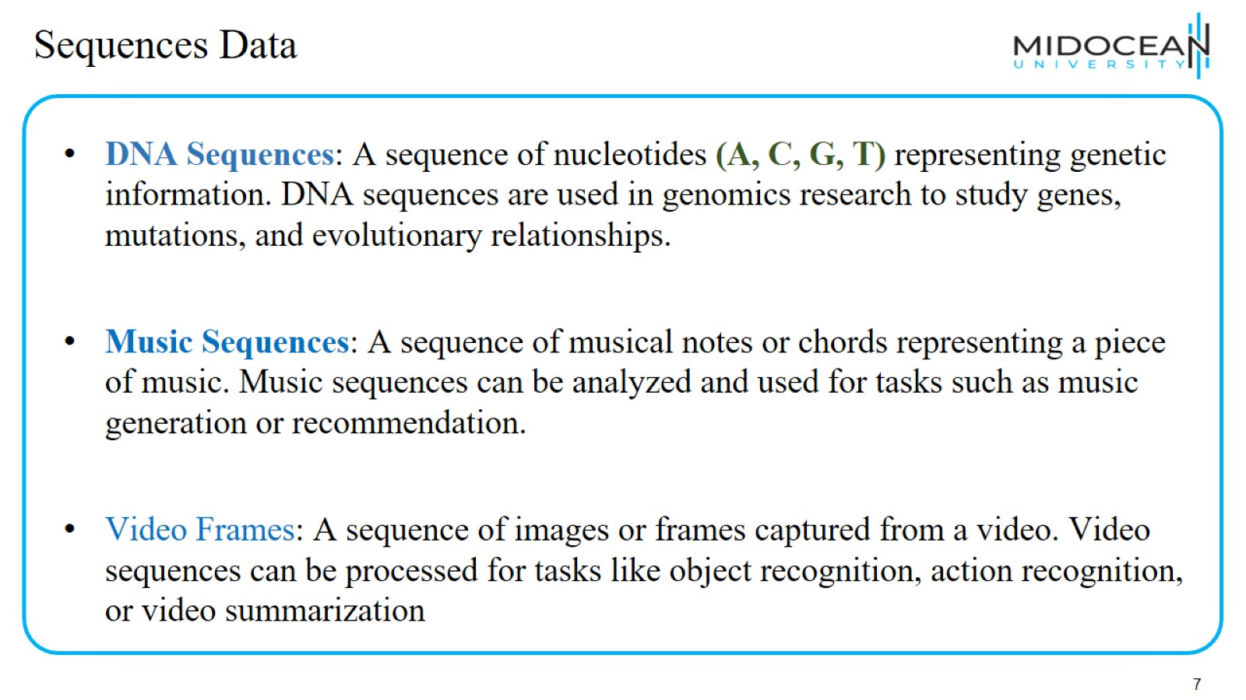
Sequences Data

Slide 8
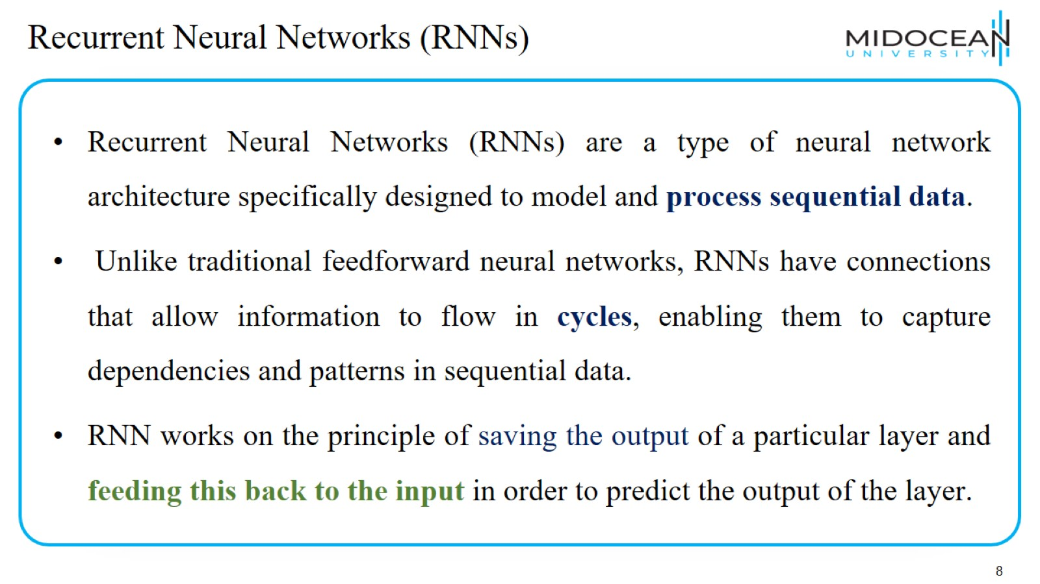
Recurrent Neural Networks (RNNs)

Slide 9
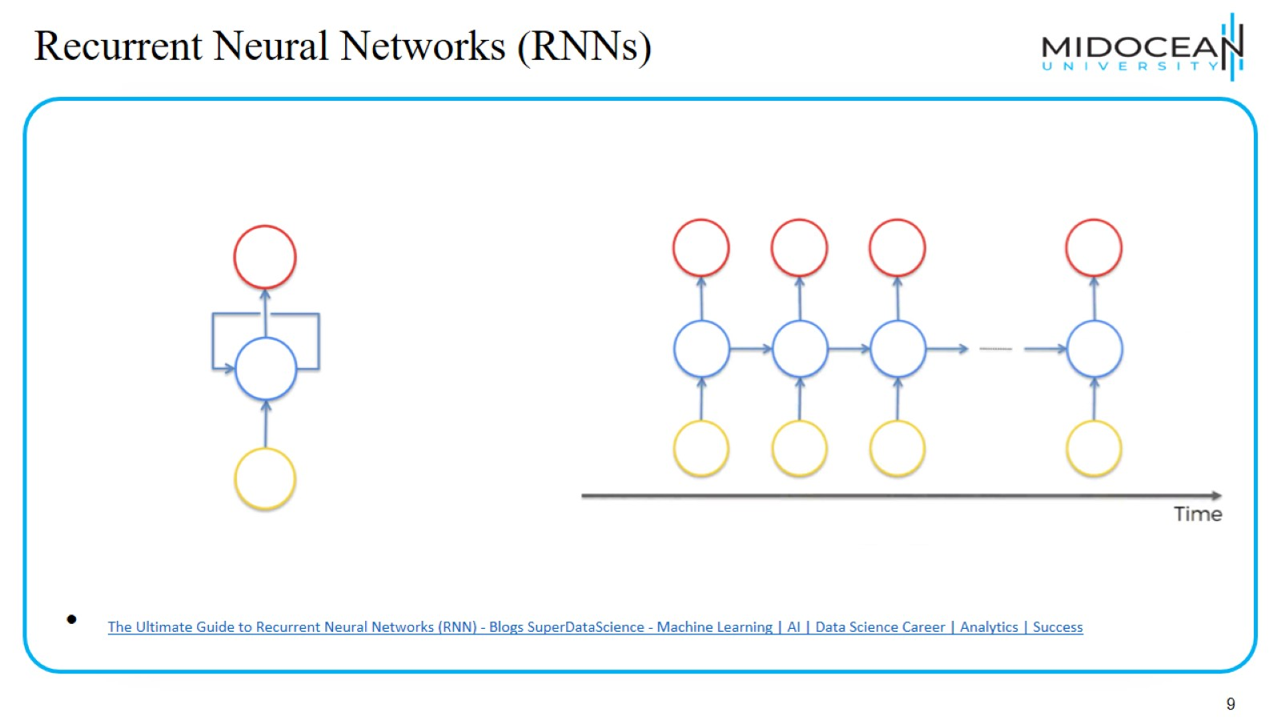
Recurrent Neural Networks (RNNs)

Slide 10
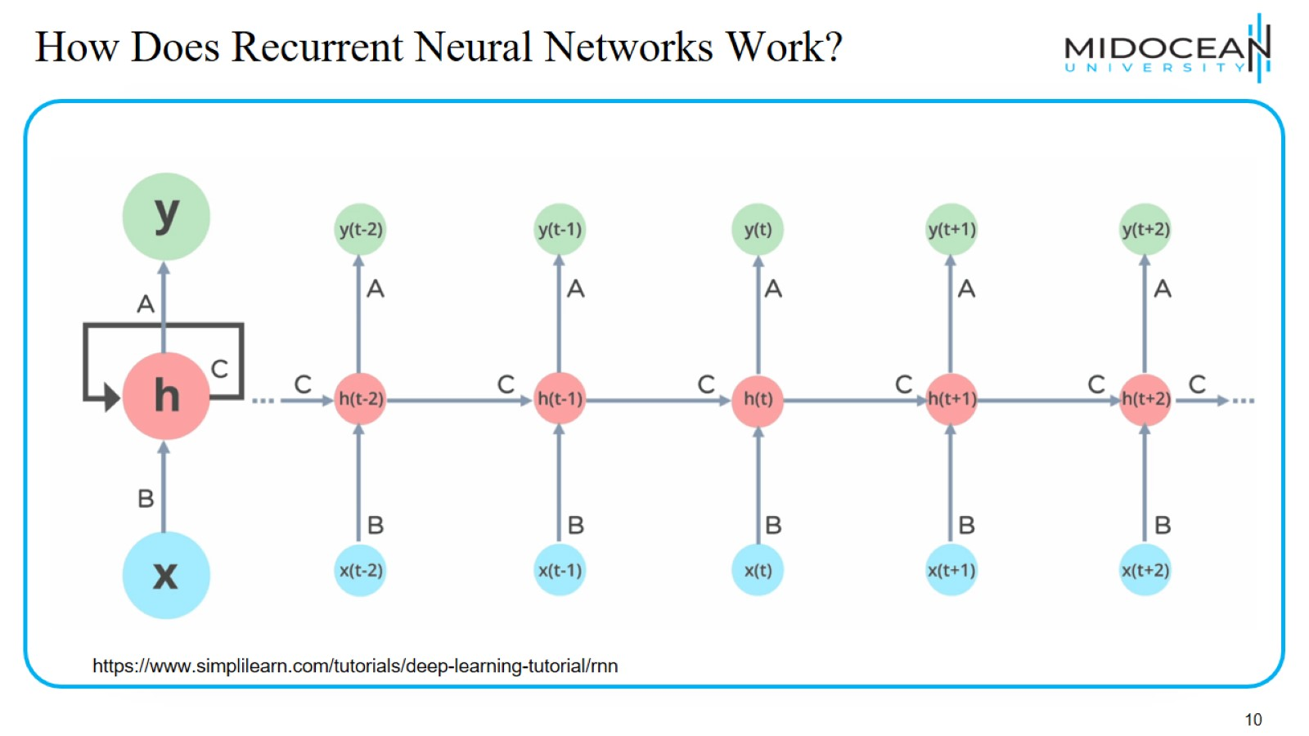
How Does Recurrent Neural Networks Work?

Slide 11
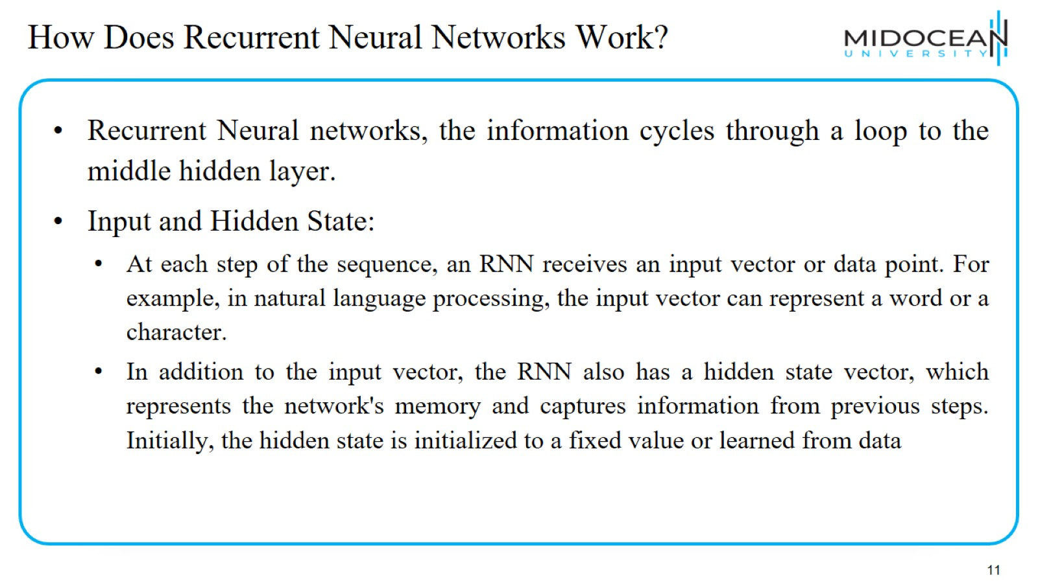
How Does Recurrent Neural Networks Work?

Slide 12
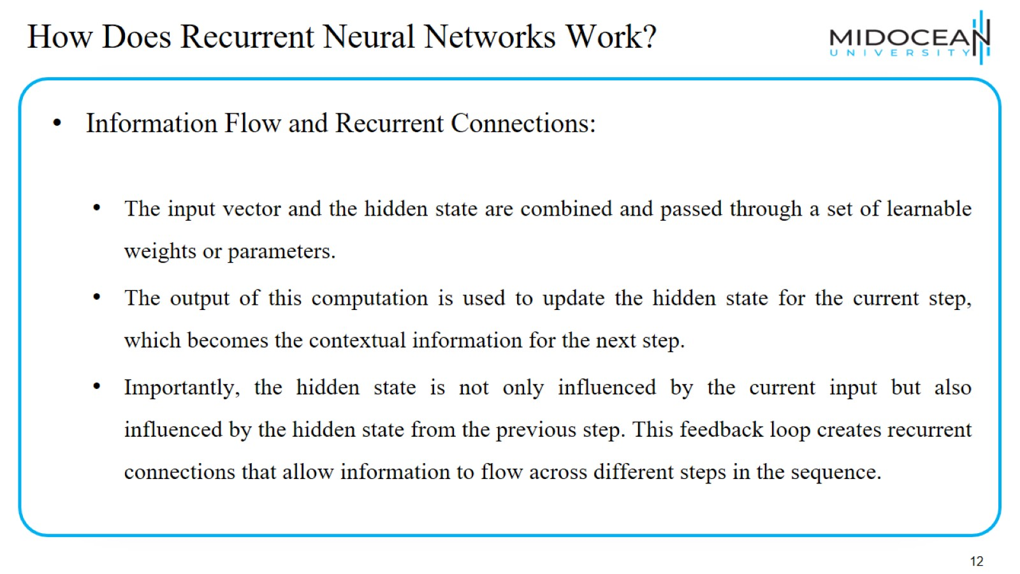
How Does Recurrent Neural Networks Work?

Slide 13
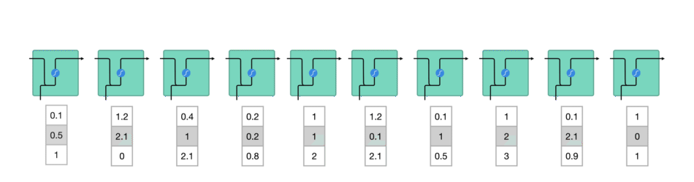
How Does Recurrent Neural Networks Work?
(1)- words get transformed into machine-readable vectors. Then the RNN processes the sequence of vectors one by one.
https://towardsdatascience.com/illustrated-guide-to-lstms-and-gru-s-a-step-by-step-explanation-44e9eb85bf21

Slide 14
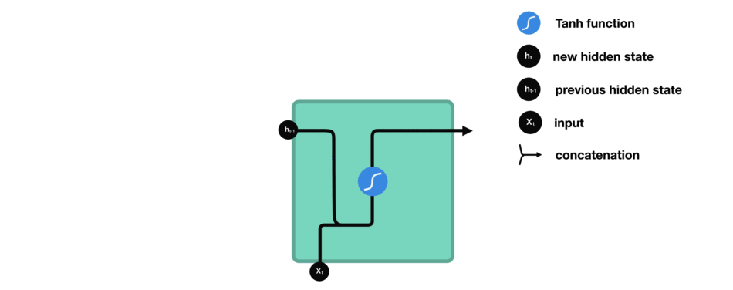
How Does Recurrent Neural Networks Work?
RNN Cell :the input and previous hidden state are combined to form a vector. That vector now has information on the current input and previous inputs. The vector goes through the tanh activation, and the output is the new hidden state, or the memory of the network.
https://towardsdatascience.com/illustrated-guide-to-lstms-and-gru-s-a-step-by-step-explanation-44e9eb85bf21

Slide 15
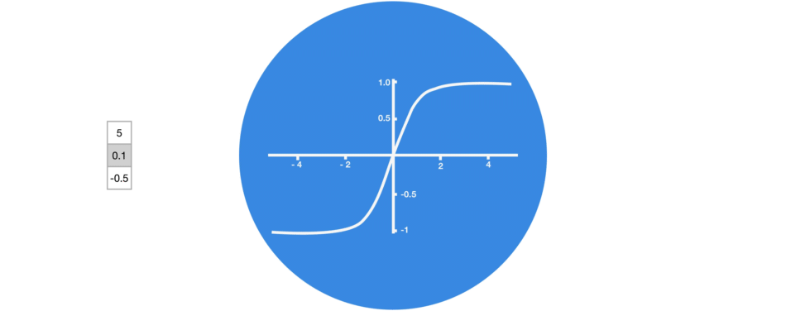
How Does Recurrent Neural Networks Work?
Tanh squishes values to be between -1 and 1
https://towardsdatascience.com/illustrated-guide-to-lstms-and-gru-s-a-step-by-step-explanation-44e9eb85bf21

Slide 16
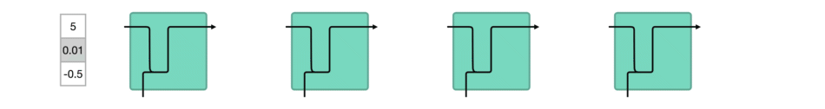
How Does Recurrent Neural Networks Work?
When vectors are flowing through a neural network, it undergoes many transformations due to various math operations.
https://towardsdatascience.com/illustrated-guide-to-lstms-and-gru-s-a-step-by-step-explanation-44e9eb85bf21

Slide 17
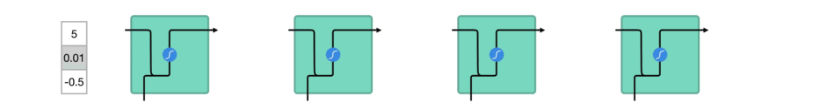
How Does Recurrent Neural Networks Work?
A tanh function ensures that the values stay between -1 and 1, thus regulating the output of the neural network. You can see how the same values from above remain between the boundaries allowed by the tanh function.
https://towardsdatascience.com/illustrated-guide-to-lstms-and-gru-s-a-step-by-step-explanation-44e9eb85bf21

Slide 18
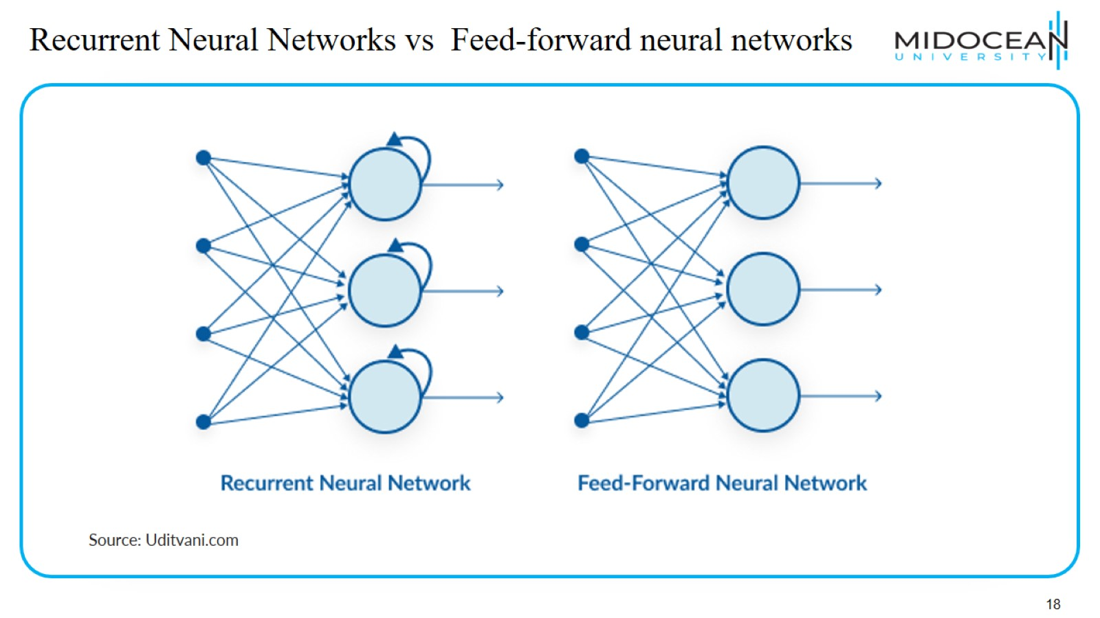
Recurrent Neural Networks vs Feed-forward neural networks

Slide 19
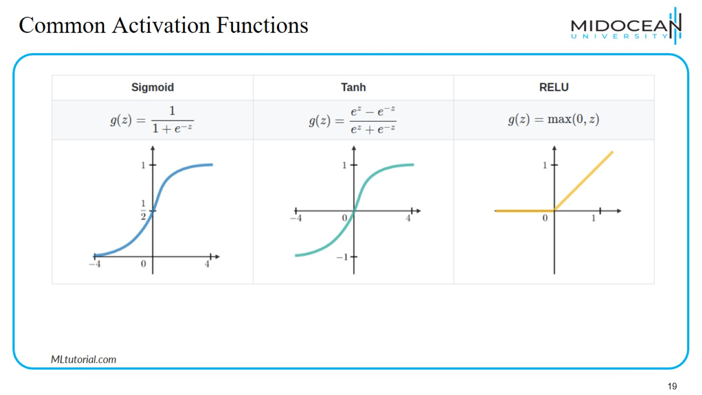
Common Activation Functions

Slide 20
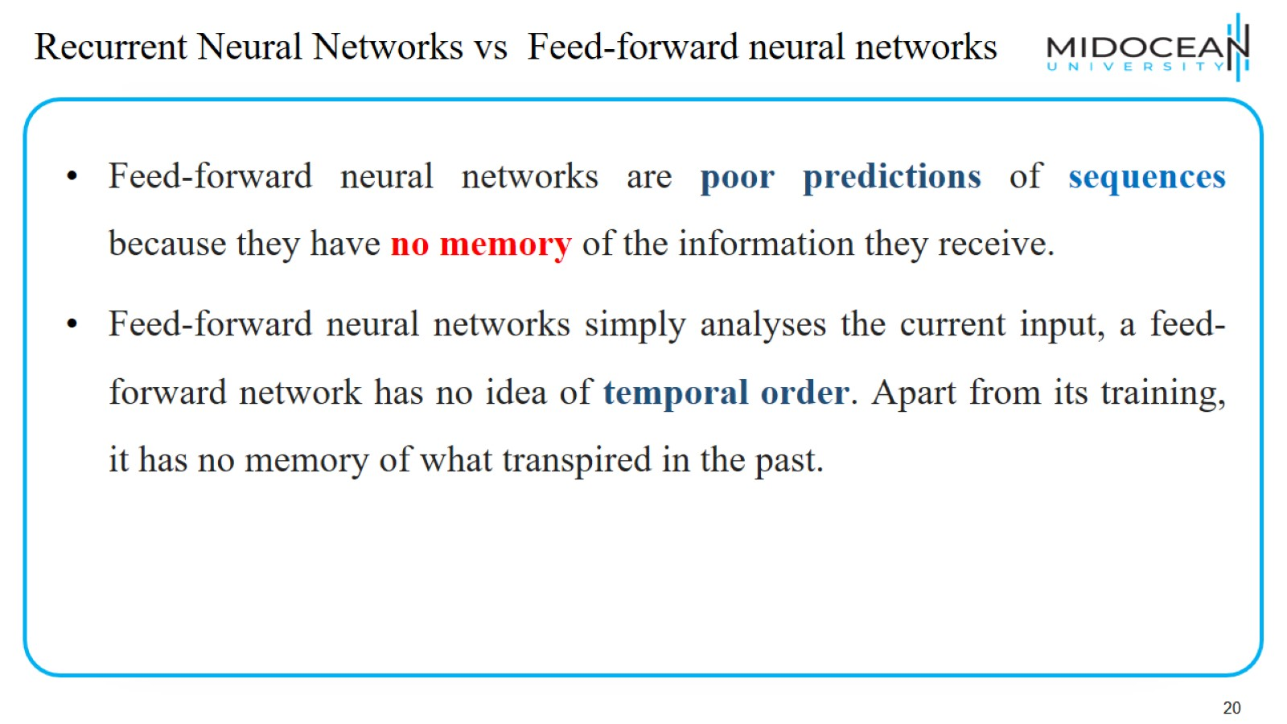
Recurrent Neural Networks vs Feed-forward neural networks

Slide 21
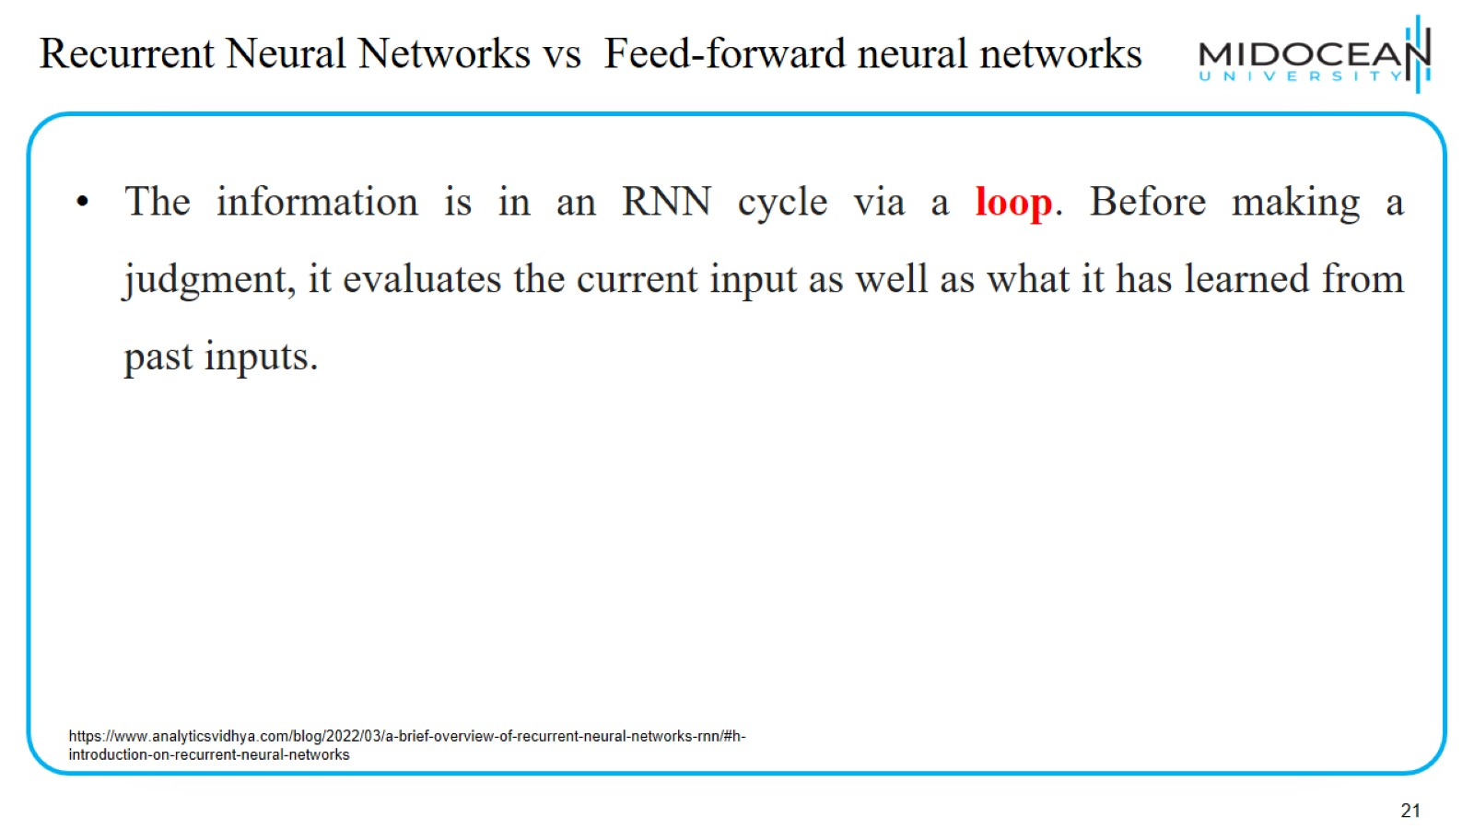
Recurrent Neural Networks vs Feed-forward neural networks

Slide 22
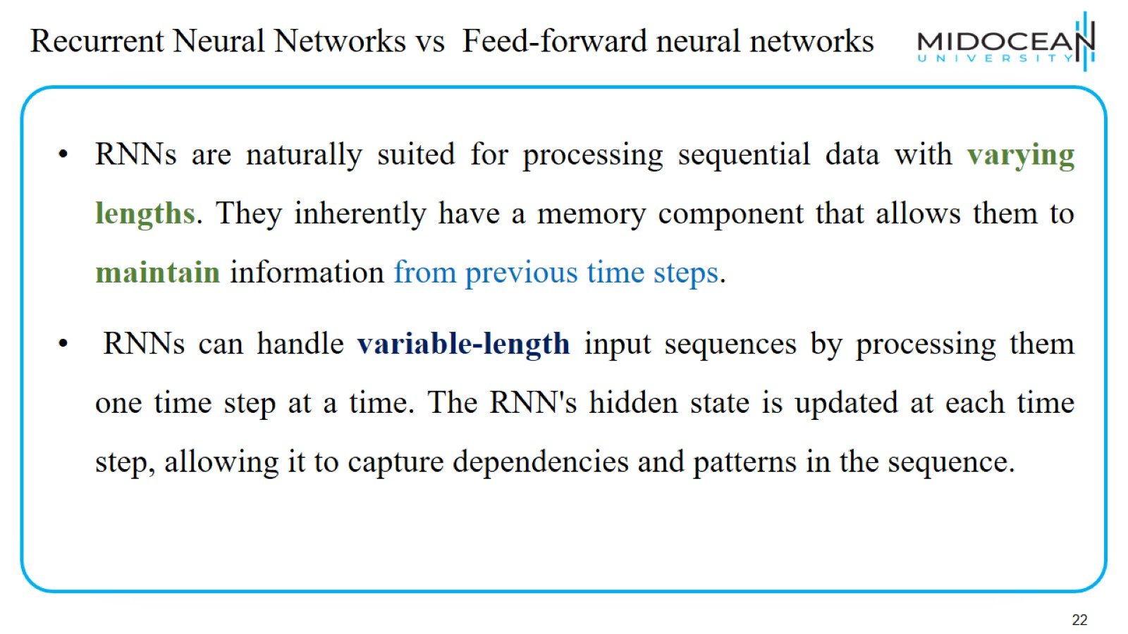
Recurrent Neural Networks vs Feed-forward neural networks

Slide 23
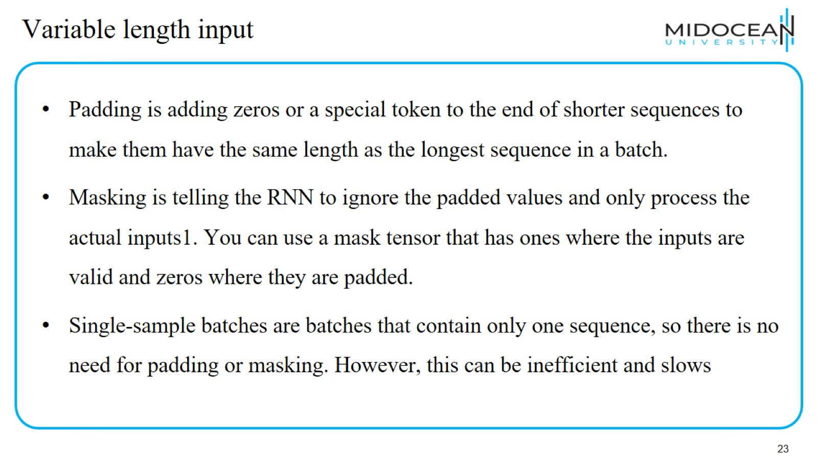
Variable length input

Slide 24
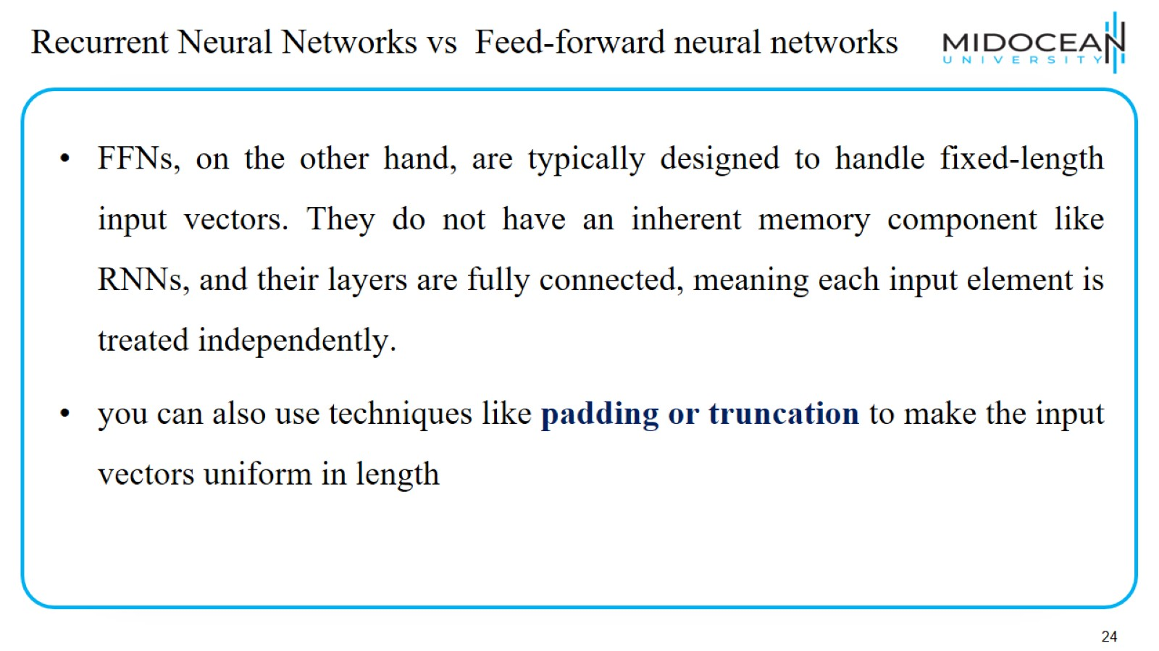
Recurrent Neural Networks vs Feed-forward neural networks

Slide 25
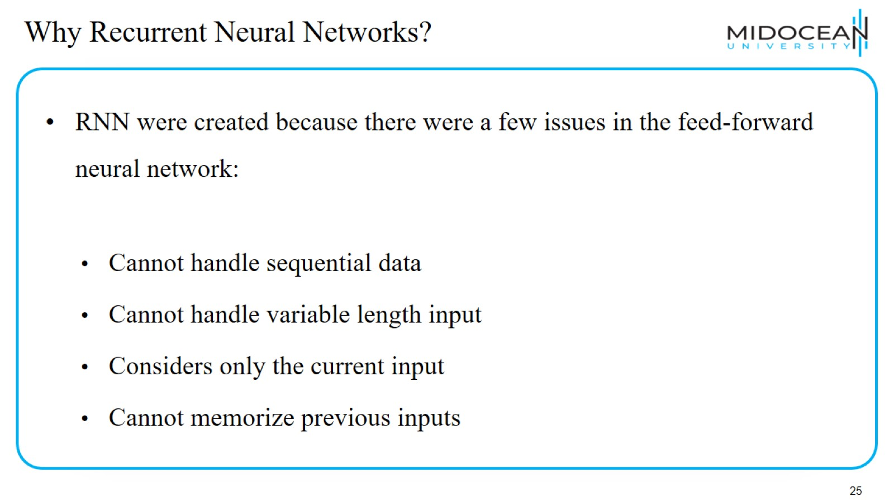
Why Recurrent Neural Networks?

Slide 26
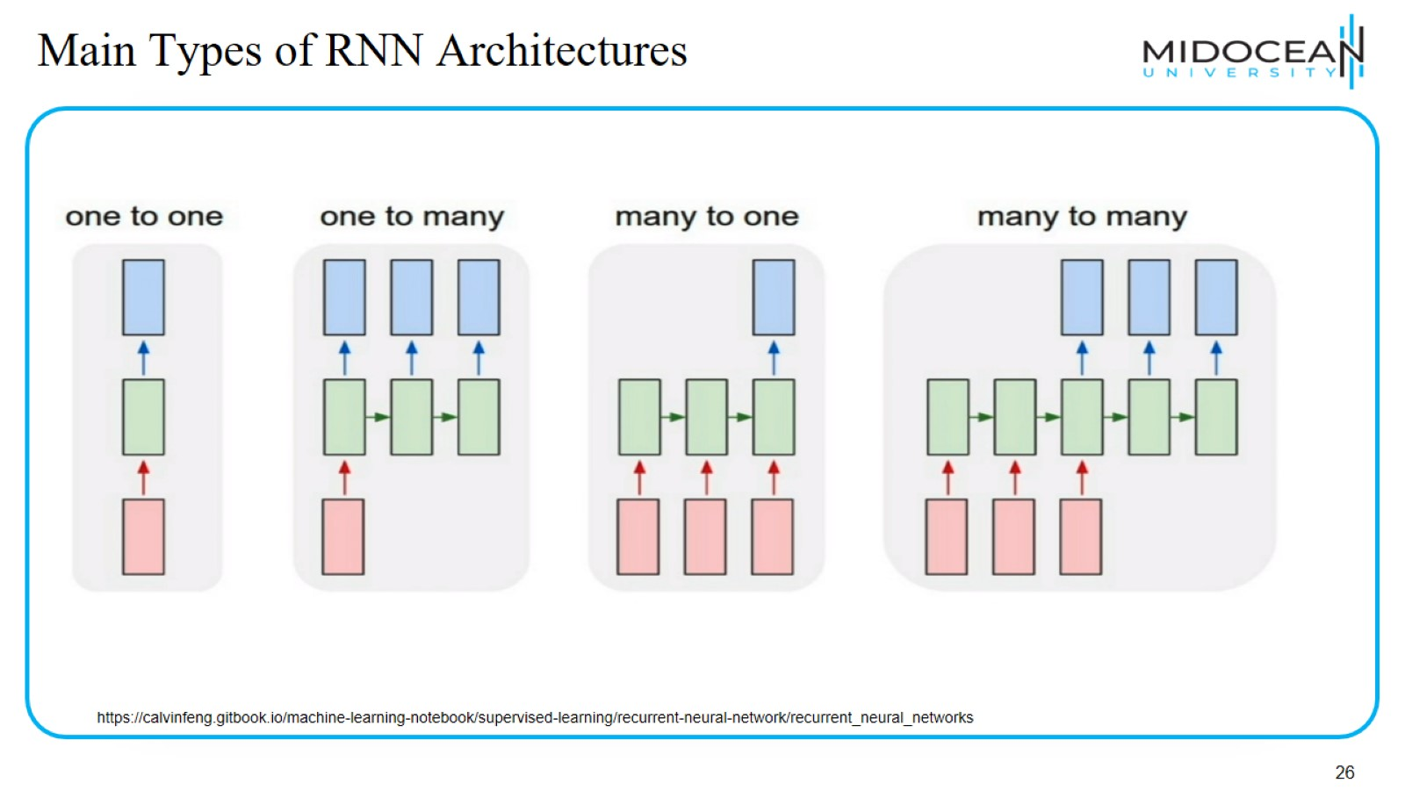
Main Types of RNN Architectures

Slide 27
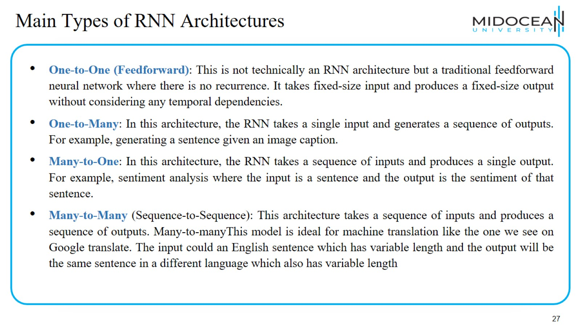
Main Types of RNN Architectures

Slide 28
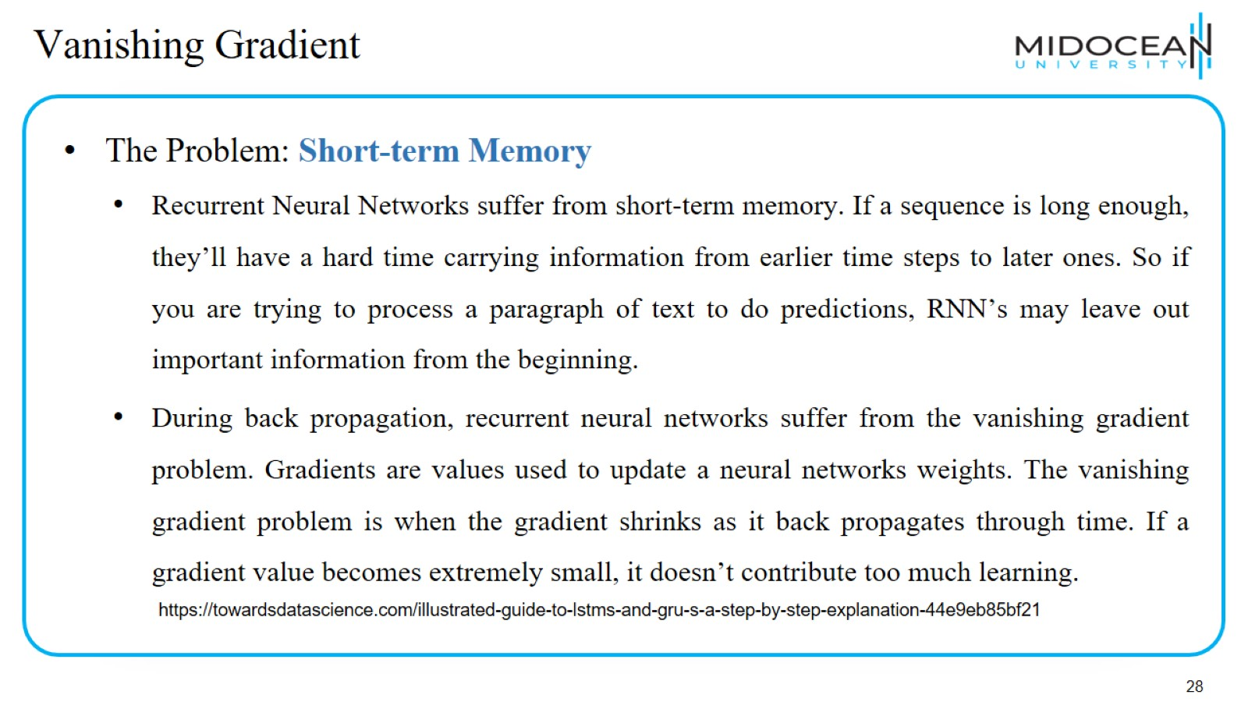
Vanishing Gradient

Slide 29
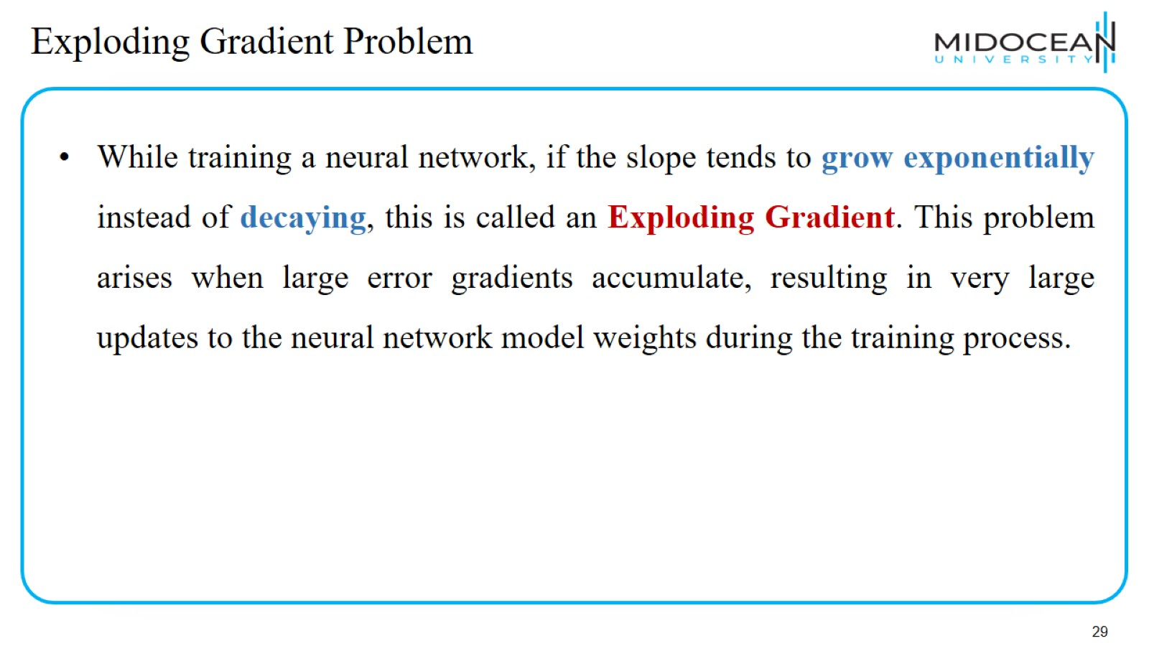
Exploding Gradient Problem

Slide 30
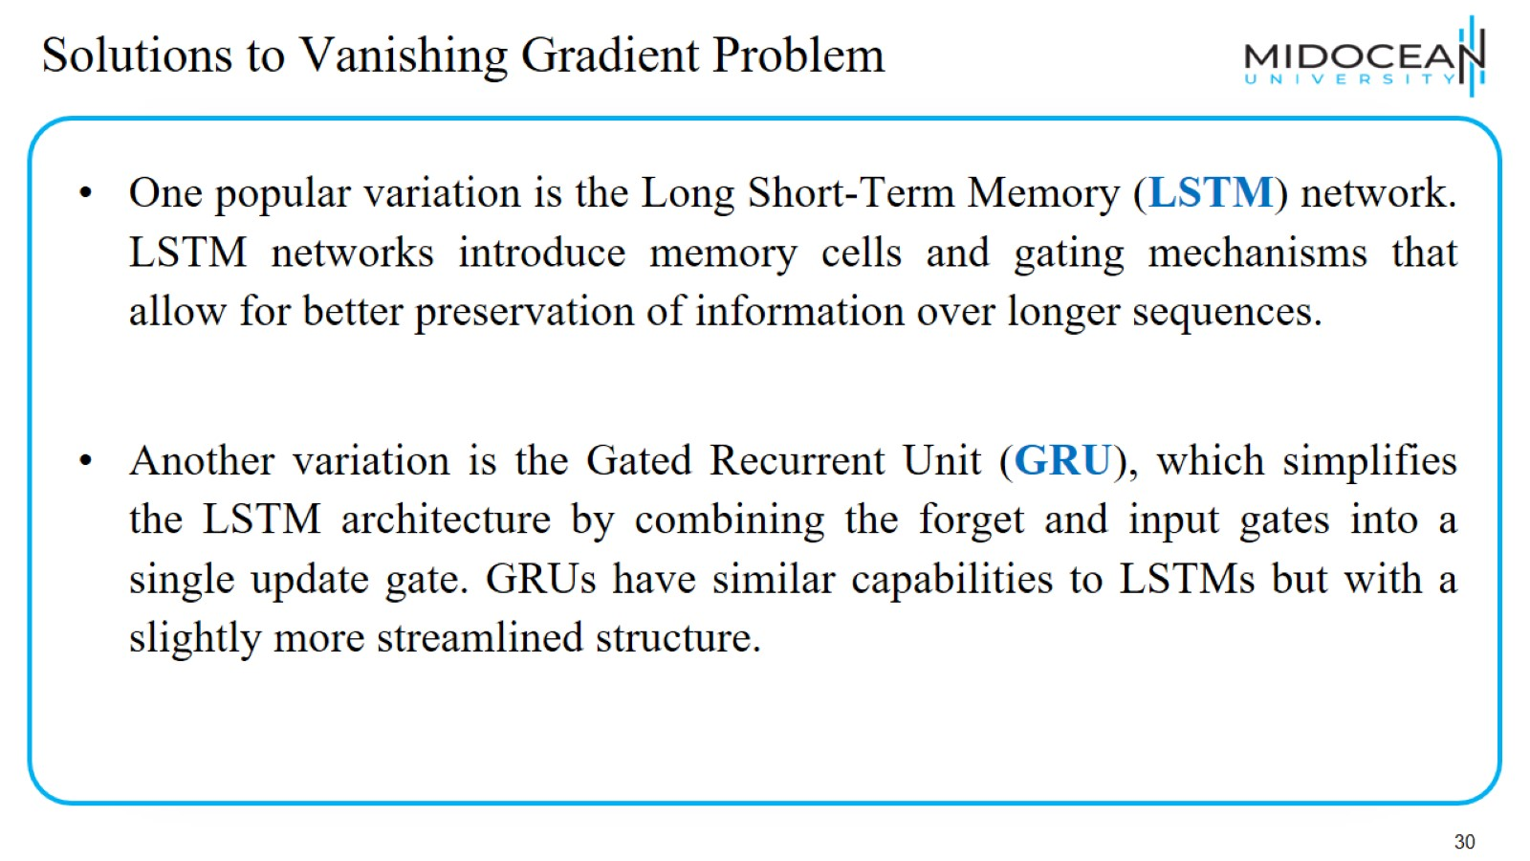
Solutions to Vanishing Gradient Problem

Slide 31
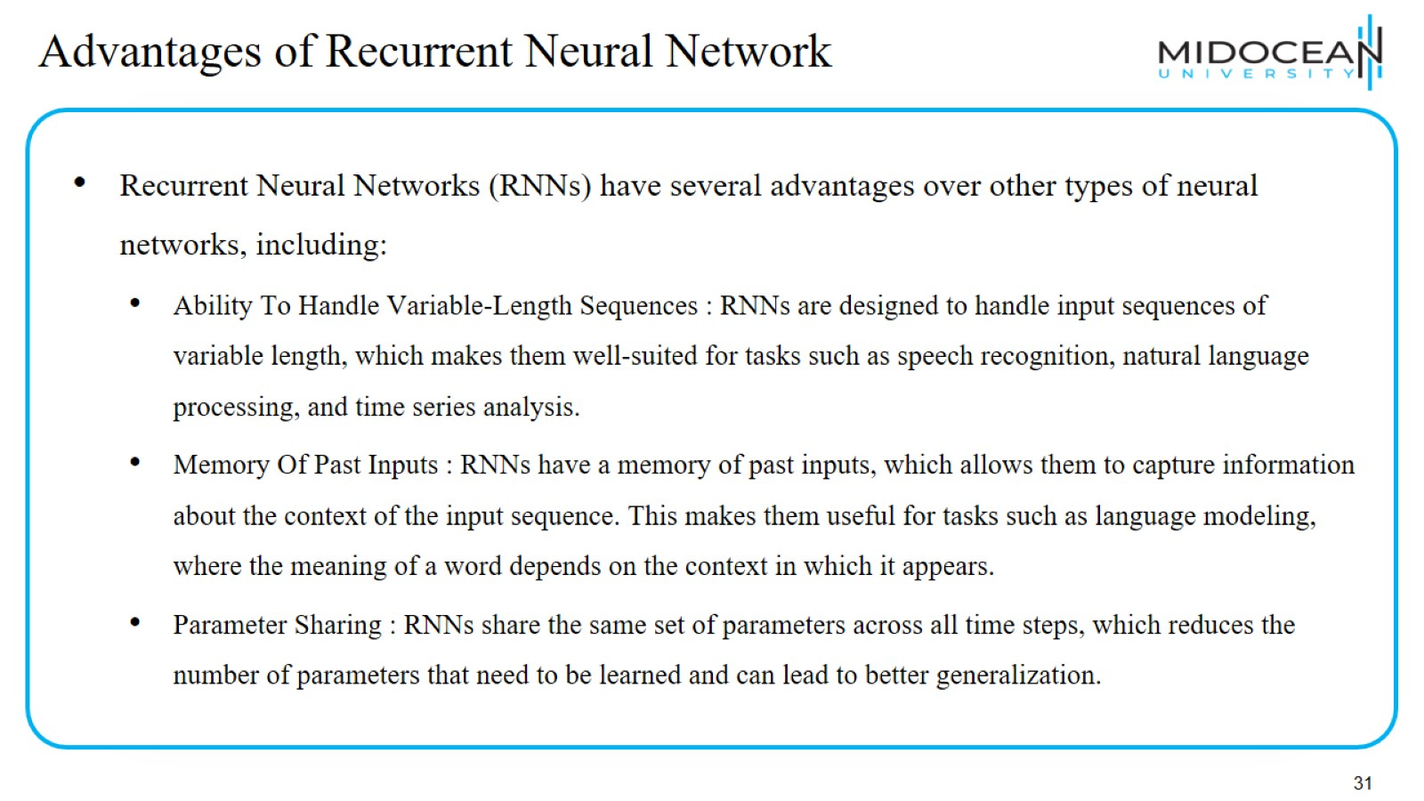
Advantages of Recurrent Neural Network

Slide 32
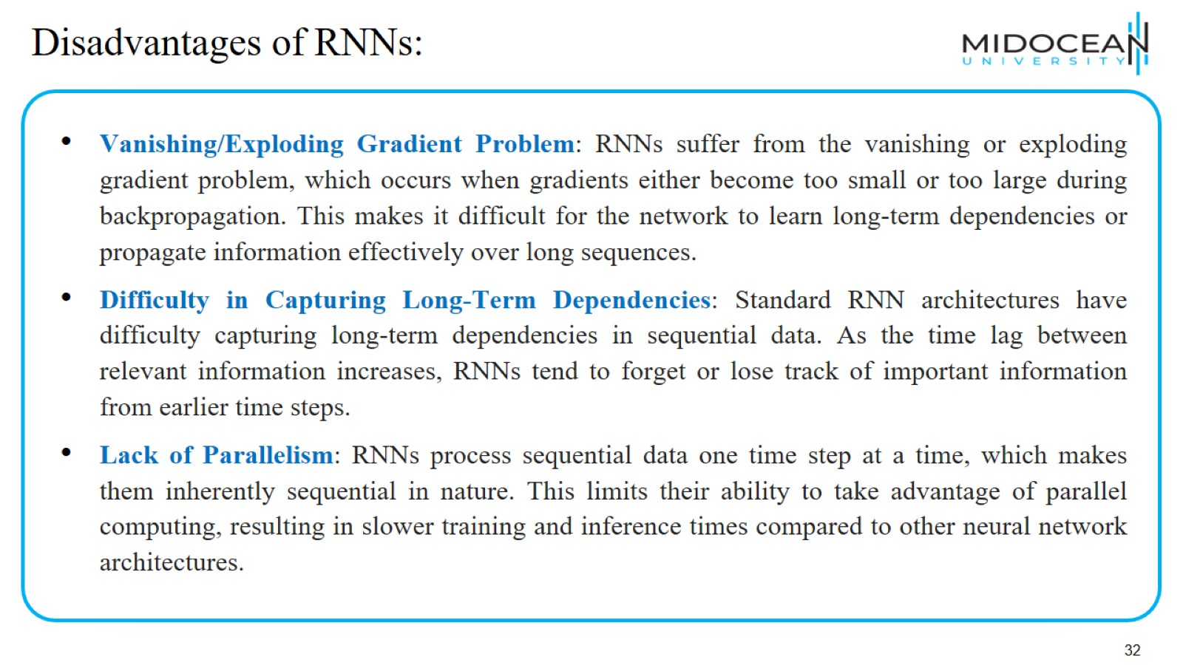
Disadvantages of RNNs:

Slide 33
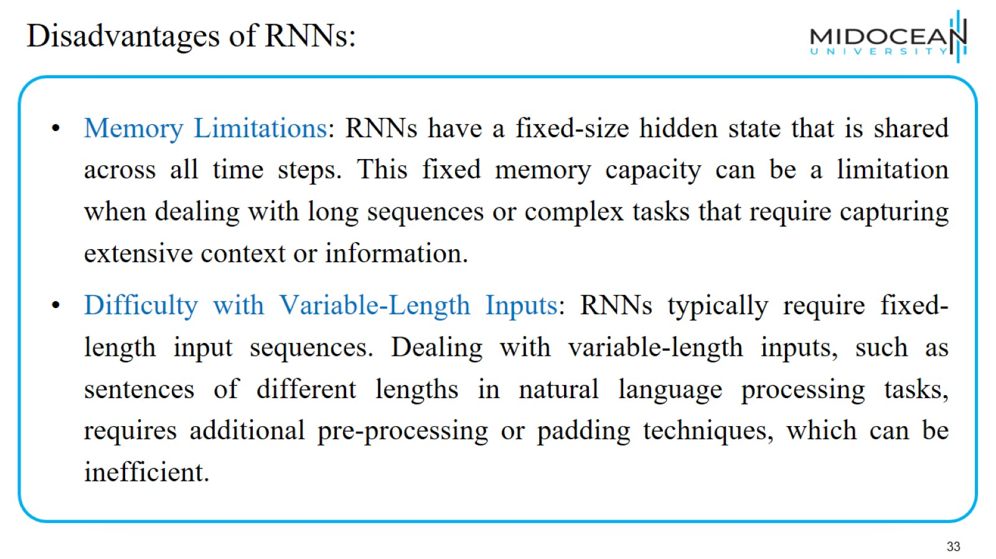
Disadvantages of RNNs:

Slide 34
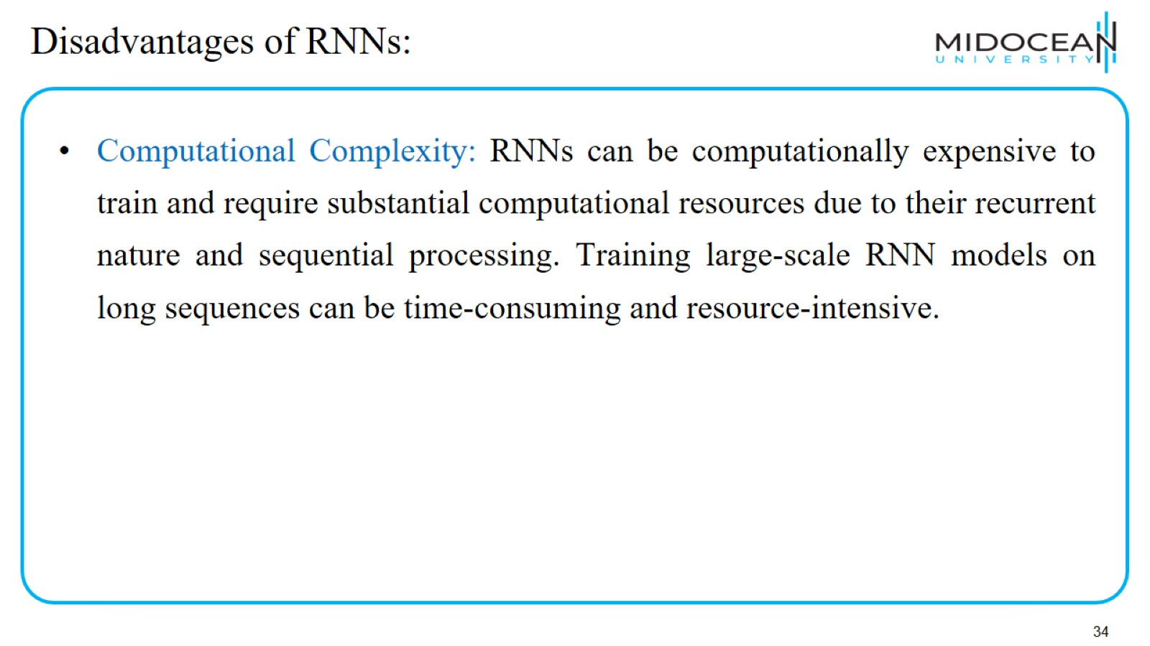
Disadvantages of RNNs:

Slide 35
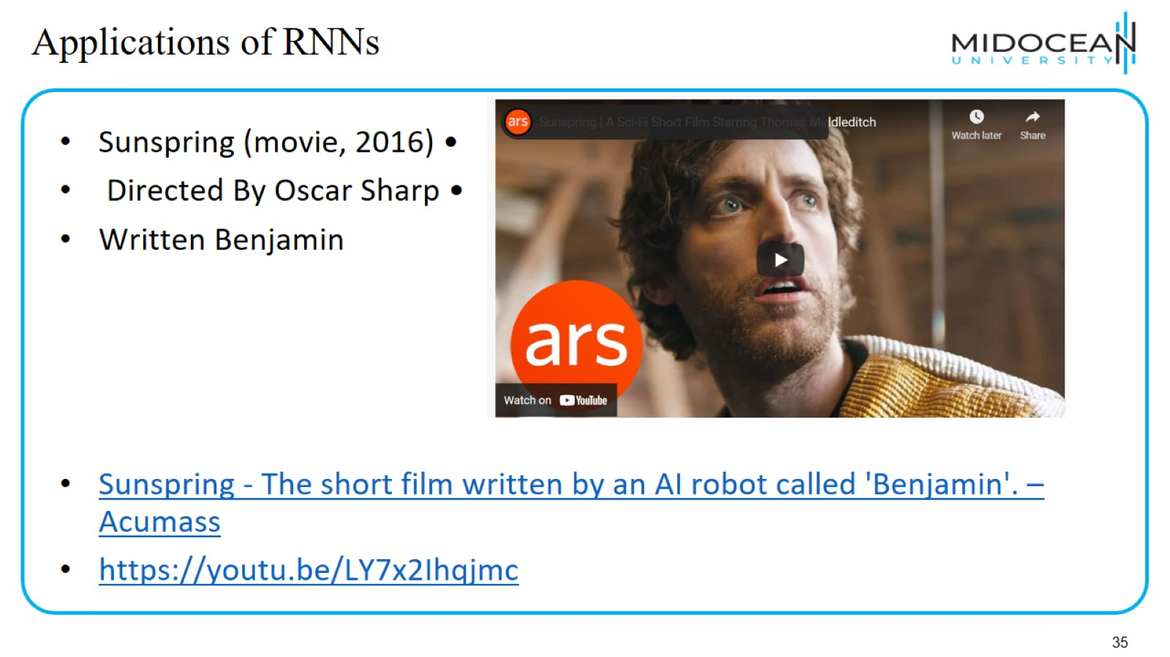
Applications of RNNs

Slide 36
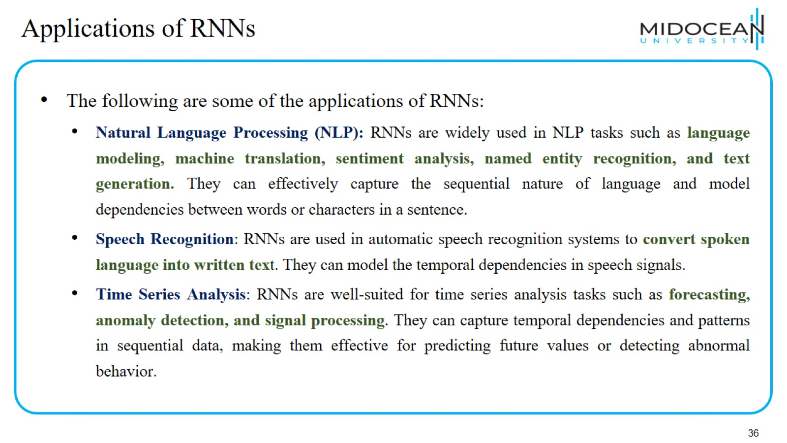
Applications of RNNs

Slide 37
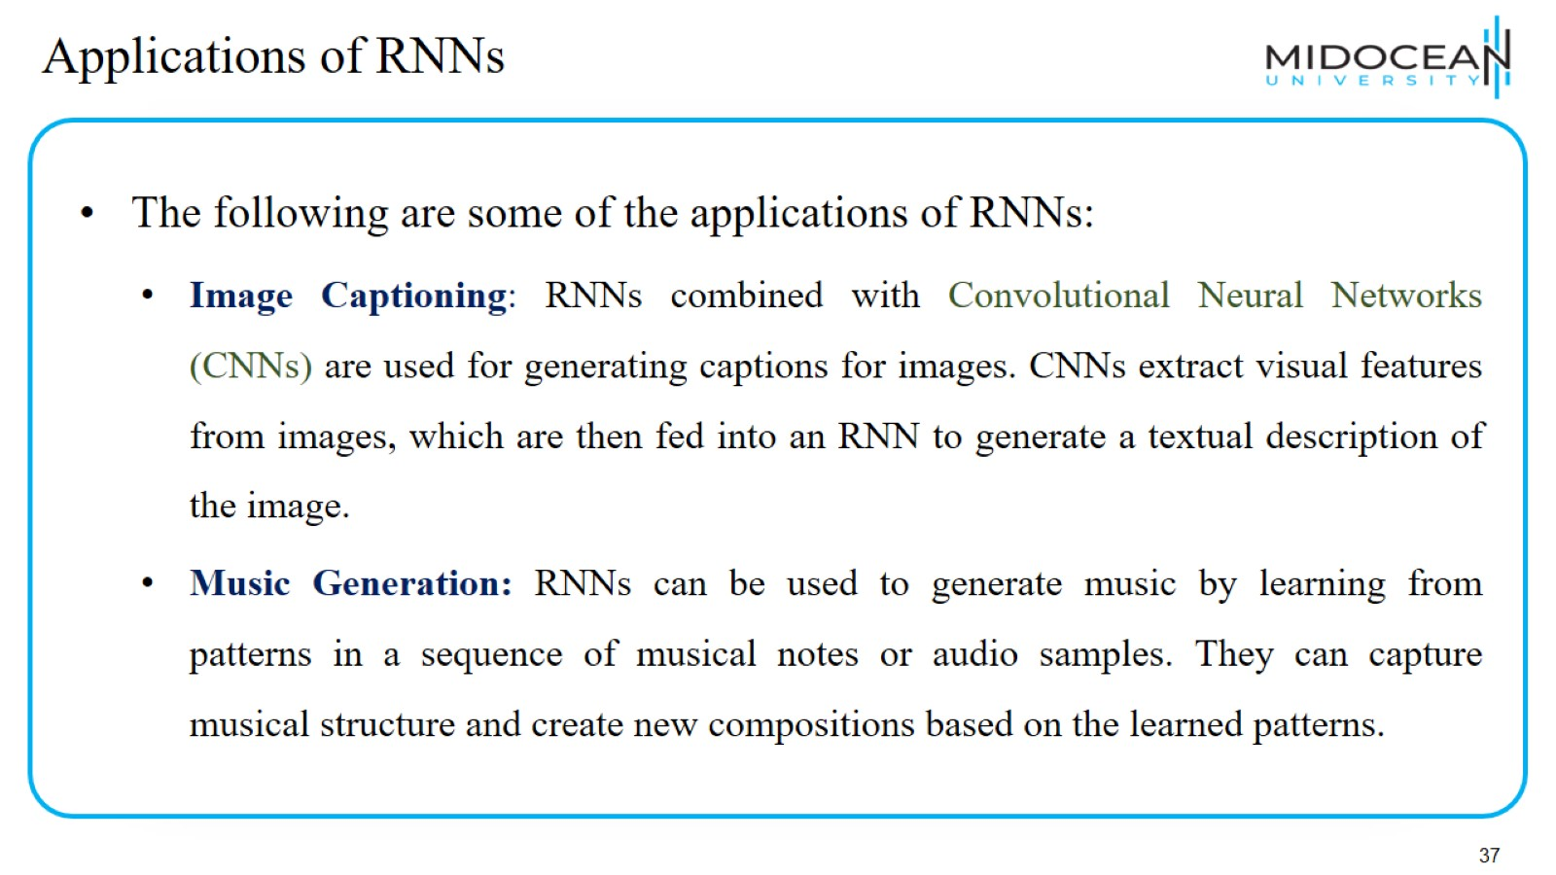
Applications of RNNs

Slide 38
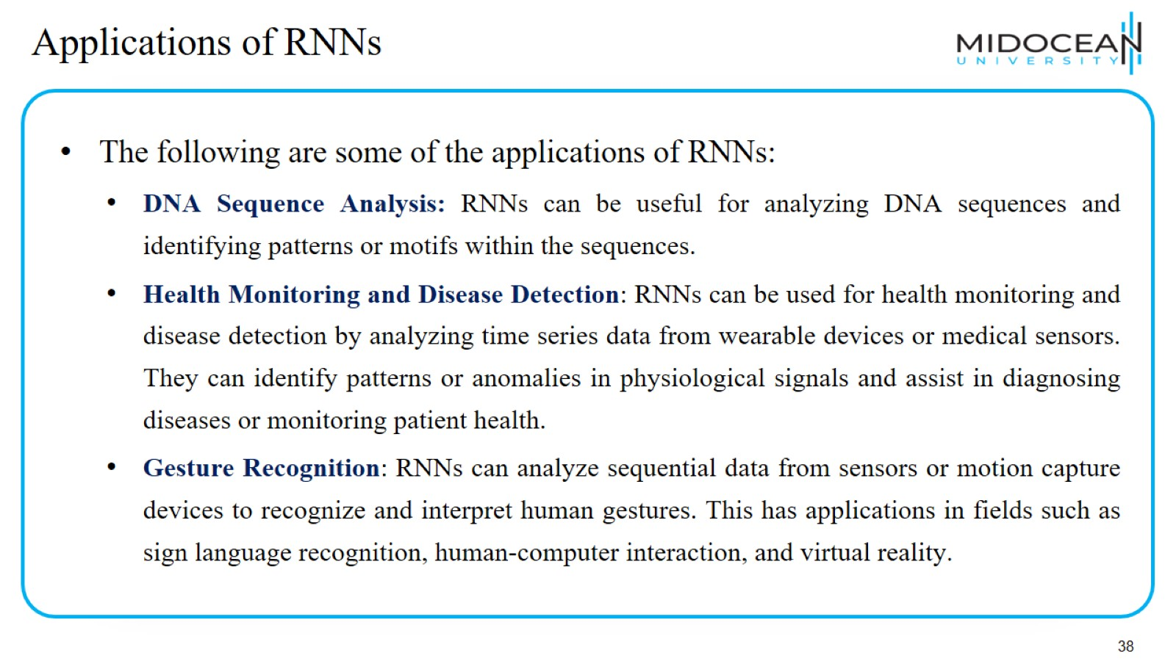
Applications of RNNs

Slide 39
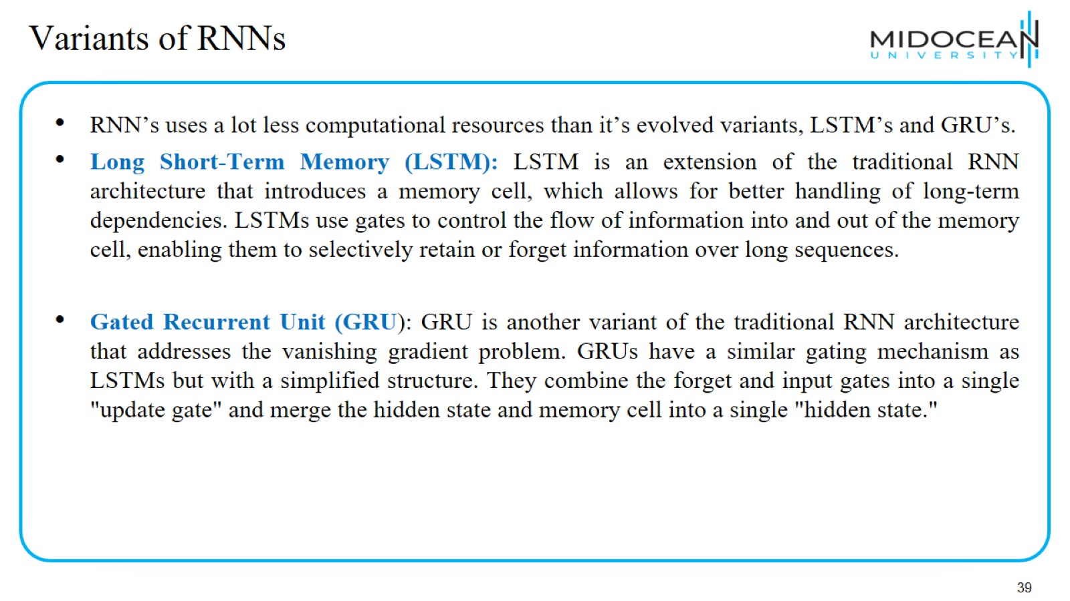
Variants of RNNs

Slide 40
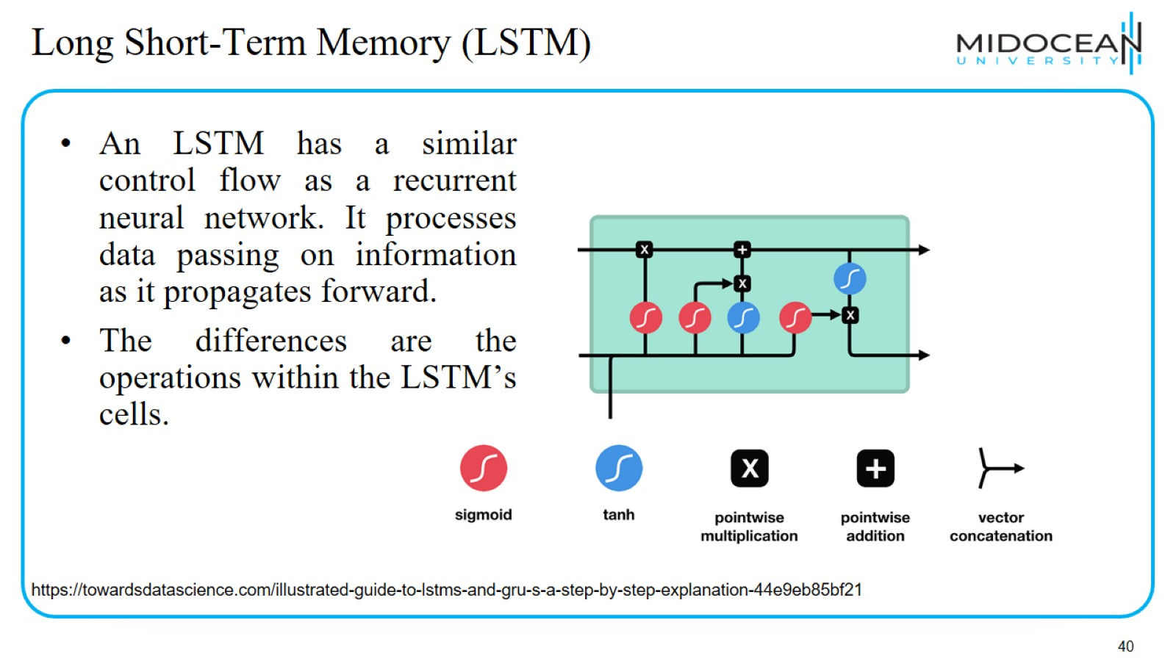
Long Short-Term Memory (LSTM)

Slide 41
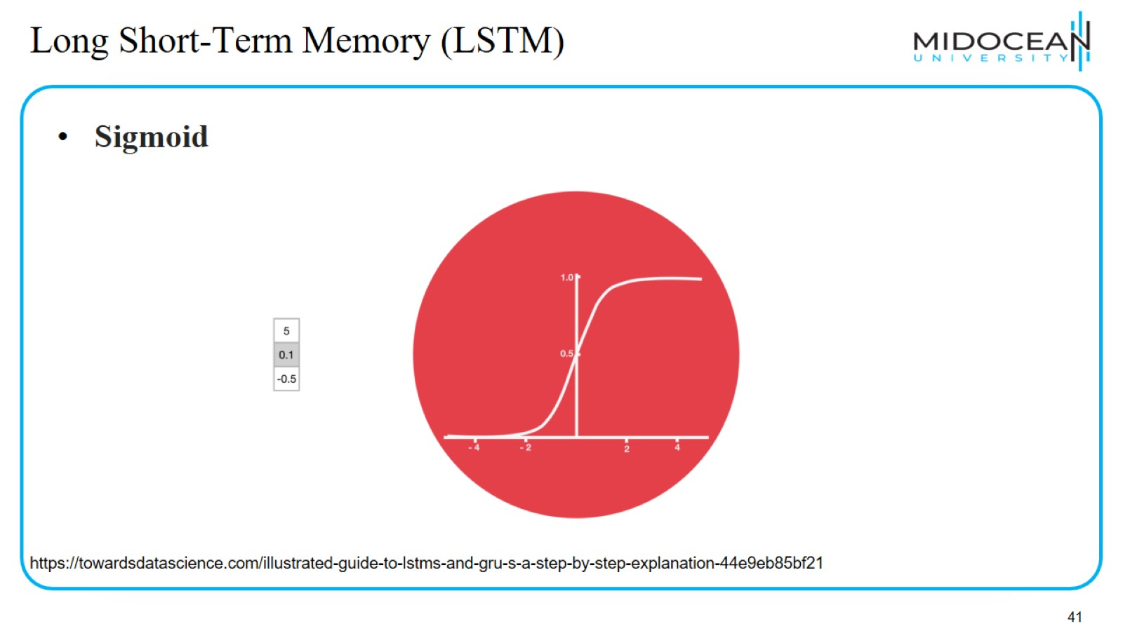
Long Short-Term Memory (LSTM)

Slide 42
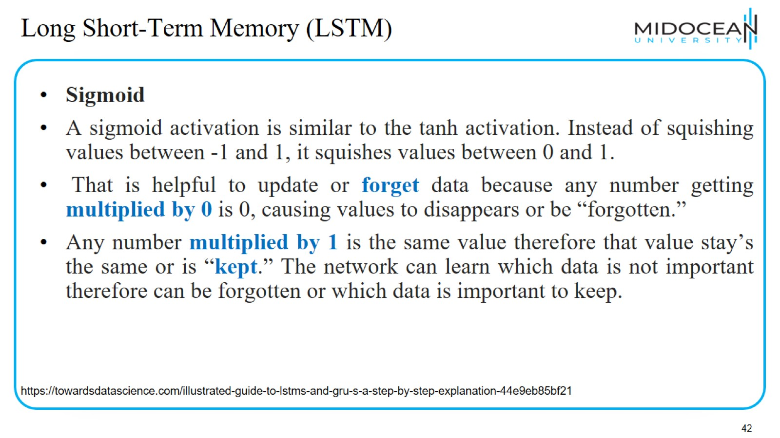
Long Short-Term Memory (LSTM)

Slide 43
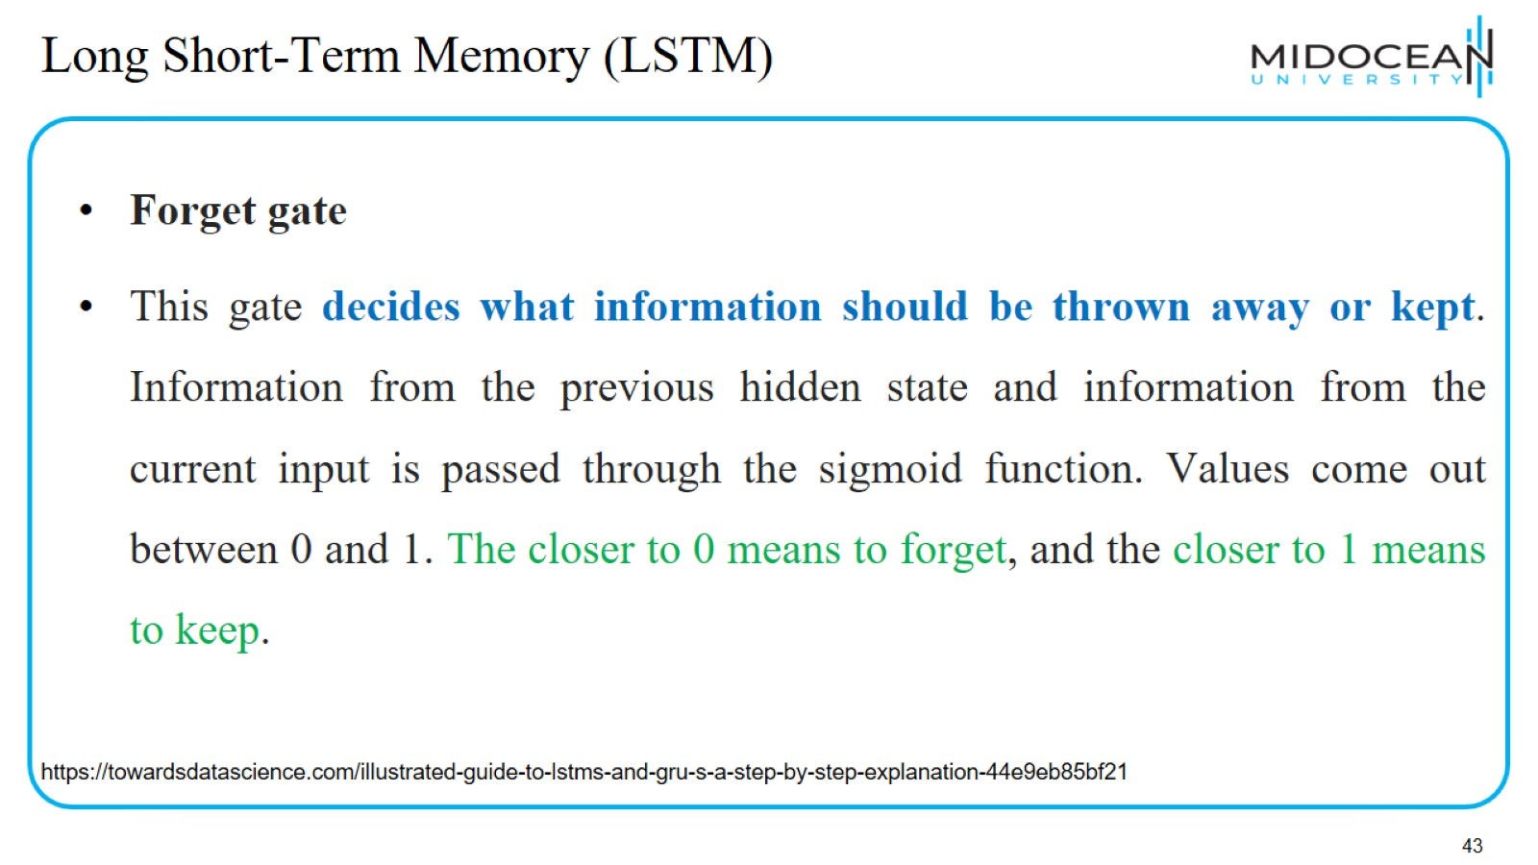
Long Short-Term Memory (LSTM)

Slide 44
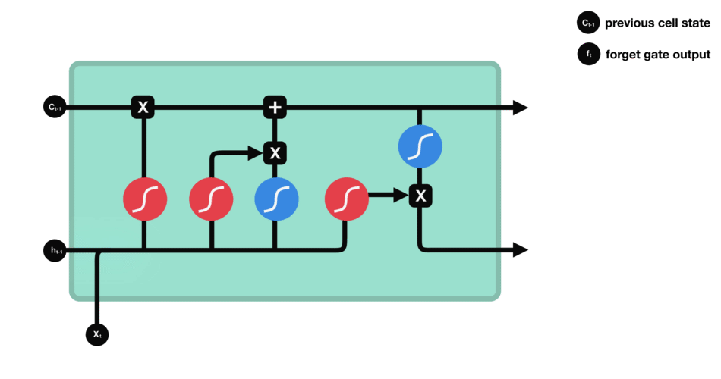
Long Short-Term Memory (LSTM)
https://towardsdatascience.com/illustrated-guide-to-lstms-and-gru-s-a-step-by-step-explanation-44e9eb85bf21

Slide 45
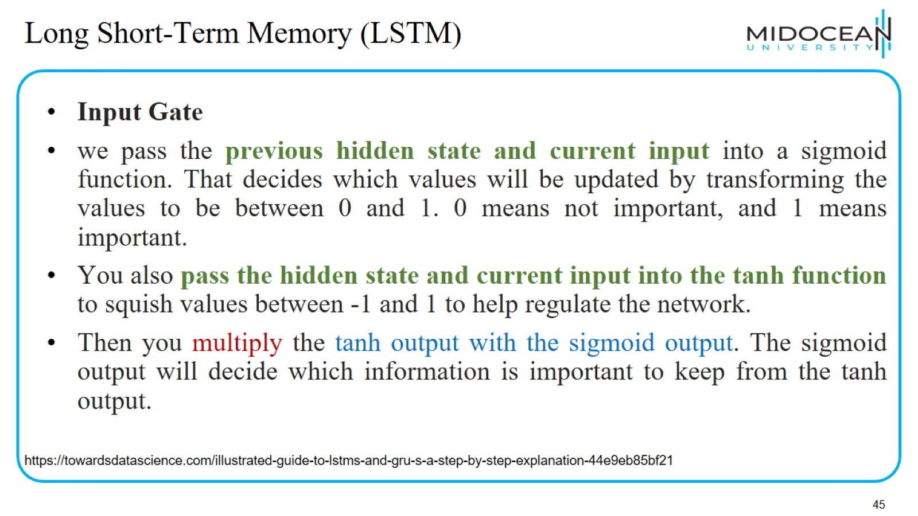
Long Short-Term Memory (LSTM)

Slide 46
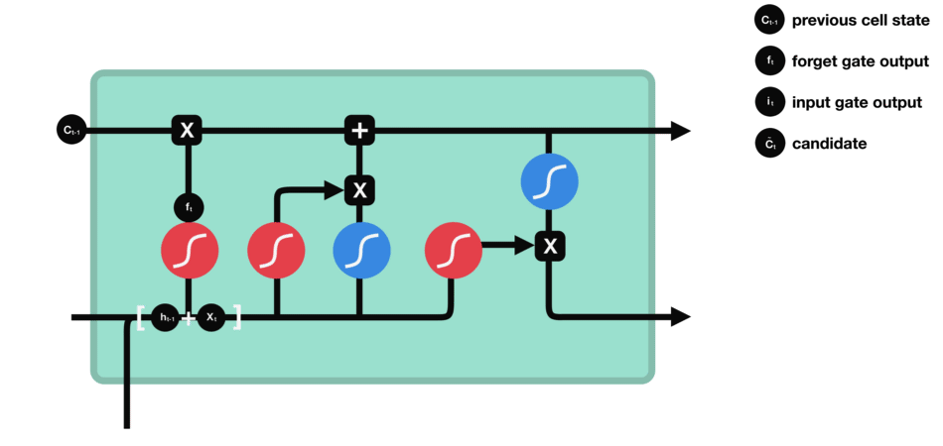
Long Short-Term Memory (LSTM)
https://towardsdatascience.com/illustrated-guide-to-lstms-and-gru-s-a-step-by-step-explanation-44e9eb85bf21

Slide 47
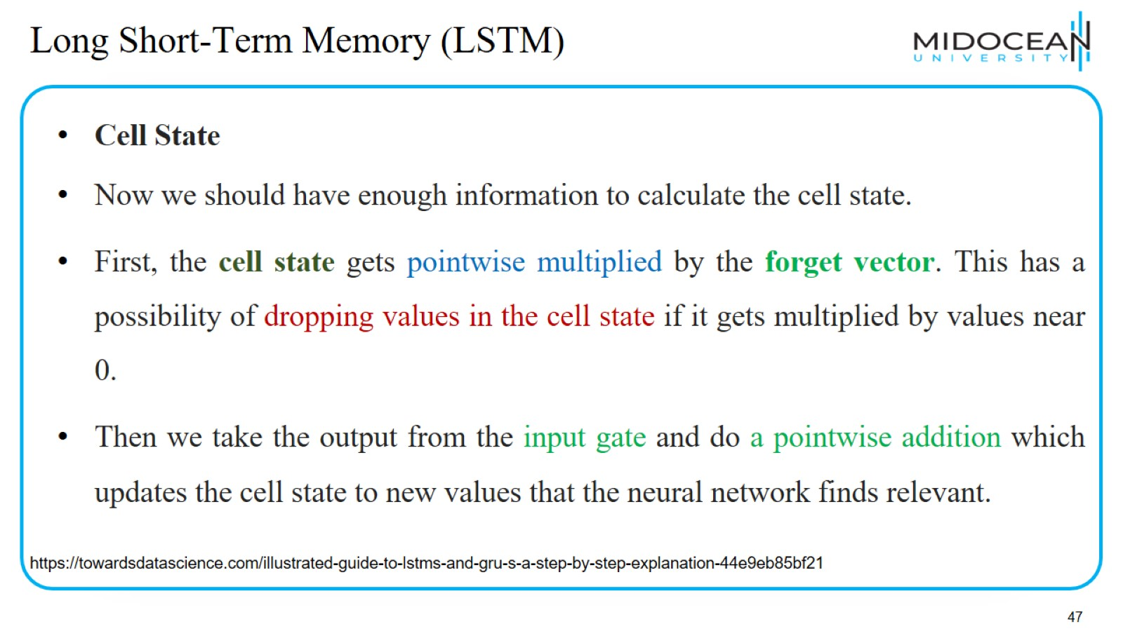
Long Short-Term Memory (LSTM)

Slide 48
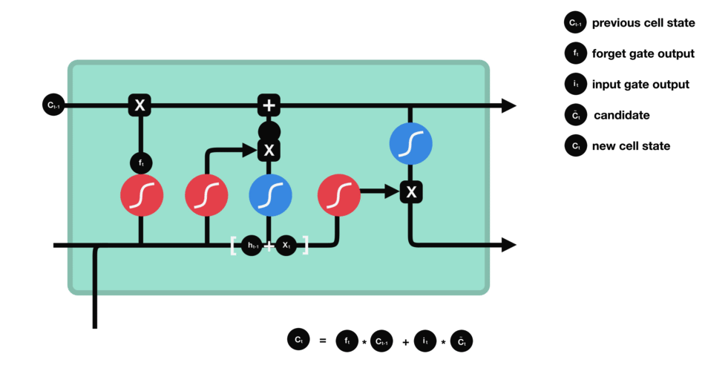
Long Short-Term Memory (LSTM)
https://towardsdatascience.com/illustrated-guide-to-lstms-and-gru-s-a-step-by-step-explanation-44e9eb85bf21

Slide 49
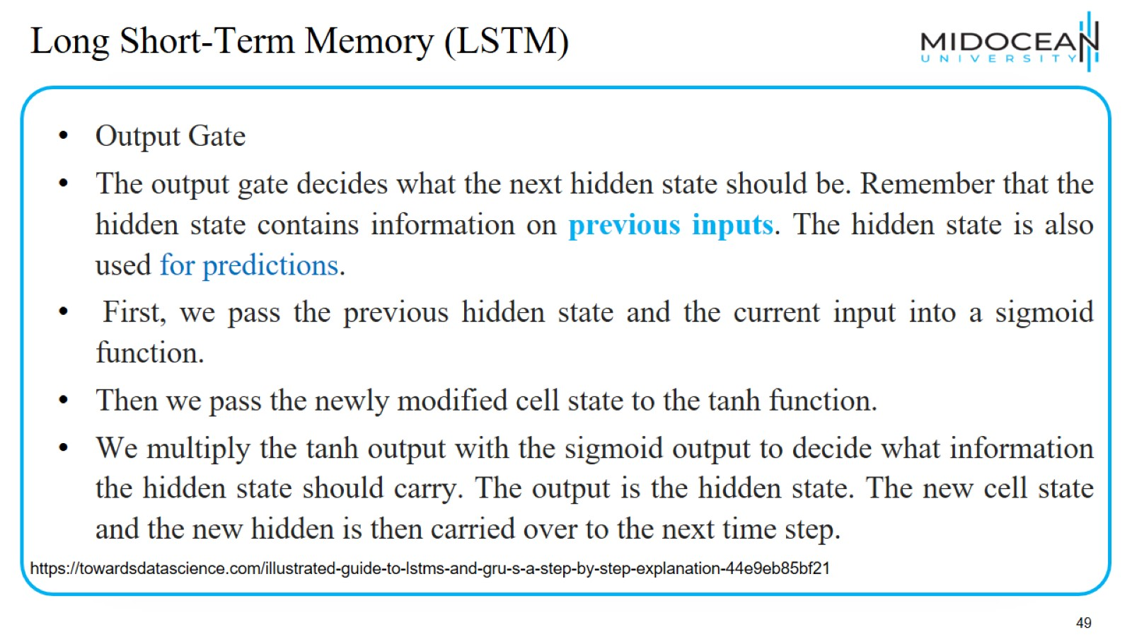
Long Short-Term Memory (LSTM)

Slide 50

Long Short-Term Memory (LSTM)

Slide 51
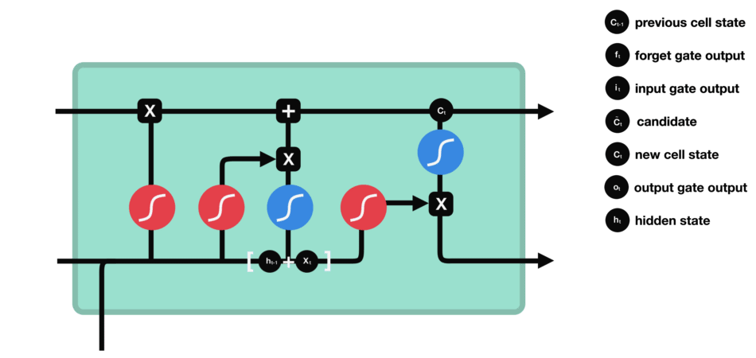
Long Short-Term Memory (LSTM)
https://towardsdatascience.com/illustrated-guide-to-lstms-and-gru-s-a-step-by-step-explanation-44e9eb85bf21

Slide 52
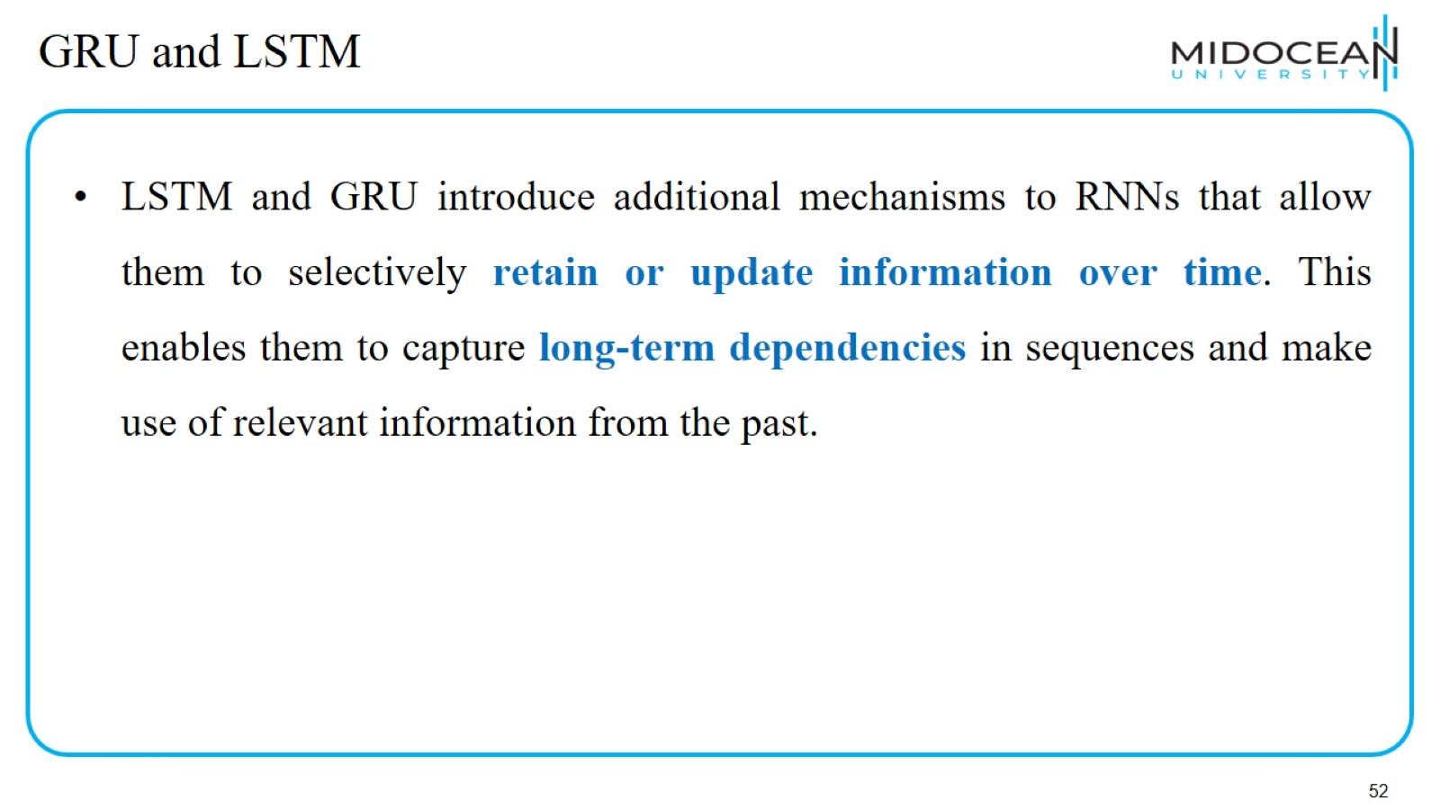
GRU and LSTM

Slide 53

LSTM

Slide 54

GRU stands for Gated Recurrent Unit.(GRU)

Slide 55

GRU vs LSTM

Slide 56

Bidirectional RNN (BiRNN)

Slide 57

Transformers

Slide 58

Transformers

Slide 59

LAB 1

Slide 60


Slide 61

LAB 2

Slide 64


Slide 65

Deep Learning Recent Updates

Slide 66

Deep Learning Recent Updates

Slide 67

Deep Learning Recent Updates

Slide 68

Deep Learning Recent Updates

Slide 69


