Slide 1



Machine Learning
Prepared by Dr. Yasser Abdelhamid
DS 620
Machine Learning
Lecture 3

Slide 2

Outline
Linear regression
Cost function
Gradient descent
Normal equation

Slide 3
Linear regression
Linear regression is a popular algorithm used in machine learning and statistical analysis to model the relationship between a dependent variable and one or more independent variables.
It aims to find a linear equation that best fits the given data points and can be used to predict future values.
In regression problems we predict real-valued output, where in classification problems we predict discrete values.

Slide 4
Dataset, Features, target variables, hypothesis
The general Idea of ML depends on the availability of sufficient instances/cases that we call Dataset.
A dataset is composed of two parts:
  features/predictors parameters, and
  labels/target parameter.
There is a hypothesis of predicting target given some values of features/input.

Slide 5

Example 1: IRIS Dataset
Classification
Attribute Information:
1. Sepal length in cm
2. Sepal width in cm
3. Petal length in cm
4. Petal width in cm
5. class:
-- Iris Setosa
-- Iris Versicolour
-- Iris Virginica
Sample instances
5.1,3.5,1.4,0.2,Iris-setosa 4.9,3.0,1.4,0.2,Iris-setosa 4.7,3.2,1.3,0.2,Iris-setosa
7.0,3.2,4.7,1.4,Iris-versicolor 6.4,3.2,4.5,1.5,Iris-versicolor 6.9,3.1,4.9,1.5,Iris-versicolor
6.3,3.3,6.0,2.5,Iris-virginica 5.8,2.7,5.1,1.9,Iris-virginica 7.1,3.0,5.9,2.1,Iris-virginica

Slide 6
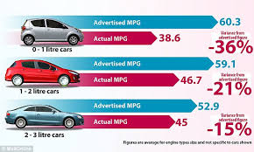
Example 2: Auto MPG DataSet
Regression
1. mpg: continuous
2. cylinders: multi-valued discrete
3. displacement: continuous
4. horsepower: continuous
5. weight: continuous
6. acceleration: continuous
7. model year: multi-valued discrete
8. origin: multi-valued discrete
9. car name: string (unique for each instance)
18.0 8 307.0 130.0 3504. 12.0 70 1 "chevrolet chevelle malibu“
15.0 8 350.0 165.0 3693. 11.5 70 1 "buick skylark 320“
18.0 8 318.0 150.0 3436. 11.0 70 1 "plymouth satellite“
16.0 8 304.0 150.0 3433. 12.0 70 1 "amc rebel sst“
17.0 8 302.0 140.0 3449. 10.5 70 1 "ford torino“
15.0 8 429.0 198.0 4341. 10.0 70 1 "ford galaxie 500"

Slide 7
notations
Instances.
x input features/predictors
y output/target/label
(x^{(i)}, y^{(i)}) row number i in the dataset.
X | Y
12.4 | 11.2
14.3 | 12.5
14.5 | 12.7
14.9 | 13.1
16.1 | 14.1
16.9 | 14.8
16.5 | 14.4
15.4 | 13.4
17 | 14.9
X |  |  |  | Y
5.1 | 3.5 | 1.4 | 0.2 | Iris-setosa
7.0 | 3.2 | 4.7 | 1.4 | Iris-versicolor
6.3 | 3.3 | 6.0 | 2.5 | Iris-virginica

Slide 8
How does it look like?
X | Y
12.4 | 11
14.3 | 13
14.5 | 11
14.9 | 13.1
16.1 | 12
16.9 | 15.5
16.5 | 14.4
15.4 | 13
17 | 15

Slide 9
Linear regression
It is not always the case that we model the dataset using a linear function.
Linear regression with only one input variable is called Uni-variate (only one independent variable) Linear Regression
it looks like this:
h_{Ɵ}(x) = Ɵ₀ + Ɵ₁x

Slide 10
Linear regression
To fit the best possible line within our data, we need to know the values of Ɵ₀ and Ɵ₁ to make h(x) as close as possible to y.
keep (h(x) – y) >>>> at Minimum

Slide 11

Cost function
We need to find values of Ɵ₀ and Ɵ₁ to keep this function at minimum, this can be accomplished using the cost function as follows.
X | Y | h_{Ɵ}(x)
12.4 | 11
14.3 | 13
14.5 | 11
14.9 | 13.1
16.1 | 12
16.9 | 15.5
16.5 | 14.4
15.4 | 13
17 | 15
h_{Ɵ}(x) = Ɵ₀ + Ɵ₁x

Slide 12
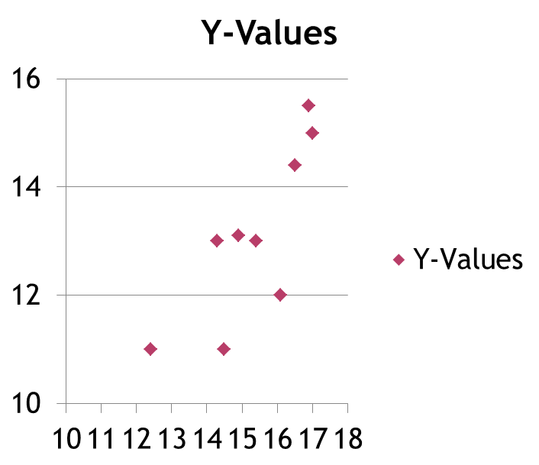
Hypothesis function
X | Y | h_{Ɵ}(x)
12.4 | 11
14.3 | 13
14.5 | 11
14.9 | 13.1
16.1 | 12
16.9 | 15.5
16.5 | 14.4
15.4 | 13
17 | 15

Slide 13
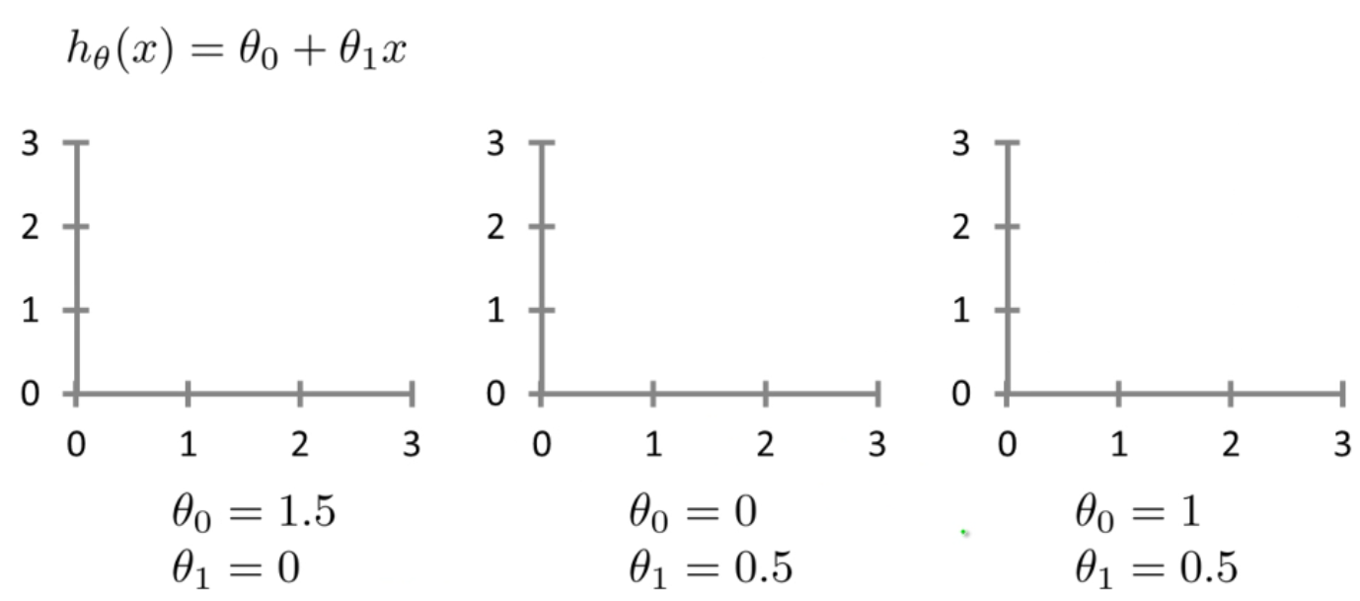
Different choices of Ɵ values

Slide 14

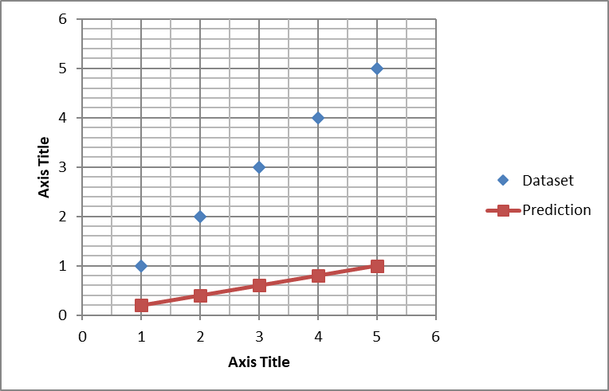
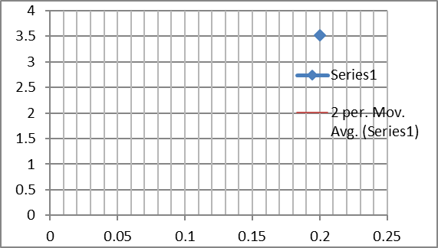
Hypothesis function and Cost function
Dataset
Hypothesis function
Cost function

Slide 15
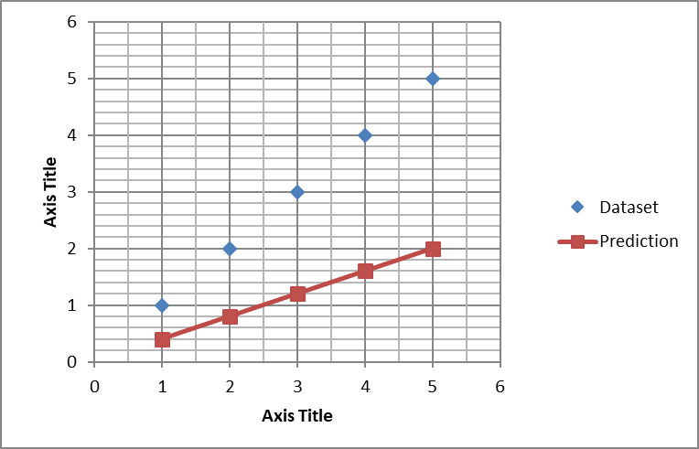
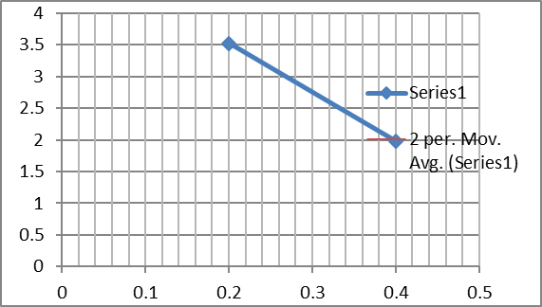
Hypothesis function and Cost function
Dataset
Hypothesis function
Cost function

Slide 16
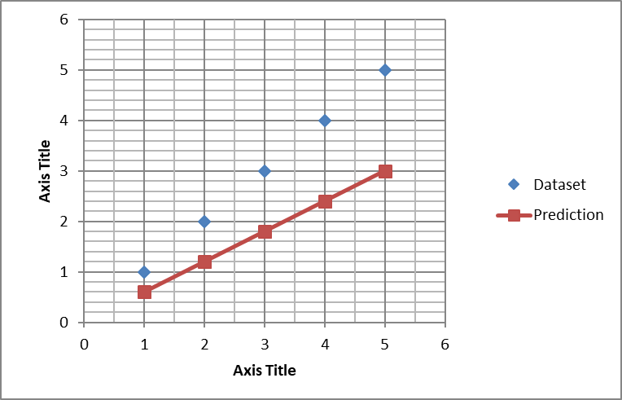
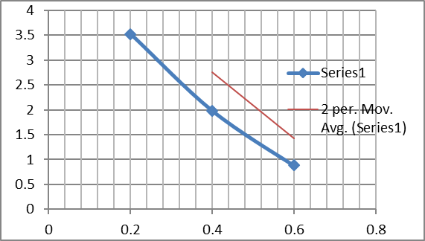
Hypothesis function and Cost function
Dataset
Hypothesis function
Cost function

Slide 17
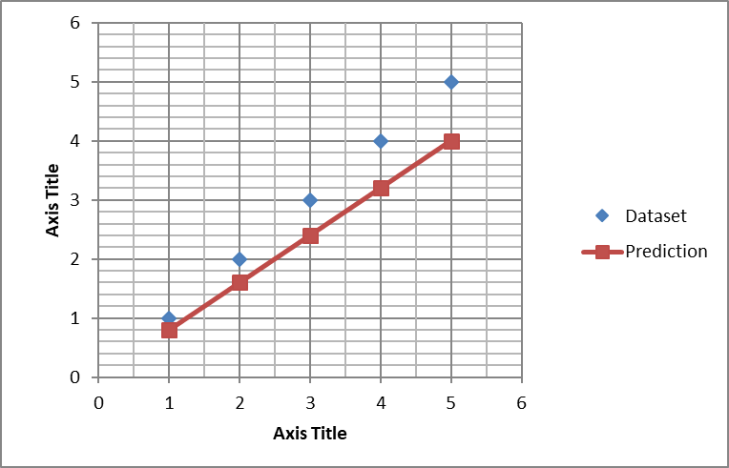
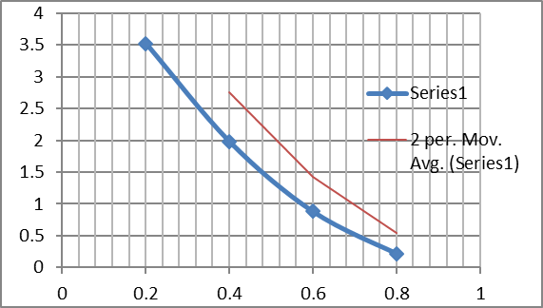
Hypothesis function and Cost function
Dataset
Hypothesis function
Cost function

Slide 18
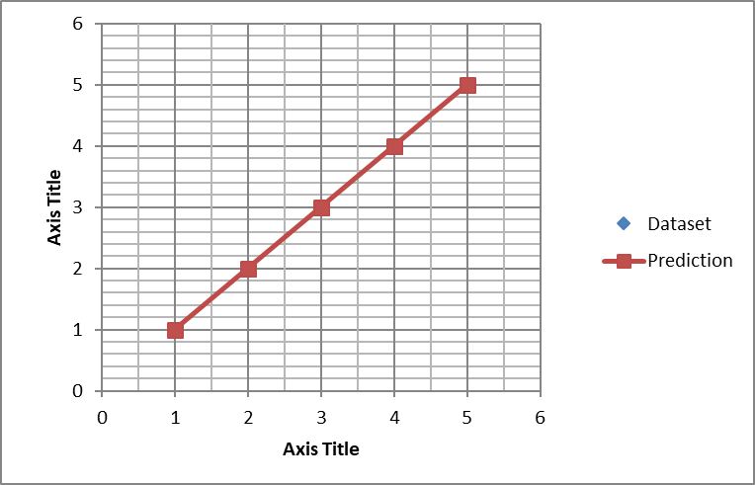
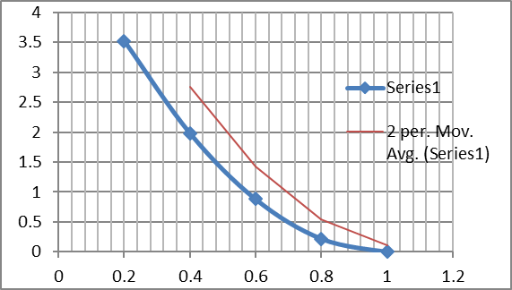
Hypothesis function and Cost function
Dataset
Hypothesis function
Cost function

Slide 19
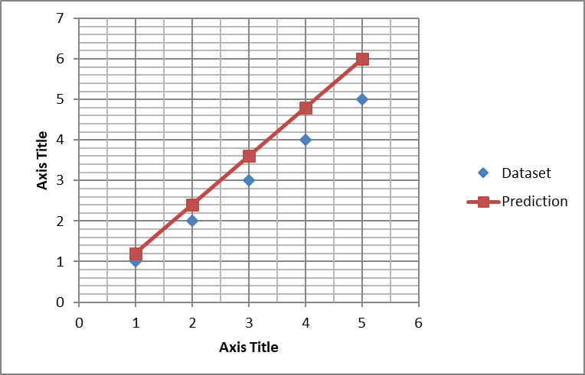
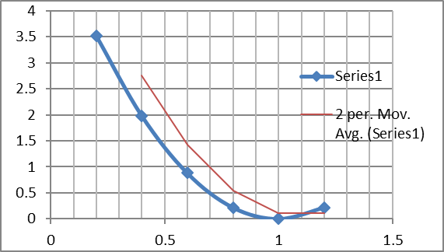
Hypothesis function and Cost function
Dataset
Hypothesis function
Cost function

Slide 20
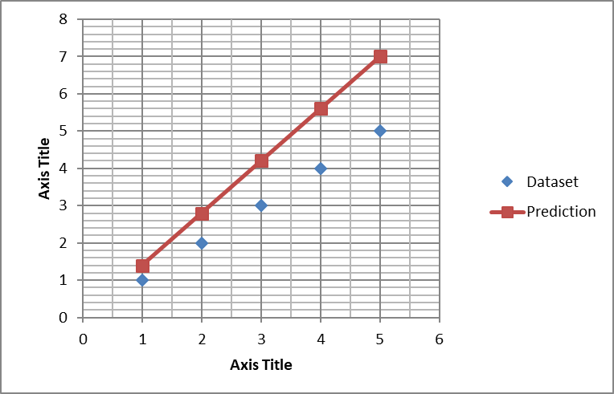
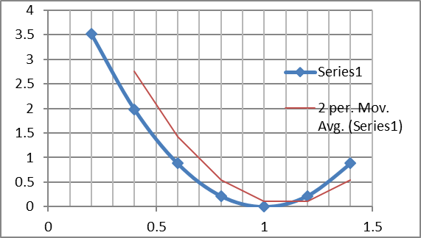
Hypothesis function and Cost function
Dataset
Hypothesis function
Cost function

Slide 21
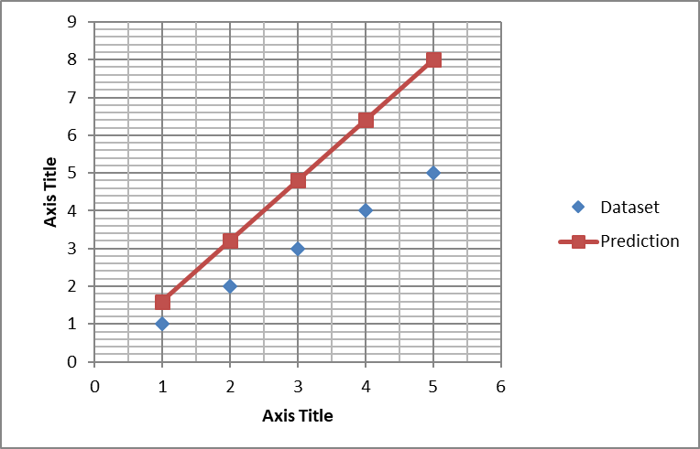
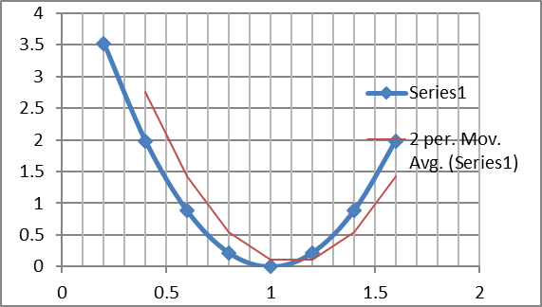
Hypothesis function and Cost function
Dataset
Hypothesis function
Cost function

Slide 22
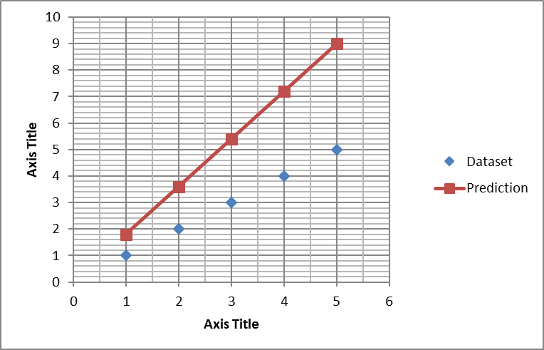
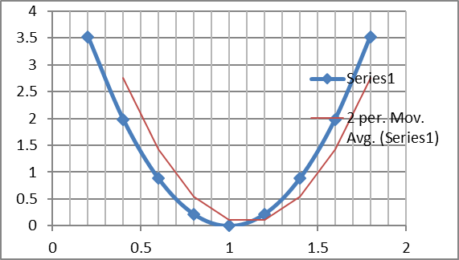
Hypothesis function and Cost function
Dataset
Hypothesis function
Cost function

Slide 23
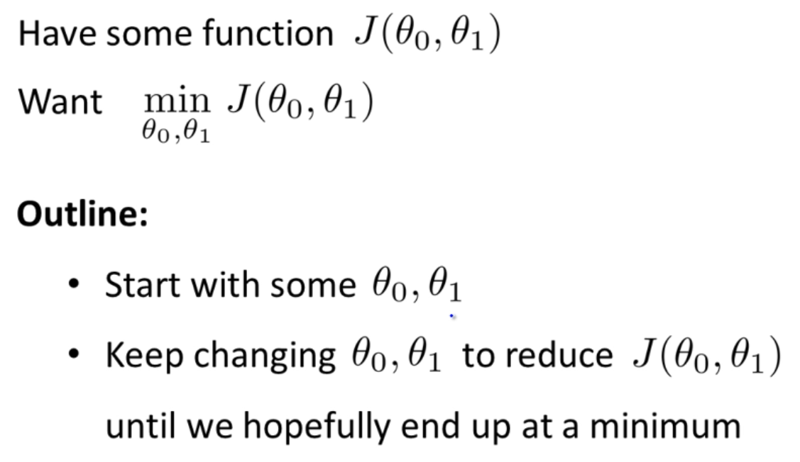
Gradient descent algorithm

Slide 24
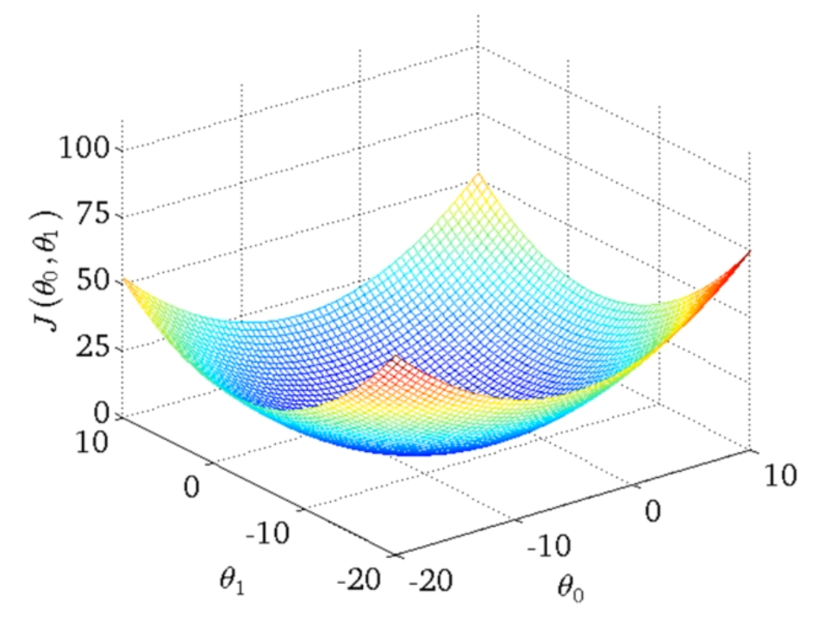
Gradient descent with two parameters

Slide 25
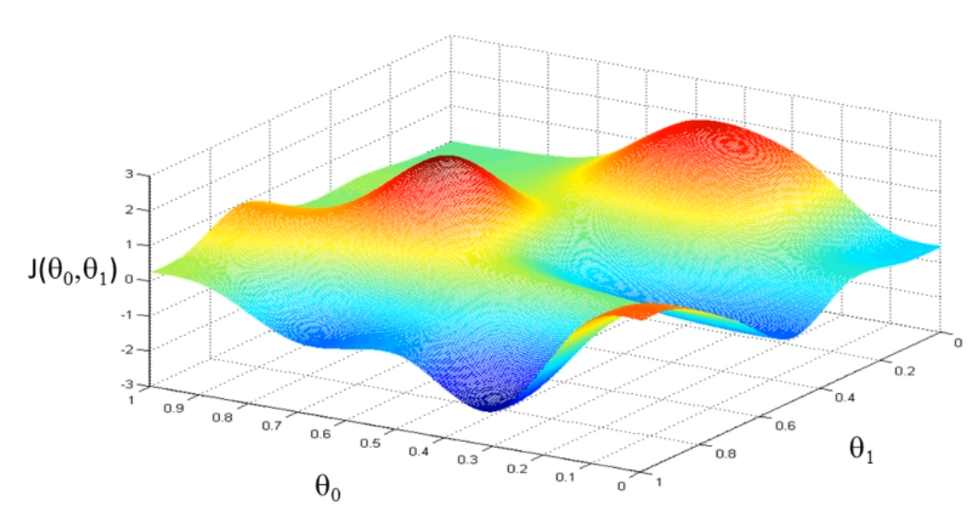
Gradient descent algorithm

Slide 26
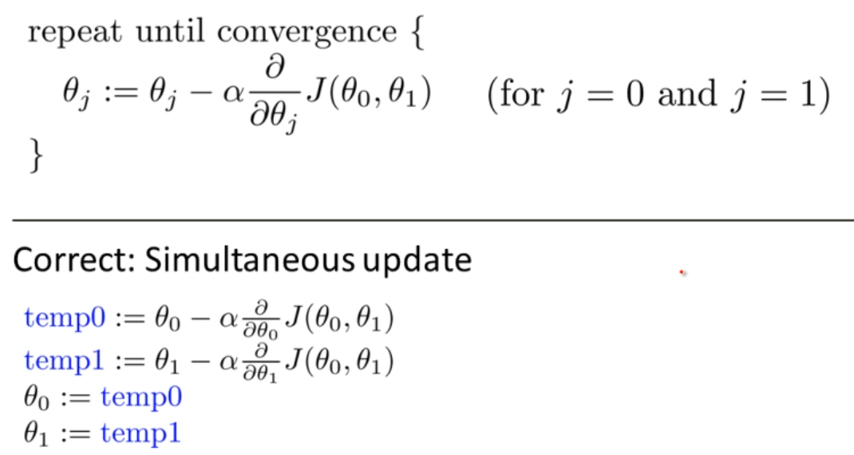
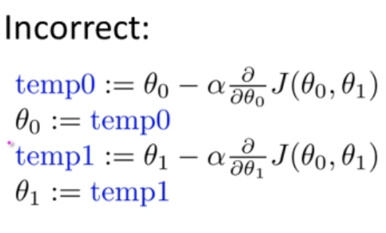
Gradient descent algorithm

Slide 27
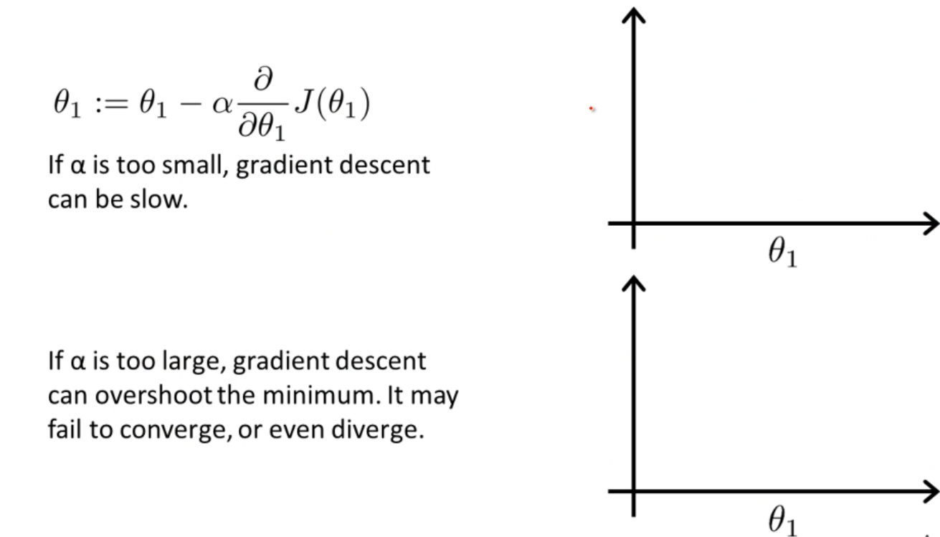
Gradient descent algorithm

Slide 28
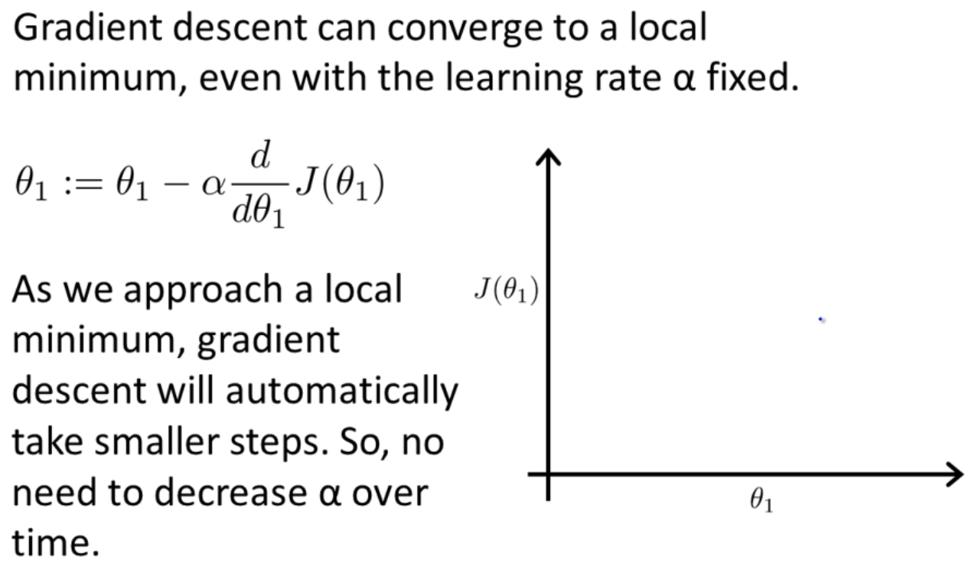
Gradient descent algorithm

Slide 29
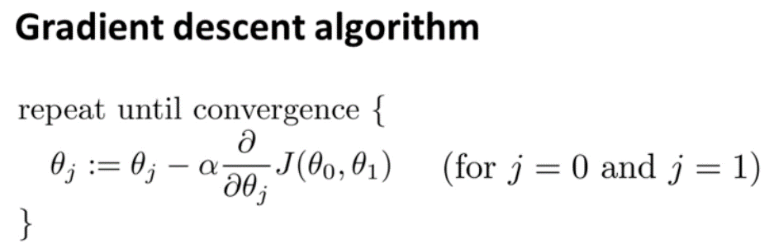
Gradient descent algorithm
α is the learning rate.

Slide 30
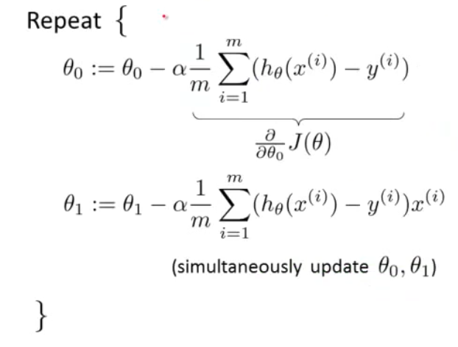
Gradient descent algorithm
h_{Ɵ}(x^{(i)}) = Ɵ₀ + Ɵ₁x^{(i)}

Slide 31
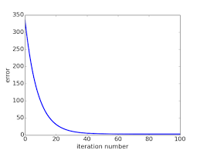
Convergence
Gradient descent is an iterative algorithm.
It has to keep repeating the process until the cost is almost constant, or has minor changes.

Slide 32
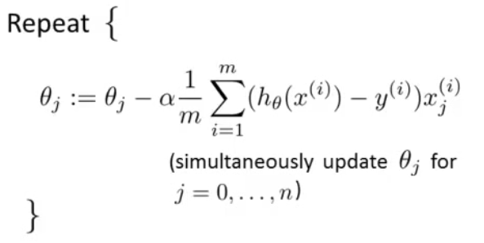
General form
h_{Ɵ}(x^{(i)}) = Ɵ₀ + Ɵ₁x₁^{(i)} + Ɵ₂x₂^{(i)} +… + Ɵ_{n}x_{n}^{(i)}
by adding the term x₀ that always has the value 1
h_{Ɵ}(x^{(i)}) = Ɵ₀x₀^{(i)} + Ɵ₁x₁^{(i)} + Ɵ₂x₂^{(i)} + … + Ɵ_{n}x_{n}^{(i)}
i | x₀ | x₁ | y
1 | 1 | 12.4 | 11
2 | 1 | 14.3 | 13
3 | 1 | 14.5 | 11
4 | 1 | 14.9 | 13.1
5 | 1 | 16.1 | 12
6 | 1 | 16.9 | 15.5
7 | 1 | 16.5 | 14.4
8 | 1 | 15.4 | 13
9 | 1 | 17 | 15

Slide 33
Normal equation
The normal equation is a mathematical formula used in linear regression to find the optimal values for the coefficients (weights) of the linear regression model.

Slide 34


Normal equation
Our hypothesis function:
Our goal is to minimize the cost function:

Slide 35
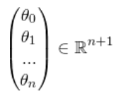


Normal equation
We can represent Ɵ as a vector:
The hypothesis function will become:
The parameters vector:

Slide 36
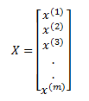
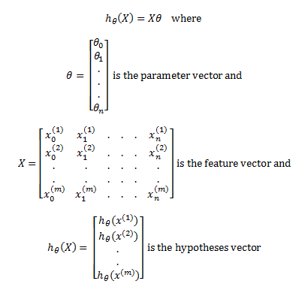
Feature vector

Slide 37
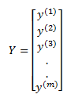
Target vector
Target vector

Slide 38
Parameters vector
The parameters vector:

Slide 39
Normal Equation vs gradient descent
Normal Equation
Gradient descent
Directly solve for the optimum values of the parameters Ɵ.
No need for setting a learning rate.
Not suitable for large number of features.
In Gradient descent we start with some value of Ɵ then we make a number of iterations to converge.
We have to set a suitable value for the learning rate α
Can be used with large number of features.

Slide 40
SUmmary
Linear regression
Hypothesis function
Cost function
Convergence
Gradient descent
Normal equation
Gradient descent vs Normal equation

Slide 41


Thank You

