Slide 1



Accounting for
Managers
Prepared by Dr. Sara Ahmed
MGM 341
Lecture 8

Slide 2



Chapter 8: Relevant Costs
for Short-term Decision
Lecture 8
Prepared by
Dr. Sara Ahmed

Slide 3


Chapter
Learning Objectives
08
Describe and identify information relevant to short-term business decisions
Decide whether to accept a special order
Decide whether to discontinue a product, department, or store
Analyze outsourcing (make-or-buy) decisions
Factor resource constraints into product mix decisions
Decide whether to sell a product “as is” or process it further

Slide 4
Chapter
08
Volume Trade-Off Decisions
Companies are forced to make volume trade-off decisions when they do not have enough capacity to produce all of the products and sales volumes demanded by their customers.
In these situations, companies must trade off, or sacrifice production of some products in favor of others in an effort to maximize profits.

Slide 5
Chapter
08
Key Terms and Concepts
When a limited resource of some type restricts the company’s ability to satisfy demand, the company is said to have a constraint.
The machine or process that is limiting overall output is called the bottleneck – it is the constraint.

Slide 6
Determine the most profitable use of a constrained resource.

Slide 7
Chapter
08
Utilization of a Constrained Resource
Fixed costs are usually unaffected in these situations, so the product mix that maximizes the company’s total contribution margin should ordinarily be selected.
A company should not necessarily promote those products that have the highest unit contribution margins.
Rather, total contribution margin will be maximized by promoting those products or accepting those orders that provide the highest contribution margin in relation to the constraining resource.

Slide 8
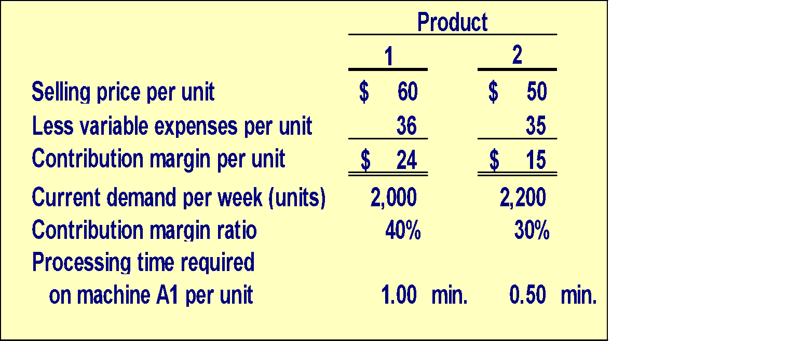
Chapter
Utilization of a Constrained
Resource – An Example – Part 1
08
Ensign Company produces two products and selected data are shown below:

Slide 9
Chapter
08
Utilization of a Constrained
Resource – An Example – Part 2
Machine A1 is the constrained resource and is being used at 100% of its capacity.
There is excess capacity on all other machines.
Machine A1 has a capacity of 2,400 minutes per week.
Should Ensign focus its efforts on Product 1 or Product 2?

Slide 10
Chapter
08
Concept Check 2
How many units of each product can be processed through Machine A1 in one minute?
Product 1 Product 2
  a. 1 unit 0.5 unit
  b. 1 unit 2.0 units
  c. 2 units 1.0 unit
  d. 2 units 0.5 unit

Slide 11
Chapter
08
Concept Check 2a
How many units of each product can be processed through Machine A1 in one minute?
Product 1 Product 2
  a. 1 unit 0.5 unit
  b. 1 unit 2.0 units
  c. 2 units 1.0 unit
  d. 2 units 0.5 unit

Slide 12
Chapter
08
Concept Check 2b
What generates more profit for the company, using one minute of machine A1 to process Product 1 or using one minute of machine A1 to process Product 2?
  a. Product 1
  b. Product 2
  c. They both would generate the same profit.
  d. Cannot be determined.

Slide 13
Chapter
08
Concept Check 2c
What generates more profit for the company, using one minute of machine A1 to process Product 1 or using one minute of machine A1 to process Product 2?
  a. Product 1
  b. Product 2
  c. They both would generate the same profit.
  d. Cannot be determined.
With one minute of machine A1, Ensign could make 1 unit of Product 1, with a contribution margin of $24, or 2 units of Product 2, each with a contribution margin of $15 per unit.
2 × $15 = $30 > $24

Slide 14
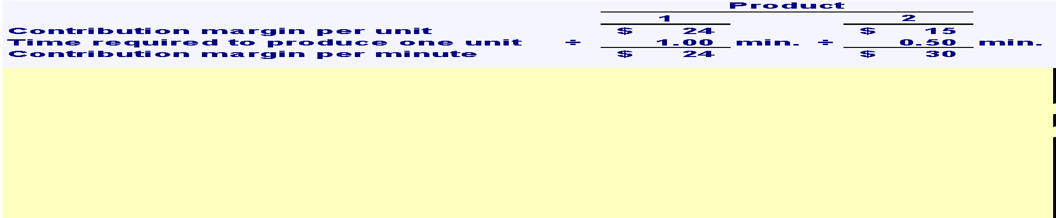
Chapter
Utilization of a Constrained
Resource – Part 1
08
The key is the contribution margin per unit of the constrained resource.
Ensign should emphasize Product 2 because it generates a contribution margin of $30 per minute of the constrained resource relative to $24 per minute for Product 1.

Slide 15
Chapter
08
Utilization of a Constrained
Resource – Part 2
The key is the contribution margin per unit of the constrained resource.
Ensign can maximize its contribution margin by first producing Product 2 to meet customer demand and then using any remaining capacity to produce Product 1. The calculations would be performed as follows.

Slide 16
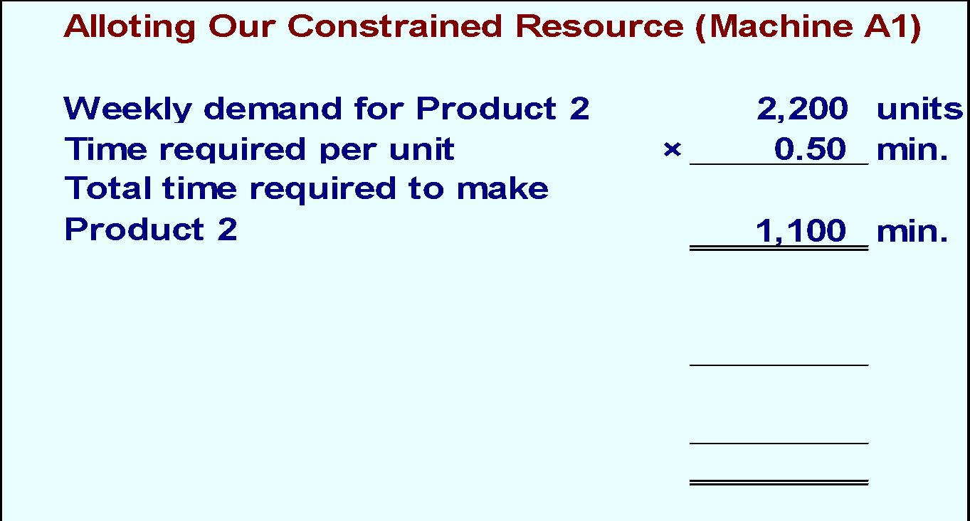
Chapter
Utilization of a Constrained
Resource – Part 3
08
Let’s see how this plan would work.

Slide 17
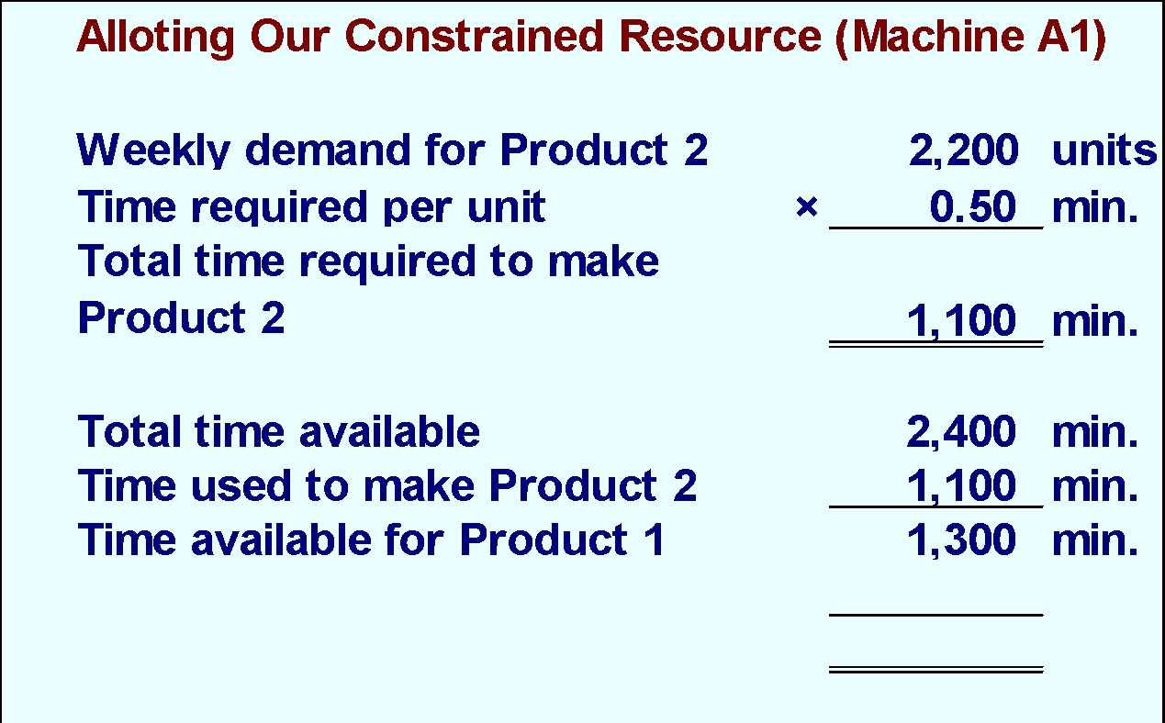
Chapter
08
Utilization of a Constrained
Resource – Part 4
Let’s see how this plan would work.

Slide 18
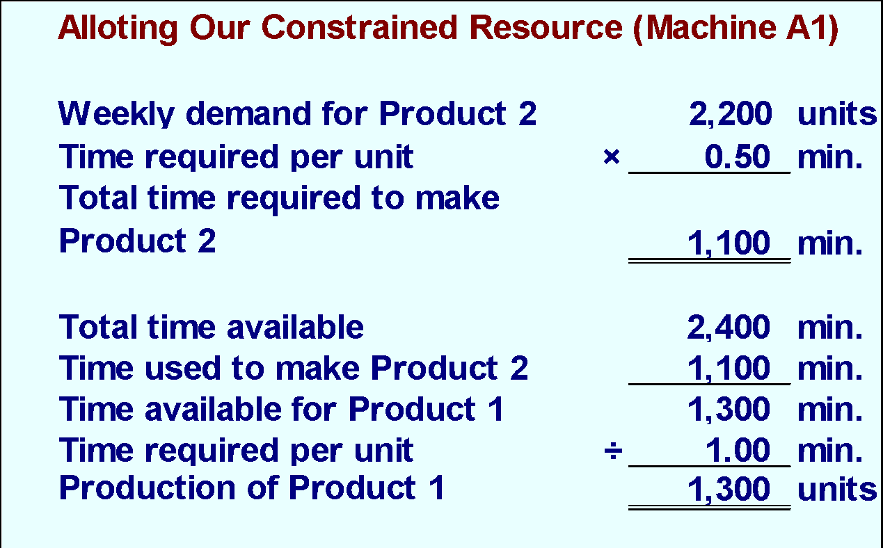
Chapter
Utilization of a Constrained
Resource – Part 5
08
Let’s see how this plan would work.

Slide 19
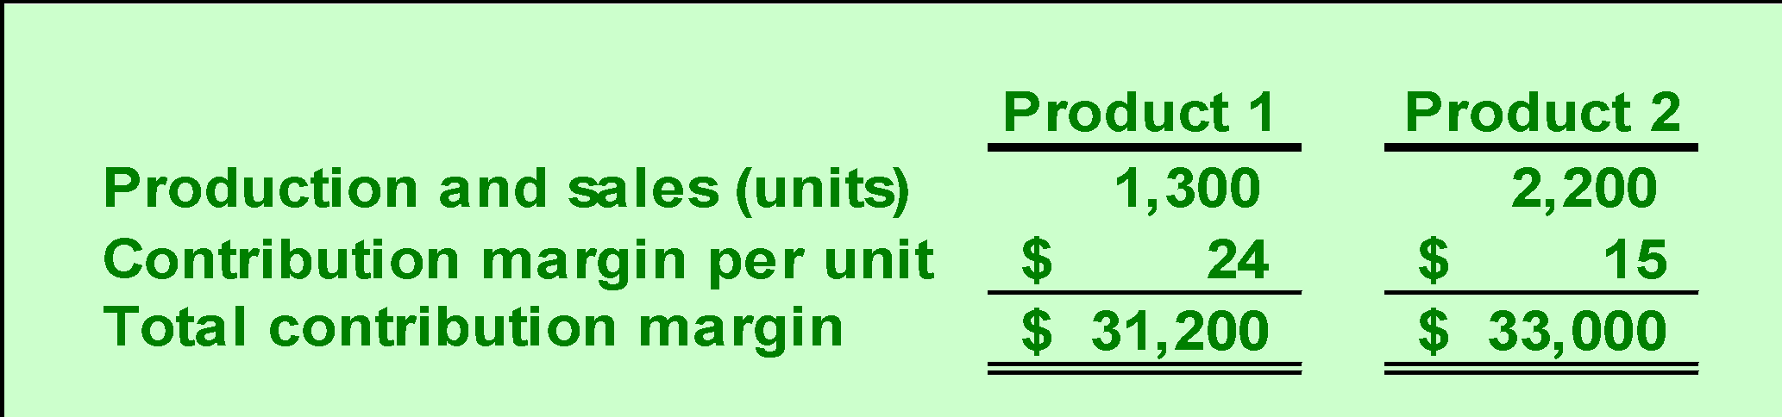
Chapter
08
Utilization of a Constrained
Resource – Part 6
According to the plan, we will produce 2,200 units of Product 2 and 1,300 of Product 1. Our contribution margin looks like this.
The total contribution margin for Ensign is $64,200.

Slide 20
Determine the value of obtaining more of the constrained resource.

Slide 21
Chapter
08
Value of a Constrained Resource - Example
Increasing the capacity of a constrained resource should lead to increased production and sales.
How much should Ensign be willing to pay for an additional minute of Machine A1 time?

Slide 22
Chapter
08
Value of a Constrained Resource - Solution
The additional machine time would be used to make more units of Product 1, which had a contribution margin per minute of $24.
Ensign should be willing to pay up to $24 per minute. This amount equals the contribution margin per minute of machine time that would be earned producing more units of Product 1.

Slide 23
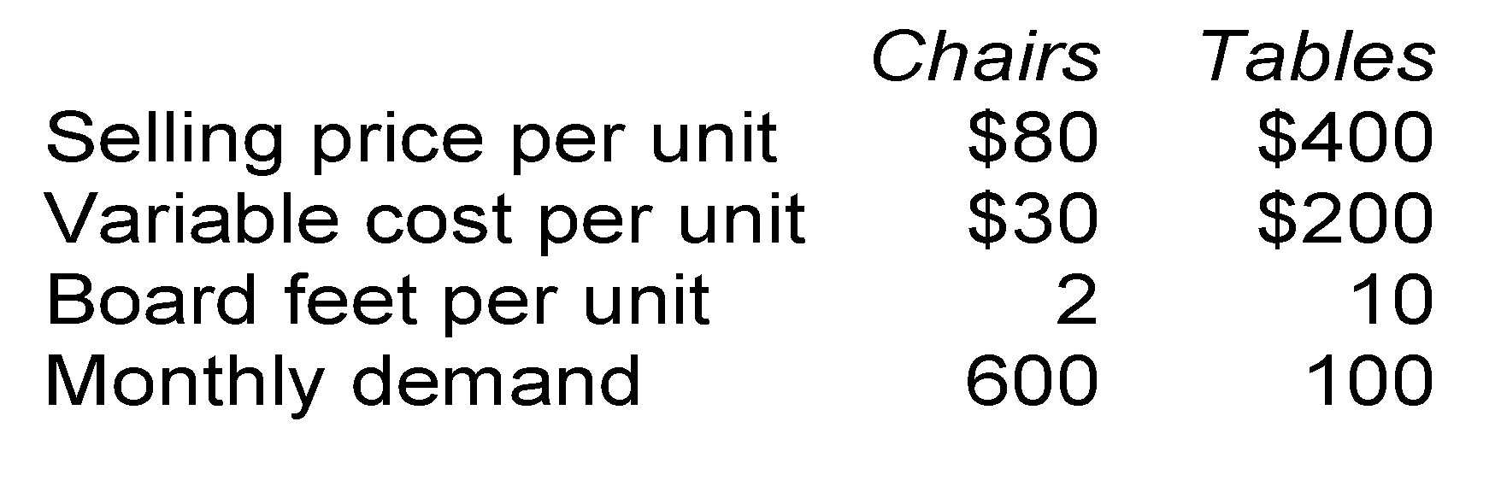
Chapter
08
Concept Check 3
Colonial Heritage makes reproduction colonial furniture from select hardwoods.
The company’s supplier of hardwood will only be able to supply 2,000 board feet this month. Is this enough hardwood to satisfy demand?
  a. Yes
  b. No

Slide 24
Chapter
08
Concept Check 3a
Colonial Heritage makes reproduction colonial furniture from select hardwoods.
The company’s supplier of hardwood will only be able to supply 2,000 board feet this month. Is this enough hardwood to satisfy demand?
  a. Yes
  b. No
(2 × 600) + (10 × 100 ) = 2,200 > 2,000

Slide 25
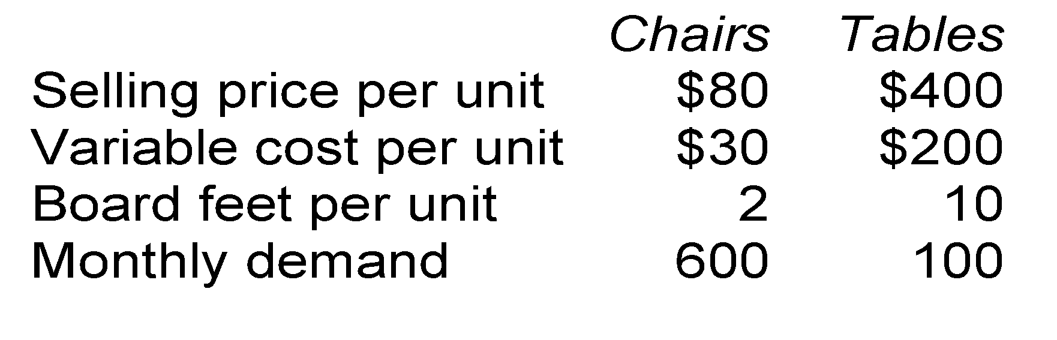
Chapter
08
Concept Check 4
The company’s supplier of hardwood will only be able to supply 2,000 board feet this month. What plan would maximize profits?
  a. 500 chairs and 100 tables
  b. 600 chairs and 80 tables
  c. 500 chairs and 80 tables
  d. 600 chairs and 100 tables

Slide 26
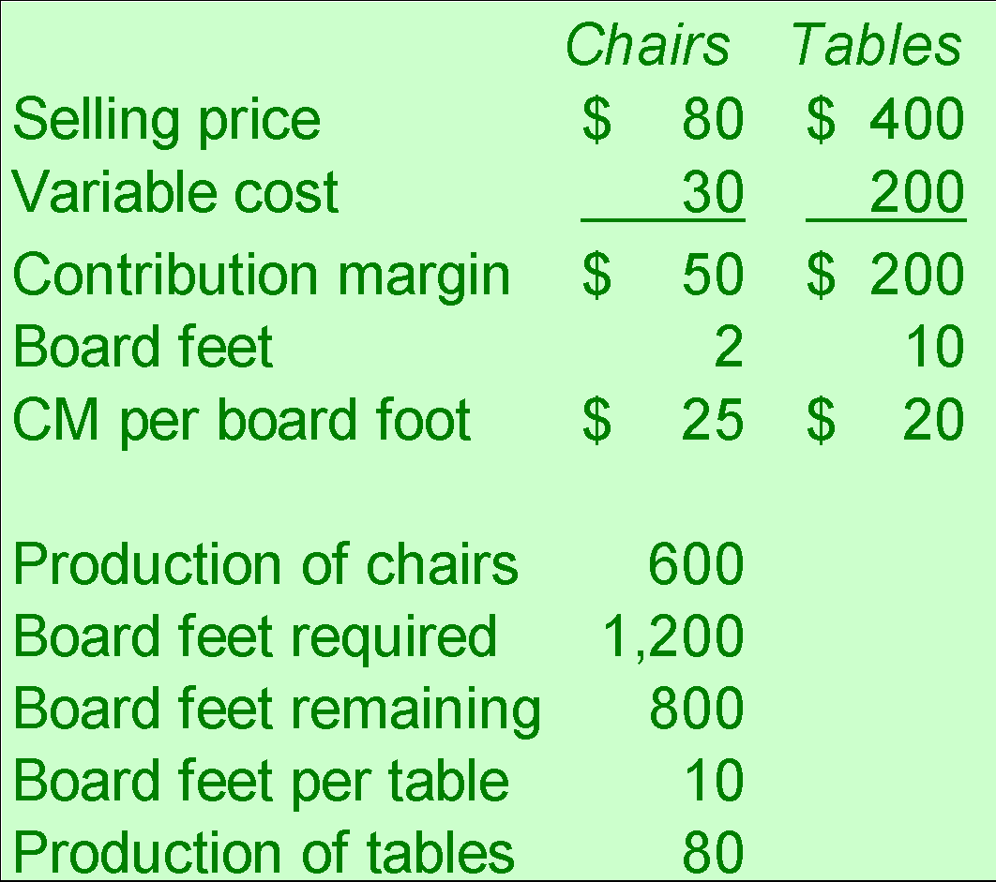
Chapter
08
Concept Check 4a
The company’s supplier of hardwood will only be able to supply 2,000 board feet this month. What plan would maximize profits?
  a. 500 chairs and 100 tables
  b. 600 chairs and 80 tables
  c. 500 chairs and 80 tables
  d. 600 chairs and 100 tables

Slide 27
Chapter
08
Concept Check 5
As before, Colonial Heritage’s supplier of hardwood will only be able to supply 2,000 board feet this month. Assume the company follows the plan we have proposed. Up to how much should Colonial Heritage be willing to pay above the usual price to obtain more hardwood?
  a. $40 per board foot
  b. $25 per board foot
  c. $20 per board foot
  d. Zero

Slide 28
Chapter
08
Concept Check 5a
The additional wood would be used to make tables. In this use, each board foot of additional wood will allow the company to earn an additional $20 of contribution margin and profit.
As before, Colonial Heritage’s supplier of hardwood will only be able to supply 2,000 board feet this month. Assume the company follows the plan we have proposed. Up to how much should Colonial Heritage be willing to pay above the usual price to obtain more hardwood?
  a. $40 per board foot
  b. $25 per board foot
  c. $20 per board foot
  d. Zero

Slide 29
Chapter
08
Managing Constraints
It is often possible for a manager to increase the capacity of a bottleneck, which is called relaxing (or elevating) the constraint, in numerous ways such as:
  Working overtime on the bottleneck.
  Subcontracting some of the processing that would be done at the bottleneck.
  Investing in additional machines at the bottleneck.
  Shifting workers from non-bottleneck processes to the bottleneck.
  Focusing business process improvement efforts on the bottleneck.
  Reducing defective units processed through the bottleneck.

Slide 30
Prepare an analysis showing whether joint products should be sold at the split-off point or processed further.

Slide 31
Chapter
08
Joint Product Costs
In some industries, two or more products, known, as joint products are produced from a single raw material input.
The point in the manufacturing process where joint products can be recognized as a separate product is called the split-off point.
A decision as to whether a joint product should be sold at the split-off point or processed further is known as a sell or process further decision.

Slide 32
Chapter
08
Joint Products
For example, in the petroleum refining industry, a large number of products are extracted from crude oil, including gasoline, jet fuel, home heating oil, lubricants, asphalt, and various organic chemicals.
Oil
Joint
Input
Common
Production
Process
Gasoline
Chemicals
Chemicals
Split-Off
Point

Slide 33
Chapter
08
Joint Products – Additional Processing
Joint costs
are incurred
up to the
split-off point
Separate
Processing
Final
Sale
Oil
Joint
Input
Common
Production
Process
Gasoline
Final
Sale
Separate
Processing
Final
Sale
Chemicals
Split-Off
Point
Separate
Product
Costs

Slide 34
Chapter
08
The Pitfalls of Allocation
Joint costs are traditionally allocated among different products at the split-off point. A typical approach is to allocate joint costs according to the relative sales value of the end products.
Although allocation is needed for some purposes such as balance sheet inventory valuation, allocations of this kind are very dangerous for decision making.

Slide 35
Chapter
08
Sell or Process Further
Joint costs are irrelevant in decisions regarding what to do with a product from the split-off point forward. Therefore, these costs should not be allocated to end products for decision-making purposes.
  With respect to sell or process further decisions, it is profitable to continue processing a joint product after the split-off point so long as the incremental revenue from such processing exceeds the incremental processing costs incurred after the split-off point.

Slide 36
Chapter
08
Sell or Process Further – An Example
Sawmill, Inc. cuts logs from which unfinished lumber and sawdust are the immediate joint products.
Unfinished lumber is sold “as is” or processed further into finished lumber.
Sawdust can also be sold “as is” to gardening wholesalers or processed further into “presto-logs.”

Slide 37
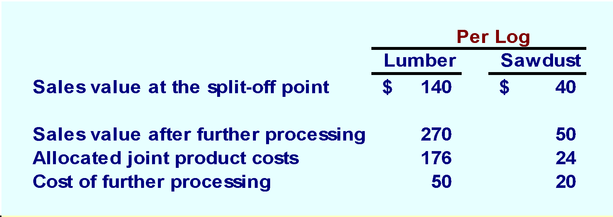
Chapter
08
Sell or Process Further – Additional Data
Data about Sawmill’s joint products includes:

Slide 38
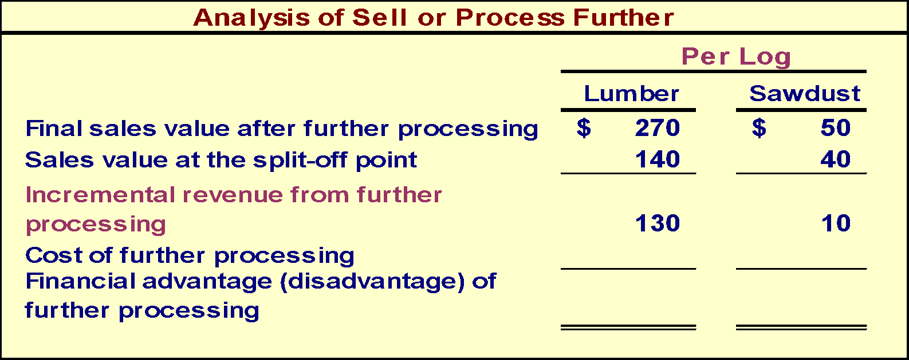
Chapter
08
Sell or Process Further – Part 1

Slide 39

Chapter
08
Sell or Process Further – Part 2
The lumber should be processed further and the sawdust should be sold at the split-off point.

Slide 40


Thank You

