Slide 1


College of Management
Project Communications
Lecturer: Dr. Raef Baraka
PMG 112
Lecture 10

Slide 2


Reference Book:
Ch1: Introduction.
Ch2: Exploring Communication Theories.
Ch3: Knowing Your Audience.
Ch4: Starting with the Basics.
Ch5: Planning Project Communications.
Ch6: Managing and Monitoring Project Communications.
Ch7: Using Project Communication Tools.
Ch8: Communicating Change.
Ch9: Managing Conflict through Communication.
Ch10: Closing.

Slide 3

Chapter 10: Contemporary Issues in Business Communication
The purpose of this chapter is to help you:
Understand the concept and importance of Green Communication.
Explain environmental and social responsibility in corporate communication.
Apply ethical sustainability messaging principles.
Identify greenwashing and propose ways to avoid it.

Slide 4
Chapter 10: Contemporary Issues in Business Communication
The purpose of this chapter is to help you:
Interpret basic ESG reporting and stakeholder communication.
Distinguish transparent and credible environmental claims.
Develop communication strategies that support sustainability impact.
Recognize future trends in green and sustainable communication.

Slide 5

Chapter 10: Closing
Ends are not bad things; they just mean that something else is about to begin. And there
are many things that don’t really end, anyway, they just begin again in a new way. Ends are
not bad, and many ends aren’t really an ending; some things are never-ending

Slide 6
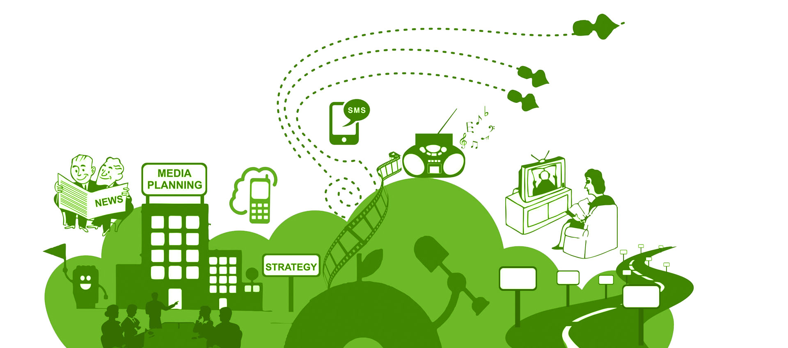
Contemporary Issues in Business Communication
Green Communication

Slide 7
Chapter 10: Contemporary Issues in Business Communication
Introduction to Green Communication
Green communication refers to a strategic approach that integrates environmental awareness into organizational messaging.
It aligns communication practices with sustainability goals and promotes ecological responsibility.
By shaping public attitudes and influencing behavioral change, green communication supports broader societal efforts to address climate concerns and environmental decline.
Dr. Raef Baraka

Slide 8
Chapter 10: Contemporary Issues in Business Communication
Introduction to Green Communication
Green communication is an interdisciplinary field drawing from environmental science, psychology, and strategic communication.
It helps organizations address complex challenges such as climate risk, consumer skepticism, and environmental ethics.
Its relevance continues to grow as global systems move toward sustainability‑driven development.
Dr. Raef Baraka

Slide 9

Chapter 10: Contemporary Issues in Business Communication
The emergence of green communication is linked to rising global concerns about climate change and resource depletion.
Organizations use sustainability-focused communication to demonstrate accountability, reduce reputational risks, and strengthen stakeholder engagement.
This makes green communication a central pillar in responsible business practice.

Slide 10
Chapter 10: Contemporary Issues in Business Communication
A key component of green communication is reliance on accurate and science‑based information.
Organizations provide stakeholders with credible data to help them understand environmental impacts.
This enhances transparency, promotes informed decision‑making, and encourages environmentally responsible behavior across communities and institutions.

Slide 11
Chapter 10: Contemporary Issues in Business Communication
Introduction to Green Communication
Green communication also focuses on building trust between organizations and stakeholders.
Trust is fostered when sustainability messages are consistent, transparent, and backed by real evidence.
This strengthens organizational legitimacy and improves public confidence in environmental initiatives and long‑term sustainability ambitions.
Dr. Raef Baraka

Slide 12
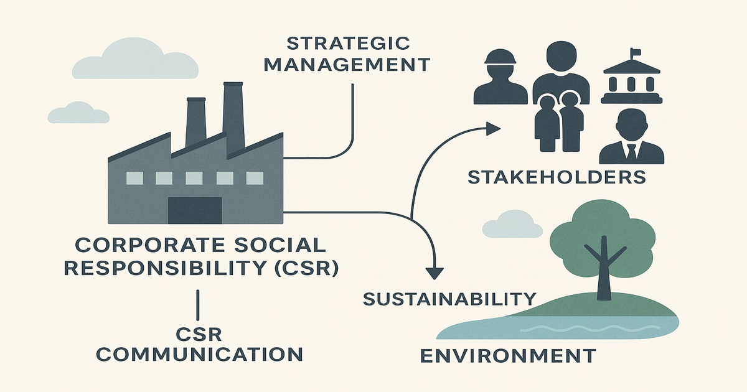
Contemporary Issues in Business Communication
Environmental & Social Responsibility in Business Communication

Slide 13
Chapter 10: Contemporary Issues in Business Communication
Environmental Responsibility in Communication
Environmental responsibility in communication requires organizations to disclose how their activities impact ecosystems and natural resources.
This involves reporting carbon emissions, waste management, and energy consumption.
Transparent communication allows stakeholders to understand environmental risks while reinforcing organizational accountability.
Dr. Raef Baraka

Slide 14
Chapter 10: Contemporary Issues in Business Communication
Environmental Social Responsibility in Communication
Social responsibility in communication concerns how organizations represent fairness, respect, and human welfare.
Ethical communication protects communities from misleading information and ensures messages support wellbeing.
This strengthens trust and demonstrates a genuine commitment to socially responsible business practices.
Dr. Raef Baraka

Slide 15
Chapter 10: Contemporary Issues in Business Communication
Environmental Social Responsibility in Communication
Integrating environmental and social responsibility ensures a comprehensive sustainability focus.
Organizations must balance ecological preservation with human development, labor rights, and community welfare.
Holistic communication reflects broad sustainability goals that extend beyond environmental impacts alone.
Dr. Raef Baraka

Slide 16
Chapter 10: Contemporary Issues in Business Communication
Environmental Social Responsibility in Communication
Responsible communication acknowledges links between environmental harm and social inequality. Issues like pollution and climate risks often disproportionately affect vulnerable communities.
Transparent communication about these impacts strengthens environmental justice and demonstrates ethical responsibility.
Dr. Raef Baraka

Slide 17
Chapter 10: Contemporary Issues in Business Communication
Environmental Social Responsibility in Communication
Organizations that consistently practice responsible sustainability communication build long‑term legitimacy.
Such credibility leads to a stronger reputation, improved stakeholder loyalty, and enhanced ability to influence environmental and social progress across the sectors in which they operate.
Dr. Raef Baraka

Slide 18

Contemporary Issues in Business Communication
Ethical Sustainability Messaging

Slide 19
Chapter 10: Contemporary Issues in Business Communication
Ethical Sustainability Messaging
Ethical sustainability messaging ensures that environmental claims are accurate and grounded in evidence.
Organizations must avoid exaggeration and provide clear explanations of sustainability actions.
Ethical messaging supports transparency, improves public trust, and strengthens the credibility of sustainability initiatives.
Dr. Raef Baraka

Slide 20

Chapter 10: Contemporary Issues in Business Communication
A vital component of ethical sustainability messaging is balanced disclosure.
Organizations must communicate not only successes but also challenges.
This balance prevents the perception of selective information and demonstrates integrity in sustainability efforts..

Slide 21
Chapter 10: Contemporary Issues in Business Communication
Ethical sustainability messaging relies on standards such as GRI, ISO, and lifecycle assessment frameworks.
These standards guide organizations in assessing environmental impacts and reporting them transparently. Stakeholders use these frameworks to evaluate the reliability of sustainability claims.

Slide 22
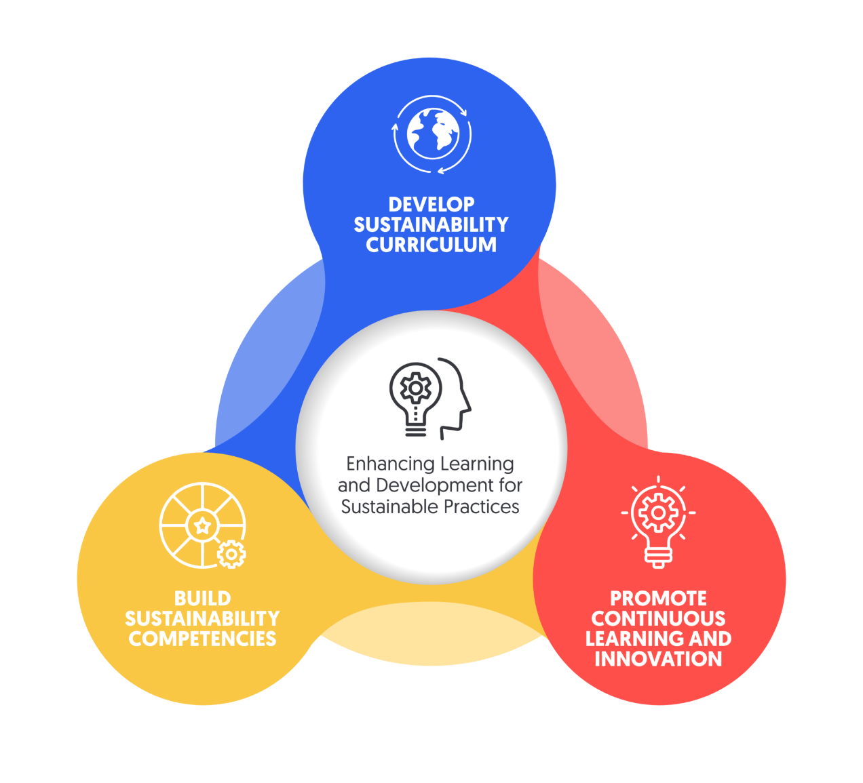
Chapter 10: Contemporary Issues in Business Communication
Organizations must train communication teams to ensure they understand sustainability concepts and environmental science.
Such training reduces misinformation risks and strengthens message accuracy. Effective internal capacity building is essential for ethical sustainability communication.

Slide 23
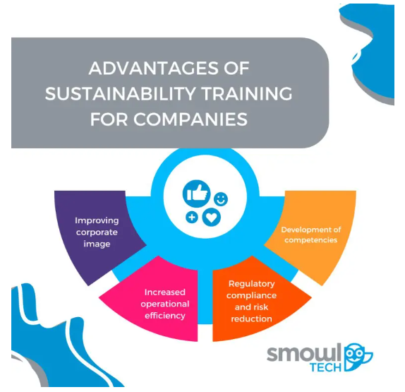
Chapter 10: Contemporary Issues in Business Communication
Ethical sustainability messaging empowers consumers and stakeholders to make informed decisions.
When environmental information is clear and credible, it influences purchasing behavior and supports wider societal efforts toward sustainable living and responsible resource use.

Slide 24
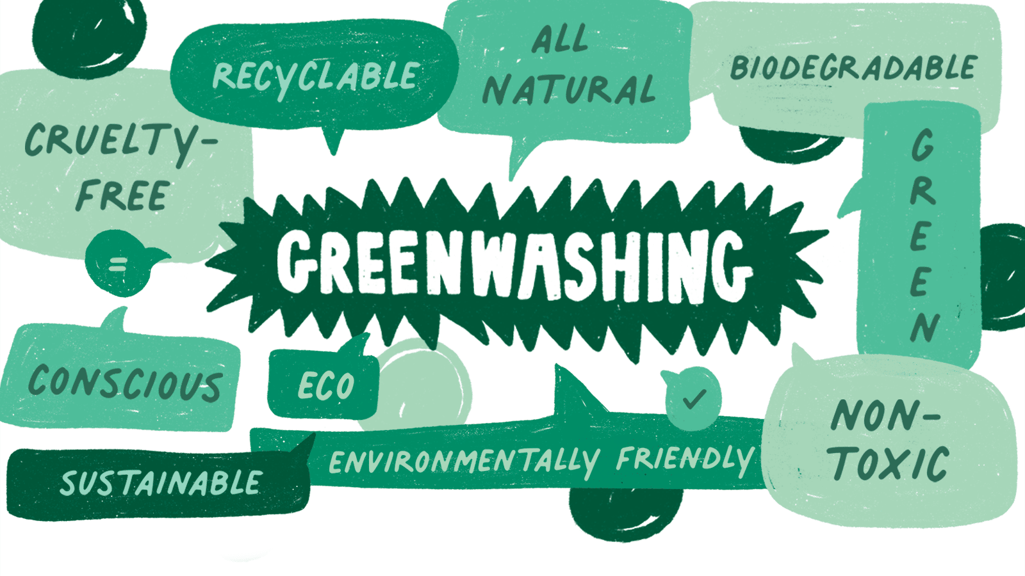
Contemporary Issues in Business Communication
Avoiding Greenwashing

Slide 25
Chapter 10: Contemporary Issues in Business Communication
Greenwashing
Greenwashing occurs when organizations exaggerate or falsify environmental claims.
It undermines public trust, damages credibility, and contradicts sustainability values.
Avoiding greenwashing is essential for maintaining ethical communication and supporting genuine sustainability performance.
Dr. Raef Baraka

Slide 26
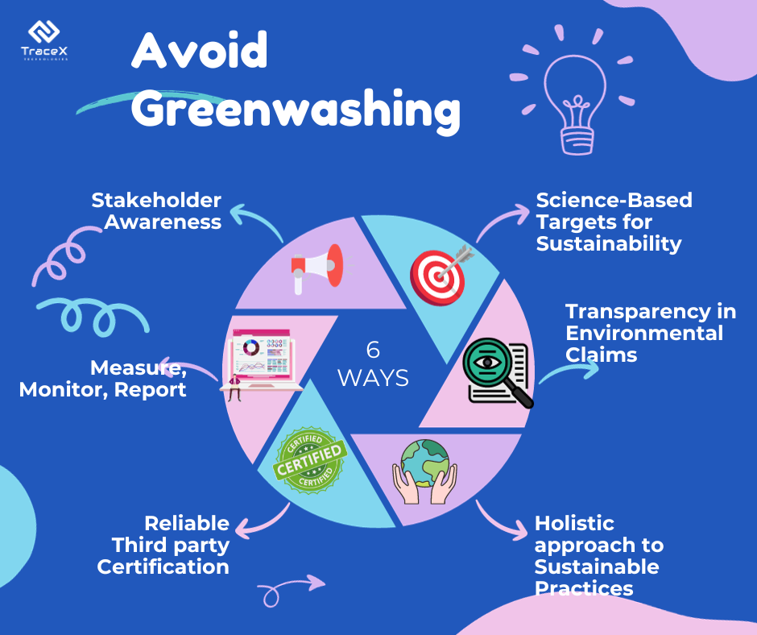
Chapter 10: Contemporary Issues in Business Communication
Common greenwashing practices include vague claims, irrelevant information, false certifications, and selective disclosure.
Stakeholders have become increasingly aware of these tactics, making organizational transparency more important than ever in sustainability communication.

Slide 27
Chapter 10: Contemporary Issues in Business Communication
To avoid greenwashing, environmental claims must be directly linked to measurable actions.
Organizations should provide data‑driven evidence of sustainability progress and explain how claims are verified.
This strengthens legitimacy and stakeholder trust.

Slide 28
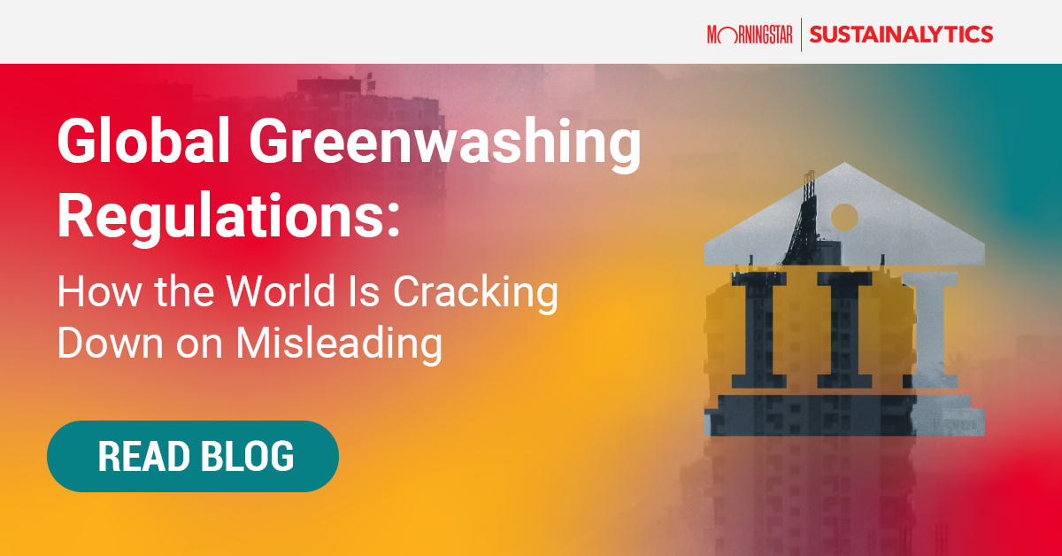
Chapter 10: Contemporary Issues in Business Communication
Transparency is the strongest tool against greenwashing.
Organizations that offer complete information, third‑party verification, and detailed methodologies build trust and demonstrate a genuine commitment to sustainability improvement.

Slide 29
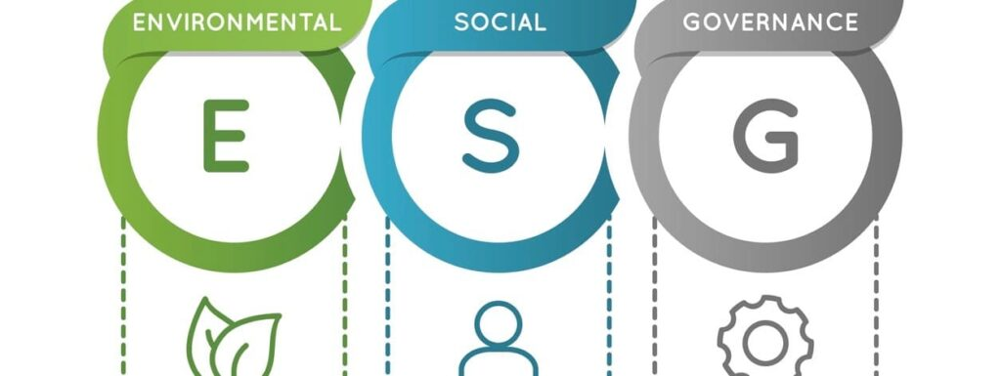
Contemporary Issues in Business Communication
ESG Rreporting

Slide 30
Chapter 10: Contemporary Issues in Business Communication
ESG Reporting
ESG reporting integrates environmental, social, and governance data into comprehensive disclosures.
Organizations use ESG frameworks to communicate carbon emissions, labor conditions, governance quality, and community impact.
ESG reporting strengthens transparency and supports sustainable decision‑making.
Dr. Raef Baraka

Slide 31
Chapter 10: Contemporary Issues in Business Communication
ESG Reporting
Stakeholder communication within ESG frameworks requires tailored information.
Investors seek risk and performance metrics, employees look for fairness and inclusion, and regulators focus on compliance.
Effective communication must align with these diverse needs while remaining accurate and consistent.
Dr. Raef Baraka

Slide 32
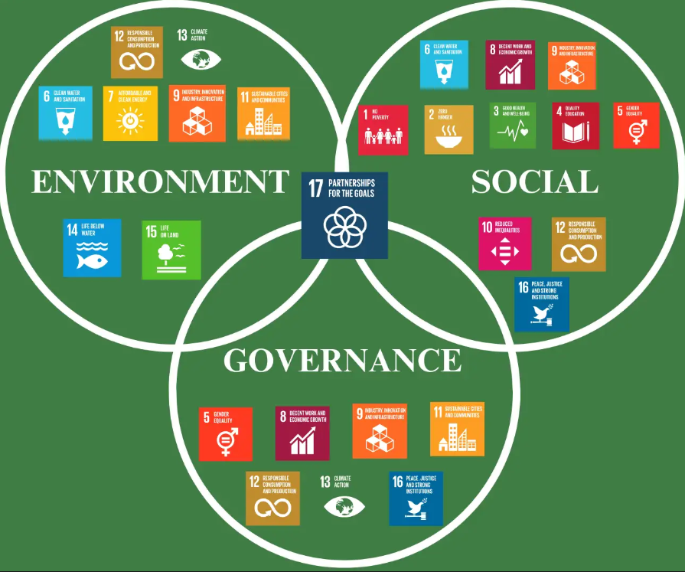
Chapter 10: Contemporary Issues in Business Communication
Recognized ESG standards such as GRI, SASB, TCFD, and IFRS Sustainability Reporting enhance comparability and credibility.
Organizations adopting these frameworks improve global competitiveness while ensuring transparent disclosure of sustainability performance.

Slide 33
Chapter 10: Contemporary Issues in Business Communication
ESG Reporting
Investors increasingly use ESG reports to evaluate long‑term risk exposure and sustainability opportunities.
Transparent communication helps investors understand climate risks, ethical concerns, and organizational resilience, ultimately influencing financial decisions.
Dr. Raef Baraka

Slide 34
Chapter 10: Contemporary Issues in Business Communication
ESG Reporting
ESG communication also supports internal decision‑making.
Integrating sustainability metrics into strategy enables leaders to identify risks, design resilient models, and foster innovation that aligns with environmental and social goals.
Dr. Raef Baraka

Slide 35
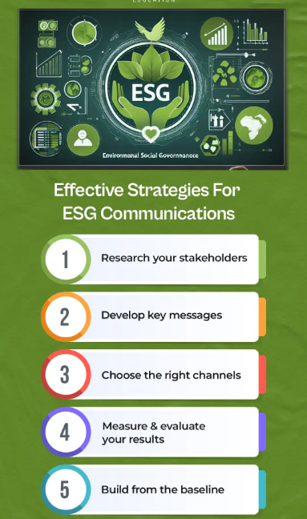
Contemporary Issues in Business Communication
Effective Green Communication Strategies

Slide 36
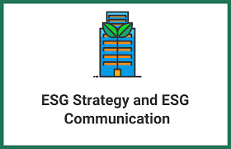
Chapter 10: Contemporary Issues in Business Communication
Organizations use multi‑channel strategies including reports, digital platforms, community outreach, and social media.
This ensures sustainability messages reach diverse audiences and remain accessible across communication environments.

Slide 37
Chapter 10: Contemporary Issues in Business Communication
Behavioral science enhances communication effectiveness by addressing cognitive biases and motivation.
Social norms, nudges, and framing techniques can guide stakeholders toward more sustainable behaviors in both personal and organizational contexts.

Slide 38
Chapter 10: Contemporary Issues in Business Communication
Effective Green Communication Strategies
Effective communication strategies align sustainability messages with organizational values and stakeholder expectations.
Clear and evidence‑based messages strengthen engagement and support behavioral change, increasing the impact of sustainability initiatives.
Dr. Raef Baraka

Slide 39
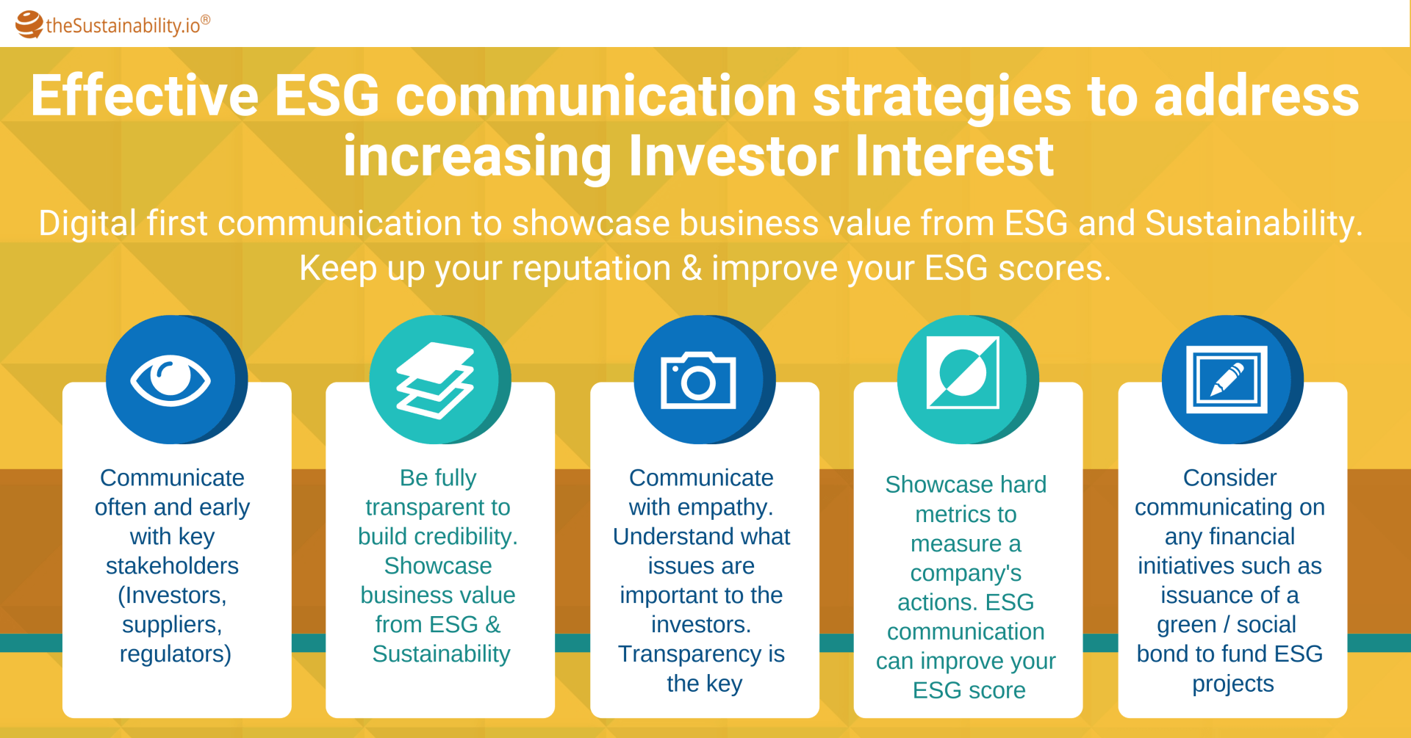
Chapter 10: Contemporary Issues in Business Communication

Slide 40
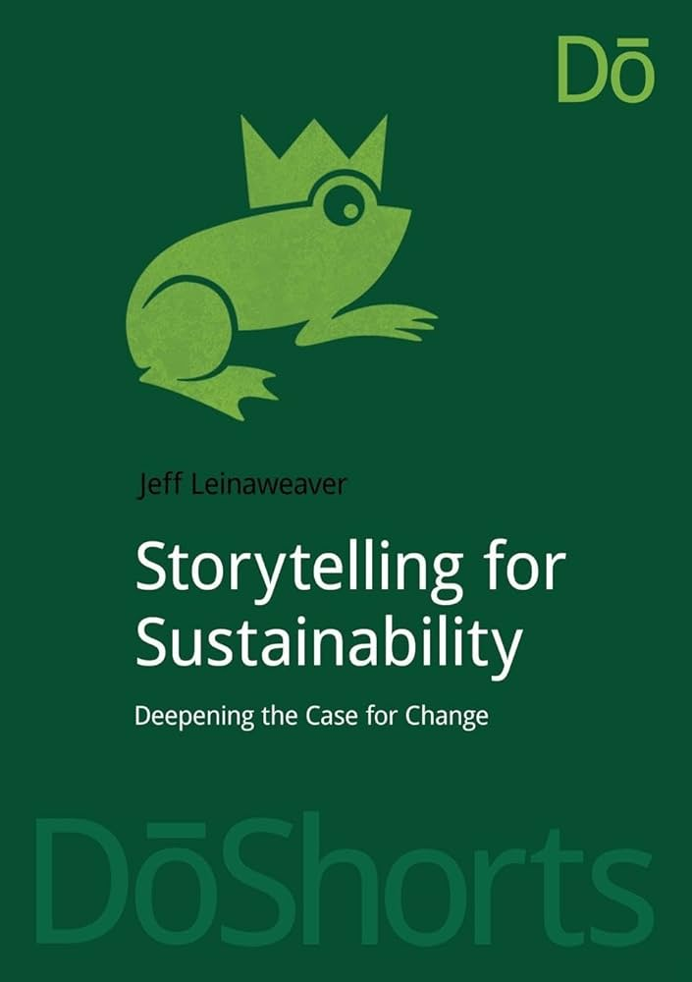
Chapter 10: Contemporary Issues in Business Communication
Sustainability Storytelling is a persuasive communication approach. Narratives about environmental challenges and community impact make sustainability relatable and emotionally engaging.
Storytelling strengthens message retention and public involvement.

Slide 41
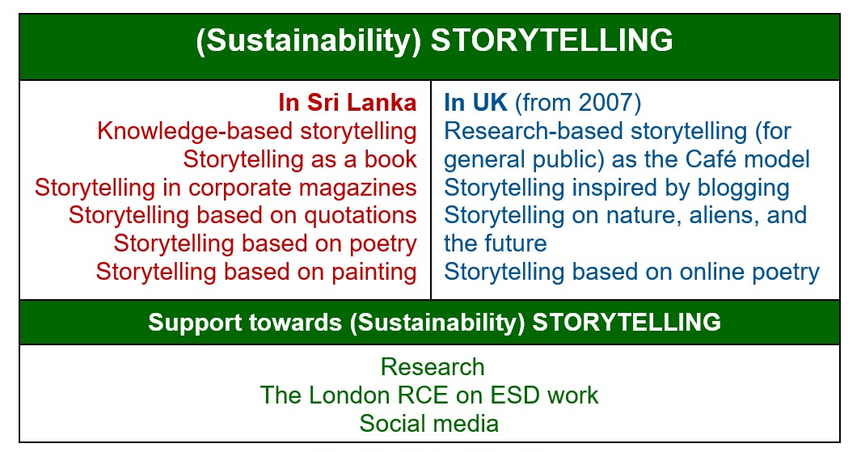
Chapter 10: Contemporary Issues in Business Communication

Slide 42



Thank You

