Slide 1
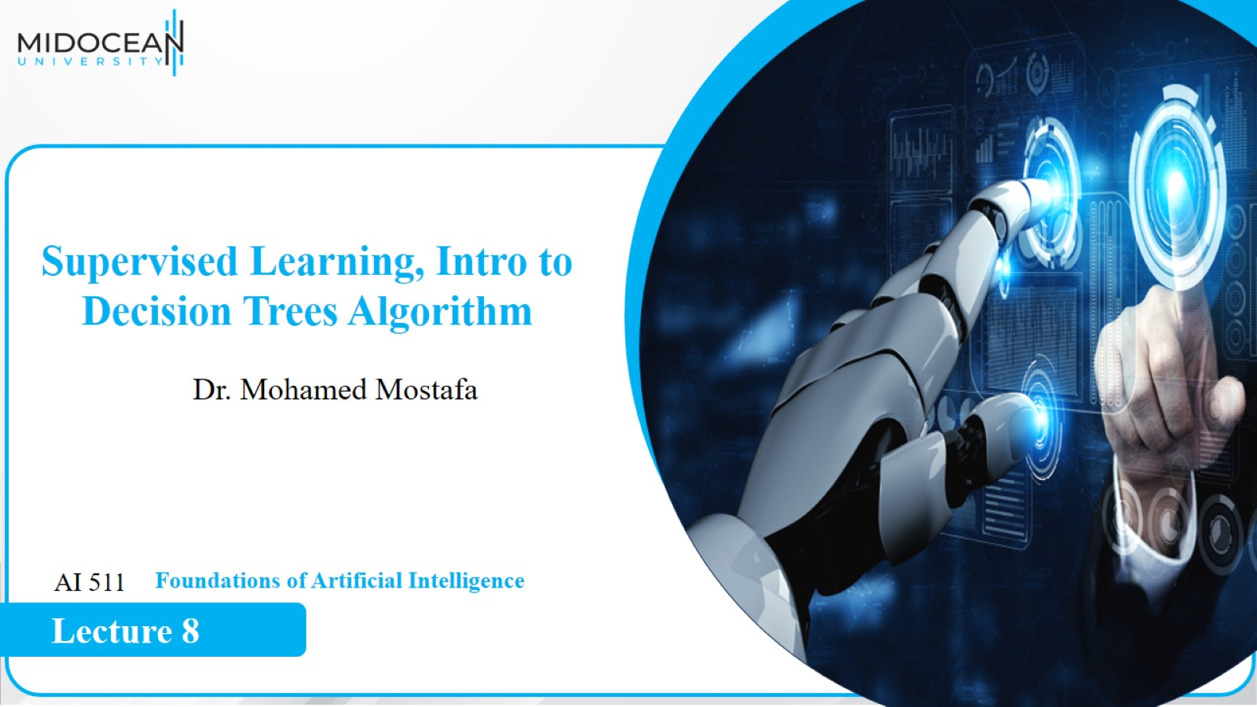

Slide 2
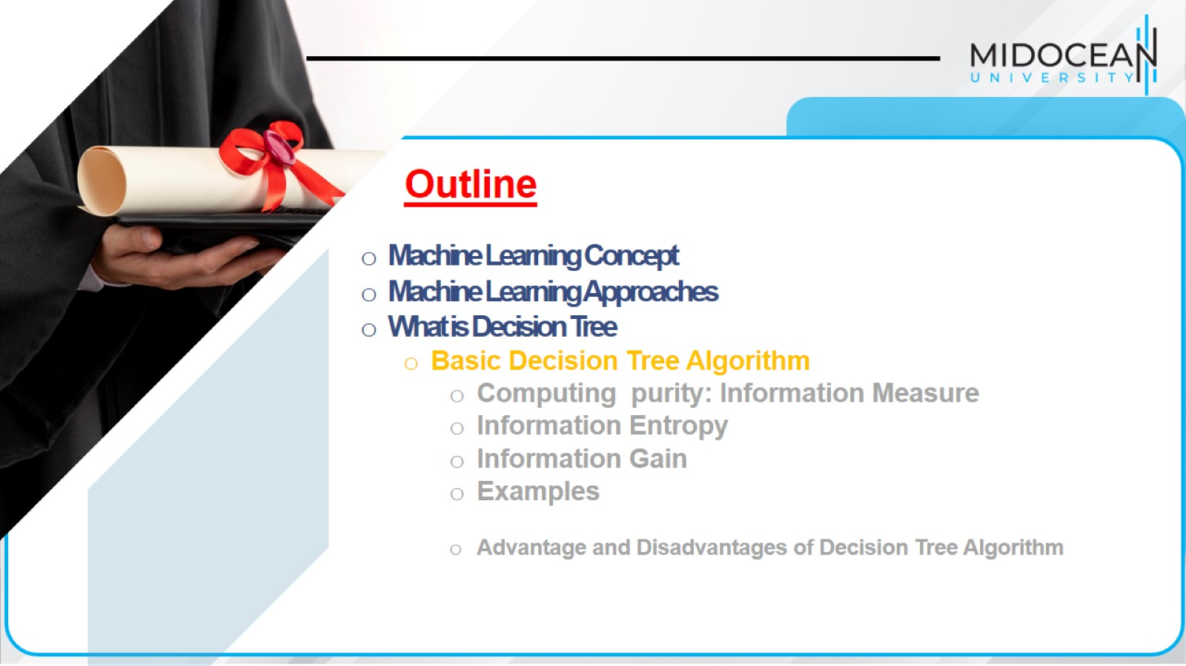

Slide 3
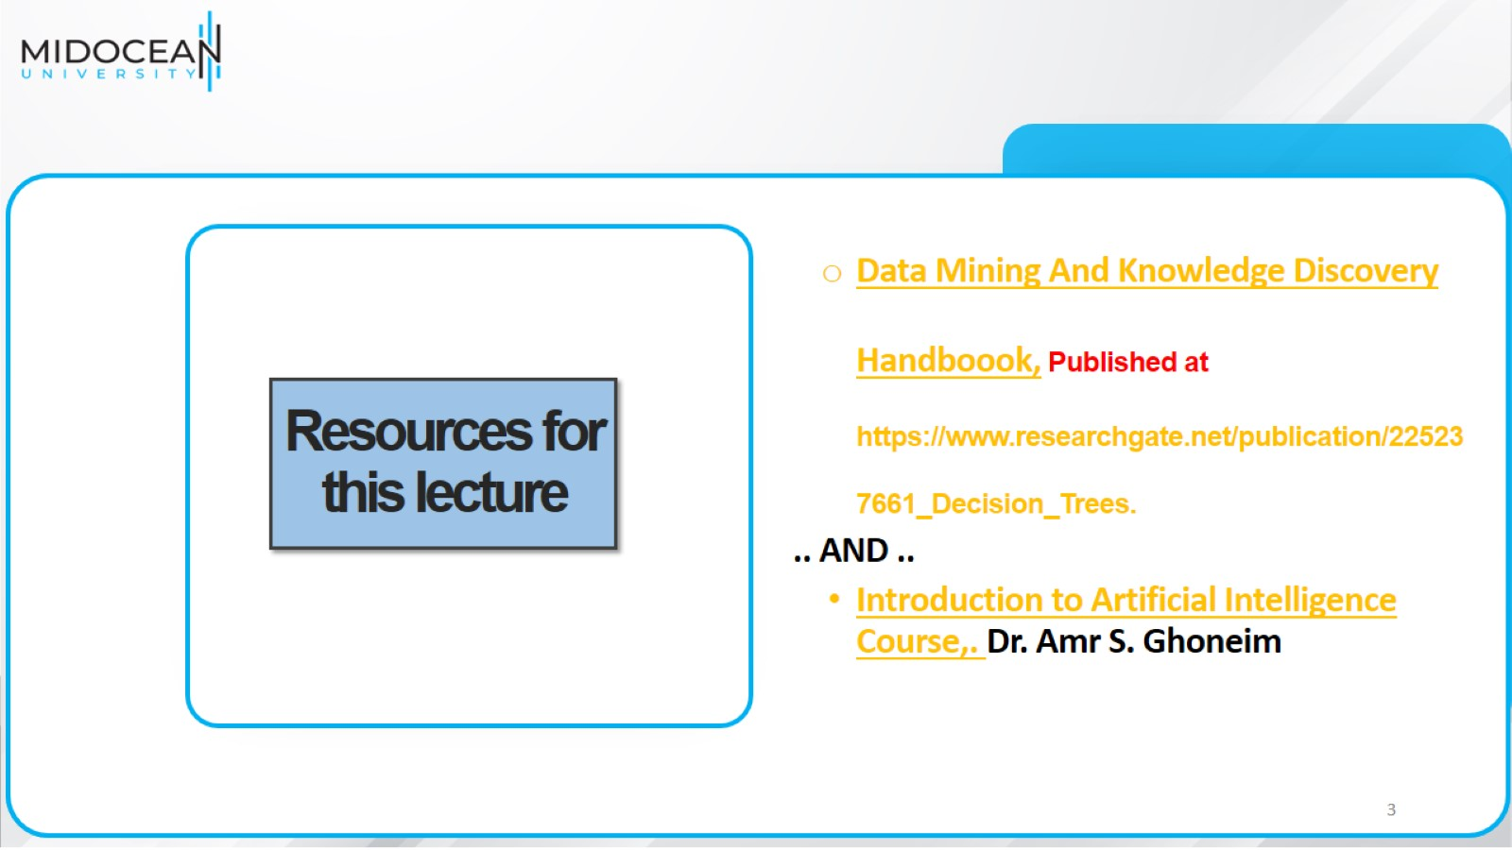
Resources for this lecture

Slide 4
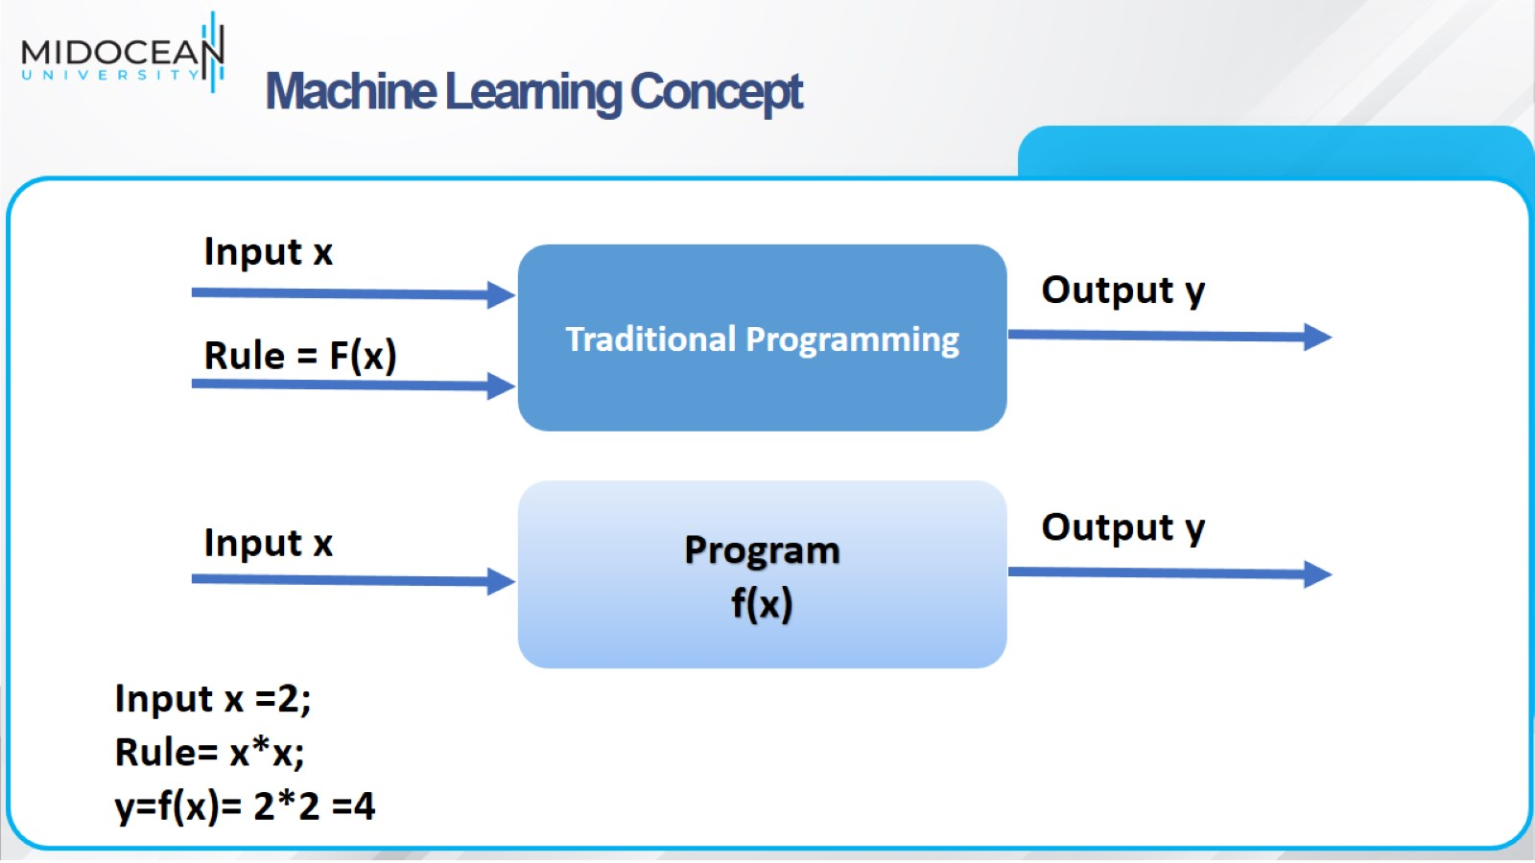
Machine Learning Concept

Slide 5
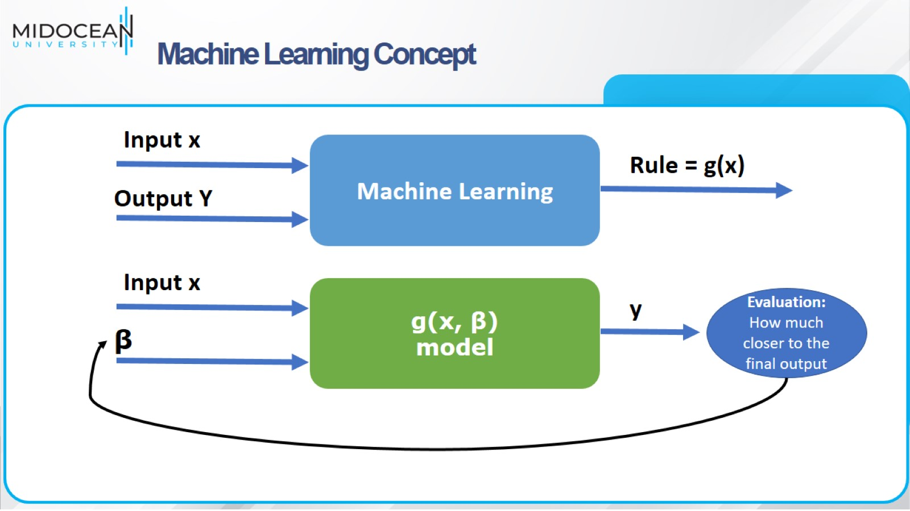
Machine Learning Concept

Slide 6
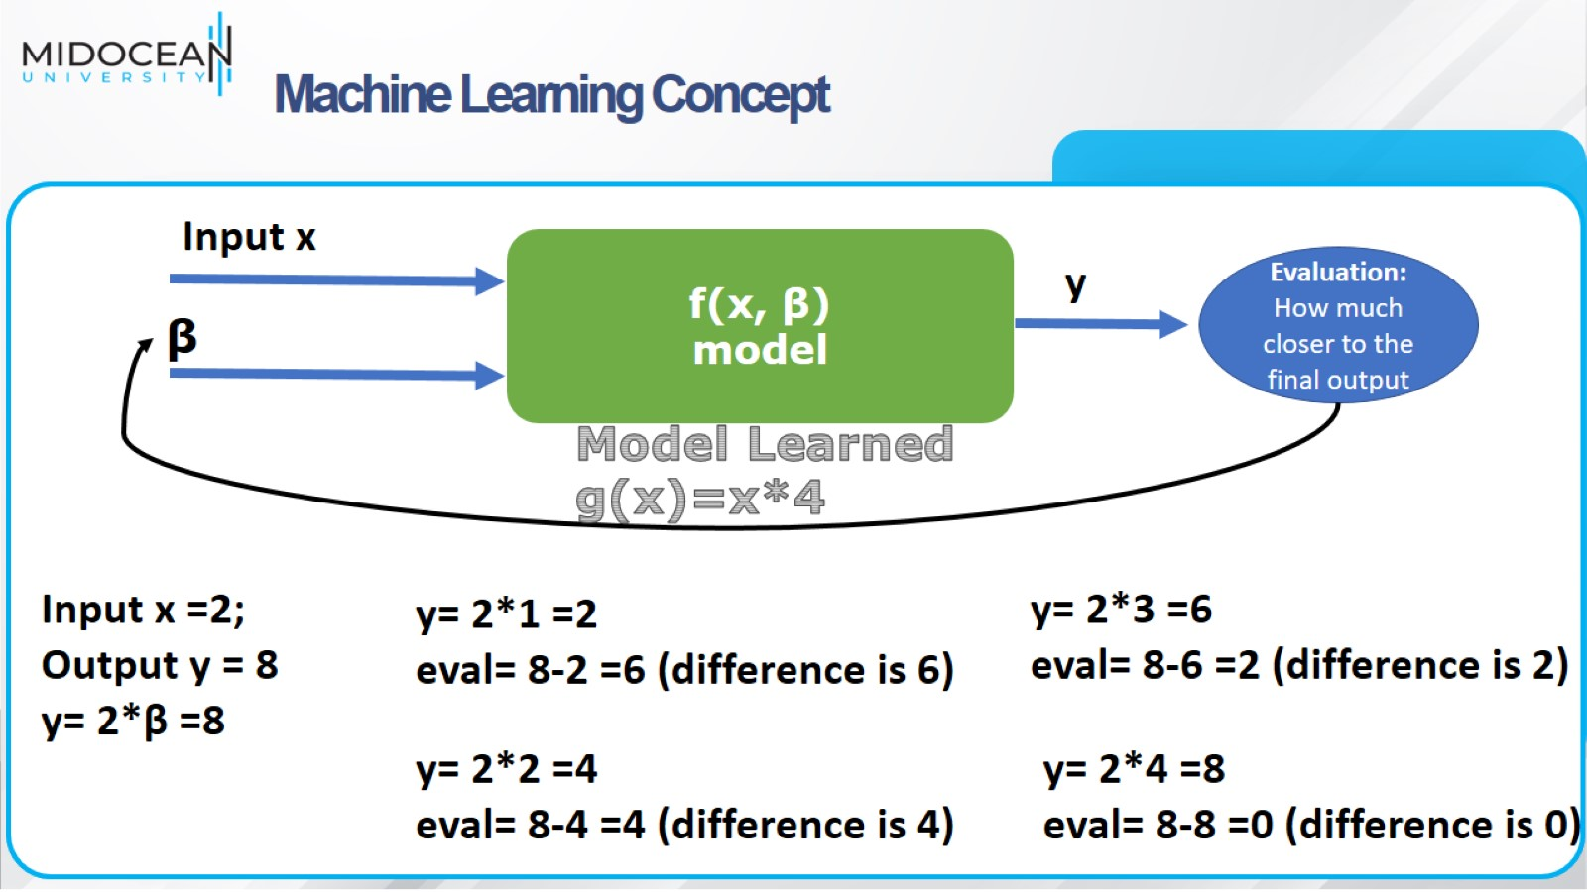
Machine Learning Concept

Slide 7
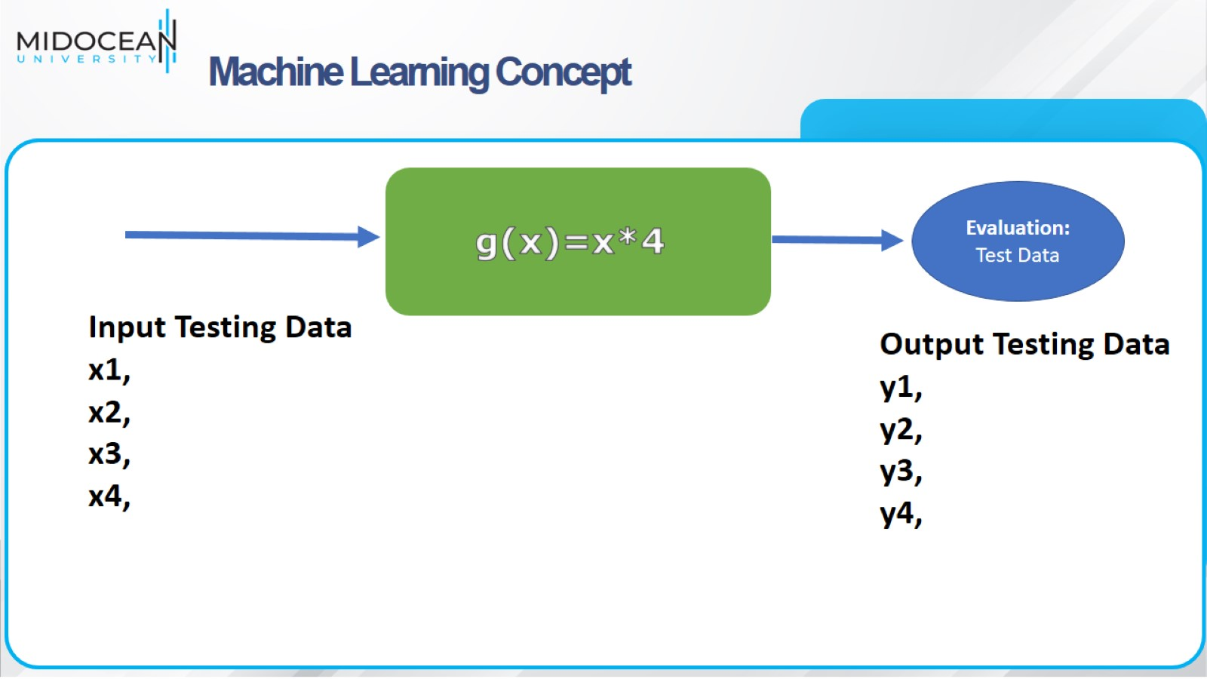
Machine Learning Concept

Slide 8
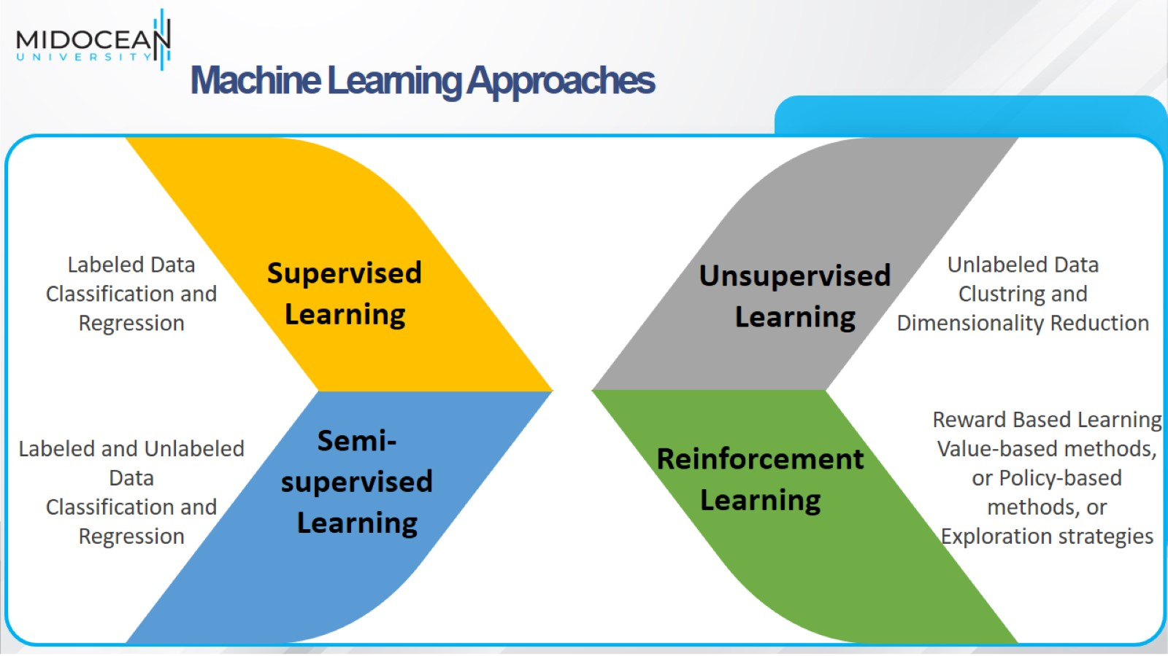
Machine Learning Approaches

Slide 9
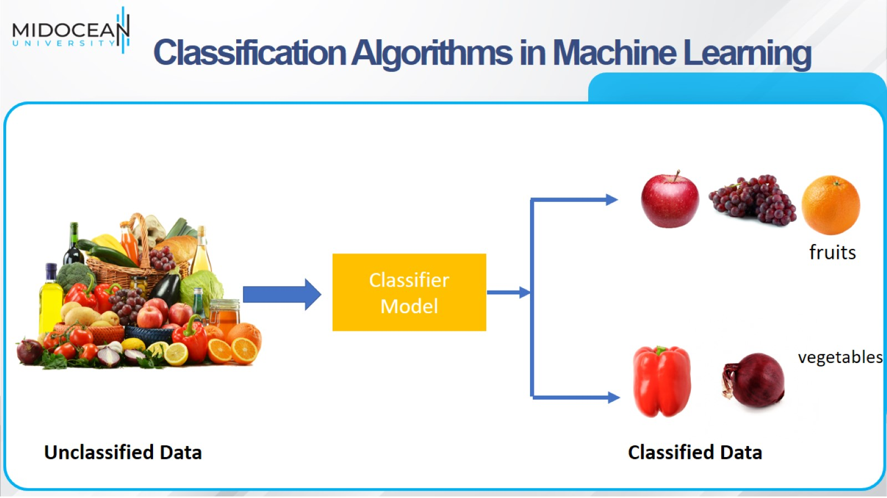
Classification Algorithms in Machine Learning

Slide 10
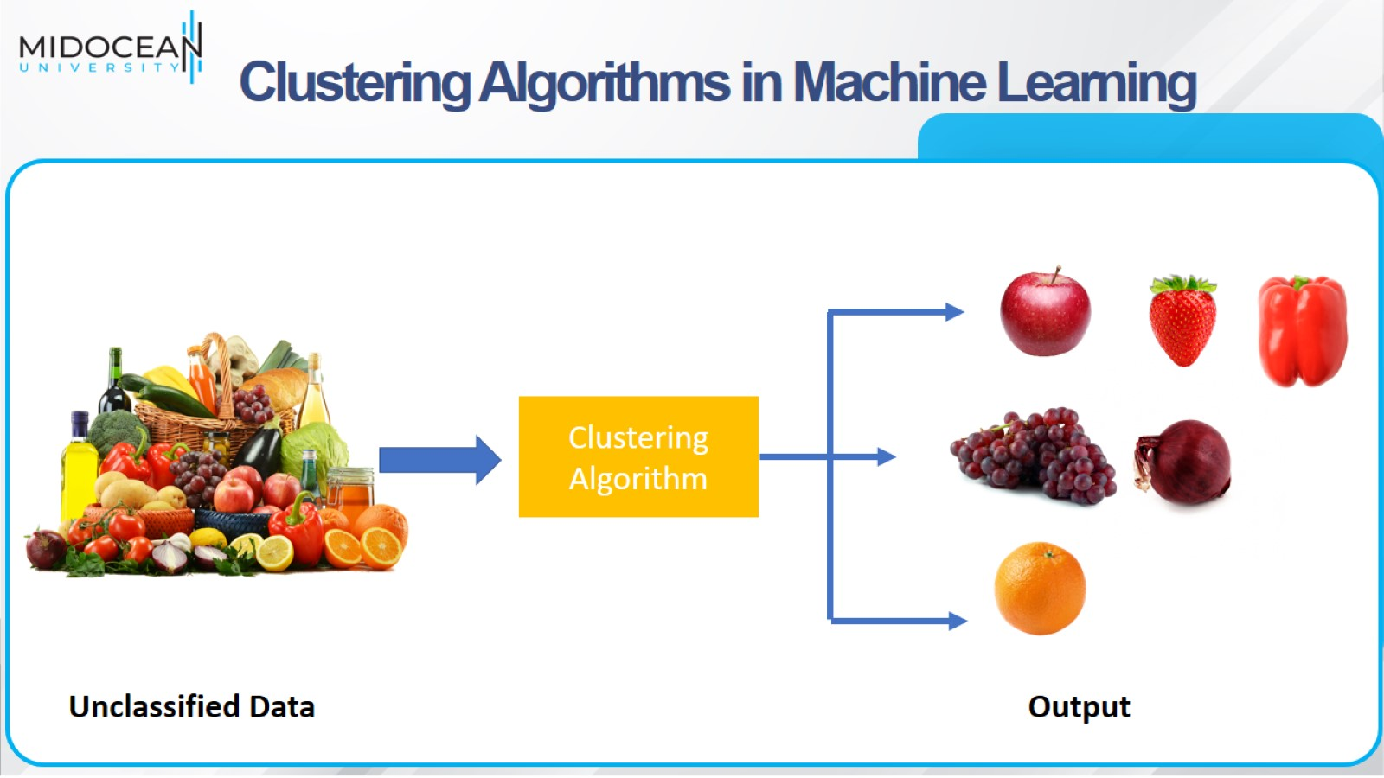
Clustering Algorithms in Machine Learning

Slide 11
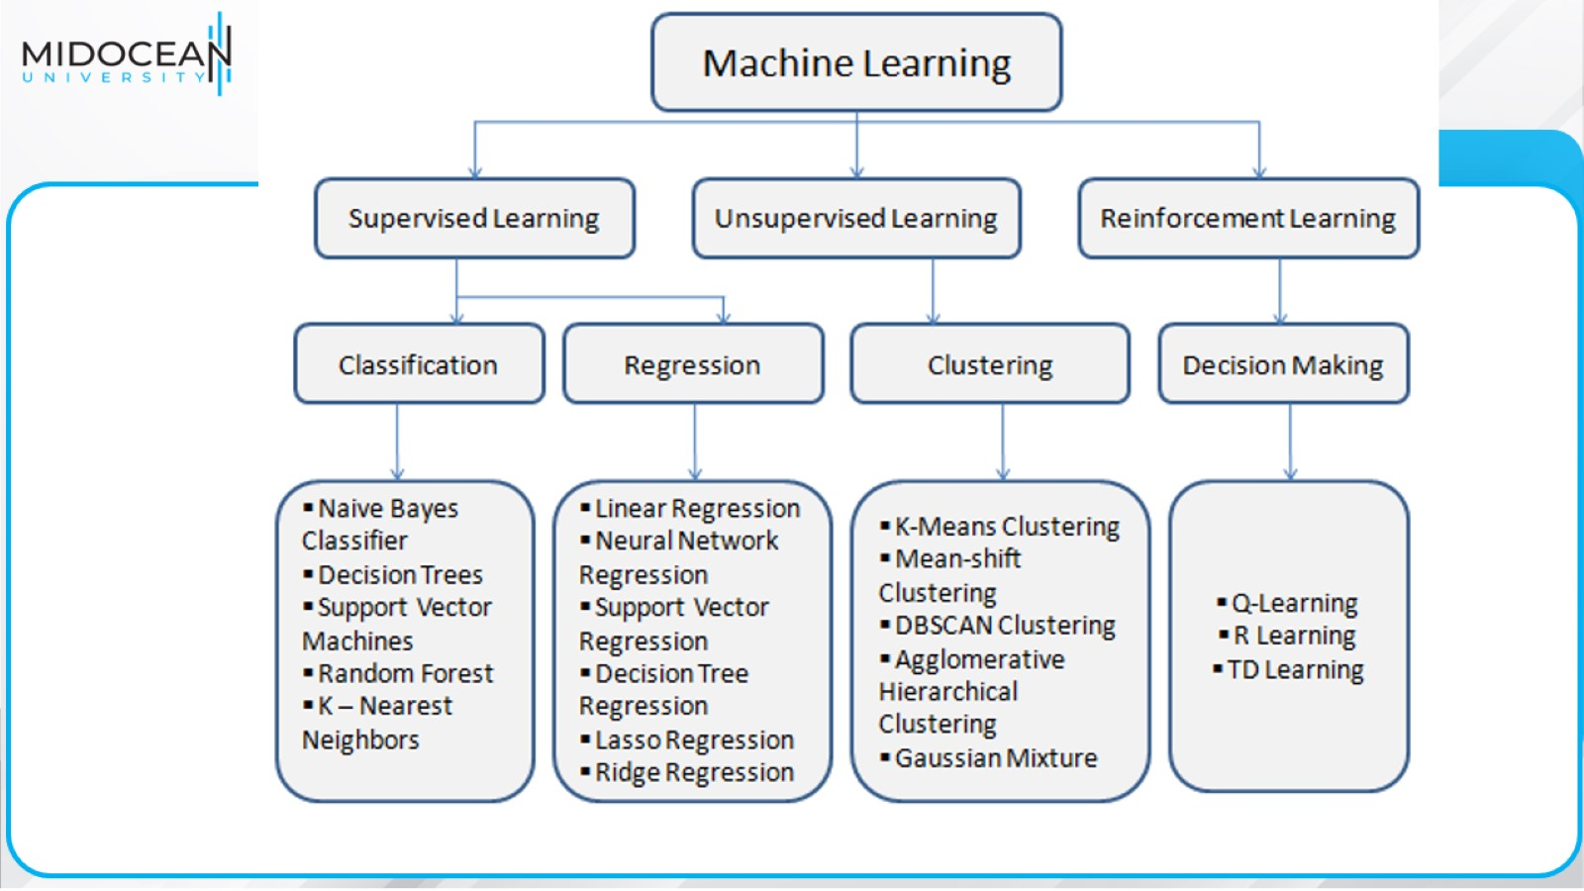

Slide 12
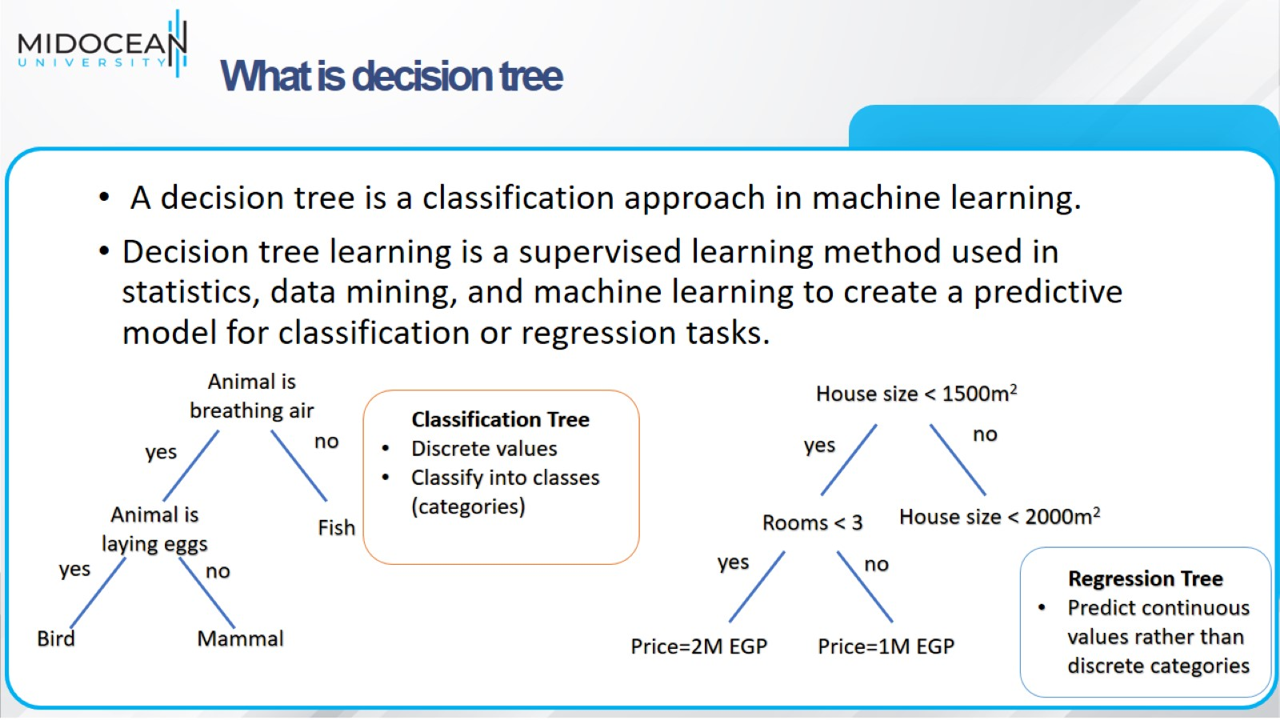
What is decision tree

Slide 13
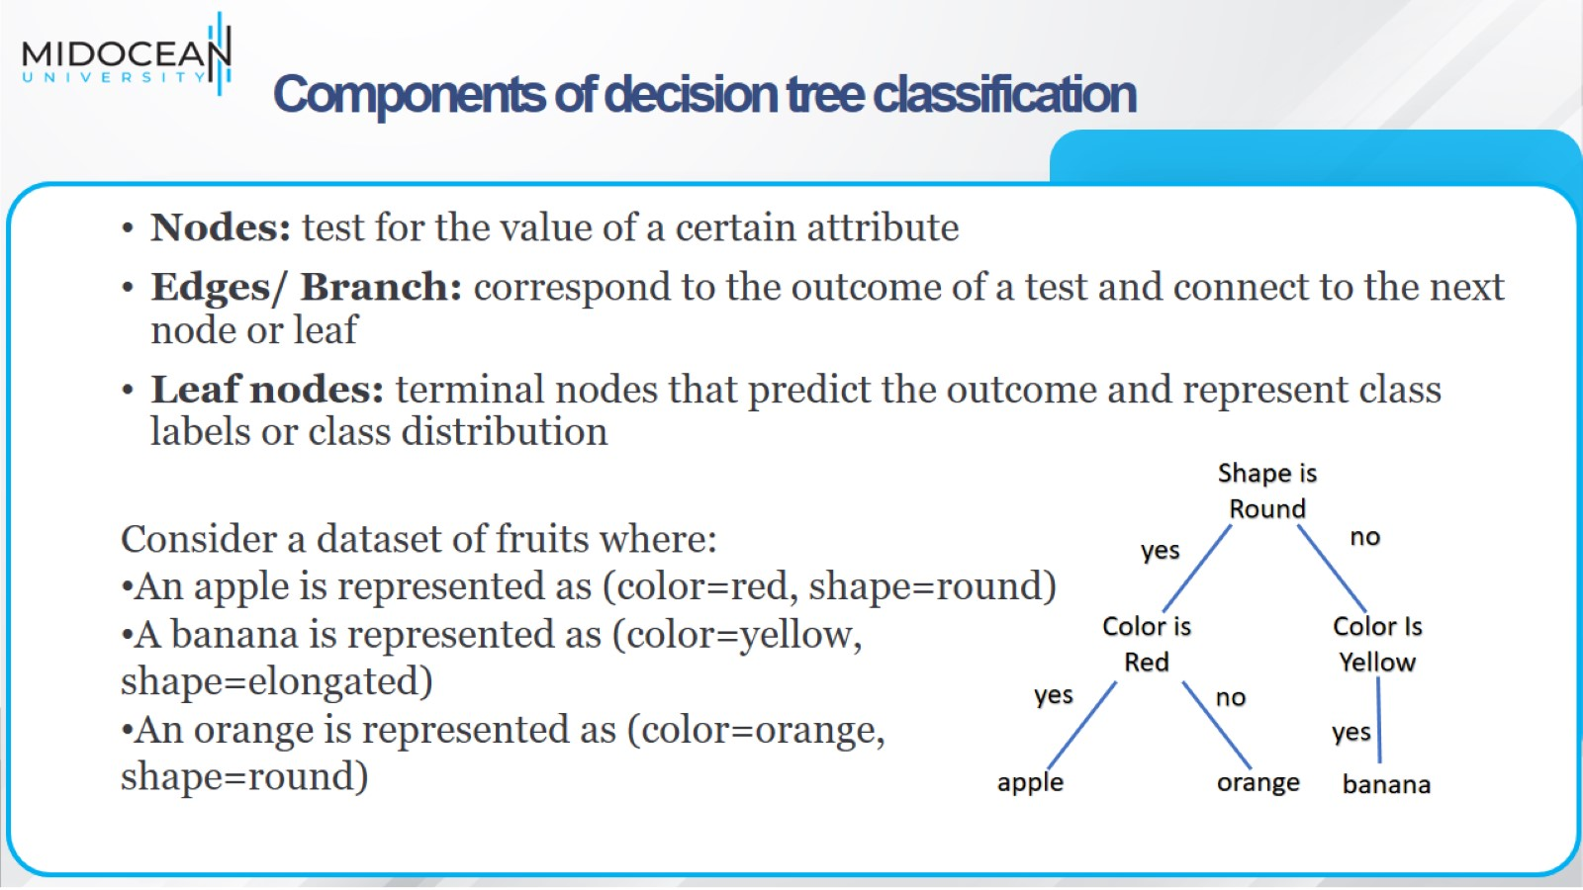
Components of decision tree classification

Slide 14
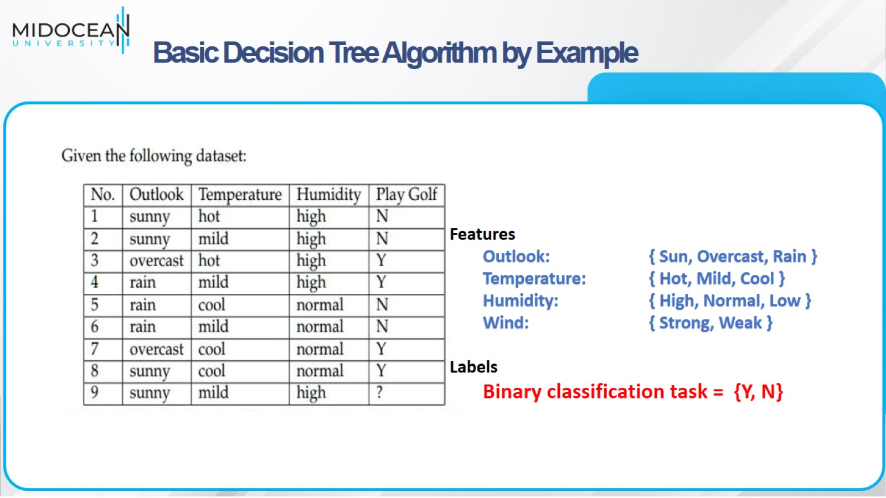
Basic Decision Tree Algorithm by Example

Slide 15
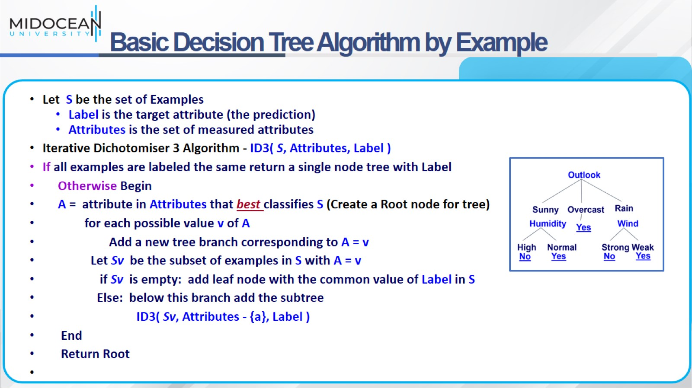
Basic Decision Tree Algorithm by Example

Slide 16
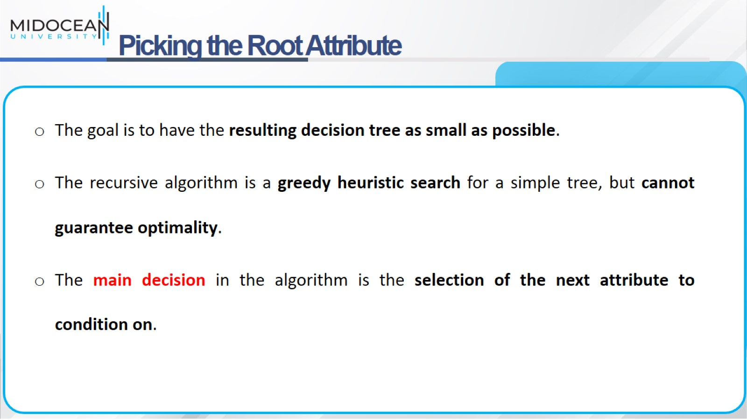
Picking the Root Attribute

Slide 17
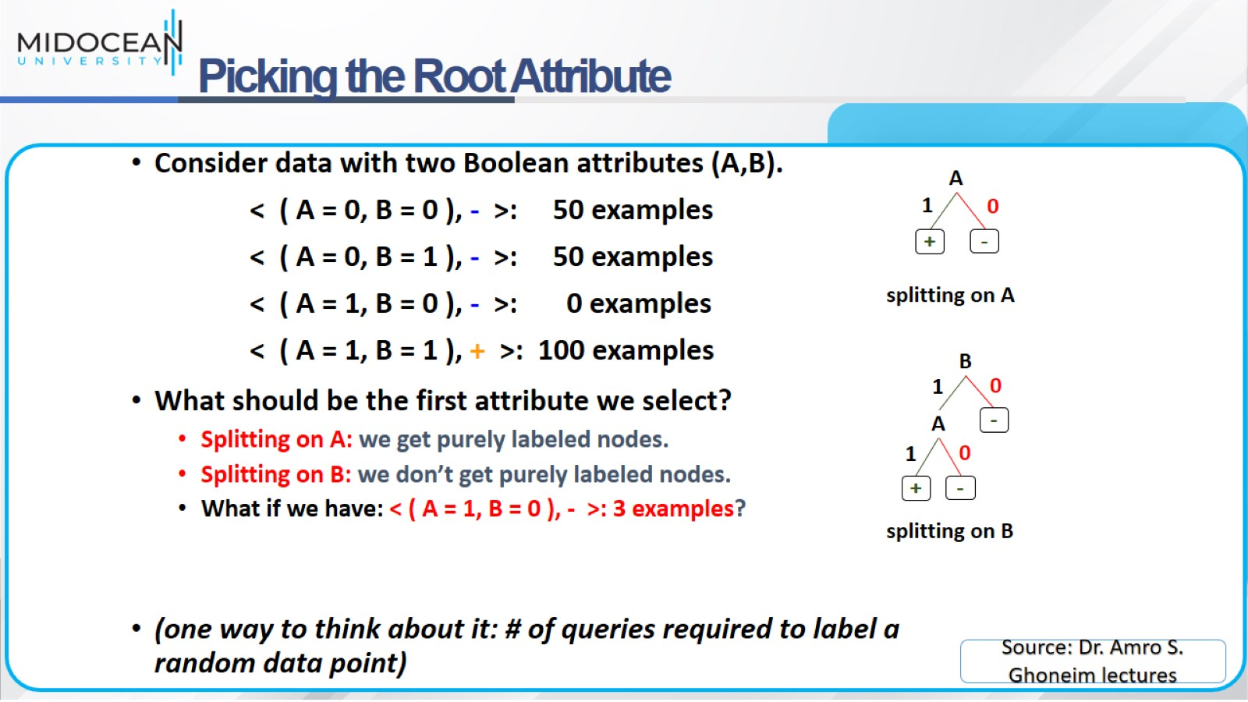
Picking the Root Attribute

Slide 18
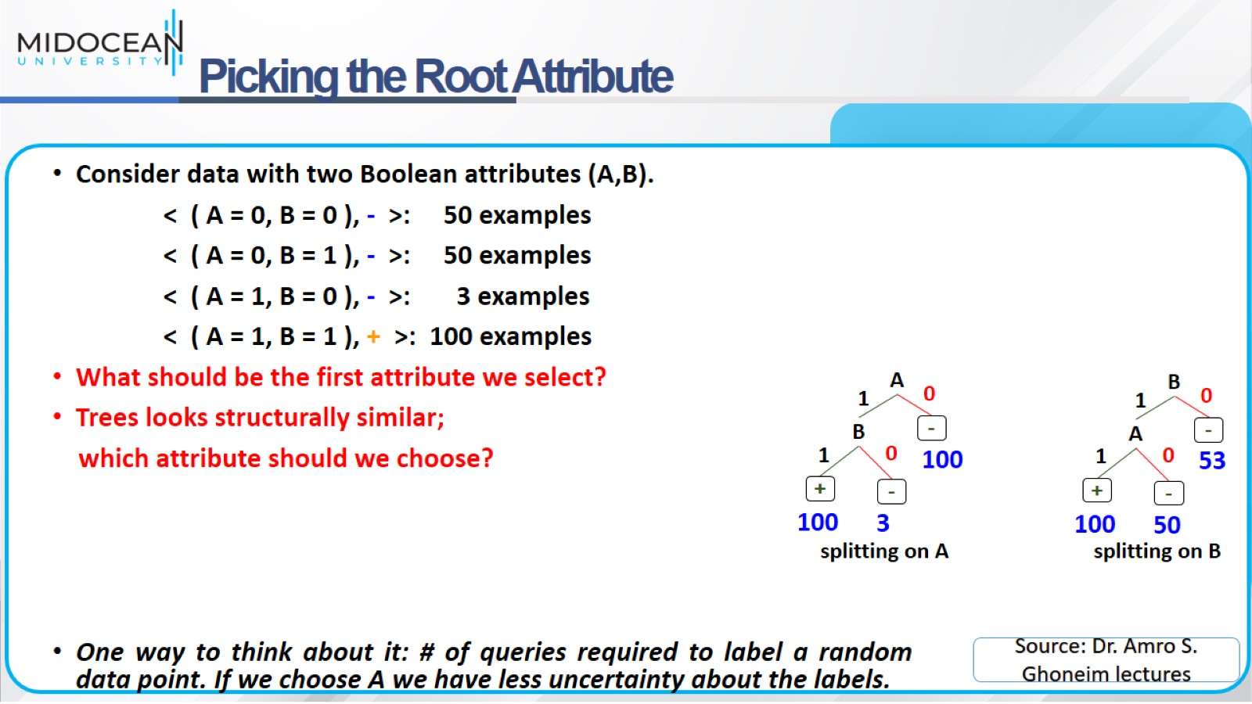
Picking the Root Attribute

Slide 19
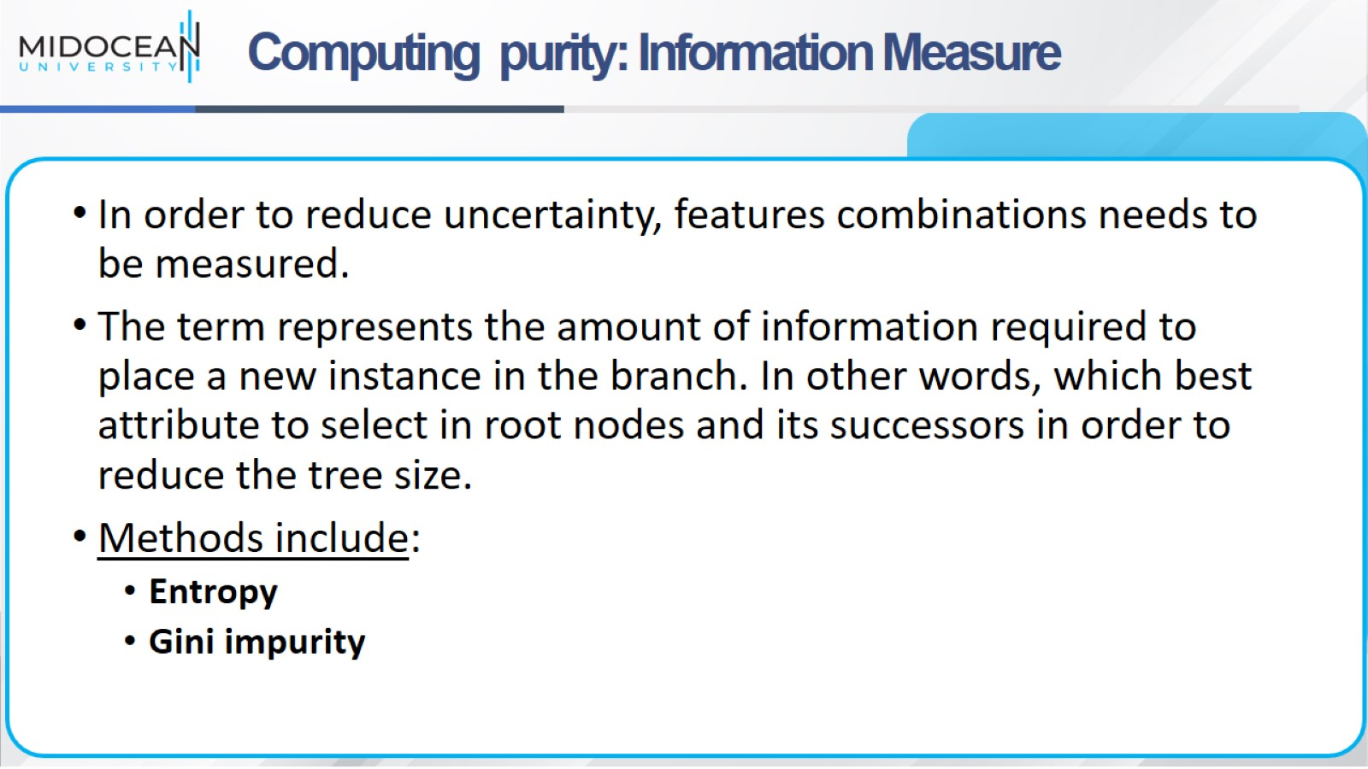
Computing purity: Information Measure

Slide 20
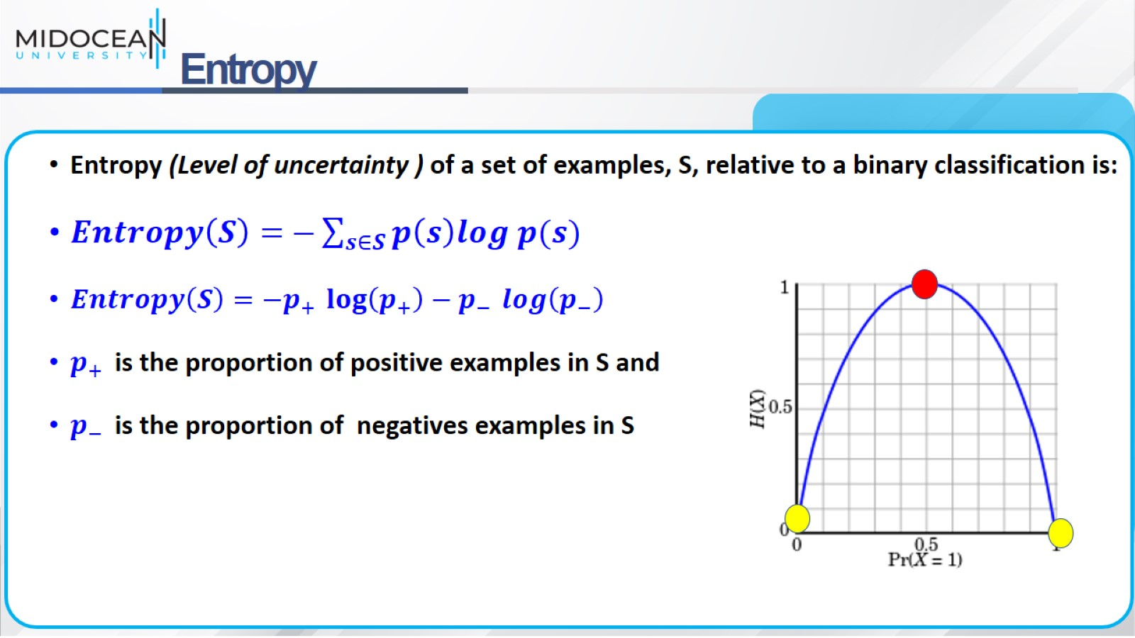
Entropy

Slide 21
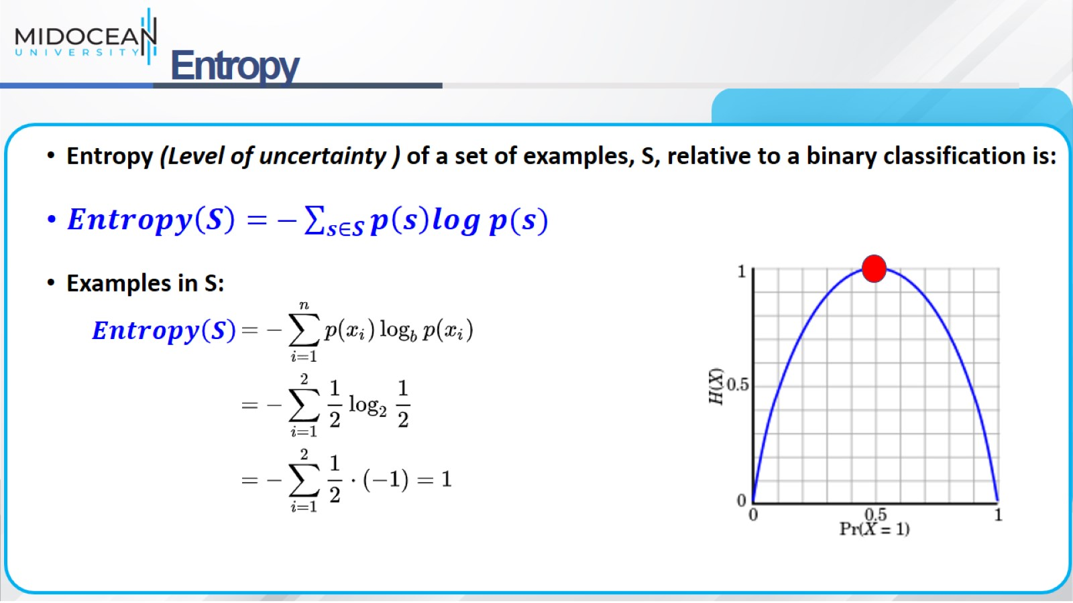
Entropy

Slide 22
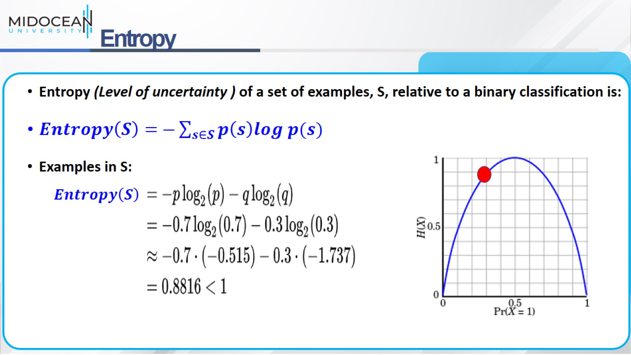
Entropy

Slide 23
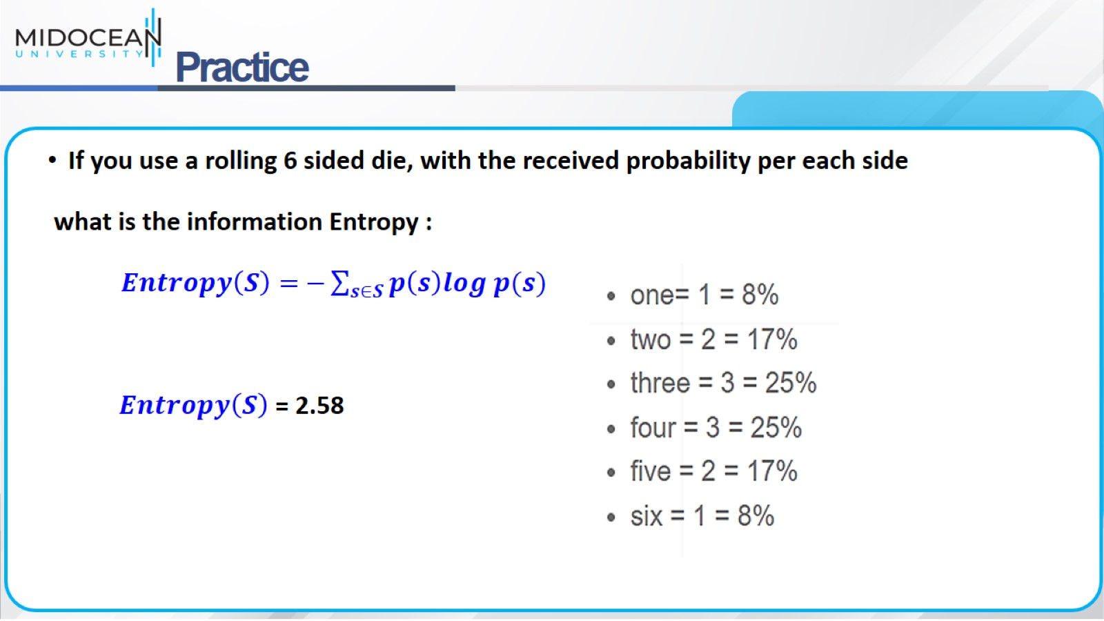
Practice

Slide 24
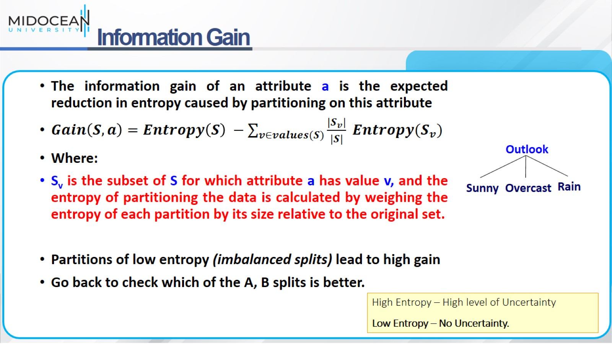
Information Gain

Slide 25
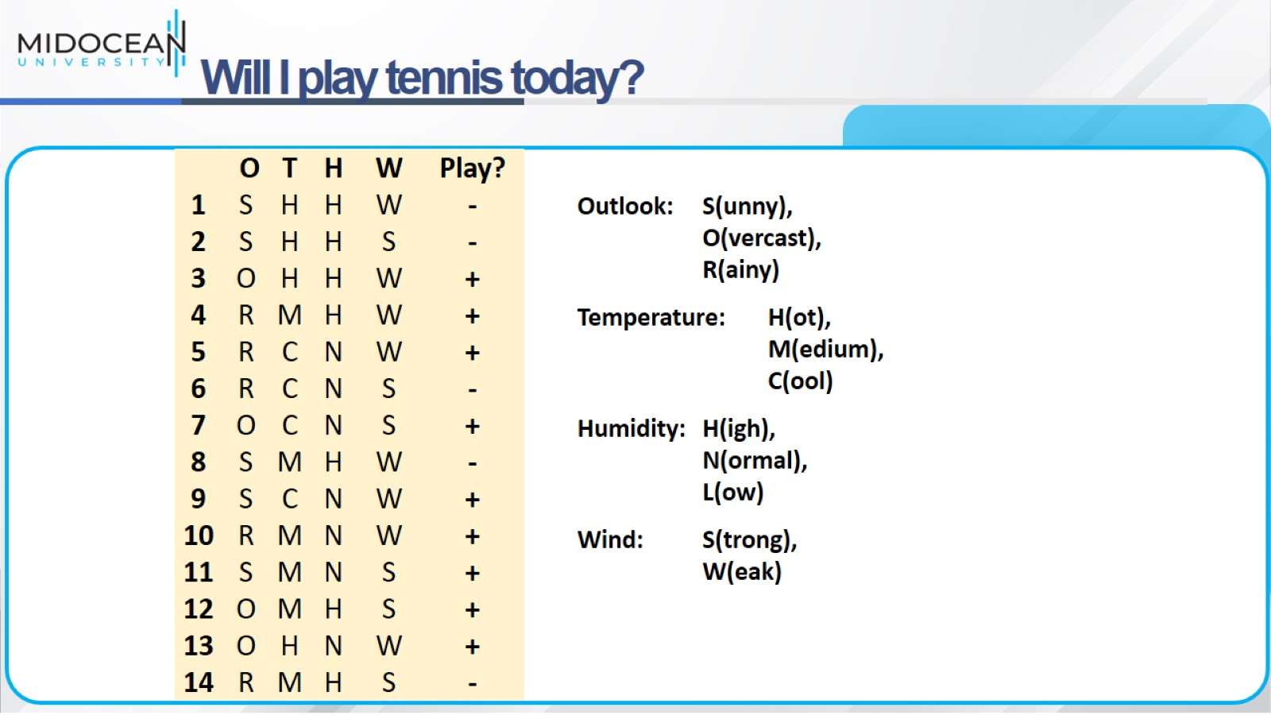
Will I play tennis today?

Slide 26
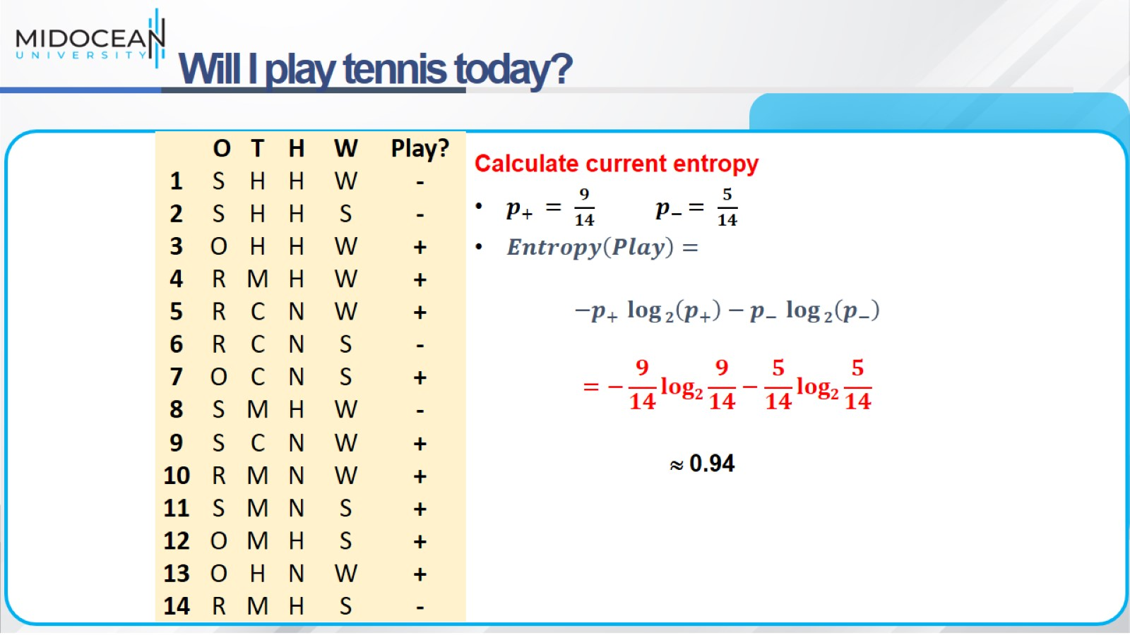
Will I play tennis today?

Slide 27
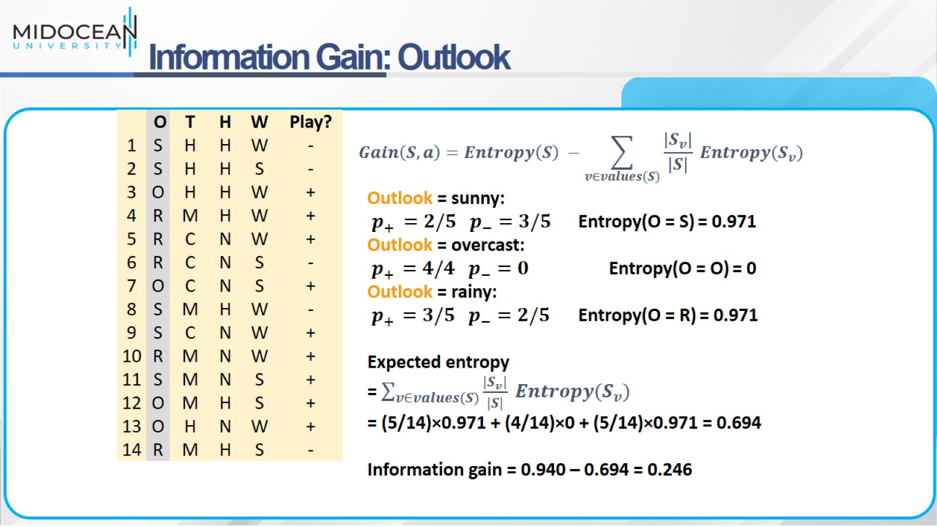
Information Gain: Outlook

Slide 28
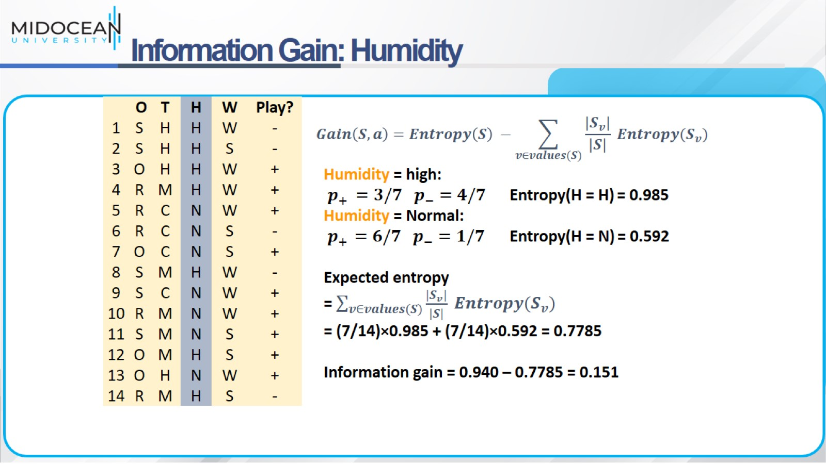
Information Gain: Humidity

Slide 29
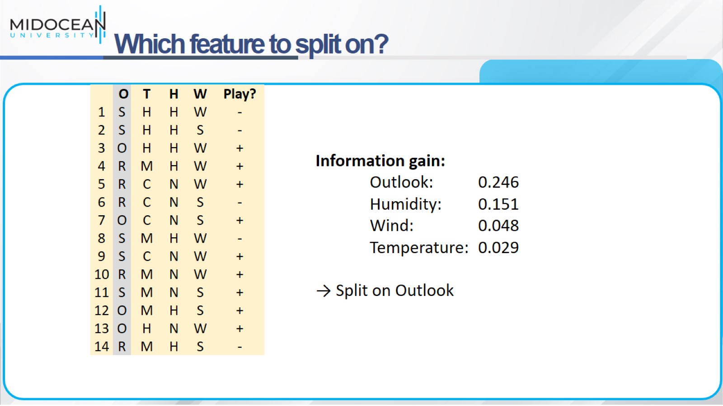
Which feature to split on?

Slide 30
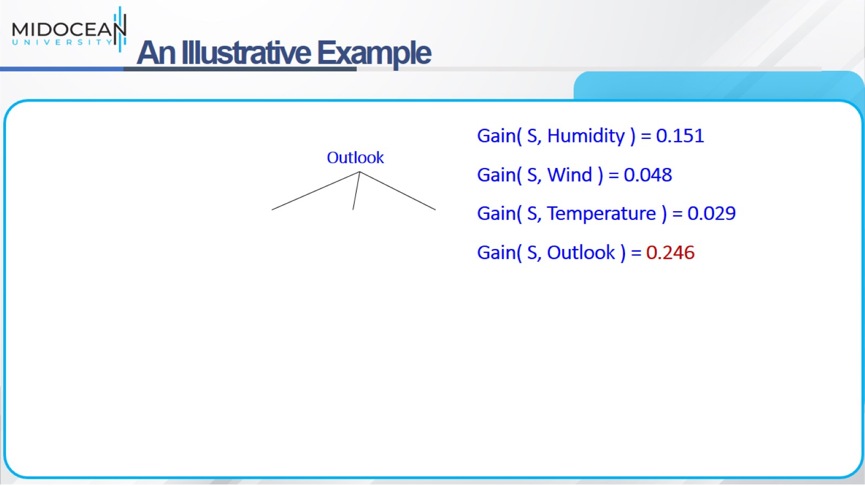
An Illustrative Example

Slide 31
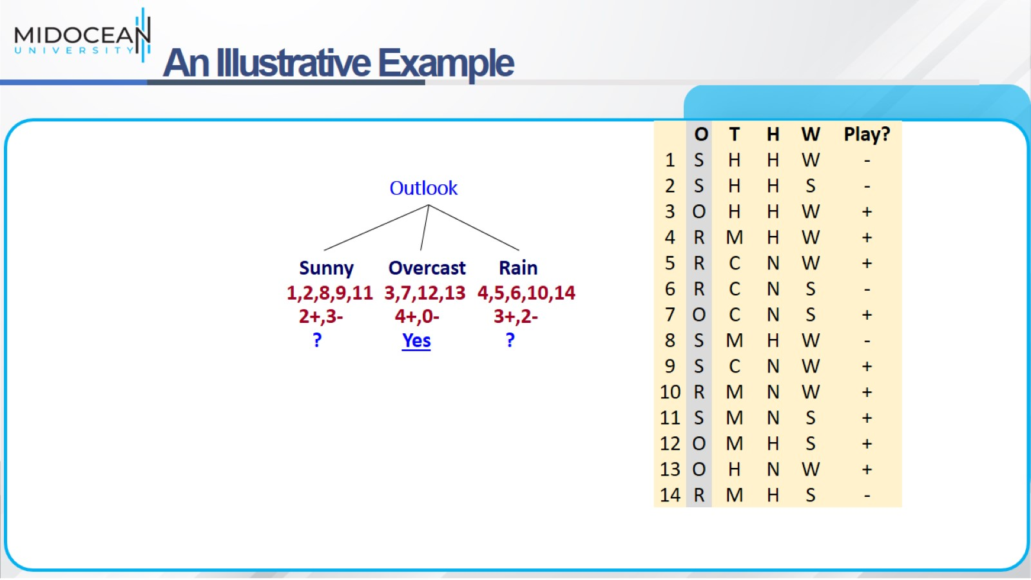
An Illustrative Example

Slide 32
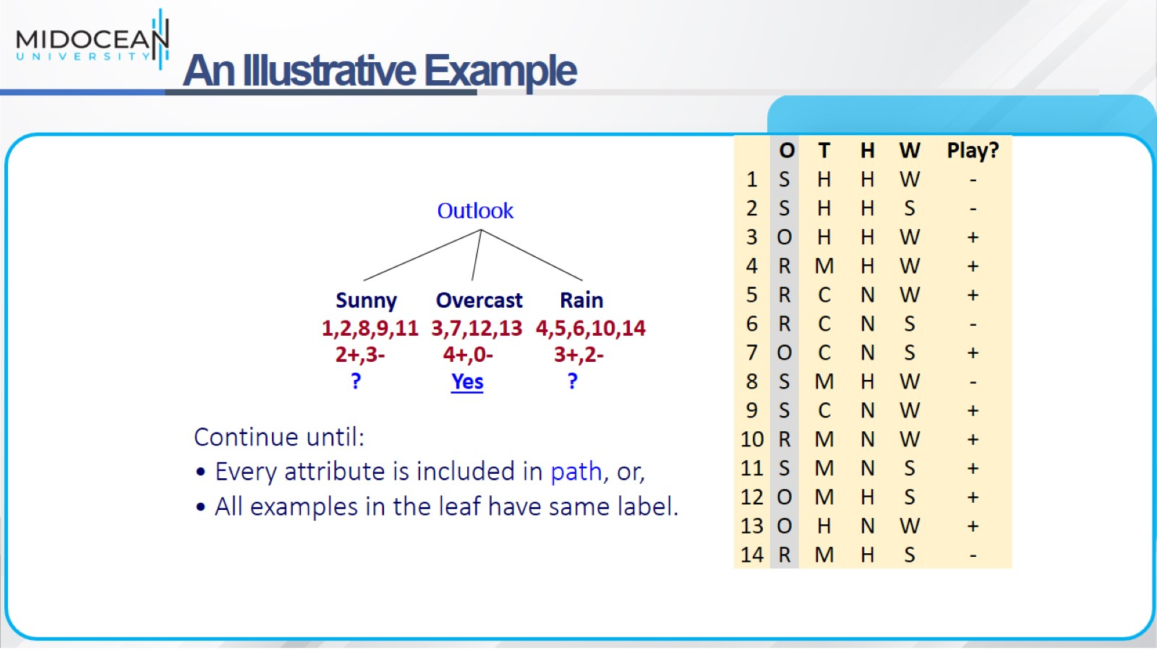
An Illustrative Example

Slide 33
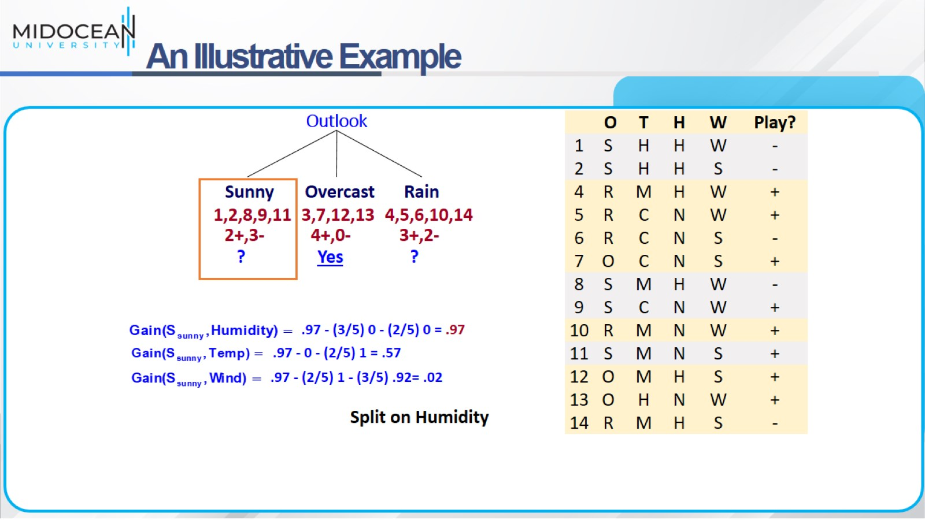
An Illustrative Example

Slide 34
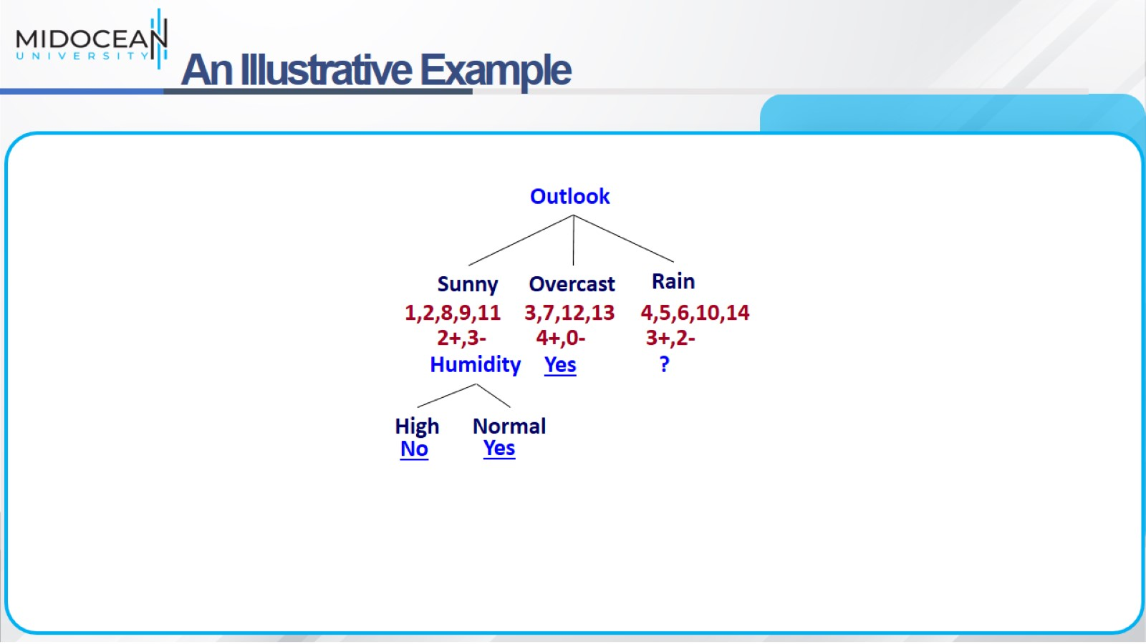
An Illustrative Example

Slide 35
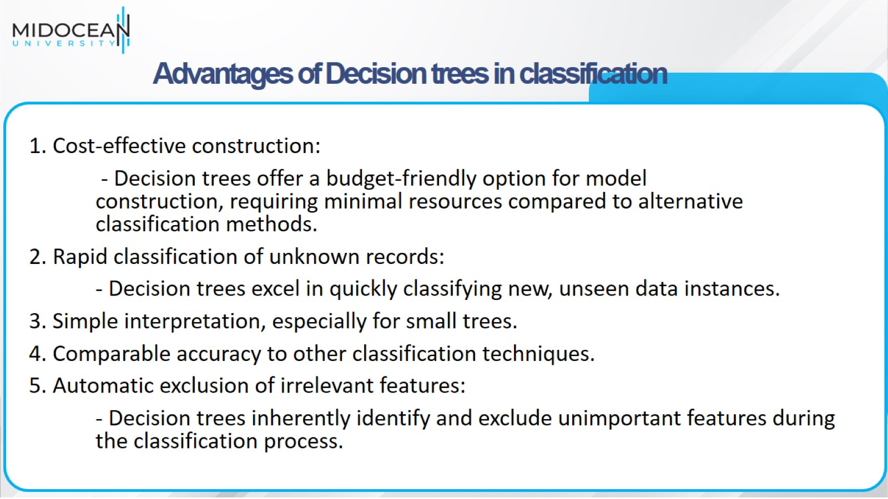
Advantages of Decision trees in classification

Slide 36
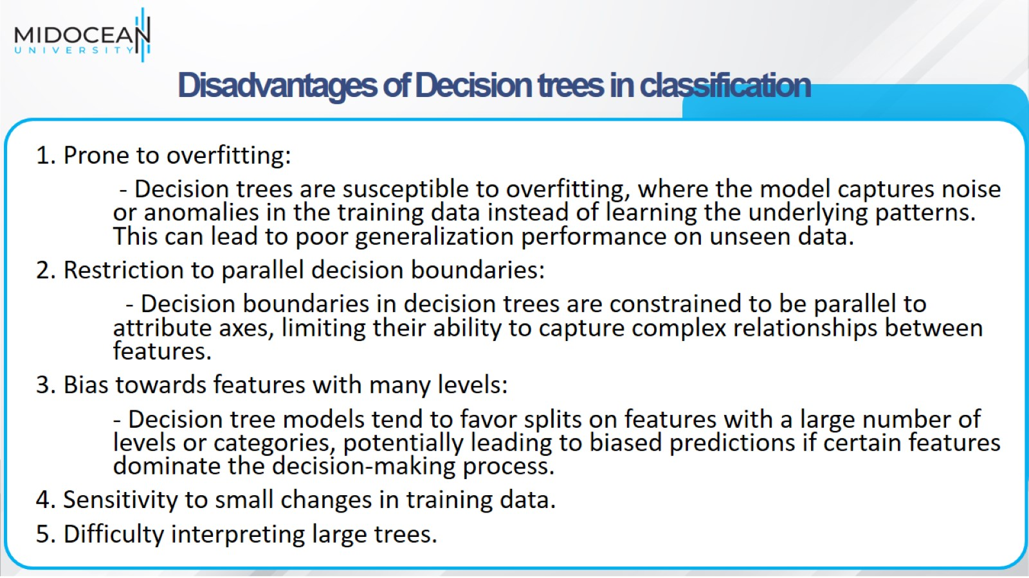
Disadvantages of Decision trees in classification

Slide 37
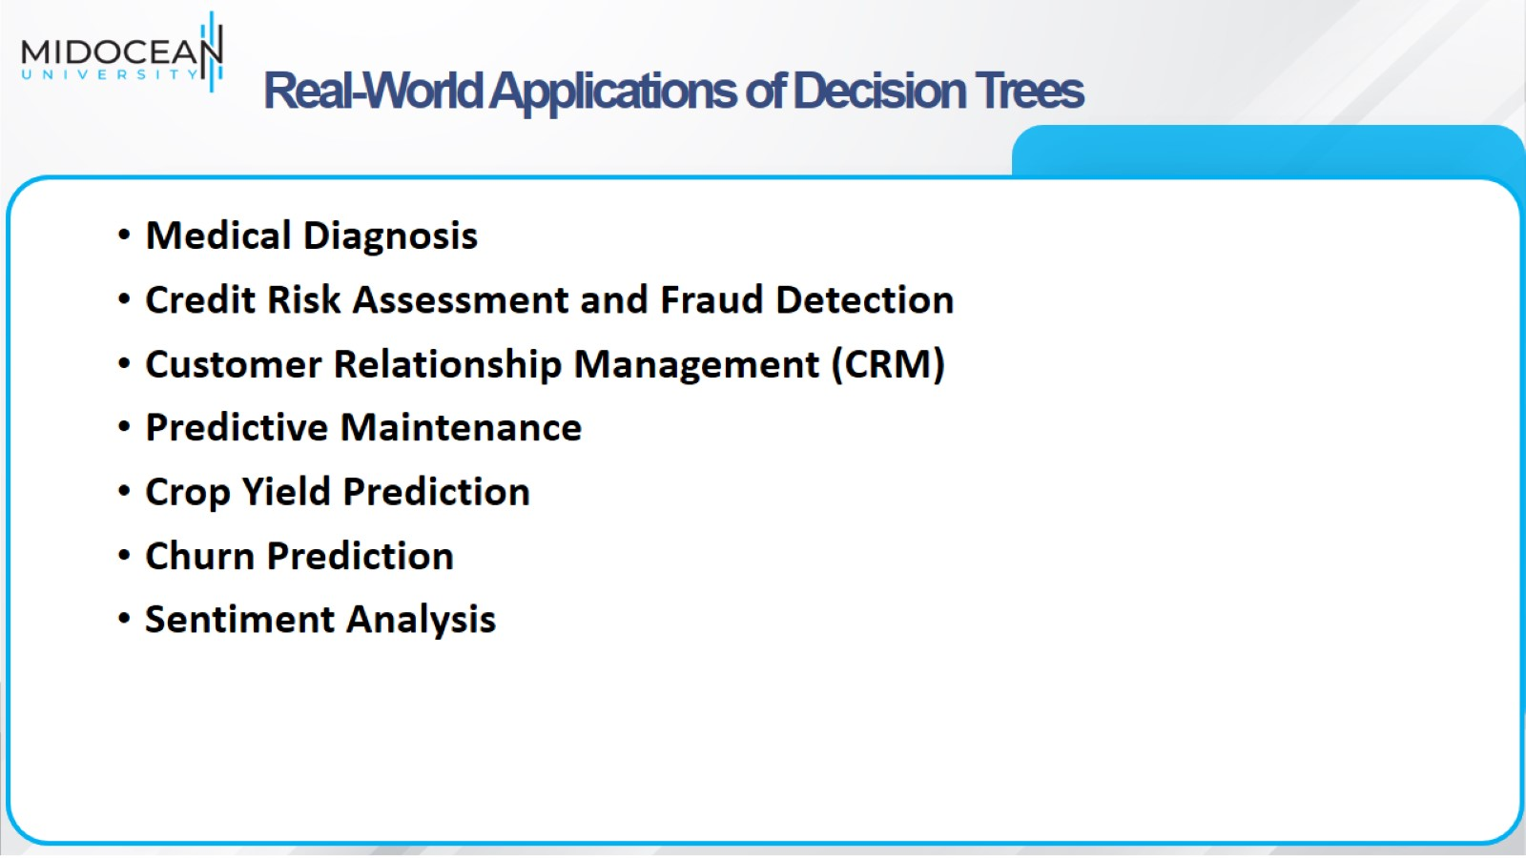
Real-World Applications of Decision Trees

Slide 38
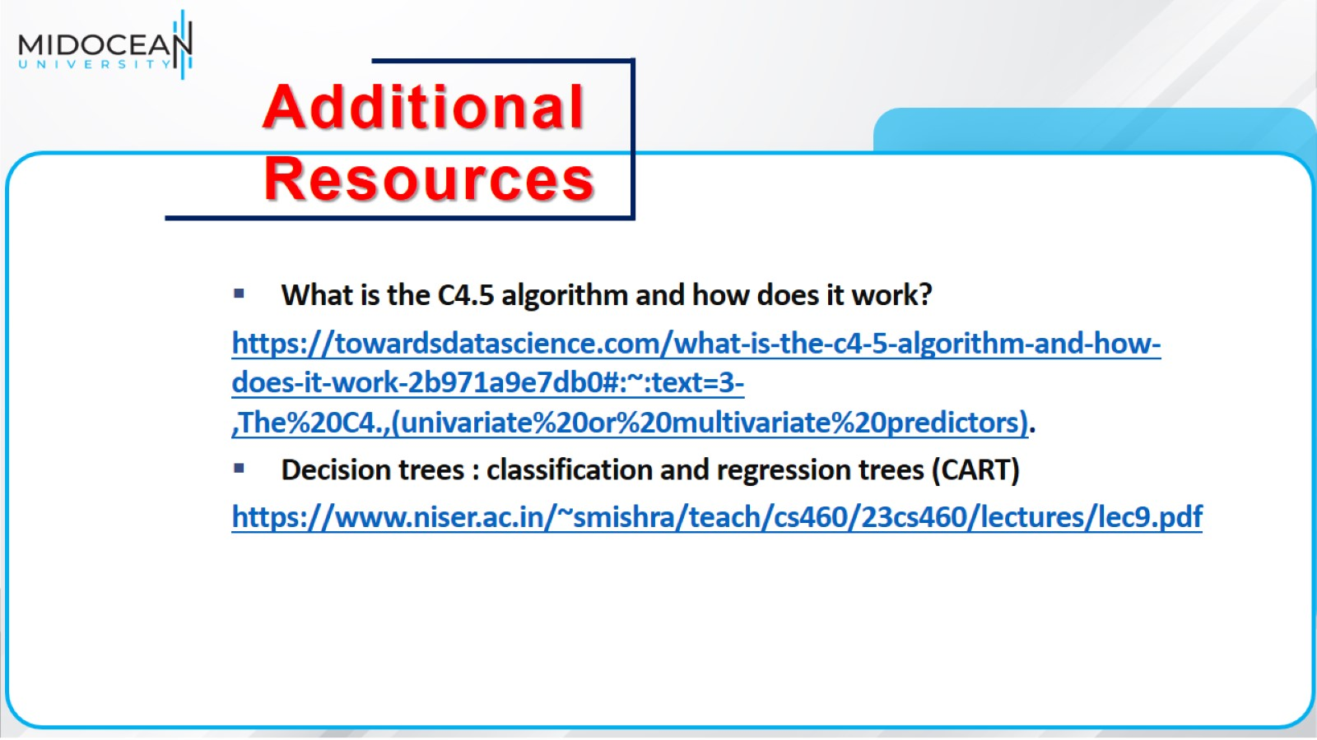

Slide 39


