Slide 1

Chapter 10
Everyone’s Smart
University
Leadership and Communication
Leadership and Communication success for teams and stakeholders
PMG511
Project Leadership
Dr.Sara Adel

Slide 2

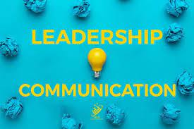
Learning Outcomes:
10.1 Effective Communication?
10.2 The Importance of Project Communication.
10.3 Leaders and communication.
10.4 Basic Communication Concepts.
10.5 Leadership communication skills in the workplace.
10.6 Communications within the Team: Meeting Success.
10.7 Communicating with Metrics and Reports.
10.8 Ethics in Communication.
10.9 Stakeholder Expectation Management.
10.10 How to improve leadership communication skills?
10.11 Summary and Conclusions.
10.12 Self Assessment.
Dr.Sara Adel

Slide 3
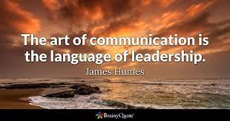
Dr.Sara Adel

Slide 4
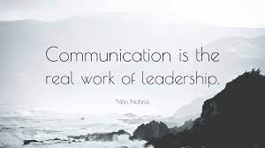
Dr.Sara Adel

Slide 5
10.1 Effective Communication
Dr.Sara Adel

Slide 6

Effective Communication?
Communication : Is a transfer of understanding and meaning from one person to another.
Effective Communication is defined as the ability to convey information to another effectively and efficiently.
Dr.Sara Adel

Slide 7
10.2 The Importance of Project Communication
Dr.Sara Adel

Slide 8

Why Project Communication?
Important because:
Stakeholders affect projects whether you communicate or not.
Because of technology, customers expect more interaction.
Team members:
  Leadership and motivation factors can have a huge effect on the project.
  Often are split between multiple projects.
Interactive communication is considered ideal.
Dr.Sara Adel

Slide 9

Good Project Communication
Good communication is usually effective communication.
Large organizations which develop inadequate communication (diseconomies of scale) may address this by:
Developing flatter structures of management.
Creating a more empowered workforce.
Offering better employee training for different cultural and linguistic attitudes.
Controlling the volume of communication.
Limiting communication to those who need the information rather than copying it widely.
Dr.Sara Adel

Slide 10
Successful Project communication
If communication is successful:
Change is encouraged and transitions are easier .
Commitment is developed among staff (and therefore enhances motivation).
Co-ordination within the organization is more effective (therefore ensuring that the efficient implementation of plans and strategies).
Roles and responsibilities are clarified.
If communication is not successful :
Problems are not identified and addressed.
Leaders becoming isolated and follow events rather than shaping them.
Department rivalries develop.
Motivation and morale may be affected.
Bureaucracy becomes endemic and decision making slows.
Profit falls.
Dr.Sara Adel
Malachowsky, Samuel. Project Team Leadership and Communication. Lintwood Press. 2018. p. 149-150.
Notes:
Corresponds to pages 149-150 of the Project Team Leadership and Communication book.

Slide 11
10.3 Leaders and communication
Dr.Sara Adel

Slide 12

Leaders and communication?
Strong leadership communication skills can foster trust, instill motivation and help team members be as productive as possible.
Leadership communication skills are important because they:
Promote collaboration among team members and between teams.
Ensure communication channels between team members and leaders remain open and effective.
Make sure team members clearly understand their responsibilities.
Increase the productivity of team members.
Help employees remain focused on goals and outcomes.
Dr.Sara Adel

Slide 13

Effective Leadership is all About Communicating
Effectively
With an increase in leader’s portfolio there is a need to improvise communication skills to match the leader’s horizon and to become much more effective all possible situations.
The biggest challenge of the leader is to win the trust of his team, efficient leaders it is easy to earn trust because they know the value and importance of building and sustaining trust.
Communications plays significant role in building trust by creating an environment which empowers leaders to lead efficiently motivating employees to work and achieving the ultimate goal.
Dr.Sara Adel

Slide 14

Effective Leadership is all About Communicating
Effectively
A communicative leader is one who engages employees in dialogue, actively shares and seeks feedback, practices participative decision-making, and is perceived as open and involved.
Dr.Sara Adel

Slide 15

Are you a communicative leader?
Dr.Sara Adel

Slide 16

Leadership Communication
Leadership communication is defined as inspiring and encouraging an individual or a group by systematic and meaningful sharing of information by using excellent communication skills.
Leadership communication is a complex process which starts from developing strategy for communicating, writing precisely and then Speaking effectively to control difficult situations.
Dr.Sara Adel

Slide 17
Leadership Communication
Leadership communication has three major aspects: Core, Managerial, and Corporate.
The Core Aspects Approach includes writing and speaking: these are the individualized skills and are required to be expanded, to lead and manage bigger groups or teams.
Expressive cultural understandings, listening patiently, team management and team meetings, providing training facilities and mentoring are the skills which aid to manage huge groups and are Managerial Aspect Approach of leadership communication.
The Corporate Aspects Approach are the skills required at much higher levels of leadership, and there is a need to interact with an external sphere, skills which are most needed: maintain employee relations, communication during change and crises.
Dr.Sara Adel

Slide 18
10.4 Basic Communication Concepts
Dr.Sara Adel

Slide 19
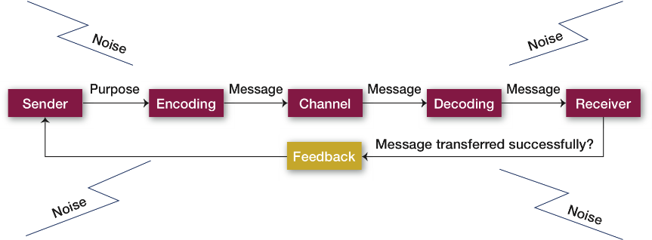
The Communication Process
Dr.Sara Adel
© Pearson Education Limited 2015

Slide 20
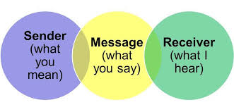
The Communication Process
depicts the seven-part communication process of transferring and understanding meaning: (1) the communication source or sender; (2) encoding; (3) the message; (4) the channel; (5) decoding; (6) the receiver; and (7) feedback.
The sender is the source of the communication.
Encoding means converting a message into symbolic form.
The message is the purpose to be conveyed in the communication.
The channel is the medium by which a message travels.
Decoding means translating a received message.
The receiver is the recipient of the communication.
Feedback is checking to see how successfully a message has been transferred
Dr.Sara Adel
© Pearson Education Limited 2015

Slide 21
Factors Affecting Encoding
  The source initiates a message by encoding a thought. Four conditions affect the encoded message: skill, attitudes, knowledge, and social cultural system.
  Skill: determines a person’s total communicative success and includes speaking, reading, listening, and reasoning skills.
  Attitudes: Skill Attitudes influence our behavior.
  Knowledge: Knowledge of the subject matters allows us to communicate more clearly or, if our knowledge is quite extensive, to confuse our receiver with overly complex information.
  Social cultural system: our beliefs and values—influences each of us as a communicative source.
Dr.Sara Adel

Slide 22
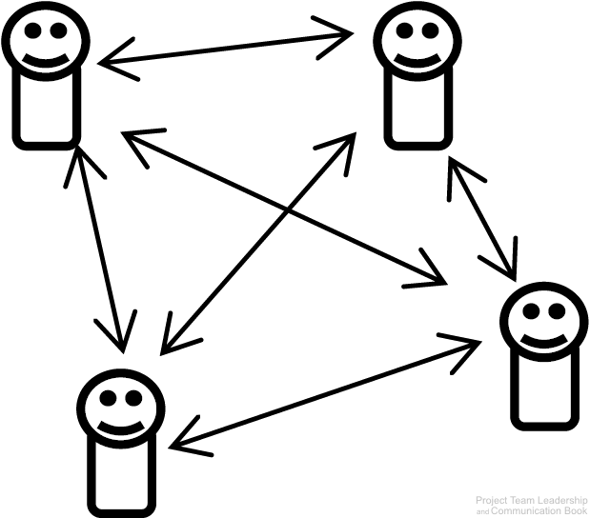
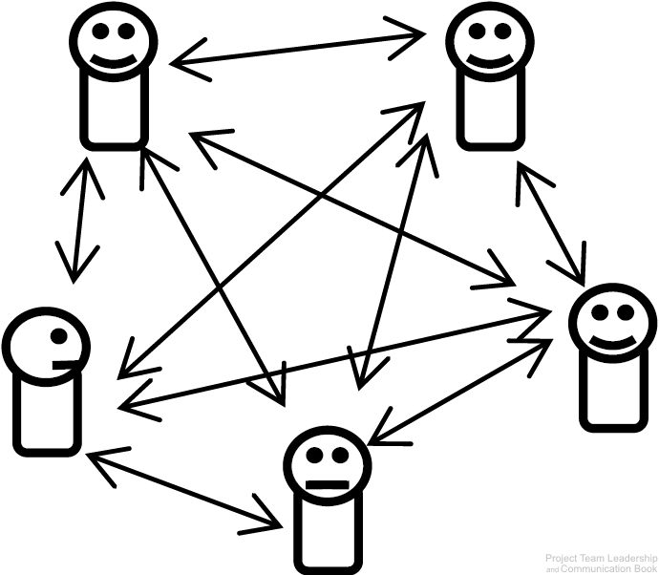
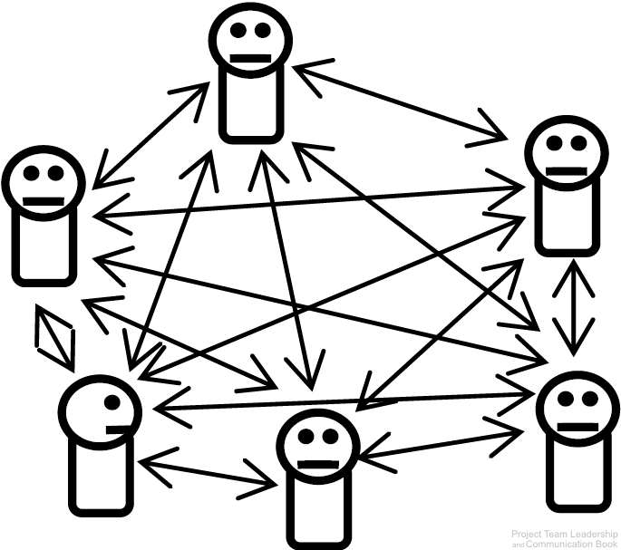
Channels of Communication
A communication channel is the path through which a communication must travel.
Leaders and team members must maintain channels of communication with each other.
As the number of team members increase, the number of channels increases much quicker.
10 Channels
15 Channels
6 Channels
Dr.Sara Adel
Diagrams: Malachowsky, Samuel. Project Team Leadership and Communication. Lintwood Press. 2018. p. 151.
Notes:
Corresponds to pages 150-152 of the Project Team Leadership and Communication book.

Slide 23
Communication Channels
The source selects either a formal or informal channel through which the message travels.
Formal channels are established by the organization, transmit job-related messages, and traditionally follow the authority network within the organization. Personal or social messages follow the informal channels in the organization.
Level of Complexity of communication channel need a needs a smart leader to avoid any single point of failure.
Dr.Sara Adel

Slide 24

Communication Concepts
There are dozens of communication channels available at any given time:
Face-to-Face
Message Boards
Social Media
Multi-Channel
Online Video Posts
Text Messages
Email
Video Conference
Postal Mail
Television
Print Media
Photo Sharing
Instant Messages
Written Notes
Advertisement
Telephone
Blogs
and many more
Dr.Sara Adel
Malachowsky, Samuel. Project Team Leadership and Communication. Lintwood Press. 2018. p. 152.
Notes:
Corresponds to pages 152-153 of the Project Team Leadership and Communication book.
Blockers: Some of these are more obvious/detectable than others
Conclusion: communication is complicated and requires planning and constant attention

Slide 25

Communication Concepts
Additionally there are types or categories of communication:
Internal / External
Formal / Informal
Vertical / Horizontal
Written / Oral
Verbal / Nonverbal / Paralingual
Dr.Sara Adel
Malachowsky, Samuel. Project Team Leadership and Communication. Lintwood Press. 2018. p. 152.

Slide 26

Communication Concepts
And there are potential blockers to communication efforts:
Language and Culture
Interruptions
Technical Issues
Distractions such as fatigue
Negativity or hostility
Context known by only one party
Incorrect assumptions
Receiver not actively listening
Dr.Sara Adel
Malachowsky, Samuel. Project Team Leadership and Communication. Lintwood Press. 2018. p. 152.

Slide 27

The Grapevine
Dr.Sara Adel
Notes:
The grapevine is the unofficial way that communications take place in an organization and it’s neither authorized nor supported by the organization.
In the grapevine, information is spread by word of mouth—and even through electronic means. Good information travels quickly, but bad information travels even more quickly.
The biggest issue about grapevines is the accuracy of the information that is communicated. Research shows that in an organization characterized by openness, the grapevine may be extremely accurate. However, in an authoritative culture, the rumor mill may be inaccurate but still contain some element of truth. So while details may not be accurate, the reports that something is about to happen are probably on target.

Slide 28
Decoding and Feedback
Decoding:
Translating a received message.
Feedback:
Checking to see how successfully a message has been transferred.
Dr.Sara Adel
Notes:
Note that just as the skills, attitudes, knowledge, and social culture of the sender affect the sender’s ability to encode a message, the skills, attitudes, knowledge, and social culture of the receiver to whom the message is directed affect his or her ability to decode the message.
The final link in the communication process is a feedback loop, which checks how successfully we’ve transferred our messages and whether we have achieved understanding. Given the cultural diversity of today’s workforce, effective feedback is critical.

Slide 29
Push / Pull / Hybrid Communication
Interactive Communication is ideal, but not always available or practical.
Push/Pull Communication share a weakness: Sender is only sure it was sent, not if it was received or understood
  Push Communication is one-way communication sent to one or more recipients
    Email, radio broadcasts, and postal main are common examples
  Pull Communication allows the recipient(s) to receive the communication at will
    Websites and bulletin boards are common examples
Hybrid Communication combines push and pull communication, capturing the strengths of both
  Sending an email which includes a link to a website or file storage area is a common example
  By pushing the communication which includes the ability for the recipient to pull in the future, the sender increases the chance that the recipient(s) will receive the message
Dr.Sara Adel
Malachowsky, Samuel. Project Team Leadership and Communication. Lintwood Press. 2018. p. 155-158.
Notes:
Corresponds to section 5.3, pages 150-152 of the Project Team Leadership and Communication book.

Slide 30
10.5 Leadership communication skills in the workplace
Dr.Sara Adel

Slide 31

Leadership communication skills in the workplace
Here are six steps to help you communicate effectively as a leader:
Clearly define goals for each team member.
Be proactive.
Streamline your method of communication with your team.
Stay in constant contact with your team.
Set deadlines and follow up.
Dr.Sara Adel

Slide 32

Eight key principles of Communicative Leadership
Communicative leaders coach and enable employees to be self- managing.
Communicative leaders provide structures that facilitate the work.
Communicative leaders set clear expectations for quality, productivity, and professionalism.
Communicative leaders are approachable, respectful, and express concern for employees.
Communicative leaders actively engage in problem solving, follow up on feedback, and advocate for the unit.
Communicative leaders convey direction and assist others in achieving their goals.
Communicative leaders actively engage in framing of messages and events.
Communicative leaders enable and support sensemaking.
Dr.Sara Adel
Malachowsky, Samuel. Project Team Leadership and Communication. Lintwood Press. 2018. p. 159-160.
Notes:
Corresponds to pages 159-160 of the Project Team Leadership and Communication book.

Slide 33
Leadership Styles Influencing Communication
As we already know that communication has a great impact on effective leadership precisely the same is the case with leadership styles. Different leadership styles also influence communication process.
    Style According to the Situation
    Under every situation the communication gets affected as some situations demand direct and strict communication and in other situation leader has to opt for indirect ways of communication. This can even make communication an effective process sometimes or may lead to mis-communication.
Dr.Sara Adel

Slide 34
Leadership Styles Influencing Communication
2. Goal Oriented Leadership Style
    Team Involvement, effective listening, clear and timely communication is the main feature of this style. This style of leadership makes communication an effective communication.
    3. Employee Orientated Leadership Style
    The active category includes those employees who are self-motivated and enthusiastic to work hard for accomplishing the tasks given to them. Another one is those who need regular motivation and encouragement to perform their duties. The leader has to make strategies in accordance to employees to make them attached to their work
Dr.Sara Adel

Slide 35

Communicative Leadership Styles
    Listen First
    The Teacher
    The Motivator
    The Coach
    Assertive
    Directive
    Advisory
    Hands-Off
Find Your Style?
Dr.Sara Adel
Notes:
Corresponds to pages 159-160 of the Project Team Leadership and Communication book.

Slide 36

Examples of leadership communication skills
The following are a few leadership communication skills that can make you a more effective leader when practiced in the workplace:
Active listening
Storytelling
Adaptability
Motivation
Open-mindedness
Empathy
Delegation
Positivity
Awareness
Nonverbal communication
Dr.Sara Adel

Slide 37
10.6 Communications within the Team: Meeting Success
Dr.Sara Adel

Slide 38

Meeting Issues
Meetings have many common complaints:
  “My time could be better spent”
    Discussion or debate is out of control.
    Facilitator unprepared.
    Bad timing (time of day, week, business cycle).
  “Most of what was discussed wasn’t relevant to me”
    The subject isn’t appropriate for a meeting (“status meetings”)
    The wrong attendees.
  “It felt disorganized”
    Attendees are unprepared.
    Distractions / Poor timing.
    Interpersonal issues.
Dr.Sara Adel
Malachowsky, Samuel. Project Team Leadership and Communication. Lintwood Press. 2018. p. 159-160.
Notes:
Corresponds to pages 159-160 of the Project Team Leadership and Communication book.

Slide 39
Meeting Success:
Manage time properly
  Proper advanced notice, proper frequency of meetings.
  Time management in the meeting so that topics are not over or under-discussed.
Prepare beforehand
  Prepare and send agenda (many templates are available online or within organizations)
    Names, roles, location, date/time.
    Objective / purpose for the meeting.
    Schedule of topics with specific timeframes.
  Ensure technology (projector, online meeting software, document storage) is all set.
Document and follow up
  Record and publish clear meeting results, decisions, and action items.
  Ensure that important stakeholders receive and acknowledge documentation.
Dr.Sara Adel
Malachowsky, Samuel. Project Team Leadership and Communication. Lintwood Press. 2018. p. 161-162.
Notes:
Corresponds to pages 161-162 of the Project Team Leadership and Communication book.

Slide 40
Meeting Agenda
Meeting Title / Subject |  | Date, Time, Location, Online/Telephone Details |  |  | Facilitator/Called By Name
Attendee Names and Titles |  |  | In-Meeting Roles (Presenter, Timekeeper, Note keeper)
Start Time – End Time | Facilitator /Presenter Name(s) |  |  | Subject / Discussion Topic / Notes
Start Time – End Time | Facilitator /Presenter Name(s) |  |  | Subject / Discussion Topic / Notes
Start Time – End Time | Facilitator /Presenter Name(s) |  |  | Subject / Discussion Topic / Notes
Start Time – End Time | Facilitator /Presenter Name(s) |  |  | Subject / Discussion Topic / Notes
Where meeting minutes, actions, decisions, etc. are stored after the meeting
Dr.Sara Adel

Slide 41
10.7 Communicating with Metrics and Reports
Dr.Sara Adel

Slide 42
Communicating Metrics and Reports for leaders
Metrics are a useful quantitative representation of a project attribute, which help leaders or team members make decisions about the project
  Private metrics are known only to the team and risk misinterpretation if shared
  Public metrics are designed to be shared outside the team for comparison across projects
Reports are more complex representations of the project designed to be communicated to stakeholders and typically contain multiple metrics.
Making metrics and reports useful requires attention to several aspects:
  Level of detail as well as ethical and appropriate interpretation for stakeholders.
  Choosing an appropriate communication channel.
  Considering the role of the recipient, as well as their preferences.
  An appropriate understanding of what the information.
Dr.Sara Adel
Malachowsky, Samuel. Project Team Leadership and Communication. Lintwood Press. 2018. p. 164-165.
Notes:
Corresponds to section 5.6, pages 164-165 of the Project Team Leadership and Communication book.

Slide 43
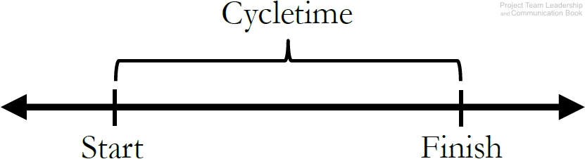
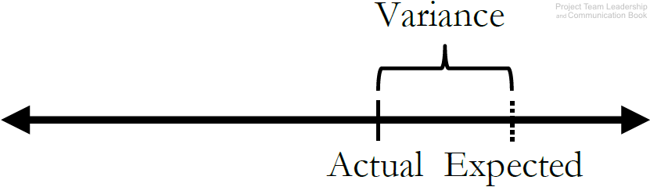
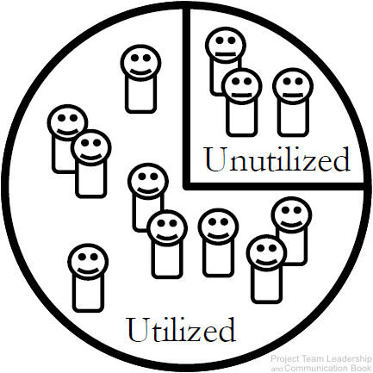
Example Project Metrics (1 of 2)
Cycletime measures the average amount of time it takes to complete a cycle. Defining a ‘cycle’ is up to the team – it can be a single phase or the entire project.
Schedule or Cost Variance demonstrates how far the expected value (baseline) is from the actual value. Related to a project’s Earned Value.
Resource Utilization tracks how effectively of the team’s available work hours are being utilized. A percentage significantly below 100% may indicate wasted time, and over 100% could lead to burn-out. Similar metrics exist for other (non-human) resources.
Dr.Sara Adel
Diagrams: Malachowsky, Samuel. Project Team Leadership and Communication. Lintwood Press. 2018. p. 166.
Notes:
Corresponds to section 5.6, page 166 of the Project Team Leadership and Communication book.

Slide 44
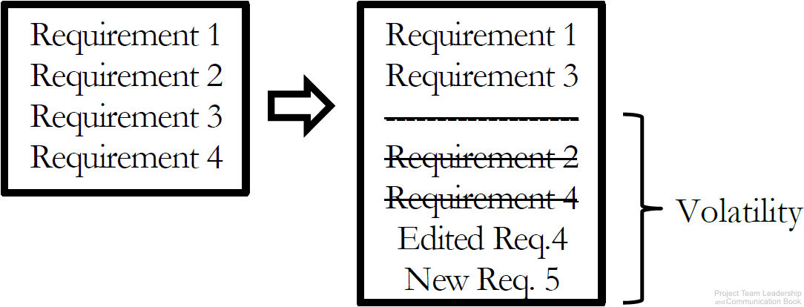
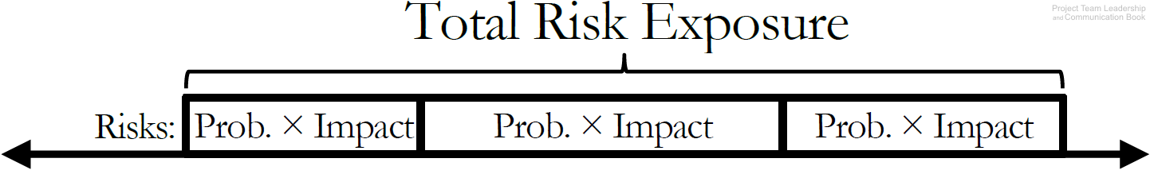
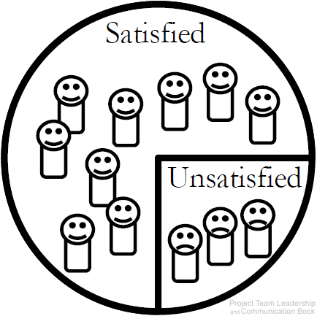
Example Project Metrics (2 of 2)
Requirements/Specifications Volatility measures the number of changes to requirements/specifications as the project proceeds. These changes often have significant impacts on the productivity of the team.
Total Risk Exposure is the sum of a project’s individual risk exposures. The result is the expected total impact to resources or schedule.
Customer Satisfaction is an important metric to many organizations. Measured in various ways (surveys, etc.). Understanding why customer satisfaction is where it is represents a much more difficult task.
Dr.Sara Adel
Diagrams: Malachowsky, Samuel. Project Team Leadership and Communication. Lintwood Press. 2018. p. 166-167.
Notes:
Corresponds to section 5.6, pages 166-167 of the Project Team Leadership and Communication book.

Slide 45
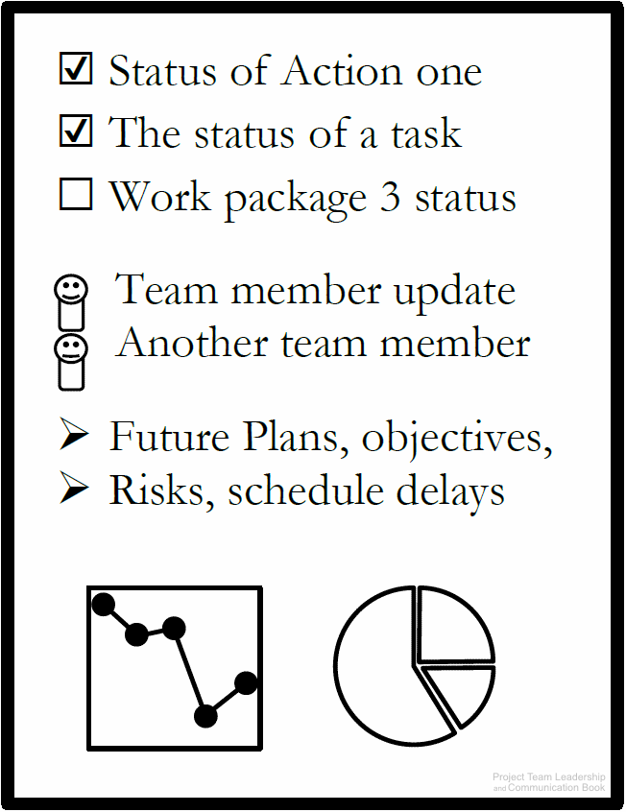
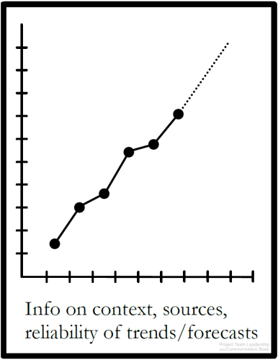
Example Project Reports (1 of 3)
Status Reports indicate the overall condition of a project.
  Overall health
  Schedule/budget status
  Issues/risks
Almost any relevant metric can be included
Trend/Forecasting Reports extrapolate important project data, giving insight into important factors of the project.
  Is performance improving or deteriorating?
  Will the data and its forecast factor into important decisions?
Sources, justifications, and expected ranges help make the report more relevant/readable
Automatically generated reports can be extremely useful here
Data/Metrics: Cycletime, Schedule, Cost, etc.
Quad Charts are a useful example of a status report
  Limited to one side of one page or one presentation slide
Completed Since Last Report | Plans For Current Period
Risks & Issues | Needs & Discussion
Dr.Sara Adel
Diagrams: Malachowsky, Samuel. Project Team Leadership and Communication. Lintwood Press. 2018. p. 167-168.
Notes:
Corresponds to section 5.6 and 5.8, pages 167-168 and 173-174 of the Project Team Leadership and Communication book.

Slide 46
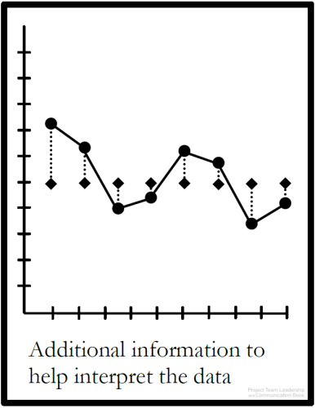
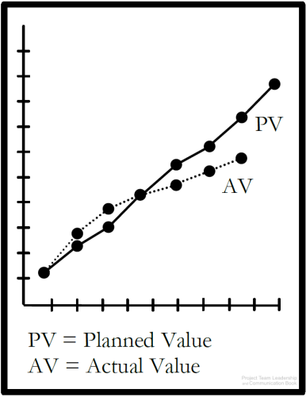
Example Project Reports (2 of 3)
Variance Reports measure how actual results compare to the expected value, or “baseline.”
Both overspending and “underspeinding” time or resources can represent a problem
Earned Value Reports are similar to Trend/Fore-casting and Variance Reports, but follow a specific method.
  Actual, or “Earned Value” are plotted against expected value.
  In an “ideal” project, both graphed lines would match perfectly. A gap indicates variance
Some project management software automatically generates this report
Data/Metrics: Earned Value, Planned Value
The expected values may not always be constant/linear. Projects often plan to work and spend resources at varying rates
Often, more data is included to provide clarity
Data/Metrics: Schedule Variance, Cost Variance, analysis/clarification where needed
Dr.Sara Adel
Diagrams: Malachowsky, Samuel. Project Team Leadership and Communication. Lintwood Press. 2018. p. 169.
Notes:
Corresponds to section 5.6, page 169 of the Project Team Leadership and Communication book.
Note that Earned Value is covered more extensively in the chapter 3 slides as well as the book on pages 94-97 (section 3.6).

Slide 47
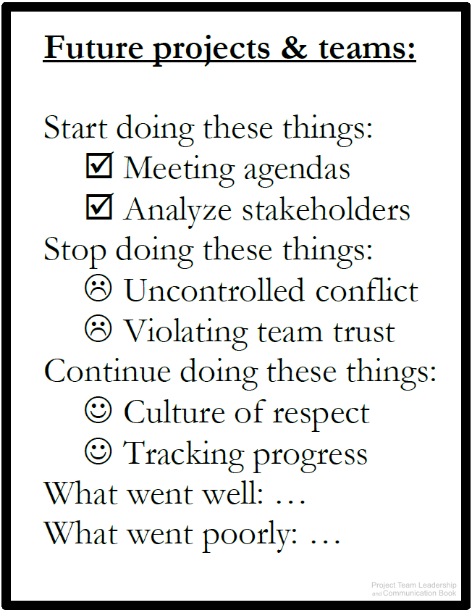
Example Project Reports (3 of 3)
Lessons Learned Reports present an opportunity for the project team to review, document, learn from, and communicate what went well and what went poorly throughout the project.
  Often three questions are asked:
    What should the team start doing?
    What should the team stop doing?
    What should the team continue doing?
  Also known as a “Postmortem,” which implies lessons learned activities are only completed at the end of a project. In reality, they should happen throughout, and team can benefit immediately
  Previous Lessons Learned reports can also benefit teams completing projects in the future
Dr.Sara Adel
Diagram: Malachowsky, Samuel. Project Team Leadership and Communication. Lintwood Press. 2018. p. 170.
Notes:
Corresponds to section 5.6, page 170 of the Project Team Leadership and Communication book.

Slide 48
10.8 Ethics in Communication.
Dr.Sara Adel

Slide 49

Ethical Communication
Presented material that contains all the relevant information, is true in every sense, and is not deceptive in any way.
Notes:
It’s particularly important today that a company’s communication efforts be ethical. This means that the communication includes all relevant information, is true in every sense, and is not deceptive in any way.
Unethical communication often distorts the truth or manipulates audiences—for example, by omitting essential information, selectively misquoting, misrepresenting numbers, distorting visuals, or failing to respect privacy or information security needs.
Managers encourage ethical communication by establishing clear ethical guidelines for behavior and business communication.
In a global survey by the International Association of Business Communicators, 70 percent of communication professionals said their companies clearly define what is considered ethical and unethical behavior.
If no clear ethical guidelines exist, apply the following questions to help you think through your communication choices and consequences:
Has the situation been defined fairly and accurately?
Why is the message being communicated?
How will the people who may be affected by the message or who receive the message be impacted?
Does the message help achieve the greatest possible good while minimizing possible harm?
Will this decision that appears to be ethical now seem so in the future?
How comfortable are you with your communication effort?
What would a person you respect think of it?

Slide 50
Ethical Communication
Communication presents the majority of ethical decisions for most individuals
Ethics focus on truthfulness
  Honesty before the project begins
    Ensuring that the project team and stakeholders are presented with an honest view of circumstances
  Trying to understand the truth
    Remember that perceptions can be inaccurate. Seek the whole truth
  Being truthful in all communications
    Stressful or less-than-ideal circumstances make this difficulty. Trust is built in the bad times, not the good
  Creating an environment where others tell the truth
    As a leader or peer, consistently telling the truth communicates to others that truthfulness is the only acceptable option
Dr.Sara Adel
Malachowsky, Samuel. Project Team Leadership and Communication. Lintwood Press. 2018. p. 162-163.
Notes:
Corresponds to section 5.5, pages 162-163 of the Project Team Leadership and Communication book.

Slide 51
10.9 Stakeholder Expectation Management
Dr.Sara Adel

Slide 52
Stakeholder Expectation Management
Stakeholders fall into 2 groups
  Those who affect the project: often the most apparent to the team and the most demanding
  Those who are affected by the project: often easier to ignore
Expectations have a direct connection to perception, and perception is influenced by communication. Several factors can affect this:
  Stakeholders’ previous projects and experiences.
  Patterns of communication and normal rhythms of the organizational environment.
  Expectations of individual stakeholders: simply asking is often most effective here
  Previous commitments made by the project team. These should be carefully recorded and considered
  Hard data: numbers (metrics, reports, etc.) and appropriate context are extremely valuable
Dr.Sara Adel
Malachowsky, Samuel. Project Team Leadership and Communication. Lintwood Press. 2018. p. 171-172.
Notes:
Corresponds to section 5.7, pages 171-172 of the Project Team Leadership and Communication book.

Slide 53
10.10 How to improve leadership communication skills?
Dr.Sara Adel

Slide 54

How to improve leadership communication skills?
The following are steps you can take to improve your leadership communication skills:
Have a purpose for your communication. Before you speak or send correspondence, make sure you have a clear goal so your message stays focused.
Make sure your team members fully understand your agenda. Explain the objective of the conversation so your team members understand their responsibilities and what you expect of them.
Choose your words carefully. Each word you use should have a specific purpose for a more straightforward message. Think before you speak, and reread and written communication before you send it.
Eliminate fillers from your vocabulary. Reducing fillers, such as "um," can make you seem more confident and composed when you speak. If you need to, you can take a short pause before completing a thought instead of filling the space.

Slide 55
10.11 Summary and Conclusions.
Dr.Sara Adel

Slide 56
Summary and Conclusions:
Teams may not give communication enough consideration because in general communication is a large part of everyday life
Communication requires careful planning, and should consider factors such as the appropriate channel and potential blockers.
Carefully consider whether interactive, push, pull, and hybrid communication types are appropriate
External communication affects the expectations of stakeholders
Communication represents the majority of ethical considerations for project teams
When communicating with metrics and reports, special consideration must be given to how they are perceived. Provide appropriate interpretation and context.
How to improve leadership communication skills?
Dr.Sara Adel

Slide 57
10.12 Self Assessment.
Dr.Sara Adel

Slide 58

Activity – Detecting Communication Blockers
Consider each of the following communication channels:
For each, which communication blockers are most likely to go undetected? Which would be the most obvious?
Face-to-Face
Social Media
Text Messages
Email
Video Conference
Postal Mail
Instant Messages
Telephone
Language and Culture
Interruptions
Technical Issues
Distractions such as fatigue
Negativity or hostility
Context known by only one party
Incorrect assumptions
Dr.Sara Adel

Slide 59
Activity – Planning and Holding a Meeting
In teams of 3-4, consider the following scenario:
Your team wishes to establish a unique identity which sets them apart from other teams within your organization. You’ve decided that an animal mascot would be the perfect way to represent your team, but you need to decide which animal best fits your team.
A meeting is needed to decide on an appropriate mascot:
  Create a simple agenda for the 3-5 minute meeting. Basic templates are easily found online
  Hold the meeting, following the agenda you’ve just created
  Publish the results of the meeting so that others in the room understand what decisions were made. Did everyone participate/provide input? If not, could this be addressed in the agenda?
Dr.Sara Adel
Notes:
Corresponds to section 5.4, pages 159-162 of the Project Team Leadership and Communication book.
10-15 Minute activity (segments can be timed)
3 minutes to create the agenda
3 minutes to hold the meeting
4 minutes to publish the results and answer the follow-up questions
Learning Objective: Create a published agenda, planning and participating in a basic team meeting
Whiteboards, if available, could be used to create the agenda and results portions of this activity

Slide 60
Activity – Ethical Communication
Consider each of the following scenarios:
Your project is 3 weeks behind, but you believe you can “catch up” with a little luck and a lot of hard work. The customer is unaware of the situation.
A team member has accidently left some sensitive customer data exposed for the past week. You believe no one has accessed the data.
You suspect that a fellow team member is misreporting important project metrics to management. You’re not 100% certain.
Do you have an ethical obligation to act? What communications should take place?
What may happen if you choose not to act?
How could taking action affect relationships? How might not acting affect them?
Dr.Sara Adel
Notes:
Corresponds to section 5.5, pages 162-163 of the Project Team Leadership and Communication book.
10 Minute activity
Learning Objective: Analyze several basic ethics scenarios and potential ramifications
Activity could be adapted: have participants create their own scenarios and exchange them for analysis with others.

Slide 61

Resources:
Project Team Leadership and Communication by Samuel Malachowsky, 2018.
Dr.Sara Adel

Slide 62
THANKS!
Dr.Sara Adel

