Slide 1


Slide 2

Lecture
06
Lecture Objectives
Lecture Objectives
1- The first aim is to know well what we mean by infinite series
2- Secondly, The definition of convergent and divergent
3- It is important to know some notes when solving limits
4- Know the different Convergent tests
5- Taylor series
Lecture 6 Dr. Israa Lewaa Mathematics 1

Slide 3
Lecture
06
Lecture Outline
Chapter Outline
1- Infinite Series
2- Convergent and Divergent Definition
3- Different Convergent tests
4- Taylor series
Lecture 6 Dr. Israa Lewaa Mathematics 1

Slide 4
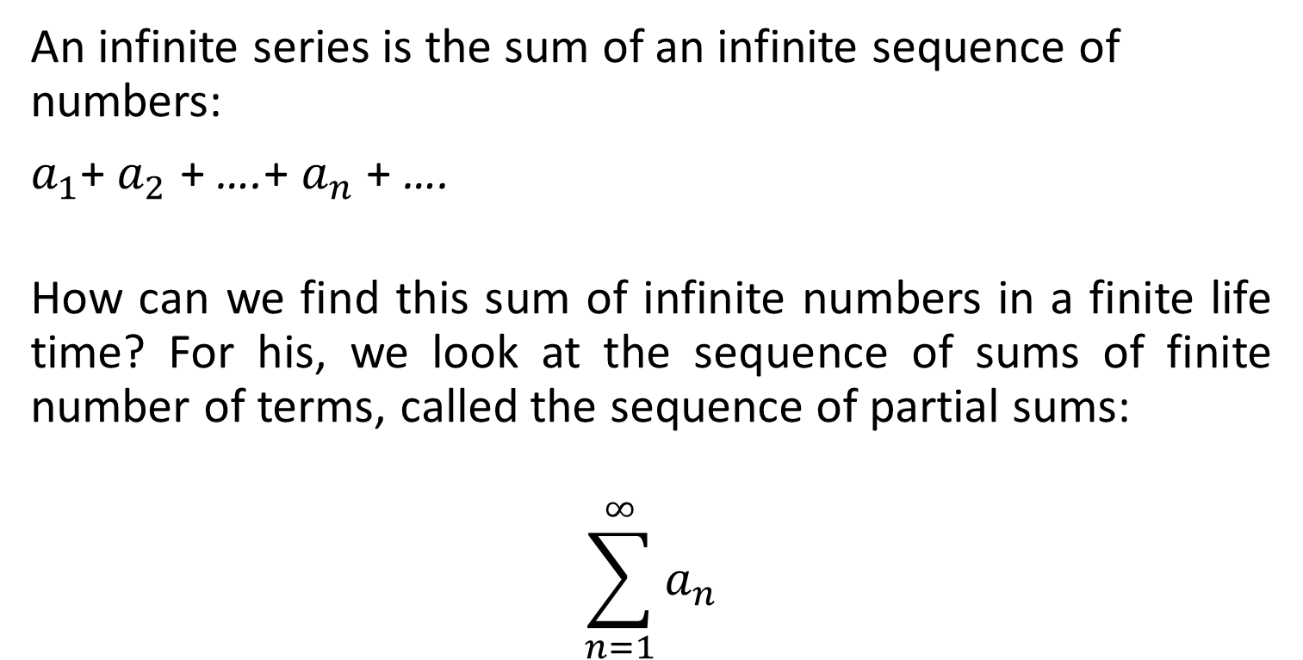
Lecture
06
Infinite Series
Infinite Series
An infinite series is the sum of an infinite sequence of numbers:
$a_{1}$+ $a_{2}$ + ….+ $a_{n}$ + ….
How can we find this sum of infinite numbers in a finite life time? For his, we look at the sequence of sums of finite number of terms, called the sequence of partial sums:
$$\sum_{n=1}^{∞}{a_{n}}$$
Lecture 6 Dr. Israa Lewaa Mathematics 1

Slide 5
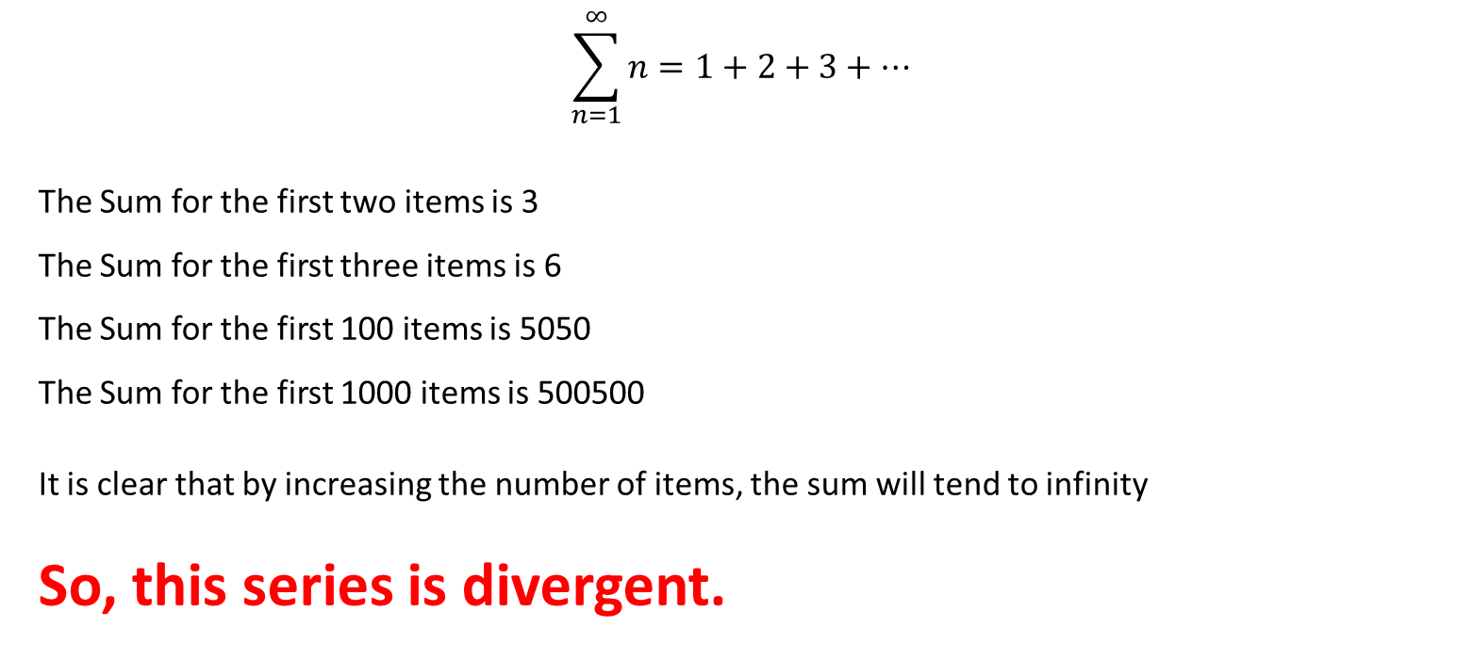
Lecture
06
Illustrative Example
illustrative Example
$$\sum_{n=1}^{∞}{n=1+2+3+…}$$
The Sum for the first two items is 3
The Sum for the first three items is 6
The Sum for the first 100 items is 5050
The Sum for the first 1000 items is 500500
It is clear that by increasing the number of items, the sum will tend to infinity
So, this series is divergent.
Lecture 6 Dr. Israa Lewaa Mathematics 1

Slide 6
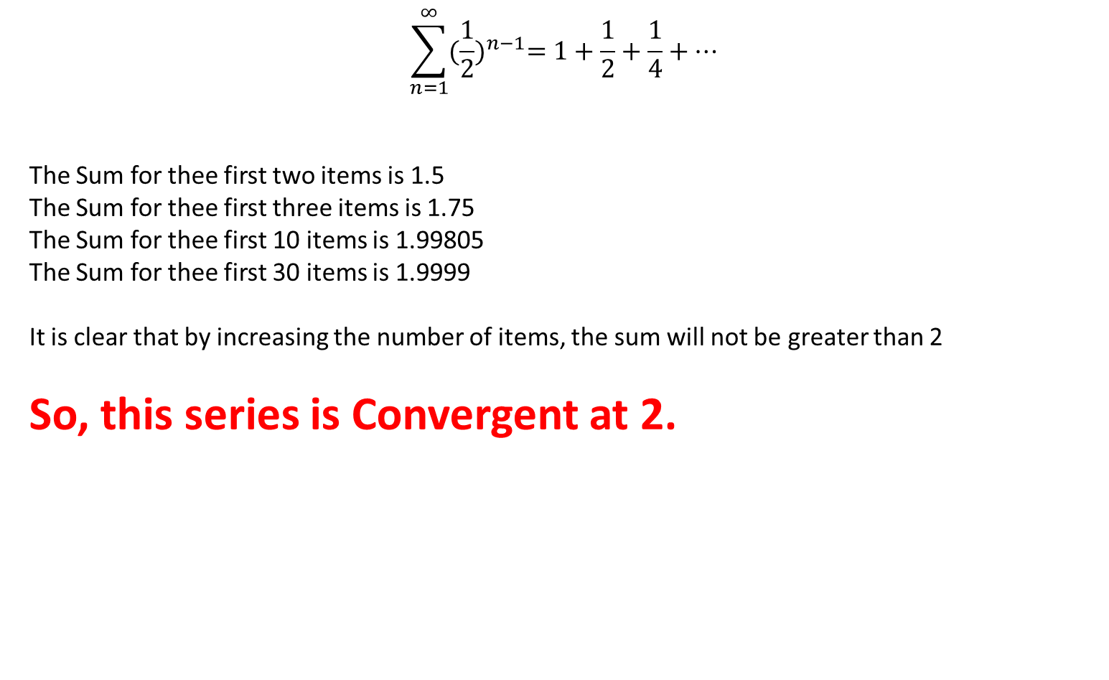
Lecture
06
Illustrative Example
illustrative Example
$$\sum_{n=1}^{∞}{{(\frac{1}{2})}^{n−1}=1+\frac{1}{2}+\frac{1}{4}+…}$$
The Sum for thee first two items is 1.5
The Sum for thee first three items is 1.75
The Sum for thee first 10 items is 1.99805
The Sum for thee first 30 items is 1.9999
It is clear that by increasing the number of items, the sum will not be greater than 2
So, this series is Convergent at 2.
Lecture 6 Dr. Israa Lewaa Mathematics 1

Slide 7
Lecture
06
Strategy for Testing Series
Strategy for Testing Series
1- nth Term Test
2- Direct Comparison Test
3- Limit Comparison Test
    4- Cauchy Test
    5- Integral Test
    6- Ratio Test
  7- Root Test
  8- Alternating Series Test

Slide 8

Lecture
06
Strategy for Testing Series
Strategy for Testing Series
we will learn about:
The ways of testing a series for convergence or divergence.
Nth term Test
Limit Comparison Test
Cauchy Test
We will need some important notes for limits
Lecture 6 Dr. Israa Lewaa

Slide 9
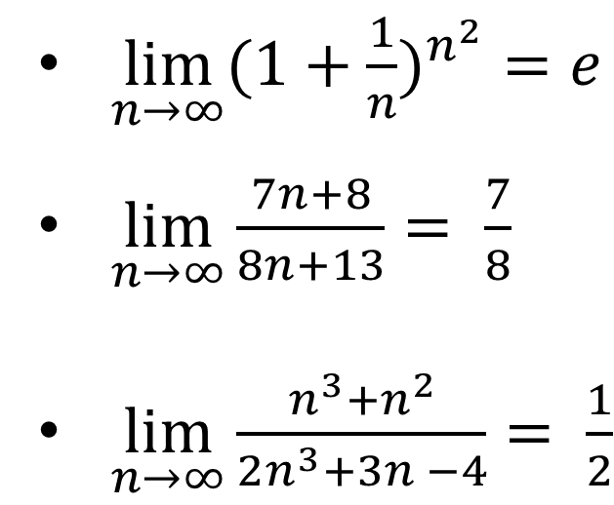
Lecture
06
Important Note for Limits
Important Note for Limits:
$\lim_{n→∞}{({1+\frac{1}{n})}^{n^{2}}=e}$
$\lim_{n→∞}{\frac{7n+8}{8n+13}= \frac{7}{8}}$
$\lim_{n→∞}{\frac{n^{3}+n^{2}}{2n^{3}+3n −4}= \frac{1}{2}}$
Lecture 6 Dr. Israa Lewaa Mathematics 1

Slide 10

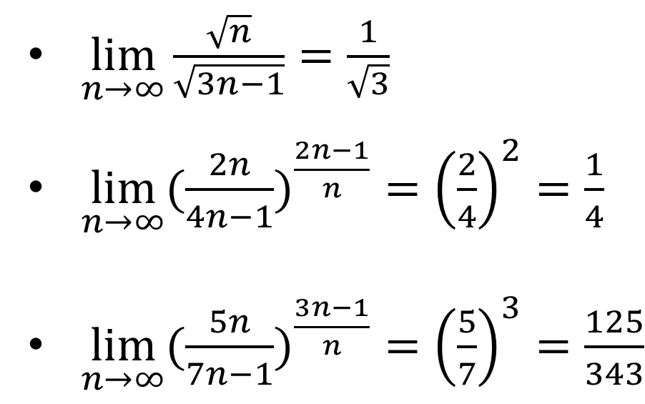
Lecture
06
Important Note for Limits
****Important Notes for Limits
$\lim_{n→∞}{\frac{\sqrt{n}}{\sqrt{3n−1}}=\frac{1}{\sqrt{3}}}$
$\lim_{n→∞}{({\frac{2n}{4n−1})}^{\frac{2n−1}{n}}={\left(\frac{2}{4}\right)}^{2}=\frac{1}{4}}$
$\lim_{n→∞}{({\frac{5n}{7n−1})}^{\frac{3n−1}{n}}={\left(\frac{5}{7}\right)}^{3}=\frac{125}{343}}$
Lecture 6 Dr. Israa Lewaa Mathematics 1

Slide 11
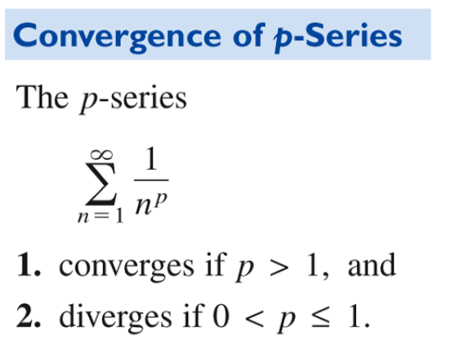
Lecture
06
Note for Some Series
****Note for some series

Slide 12
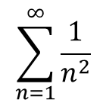
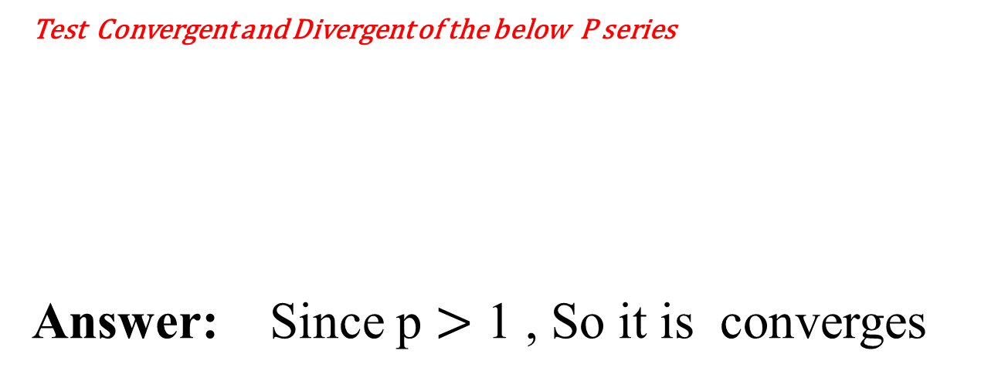
Lecture
06
Example A
****Example A
Test Convergent and Divergent of the below P series
Answer: Since p $>$ 1 , So it is converges
$$\sum_{n=1}^{∞}{\frac{1}{n^{2}}}$$
Lecture 6 Dr. Israa Lewaa Mathematics 1

Slide 13
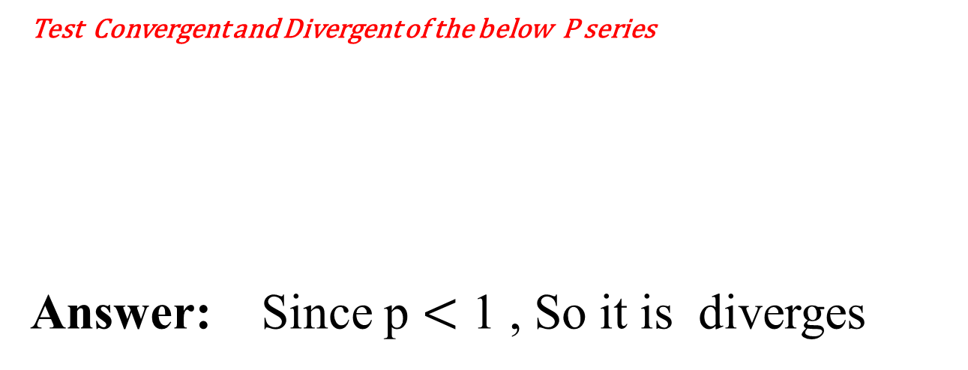
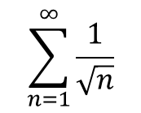
Lecture
06
Example B
****Example B
Test Convergent and Divergent of the below P series
Answer: Since p $<$ 1 , So it is diverges
$$\sum_{n=1}^{∞}{\frac{1}{\sqrt{n}}}$$
Lecture 6 Dr. Israa Lewaa Mathematics 1

Slide 14
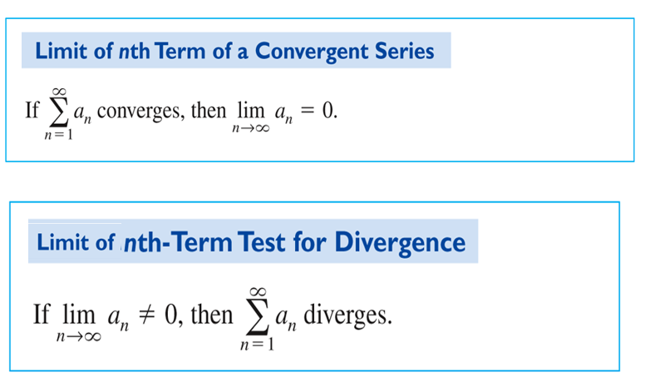
Lecture
06
1- nth Term Test
1- nth Term Test
Lecture 6 Dr. Israa Lewaa Mathematics 1

Slide 15
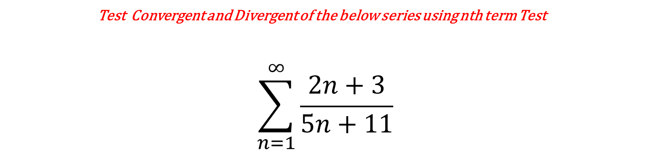
Lecture
06
Example 1
**Example 1
Test Convergent and Divergent of the below series using nth term Test
$$\sum_{n=1}^{∞}{\frac{2n+3}{5n+11}}$$
Lecture 6 Dr. Israa Lewaa Mathematics 1

Slide 16
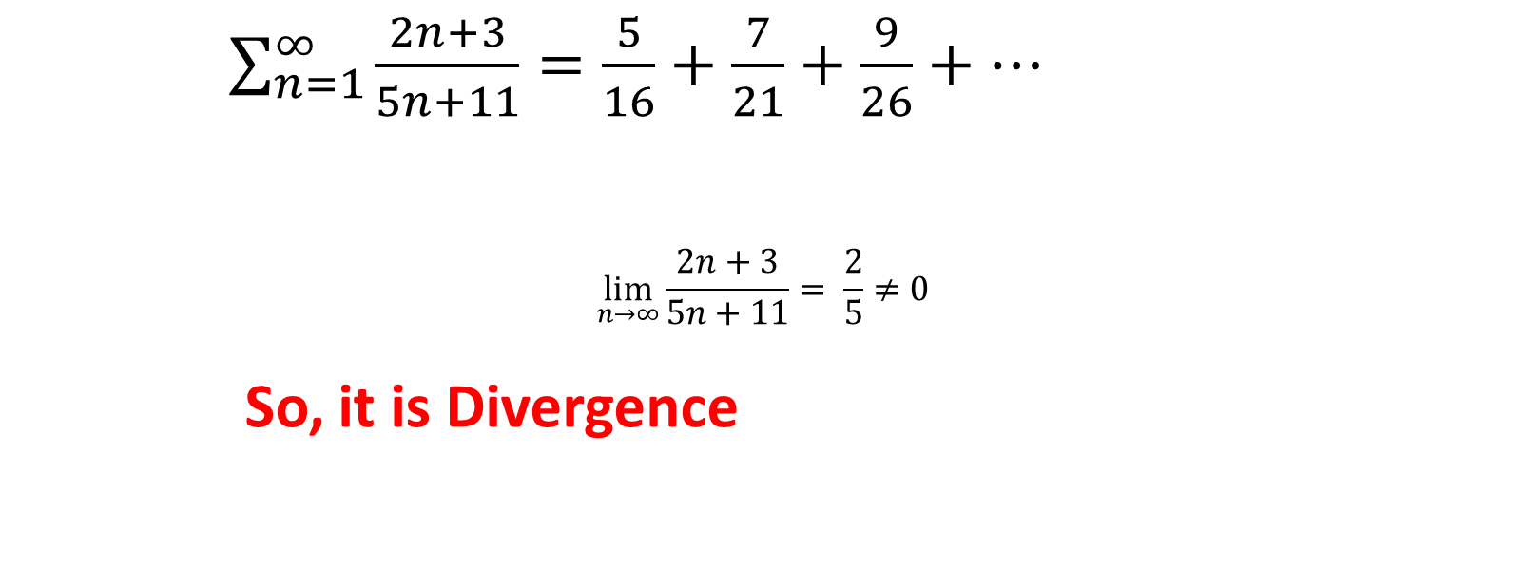
Lecture
06
Example 1 Solution
Example 1 Solution
$\sum_{n=1}^{∞}{\frac{2n+3}{5n+11}}=\frac{5}{16}+\frac{7}{21}+\frac{9}{26}+…$
$$\lim_{n→∞}{\frac{2n+3}{5n+11}= \frac{2}{5}}≠0$$
So, it is Divergence
Lecture 6 Dr. Israa Lewaa Mathematics 1

Slide 17
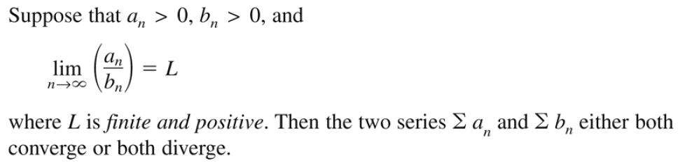
Lecture
06
2- Limit Comparison Test
2- Limit Comparison Test
Lecture 6 Dr. Israa Lewaa Mathematics 1

Slide 18
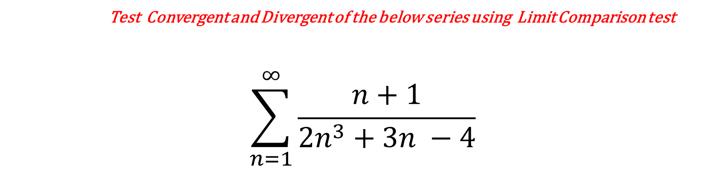
Lecture
06
Example 2
Example 2
Test Convergent and Divergent of the below series using Limit Comparison test
$$\sum_{n=1}^{∞}{\frac{n+1}{2n^{3}+3n −4}}$$
Lecture 6 Dr. Israa Lewaa Mathematics 1

Slide 19

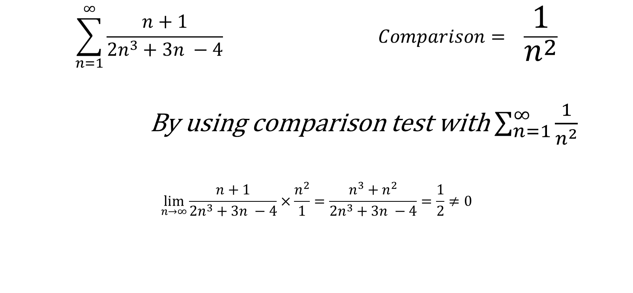
Lecture
06
Example 2 Solution
Example 2 Solution
$$\sum_{n=1}^{∞}{\frac{n+1}{2n^{3}+3n −4}} Comparison= \frac{1}{n^{2}}$$
By using comparison test with $\sum_{n=1}^{∞}{\frac{1}{n^{2}}}$
$$\lim_{n→∞}{\frac{n+1}{2n^{3}+3n −4}×\frac{n^{2}}{1}=\frac{n^{3}+n^{2}}{2n^{3}+3n −4}=\frac{1}{2}}≠0$$

Slide 20
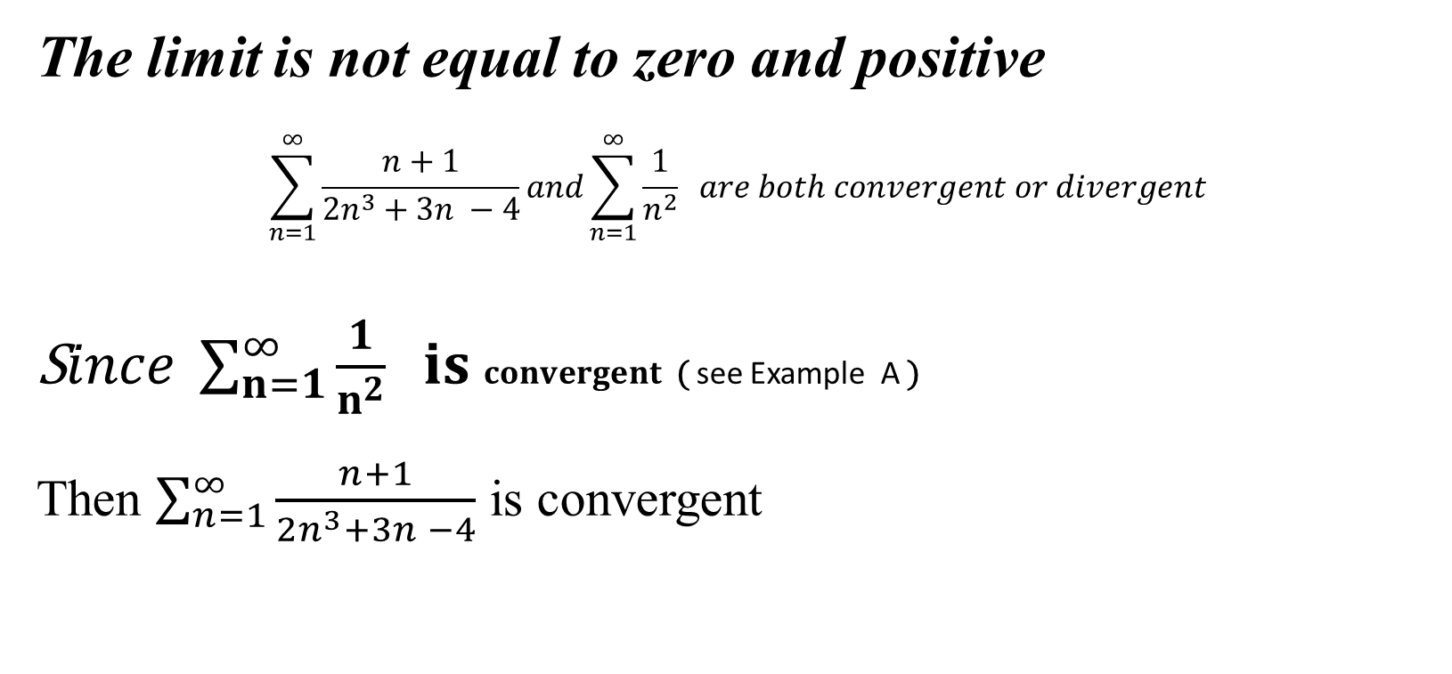
Lecture
06
Example 2 Solution
Example 2 Solution
The limit is not equal to zero and positive
$$\sum_{n=1}^{∞}{\frac{n+1}{2n^{3}+3n −4}}and\sum_{n=1}^{∞}{\frac{1}{n^{2}}} are both convergent or divergent$$
S$ince \sum_{n=1}^{∞}{\frac{1}{n^{2}}} is convergent$ ( see Example A )
Then $\sum_{n=1}^{∞}{\frac{n+1}{2n^{3}+3n −4}}$ is convergent
Lecture 6 Dr. Israa Lewaa Mathematics 1

Slide 21
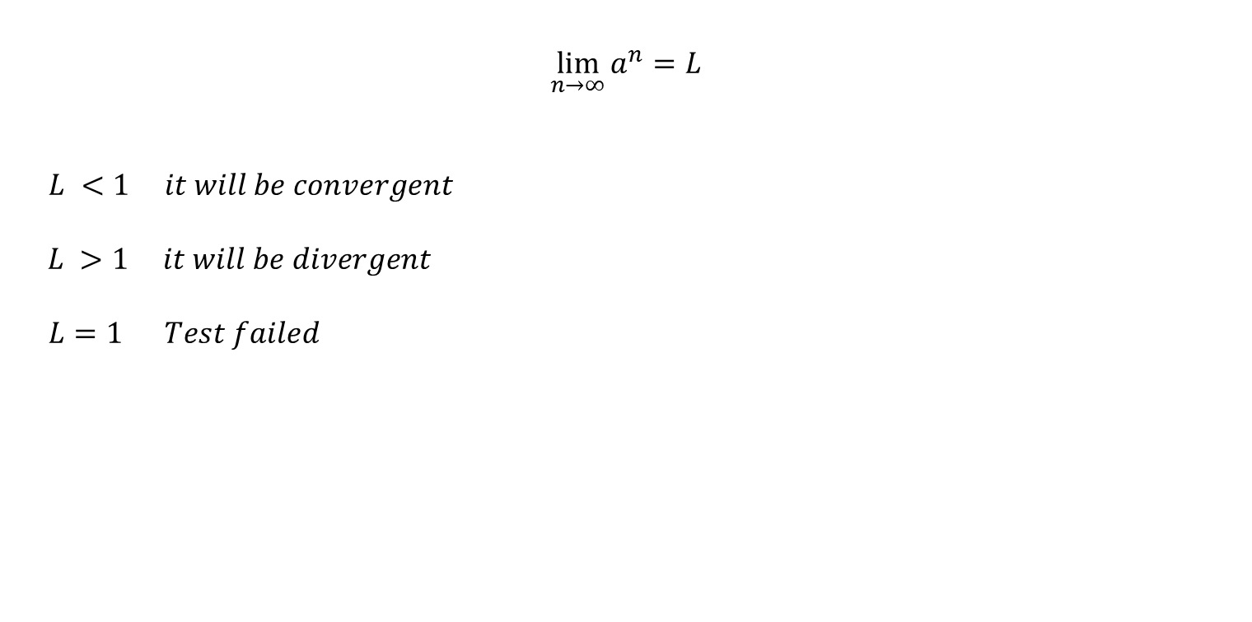
Lecture
06
3- Cauchy Test
Cauchy Test
$$\lim_{n→∞}{a^{n}=L}$$
$L <1 it will be convergent$
$L >1 it will be divergent$
$L=1 Test failed$
Lecture 6 Dr. Israa Lewaa Mathematics 1

Slide 22
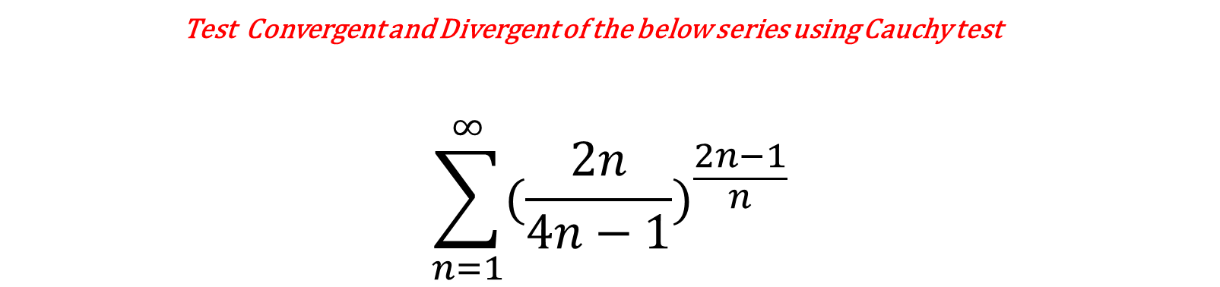
Lecture
06
Example 3
Example 3
Test Convergent and Divergent of the below series using Cauchy test
$$\sum_{n=1}^{∞}{({\frac{2n}{4n−1})}^{\frac{2n−1}{n}}}$$
Lecture 6 Dr. Israa Lewaa Mathematics 1

Slide 23
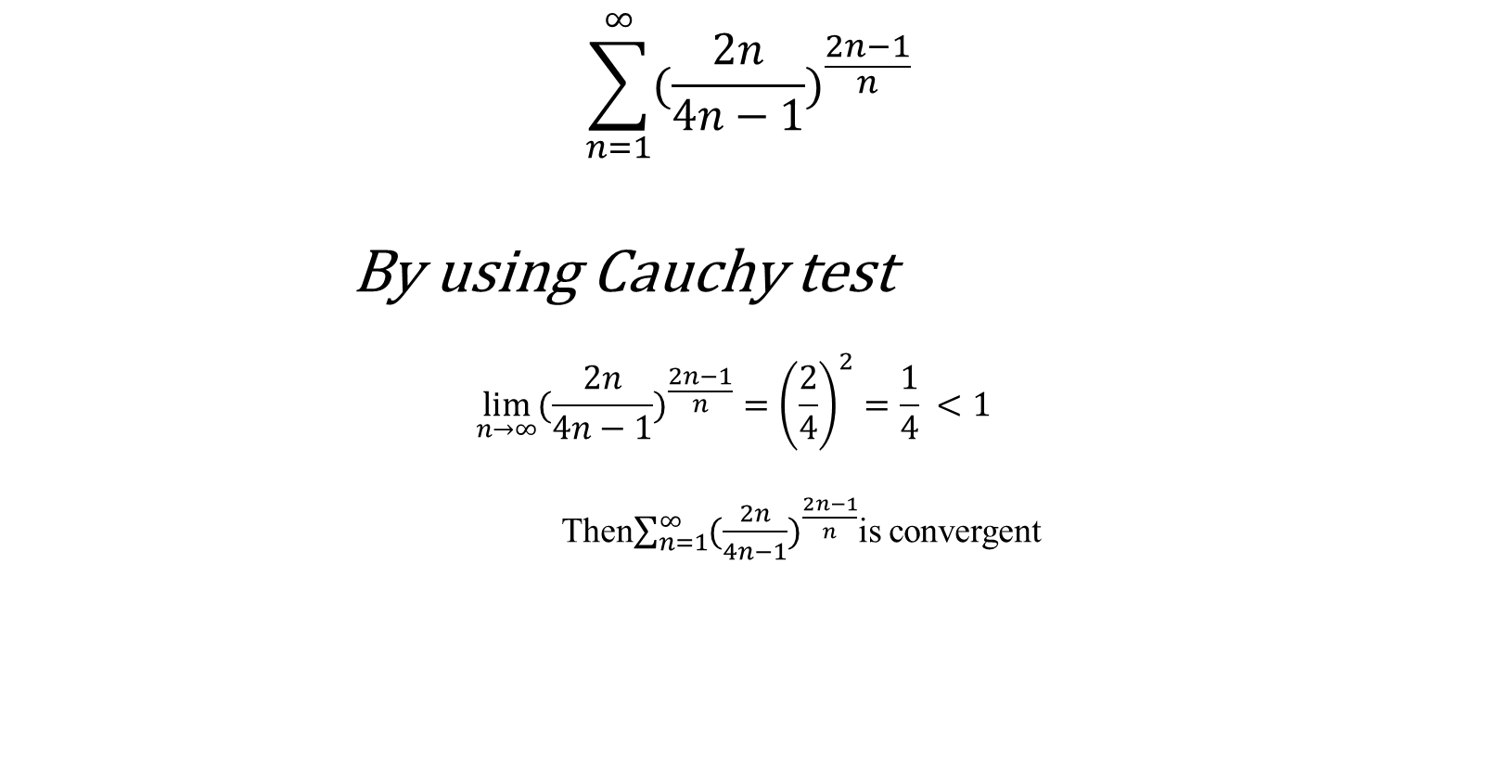
Lecture
06
Example 3 Solution
Example 3 Solution
$$\sum_{n=1}^{∞}{({\frac{2n}{4n−1})}^{\frac{2n−1}{n}}}$$
By using Cauchy test
$$\lim_{n→∞}{({\frac{2n}{4n−1})}^{\frac{2n−1}{n}}={\left(\frac{2}{4}\right)}^{2}=\frac{1}{4}} <1$$
Then$\sum_{n=1}^{∞}{({\frac{2n}{4n−1})}^{\frac{2n−1}{n}}}$is convergent
Lecture 6 Dr. Israa Lewaa Mathematics 1

Slide 24

Lecture
06
Extra Practice – Example 4
Extra Practice -- Example 4
Test Convergent and Divergent of the below series using Limit Comparison test
$$\sum_{n=1}^{∞}{\frac{1}{n(n+1)}}$$
Lecture 6 Dr. Israa Lewaa Mathematics 1

Slide 25
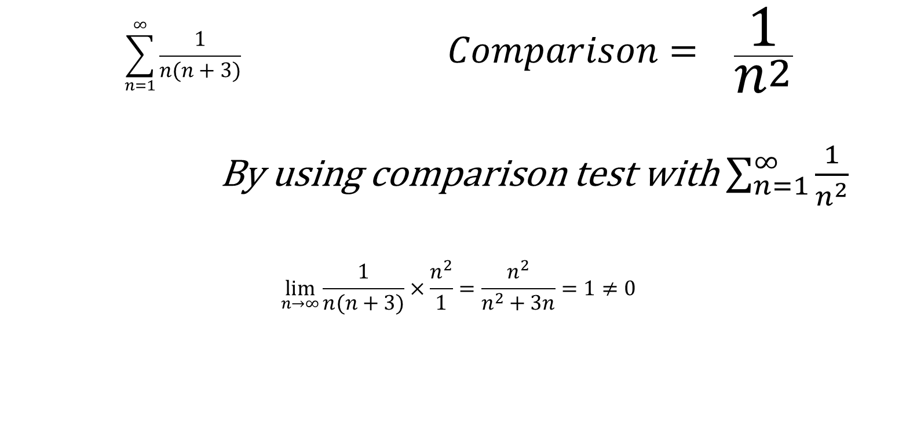
Lecture
06
Example 4 Solution
Example 4 Solution
$$\sum_{n=1}^{∞}{\frac{1}{n(n+3)}} Comparison= \frac{1}{n^{2}}$$
By using comparison test with $\sum_{n=1}^{∞}{\frac{1}{n^{2}}}$
$$\lim_{n→∞}{\frac{1}{n(n+3)}×\frac{n^{2}}{1}=\frac{n^{2}}{n^{2}+3n}=1}≠0$$
Lecture 6 Dr. Israa Lewaa Mathematics 1

Slide 26
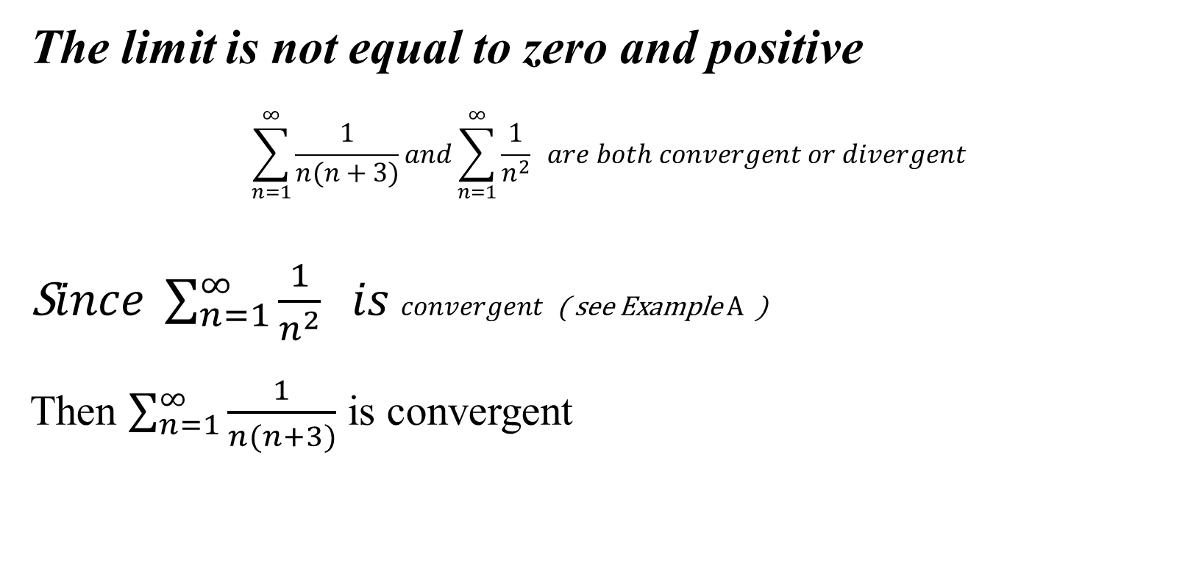
Lecture
06
Example 4 Solution
Example 4 Solution
The limit is not equal to zero and positive
$$\sum_{n=1}^{∞}{\frac{1}{n(n+3)}}and\sum_{n=1}^{∞}{\frac{1}{n^{2}}} are both convergent or divergent$$
S$ince \sum_{n=1}^{∞}{\frac{1}{n^{2}}} is convergent$ ( see Example A )
Then $\sum_{n=1}^{∞}{\frac{1}{n(n+3)}}$ is convergent
Lecture 6 Dr. Israa Lewaa Mathematics 1

Slide 27
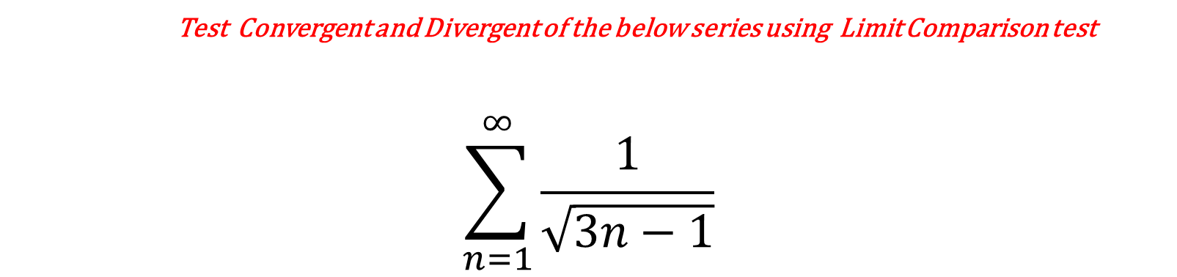
Lecture
06
Extra Practice – Example 5
Extra Practice -- Example 5
Test Convergent and Divergent of the below series using Limit Comparison test
$$\sum_{n=1}^{∞}{\frac{1}{\sqrt{3n−1}}}$$
Lecture 6 Dr. Israa Lewaa Mathematics 1

Slide 28
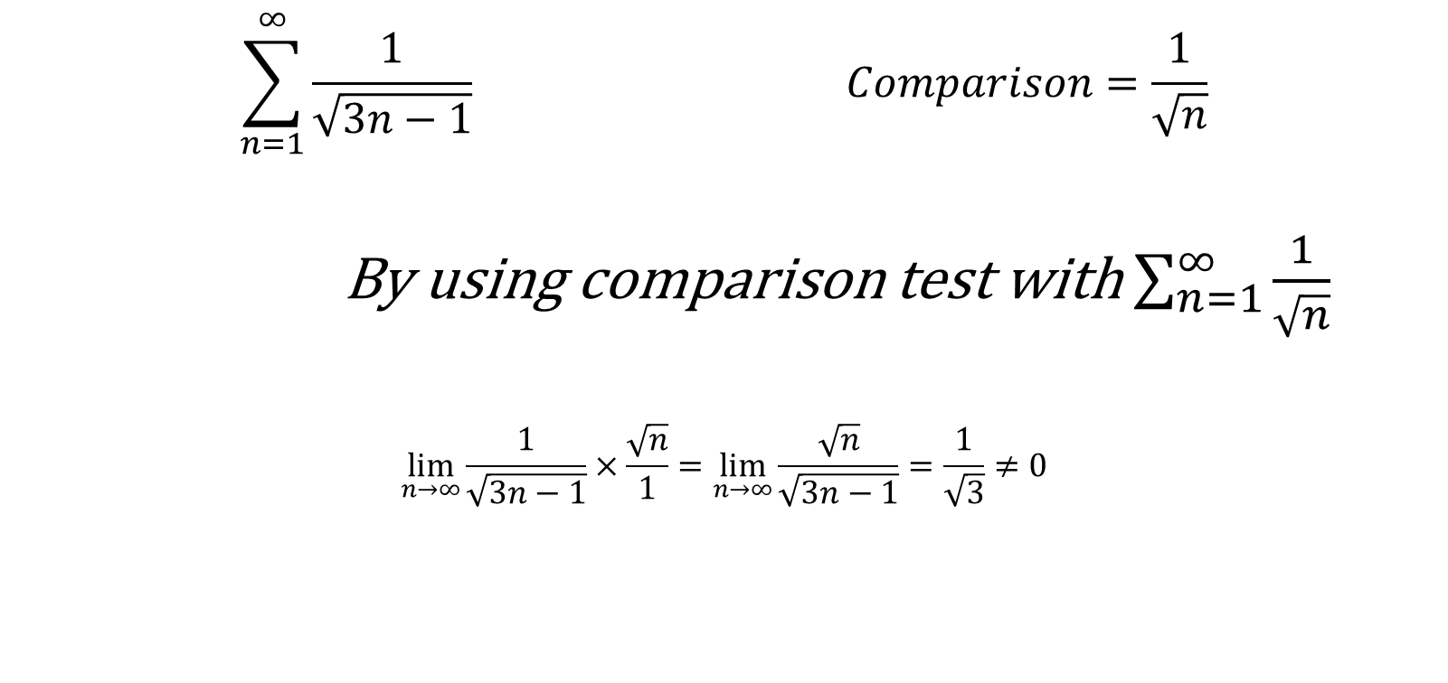
Lecture
06
Example 5 Solution
Example 5 Solution
$$\sum_{n=1}^{∞}{\frac{1}{\sqrt{3n−1}} }Comparison=\frac{1}{\sqrt{n}}$$
By using comparison test with $\sum_{n=1}^{∞}{\frac{1}{\sqrt{n}}}$
$$\lim_{n→∞}{\frac{1}{\sqrt{3n−1}}×\frac{\sqrt{n}}{1}=\lim_{n→∞}{\frac{\sqrt{n}}{\sqrt{3n−1}}=\frac{1}{\sqrt{3}}}}≠0$$
Lecture 6 Dr. Israa Lewaa Mathematics 1

Slide 29
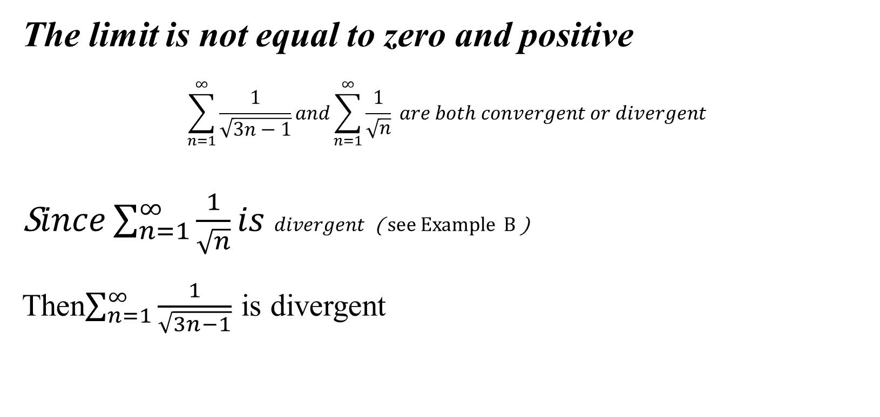
Lecture
06
Example 5 Solution
Example 5 Solution
The limit is not equal to zero and positive
$$\sum_{n=1}^{∞}{\frac{1}{\sqrt{3n−1}}}and\sum_{n=1}^{∞}{\frac{1}{\sqrt{n}}} are both convergent or divergent$$
S$ince\sum_{n=1}^{∞}{\frac{1}{\sqrt{n}}}is divergent$ ( see Example B )
Then$\sum_{n=1}^{∞}{\frac{1}{\sqrt{3n−1}}}$ is divergent
Lecture 6 Dr. Israa Lewaa Mathematics 1

Slide 30

Lecture
06
Extra Practice – Example 6
Extra Practice -- Example 6
Test Convergent and Divergent of the below series using Cauchy test
$$\sum_{n=1}^{∞}{({1+\frac{1}{n})}^{n^{2}}}$$
Lecture 6 Dr. Israa Lewaa Mathematics 1

Slide 31
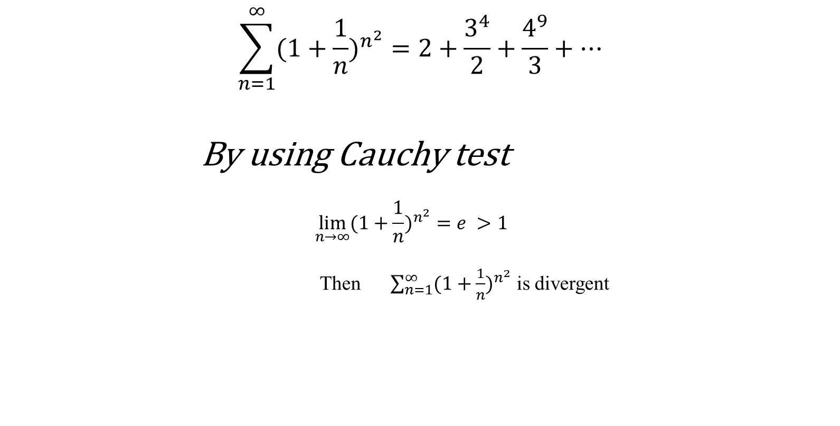
Lecture
06
Example 6 Solution
Example 6 Solution
$$\sum_{n=1}^{∞}{({1+\frac{1}{n})}^{n^{2}}}=2+\frac{3^{4}}{2}+\frac{4^{9}}{3}+…$$
By using Cauchy test
$$\lim_{n→∞}{({1+\frac{1}{n})}^{n^{2}}=e} >1$$
Then $\sum_{n=1}^{∞}{({1+\frac{1}{n})}^{n^{2}}}$ is divergent
Lecture 6 Dr. Israa Lewaa Mathematics 1

Slide 32
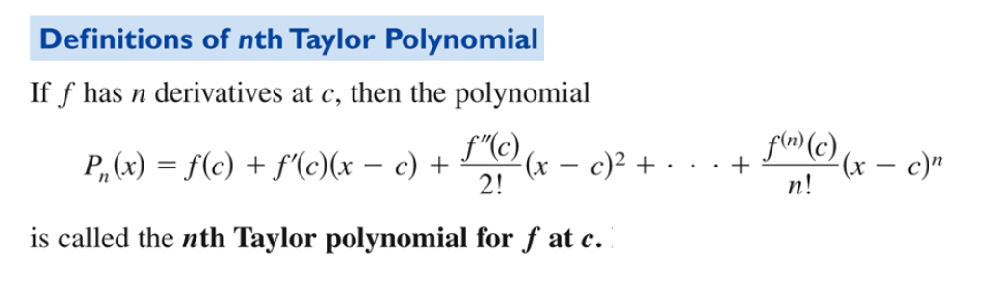
Lecture
06
Taylor Series
Taylor Series
Lecture 6 Dr. Israa Lewaa Mathematics 1

Slide 33
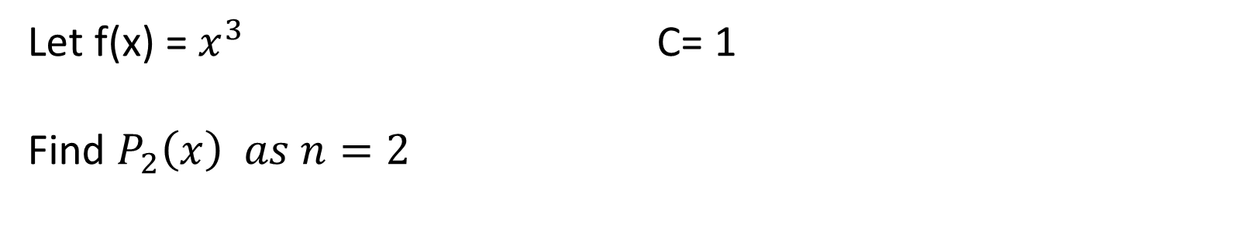
Lecture
06
Example 1 – Taylor Series
Example 1- Taylor Series
Let f(x) = $x^{3}$ C= 1
Find $P_{2}\left(x\right) as n=2$
Lecture 6 Dr. Israa Lewaa Mathematics 1

Slide 34

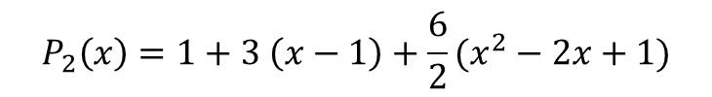
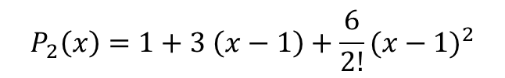
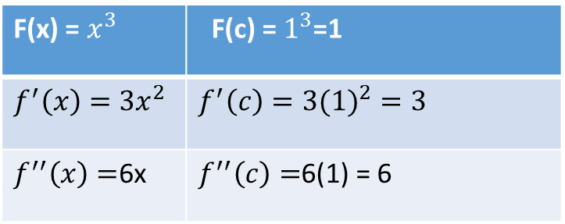

Lecture
06
Example 1 Solution
Example 1 Solution
$$as n=2 and C=1$$
$$P_{2}\left(x\right)=1+3 \left(x−1\right)+\frac{6}{2!}{(x−1)}^{2}$$
F(x) = $x^{3}$ | F(c) = $1^{3}$=1
$${f^{′}\left(x\right)=3x}^{2}$$ | $${f^{′}\left(c\right)=3(1)}^{2}=3$$
$f^{′′}\left(x\right)=$6x | $f^{′′}\left(c\right)=$6(1) = 6
$$P_{2}\left(x\right)=1+3 \left(x−1\right)+\frac{6}{2}(x^{2}−2x+1)$$
$$P_{2}\left(x\right)=1+3 x−3+3(x^{2}−2x+1)$$
$$P_{2}\left(x\right)=1+3 x−3+3x^{2}−6x+3$$
$$P_{2}\left(x\right)=3x^{2}−3x+1$$

Slide 35
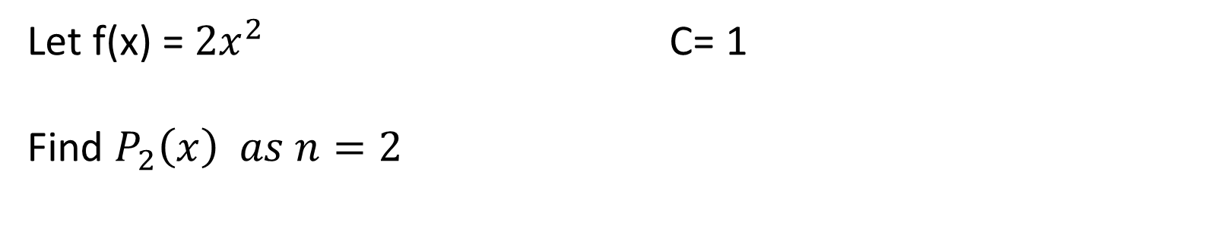
Lecture
06
Example 2 – Taylor Series
Example 2- Taylor Series
Let f(x) = ${2x}^{2}$ C= 1
Find $P_{2}\left(x\right) as n=2$
Lecture 6 Dr. Israa Lewaa Mathematics 1

Slide 36
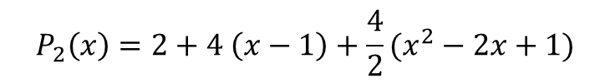
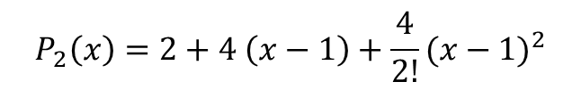
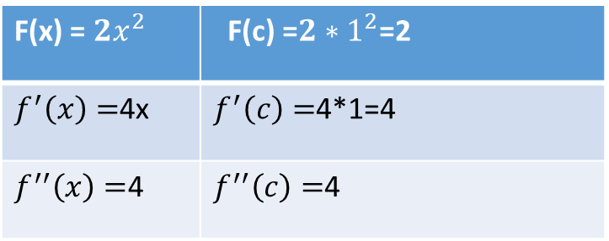
Lecture
06
Example 2 Solution
Example 2 Solution
$$as n=2 and C=1$$
$$P_{2}\left(x\right)=2+4 \left(x−1\right)+\frac{4}{2!}{(x−1)}^{2}$$
F(x) = ${2x}^{2}$ | F(c) =${2∗1}^{2}$=2
$f^{′}\left(x\right)=$4x | $f^{′}\left(c\right)=$4*1=4
$f^{′′}\left(x\right)=$4 | $f^{′′}\left(c\right)=$4
$$P_{2}\left(x\right)=2+4 \left(x−1\right)+\frac{4}{2}(x^{2}−2x+1)$$
$$P_{2}\left(x\right)=2+4 x−4+2(x^{2}−2x+1)$$
$$P_{2}\left(x\right)=2+4 x−4+2x^{2}−4x+2$$
$$P_{2}\left(x\right)=2x^{2}$$
Lecture 6 Dr. Israa Lewaa Mathematics 1

Slide 37
Lecture
06
Lecture Summary
Lecture Summary
1- Infinite Series
2- Convergent and Divergent Definition
Lecture 6 Dr. Israa Lewaa Mathematics 1

Slide 38
Lecture
06
Lecture Summary
Lecture Summary
3- Different Convergent tests
Nth term Test
Limit Comparison Test
Cauchy Test
Lecture 6 Dr. Israa Lewaa Mathematics 1

Slide 39
Lecture
06
Lecture Summary
Lecture Summary
3- Different Convergent tests
Nth term Test
Limit Comparison Test
Cauchy Test
4- Taylor series
Lecture 6 Dr. Israa Lewaa Mathematics 1

Slide 40
Lecture
06
Important Announcement
IMPORTANT ANNOUNCEMENT
Differential Revision is essential
Lecture 6 Dr. Israa Lewaa Mathematics 1

