Slide 1


Entrepreneurial
New Ventures
Prepared by Dr. Sarah Chahine
ENT 634
Entrepreneurial New Ventures
Lecture 1

Slide 2



Entrepreneurial
New Ventures
Lecture 1
ENT 634
Entrepreneurial New Ventures
Prepared by
Dr. Sarah Chahine

Slide 3
Chapter
Why Entrepreneurship Matters
01
Entrepreneurship converts change, unmet needs, and new knowledge into value.
New ventures can create jobs, introduce innovations, and challenge established ways of working.
The same entrepreneurial logic can be used in commercial, social, public, and corporate settings.

Slide 4
Chapter
Learning Outcomes
01
By the end of this lecture, you should be able to:
Define entrepreneur and entrepreneurship.
Explain why people choose entrepreneurship.
Discuss key characteristics, myths, venture types, and impacts.
Outline the entrepreneurial process and apply it to a simple idea.

Slide 5
Chapter
How GEM Measures Activity
01
There is a tremendous interest in entrepreneurship around the world. Although this statement may seem bold, there is evidence supporting it, some of which is provided by the Global Entrepreneurship Monitor (GEM).
The Global Entrepreneurship Monitor (GEM) compares entrepreneurial activity across economies.

Slide 6
Chapter
How GEM Measures Activity
01
Total early-stage entrepreneurial activity (TEA) includes people actively starting a business and owner-managers of young firms.
GEM also examines attitudes, motivations, aspirations, and the conditions that support entrepreneurship.

Slide 7
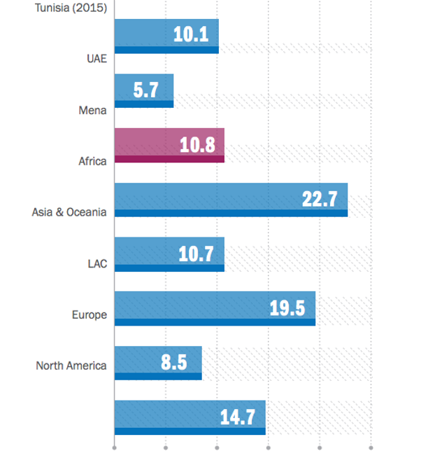
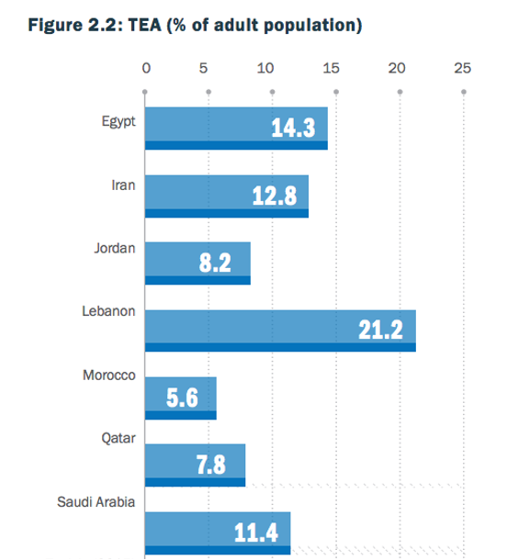
Chapter
How GEM Measures Activity
01

Slide 8
Chapter
Who Is an Entrepreneur?
01
The term comes from the French entreprendre: “to undertake.”
An entrepreneur identifies or shapes an opportunity, organizes resources, accepts uncertainty, and acts to create value through a new or existing organization.

Slide 9
Chapter
What Is Entrepreneurship?
01
Entrepreneurship is the process of pursuing an opportunity and mobilizing resources to create value under conditions of uncertainty.
It is more than having an idea: it requires action, learning, resourcefulness, and implementation.

Slide 10
Chapter
From Idea to Opportunity
01
An idea becomes an opportunity when it addresses a real need and can support a workable solution.
Ask:
  Who experiences the problem?
  What value would the solution create?
  Will people adopt or pay for it?
  Can the venture deliver it sustainably?

Slide 11
Chapter
Mobilizing Resources
01
Entrepreneurs assemble and combine:
  People and capabilities
  Finance and physical assets
  Knowledge, technology, and data
  Partners, networks, and legitimacy
  A business model and strategy
Resourcefulness often matters as much as ownership.

Slide 12
Chapter
Entrepreneurship Within Firms
01
Existing organizations can also act entrepreneurially. Corporate entrepreneurship—or intrapreneurship—encourages employees and teams to create new products, processes, business models, or ventures within an established firm.

Slide 13
Chapter
Entrepreneurial Intensity
01
Entrepreneurial intensity combines:
  Innovativeness: experimenting and introducing novelty
  Proactiveness: acting ahead of emerging needs
  Risk-taking: committing resources despite uncertainty
The appropriate level depends on the organization and its context.

Slide 14
Chapter
Why Become an Entrepreneur?
01
Common motivations include:
  Independence and greater control over work
  The opportunity to pursue an idea
  Achievement, challenge, and personal development
  Financial rewards and wealth creation
  Flexibility or necessity
  A desire to solve a social or environmental problem

Slide 15
Chapter
Independence Has Trade-Offs
01
Being your own boss can provide autonomy, but it also brings accountability.
Entrepreneurs make the final decisions, yet must answer to customers, employees, partners, lenders, investors, regulators, and the venture’s cash flow. Part-time experimentation can test whether entrepreneurship fits the individual.

Slide 16
Chapter
Pursuing an Idea
01
People often start ventures after recognizing an unmet need through work, study, hobbies, community experience, or daily life.
Example: repeated food waste at home may inspire a preservation solution—but customer interviews are still needed to determine whether the problem is widespread and worth solving.

Slide 17
Chapter
Pursuing an Idea
01
Example: a food preservation solution that helps people reduce waste and keep food fresh longer.
1. Observed problem
2. Target users
3. Value created
4. Opportunity test
Food is bought, stored,
and then thrown away
before being used.
Busy households
Meal-prep users
Small food sellers.
Longer freshness
Less food waste
Better storage habits.
Interview users
Test willingness to pay
Run a small pilot.
Key idea: the opportunity is not the product itself; it is the match between a real problem, a workable solution, and evidence from customers.

Slide 18
Chapter
More Than Financial Rewards
01
Financial rewards matter, but founders may also value:
  Purpose and social contribution
  Learning and achievement
  Recognition and identity
  Control over how value is created
Growth capital can increase potential while reducing founder control.

Slide 19
Chapter
Traits That Support Success
01
No single personality guarantees success. Useful, developable characteristics include:
  Passion and commitment
  Product and customer focus
  Tenacity with adaptability
  Execution intelligence
  Curiosity, learning, and ethical judgment

Slide 20
Chapter
Passion Needs Discipline
01
Passion sustains effort and communicates commitment, especially when progress is slow.
However, passion should not become blind attachment. Effective entrepreneurs remain willing to question assumptions, examine evidence, and change direction when customers or results contradict the original idea.

Slide 21
Chapter
Start With the Customer
01
A product creates value only when it solves a meaningful problem. Investigate:
  The customer’s situation and priorities
  Existing alternatives and frustrations
  The value promised by the solution
  Reasons to adopt, pay, return, or recommend

Slide 22
Chapter
Tenacity Is Not Stubbornness
01
Tenacity is the capacity to continue through setbacks. Adaptability is the capacity to learn and change.
Persistent entrepreneurs remain committed to the problem or purpose while adjusting the solution, target market, price, channel, or business model when evidence requires it.

Slide 23
Chapter
Execution Intelligence
01
Execution intelligence converts an idea into coordinated action:
  Define a workable business model
  Build a capable team
  Test assumptions
  Secure resources and partnerships
  Manage cash and operations
  Learn from results

Slide 24
Chapter
The Entrepreneurial Mindset
01
An entrepreneurial mindset emphasizes:
  Opportunity awareness
  Initiative and experimentation
  Learning from feedback
  Resourcefulness and collaboration
  Calculated risk and resilience
These habits can be developed through practice.

Slide 25
Chapter
Myth 1: Born Entrepreneurs
01
Entrepreneurship is not reserved for a fixed personality type.
Experience, education, role models, networks, deliberate practice, and the surrounding environment can strengthen entrepreneurial knowledge, skills, confidence, and intention. Individual differences matter—but capability can grow.

Slide 26
Chapter
Myth 2: Entrepreneurs Gamble
01
Effective entrepreneurs do not simply seek danger. They manage uncertainty by:
  Gathering evidence
  Testing on a small scale
  Limiting possible loss
  Sharing risk with partners
  Keeping options open
Risk is managed—not celebrated for its own sake.

Slide 27
Chapter
Myth 3: Money Is Everything
01
Profit is essential for the survival of most commercial ventures, but founders commonly pursue a mix of goals: independence, achievement, purpose, impact, identity, and financial return.
Motivations may also change as the venture develops.

Slide 28
Chapter
Three Start-Up Types
01
Salary-substitute firms provide an owner with income.
Lifestyle firms support a preferred way of living.
Entrepreneurial firms pursue innovation and scalable growth.
All three can create value; they differ mainly in objectives and growth logic.

Slide 29
Chapter
Who Participates Is Changing
01
Entrepreneurship is increasingly diverse across gender, age, nationality, professional background, and life stage.
Students, employees, researchers, migrants, parents, retirees, and experienced executives can all become entrepreneurs. Their different experiences can reveal different problems and opportunities.

Slide 30
Chapter
Who Participates Is Changing
01
Women Entrepreneurs:
While men are still more likely to start businesses than women, the number of women-owned businesses is increasing.
Between 2007 and 2016, the number of women-owned firms increased by 45 percent. As a result, over the past nine years, the number of women-owned businesses has grown at a rate five times faster than the national average.

Slide 31
Chapter
Who Participates Is Changing
01
Senior Entrepreneurs:
The number of seniors starting businesses is substantial and growing. The percentage of individuals age 62 and older starting a business increased from 4.2 percent in 1988 to 5.4 percent in 2015.
The increase in senior entrepreneurs is attributed to a number of factors, including corporate downsizing, an increasing desire among older workers for more personal fulfillment in their lives, and growing worries among seniors that they need to earn additional income to pay for future health care services and other expenses.

Slide 32
Chapter
Economic Effects
01
Entrepreneurial ventures can contribute through:
  Innovation and productivity
  New jobs and specialized skills
  Competition and market renewal
  New industries, exports, and supply chains
  Regional resilience
Impact varies across ventures and contexts.

Slide 33
Chapter
Effects on Society
01
Entrepreneurship changes how people live, work, learn, communicate, travel, shop, and receive care.
Its effects can be positive or negative. A new solution may improve access and convenience while also creating concerns about privacy, labor conditions, inequality, safety, or environmental cost.

Slide 34
Chapter
Responsible Entrepreneurship
01
Ask four questions:
  Who benefits and who may be harmed?
  Is the solution safe, fair, and transparent?
  What data or resources does it consume?
  Can unintended effects be reduced?
Ethical judgment belongs inside the entrepreneurial process.

Slide 35
Chapter
The Entrepreneurial Ecosystem
01
A venture is shaped by its entrepreneurial ecosystem: the interconnected people, institutions, resources, and culture surrounding entrepreneurial activity.
Key elements include entrepreneurs, customers, universities, incubators, investors, government, professional services, infrastructure, networks, and social norms.

Slide 36
Chapter
Prototype Before You Perfect
01
A prototype is an early representation of a solution used to learn. It may be a sketch, storyboard, mock-up, sample, role-play, landing page, or limited service trial.
The goal is not to look finished. The goal is to test a critical assumption quickly, cheaply, and ethically.

Slide 37
Chapter
The Entrepreneurial Process
01
A useful four-stage view is:
  Decide to become an entrepreneur.
  Develop and evaluate a promising idea.
  Move from the idea to a firm.
  Manage and grow the firm.
Learning often sends the entrepreneur back to revise earlier decisions.

Slide 38
Chapter
The Entrepreneurial Process
01
Using the same food preservation example, the venture can move through the four stages in a disciplined way.
1. Decide
2. Develop
3. Move to firm
4. Manage & grow
Purpose
Capabilities
Acceptable risk
Customer interviews
Prototype
Feasibility
Brand and channel
Pricing
Suppliers
Feedback
Cash flow
Repeat purchase

Slide 39
Chapter
Stages 1–2
01
Stage 1 — Decide:
  Examine motivations, goals, capabilities, and acceptable risk.
Stage 2 — Develop:
  Identify a problem or change.
  Generate a solution.
  Test whether the idea is an opportunity.
  Conduct feasibility analysis.

Slide 40
Chapter
Stages 3–4
01
Stage 3 — Move toward a firm:
  Design the business model, plan, team, legal form, financing, and launch.
Stage 4 — Manage and grow:
  Acquire customers, build operations, lead people, manage cash, measure results, and choose whether and how to scale.

Slide 41
Chapter
Apply the Lecture
01
Choose one everyday problem:
  Who experiences it, and why does it matter?
  What solution might create value?
  What evidence would show a real opportunity?
  What resources do you already control?
  What small, ethical test could you run?
Key lesson: entrepreneurship is disciplined action under uncertainty.

Slide 42


Thank You

