Slide 1


Project Time Management
مقرر: إداره وقت المشروع
Prepared by Dr. Amira Elfekky
PMG 212
Lecture 2

Slide 2


Agenda
Functional Employee’s Role
The Project Manager as The Planning Agent
Project Management Growth
General Systems Management
Project Management: 1945–1960
Project Management: 1960–1985
Type of Industry
The Six Imperatives of Project Management
Project Internal and External Obstacles
www.midocean.ae

Slide 3
Agenda
Functional Employee’s Role
The Project Manager as The Planning Agent
Project Management Growth
General Systems Management
Project Management: 1945–1960
Project Management: 1960–1985
Type of Industry
The Six Imperatives of Project Management
Project Internal and External Obstacles
www.midocean.ae

Slide 4
Chapter
Functional Employee’s Role
2
Accept responsibility for accomplishing the assigned deliverables within the project’s constraints
Complete the work at the earliest possible time
Periodically inform both the project and line manager of the project’s status
Bring problems to the surface quickly for resolution
Share information with the rest of the project team
www.midocean.ae

Slide 5
Agenda
Functional Employee’s Role
The Project Manager as The Planning Agent
Project Management Growth
General Systems Management
Project Management: 1945–1960
Project Management: 1960–1985
Type of Industry
The Six Imperatives of Project Management
Project Internal and External Obstacles
www.midocean.ae

Slide 6

Chapter
THE PROJECT MANAGER AS THE PLANNING AGENT
2
The major responsibility of the project manager is planning.
If project planning is performed correctly the project manager provides overall or summary definitions of the work to be accomplished, but the line managers (the true experts) do the detailed planning.
www.midocean.ae

Slide 7
Chapter
THE PROJECT MANAGER AS THE PLANNING AGENT
2
The project manager must provide:
● Complete task definitions
● Resource requirement definitions (possibly skill levels)
● Major timetable milestones
● Definition of end-item quality and reliability requirements
● The basis for performance measurement
www.midocean.ae

Slide 8
Chapter
THE PROJECT MANAGER AS THE PLANNING AGENT
2
Project managers are responsible for project administration and, therefore, must have the right to establish their own policies, procedures, rules, guidelines, and directives provided these policies, guidelines, and so on, conform to overall company policy.
www.midocean.ae

Slide 9
Chapter
THE PROJECT MANAGER AS THE PLANNING AGENT
2
Line managers only make the promises to a functional employee concerning:
● Promotion
● Grade
● Salary
● Bonus
● Overtime
● Responsibility
● Future work assignments
www.midocean.ae

Slide 10
Agenda
Functional Employee’s Role
The Project Manager as The Planning Agent
Project Management Growth
General Systems Management
Project Management: 1945–1960
Project Management: 1960–1985
Type of Industry
The Six Imperatives of Project Management
Project Internal and External Obstacles
www.midocean.ae

Slide 11
Chapter
Project Management Growth
2
The growth and acceptance of project management has changed significantly over the past forty years, and these changes are expected to continue well into the twenty-first century, especially in the area of multinational project management.
It is interesting to trace the evolution and growth of project management from the early days of systems management to what some people call “modern project management.”
www.midocean.ae

Slide 12
Agenda
Functional Employee’s Role
The Project Manager as The Planning Agent
Project Management Growth
General Systems Management
Project Management: 1945–1960
Project Management: 1960–1985
Type of Industry
The Six Imperatives of Project Management
Project Internal and External Obstacles
www.midocean.ae

Slide 13
Chapter
GENERAL SYSTEMS MANAGEMENT
2
Organizational theory and management philosophies have undergone a dramatic change in recent years with the emergence of the project management approach to management.
Because project management is an outgrowth of systems management, it is only fitting that the underlying principles of general systems theory be described.
www.midocean.ae

Slide 14
Chapter
GENERAL SYSTEMS MANAGEMENT
2
Simply stated, general systems theory can be classified as a management approach that attempts to integrate and unify scientific information across many fields of knowledge. ببساطة ، يمكن تصنيف نظرية النظم العامة على أنها نهج إداري يحاول دمج وتوحيد المعلومات العلمية عبر العديد من مجالات المعرفة.
Systems theory attempts to solve problems by looking at the total picture, rather than through an analysis of the individual components.
www.midocean.ae

Slide 15
Agenda
Functional Employee’s Role
The Project Manager as The Planning Agent
Project Management Growth
General Systems Management
Project Management: 1945–1960
Project Management: 1960–1985
Type of Industry
The Six Imperatives of Project Management
Project Internal and External Obstacles
www.midocean.ae

Slide 16
Chapter
PROJECT MANAGEMENT: 1945–1960
2
During the 1940s, line managers used the concept of over-the-fence management to manage projects.
Each line manager, wearing the hat of a project manager, would perform the work necessitated by their line organization, and when completed, would throw the “ball” over the fence in hopes that someone would catch it.
www.midocean.ae

Slide 17
Chapter
PROJECT MANAGEMENT: 1945–1960
2
Once the ball was thrown over the fence, the line managers would wash their hands of any responsibility for the project because the ball was no longer in their yard.
If a project failed, blame was placed on whichever line manager had the ball at that time.
The problem with over-the-fence management was that the customer had no single contact point for questions.
www.midocean.ae

Slide 18
Chapter
PROJECT MANAGEMENT: 1945–1960
2
The filtering of information wasted time for both the customer and the contractor.
Customers who wanted firsthand information had to seek out the manager in possession of the ball. For small projects, this was easy.
But as projects grew in size and complexity, this became more difficult.
www.midocean.ae

Slide 19
Agenda
Functional Employee’s Role
The Project Manager as The Planning Agent
Project Management Growth
General Systems Management
Project Management: 1945–1960
Project Management: 1960–1985
Type of Industry
The Six Imperatives of Project Management
Project Internal and External Obstacles
www.midocean.ae

Slide 20
Chapter
PROJECT MANAGEMENT: 1960–1985
2
The growth of project management has come about more through necessity than through desire.
Its slow growth can be attributed mainly to lack of acceptance of the new management techniques necessary for its successful implementation.
www.midocean.ae

Slide 21
Chapter
PROJECT MANAGEMENT: 1960–1985
2
Between the middle and late 1960s, more executives began searching for new management techniques and organizational structures that could be quickly adapted to a changing environment.
The table below and the following Figure identify two major variables that executives consider with regard to organizational restructuring.
www.midocean.ae

Slide 22
Agenda
Functional Employee’s Role
The Project Manager as The Planning Agent
Project Management Growth
General Systems Management
Project Management: 1945–1960
Project Management: 1960–1985
Type of Industry
The Six Imperatives of Project Management
Project Internal and External Obstacles
www.midocean.ae

Slide 23
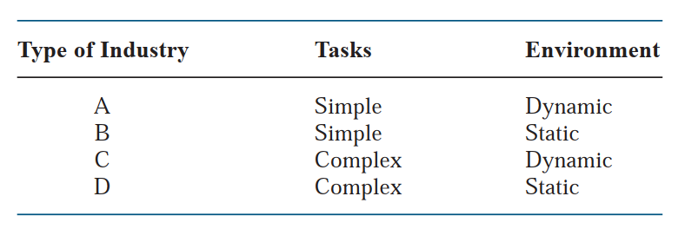
Chapter
Type of Industry
2
www.midocean.ae

Slide 24
Chapter
Type of Industry
2
Almost all type C and most type D industries have project management–related structures.
The key variable appears to be task complexity. Companies that have complex tasks and that also operate in a dynamic environment find project management mandatory.
Such industries would include aerospace, defense, construction, high-technology engineering, computers, and electronic instrumentation.
www.midocean.ae

Slide 25
Chapter
Type of Industry
2
Other than aerospace, defense, and construction, the majority of the companies in the 1960s maintained an informal method for managing projects.
In informal project management, just as the words imply, the projects were handled on an informal basis whereby the authority of the project manager was minimized.
www.midocean.ae

Slide 26
Chapter
Type of Industry
2
Most projects were handled by functional managers and stayed in one or two functional lines, and formal communications were either unnecessary or handled informally because of the good working relationships between line managers.
www.midocean.ae

Slide 27
Chapter
Type of Industry
2
Many organizations today, such as low-technology manufacturing, have line managers who have been working side by side for ten or more years.
In such situations, informal project management may be effective on capital equipment or facility development projects.
www.midocean.ae

Slide 28
Chapter
Type of Industry
2
By 1970 and again during the early 1980s, more companies departed from informal project management and restructured to formalize the project management process, mainly because the size and complexity of their activities had grown to a point where they were unmanageable within the current structure.
www.midocean.ae

Slide 29
Chapter
Type of Industry
2
The following five questions help determine whether formal project management is necessary:
● Are the jobs complex?
● Are there dynamic environmental considerations?
● Are the constraints tight?
● Are there several activities to be integrated?
● Are there several functional boundaries to be crossed?
www.midocean.ae

Slide 30
Chapter
Type of Industry
2
Some companies have successfully implemented both formal and informal project management concurrently, but these companies are few and far between.
Today we realize that the last two questions may be the most important.
www.midocean.ae

Slide 31
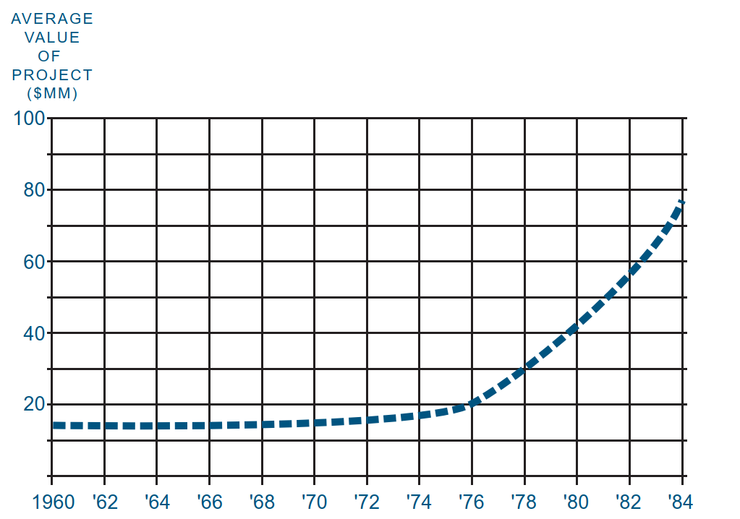
Chapter
Type of Industry
2
www.midocean.ae

Slide 32
Agenda
Functional Employee’s Role
The Project Manager as The Planning Agent
Project Management Growth
General Systems Management
Project Management: 1945–1960
Project Management: 1960–1985
Type of Industry
The Six Imperatives of Project Management
Project Internal and External Obstacles
www.midocean.ae

Slide 33
Chapter
The Six Imperatives الضروراتof Project Management
2
● The time span between project initiation and completion appears to be increasing.
● The capital committed to the project prior to the use of the end item appears to be increasing.
● As technology increases, the commitment of time and money appears to become inflexible.
www.midocean.ae

Slide 34
Chapter
The Six Imperatives الضروراتof Project Management
2
● Technology requires more and more specialized manpower.
● The inevitable ما لا مفر منهcounterpart of نظيرspecialization is organization.
● The above five “imperatives” identify the necessity for more effective planning, scheduling, and control.
www.midocean.ae

Slide 35
Agenda
Functional Employee’s Role
The Project Manager as The Planning Agent
Project Management Growth
General Systems Management
Project Management: 1945–1960
Project Management: 1960–1985
Type of Industry
The Six Imperatives of Project Management
Project Internal and External Obstacles
www.midocean.ae

Slide 36
Chapter
Project internal and external obstacles
2
Project management can overcome such internal and external obstacles as:
● Unstable economy
● Shortages
● Soaring costs ارتفاع التكاليف
● Increased complexity
www.midocean.ae

Slide 37
Chapter
Project internal and external obstacles
2
Project management can overcome such internal and external obstacles as:
● Heightened زيادهcompetition
● Technological changes
● Societal concerns الهموم المجتمعية
● Quality of work
www.midocean.ae

Slide 38

www.midocean.ae

Slide 39



Thank You

