Slide 1

Supervised Learning, Simple Linear Regression, SVM
Dr. Mohamed Mostafa
AI 511
Foundations of Artificial Intelligence
Lecture 10

Slide 2


01
  Outline
Machine Learning Regression
  Simple Regression Model
  Multiple Linear Regression
Support Vector Machine
Underfitting and Overfitting

Slide 3
Resources for this lecture
  Book "Business Statistics", 7th edition, David M. Levine, et al.
  .. AND ..
Andrew W. Moore, School of Computer
Science, Carnegie Mellon University,

Slide 4
Machine Learning Regression
Regression is a supervised machine learning technique which is used to predict continuous values.
The ultimate goal of the regression algorithm is to plot a best-fit line or a curve between the data.
Based on the number of input features and output labels, regression is classified as linear (one input and one output), multiple (many inputs and one output) and multivariate (many outputs).

Slide 5
Machine Learning Regression
Ex. The primary objective while using linear regression is to locate the best-fit line, which implies that the error between the predicted and actual values should be kept to a minimum. There will be the least error in the best-fit line.
The tuning of coefficient and intercept is achieved through gradient descent or a cost function — least squares method.

Slide 6
Regression Analysis
Regression analysis is used to:
  Predict the value of a dependent variable based on the value of at least one independent variable
  Explain the impact of changes in an independent variable on the dependent variable
Dependent variable: the variable we wish to predict or explain
Independent variable: the variable used to predict or explain the dependent variable

Slide 7
Simple Regression Model
Population
Y intercept (Constant)
Population Slope
Coefficient
Random Error term
Independent Variable (IV)
Dependent Variable (DV)
Linear component
Random Error
component

Slide 8
Simple Regression Model
Y
Observed Value of Y for X_{i}
Predicted Value of Y for X_{i}
Intercept = β₀
X_{i}
X

Slide 9
Simple Regression Model
Y
Observed Value of Y for X_{i}
Slope = β₁
Predicted Value of Y for X_{i}
Intercept = β₀
X_{i}
X

Slide 10
Simple Regression Model
Y
Observed Value of Y for X_{i}
ε_{i}
Slope = β₁
Predicted Value of Y for X_{i}
Random Error for this X_{i}
(Actual - predict )
Intercept = β₀
X_{i}
X

Slide 11
Simple Regression Model (Prediction Line)
The simple linear regression equation provides an estimate of the population regression line
Estimated (or predicted) Y value for observation i
Estimate of the regression
intercept
Estimate of the regression slope
Value of X for observation i

Slide 12
Simple Regression Model (Prediction Line)
b₀ is the estimated mean value of Y when the value of X is zero.
For example; when there is no sales the incentives will be 2K EGP.
b₁ is the estimated change in the mean value of Y as a result of a one-unit increase in X

Slide 13
The Least Squares Method
Incentives
Sales

Slide 14
The Least Squares Method
Incentives
Y_{i}
Error ε_{i}
Min (Sum(Y- )²)
Sales

Slide 15
Simple Linear Regression Example
Suppose we have a dataset containing information about the number of hours studied by students and their corresponding exam scores. Here's a hypothetical dataset:
Hours Studied | Exam Score
2 | 65
3 | 70
4 | 75
5 | 80
6 | 85

Slide 16
Simple Linear Regression Example
Scatter Plot
Hours Studied | Exam Score
2 | 65
3 | 70
4 | 75
5 | 80
6 | 85

Slide 17
Simple Linear Regression Example
we'll fit a line to the data that best represents the relationship between the number of hours studied and exam scores. The equation of a simple linear regression model is:

Slide 18
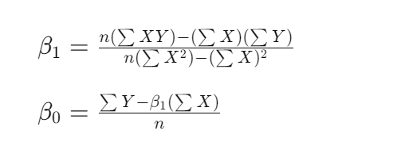
Simple Linear Regression Example
Let’s try to estimate the regression coefficients B₀​ and B₁
Where:
n is the number of data points.
∑X and ∑Y represent the sum of the hours studied and exam scores, respectively.
∑XY represents the sum of the products of hours studied and exam scores.
2∑X² represents the sum of the squared hours studied.

Slide 19
Simple Linear Regression Example
Let’s try to estimate the regression coefficients B₀​ and B₁
Where:
n is the number of data points.
∑X and ∑Y represent the sum of the hours studied and exam scores, respectively.
∑XY represents the sum of the products of hours studied and exam scores.
2∑X² represents the sum of the squared hours studied.

Slide 20
Simple Linear Regression Example
Let's calculate these coefficients using our dataset:
n=5
∑X=2+3+4+5+6=20
∑Y=65+70+75+80+85=375
∑XY=(2∗65)+(3∗70)+(4∗75)+(5∗80)+(6∗85)=2005
∑X²=(22)+(32)+(42)+(52)+(62)=90

Slide 21
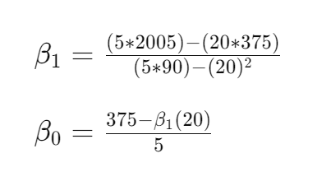
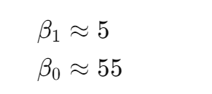
Simple Linear Regression Example
Let’s calculate the coefficients

Slide 22
Simple Linear Regression Example
Then the estimated regression equation is:
Exam Exam Score=55+5×Hours Studied
we use the previous equation to predict exam scores for new values of hours studied. For example, if a student studies for 7 hours:
Exam Score=55+5×7=90

Slide 23
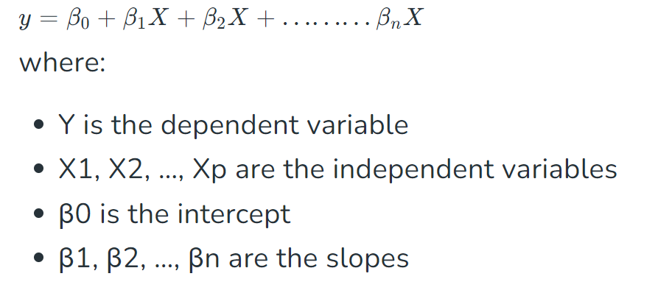
Multiple Linear Regression
This involves more than one independent variable and one dependent variable.

Slide 24
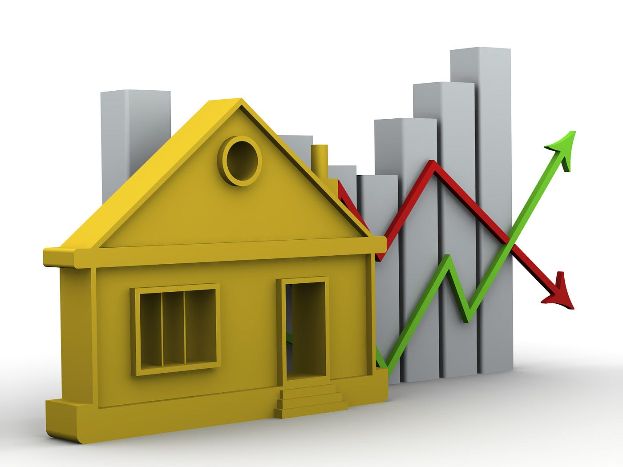
Practice
Predicting House Prices Based on Square Footage
Square Footage (sqft) | Selling Price ($)
1500 | 200,000
1800 | 220,000
2000 | 250,000
2200 | 270,000
2500 | 300,000
2700 | 320,000
3000 | 350,000
3200 | 370,000
3500 | 400,000
3800 | 420,000
  Suppose you're a real estate agent trying to help clients determine the selling price of their homes. One of the factors that significantly influences the price of a house is its square footage. You decide to use linear regression to build a model that predicts house prices based on square footage.
Notes:
Data Collection: First, you collect data on recent home sales in the area, including information about each house's square footage and selling price. You gather data from various sources such as real estate listings, public records, or your agency's database.
Data Preparation: Once you have the data, you organize it into a dataset with two columns: square footage (input) and selling price (output). You may need to clean the data, handle missing values, and remove outliers to ensure the quality of the dataset.
Data Visualization: Before building the model, you visualize the relationship between square footage and selling price using a scatter plot. This helps you understand if there's a linear relationship between the two variables and identify any patterns or trends.
Model Building: Using the dataset, you build a linear regression model to predict house prices based on square footage. You split the data into training and testing sets, fit the model to the training data, and evaluate its performance using metrics like mean squared error or R-squared.
Model Evaluation: After training the model, you evaluate its performance on the testing data to see how well it predicts house prices. You may compare the predicted prices to the actual selling prices to assess the model's accuracy and identify any areas for improvement.
Prediction: Finally, you use the trained model to make predictions on new data. When clients ask for price estimates for their homes, you input the square footage into the model, and it provides a predicted selling price based on the linear relationship between square footage and house prices.

Slide 25
Support Vector Machine Algorithm

Slide 26
Support Vector Machine (SVM)
Support Vector Machine (SVM) is a powerful machine learning algorithm used for linear or nonlinear classification, regression, and even outlier detection tasks.
SVMs can be used for a variety of tasks, such as text classification, image classification, spam detection, handwriting identification, gene expression analysis, face detection, and anomaly detection.
SVMs are adaptable and efficient in a variety of applications because they can manage high-dimensional data and nonlinear relationships.
SVM algorithms are very effective as we try to find the maximum separating hyperplane between the different classes available in the target feature.

Slide 27
Linear Classifiers
How would you classify this data?
denotes +1
denotes -1

Slide 28
Linear Classifiers
denotes +1
denotes -1

Slide 29
Linear Classifiers
denotes +1
denotes -1

Slide 30
Linear Classifiers
denotes +1
denotes -1

Slide 31
Linear Classifiers
denotes +1
denotes -1
Any of these would be fine..
..but which is best?

Slide 32
Classifier Margin
denotes +1
denotes -1
Define the margin of a linear classifier as the width that the boundary could be increased by before hitting a datapoint.

Slide 33
Maximum Margin
Marginal Distance
d+
d-
denotes +1
denotes -1
The maximum margin linear classifier is the linear classifier with the, um, maximum margin.
This is the simplest kind of SVM (Called an Linear SVM)

Slide 34
Maximum Margin
denotes +1
denotes -1
The maximum margin linear classifier is the linear classifier with the, um, maximum margin.
This is the simplest kind of SVM (Called an Linear SVM)
Support Vectors are those datapoints that the margin pushes up against

Slide 35
Specifying a line and margin
Plus-Plane
“Predict Class = +1” zone
Classifier Boundary
Minus-Plane
“Predict Class = -1” zone
How do we represent this mathematically?
…in m input dimensions?

Slide 36
Specifying a line and margin
Plus-Plane
“Predict Class = +1” zone
Classifier Boundary
Minus-Plane
“Predict Class = -1” zone
wx+b=1
Plus-plane = { x : w . x + b = +1 }
Minus-plane = { x : w . x + b = -1 }
wx+b=0
wx+b=-1
Classify as.. | +1 | if | w . x + b >= 1
 | -1 | if | w . x + b <= -1

Slide 37
Specifying a line and margin
M = Margin Width
“Predict Class = +1” zone
How do we compute M in terms of w and b?
“Predict Class = -1” zone
wx+b=1
wx+b=0
wx+b=-1
Plus-plane = { x : w . x + b = +1 }
Minus-plane = { x : w . x + b = -1 }
Claim: The vector w is perpendicular to the Plus Plane. Why?
Notes:
In SVMs, the decision boundary that separates different classes is determined by a hyperplane. For a binary classification problem, this hyperplane is referred to as the decision boundary or the Plus Plane. The vector �w represents the normal vector to this decision boundary.
Since the decision boundary separates the classes, it should be orthogonal (perpendicular) to the vectors that connect any point in one class to any point in the other class. This ensures that the decision boundary maximizes the margin between the classes.
Mathematically, the dot product of the vector �w with any vector lying in the Plus Plane should be zero, indicating orthogonality. This property ensures that the decision boundary effectively separates the classes.
Therefore, the claim that the vector �w is perpendicular to the Plus Plane is valid based on the geometric interpretation and mathematical principles of SVM classification.

Slide 38
Specifying a line and margin
M = Margin Width
“Predict Class = +1” zone
How do we compute M in terms of w and b?
“Predict Class = -1” zone
wx+b=1
wx+b=0
Plus-plane = { x : w . x + b = +1 }
Minus-plane = { x : w . x + b = -1 }
Claim: The vector w is perpendicular to the Plus Plane. Why?
wx+b=-1
Let u and v be two vectors on the Plus Plane. What is w . ( u – v ) ?
And so of course the vector w is also perpendicular to the Minus Plane

Slide 39
Specifying a line and margin
x⁺
M = Margin Width
“Predict Class = +1” zone
x⁻
How do we compute M in terms of w and b?
“Predict Class = -1” zone
wx+b=1
wx+b=0
wx+b=-1
Plus-plane = { x : w . x + b = +1 }
Minus-plane = { x : w . x + b = -1 }
The vector w is perpendicular to the Plus Plane
Let x⁻ be any point on the minus plane
Let x⁺ be the closest plus-plane-point to x⁻.

Slide 40
Specifying a line and margin
“Predict Class = +1” zone
x⁺
M = Margin Width
x⁻
How do we compute M in terms of w and b?
“Predict Class = -1” zone
wx+b=1
wx+b=0
wx+b=-1
Plus-plane = { x : w . x + b = +1 }
Minus-plane = { x : w . x + b = -1 }
The vector w is perpendicular to the Plus Plane
Let x⁻ be any point on the minus plane
Let x⁺ be the closest plus-plane-point to x⁻.
Claim: x⁺ = x⁻ + λ w for some value of λ. Why?

Slide 41
Specifying a line and margin
“Predict Class = +1” zone
x⁺
M = Margin Width
The line from x⁻ to x⁺ is perpendicular to the planes.
So to get from x⁻ to x⁺ travel some distance in direction w.
x⁻
“Predict Class = -1” zone
wx+b=1
wx+b=0
wx+b=-1
Plus-plane = { x : w . x + b = +1 }
Minus-plane = { x : w . x + b = -1 }
The vector w is perpendicular to the Plus Plane
Let x⁻ be any point on the minus plane
Let x⁺ be the closest plus-plane-point to x⁻.
Claim: x⁺ = x⁻ + λ w for some value of λ. Why?

Slide 42
Specifying a line and margin
“Predict Class = +1” zone
x⁺
M = Margin Width
x⁻
How do we compute M in terms of w and b?
“Predict Class = -1” zone
wx+b=1
wx+b=0
What we know:
w . x⁺ + b = +1
w . x⁻ + b = -1
x⁺ = x⁻ + λ w
|x⁺ - x⁻ | = M
It’s now easy to get M in terms of w and b
wx+b=-1

Slide 43
Specifying a line and margin
w . (x ⁻ + λ w) + b = 1
=>
w . x ⁻ + b + λ w .w = 1
=>
-1 + λ w .w = 1
=>
What we know:
w . x⁺ + b = +1
w . x⁻ + b = -1
x⁺ = x⁻ + λ w
|x⁺ - x⁻ | = M
It’s now easy to get M in terms of w and b

Slide 44
Specifying a line and margin
x⁺
M = Margin Width =
“Predict Class = +1” zone
x⁻
“Predict Class = -1” zone
M = |x⁺ - x⁻ | =| λ w |=
wx+b=1
wx+b=0
wx+b=-1
What we know:
w . x⁺ + b = +1
w . x⁻ + b = -1
x⁺ = x⁻ + λ w
|x⁺ - x⁻ | = M

Slide 45
Specifying a line and margin
Given a guess of w and b we can
Compute whether all data points in the correct half-planes
Compute the width of the margin
So now we just need to write a program to search the space of w’s and b’s to find the widest margin that matches all the datapoints.

Slide 46
Margin Classifier
x⁺
x⁺
x⁺
Hard Margin
x⁻
x⁻
x⁻
wx+b=1
wx+b=0
wx+b=-1
x⁺
x⁺
x⁺
x⁺
Soft Margin
x⁻
x⁺
x⁻
x⁻
wx+b=1

Slide 47
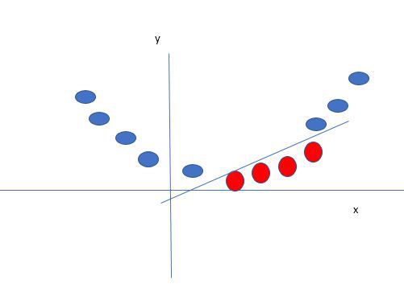
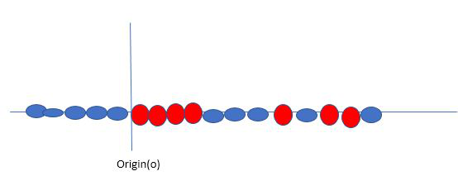
Support Vector Machine Kernels
Kernel: Kernel is the mathematical function, which is used in SVM to transfer (map) the original input data points into high-dimensional feature spaces, so, that the hyperplane can be easily found out even if the data points are not linearly separable in the original input space. Some of the common kernel functions are linear, polynomial, radial basis function(RBF), and sigmoid.

Slide 48
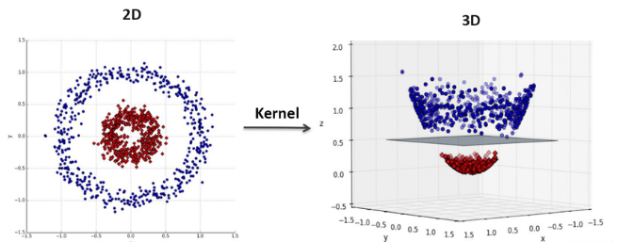
Polynomial kernel SVM Example
Image Source: medium

Slide 49
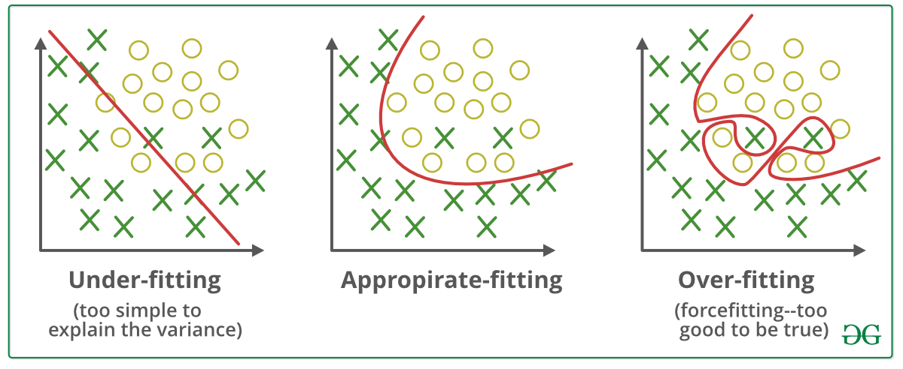
Underfitting and Overfitting
Bias and variance are two fundamental concepts in machine learning that help us understand the performance of models and the underlying factors contributing to their errors.

Slide 50
Underfitting and Overfitting
Bias:
Bias refers to the error introduced by the simplifying assumptions made by a model when trying to capture the underlying relationships between features and the target variable.
A high bias model tends to oversimplify the data and may not capture the true patterns, leading to underfitting.

Slide 51
Underfitting and Overfitting
Variance:
Variance refers to the amount by which the model's predictions vary for different training datasets.
A high variance model is overly sensitive to the training data and captures random noise instead of true patterns, leading to overfitting.
Models with high variance tend to perform well on the training data but poorly on unseen data because they memorize the training examples instead of learning generalizable patterns.

Slide 52
Additional Resources
"Hands-On Machine Learning with Scikit-Learn, Keras, and TensorFlow“ Book by Aurélien Géron
Research paper “Support-Vector Networks" by Vladimir Vapnik
  https://link.springer.com/article/10.1007/BF00994018

Slide 53


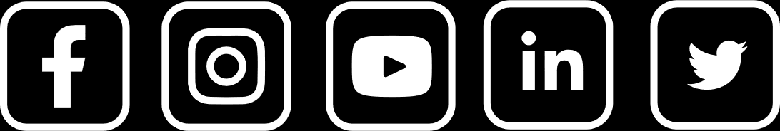
Thank You

