Slide 1

The Internet:
Digital and Social Media
And AI Elevation
Prepared by Dr. Perihan Salah
MKT728
10

Slide 2
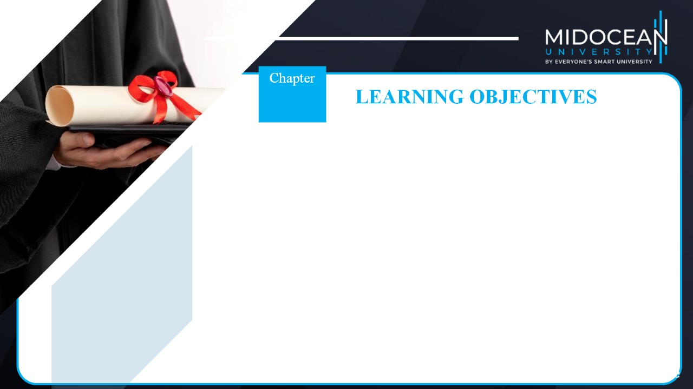
10
To understand the role of the Internet and digital and social media in an IMC program
To understand the use of Web 1.0 and Web 2.0 media platforms in the IMC process
To understand how to evaluate the effectiveness of communications through the Internet, and digital and social media
To know the advantages and disadvantages of the Internet and digital and social media
To examine the social and ethical issues associated with the Internet and digital and social media

Slide 3


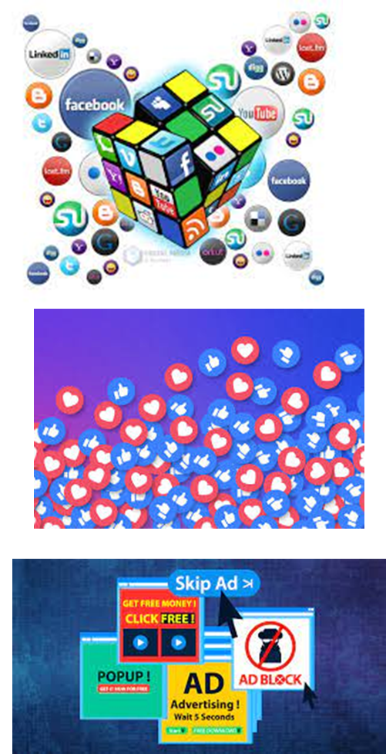


The Growth of the Internet
Why the Rapid Adoption of the Internet? (The reasons)
  Consumers’ increased desire for easily obtainable information(24/7 on mobile)
  The speed and convenience of obtaining information (quick & anytime)
  Ability to control the flow of information being received. i.e. The ability to control what and how much is received (like, dislike, follow, unfollow, block, mute)
  Ability to conduct e-commerce (Affiliate mktg)
    E-commerce: Direct selling of goods and services on the internet
  Ability to target customers effectively
  The increased attention for accountability on the part of businesses
  (can measure the revenues)

Slide 4
Chapter
Web Objectives
Create awareness
Generate interest
Disseminate information
Create an image
Create a strong brand
Stimulate trial
Create buzz
Gain consideration

Slide 5
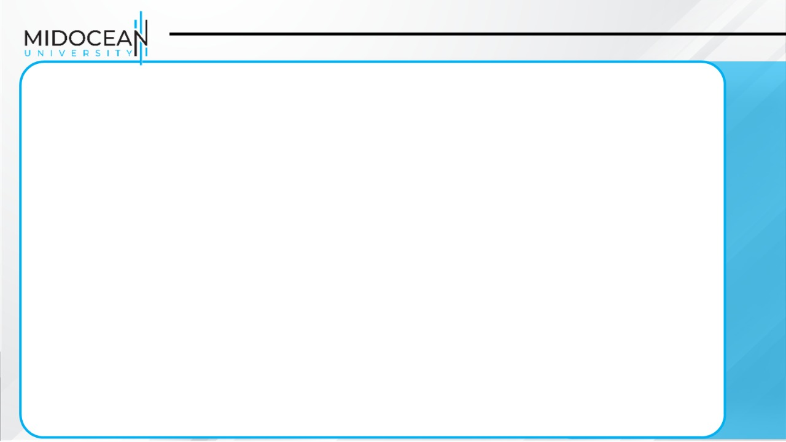
Web Objectives
How the Internet is used to achieve IMC objectives.
  Creating awareness for companies with limited budgets, the Web offers awareness opportunities beyond what can be achieved through traditional media.
  Generating interest - News, downloads, videos, promotions, and so on
  Disseminating information - Done more quickly than through other media
  Creating an image - Websites reflect the image the company wants to display.
  Creating a strong brand - Can be a useful branding tool
  Stimulating trial - Offering samples, promotions, and/or sweepstakes
  Creating buzz - Social networking sites are attractive to marketers.
  Gaining consideration - Blogs and discussion boards are useful for providing information.

Slide 6
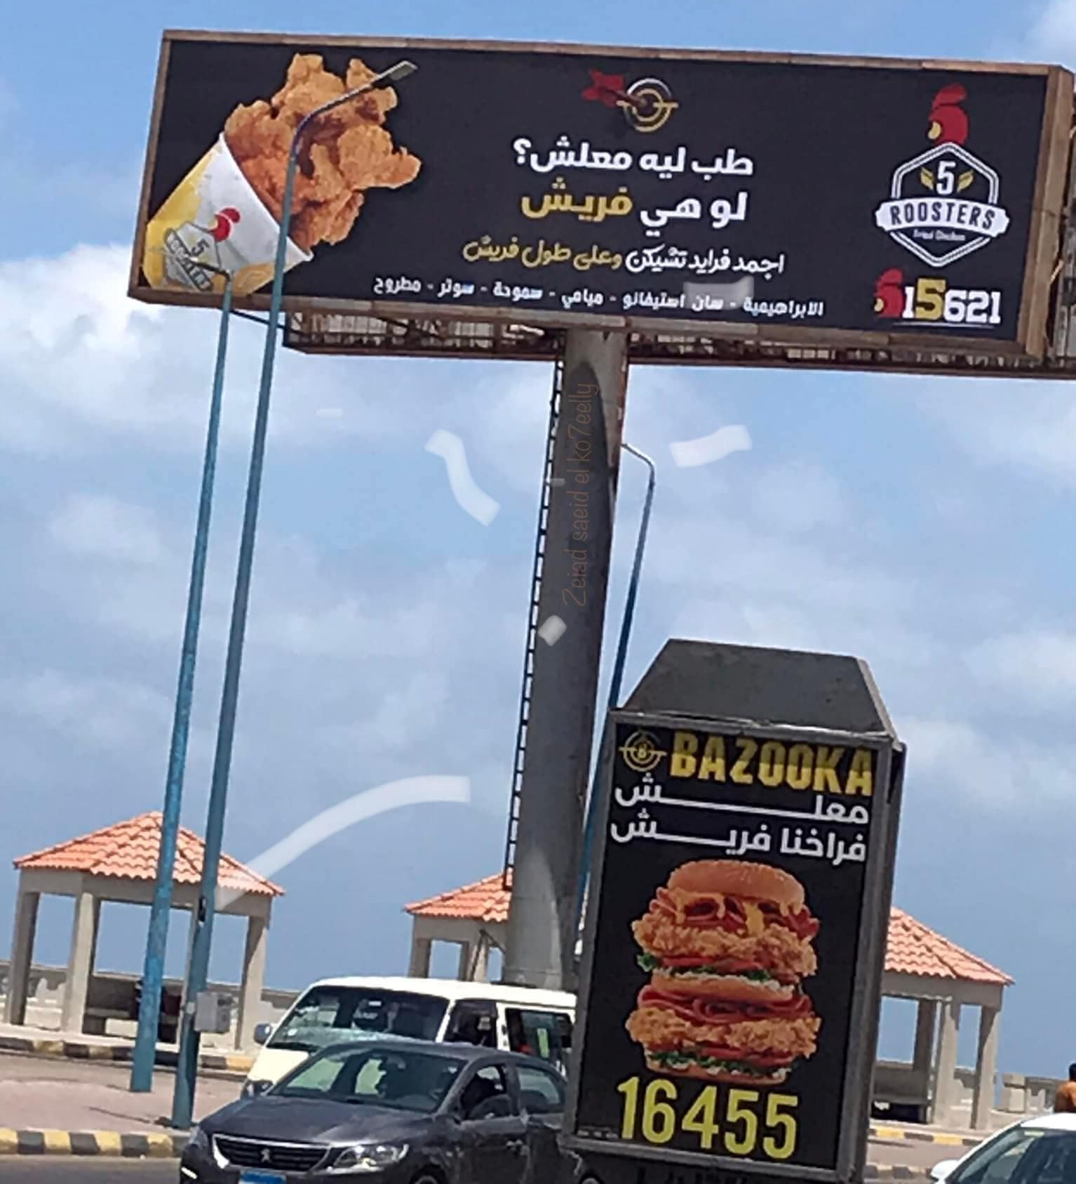

The Growth of the Internet
Create buzz

Slide 7


Slide 8


Slide 9
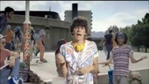

Slide 10


Slide 11
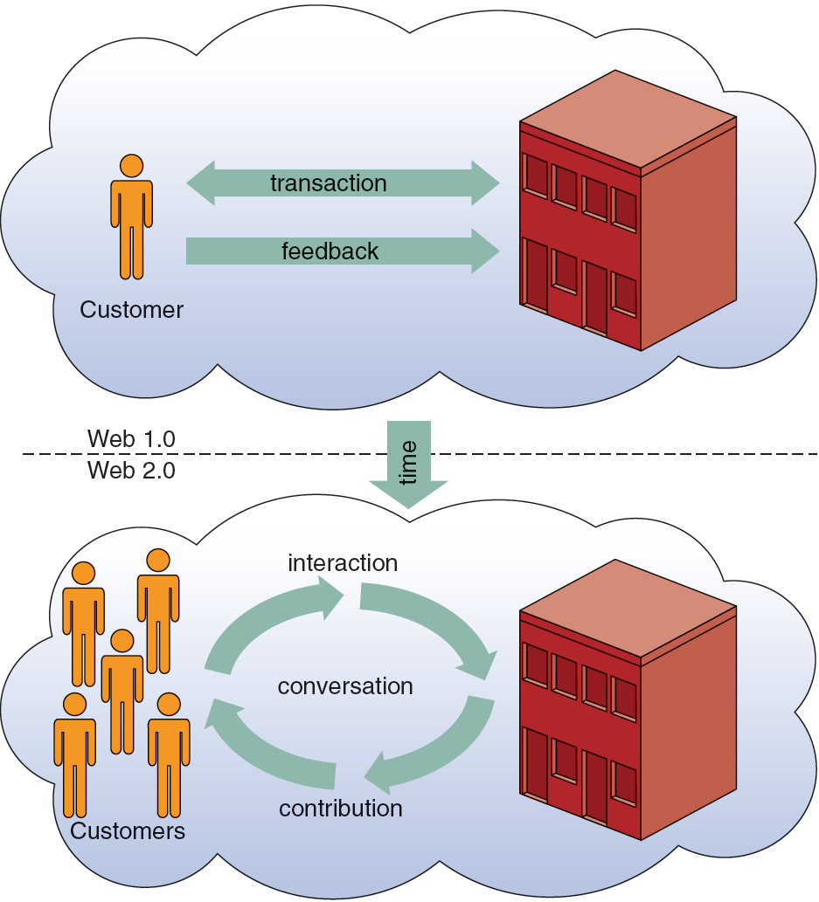
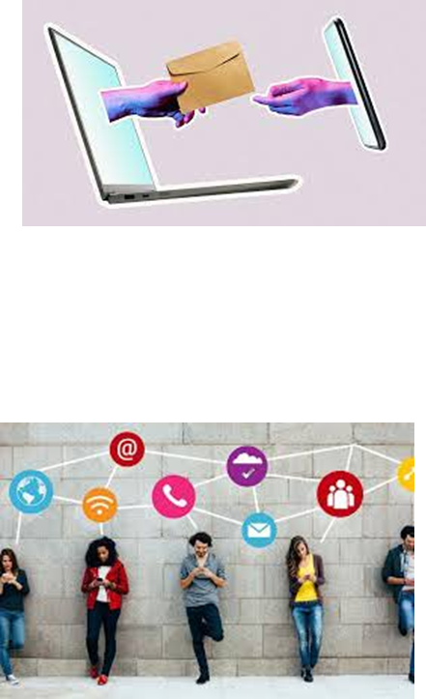
Differences in the Way Organizations Have Interacted with Customers on the Web
Web 1.0 - Consisted mainly of static sites, resulting in a one-way flow of information.
Web 2.0 - Decentralized content and interactivity, with information provided by users as contributors

Slide 12
The Internet and Integrated Marketing Communications
Advertising on the Internet—Web 1.0
  Banner Ads
    Create awareness or recognition
    Used to seek entry into contests and sweepstakes
    Fulfill direct-marketing objectives
  Sponsorships
    Regular sponsorship: Company pays to sponsor a section of a site
    Content sponsorship: Sponsor not only provides money in return for name association but also participates in providing the content itself. (page sponsored by..)

Slide 13
The Internet and Integrated Marketing Communications
The most common form of advertising on the web is banner ads. Banner ads may be used for creating awareness or recognition, entering viewers into contests and sweepstakes, or direct-marketing objectives. They can be static, animated, or in flash.
Another common form of advertising is sponsorships. There are two types of sponsorships.
  Regular sponsorships occur when a company pays to sponsor a section of a site.
  Content sponsorship is a type of sponsorship in which the sponsor not only provides money in return for name association but also participates in providing the content itself.

Slide 14

The Internet and Integrated Marketing Communications
Advertising on the Internet—Web 1.0 continued
  Pop-ups
    Ads that appear when certain sites are accessed. They are usually larger than banner ads but smaller than a full screen.
  Pop-unders
    Ads that appear underneath the web page and become visible only when the user leaves the site
  Interstitials
    Ads that appear on screen while waiting for a site’s content to download

Slide 15
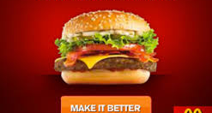
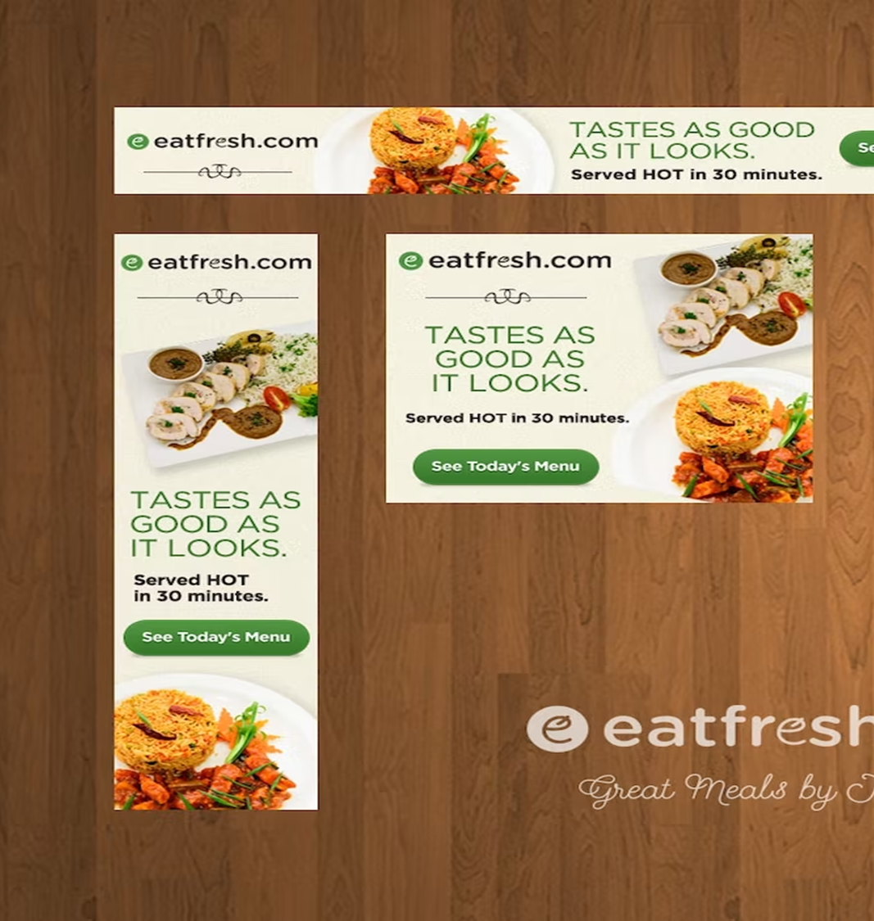
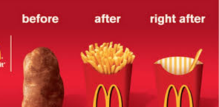

Slide 16



Slide 17

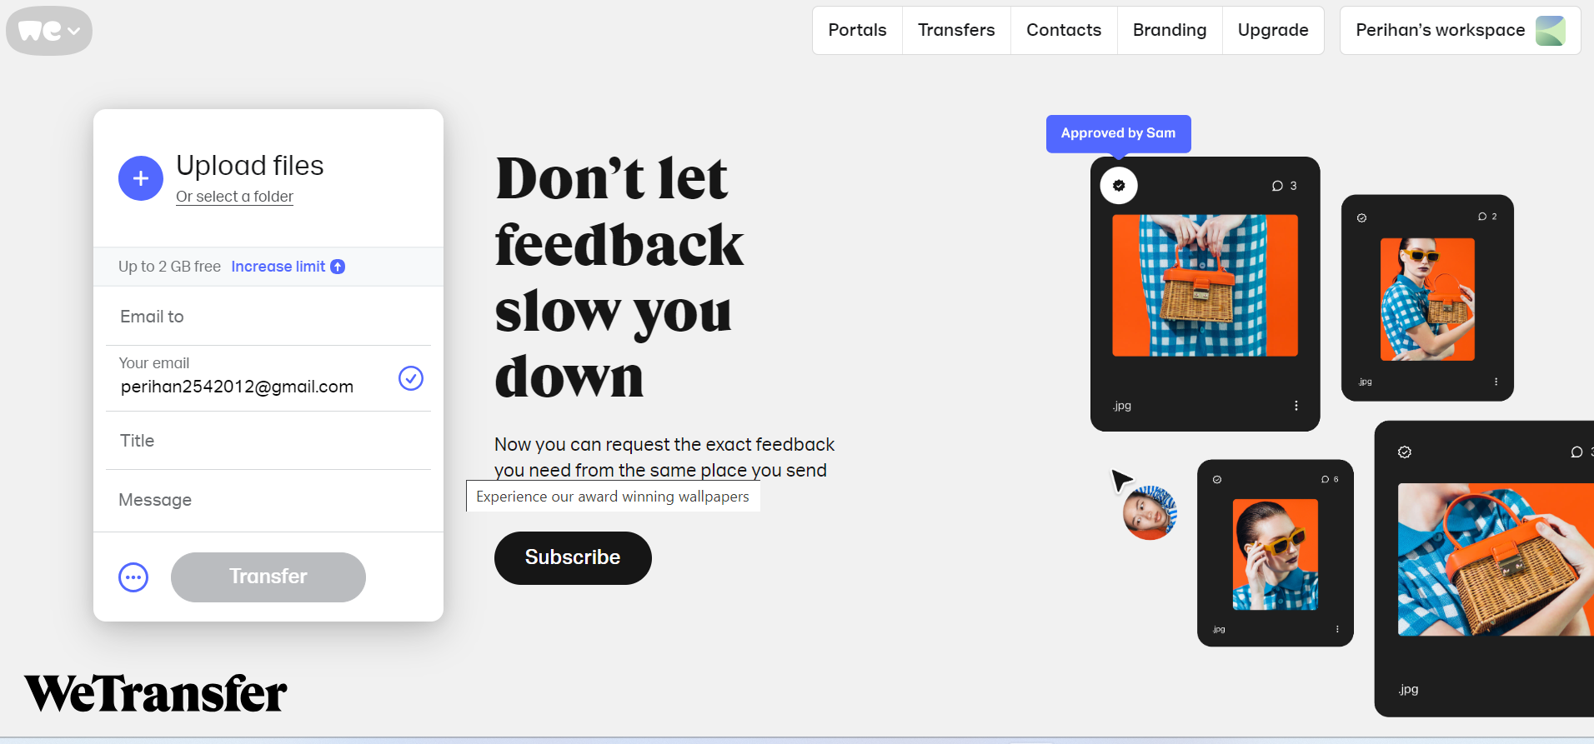
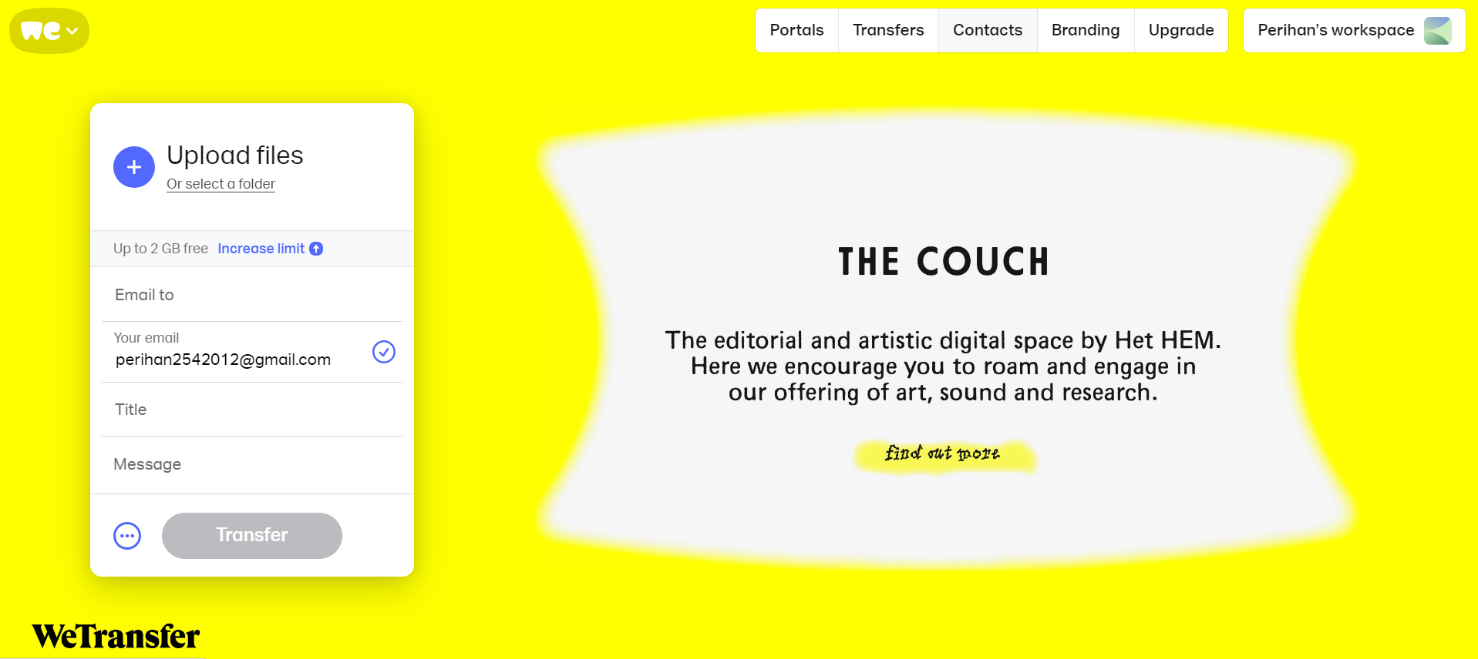
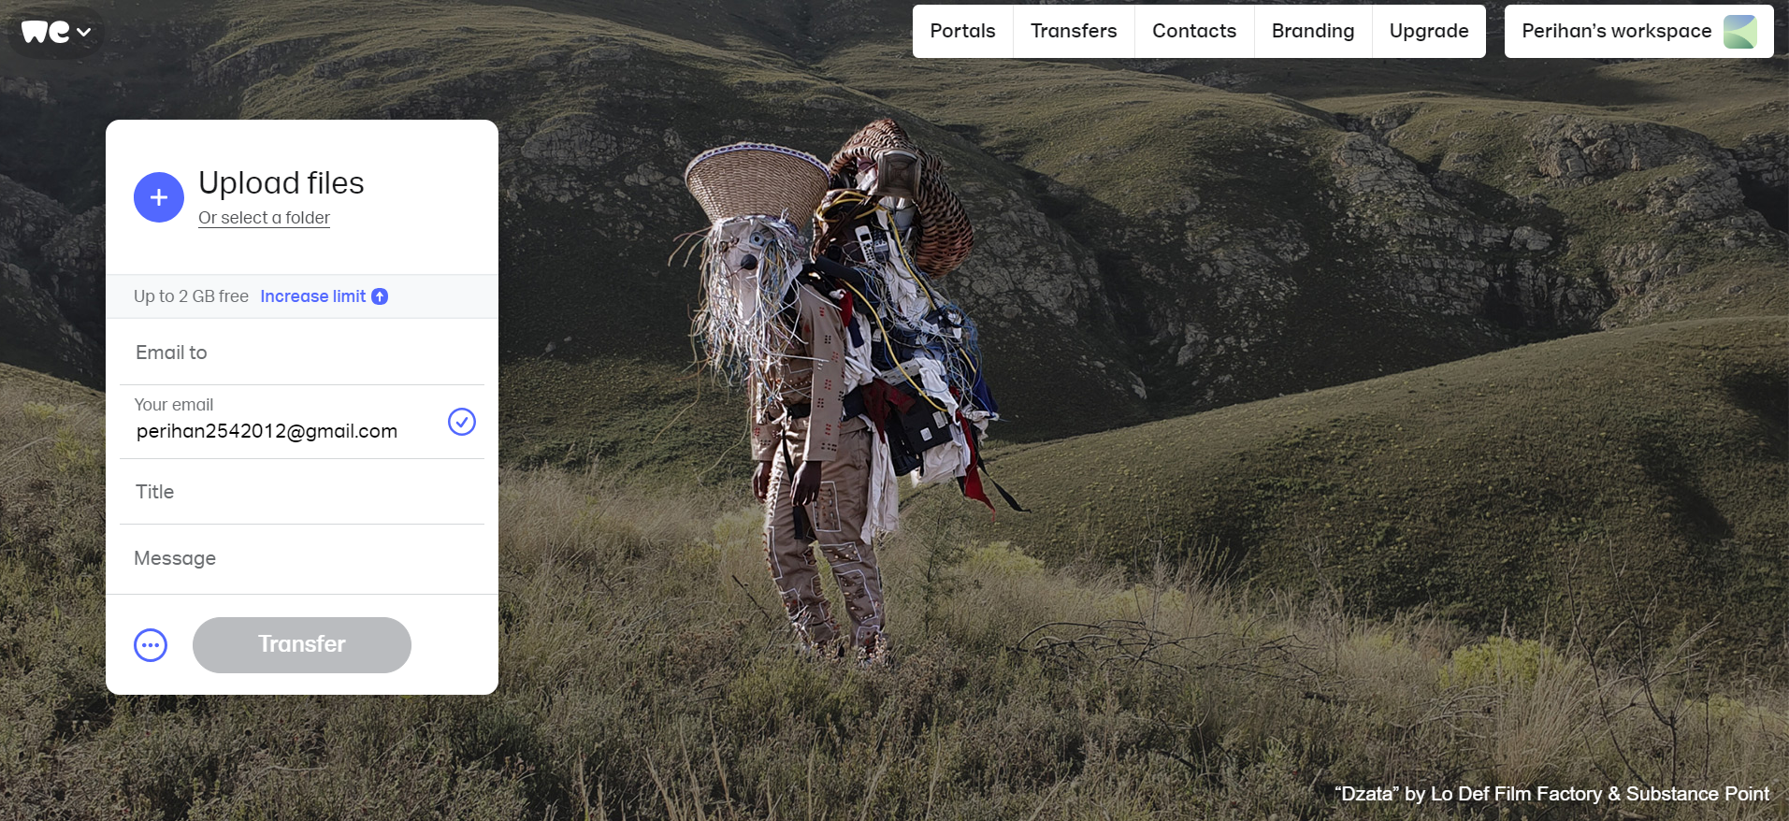
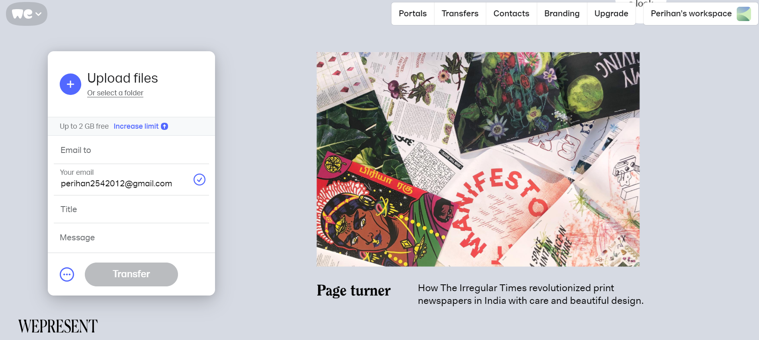
Interstitials

Slide 18
The Internet and Integrated Marketing Communications
Advertising on the Internet—Web 1.0 continued
  Paid Searches
    The higher a site appears on a search page, the more visitors it will receive.
  Organic search results
      Appear due to their relevance to the search terms (using keywords to facilitate searching)
    Pay-per-click
      Placing ads on web pages that display results from search engine queries
    Search engine optimization (SEO)
      Improving the volume of traffic to a site by a search engine through unpaid results (google, firefox, yahoo, explorer)

Slide 19
The Internet and Integrated Marketing Communications
The higher a site appears on a search page the more visitors it will receive. Organic search results are those that appear because of their relevance to the search terms, not advertisements. Advertisers will also attempt to reach consumers through nonorganic or paid search such as pay-per-click advertising by placing their ads on web pages that display results from search engine queries.
In an effort to more specifically target customers who may be interested in their offerings, advertisers employ search engine optimization (SEO) . SEO is the process of improving the volume of traffic driven to one’s site by a search engine through unpaid (organic) results as opposed to paid inclusions.

Slide 20

The Internet and Integrated Marketing Communications
Advertising on the Internet—Web 1.0 continued
Behavioral Targeting
    Based on advertisers’ targeting consumers by tracking their website surfing behaviors, such as which websites they have visited and/or searches they have made.
Retargeting
  Advertisers have increased their use of retargeting. Once a user visits a website and leaves without purchasing the product, a specifically targeted ad will display on participating subsequent websites the user visits.
  Ads follow a website user and are displayed on every participating subsequent websites the user visits
  ***We are all monitored and tracked

Slide 21
The Internet and Integrated Marketing Communications
Advertising on the Internet—Web 1.0 continued
  Contextual Ads
    Ads are determined by the content on the web page
    Native advertising
      Advertiser gains attention by providing valuable content in the context of the user’s experience
      Controversial
      May be deceptive
Native advertising is a web advertising in which the advertiser attempts to gain attention by providing valuable content in the context of the user’s experience; it is similar in concept to an advertorial which is a paid placement attempting to look like an article.

Slide 22

The Internet and Integrated Marketing Communications
Advertising on the Internet—Web 1.0 continued
Rich Media
  Interactive digital media that exhibit dynamic motion
  Online commercials
    Advertisements that appear on the net
    Pre-rolls: Commercials that appear before the content that the user is seeking
  Video on demand
    Video clips of various entertainment activities that can be accessed on demand from the Internet
  Webisodes
    Short featured films created by the advertiser

Slide 23
The Internet and Integrated Marketing Communications
Rich media, are a broad range of interactive digital media that exhibit dynamic motion, taking advantage of enhanced sensory features such as video, audio and animation.
The equivalent of traditional television commercials, online commercials are appearing more often on the net. Online advertising spending continues to rise, and consumer acceptance of these ads is increasing.
Video-on-demand - Video clips of various entertainment activities (which include ads or are sponsored) are available through the Internet.
Webisodes are short featured films created by the advertiser, in which companies create their own content to advertise their products.

Slide 24


Slide 25


Slide 26


Slide 27
Types of New Media
Types of New Media | Primary Purpose | Material | Examples
Forums and Chat Rooms | Discussion on topics, interest group sharing of information | Forums, discussion boards | Hardwarezone.com Forums
E-mail | Sending of electronic mail with file attachments | Web-based and non-web-based e-mail platforms | Hotmail, Gmail, Yahoo! Mail
Social Networking Sites | Peer networking | Fan sites, alumni networks, personal news updates | Facebook, Twitter, LinkedIn
Content Aggregators | Hosting of content for information and entertainment | Informative content, podcasts, videos, channels | YouTube, Hulu
Virtual Reality | 3-D experience, alternate space | Simulated environments, experiences | Second Life

Slide 28
Types of New Media
Types of New Media | Primary Purpose | Material | Examples
Online Gaming | Alternate fantasy, entertainment, gaming | MMORPG (massively multiplayer online role-playing games), multiplayer online games | World of Warcraft, StarCraft II
Blogs | Opinions, information, viewpoints | Helpdesk, viewpoints, opinions | MrBrown.com Xiaxue.com
Portals | Aggregating news, communication tools | News studies, sponsored pages, ads | Asiaone.com, Yahoo!
Social News Sites | Peer-ranked news stories | News stories, popular blog content | Digg.com

Slide 29
The Internet and Integrated Marketing Communications
IMC Using Social and Other Media—Web 2.0
  Allow the creation and exchange of user-generated content
  Educating one another about products, brands, services, people and other topics of interest
  Social networking sites: Platforms for networks or social relations
    Allow sharing interests, activities, backgrounds, or real-life connections
Motivations for Using Social Media (reasons)
    To share ideas, activities, and events
    Community involvement
    To gain information
    Entertainment
    Remuneration

Slide 30
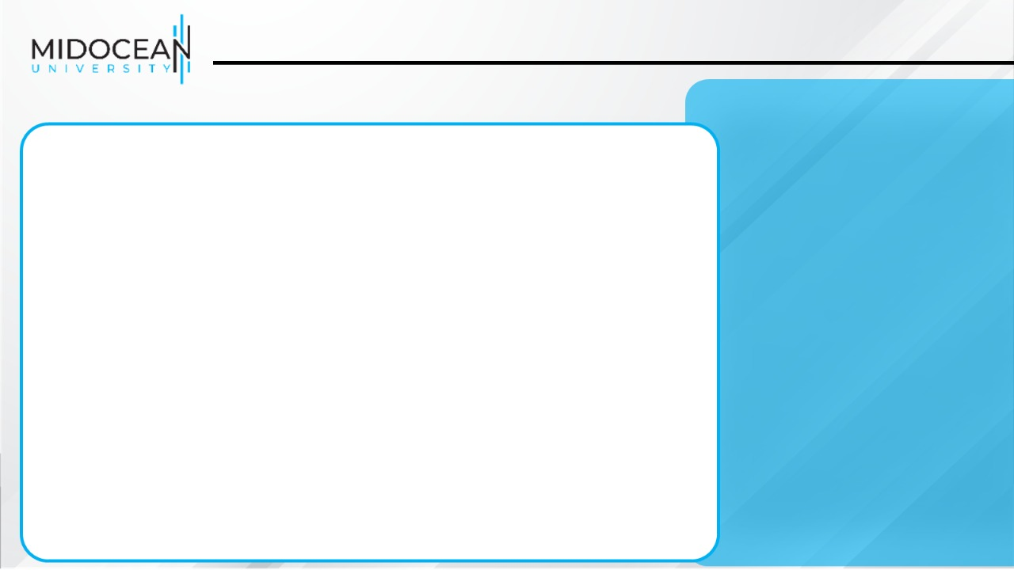
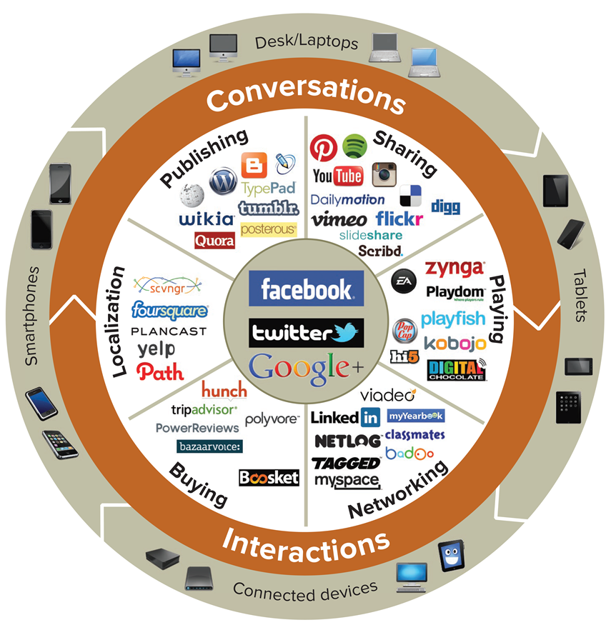
Social Media Landscape
We all love sharing

Slide 31
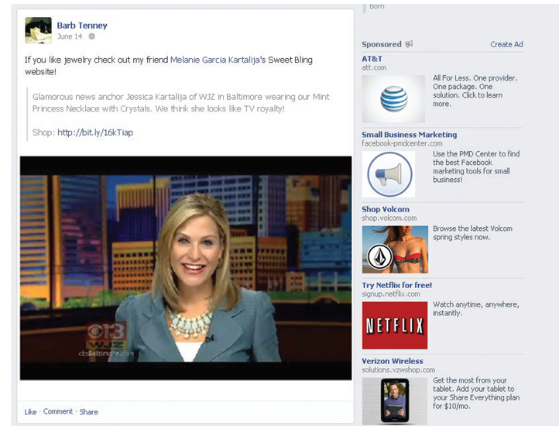
The Internet and Integrated Marketing Communications
IMC Using Social and Other Media—Web 2.0
  Marketers’ Reasons for Using Social Media
    Driving traffic to one’s site
    Communicating with customers
    Gaining brand exposure

Slide 32
The Internet and Integrated Marketing Communications
IMC Using Social and Other Media—Web 2.0
  Facebook
    Largest of all social networks (1.4 billion users)
    Allows advertising that targets subsets of Facebook users
      Based on demographic and geographic data and interests and activities
    Used to:
      Create and push content
      Help manage reputation

Slide 33
The Internet and Integrated Marketing Communications
IMC Using Social and Other Media—Web 2.0
  Twitter
    Enables users to send and receive text-based messages up to 140 characters
    Benefits
      Best channel for direct communication with customers
      Easy and cost-effective way to gain brand exposure
      Good ability to drive traffic directly to a site
    Used to:
      Respond to customer complaints and/or inquiries
      Re-tweet important information
      Monitor the market for opportunities or threats

Slide 34
The Internet and Integrated Marketing Communications
IMC Using Social and Other Media—Web 2.0
  Instagram
    Fastest-growing social network
    Allows users to:
      Post and edit pictures
      Share them on a variety of social networks
    Visual content allows companies to post pictures or video news, events, new product introductions, and other company- or brand-related activities
    Many marketers feel that Instagram is the most engaging of all social networks

Slide 35
The Internet and Integrated Marketing Communications
IMC Using Social and Other Media—Web 2.0
  Snapchat
    Originally developed as an app that had disappearing pictures
    Now, a mix of private messaging and public content, including:
      Brand networks
      Publications
      Live events
    Fast growth of the app among millennials has made Snapchat attractive to advertisers

Slide 36
The Internet and Integrated Marketing Communications
IMC Using Social and Other Media—Web 2.0
  Pinterest
    Pinboard-style photo-sharing site
    Allows users to create and manage theme-based image collections
    Most attractive to females (71% of users)
  LinkedIn
    Social network for business professionals
    Over 400 million members (128 million in US)
    Marketers target a professional audience

Slide 37
The Internet and Integrated Marketing Communications
IMC Using Social and Other Media—Web 2.0
  YouTube
    Hosts content for information and entertainment
    Users can upload and share their own videos and those placed by others
    Used as an advertising medium or search platform by marketers
  Additional Social Media
    Periscope
      New but quickly growing live streaming app
      Gives users 24 hours to watch a live stream of an event
      Encourages engagement by having viewers use “likes”
      Brands using Periscope in a variety of ways

Slide 38
The Internet and Integrated Marketing Communications
IMC Using Social and Other Media—Web 2.0
  Podcasting
    Uses the Internet to distribute audio/video files
  Really Simple Syndication (RSS)
    Specification that uses XML to organize and format web-based content in a standard way
  Blog
    Web-based publication consisting primarily of periodic articles
    Presented in reverse chronological order

Slide 39
The Internet and Integrated Marketing Communications
IMC Using Social and Other Media—Web 2.0
  Other 2.0 Media Forms
    Virtual and augmented reality
    QR codes
      Barcodes used in print ads
    Near field communication (NFC)
      Delivers content through an embedded chip that allows wireless communications just by touching the material
      NFC tag performs same function as a QR code but with much less effort.
      May replace QR codes

Slide 40
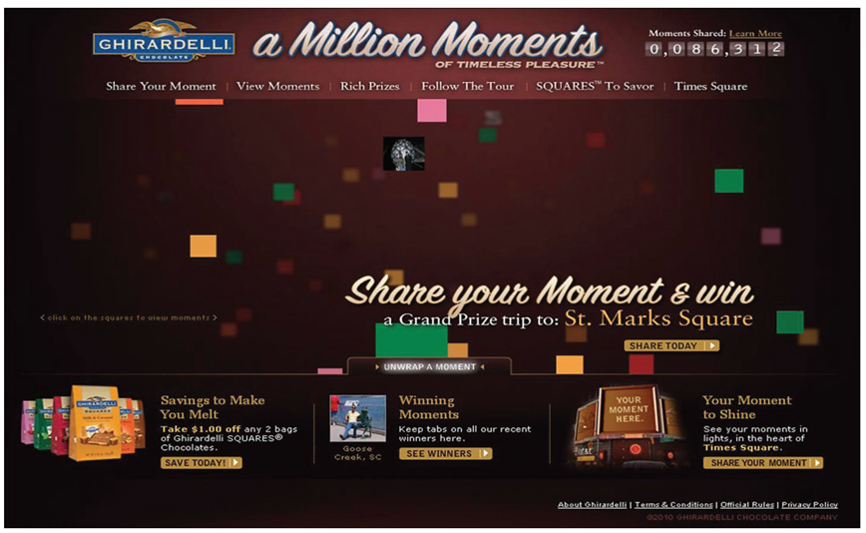
The Internet and Integrated Marketing Communications
Sales Promotion on the Internet
  Websites
  Social media
  Other forms of digital media
Internet is a very effective medium for disseminating sales promotions.
Numerous companies tie in sales promotions to their websites and/or through other forms of digital and social media.

Slide 41
The Internet and Integrated Marketing Communications
Personal Selling on the Internet
  Disadvantage
    Companies are reducing staff to build a strong online presence
  Advantages
    Websites enhance and support the selling effort
    Website visitors become part of a prospect database
    Enables companies to serve and qualify prospects more cost-effectively
    Stimulates trial
    Improves one-on-one relationships between customers and sellers
    Increases opportunity for cross-selling and customer retention

Slide 42
The Internet and Integrated Marketing Communications
Personal Selling on the Internet
  A major disadvantage is the high-cost and poor-reach of personal selling. This allows the companies to reduce new hires and even cut back on their existing sales forces.
  On the positive side, websites have been used quite effectively to enhance and support the selling effort. markets. Visitors to websites can gain volumes of information about a company’s products and services.
  Potential customers can learn about the company’s offerings, and the selling organization can serve and qualify prospects more cost-effectively.
  The web can also be used to stimulate trial. Companies have used the Internet to improve their one-on-one relationships with customers.
  By providing more information in a more timely and efficient manner, a company enables customers to learn more about what it has to offer. This increases the opportunity for cross-selling and customer retention.

Slide 43
The Internet and Integrated Marketing Communications
Public Relations and Direct Marketing on the Internet
  Websites
    Provide information about a company, its philanthropic activities, and annual reports
  Internet based direct-marketing tools
    E-mails and infomercials
  E-commerce
    Used in direct marketing
Many sites devote a portion of their content to public relations activities, including the provision of information about the company, its philanthropic activities, annual reports, and more.
Direct-marketing tools have been used for communications objectives and e-commerce. Many direct-marketing tools like direct mail, infomercials, and the like have been adapted to the Internet. E-commerce—selling directly to the consumer via the Internet—has become an industry all its own.

Slide 44
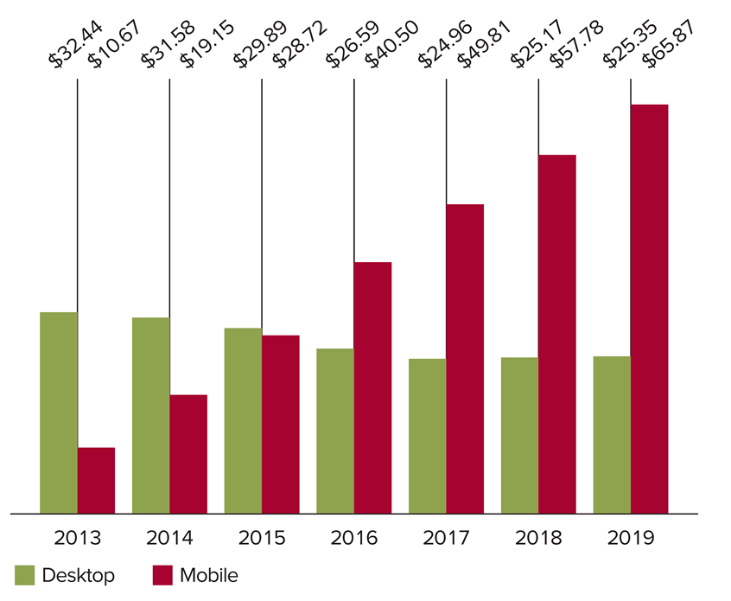
Mobile
Has significant impact on companies’ IMC programs
Rapid growth and adoption by consumers is making marketers realize their potential in a marketing context
Note: Desktop includes spending primarily on desktop-based ads. Mobile includes classifieds, display (banners and other, rich media, and video), e-mail, lead generation, messaging-based advertising and search advertising; ad spending on tablets is included.
Digital Ad Spending, by Device, 2013–2019 (in billions)

Slide 45
Mobile
Disadvantages of Mobile
  Creative challenges
    Small screens are limiting
  Time
    Viewers are on the move
  Sharing
    99% of mobile device users do not share what they see
  Reach
    Demographics outside millennials hard to reach

Slide 46
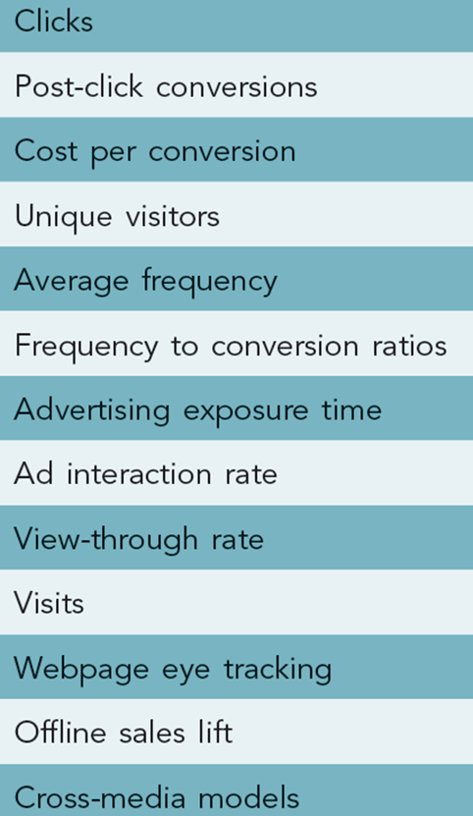
Internet Metrics
Example Internet Metrics
Audience Measures and Measures of Effectiveness
  Internet-specific measures
    Allows measures to be taken in real time
    Includes audience measures specific to the Internet and interactive industry, such as: clicks, post-click conversions, unique visitors, and more.
  Traditional measures
    Recall and retention
    Surveys
    Sales
    Tracking
    ROI

Slide 47
Advantages and Disadvantages of the Internet
and Digital and Social Media
Advantages
  Target marketing
  Message tailoring
  Interactive capabilities
  Information access
  Sales potential
  Creativity
  Exposure
  Speed
  Complement to IMC
  Timeliness
Disadvantages
  Measurement problems
  Clutter
  Potential for deception
  Lack of privacy
  Irritation

Slide 48
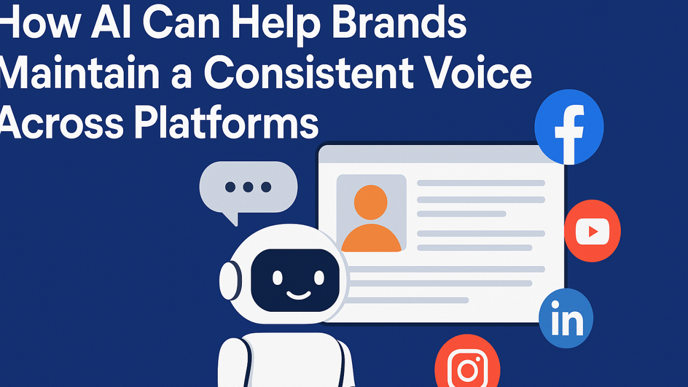
How AI can elevate digital and social media strategies while maintaining a cohesive brand voice across channels.
How AI can elevate digital and social media strategies while maintaining a cohesive brand voice across channels.

Slide 49
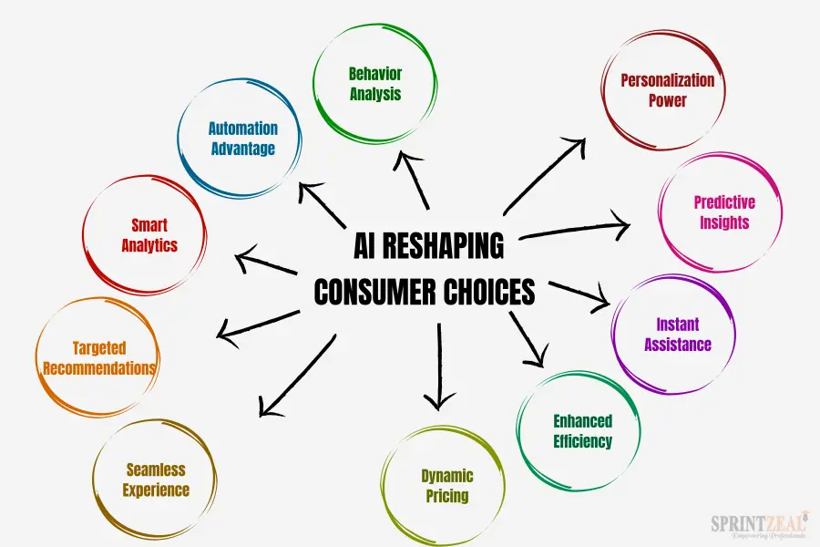

Slide 50
1) AI-driven audience insights for digital and social
How AI can elevate digital and social media strategies while maintaining a cohesive brand voice across channels.
What it is: Leveraging AI to create and combine data from social listening, web analytics, CRM, and campaign data to identify audience segments, intent, and cross-channel behaviors.
Why it matters: Enables more precise targeting, personalization, and channel-specific messaging that still feels consistent with overall brand story.
Practical approaches:
  Topic modeling and sentiment analysis on social conversations to inform content themes.
  Clustering of users by behavior to tailor social content, ads, and landing experiences.
  Real-time trend detection to capitalize on emerging topics and moments.

Slide 51
2) Personalization at scale across digital touchpoints
What it is: AI-enabled personalization across website, email, social ads, and messaging while preserving brand consistency.
Why it matters: Boosts engagement and conversion without diluting brand voice or visual identity.
Practical approaches:
  Natural Language Processing - is a branch of artificial intelligence (AI) that focuses on enabling computers to understand, interpret, and generate human language. It acts as a bridge between the natural, messy way humans communicate and the structured, binary code machines use.
  NLP-driven dynamic copy that adapts tone slightly for segments but stays within brand voice guidelines.
  Visual personalization using brand-safe templates and style rules (colors, typography, imagery) tied to user context.
  Predictive recommendations and retargeting that reflect brand storytelling pillars.

Slide 52
3) AI-assisted content creation for digital and social
What it is: Generative AI tools assist copy, visuals, short-form video scripts, and social media calendars for digital channels.
Why it matters: Increases throughput, enables rapid experimentation, and frees humans to focus on strategic storytelling.
Practical approaches:
  Generate on-brand social captions, ad copy, and blog intros; apply a human review stage with a brand guardrail checklist.
  Brand-safe prompts library and a golden asset library to ensure consistency.
  Use AI to storyboard short-form videos or reels aligned with campaign narratives.

Slide 53
4) Social media monitoring, crisis detection, and reputation management
What it is: Real-time AI monitoring of brand mentions, sentiment, competitive landscape, and potential PR crises across social platforms.
Why it matters: Enables proactive issue management and risk mitigation in the digital space.
Practical approaches:
  Alerts for abrupt sentiment shifts or misleading brand use.
  Automated response playbooks for common inquiries with escalation criteria.
  Post-crisis simulation scenarios to stress-test comms and recovery paths.

Slide 54
5) AI-enhanced media planning and optimization for digital channels
What it is: AI assists in budget allocation, bidding, and creative optimization across paid social, search, display, and video.
Why it matters: Improves ROI, scales efficiently, and ensures messaging remains on-brand across paid channels.
Practical approaches:
  Automated A/B/n testing of ad variants with brand guardrails to ensure tone/visuals stay within guidelines.
  Creative optimization that respects brand identity (logo usage, color palette, typography) while maximizing performance.
  Predictive budgeting and pacing to maximize reach and frequency without overexposing the audience to off-brand content.

Slide 55
6) AI-powered direct response and engagement on digital channels
What it is: AI chat, bots, and interactive experiences on websites, social DMs, and messaging apps that drive engagement and conversion.
Why it matters: Scales personalized interactions while maintaining a consistent brand experience.
Practical approaches:
  Brand-aligned chatbot personas and response styles; predefined scripts and escalation paths to human agents.
  AI-driven chat prompts that reflect brand voice, with a governance layer to avoid off-brand language.
  Interactive content (quizzes, polls, calculators) designed to tell the brand story and drive social sharing.

Slide 56
7) Social listening-informed PR and influencer collaboration
What it is: Using AI to identify authentic influencers and monitor influencer performance in the context of brand narratives.
Why it matters: Strengthens credible storytelling and ensures influencer content aligns with brand values.
Practical approaches:
  AI-based influencer scoring with alignment to messaging pillars and audience quality.
  Monitoring content performance and sentiment around influencer collaborations.
  Safe playbooks for disclosures and attribution to preserve trust and compliance.

Slide 57
8) Measurement, attribution, and ROAS for digital IMC
What it is: Advanced analytics to attribute impact of digital and social activities within the broader IMC mix.
Why it matters: Demonstrates AI-enabled improvements in reach, engagement, and eventual conversions while considering brand lift.
Practical approaches:
  Multi-touch attribution that includes brand lift and long-term brand equity signals in digital channels.
  Visual and engagement metrics (recall, recognition) measured via computer vision or crowdsourced studies.
  Incrementality tests to isolate the effect of AI-driven digital initiatives on brand outcomes.

Slide 58
9) Governance, ethics, and brand safety in AI-driven digital IMC
What it is: Policies and controls to ensure responsible use of AI in digital and social campaigns.
Why it matters: Protects brand integrity, consumer trust, and legal/compliance requirements.
Practical approaches:
  Clear disclosure for AI-generated content and automated responses.
  Brand safety checks for generated assets (logos, imagery, copy) against policy.
  Data privacy, accessibility, and copyright considerations baked into workflows.

Slide 59
10) Implementation roadmap for Digital Marketing and Social Media IMC
What it is: A practical plan to embed AI into digital and social IMC activities across short, mid, and long term.
Why it matters: Aligns AI capabilities with campaign calendars, budgets, and brand strategy.
Practical approaches:
  Create a Digital IMC AI Playbook: define the brand voice, content pillars, approved prompts, and review workflows for AI outputs.
  Run a controlled digital campaign pilot: test AI-generated variations for social posts, landing pages, and ads; measure brand alignment and performance.
  Align vendors and tools with IMC goals: prioritize capabilities for tone control, governance, asset provenance, and cross-channel consistency.
  Establish IMC-specific metrics: track reach, engagement quality, brand lift at digital touchpoints, and integrated ROAS (including long-term branding effects).

Slide 60
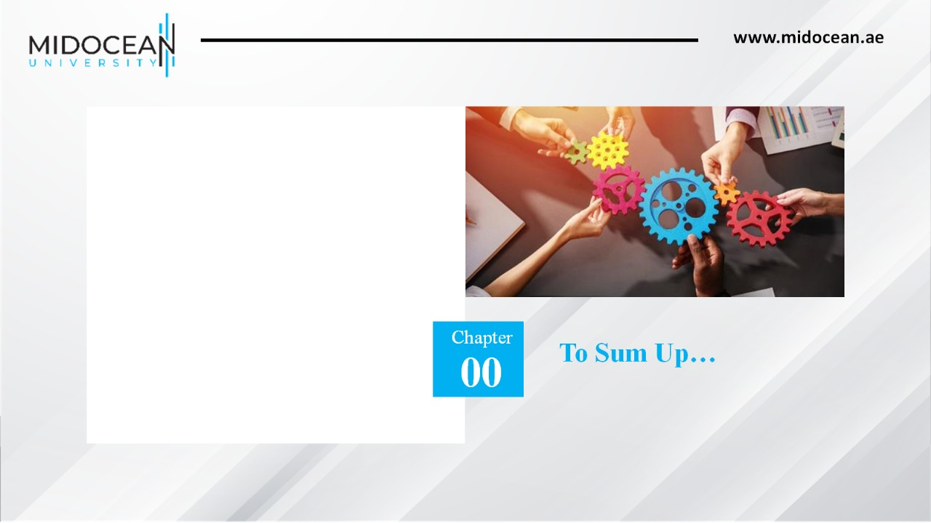
To Sum Up…
Understood the role of the Internet and digital and social media in an IMC program
Understood the use of Web 1.0 and Web 2.0 media platforms in the IMC process
Understood how to evaluate the effectiveness of communications through the Internet, and digital and social media
Knew the advantages and disadvantages of the Internet and digital and social media
Examined the social and ethical issues associated with the Internet and digital and social media
10

Slide 61


