Slide 1


Prepared by Dr. Wesam Ahmed
IT402
Internet of Things
Lecture 9

Slide 2



IoT and 5G Networks
Lecture 9
IT402‎
Internet of Things
Prepared by
Dr. Wesam Ahmed

Slide 3

09
Learning Objectives:
1.1 Describe the Edge or Cloud for data analytics
1.2 Describe the integration of IoT and 5G
1.3 Describe the web of things

Slide 4
09
Data analysis options: Edge, Cloud , OR Combination?
Understand the Importance of Business Intelligence
There are three main options for data analysis: edge, cloud, or a combination of both.
In edge computing, data analysis is performed directly on the edge devices or edge servers near the data source such as sensors, IoT devices, gateways, or local edge servers.
How It Works
Data is collected from sensors or IoT devices.
Instead of being sent to the cloud, the data is processed locally on the device or on a nearby edge server.
Decisions or actions are taken immediately at the device level.
Advantages:
Real-Time Analytics
Continuous and immediate processing enables real-time monitoring, anomaly detection, and fast decision-making.
Data Privacy & Security
Sensitive data can remain at the device level, reducing risks

Slide 5
09
Data analysis options: Edge, Cloud , OR Combination?
Understand the Importance of Business Intelligence
In edge computing:
Challenges
Limited processing power compared to the cloud—edge devices might not handle complex algorithms or large datasets.
Energy and resource constraints on devices.
Use Cases
Predictive maintenance in industrial IoT
Smart cameras and real-time video analytics
Real-time patient monitoring in healthcare
Robotics and automation systems

Slide 6
09
Data analysis options: Edge, Cloud , OR Combination?
Understand the Importance of Business Intelligence
Hybrid Edge–Cloud Data Analysis (Combination Approach)
The hybrid model combines both paradigms to take advantage of the strengths of each.
How It Works
Edge Level:
  Performs initial filtering, noise reduction, and light analytics.
  Generates quick alerts or actions (e.g., shutting down machinery when an anomaly is detected).
Cloud Level:
  Receives selected or aggregated data.
  Performs deeper, more computationally intensive analysis.
  Stores long-term data for modeling and future predictions

Slide 7
09
Data analysis options: Edge, Cloud , OR Combination?
Understand the Importance of Business Intelligence
Hybrid Edge–Cloud Data Analysis (Combination Approach)
Advantages
Balanced Performance
Real-time decisions at the edge + advanced analytics in the cloud.
Optimized Bandwidth Usage
Only relevant or preprocessed data is sent to the cloud.
Improved Reliability
Systems continue operating even with intermittent network connectivity, since edge devices can function autonomously.
Use Cases
Smart cities (traffic control, waste management, energy optimization)
Remote environmental monitoring
Smart grids and energy management
Healthcare systems combining real-time monitoring and advanced cloud analytics

Slide 8
09
Cloud of things
Understand the Importance of Business Intelligence
The Cloud of Things (CoT) is an emerging technological paradigm that integrates cloud computing (CC) with the Internet of Things (IoT) to create a scalable, cloud-based environment for remotely managing and monitoring IoT devices .
This integration offers a novel business model in which users can seamlessly connect heterogeneous devices and machines to the cloud, enabling real-time monitoring, control, and automation from any location.
Through the CoT, organizations can collect, store, and analyze the massive volumes of data generated by IoT devices, thereby supporting informed, data-driven decision-making.
The CoT also provides a cost-effective solution for processing and storing IoT data, reducing the need for on-premises infrastructure and allowing enterprises to leverage pay-as-you-go cloud services. Ultimately, the CoT has the potential to transform a wide range of industries by offering a unified, flexible, and highly scalable platform for managing large IoT ecosystems.

Slide 9
09
Internet of Things in the Era of 5G
Understand the Importance of Business Intelligence
5G is the fifth generation of mobile network technology, developed to overcome the limitations of previous generations such as 3G and 4G LTE.
With the rapid growth of the Internet of Things (IoT)—billions of interconnected devices like sensors, smart appliances, autonomous systems, and industrial equipment—the demand for higher data speeds, lower latency, and greater network capacity has increased dramatically.
5G is designed to meet these demands by introducing new radio technologies, advanced antenna systems, and a more flexible network architecture.
Although 5G deployment is ongoing worldwide, its full capabilities will gradually emerge as more infrastructure is built and new 5G-enabled applications are developed.

Slide 10
09
Internet of Things in the Era of 5G
Understand the Importance of Business Intelligence
Faster Data Rates: One of the most noticeable improvements in 5G is its extremely high data speed.
4G vs. 5G Speeds
4G LTE: typically several hundred Mbps.
5G: can reach multi-gigabit per second (Gbps) speeds.
Ultra-Low Latency: Latency is the delay between sending and receiving data.
Comparison
3G: ~100 ms
4G: ~30–50 ms
5G: as low as 1 ms (in ideal conditions)
This ultra-low latency enables real-time responsiveness, which is essential for technologies such as:
Remote surgery (robotic operations performed by doctors from another location)
Autonomous vehicles (instant decision-making based on surrounding environment)
Industrial automation (robotic arms working in perfect synchronization)

Slide 11
09
Internet of Things in the Era of 5G
Understand the Importance of Business Intelligence
What Is 5G?
5G technology enables a wide spectrum of advanced applications across multiple sectors due to its high speed, low latency, and ability to support an extremely large number of connected devices.
One of its major benefits is the delivery of fast download and upload speeds, which allows seamless streaming of high-definition video, virtual reality (VR) content, augmented reality (AR) applications, and immersive mobile gaming experiences. This capability forms the foundation for new forms of digital entertainment, interactive applications, and real-time communication technologies.

Slide 12
09
Internet of Things in the Era of 5G
Understand the Importance of Business Intelligence
What Is 5G?
Another important advantage of 5G is its ability to support the massive deployment of Internet of Things (IoT) devices.
Traditional networks struggle when thousands of devices attempt to connect simultaneously, but 5G is specifically designed to handle a dramatically higher device density. This makes it ideal for IoT ecosystems such as smart buildings, smart agriculture, intelligent transportation, and industrial automation, where many interconnected sensors and devices must operate reliably and efficiently.

Slide 13
09
Internet of Things in the Era of 5G
Understand the Importance of Business Intelligence
What Is 5G?
In the field of healthcare, 5G enables the growth of telemedicine and remote healthcare services by offering reliable, high-bandwidth connections. The technology supports real-time video consultations, continuous remote patient monitoring, and the rapid transmission of large medical imaging files, such as MRI or CT scans.
This significantly improves access to healthcare services in remote or underserved regions and enhances the efficiency of modern medical systems by enabling remote diagnostics, remote surgery assistance, and emergency care management.

Slide 14
09
Internet of Things in the Era of 5G
Understand the Importance of Business Intelligence
What Is 5G?
The International Telecommunication Union (ITU) identified three major service categories that define how 5G networks are designed and deployed. These categories—massive Machine-Type Communications (mMTC), Ultra-Reliable and Low-Latency Communications (URLLC), and Enhanced Mobile Broadband (eMBB)—represent different types of use cases, each with unique requirements in terms of speed, reliability, latency, and device density. Figure 8.1 illustrates the range of application areas supported by these 5G service types.
Collectively, these categories demonstrate the versatility of 5G, which is capable of supporting everything from low-power IoT sensors to mission-critical systems and high-speed multimedia applications.

Slide 15
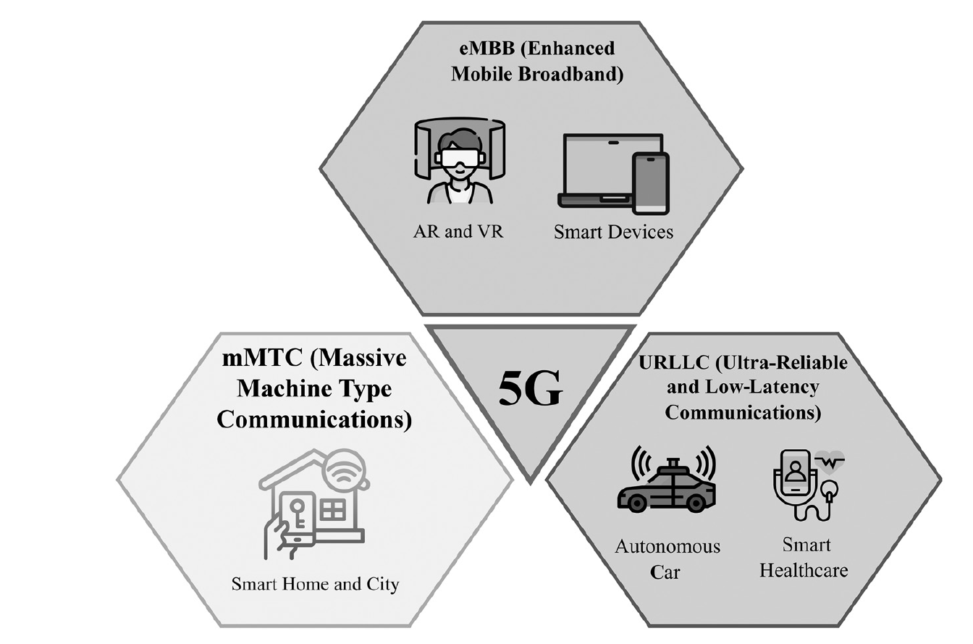
09
Internet of Things in the Era of 5G
Understand the Importance of Business Intelligence
Figure 9.1 : Range of application areas that 5G supports.

Slide 16
09
Internet of Things in the Era of 5G
Understand the Importance of Business Intelligence
Massive Machine-Type Communications (mMTC):
mMTC refers to the ability of 5G networks to connect a massive number of low-power, low-cost, and low-data-rate IoT devices simultaneously. While each device typically transmits only small and infrequent data packets, the sheer number of devices places high demands on the network infrastructure.
Key Features of mMTC
Supports up to one million devices per square kilometer
Optimized for low energy consumption and long battery life
Focuses on efficient and scalable communication for IoT nodes
mMTC Use Cases
Smart cities: smart meters, intelligent lighting, traffic sensors
Industrial IoT: machine monitoring, predictive maintenance
Agricultural monitoring: soil sensors, livestock tracking
Environmental monitoring: air quality sensors, weather stations
The primary goal of mMTC is to ensure reliable and efficient communication for extremely large numbers of IoT devices without overloading the network.

Slide 17
09
Internet of Things in the Era of 5G
Understand the Importance of Business Intelligence
Ultra-Reliable and Low-Latency Communications (URLLC):
URLLC is designed for applications requiring very low latency, typically less than 1 millisecond, and extreme reliability (up to 99.999% availability). These applications cannot tolerate delays or interruptions, as they involve time-critical or safety-critical operations.
Key Features of URLLC
Ultra-low latency for instantaneous communication
High reliability and availability for mission-critical functions
Deterministic and prioritized data transmission
URLLC Use Cases
Autonomous vehicles: real-time communication between cars and infrastructure
Industrial automation: robotic control in smart factories
Remote surgery: real-time control of medical robotic systems
Public safety systems: emergency communication and response networks
URLLC requires optimized network infrastructure to minimize delay and ensure consistent, error-free communication, which is essential for life-critical and time-sensitive applications.

Slide 18
09
Internet of Things in the Era of 5G
Enhanced Mobile Broadband (eMBB):
eMBB focuses on delivering significantly higher data rates and greater overall network capacity compared to previous generations such as 4G LTE. It provides users with extremely fast and stable internet connectivity.
Key Features of eMBB
Multi-gigabit per second speeds
High capacity to support dense user environments
Low latency for smooth interactive experiences
Enhanced user experience in mobility
eMBB Use Cases
4K/8K video streaming
Immersive media and digital experiences
eMBB enables bandwidth-intensive applications that depend on large-scale data transfer and real-time responsiveness, redefining mobile broadband services.
Understand the Importance of Business Intelligence

Slide 19
09
Internet of Things in the Era of 5G
What Is 5G IoT?
5G is the latest wireless communication technology designed to enhance global connectivity by providing faster speeds, lower latency, and greater capacity compared to previous generations.
It introduces a new framework known as 5G New Radio (5G NR) along with an entirely new core network architecture. This advanced system standardizes the concept of multiple access, enabling seamless integration of various connectivity technologies such as satellite networks, Wi-Fi, fixed-line systems, and cellular networks.
Through these advancements, 5G is capable of connecting significantly more devices, delivering higher data rates, and reducing communication delays, all of which contribute to an exceptional user experience across different devices, applications, and services.
A key advantage of 5G is its ability to support massive cellular IoT technologies, which are designed to be cost-effective, energy-efficient, and highly scalable. These technologies offer wide indoor and outdoor coverage, secure connectivity and authentication, simplified deployment, and flexible capacity expansion. As a result, businesses, city planners, and industrial sectors can leverage 5G’s adaptability to connect large numbers of devices with enhanced capabilities and lower operational costs.
Understand the Importance of Business Intelligence

Slide 20
09
Internet of Things in the Era of 5G
What Is 5G IoT?
5G is a broad term representing the overall advancements in wireless communication, while 5G IoT specifically focuses on the application of 5G technology to optimize the Internet of Things ecosystem.
5G encompasses improvements such as:
Faster mobile broadband speeds
Lower latency
Higher network capacity
Network slicing
Enhanced reliability
These advancements support a wide variety of applications beyond IoT, including autonomous vehicles, AR/VR, high-definition video streaming, mission-critical services, and more.
Understand the Importance of Business Intelligence

Slide 21
09
Internet of Things in the Era of 5G
Understand the Importance of Business Intelligence
What Is 5G IoT?
In contrast, 5G IoT focuses on how 5G can optimize IoT deployments by enabling seamless connectivity and communication among billions of devices. It specifically addresses IoT-related requirements such as:
Low power consumption
Extended coverage : IoT devices are often placed in challenging environments:
deep inside buildings
underground (e.g., water meters)
rural or large outdoor areas
Support for massive device density : 5G IoT is designed to handle up to one million devices per square kilometer. This massive connectivity is essential for many environments.
Efficient management of large-scale sensor networks : Managing millions of IoT devices requires efficient data handling.
While 5G provides the general wireless infrastructure, 5G IoT tailors these capabilities to IoT use cases, enabling applications such as smart cities, industrial automation, precision agriculture, healthcare monitoring, and real-time asset tracking.

Slide 22
09
Internet of Things in the Era of 5G
Understand the Importance of Business Intelligence
Mobile IoT Systems are Paving the Way for 5G:
Mobile IoT (MIoT) systems are becoming fundamental to the development and deployment of 5G wireless networks. As communication systems evolve, both individuals and industries increasingly rely on smart, connected devices to exchange data, automate tasks, and improve efficiency.
MIoT technologies support this shift by providing reliable, low-power, wide-area connectivity specifically designed for the Internet of Things (IoT).
MIoT refers to a group of cellular-based IoT technologies created to connect large numbers of devices that require low power, extended battery life, and wide-area coverage.
Unlike traditional cellular networks that focus on high-speed data for smartphones, MIoT is optimized for devices that send small amounts of data, but must do so efficiently and over long distances.

Slide 23
09
Internet of Things in the Era of 5G
Understand the Importance of Business Intelligence
MIoT includes two key technologies:
Narrowband IoT (NB-IoT):
A low-power, narrow-bandwidth technology designed for applications where data is transmitted infrequently but reliably. It offers superior indoor penetration and can connect millions of devices in a small geographical area.
LTE-M (Long-Term Evolution for Machines):
A low-power extension of LTE that supports slightly higher data rates and mobility. It is suitable for devices that require voice support, firmware updates, or movement, such as wearables or asset trackers.
Both NB-IoT and LTE-M operate on licensed cellular spectrum, meaning they benefit from operator-managed security, reliability, and nationwide coverage.

Slide 24
09
Internet of Things in the Era of 5G
Understand the Importance of Business Intelligence
With the rise of smart devices—such as smart meters, environmental sensors, industrial machines, and connected appliances—there is a massive increase in demand for stable, energy-efficient, and scalable communication networks. Traditional connectivity technologies (Wi-Fi, Bluetooth, Zigbee) often struggle with:
limited range
high power consumption
network congestion
poor reliability in large-scale deployments
MIoT solves these challenges by leveraging existing cellular infrastructure but optimizing it for devices that need long battery life, strong signal penetration, and minimal data usage.

Slide 25
09
Internet of Things in the Era of 5G
Understand the Importance of Business Intelligence
Advantages of MIoT
1. Power Efficiency
MIoT technologies are designed with power-saving mechanisms such as Power Saving Mode (PSM) and Extended Discontinuous Reception (eDRX). These features allow devices to:
sleep for long periods
wake only when transmitting data
operate for 10+ years on a single battery
This makes MIoT ideal for remote sensors (e.g., water meters, gas meters, soil moisture sensors) that cannot be frequently serviced.

Slide 26
09
Internet of Things in the Era of 5G
Understand the Importance of Business Intelligence
Advantages of MIoT:
Cost Effectiveness
Since MIoT devices send small, infrequent data packets, they consume minimal network resources. As a result:
cellular operators offer very low-cost IoT subscriptions
hardware modules are inexpensive
deployment costs are low because no new infrastructure is needed
This allows industries such as agriculture, utilities, and logistics to deploy thousands of devices cost-effectively.

Slide 27
09
Internet of Things in the Era of 5G
Understand the Importance of Business Intelligence
The Role of MIoT in Advancing 5G
MIoT technologies are considered precursors to full 5G IoT, because they:
enable the massive device connectivity expected in 5G (mMTC)
inspire power-saving techniques now used in 5G standards
ensure a smooth transition from LTE networks to 5G NR
As 5G matures, MIoT will integrate more tightly with 5G to support:
smart cities
intelligent transportation systems
environmental monitoring
health and safety systems
Thus, MIoT forms the foundation for many future 5G-based IoT services.

Slide 28
09
Internet of Things in the Era of 5G
Current Applications of 5G IoT:
The arrival of 5G technology has transformed the Internet of Things (IoT) by providing high-speed, low-latency communication, and supporting massive device connectivity. This combination enables advanced, real-time applications across many sectors.
Smart Cities: 5G IoT enhances smart city ecosystems by allowing millions of devices—traffic sensors, cameras, meters, and environmental systems—to communicate instantly. This enables cities to be more efficient, safe, and sustainable.
Industrial IoT (IIoT): 5G supports real-time monitoring and control of machines, robots, and production lines. It allows industries to automate processes, improve safety, and minimize downtime through predictive insights.
Understand the Importance of Business Intelligence

Slide 29
09
Internet of Things in the Era of 5G
Current Applications of 5G IoT:
Telemedicine: 5G IoT allows doctors to monitor patients remotely with immediate access to vital signs and health changes. It also enables high-quality virtual consultations and integration with healthcare systems.
Energy Management: 5G IoT supports smart grids, renewable energy integration, and efficient energy use in homes, industries, and cities.
A smart grid is an upgraded power grid that uses smart meters, sensors, automation, and data analytics to make electricity systems more reliable, efficient, eco-friendly, and responsive.
It enables real-time data exchange and automation across the energy ecosystem.
Understand the Importance of Business Intelligence

Slide 30
09
Web of Things
Understand the Importance of Business Intelligence
The terms IoT (Internet of Things) and WoT (Web of Things) are related but not the same.
They work together, but they focus on different layers of the connected-device ecosystem.
WoT uses web technologies to make IoT devices easier to access, integrate, and control.
WoT uses familiar web standards such as:
HTTP / HTTPS
JavaScript
HTML
WoT turns IoT devices into “web resources” that can be accessed using standard web tools.

Slide 31
09
Web of Things
Understand the Importance of Business Intelligence
IoT = connected devices that talk using IoT protocols
WoT = IoT + Web layer that makes devices usable via browsers and web apps
Example Scenario: Smart Home Temperature Control:
IoT Version (Traditional IoT)
A smart thermostat is connected to sensors in your home.
It measures temperature and sends the data to a mobile app through a manufacturer’s private cloud.
Devices communicate using IoT protocols such as MQTT or CoAP.
Data is stored in vendor-specific servers.

Slide 32
09
Web of Things
Understand the Importance of Business Intelligence
Example Scenario: Smart Home Temperature Control:
The same smart thermostat is connected using standard web technologies (HTTP, REST, JSON).
The thermostat exposes a web API like:
  GET /temperature
  POST /temperature
Any device with a browser (phone, laptop, smartwatch) can access it.
It can be integrated with other web services easily (e.g., Google Home).
Developers can build custom dashboards using HTML/JavaScript.

Slide 33
09
Web of Things
Understand the Importance of Business Intelligence
The Web of Things (WoT) enhances IoT by providing a web-based framework for interacting with connected devices. Its features and benefits can be explained as follows:
Security:
WoT uses standard web security mechanisms, such as HTTPS (for secure communication) and OAuth (for secure access control).
IoT devices often handle sensitive information (e.g., health data or industrial parameters). Ensuring secure communication and authorized access is critical.
Protects data from unauthorized access or tampering and ensures privacy and integrity of device communications.

Slide 34
09
Web of Things
Accessibility:
WoT devices can be accessed and controlled through any web browser, from anywhere in the world.
Traditional IoT systems often require specialized software or apps, limiting ease of use.
Remote monitoring and control become simple. For example, a user can adjust a thermostat from their phone or a doctor can check a patient’s vital signs remotely.
Scalability: WoT is built to support a large number of devices and services.
The WoT framework allows adding new devices and services easily without redesigning the system. It can handle high data volumes and adapt to growing networks.
Understand the Importance of Business Intelligence

Slide 35
09
Web of Things
Understand the Importance of Business Intelligence
Applications in Various Industries:
The combination of IoT and WoT is transforming multiple sectors by enabling real-time data access, remote control, and intelligent decision-making:
Healthcare
IoT devices: Wearables (smartwatches, fitness trackers), remote monitoring devices.
WoT contribution: These devices can send real-time data to web-based dashboards, alerting healthcare providers if a patient shows abnormal readings.
Benefits: Early detection of health issues, medication adherence, reduced hospital visits, and better patient care.

Slide 36
09
Web of Things
Understand the Importance of Business Intelligence
Applications in Various Industries:
Transportation
IoT devices: GPS-enabled vehicles, traffic sensors, smart traffic signals.
WoT contribution: Traffic data can be integrated into web-based management systems to optimize routes, control traffic flow, and track vehicles.
Benefits: Safer roads, reduced fuel consumption, efficient logistics, and enhanced urban mobility.

Slide 37
09
Web of Things
Understand the Importance of Business Intelligence
Applications in Various Industries:
Industrial Automation
IoT devices: Smart sensors monitoring temperature, pressure, humidity, vibration, etc.
WoT contribution: Real-time web-based access to sensor data allows managers to analyze trends, detect anomalies, and optimize production processes.
Benefits: Increased productivity, reduced downtime, improved safety, and cost savings.

Slide 38
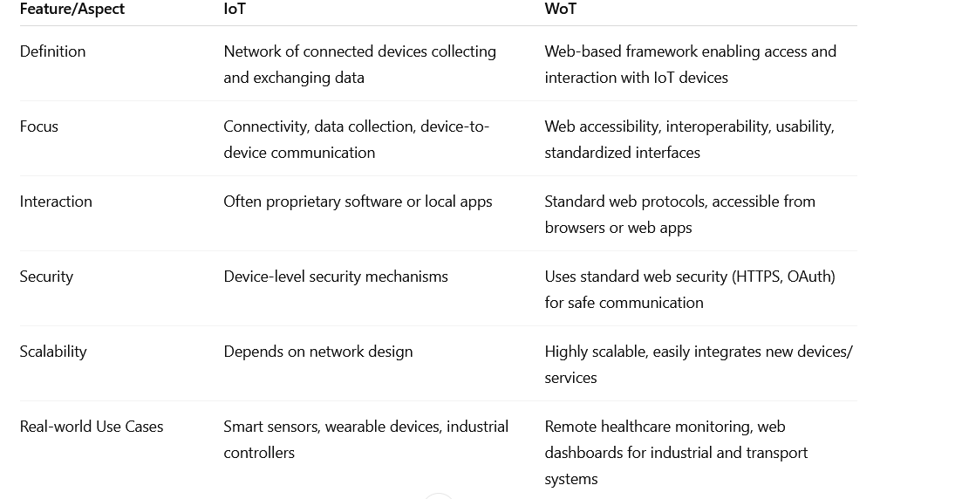
09
Web of Things
Understand the Importance of Business Intelligence
IoT vs WoT

Slide 39
Summary
09
Gorry and Scott-Morton (1971) proposed a framework that is a 3-by-3 matrix
IoT and 5G
WOT

Slide 40


Thank You

