Slide 1


Agile Project
Management
Prepared by Eng. Ahmed Hussein, MBA, PfMP©, PMP©, CMP APMG
PMG 622
Master of Project Management
Lecture 06

Slide 2


Working with a Framework (Scrum)
Lecture 6
PMG 622
Agile Project Management
Prepared by
Eng. Ahmed Hussein, MBA, PfMP©, PMP©, CMP APMG
www.midocean.ae

Slide 3

Chapter
Learning Objectives
06
Apply Scrum framework on a sample project to:
  Develop a Product Vision, Product Roadmap, and Release Plan
  Develop an Initial Product Backlog
  Perform Story Mapping
  Perform Sprint Planning including story splitting, user story development and estimation
  Use Kanban Boards to manage Sprints
  Develop Burndown Charts and calculate Velocity
  Perform Sprint Review and Retrospective
  Perform Backlog Refinement
www.midocean.ae

Slide 4
Note for Lecture Exam:
Please Review Lecture 2 and Lecture 4 for definitions of terms used in this Lecture.

Slide 5
Chapter
Key Points from Previous Lecture
06
Scrum is the most widely used Agile Methodology
Some Agile methodologies as Lean, Crystal has no prescribed processes
Most methodologies started in the Software Industry, except for Lean and Kanban who came from manufacturing
You can mix tools from different methodologies together in your Agile project
www.midocean.ae

Slide 6
Chapter
There are many different Agile Frameworks
06
Lean
Agile
Scrum
ScrumBan
Kanban
Crystal
DSDM
XP
FDD
www.midocean.ae

Slide 7

Chapter
The Project: Develop a Calculator Application
05
Arithmetic Functions
Algebraic Equations
Trigonometric Functions
Statistical Functions
Works on multiple platforms:
  Web
  IOS
  Android
www.midocean.ae

Slide 8
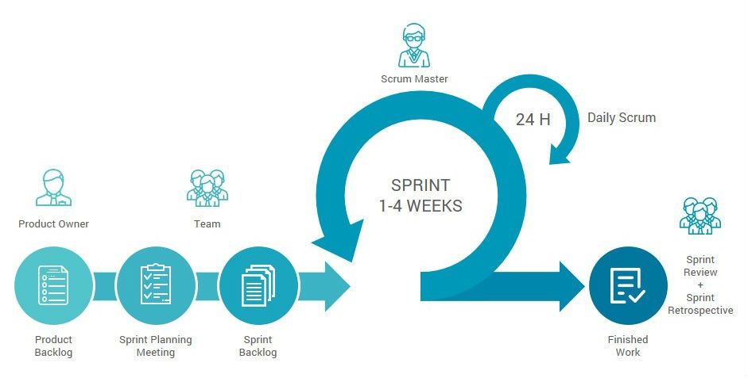
Chapter
Scrum Process
06
www.midocean.ae

Slide 9

Chapter
Product Vision, Roadmap, and Release Plan
06
www.midocean.ae

Slide 10
Product Vision
Describes the purpose of a Product, the intention with which the Product is being created, what problems it tries to resolve, and what it aims to achieve for customers
VISION: The BEST Calculator APP for Students.
Target Group:
High School Students
University Students
Post-Graduate Students
Needs:
User Friendly
Performs Arithmetic, Algebra, Trigonometry, and statistics Functions
Product:
Multi-Platform (Web, IOS, Android)
Supports Touchscreens
Uses AI to predict input
Business Goals:
Gain 1 M subscribers by end of year 1
Generate 1 M USD/month by end of Month 6

Slide 11
Product Roadmap
A visual depiction of the product releases and the main components that will be included in each release.
Usually, developed by Product Owner to decide on business priorities with some input from the team.
Start
2 Weeks
2 Months
3 Months
4 Months
User Interface
Design
Coding
Web
Arith.
Alg.
Trig.
Stat.
IOS
Arith.
Alg.
Trig.
Stat.
Android
Arith.
Alg.
Trig.
Stat.

Slide 12
Product Release Plan
Start
2 Weeks
2 Months
3 Months
4 Months
User Interface
Design
Coding
Web
Arith.
Alg.
Trig.
Stat.
IOS
Rel. #1
Arith.
Alg.
Trig.
Stat.
Rel. #2
Rel. #3
Rel. #4
Android
Rel. #5
Rel. #6
Arith.
Alg.
Trig.
Stat.
Rel. #7
Rel. #8
Rel. #9
Rel. 10#
Rel. #11
Rel. #12

Slide 13
User Stories, Story Mapping, Product Backlog, and Estimating
Chapter
06
www.midocean.ae

Slide 14
EPIC vs. Features vs. User Stories
Epics are big chunks of work that has multiple features
Features are divided into multiple User Stories (Story Splitting)
Big User-Stories can be further divided into multiple User Stories (Story splitting)
Product backlog can be developed on feature or user story levels
Epics
Features
User Stories
User Interface
Design
Coding
Web Application
Arithmetic
Add
Algebraic
Subtract
IOS Application
Trigonometric
Multiply
Android Application
Statistics
Divide

Slide 15
Writing User Stories
A short description of a feature or requirement from the user perspective.
Written on a card in the following format:
User Story #1 (ADD)
As a User
I want to Add 2 Numbers
So that I can perform basic Arithmetic Function
Acceptance Criteria
The user should be able to enter two numbers into the calculator.
The user should be able to select the addition operation.
The calculator should display the sum of the two numbers.
User Story #2 (Subtract)
As a User
I want to Subtract 2 Numbers
So that I can perform basic Arithmetic Function
Acceptance Criteria
The user should be able to enter two numbers into the calculator.
The user should be able to select the subtract operation.
The calculator should display the difference of the two numbers.
User Story #20 (Sin)
As a User
I want to be able to calculate the Sin of a Number
So that I can perform trigonometric Function
Acceptance Criteria
The user should be able to enter a number into the calculator.
The user should be able to select the sin operation.
The calculator should display the sine of a number.

Slide 16
Story Mapping
Story mapping consists of ordering user stories along two independent dimensions.
Horizontal axis user activities are put roughly in the order in which the user would perform the task.
Vertical axis, user stories are ordered by priority and/or increasing sophistication of the implementation.
User Interface
Design
Coding
Arithmetic
Add
Subtract
Multiply
Divide
Trigonometric
Sin
Cos
Tan
Sec
Csc
Cot
Web
Algebraic
Polynomial
Rational
Exponentials
Logarithmic
Radical
Statistical
Mean
Median
Mode
Std. Deviation
Variance
Count
IOS
Repeat User Stories
Android
Repeat User Stories

Slide 17
Initial Product Backlog
A prioritized list of all the work that needs to be done to complete the project as new features, changes to existing features, fixes, process changes, or other activities.
Id | Backlog Item | Assigned to Sprint | Status | Size (In Story Points)
1 | Design |  | Open
2 | Coding |  | Open
3 | Add |  | Open
4 | Subtract |  | Open
5 | Multiply |  | Open
6 | Divide |  | Open
7 | Sin |  | Open
8 | Cos |  | Open
9 | Tan |  | Open
10 | Sec |  | Open
Id | Backlog Item | Assigned to Sprint | Status | Size (In Story Points)
11 | Csc |  | Open
12 | Cot |  | Open
13 | Polynomial |  | Open
14 | Rational |  | Open
15 | Exponential |  | Open
16 | Logarithmic |  | Open
17 | Radical |  | Open
18 | Mean |  | Open
19 | Median |  | Open
20 | Mode |  | Open
Id | Backlog Item | Assigned to Sprint | Status | Size (In Story Points)
21 | Std. Deviation |  | Open
22 | Variance |  | Open
23 | Count |  | Open
24
25
26
27
28
29
40
 |  |  | Total

Slide 18
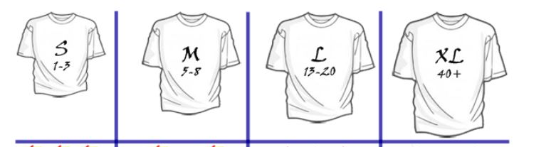
Estimating
# of Story Points
Add: 3
Sin: 5
Design: 15
Log.: 40
Subtract: 3
Cos: 5
Coding: 20
Exp.: 50
User Stories
Multiply: 3
Tan: 5
Mean: 13
Divide: 3
Sec: 5
StdDev: 13
Count: 3
Csc: 5
Var: 13
Cot: 5
Poly: 20
Median: 8
Rat.: 20
Mode: 8
Rad: 15

Slide 19
Update Product Backlog with User Story estimates
Id | Backlog Item | Assigned to Sprint | Status | Size (In Story Points)
1 | Design |  | Open | 15
2 | Coding |  | Open | 20
3 | Add |  | Open | 3
4 | Subtract |  | Open | 3
5 | Multiply |  | Open | 3
6 | Divide |  | Open | 3
7 | Sin |  | Open | 5
8 | Cos |  | Open | 5
9 | Tan |  | Open | 5
10 | Sec |  | Open | 5
Id | Backlog Item | Assigned to Sprint | Status | Size (In Story Points)
11 | Csc |  | Open | 5
12 | Cot |  | Open | 5
13 | Polynomial |  | Open | 20
14 | Rational |  | Open | 20
15 | Exponential |  | Open | 50
16 | Logarithmic |  | Open | 40
17 | Radical |  | Open | 15
18 | Mean |  | Open | 13
19 | Median |  | Open | 8
20 | Mode |  |  | 8
Id | Backlog Item | Assigned to Sprint | Status | Size (In Story Points)
21 | Std. Deviation |  | Open | 20
22 | Variance |  | Open | 13
23 | Count |  | Open | 3
24
25
26
27
28
29
40
 |  |  | Total | 287
End of Project Day 1

Slide 20
Chapter
Sprint Management
06
www.midocean.ae

Slide 21
Sprint 1: Sprint Planning Meeting
Team decided sprints will be 2 weeks long
Initially we assume velocity, let’s say velocity = 35 Story points/Sprint
All team meets at Sprint 1 Day 1 to perfrorm Sprint Planning
Product Backlog
Sprint 1 Backlog
Id | Backlog Item | Assigned to Sprint | Status | Size (In Story Points)
1 | Design |  | Open | 15
2 | Coding |  | Open | 20
3 | Add |  | Open | 3
4 | Subtract |  | Open | 3
5 | Multiply |  | Open | 3
6 | Divide |  | Open | 3
7 | Sin |  | Open | 5
8 | Cos |  | Open | 5
9 | Tan |  | Open | 5
10 | Sec |  | Open | 5
Id | Backlog Item | Assigned to Sprint | Status | Size (In Story Points)
1 | Design |  | Open | 15
2 | Coding |  | Open | 20
 |  |  | TOTAL | 35
We start taking stories in priority order from the Product Backlog to Sprint Backlog
We stop when the Sprint has user stories around the velocity threshold

Slide 22

Sprint Management - Sprint 1 Kanban Board
Chapter
Day: 5
Day: 1
Day: 10
Day: 14
Sprint Backlog
Development
(2)
Testing
(1)
Done
User Interface Design: 15
Story Splitting: Team may find these stories too big and split them into multiple user stories within the Sprint
Coding: 20
www.midocean.ae

Slide 23


Sprint 1 Review
Team makes a demo
Finished Work:
User Interface Design and Coding
Customer
Feedback:
Customer wants to change Shape of Buttons
Customer wants Two memory Buttons to store results so that they can be recalled in other calculations

Slide 24
Sprint 1 Retrospective
Scrum Master facilitates a review of the sprint
Feedback:
Development Team can take 3 tasks instead of 2 at the same time
Testing team can take 2 tasks instead of 1 at the same time
Velocity 35 is too much, we need to limit it to 30
Team identifies what went good and what can be improved

Slide 25
Product Backlog Refinement After Sprint 1
Id | Backlog Item | Assigned to Sprint | Status | Size (In Story Points)
1 | Design | 1 | CLOSED | 15
2 | Coding | 1 | CLOSED | 20
3 | Add |  | Open | 3
4 | Subtract |  | Open | 3
5 | Multiply |  | Open | 3
6 | Divide |  | Open | 3
7 | Change Button Shape |  | Open | 5
8 | Add 2 Memory Buttons |  | Open | 15
9 | Sin |  | Open | 5
10 | Cos |  | Open | 5
Id | Backlog Item | Assigned to Sprint | Status | Size (In Story Points)
11 | Tan |  | Open | 5
12 | Sec |  | Open | 5
13 | Csc |  | Open | 5
14 | Cot |  | Open | 5
15 | Polynomial |  | Open | 20
16 | Rational |  | Open | 20
17 | Exponential |  | Open | 50
18 | Logarithmic |  | Open | 40
19 | Radical |  | Open | 15
20 | Mean |  | Open | 13
Id | Backlog Item | Assigned to Sprint | Status | Size (In Story Points)
21 | Median |  | Open | 8
22 | Mode |  | Open | 8
23 | Std. Deviation |  | Open | 20
24 | Variance |  | Open | 13
25 | Count |  | Open | 3
26
27
28
29
40
 |  |  | Total | 307

Slide 26
Writing New User Stories
User Story #24 (Change Buttone Shape)
As a User
I want to have squared with round corners button shape
So that It is easier on the eye
Acceptance Criteria
Button should be a square with round corners.
User Story #25 (Memory Functions)
As a User
I want to save up to two results
So that I can use them in other calculations later Function
Acceptance Criteria
The user should be able to save result by pressing one of two memory buttons.
The user should be able to retrieve result by pressing on the memory button again

Slide 27
Sprint 2: Sprint Planning Meeting
As per team feedback Velocity = 30 Story points/Sprint
Product Backlog
Sprint 2 Backlog
Id | Backlog Item | Assigned to Sprint | Status | Size (In Story Points)
1 | Design |  | Closed | 15
2 | Coding |  | Closed | 20
3 | Add |  | Open | 3
4 | Subtract |  | Open | 3
5 | Multiply |  | Open | 3
6 | Divide |  | Open | 3
7 | Change Button Shape |  | Open | 5
8 | Add 2 Memory Buttons |  | Open | 15
9 | Sin |  | Open | 5
10 | Cos |  | Open | 5
11 | Tan |  | Open | 5
12 | Sec |  | Open | 5
Id | Backlog Item | Assigned to Sprint | Status | Size (In Story Points)
1 | Add |  | Open | 3
2 | Subtract |  | Open | 4
3 | Multiply |  | Open | 3
4 | Divide |  | Open | 3
5 | Change Button Shape |  | Open | 3
6 | Add 2 Memory Functions |  | Open | 15
 |  |  | TOTAL | 32

Slide 28
Sprint Management - Sprint 2 Kanban Board
Chapter
Day: 5
Day: 1
Day: 10
Day: 14
Sprint Backlog
Development
(3)
Testing
(2)
Done
Add: 3
Subtract: 3
Multiply: 3
Divide: 3
Change Button Shape: 5
Add 2 Memory Functions: 15
www.midocean.ae

Slide 29
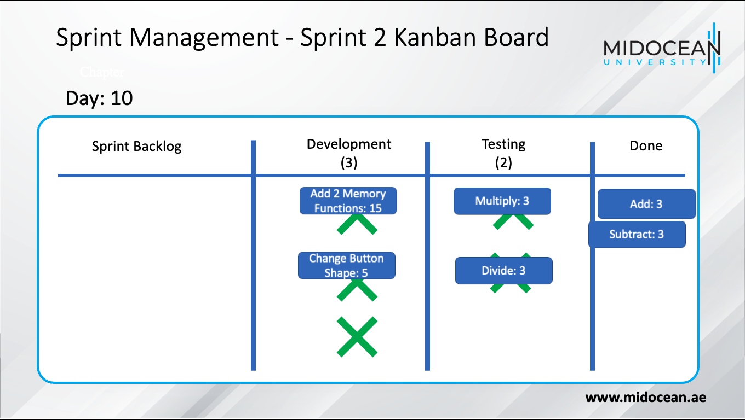
Daily Scrum Meeting (10-15 min.)
Led by Scrum Master, asks every team member:
  What did you do yesterday?
  Where are you blocked?
  What are you going to do today?
Decision-Making and Problem Solving to ensure Sprint finishes its objectives

Slide 30
Sprint Burndown Chart vs. Project Burndown Chart

Slide 31
Sprint 2 Review
Team makes a demo
Finished Work:
Arithmetic functions, button Shape,
Customer
Feedback:
Proceed with Release 1
Customer Identified minor bug to be resolved that won’t impact release 1.
Customer wants to add more than two numbers in one calculation

Slide 32
Sprint 2 Retrospective
Scrum Master facilitates a review of the sprint
Feedback:
Calculated average velocity (35+32/2) = 33.5
Decided to develop user manual (should be added as a user story)
Team identifies what went good and what can be improved

Slide 33
Product Backlog Refinement After Sprint 2
Id | Backlog Item | Assigned to Sprint | Status | Size (In Story Points)
1 | Design | 1 | CLOSED | 15
2 | Coding | 1 | CLOSED | 20
3 | Add | 2 | CLOSED | 3
4 | Subtract | 2 | CLOSED | 3
5 | Multiply | 2 | CLOSED | 3
6 | Divide | 2 | CLOSED | 3
7 | Change Button Shape | 2 | CLOSED | 5
8 | Add 2 Memory Buttons | 2 | CLOSED | 15
9 | Sin |  | Open | 5
10 | Cos |  | Open | 5
Id | Backlog Item | Assigned to Sprint | Status | Size (In Story Points)
11 | Tan |  | Open | 5
12 | Sec |  | Open | 5
13 | Csc |  | Open | 5
14 | Cot |  | Open | 5
15 | Solve Minor Bug |  | Open | 3
16 | Polynomial |  | Open | 20
17 | Rational |  | Open | 20
18 | Exponential |  | Open | 50
19 | Logarithmic |  | Open | 40
20 | Add more than 2 numbers |  | Open | 8
Id | Backlog Item | Assigned to Sprint | Status | Size (In Story Points)
21 | Radical |  | Open | 15
22 | Mean |  | Open | 13
23 | Median |  | Open | 8
24 | Mode |  | Open | 8
25 | Std. Deviation |  | Open | 20
26 | Variance |  | Open | 13
27 | Count |  | Open | 3
28 | User Manual |  | Open | 13
29
40
 |  |  | Total | 331

Slide 34
Chapter
Key Points
06
Review Lectures 2 and 4 for definitions for this lecture exam
Scrum has very minimal documents (product Backlog, Sprint Backlog) and uses many visual tools (Kanban Board, Burndown Charts, Velocity Charts)
Scrum is characterized by fast problem solving and decision making in sprint planning, daily scrum, sprint review and retrospective
As all Agile frameworks, Scrum is flexible and adapts to changing needs
Scrum involves the customer and focus on delivering high priority, high value features first
www.midocean.ae

Slide 35

www.midocean.ae
Preparation for discussion panel:
Check this link for several case studies on applying Scrum Methodologies.
“Examples of Scrum Case Studies”
Watch the video for a case study on applying Scrum “Scrum in 20 mins... (with examples)”
Watch the video for Scrum Workflow “Scrum Master Tutorial | Google Project Management Certificate”
Chapter
06
For Discussion Panel

Slide 36
www.midocean.ae
Preparation for discussion panel:
Watch the video for Scrum Example “8 Practical Examples & Case Study | Scrum Master Course | Speedily Tech”
Read the following Scrum Case Study “How to Develop an Agile Project Proposal with Use Case Analysis: A Local Grocery Store Example”
Chapter
06
For Discussion Panel

Slide 37
www.midocean.ae
Before next lecture:
Hybrid Life Cycles:
Read the Article
“Hybrid Life Cycles”
Chapter
06
For Next Lecture

Slide 38


Thank You

