Slide 1


Data Structures and Algorithms
Prepared by Prof. Shereen Taie
IT251
Information Technology Department
Lecture 9

Slide 2



Data Structures and
Algorithms
Lecture 9
IT251
Information Technology Department
Prepared by
Prof. Shereen Taie
www.midocean.ae

Slide 3
Learning Objectives:
Applications of Breadth First Search
Advantages of Breadth First Search
Disadvantages of Breadth First Search
DEPTH-FIRST SEARCH
Advantages of Depth First Search
Disadvantages of Depth First Search
Difference between BFS and DFS
Chapter
04
www.midocean.ae

Slide 4
Applications of Breadth First Search
Chapter
04
www.midocean.ae

Slide 5
1. Shortest Path for unweighted graph:
In an unweighted graph, the shortest path is the path with the least number of edges. With Breadth First, we always reach a vertex from a given source using the minimum number of edges.
2. Peer-to-Peer Networks:
In Peer-to-Peer Networks like BitTorrent, Breadth First Search is used to find all neighbor nodes.
BitTorrent is a hyper distribution communications protocol for peer-to-peer file sharing (“P2P”) which is used to distribute data and electronic files over the Internet.
Chapter
04
www.midocean.ae

Slide 6
3. Crawlers in Search Engines:
Crawlers build an index using Breadth First. The idea is to start from the source page and follow all links from the source and keep doing the same. Depth First Traversal can also be used for crawlers, but the advantage of Breadth First Traversal is, the depth or levels of the built tree can be limited.
4. Social Networking Websites:
In social networks, we can find people within a given distance ‘k’ from a person using Breadth First Search till ‘k’ levels.
Chapter
04
www.midocean.ae

Slide 7
5. GPS Navigation systems:
Breadth First Search is used to find all neighboring locations.
6. Broadcasting in Network:
In networks, a broadcasted packet follows Breadth First Search to reach all nodes.
7. To test if a graph is Bipartite:
We can either use Breadth First or Depth First Traversal.
Chapter
04
www.midocean.ae

Slide 8
8. Path Finding:
We can either use Breadth First or Depth First Traversal to find if there is a path between two vertices.
9. Cycle detection in undirected graph:
In undirected graphs, either Breadth First Search or Depth First Search can be used to detect a cycle. We can use BFS to detect cycle in a directed graph also.
Chapter
04
www.midocean.ae

Slide 9

Chapter
04
Advantages and Disadvantages of
Breadth First Search
www.midocean.ae

Slide 10
Advantages of Breadth First Search:
BFS will never get trapped exploring the useful path forever.
If there is a solution, BFS will definitely find it.
If there is more than one solution then BFS can find the minimal one that requires less number of steps.
Chapter
04
www.midocean.ae

Slide 11
Advantages of Breadth First Search:
Low storage requirement – linear with depth.
Easily programmable.
Chapter
04
www.midocean.ae

Slide 12
Disadvantages of Breadth First Search:
The main drawback of BFS is its memory requirement.
Since each level of the graph must be saved in order to generate the next level and the amount of memory is proportional to the number of nodes stored the space complexity of BFS is O(bd ), where b is the branching factor(the number of children at each node, the outdegree) and d is the depth.
As a result, BFS is severely space-bound in practice so will exhaust the memory available on typical computers in a matter of minutes.
Chapter
04
www.midocean.ae

Slide 13
DEPTH-FIRST SEARCH
One way to explore a graph!
04
www.midocean.ae

Slide 14
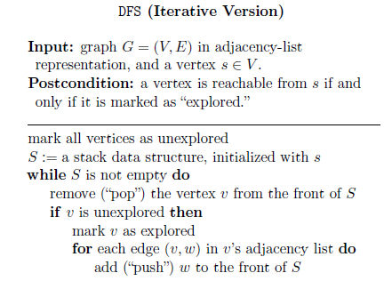
DEPTH-FIRST SEARCH
04
www.midocean.ae

Slide 15
BFS vs. DFS
Literally just BREADTH vs DEPTH:
While
BFS first explores the nodes closest to the “source” and then moves outwards in layers,
DFS goes as far down a path as it can before it comes back to explore other options.
04
www.midocean.ae

Slide 16

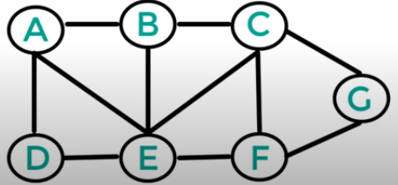
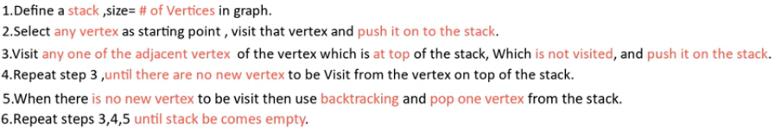
DFS stack example
STACK
04
www.midocean.ae

Slide 17
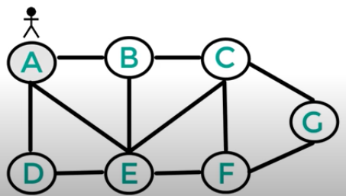

DFS stack example
A
STACK
04
www.midocean.ae

Slide 18
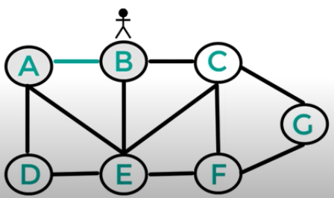

DFS stack example
A
B
STACK
04
www.midocean.ae

Slide 19
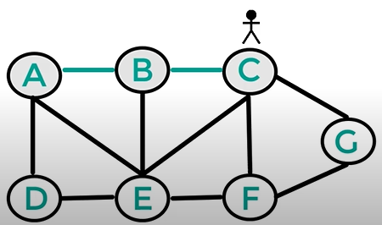

DFS stack example
A
B
C
STACK
04
www.midocean.ae

Slide 20
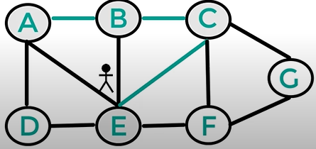

DFS stack example
A
B
STACK
C
E
04
www.midocean.ae

Slide 21

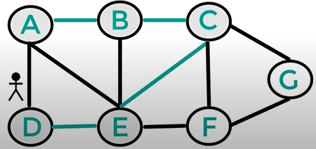
DFS stack example
A
B
STACK
C
E
D
04
www.midocean.ae

Slide 22
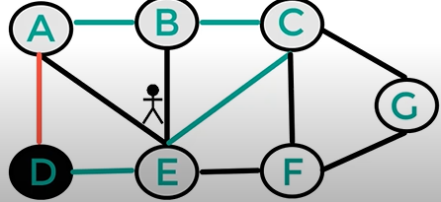

DFS stack example
A
B
STACK
C
E
D
04
www.midocean.ae

Slide 23

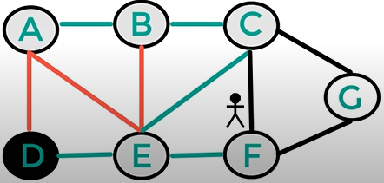
DFS stack example
A
B
STACK
C
E
D
F
04
www.midocean.ae

Slide 24
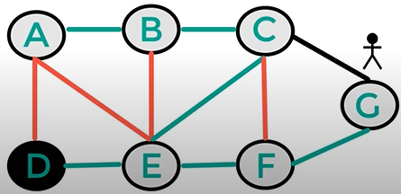

DFS stack example
A
B
STACK
C
E
D
F
G
04
www.midocean.ae

Slide 25
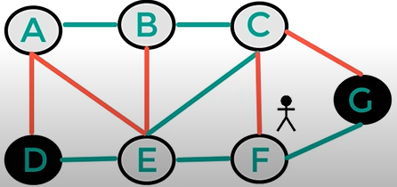

DFS stack example
A
B
STACK
C
E
D
F
G
04
www.midocean.ae

Slide 26
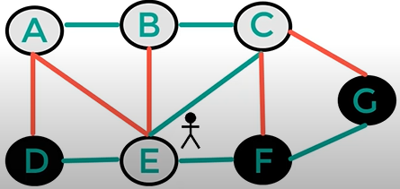

DFS stack example
A
B
STACK
C
E
D
F
G
04
www.midocean.ae

Slide 27
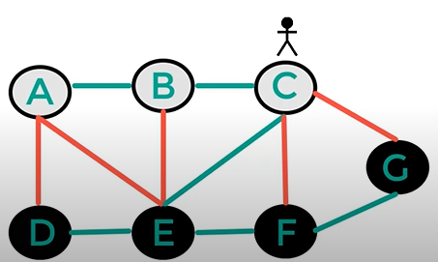

DFS stack example
A
B
STACK
C
E
D
F
G
04
www.midocean.ae

Slide 28
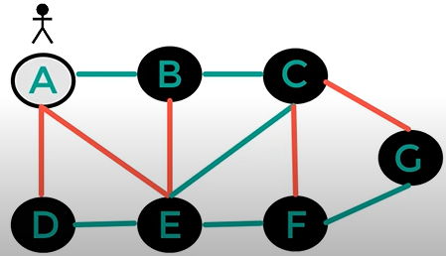

DFS stack example
A
B
STACK
C
E
D
F
G
04
www.midocean.ae

Slide 29
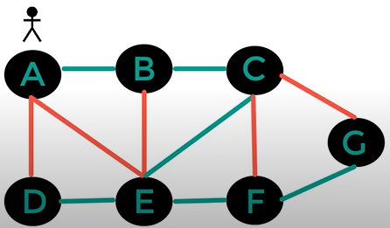

DFS stack example
A
B
STACK
C
E
D
F
G
04
www.midocean.ae

Slide 30
Chapter
04
Advantages and Disadvantages of
Depth First Search
www.midocean.ae

Slide 31
Advantages of Depth First Search:
Memory requirement is only linear with respect to the search graph. This is in contrast with breadth-first search which requires more space. The reason is that the algorithm only needs to store a stack of nodes on the path from the root to the current node.
The time complexity of a depth-first Search to depth d and branching factor b (the number of children at each node, the outdegree) is O(bd).
Chapter
04
www.midocean.ae

Slide 32
Advantages of Depth First Search:
If depth-first search finds solution without exploring much in a path then the time and space it takes will be very less.
DFS requires less memory since only the nodes on the current path are stored. By chance DFS may find a solution without examining much of the search space at all.
Chapter
04
www.midocean.ae

Slide 33
Disadvantages of Depth First Search:
The disadvantage of Depth-First Search is that there is a possibility that it may down the left-most path forever.
Depth-First Search is not guaranteed to find the solution.
And there is no guarantee to find a minimal solution, if more than one solution.
Chapter
04
www.midocean.ae

Slide 34
Chapter
04
Difference between BFS and DFS
www.midocean.ae

Slide 35
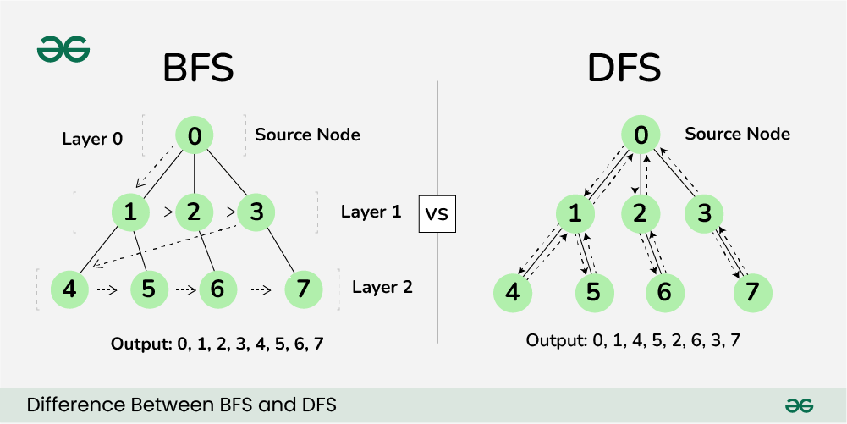
Difference between BFS and DFS:
Breadth-First Search (BFS) and Depth-First Search (DFS) are two fundamental algorithms used for traversing or searching graphs and trees.
Chapter
04
Difference between BFS and DFS
www.midocean.ae

Slide 36
Breadth-First Search (BFS):
BFS, Breadth-First Search, is a vertex-based technique for finding the shortest path in the graph.
It uses a Queue data structure that follows first in first out. In BFS, one vertex is selected at a time when it is visited and marked then its adjacent are visited and stored in the queue. It is slower than DFS.
Chapter
04
www.midocean.ae

Slide 37
Depth First Search (DFS):
DFS, Depth First Search, is an edge-based technique.
It uses the Stack data structure and performs two stages, first visited vertices are pushed into the stack, and second if there are no vertices then visited vertices are popped.
Chapter
04
www.midocean.ae

Slide 38
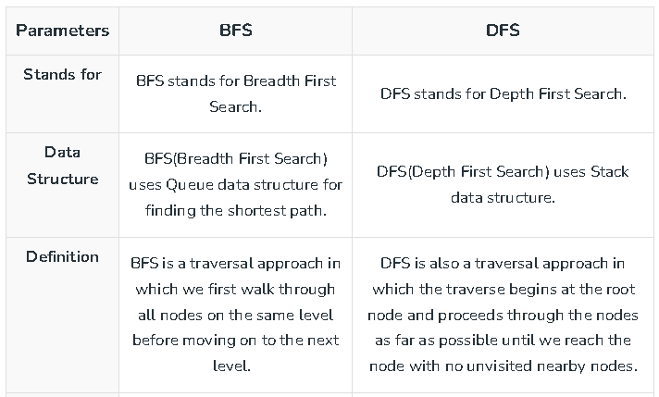
Difference between BFS and DFS:
Chapter
04
www.midocean.ae

Slide 39
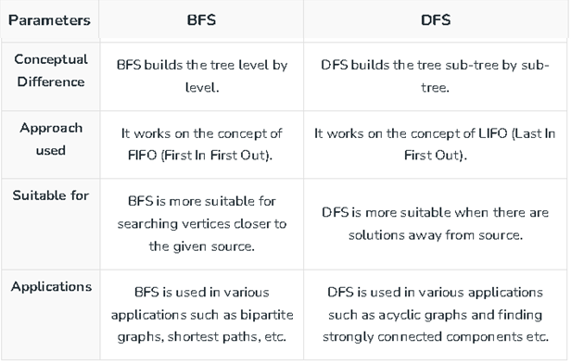
Difference between BFS and DFS:
Chapter
04
www.midocean.ae

Slide 40



Thank You

