Slide 1


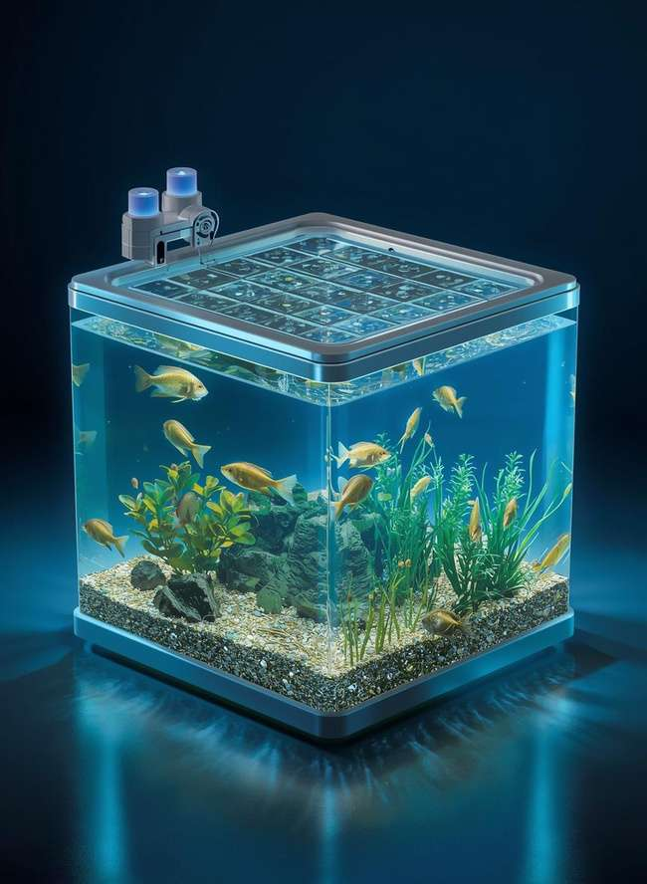
Collage of Informatics
Master of Science in Artificial Intelligence
Predicting fish growth
using Internet of Things and Artificial Intelligence in Aquaculture systems
20 Dec 2025
Presented by : Ahmed Alnahari
Supervisor Name : Dr. Hager Saleh

Slide 2
01
Introduction
06
Methodology
02
Problem Statement
07
Experimental Setup
Overview
03
Significance of the Study
08
Results
04
Thesis Contribution
09
Conclusion
05
Literature Review
10
Q&A + Thank You

Slide 3
Introduction
Aquaculture is one of the fastest-growing food production sectors, where fishpond productivity is highly dependent on maintaining optimal water quality conditions. Small variations in parameters such as temperature, pH, dissolved oxygen, and turbidity can lead to fish stress, disease, or sudden mortality. Traditional water monitoring methods are manual, infrequent, and unable to detect rapid environmental changes in real time.
The integration of Internet of Things (IoT) technologies enables continuous monitoring of fishpond environments through sensor networks that generate large volumes of real-time water quality data. However, raw IoT data alone does not provide actionable insights unless it is properly analyzed and transformed into predictive knowledge.
This thesis addresses this gap by applying machine learning regression models to IoT-based fishpond data in order to predict key water quality parameters before critical conditions occur. By comparing multiple supervised learning algorithms—such as Random Forest, XGBoost, Support Vector Regression, Linear and Lasso Regression .

Slide 4
Aquaculture systems face significant challenges in accurately predicting fish growth and water quality due to reliance on traditional and irregular monitoring methods
01
Problem Statement and Significance of the Study
Although IoT sensors provide real-time water quality data, decision-making processes remain largely reactive, based on current or historical measurements rather than future predictions
02
Sensor data is often noisy and imprecise, making it difficult for conventional approaches to model nonlinear relationships among water quality parameters.
03
This study addresses these challenges by transforming IoT data from simple numerical readings into intelligent predictive indicators that support early intervention, enhance fish growth, reduce economic losses, and improve production efficiency, thereby contributing to sustainable aquaculture management
04

Slide 5

Developed and validated a machine learning framework for parameters (length and weight) using real IoT sensor data, including pH, dissolved oxygen, temperature, and turbidity.
Thesis Contribution
Conducted a comprehensive comparison of six regression algorithms—Decision Tree (DT), Random Forest (RF), SVR, Ridge, Lasso, and XGBoost to predict fish growth using aquaponic data
Demonstrated the effectiveness of ensemble learning techniques, particularly Random Forest and XGBoost, in enhancing prediction stability and reducing errors, with RMSE values below 0.25 for length and 0.54 for weight.
This thesis provides a set of scientific and practical contributions derived from the successful development, implementation, and evaluation of machine learning models for IoT-enabled fish pond management.
Delivered a predictive analytics solution that enables fish farmers to monitor and forecast pond conditions with high accuracy, supporting early intervention and smarter management decisions.
Improved aquaculture productivity by transforming raw IoT sensor data into actionable insights that guide feeding, aeration, and water exchange strategies.
To compare the predictive accuracy of these models using standard evaluation metrics such as Mean Absolute Error (MAE), Root Mean Squared Error (RMSE), Coefficient of Determination (R²)

Slide 6
Sundararajan et al. (2025) proposed an IoT-based deep learning framework for water quality prediction in aquaponic fish ponds. Sensor data, including temperature, pH, and turbidity, were collected using the AquaBot IoT system. The study introduced a hybrid model that combines a Convolutional Autoencoder (CAE) with a GRU network to extract multi-scale features and capture temporal patterns in water quality data. The proposed approach demonstrated high predictive accuracy and effective performance in modeling dynamic aquaculture environments.
01
Hridoy et al. (2025) implemented an IoT-based monitoring system in tilapia ponds and applied ensemble machine learning techniques to predict water quality parameters. Sensor data were collected continuously over an extended period from real aquaculture environments. The study employed ensemble models based on decision trees and boosting methods to enhance the effectiveness and reliability of water quality prediction.
Literature Review
02
Xu et al. (2025) proposed a hybrid deep learning model that integrates Convolutional Neural Networks (CNN), self-attention mechanisms, and a bidirectional recurrent unit for real-time dissolved oxygen prediction. The model was trained using IoT sensor data collected from intensive fish pond environments and demonstrated strong predictive performance in capturing temporal patterns in dissolved oxygen levels.
03

Slide 7
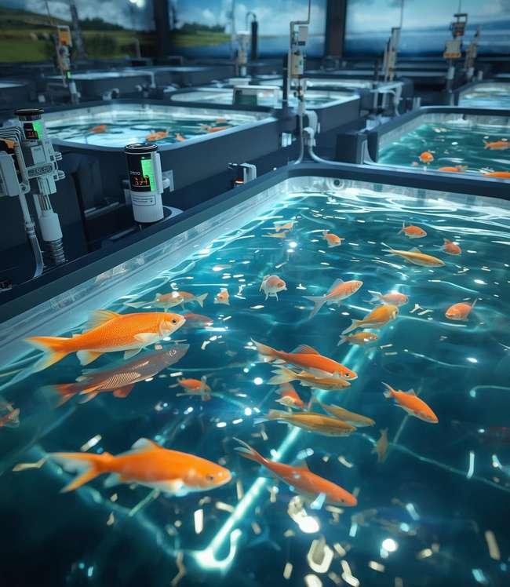
General Conclusion of the Reviewed Studies
All reviewed studies achieved high prediction accuracy using data collected from Internet of Things (IoT) sensors.
Deep learning and ensemble models consistently outperformed traditional machine learning approaches.
Model optimization techniques and attention mechanisms played a significant role in reducing prediction errors and improving model stability.
Research Gap
Despite the high accuracy reported in water quality prediction, most existing studies focus solely on water quality parameters and do not establish a direct relationship between water quality and fish growth indicators, such as fish length and weight.
This thesis addresses this gap by proposing an integrated IoT-based predictive framework that jointly models water quality and fish growth using artificial intelligence techniques.

Slide 8

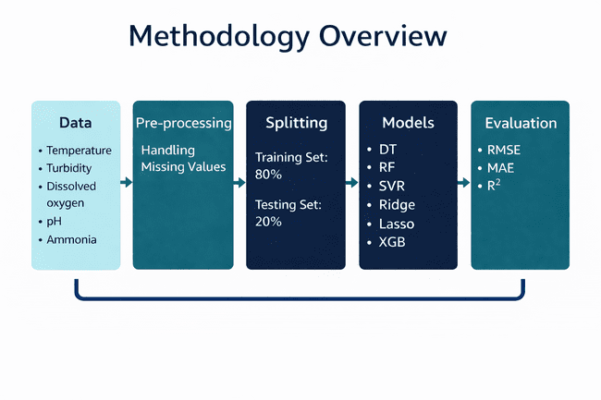

Slide 9
Methodology
This research follows a structured methodology to predict fish growth in terms of fish length and fish weight using IoT-based water quality data and machine learning regression models.
The dataset used in this study was obtained from Kaggle, known as the Fish Pond IoT Dataset, which contains water quality measurements collected using IoT sensors in a smart aquaculture environment. The dataset includes key environmental parameters such as temperature, turbidity, dissolved oxygen, pH, ammonia, and nitrate, which directly influence fish growth.
A data pre-processing stage was applied handling missing values through mean imputation or removing invalid records when necessary.
The dataset was then split into two subsets, with 80% used for training and 20% used for testing to evaluate model generalization.
Several regression models were applied, including Decision Tree, Random Forest, Support Vector Regression, Lasso Regression, Ridge Regression, and XGBoost.
All models were trained and evaluated to predict both fish length and fish weight using the same set of water quality features.
Finally, model performance was evaluated using RMSE, MAE, and R² to compare prediction accuracy and reliability.

Slide 10
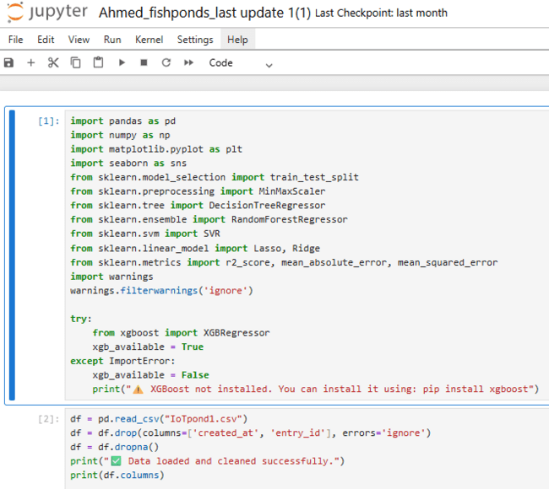
Experimental Setup
All experiments in this study were implemented using the Python programming language within a Jupyter Notebook environment, which facilitated interactive development, analysis, and visualization. Data preprocessing, feature handling, and exploratory analysis were conducted using widely adopted scientific computing libraries, including pandas and NumPy.
Machine learning model development, training, and evaluation were carried out using the scikit-learn library, which provided standardized implementations of regression algorithms and evaluation metrics. Advanced ensemble learning was implemented using the XGBoost library to support gradient boosting regression. Data visualization and result interpretation were performed using matplotlib and seaborn to illustrate data distributions, trends, and model performance.
To ensure experimental reproducibility and consistent dependency management, a dedicated Python virtual environment named fishpond_IoT was created and used throughout the study. This environment contained fixed versions of all required libraries, allowing reliable replication of experiments.
All models were trained using identical preprocessing steps, feature sets, and data splits to ensure fair comparison. Hyperparameters were selected based on commonly recommended values and empirical tuning. Model performance was evaluated using standard regression metrics, including RMSE, MAE, and R², to assess prediction accuracy, error magnitude, and model reliability.

Slide 11
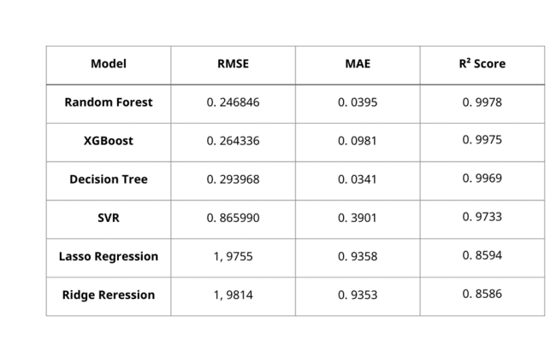
Results
  Random Forest achieved the best overall performance, recording the highest R² value (0.9978) along with very low error values (RMSE = 0.2468, MAE = 0.0395). This indicates excellent predictive accuracy and strong robustness in modeling fish length.
  XGBoost delivered performance close to Random Forest, achieving an R² of 0.9975 with slightly higher error values. This confirms the effectiveness of ensemble-based learning techniques in capturing nonlinear relationships within aquaculture data.
  Decision Tree also showed strong predictive capability, with an R² of 0.9969, although its higher RMSE suggests lower stability compared to ensemble models.
  Support Vector Regression (SVR) exhibited weaker performance, with noticeably higher RMSE and MAE values and a reduced R² of 0.9733, indicating difficulty in modeling complex growth dynamics.
  Lasso Regression and Ridge Regression produced the lowest predictive performance, with R² values below 0.86 and significantly higher error rates. This confirms that linear regression models are not well-suited for predicting fish length due to their inability to represent nonlinear biological relationships.
Length prediction results
Table 1 Performance Comparison of Regression Models for Fish Length Prediction

Slide 12

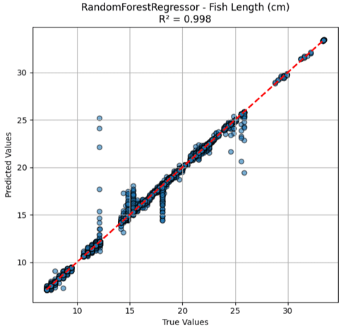
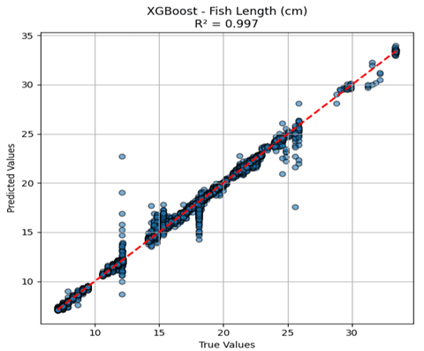
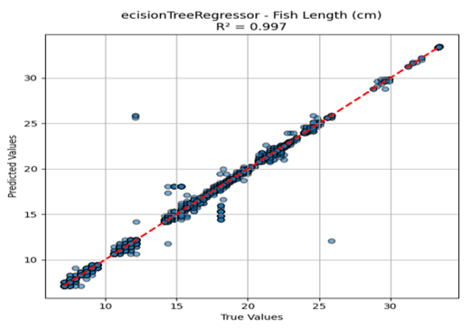
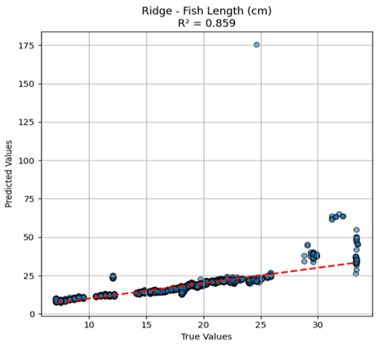
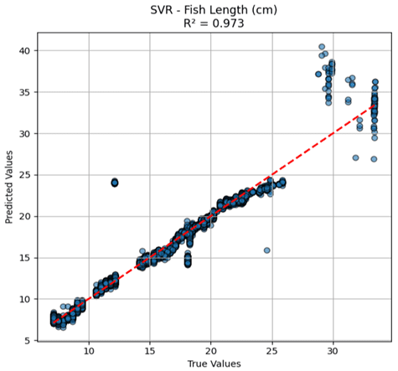
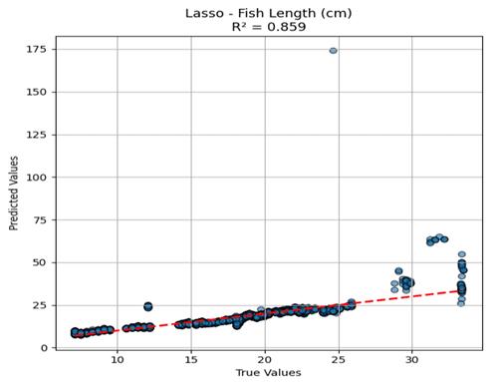

Slide 13
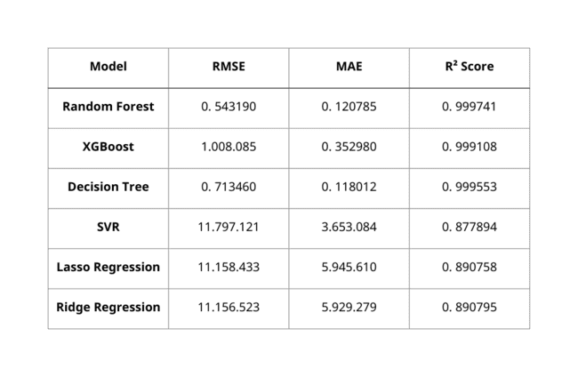
Weight prediction results
  Random Forest achieved the best overall performance, with an almost perfect R² score (0.9997) and the lowest RMSE and MAE, indicating extremely high accuracy and strong robustness in predicting fish weight.
  Decision Tree also showed strong performance, achieving a very high R² (0.9996) with slightly higher error values, but remained less stable than the ensemble-based Random Forest.
  XGBoost delivered high predictive accuracy with an R² of 0.9991, although its higher RMSE and MAE suggest increased sensitivity to data variability.
  Support Vector Regression (SVR) performed poorly, with very high error values and a significantly lower R², indicating difficulty in modeling complex biomass growth patterns.
  Lasso and Ridge Regression produced the weakest results, confirming that linear models are not suitable for predicting fish weight due to their inability to capture nonlinear biological relationships.
Table 2 Performance Comparison of Regression Models for Fish Weight Prediction

Slide 14

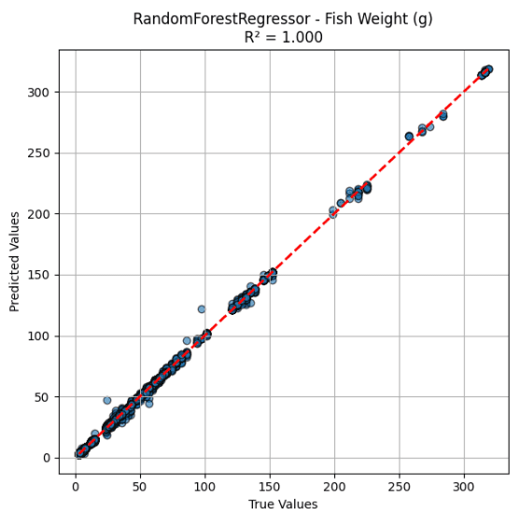
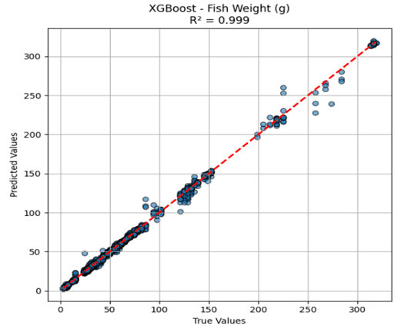
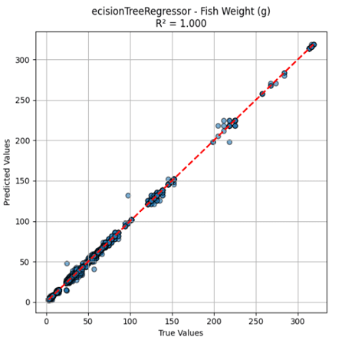
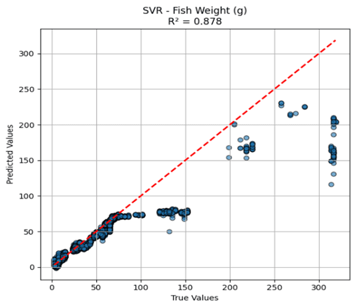
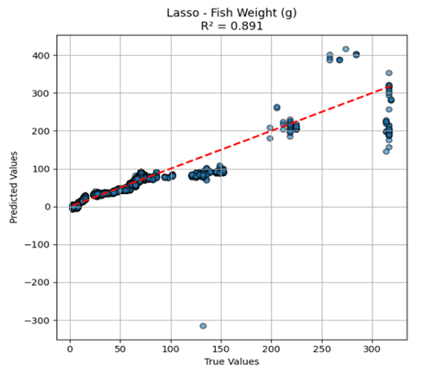
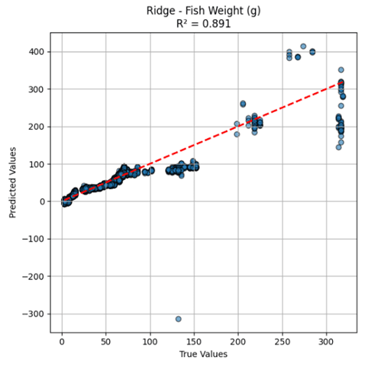

Slide 15
Conclusion
The results of this study demonstrate that water quality data collected through Internet of Things (IoT) sensors provide a reliable basis for predicting fish growth in aquaculture systems. The main contribution of this work lies in moving beyond water quality prediction alone by directly linking environmental data to actual fish growth indicators, specifically fish length and fish weight, within a unified analytical framework.
The findings show that fish growth is influenced by the combined effects of multiple environmental factors, and that advanced machine learning models are more effective than traditional approaches in capturing these relationships. Incorporating both length and weight in the evaluation process provides a more comprehensive and realistic understanding of fish growth, thereby increasing the reliability of the predictions.
This integrated analysis supports a shift from traditional reactive monitoring toward predictive, data-driven aquaculture management, enabling better-informed operational decisions such as feeding and aeration control.
Regarding future work, this research can be extended through the real-time deployment of predictive models within IoT platforms to support automated control actions. In addition, using longer-term datasets that include seasonal variations may further improve model stability and generalization. Future studies may also explore advanced deep learning architectures and growth-stage-based modeling to enhance prediction accuracy over extended periods.
Overall, this study provides a practical and scalable foundation for the development of smarter, more efficient, and sustainable aquaculture systems through the direct integration of water quality data with fish growth prediction.

Slide 16
Thank You
20 Dec 2025
Written by Ahmed Alnahari
Student ID: 251003035
Supervisor: Dr. Hager Saleh

