Slide 1


English Pronunciation Course
Prepared by
Ahmed Soliman

Slide 2



Lecture 2

Slide 3
Outline:
Linking Vowel to Vowel
Linking Consonant to Vowel

Slide 4
(linking vowel to vowel)

Slide 5


Slide 6
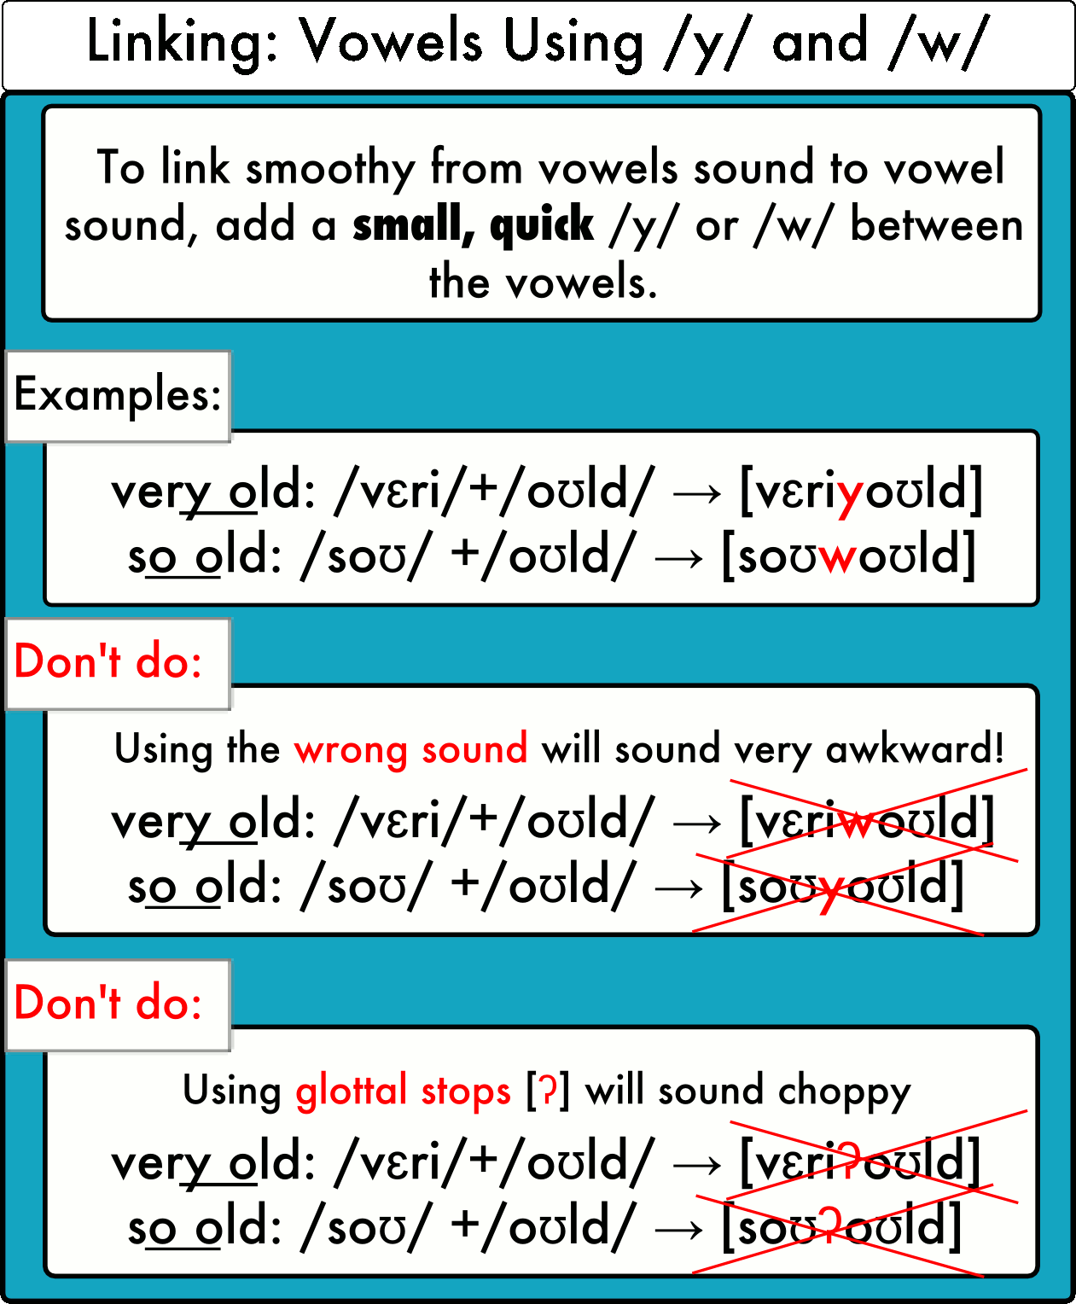

Slide 7
Practice
https://pronuncian.com/linking-vowels-into-vowels

Slide 8
(Linking Consonant to Vowel)

Slide 9
Linking Final Consonants to Words Beginning with a Vowel

Slide 10
Rules to Remember
When a word with a final consonant is followed by a word beginning with a vowel, we link the consonant to the vowel in the next word.
Why?
The final consonant will be easier to say.
Your speech will sound more natural.
Understanding this rule will help improve your listening skills because you will start to hear when native speakers do this.

Slide 11
Examples
time off ---> ti-moff
date of ---> da-tof
keep up ---> kee-pup
at a ---> a-ta

Slide 12
Note
When linking a final /t/ to a vowel, the /t/ sound often changes to a fast "d" sound.
Examples:
  date of = da-dəv
  at a = a-də

Slide 13


Slide 14
What's up?
ten hours a day
That's what I thought.
What is it?
It's his anniversary.
I'm on the train.
This is too much.
Forget about it.

Slide 15



Thank You

