Slide 1


MASTER OF SCIENCE IN AI THESIS
Cyber Security Threat Hunting
Through Log Analysis
Using LLM with Agentic Action
Presenter
Supervisor
Omar Salem Almutairi
Amjad Qatish
Midocean University | College of Informatics | 2025

Slide 2




Executive Summary
100%
0%
Modern cybersecurity is characterized by advanced dynamic attack vectors. This project develops an AI-based threat hunting system capable of autonomous log analysis and response.
RECALL
FPR
•
Model: gpt-oss-120b
•
Focus: Agentic Action (Analysis + Execution)
Perfect
•
Result: Bridge between Detection & Response
ACTION EFFICACY

Slide 3

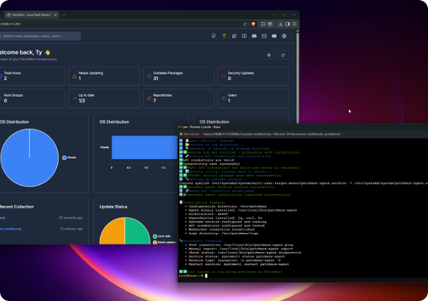
The Problem: Analyst Overload & Legacy Gaps
Reactive Defense: Legacy signature-based systems miss "living-off-the-land" methodologies.
Log Volume: Excessive data causes human fatigue, overlooking subtle indicators.
Disconnected Response: Standard NIDS provide alerts but lack automated remediation.

Slide 4




Proposed Approach: The Agentic Workflow
Our solution implements a "Cyber Defense Analyst" persona in an autonomous feedback loop.
Multi-source logs (Auth, Audit, Syslog)
LLM extracts threat-specific lines
LLM determines remediation strategy
Direct Kernel/OS intervention (iptables)

Slide 5
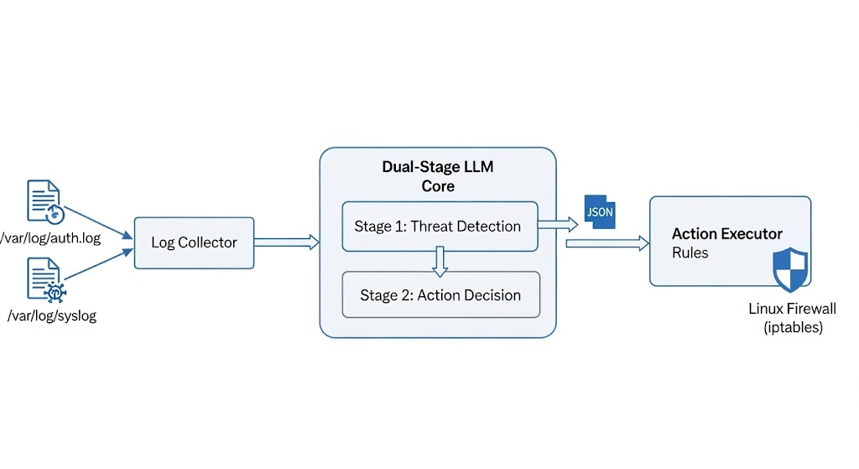
CODE Structure
T1548.001: Privilege Escalation via SUID Binaries.
T1048.003: Exfiltration over Alternative Protocol.

Slide 6


System Architecture: Dual-Stage Loop
PoC Operational Logic
1. Collection: Stateful tracking via offset management.
2. Stage 1 (Detect): Raw logs analyzed for indicators.
3. Stage 2 (Decide): JSON-structured decision generation.
4. Execution: Python subprocess executes Linux commands.
Tech Stack: Groq API, LangChain, Python, Linux iptables.

Slide 7


Work Done: Intrusion Lifecycle (Phase 1)
Initial Access: SSH Brute Force
The model accurately identified 30+ failed attempts from a single source IP (104.28.2.14) within a 60-second window.
LLM Action
Aggregated redundant logs into a single high-fidelity incident finding. Reduced alert noise by 96%.

Slide 8



Work Done: Persistence & Exfiltration
Persistence (T1053.003)
Exfiltration (T1041)
Detected unauthorized Cron job creation for a reverse shell to C2 IP 10.1.1.50.
Flagged data exfiltration via Google Search cover URLs, a complex obfuscation technique.

Slide 9
Performance Evaluation Metrics
Metric | Definition | PoC Result
Recall (Detection Rate) | Percentage of malicious events correctly identified | 100%
False Positive Rate (FPR) | Percentage of benign logs flagged as threats | 0%
Action Syntax Correctness | Percentage of valid, executable remediation scripts | 100%
MITRE Coverage | Mapping accuracy to ATT&CK techniques | 100%

Slide 10

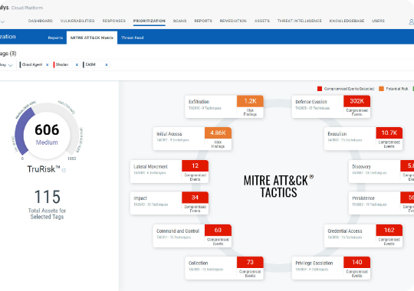
MITRE ATT&CK Framework Mapping
T1110.001: Credential Access via Brute-Force.
T1053.003: Persistence through Scheduled Cron Tasks.
T1548.001: Privilege Escalation via SUID Binaries.
T1048.003: Exfiltration over Alternative Protocol.

Slide 11


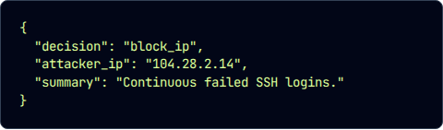
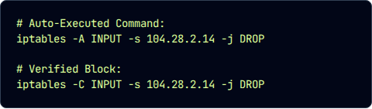
Agentic Action: Automated Remediation
The system bridges the gap by converting LLM reasoning into instant OS commands.
LLM Reasoning (JSON)
Kernel Execution (CLI)

Slide 12


Discussion: Operational Impact
Analyst Augmentation
Speed to Contain
Reduces cognitive load by synthesizing unstructured logs into summarized narratives. Allows Tier 1 analysts to handle complex forensic chains.
Automates the "Time to Contain" metric. In simulation, IP blocking occurred within 3 seconds of detection.
The 0% FPR ensures that benign administrative tasks are not disrupted, solving the "Automated Over-Blocking" problem.

Slide 13


Conclusion
This thesis validates that agentic LLMs are more than passive analysis tools—they are effective actors in cyber defense.
Key Findings
Future Work
•
100% Detection rate of known patterns.
•
Integration with live SIEM/EDR API streams.
•
Zero false positives on test noise logs.
•
Adversarial testing against "poisoned" logs.
•
Syntactically perfect remediation scripts.
•
Multi-modal analysis (Log + PCAP correlation).

Slide 14
Thank You!
Any Questions?
Contact: Omar Salem Almutairi
Midocean University | College of Informatics

Slide 15




Image Sources
https://static0.xdaimages.com/wordpress/wp-content/uploads/2025/10/patchmon-4.png?q=49&fit=crop&w=825&dpr=2
Source: www.xda-developers.com
http://conceptdraw.com/How-To-Guide/picture/network-seccurity-new.png
Source: www.conceptdraw.com
https://ik.imagekit.io/qualys/wp-content/uploads/2024/03/Qualys-MITRE-Mapping.png
Source: blog.qualys.com
https://static.vecteezy.com/system/resources/previews/070/707/983/non_2x/abstract-digital-data-stream-binary-code-visualization-for-technology-cybersecurity-and-future-concepts-photo.jpeg
Source: www.vecteezy.com

