Slide 1


Introduction to Health Insurance
Prepared by Dr. Hayat Farag
MHA631
Health Insurance
Lecture 1

Slide 2

Objectives
Understand Health Insurance & Key terms.
Explore the evolution of Health Insurance events.
Discuss the importance and purpose of medical documentation.
Identify and differentiate among various record systems (e.g., POR, EHR, EMR, PHR).

Slide 3
Chapter
Health Insurance
01
Health insurance is a contract between a policyholder and a third-party payer or government program to reimburse the policyholder for all or a portion of the cost of medically necessary treatment or preventive care provided by healthcare professionals.
Health insurance is available to individuals who participate in group (e.g., employer sponsored), individual (or personal insurance), or prepaid health plans (e.g., managed care).

Slide 4

It is important to remember the familiar phrase “If it wasn’t documented, it wasn’t done.”
It is important to remember the familiar phrase “If it wasn’t documented, it wasn’t done.”
Health Insurance Terms

Slide 5
Chapter
Health Insurance Terms
01
Group Health Insurance
Traditional healthcare coverage subsidized by employers and other organizations (e.g., labour unions) where part or all of premium costs are paid for and/or discounted group rates are offered to eligible individuals.
Individual Health Insurance
Private health insurance policy purchased by individuals or families who do not have access to group health insurance coverage. Applicants can be denied coverage, and they can also be required to pay higher premiums due to age, gender, and/or pre-existing medical conditions.

Slide 6
Chapter
Health Insurance Terms
01
Public Health Insurance
Federal and state government health programs (e.g., Medicare, Medicaid, TRICARE) available to eligible individuals.
Single–payer Plan
Centralized healthcare system adopted by some Western nations (e.g., Canada, Great Britain) and funded by taxes. The government pays for each resident’s health care, which is considered a basic social service.

Slide 7
Chapter
Health Insurance Terms
01
Socialized Medicine
A type of single-payer system in which the government owns and operates healthcare facilities and providers (e.g., physicians) receive salaries. The VA (Veterans Affairs) healthcare program is a form of socialized medicine.
Universal Health Insurance
The goal of providing every individual with access to health coverage, regardless of the system implemented to achieve that goal.

Slide 8
It is important to remember the familiar phrase “If it wasn’t documented, it wasn’t done.”
It is important to remember the familiar phrase “If it wasn’t documented, it wasn’t done.”
Significant Events in Healthcare Reimbursement

Slide 9
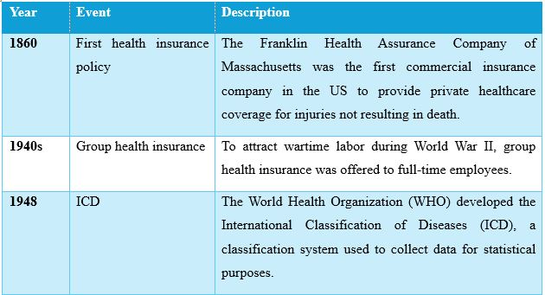
Significant Events in Healthcare Reimbursement

Slide 10
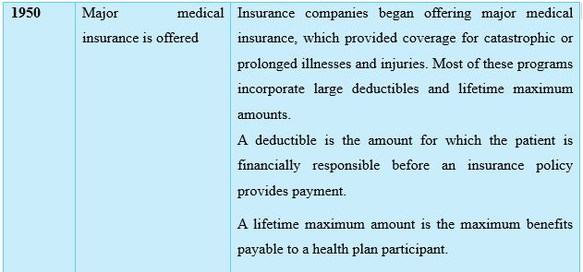
Significant Events in Healthcare Reimbursement

Slide 11
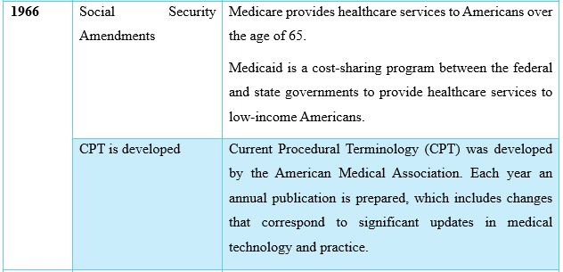
Significant Events in Healthcare Reimbursement

Slide 12
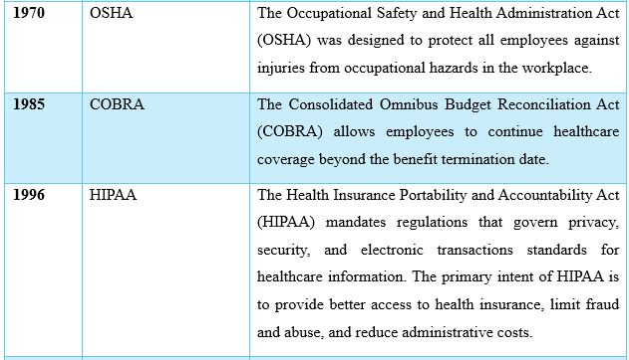
Significant Events in Healthcare Reimbursement

Slide 13
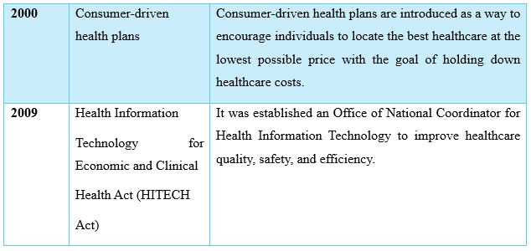
Significant Events in Healthcare Reimbursement

Slide 14

It is important to remember the familiar phrase “If it wasn’t documented, it wasn’t done.”
It is important to remember the familiar phrase “If it wasn’t documented, it wasn’t done.”
Medical Documentation

Slide 15
Chapter
Medical Documentation
01
Healthcare providers are responsible for documenting and authenticating legible, complete, and timely patient records in accordance with federal regulations and accrediting agency standards.
The provider is also responsible for correcting or altering errors in patient record documentation.
A patient record (or medical record) documents healthcare services provided to a patient by healthcare provider.
The records include:
patient demographic/ identification data,
documentation to support diagnoses and justify treatment provided,
results of treatment provided.

Slide 16
Primary purpose of patient record:
To provide continuity of care, which involves documenting patient care services so that others who treat the patient have a source of information to assist with additional care and treatment.
It serves as a communication tool for physicians and other patient care professionals and assists in planning individual patient care and documenting a patient’s illness and treatment.

Slide 17
Secondary purposes of the record (do not relate directly to patient care) and include:
Evaluating the quality of patient care.
Providing data for use in clinical research, epidemiology studies, education, public policy making, and healthcare statistics.
Providing information to third-party payers for reimbursement.
Serving the medico-legal interests of the patient, facility, and providers of care.

Slide 18
Documentation includes dictated and transcribed, typed or handwritten, and computer-generated notes and reports recorded in the patient’s records by a healthcare professional.
Documentation must be dated and authenticated (with a legible signature or electronic authentication).
Documentation in the patient record serves as the basis for coding. The information in the record must support codes submitted on claims for third-party payer reimbursement processing.

Slide 19
The patient’s diagnosis must also justify diagnostic and/or therapeutic procedures or services provided. This is called medical necessity and requires providers to document services or supplies that are:
Proper and needed for the diagnosis or treatment of a medical condition.
Provided for the diagnosis, direct care, and treatment of a medical condition.
Consistent with standards of good medical practice in the local area.
Not mainly for the convenience of the physician or healthcare facility.

Slide 20
It is important to remember the familiar phrase “If it wasn’t documented, it wasn’t done.”
It is important to remember the familiar phrase “If it wasn’t documented, it wasn’t done.”
It is important to remember that ......................
“If it wasn’t documented, it wasn’t done.”

Slide 21
Chapter
01
The patient record serves as a medico-legal document and a business record. If a provider performs a service but does not document it, the patient (or third-party payer) can refuse to pay for that service, resulting in lost revenue for the provider.
In addition, because the patient record serves as an excellent defense of the quality of care administered to a patient, missing documentation can result in problems if the record has to be admitted as evidence in a court of law.

Slide 22
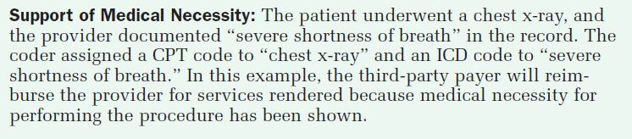
Chapter
01

Slide 23
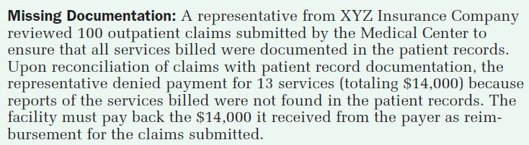
Chapter
01

Slide 24
It is important to remember the familiar phrase “If it wasn’t documented, it wasn’t done.”
It is important to remember the familiar phrase “If it wasn’t documented, it wasn’t done.”
Different Record Systems

Slide 25
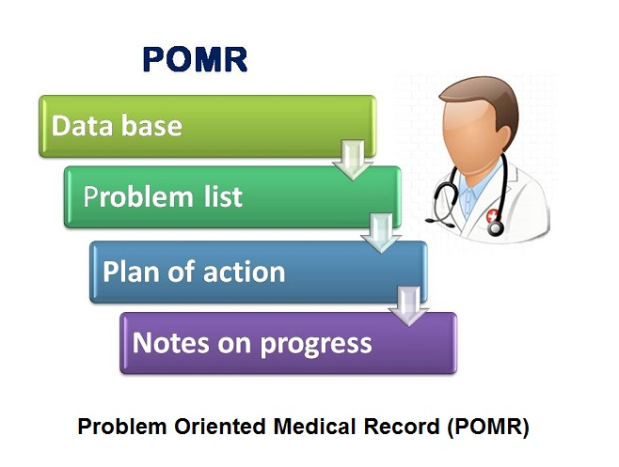
Problem-oriented Record (POR)
Chapter
01
It is a systematic method of documentation, consists of four components:
● Database
● Problem list
● Initial plan
● Progress notes

Slide 26
Problem-oriented Record (POR)
Chapter
01
The POR database contains the following patient information collected on each patient:
● Chief complaint
● Present conditions and diagnoses
● Social data
● Past, personal, medical, and social history
● Review of systems
● Physical examination
● Baseline laboratory data

Slide 27
Problem-oriented Record (POR)
Chapter
01
The POR problem list serves as a table of contents for the patient record because it is filed at the beginning of the record. It contains a numbered list of the patient’s problems, which helps to index documentation throughout the record.
The POR initial plan contains the strategy for managing patient care and any actions taken to investigate the patient’s condition and to treat and educate him or her.

Slide 28
Problem-oriented Record (POR)
Chapter
01
The initial plan consists of three categories:
● Diagnostic/management plans (plans to learn more about the patient’s condition and the management of the conditions).
● Therapeutic plans (specific medications, goals, procedures, therapies, and treatments used to treat the patient).
● Patient education plans (plans to educate the patient about conditions for which he or she is being treated).

Slide 29
Problem-oriented Record (POR)
Chapter
01
The POR progress notes are documented for each problem assigned to the patient, using the SOAP format:
Subjective (S) (patient’s statement/words about how he or she feels, including symptomatic information [e.g., “I have a headache”]).
Objective (O) (observations about the patient, such as physical findings, or lab or x-ray results [e.g., chest x-ray negative]).
Assessment (A) (judgment, opinion, or evaluation made by the healthcare provider [e.g., acute headache]).
Plan (P) (diagnostic, therapeutic, and education plans to resolve the problems [e.g., patient to take Tylenol as needed for pain]).

Slide 30
SOAP Format
Chapter
01
✔ Subjective: Patient’s own words (symptoms, concerns).
✔ Objective: Measurable data (exams, labs, imaging).
✔ Assessment: Provider’s medical conclusion.
✔ Plan: Action steps (tests, medications, referrals, education).

Slide 31
It is important to remember the familiar phrase “If it wasn’t documented, it wasn’t done.”
It is important to remember the familiar phrase “If it wasn’t documented, it wasn’t done.”
Check the following example for SOAP Format

Slide 32
SOAP Format
Chapter
Adjust medication: Increase metformin from 1000mg to 1500mg daily. Diet: Refer to nutritionist for carb-counting guidance. Monitoring: Check fasting glucose daily; return in 1 month for repeat HbA1c. Education: Teach signs of hypoglycemia (dizziness = possible low sugar).
Uncontrolled Type 2 Diabetes (HbA1c >7%) Possible dawn phenomenon (high fasting glucose)
"I've been checking my blood sugar like you said, but it’s still high in the mornings. I’ve been eating less rice, but I sometimes feel dizzy."
Blood Glucose: Fasting: 160 mg/dL (high), Post-meal: 210 mg/dL HbA1c: 8.5% (up from 8.0% 3 months ago) Weight: 185 lbs. (unchanged) BP: 130/85
Subjective (S)
Objective (O)
Assessment (A)
Plan (P)

Slide 33
Electronic Health Record (EHR)
Chapter
01
EHR includes the collection of patient information documented by a number of providers at different facilities regarding one patient.
EHR uses multidisciplinary (many specialties) and multi-enterprise (many facilities) recordkeeping approaches to facilitate record linkage, which allows patient information to be created at different locations according to a unique patient identifier or identification number.

Slide 34
Chapter
Role of Electronic Health Record (EHR)
01
It provides access to complete and accurate patient health problems, status, and treatment data.
It allows access to evidence-based decision support tools (e.g., drug interaction alerts) that assist providers with decision making.
It automates and streamlines a provider’s workflow, ensuring that all clinical information is communicated.
It prevents delays in healthcare response that result in gaps in care (e.g., automated prescription renewal notices).
It supports the collection of data for uses other than clinical care (e.g., billing, outcome reporting, public health disease surveillance/reporting, and quality management).

Slide 35
Electronic Medical Record (EMR)
Chapter
01
It has a more narrow focus than EHR.
It is the patient record created for a single medical practice using a computer.
It includes a patient’s medication lists, problem lists, clinical notes, and other documentation.
Role of EMR:
It allows providers to prescribe medications, order and view results of ancillary tests (e.g., laboratory, radiology).
It alerts the provider about drug interactions, abnormal ancillary testing results, and when ancillary tests are needed.

Slide 36
Chapter
Total Practice Management Software (TPMS)
01
It is used to generate the EMR, automating the following medical practice functions:
● Registering patients
● Scheduling appointments
● Generating insurance claims and patient statements
● Processing payments from patient and third-party payers
● Producing administrative and clinical reports

Slide 37

Personal Health Record (PHR)
Chapter
01
PHR is a web-based application that allows individuals to maintain and manage their health information (and that of others for whom they are authorized, such as family members) in a private, secure, and confidential environment.

Slide 38
SOAP Format
Chapter
"I've been checking my blood sugar like you said, but it’s still high in the mornings. I’ve been eating less rice, but I sometimes feel dizzy."
Blood Glucose: Fasting: 160 mg/dL (high), Post-meal: 210 mg/dL HbA1c: 8.5% (up from 8.0% 3 months ago) Weight: 185 lbs. (unchanged) BP: 130/85
Uncontrolled Type 2 Diabetes (HbA1c >7%) Possible dawn phenomenon (high fasting glucose)
Adjust medication: Increase metformin from 1000mg to 1500mg daily. Diet: Refer to nutritionist for carb-counting guidance. Monitoring: Check fasting glucose daily; return in 1 month for repeat HbA1c. Education: Teach signs of hypoglycemia (dizziness = possible low sugar).
Subjective (S)
Objective (O)
Assessment (A)
Plan (P)

Slide 39

Chapter
Key Takeaways
01
Health insurance is a contract between a policyholder and a third-party payer or government program for the purpose of providing reimbursement of all or a portion of medical and health care costs.
The history of healthcare reimbursement can be traced back to 1860, when the Franklin Health Assurance Company wrote the first health insurance policy.
A patient record (or medical record) documents healthcare services provided to a patient, and healthcare providers are responsible for documenting and authenticating legible, complete, and timely entries.

Slide 40
Chapter
Key Takeaways
01
4. The primary purpose of patient/medical record is to provide for continuity of care.
5. The problem-oriented record (POR) is a systematic method of documentation that consists of four components: database, problem list, initial plan, and progress notes (documented using the SOAP format).

Slide 41
Chapter
Key Takeaways
01
6. The electronic health record (EHR) is a global concept that includes the collection of patient information documented by a number of providers at different facilities regarding one patient.
7. The electronic medical record (EMR) has a more narrow focus (as compared with the EHR) because it is the patient record created for a single medical practice and uses total practice management software (TPMS) to generate the EMR and automate medical practice functions.

Slide 42



Thank You

