Slide 1


System Administration 1
Prepared by Dr. Ahmed Omar
IT391
System Administration 1
Lecture 1

Slide 2


Agenda
Defining Systems, Components, and Services
The Importance of System Administration
Core Responsibilities and Daily Tasks
Essential Tools and Technologies
Common Challenges Faced
Guiding Rules and Best Practices
Ethical Considerations in System Administration

Slide 3
Defining "System" in an IT Context
What is an IT System?
"A system is an organized collection of interconnected components that work together to achieve specific objectives.
Key Characteristics:
  Integration: Components work as unified whole
  Purpose: Designed to accomplish specific goals
  Interaction: Elements communicate and depend on each other
  Boundaries: Clear definition of what's inside vs outside
  Environment: Operates within specific context

Slide 4
Defining "System" in an IT Context
Types of Systems in IT:
Operating Systems (Windows, Linux, macOS)
Network Systems
Database Systems
Application Systems
Security Systems

Slide 5
Core Components of IT Systems : Tangibles
IT Components:
The building blocks – "Hardware, software, networks, and services that support organizational operations". They form the "foundation of any organization's technology ecosystem".

Slide 6
Core Components of IT Systems
Hardware:
Processors (CPU): Execute instructions and calculations
Memory (RAM): Temporary data storage and processing
Storage: Permanent data retention (HDDs, SSDs)
Network Interfaces: Communication pathways
Input/Output Devices: User interaction point

Slide 7
Core Components of IT Systems
Software:
Operating System: Core system management
Applications: User-facing programs
Drivers: Hardware communication interfaces
Utilities: System maintenance tools
Firmware: Low-level hardware control

Slide 8
Core Components of IT Systems
Networks:
Connect devices and facilitate data transmission.
Examples: Local Area Networks (LANs), Wide Area Networks (WANs), wireless networks.

Slide 9
Understanding IT Services
Definition: Services enabled by the IT components, supporting organizational operations and user needs
Core System Services:
Process Management: Running and scheduling programs
Memory Management: Allocating and organizing RAM
File System: Organizing and accessing data
Security Services: Authentication and authorization
Network Services: Communication protocols

Slide 10
Understanding IT Services
Infrastructure Services:
DNS (Domain Name System): Name resolution
DHCP: Automatic IP address assignment
Web Services: HTTP/HTTPS protocols
Email Services: SMTP, POP3, IMAP
Database Services: Data storage and retrieval

Slide 11
Understanding IT Services
Application Services:
Directory Services: User and resource management
Backup Services: Data protection and recovery
Monitoring Services: System health tracking
Update Services: Software maintenance
Remote Access: SSH, RDP, VPN

Slide 12
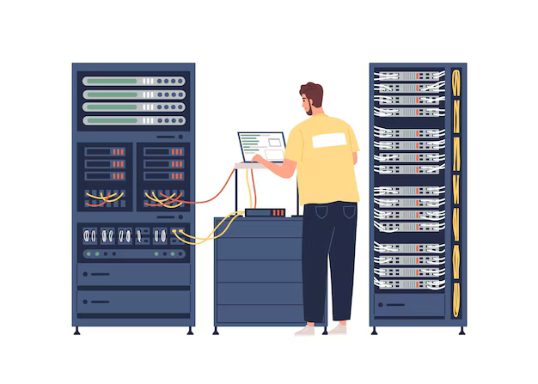
What is System Administration
System administration refers to managing the operation of computer systems in a multi-user environment and encompasses the tasks and responsibilities involved in maintaining, monitoring, and supporting the operation of these systems

Slide 13
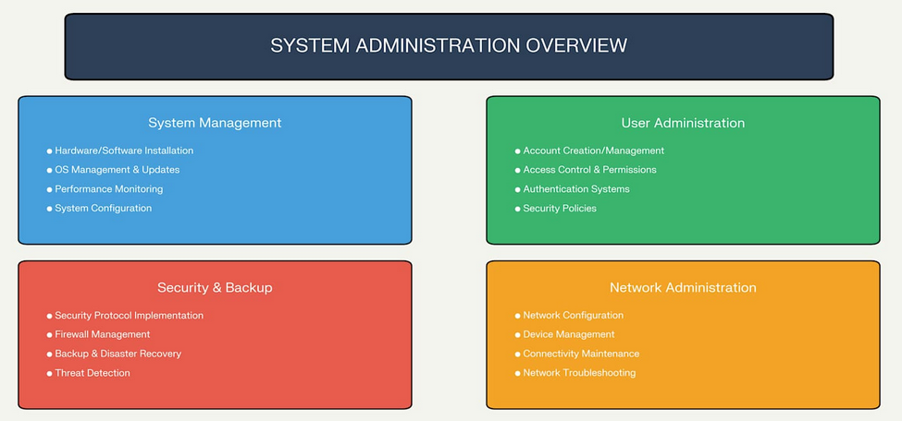
Core Areas of System Administration

Slide 14
System Administrator
A system administrator, commonly known as a sysadmin, is an information technology professional who supports a multiuser computing environment and ensures continuous, optimal performance of IT services and support systems.
The system administrator seeks to ensure that the uptime, performance, resources, and security of the computers they manage meet the needs of the users, without exceeding a set budget when doing so.

Slide 15
Importance of System Administration
Why System Administration Matters:
Business Continuity:
  Ensures systems remain operational 24/7
  Minimizes downtime and service interruptions
  Maintains productivity and revenue flow
  Supports business growth and scalability
Data Protection:
  Safeguards critical business information
  Implements backup and disaster recovery
  Ensures data integrity and availability
  Complies with regulatory requirements

Slide 16
Importance of System Administration
Why System Administration Matters:
Security Assurance:
  Protects against cyber threats and attacks
  Maintains system and network security
  Manages user access and permissions
  Monitors for suspicious activities
Performance Optimization::
  Ensures systems run efficiently
  Manages resource allocation
  Optimizes network performance
  Plans for capacity requirements

Slide 17
Importance of System Administration
Why System Administration Matters:
Cost Management:
    Reduces operational expenses
    Prevents costly system failures
    Optimizes resource utilization
    Plans strategic technology investments

Slide 18
System Administration Challenges
Technical Challenges:
    Complexity: Managing diverse, interconnected systems
    Scale: Handling growing data and user volumes
    Integration: Connecting different technologies
    Legacy Systems: Maintaining older infrastructure
    Rapid Change: Keeping up with technology evolution

Slide 19
System Administration Challenges
Security Challenges:
    Cyber Threats: Evolving attack methods
    Compliance: Meeting regulatory requirements
    Access Management: Controlling user permissions
    Data Privacy: Protecting sensitive information
    Incident Response: Handling security breaches

Slide 20
System Administration Challenges
  Operational Challenges:
    24/7 Availability: Ensuring continuous operation
    Resource Constraints: Limited budget and staff
    Skills Gap: Finding qualified personnel
    Documentation: Maintaining accurate records
    Change Management: Implementing updates safely

Slide 21
System Administration Challenges
  Business Challenges:
    Alignment: Supporting business objectives
    Communication: Translating technical issues
    Budget Justification: Proving ROI
    Risk Management: Balancing security and usability
    Vendor Management: Coordinating with suppliers

Slide 22
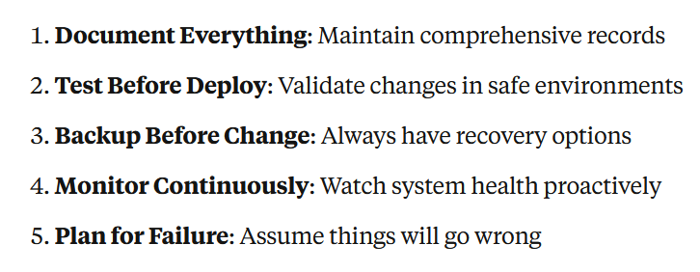
System Administration Rules and Best Practices
  Fundamental Principles

Slide 23
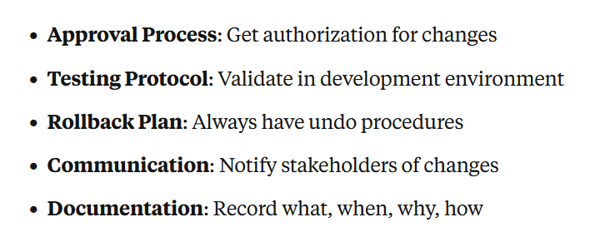
System Administration Rules and Best Practices
  Change Management Rules:

Slide 24
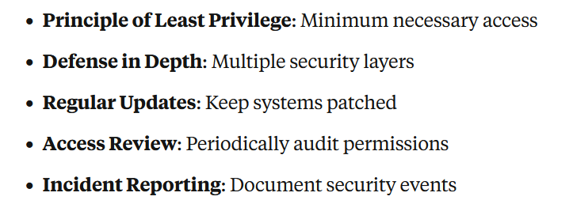
System Administration Rules and Best Practices
  Security Rules:

Slide 25
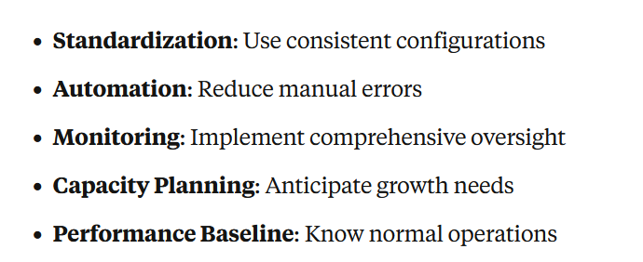
System Administration Rules and Best Practices
  Operational Rules:

Slide 26
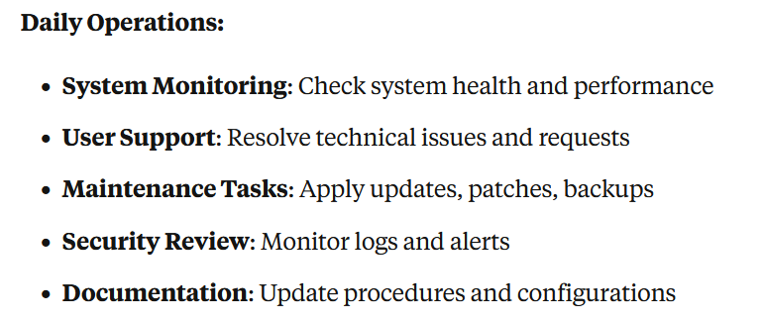
System Administrator Responsibilities
  Core Duties and Expectations

Slide 27
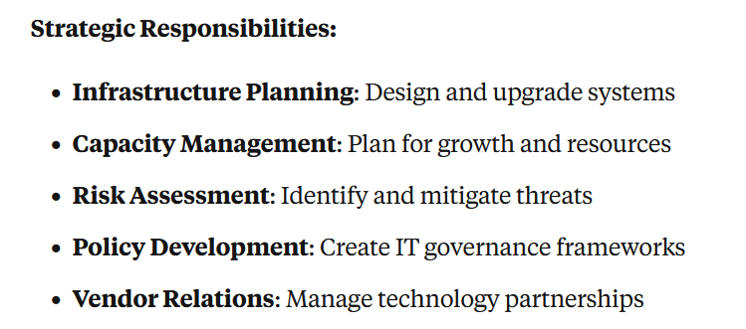
System Administrator Responsibilities
  Core Duties and Expectations

Slide 28
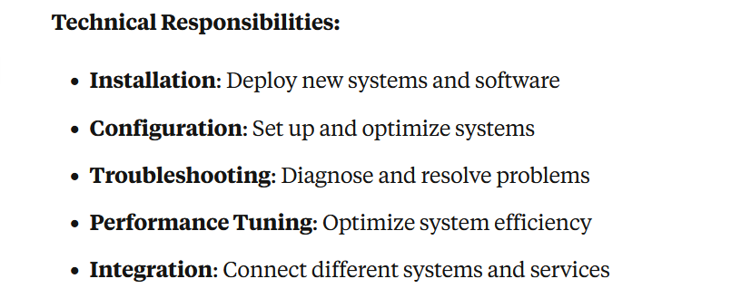
System Administrator Responsibilities
  Core Duties and Expectations

Slide 29
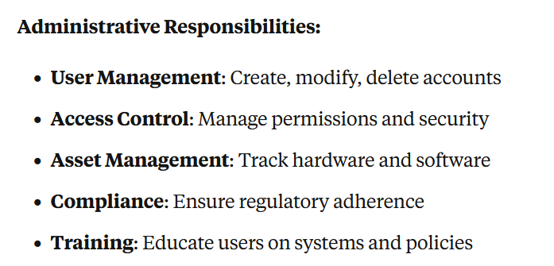
System Administrator Responsibilities
  Core Duties and Expectations

Slide 30
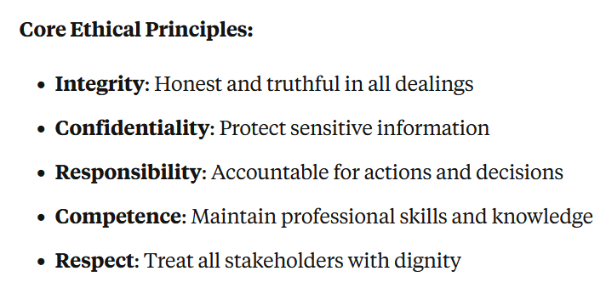
System Administration Ethics
  Professional Standards and Principles

Slide 31
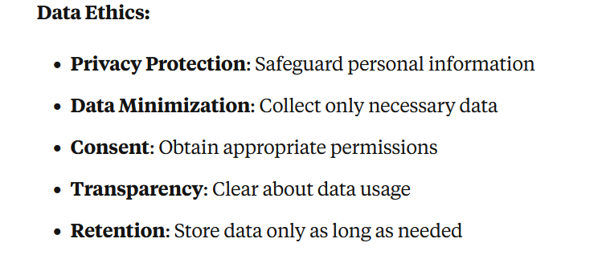
System Administration Ethics
  Professional Standards and Principles

Slide 32
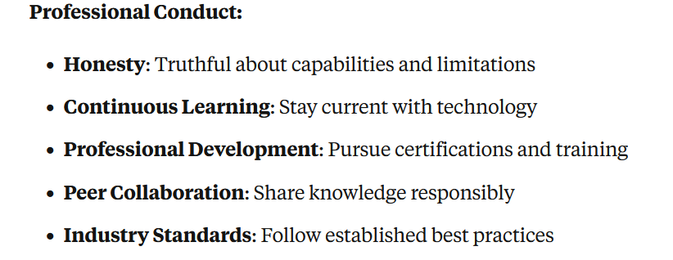
System Administration Ethics
  Professional Standards and Principles

Slide 33
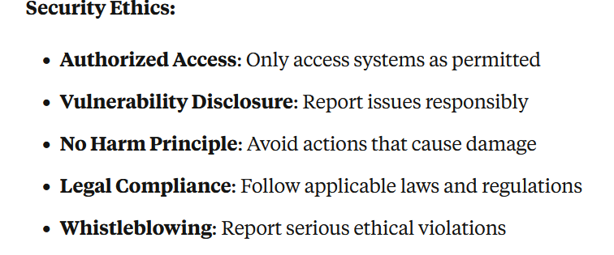
System Administration Ethics
  Professional Standards and Principles

Slide 34
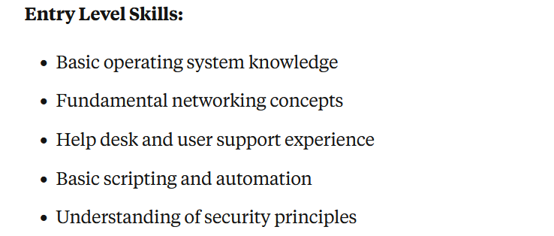
Professional Development Path
  Building System Administration Career

Slide 35
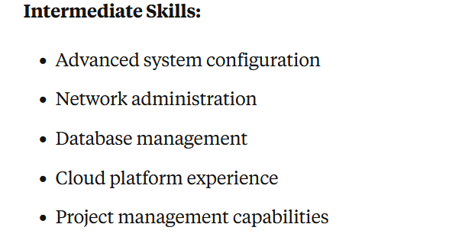
Professional Development Path
  Building System Administration Career

Slide 36
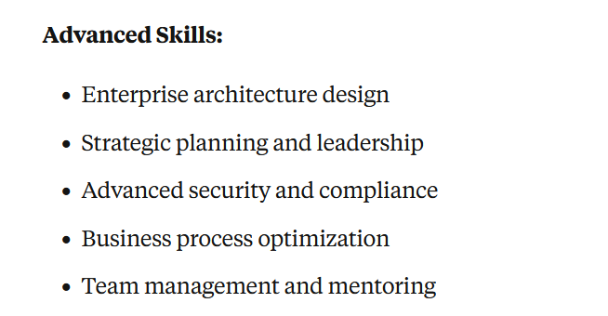
Professional Development Path
  Building System Administration Career

Slide 37
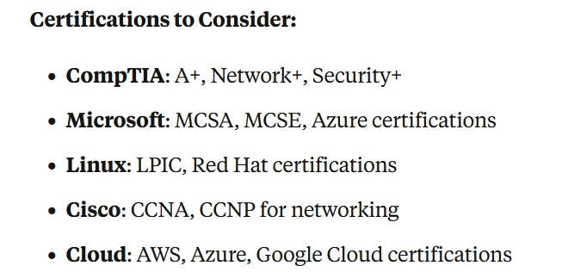
Professional Development Path
  Building System Administration Career

Slide 38
Summary and Key Takeaways
Essential Concepts Covered:Systems: Integrated components working toward common goalsComponents: Hardware, software, and data elementsServices: Core functions provided by systemsImportance: Business continuity, security, and efficiencyChallenges: Technical, security, operational, and business complexities
Essential Concepts Covered:
  Systems: Integrated components working toward common goals
  Components: Hardware, software, and data elements
  Services: Core functions provided by systems
  Importance: Business continuity, security, and efficiency
  Challenges: Technical, security, operational, and business complexities

Slide 39
Summary and Key Takeaways
Essential Concepts Covered:Systems: Integrated components working toward common goalsComponents: Hardware, software, and data elementsServices: Core functions provided by systemsImportance: Business continuity, security, and efficiencyChallenges: Technical, security, operational, and business complexities
Professional Foundation:
Rules: Best practices for safe and effective administration
Responsibilities: Daily operations and strategic planning
Tools: Essential software for system management
Ethics: Professional conduct and moral principles
Development: Continuous learning and career growth

Slide 40



Thank You

