Slide 1


Design Thinking
Prepared by Dr. Aya Mohamed
ENT 621
Master of Entrepreneurship
Lecture 10

Slide 2

In The previous Lecture: Design Thinking
Topics
v
Stakeholder Mapping
What is stakeholder mapping?
Why is stakeholder mapping important?
Common types of stakeholders
Methods for mapping stakeholders
A step-by-step guide for mapping stakeholders
Stakeholder
Mapping
Guide

Slide 3
In This Lecture: Design Thinking
Topics
v
Prototyping
Benefits of prototyping
Prototyping techniques
Storyboards
Types of storyboards
Product - Market fit
Prototyping
Storyboard
Product-market fit

Slide 4
Prototyping
What is prototyping?
A prototype is an early mock-up or model of your product that tests out your ideas and see how viable they are. This might also be referred to as beta testing, sampling, or building a minimum viable product (MVP).
A prototype is an initial version of a system which may be used for experimentation
Prototypes are valuable for requirements elicitation because users can experiment with the system and point out its strengths and weaknesses. They have something concrete to criticize
A prototype gives the stakeholder something real, or at least something that has the appearance of reality. The prototype makes the product real enough for stakeholders to bring up requirements that might otherwise be missed.
Rapid development of prototypes is essential so that they are available early in the elicitation process

Slide 5
The benefits of prototyping
What prototyping does is give you a way to gather feedback and make course corrections before you’ve invested too much time, money, or cash into a given feature or idea. With prototyping, you can:
See in real time how viable your product is
Understand potential go-to-market issues upfront, such as cost, time for development, or materials
Gather feedback from internal stakeholders and customers
Test out new ideas that may not be in the market currently Get buy-in and support from investors and mentors

Slide 6
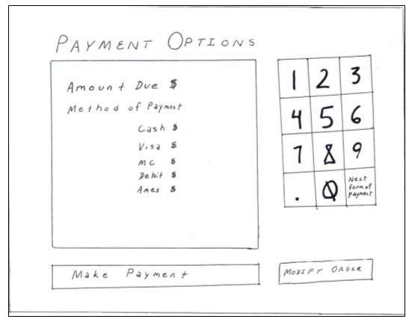
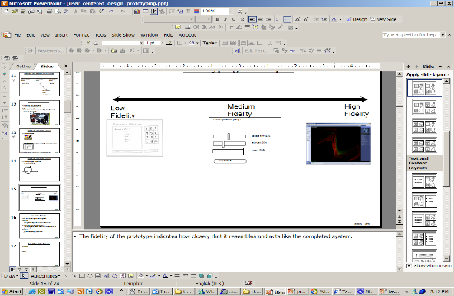
Prototyping Techniques
Low-Fidelity Prototypes
High-Fidelity Prototypes
Storyboards
  Passive storyboards
  Active storyboards
  Interactive storyboards
Low Fidelity
Medium Fidelity
High Fidelity
Control panel for pump 2
coolant flow 45 %
retardant 20%
speed 100%
Shut Down

Slide 7
Low Fidelity Prototypes
Low-fidelity prototyping is a quick, simple way to show your idea — often a sketch, paper, or click-through visualization — that requires minimal effort to create
The Low-Fidelity prototype is not meant to look all that much like the finished product.
It is obviously an easy-to-change mock-up.
The Low-Fidelity prototype encourages iteration. When you sketch a Low-Fidelity prototype, you demonstrate your ideas to the stakeholders and encourage them to iterate by changing and improving your ideas.

Slide 8
Low Fidelity Prototypes
Hand drawn mockups of some design ideas
Focus on:
  Brainstorming as many ideas as possible (discount usability)
  Making it clear enough to be understandable
But don’t focus on making it “pretty”
  They are not computer-generated images (don’t use drawing programs to generate them)
May be used to elicit feedback from the user

Slide 9
Low Fidelity Prototypes
Physical prototyping:
Creating a mock-up of your product to understand dimensions, buttons, features, or design so you can see what it looks like in real life. This could be a quick 3D printout, simplified model, or a single sample from a supplier. This is not usually functional, but you can get a sense of size, materials, and how it appears.
Design or visual prototyping:
On a software level, mapping out the usability — how a person moves through the software step by step — within a dashboard, website, or marketing campaign, so you can collect feedback from users and teammates on logic, intended functionality, and overall design. This often takes the format of a sketch, either within a software tool, PowerPoint, or simply on paper. You can’t interact with any features, but the prototype represents how it would work in different contexts and what it looks like

Slide 10
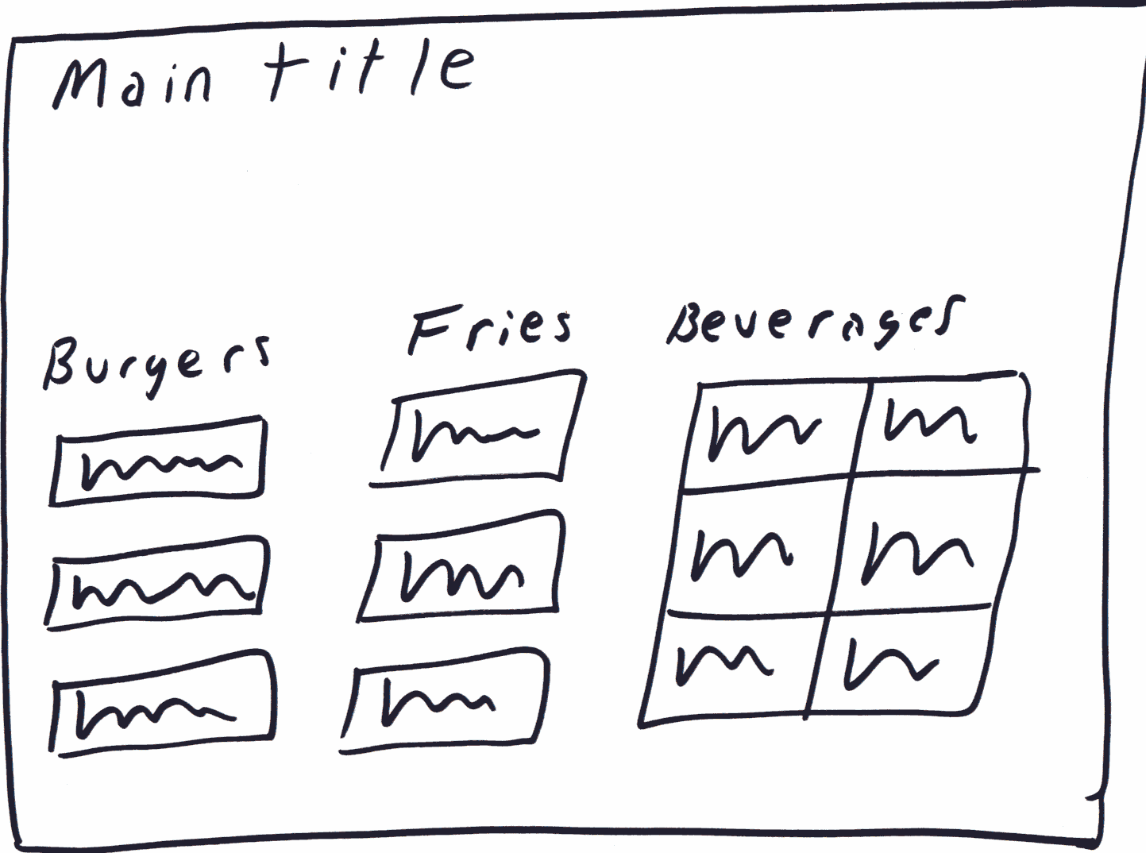
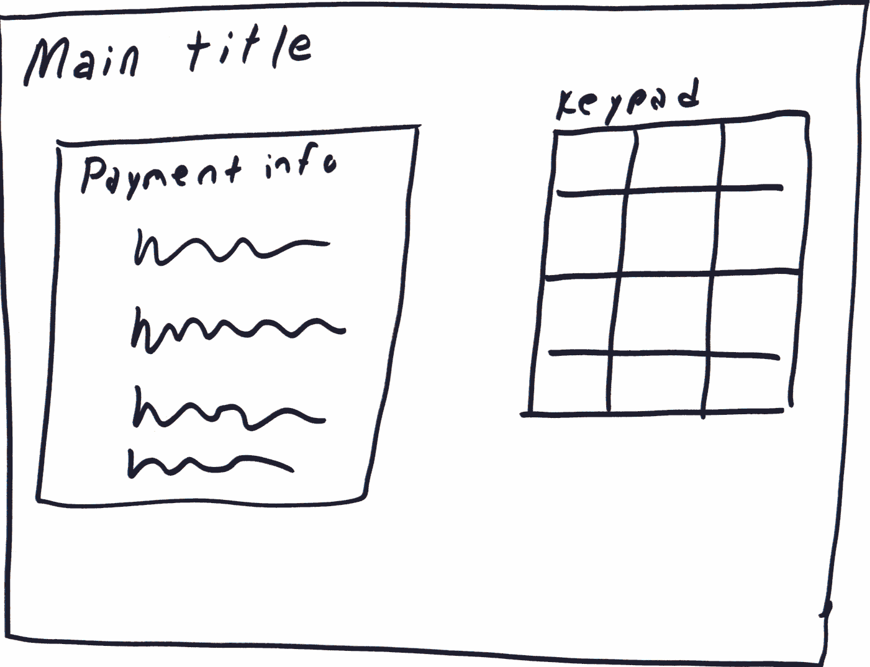
Low Fidelity Prototypes
Sketches:
  A drawing of the high-level appearance of the intended system
  The crudity of the prototype means people concentrate on high level concepts
  It may be hard to envision the progression of a dialog
Screen 1: Initial order screen
Screen 2: Payment screen1

Slide 11
Medium Fidelity Prototypes
Many different types
  Range from simple computer drawn images to partially working systems
They may take longer to generate and change than simple low fidelity representations
Benefits
  It seems more like the completed system so it provides a clearer idea of how it works
  May be used to elicit feedback from the user when low-fidelity approaches cannot be used
  Depending upon the type of medium fidelity prototype it may allow for some user testing.
Pitfalls
  User’s reactions are usually “in the small”
    Blinds people to major representational flaws because of a tendency to focus on more minor details
  Users reluctant to challenge/change the design itself
    Designs are too “pretty”, egos…
  Management may think its real!

Slide 12
High Fidelity Prototypes
High-fidelity prototypes are built using software tools and have the appearance of working software products.
They appear to do whatever the use case does, and give stakeholders the opportunity to "use" a realistic-looking product and decide whether the product displays the correct requirements.
The high-fidelity prototype gives the stakeholders greater opportunities to explore all the possibilities for the use case - the exception and alternative paths;
The high-fidelity prototype is also effective for discovering usability requirements.
High-fidelity prototypes, on the other hand, function much closer to the final product. They may have more design elements or interactivity, and can be used for more complex testing

Slide 13
Storyboards
Building a storyboard means thinking of the proposed functionality as a story and breaking it into a series of steps, or discrete actions Many storyboards show the user at a screen in each panel
Sometimes one picture is enough to illustrate all the actions and outcomes for a use case.
For more complex use cases, or for playing out of several use cases or aspects of the whole product, you need a sequence of pictures.

Slide 14
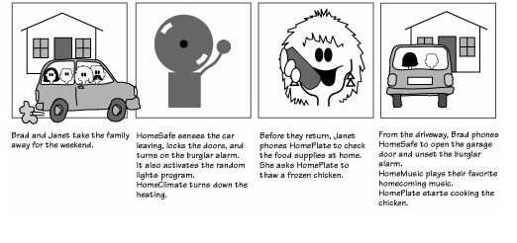
A storyboard demonstrates to the potential users how a product or different parts of a product, could work. Each panel represents an identifiable part of the story. The requirements analyst uses this kind of prototype to play through the product, experimenting with it and learning the requirements.

Slide 15
Types of StoryBoards
Passive StoryBoards
Active StoryBoards
Interactive StoryBoards
What Storyboards Do
In software, storyboards are used most often to work through the details of the human-to-machine interface.

Slide 16
Passive Storyboards
Tell a story to the user
They consist of sketches, pictures, screen shots, PowerPoint presentations, or sample application outputs.
The analyst plays the role of the system and simply walks the user through the storyboard, with a "When you do this, this happens" explanation.

Slide 17
Active StoryBoards
Make the user see "a movie that hasn't actually been produced"
Active storyboards are animated or automated, perhaps by an automatically sequencing slide presentation, an animation tool, a recorded computer script or simulation, or even a homemade movie.
They provide an automated description of the way the system behaves in a typical usage or operational scenario.

Slide 18
Interactive StoryBoards
Let the user experience the system in as realistic a manner as practical.
They require participation by the user.
Interactive storyboards can be simulations or mock-ups or can be advanced to the point of throwaway code.
An advanced, interactive storyboard built out of throwaway code can be very close to a throwaway prototype.

Slide 19
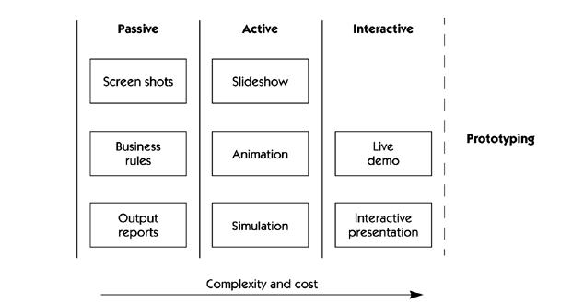
Storyboarding

Slide 20
Storyboards for User Based Systems
Storyboards for user-based systems deal with the three essential elements of any activity:
  Who the players are
  What happens to them
  How it happens

Slide 21
Three Essential Elements
The who element defines the players, or the users of the system.
The “who” are such players as users, other systems, or devices— they are the actors that interact with the solution system.
The what element represents the behavior of the users as they interact with the system as well as the behavior of the system as it interacts with the user.
The how element provides descriptions of how this interaction happens, showing events, states, and state transitions.

Slide 22


Storyboarding
  It’s a series of key frames
    Originally from film; used to get the idea of a scene
    Snapshots of the interface at particular points in the interaction
For interfaces it allows users to quickly evaluate the direction of the design

Slide 23
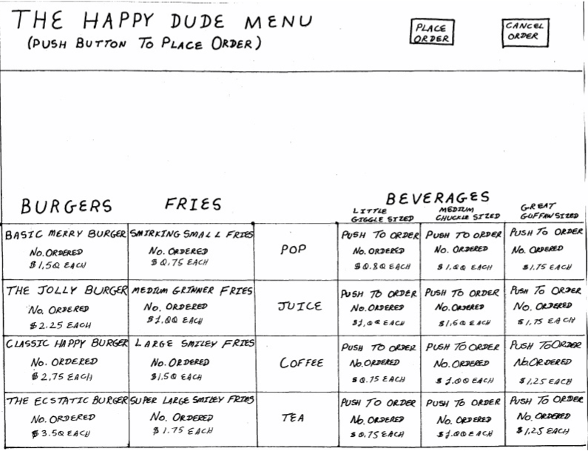
Storyboarding
Initial order screen

Slide 24
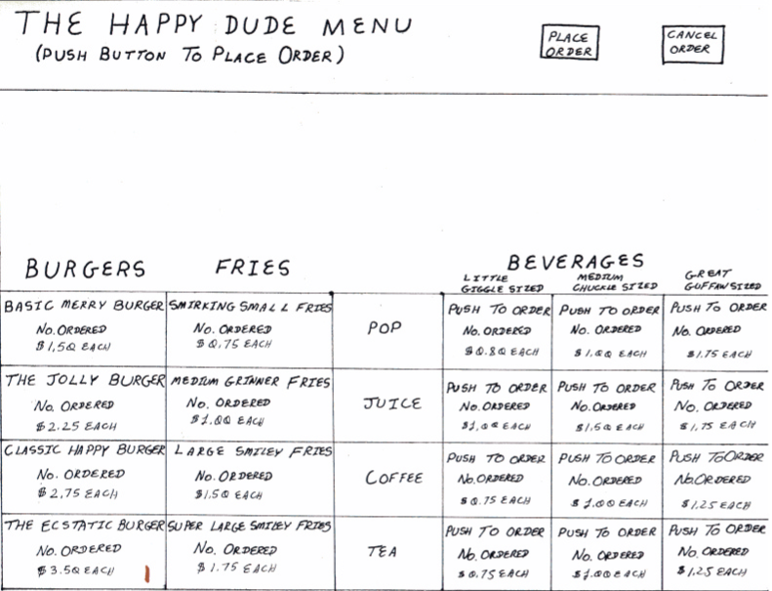
Storyboarding (2)
Person orders an “Ecstatic Burger”

Slide 25
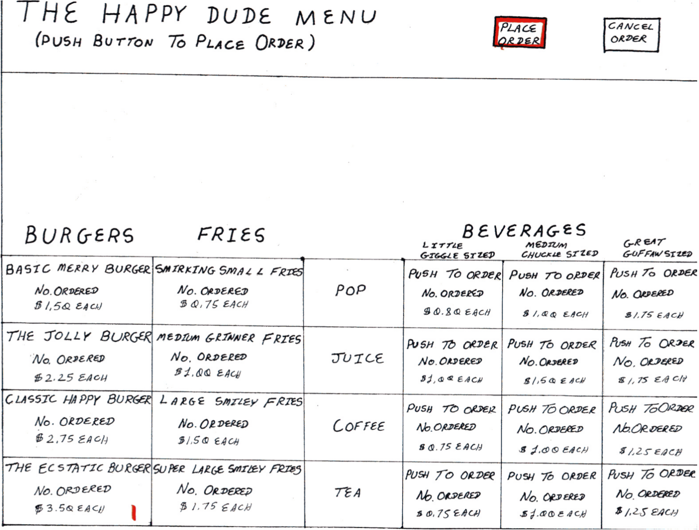
Storyboarding (3)
Order is placed

Slide 26
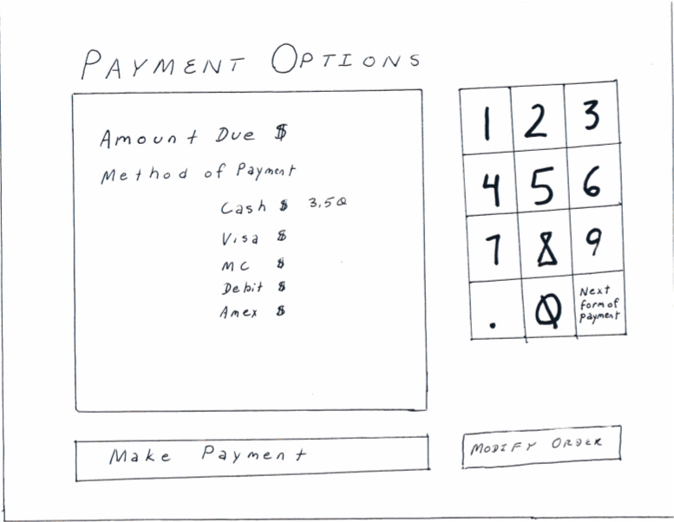
Storyboarding (4)
Payment screen comes up

Slide 27
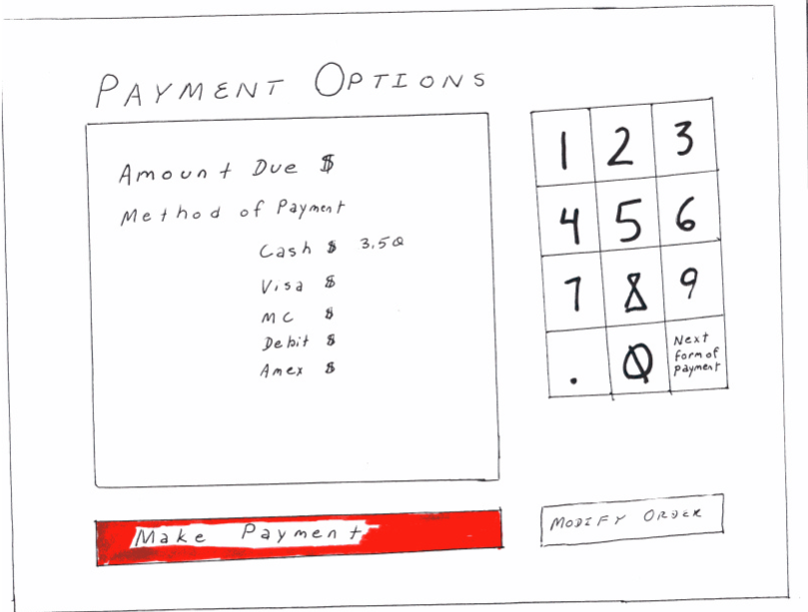
Storyboarding (5)
User pays with cash

Slide 28
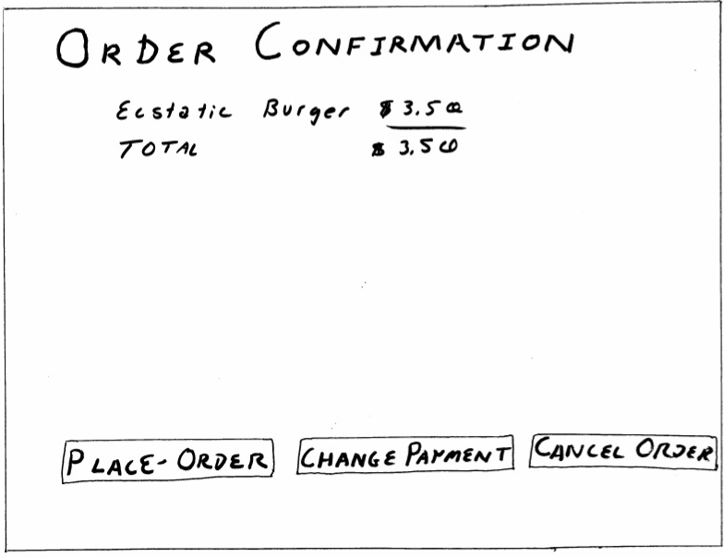
Storyboarding (6)
Order confirmation screen comes up

Slide 29
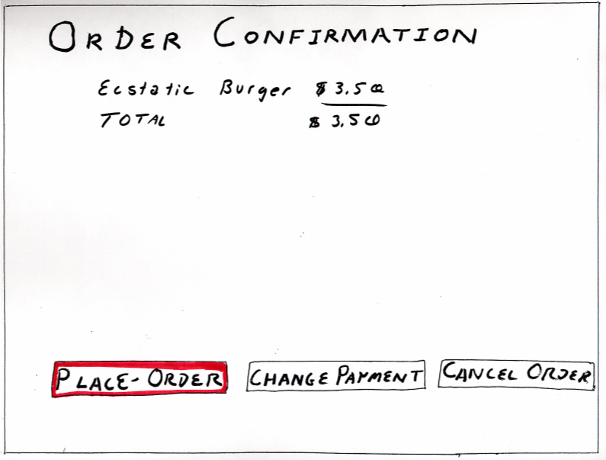
Storyboarding (7)
Order is placed

Slide 30
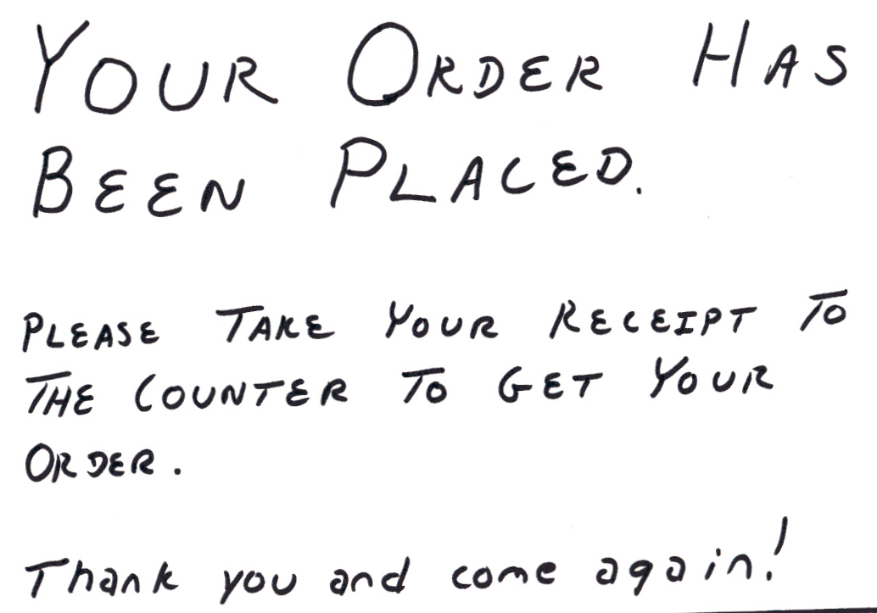
Storyboarding (8)
Order confirmation is shown

Slide 31
Storyboarding (9)
Showing key points in the interaction makes it easy to figure out how the system works.
Showing an alternative interaction requires a whole new series of panels to be made.

Slide 32
Tips for Storyboarding
Don't invest too much in a storyboard. Customers will be intimidated about making changes if it looks like a real work product or they think they might insult you.
If you don't change anything, you don't learn anything. Make the storyboard easy to modify.
Don't make the storyboard too functional. If you do, some stakeholders may want you to "ship it."
Whenever possible, make the storyboard interactive. The customer's experience of use will generate more feedback and will elicit more new requirements than a passive storyboard will.

Slide 33
Throw-Away Prototypes
Prototyping for requirements gathering are throw-away prototypes
  Intended to help elicit and develop the system requirements
  Build the prototype to help capture requirements;
  Discard prototype later and build production quality system;
  Derive specs from prototype -- use for final, conventional software process model

Slide 34
Perceptions of Prototyping
Main argument against prototyping is that the cost is too large a percentage of the total cost;
May be cheaper to modify finished product to get requirements right than to allow user to get requirements right and refine them with prototype before final system.
This may be true for some systems, but prototyping increases software quality and decreases costs overall;
“Build cheap and fix later” can be more expensive in the long run.

Slide 35
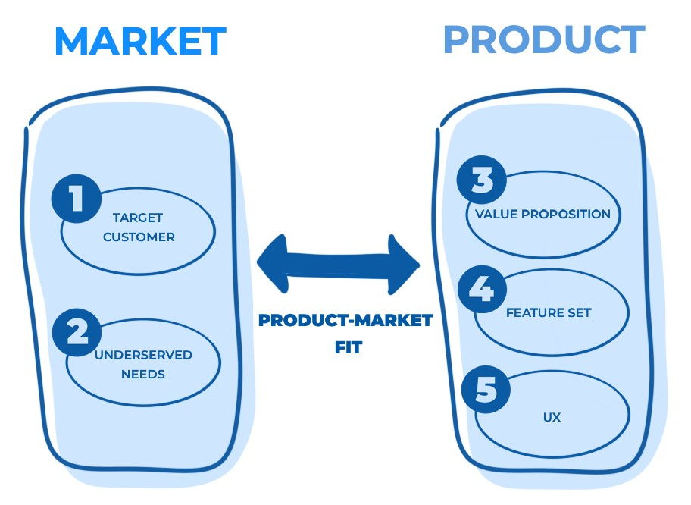

What is product-market fit?
Product-market fit is when your product addresses and solves the needs of your buyer personas in correlating market segments and channels. Using this framework can potentially result in more business success than without proper alignment.

Slide 36
How To Measure Product-Market Fit
The most tangible way to assess your product-market fit and understand how consumers view your products is by sending them surveys. The questions in these surveys are pointed and ask customers if they think your product is a must-have and if they would miss it if it were gone.
Multiple Choice Questions
aid in better understanding the buyer persona that looks for your business.
This can range from asking for information on their location, demographic, career aspirations, or current priorities to better envision the target market your product is going to serve

Slide 37
How To Measure Product-Market Fit
2. Open-Ended Questions
The following questions are open-ended and can help you understand how well your product fits into the market based on your consumers' individual experiences.
“What is the main benefit that you get from using [your product name]?”
“What type of person would benefit most from [your product name]?”
“How can we improve [your product name] to best meet your needs?”
“What motivated you to use our product?”
“Why are you using our product as opposed to other solutions?”
“What makes our product a must-have product?”
Pro Tip: The 40% rule is a popular metric for understanding product-market fit survey results. It states that if at least 40% of customers say they would be “very disappointed” if they no longer have access to your product or service or consider it a “must-have” (wouldn’t use an alternative), you’ve created a product that fits into the market

Slide 38
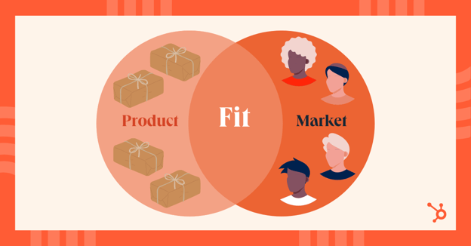
Product-Market Fit Goals for Startups
Many startups fail because they waste money on products that no one wants to buy.
Startups should prioritize product-market fit above all other goals because those that find it will dramatically increase their odds of success.
To avoid this fate, ensure you understand the pain points your product solves, and your customers seek to solve. You can do this by focusing on six primary areas

Slide 39
Product-Market Fit Goals for Startups
Determine your target customer.
Work to identify the target customer who represents the users that will most likely benefit from your product. Use market segments to define your ideal customer, and develop buyer personas for those customers, so your team will clearly understand whom it's building toward
1-Analyzing your product or service
2-Familiarizing yourself with your competition
3-Choosing segment criteria
4-Performing research
2. Gather information
Talk to your customers to determine their pain points and how much they would consider paying for a solution to those challenges. (your sales and marketing teams -meaningful feedback-face-to-face conversations -online surveys)

Slide 40
Product-Market Fit Goals for Startups
3. Focus on a single vertical.
Startups have small budgets, which means that trying to sell your products to everyone will likely result in disaster. Begin with a narrow focus and dive deep into that industry. Establish yourself as the industry expert in a single domain to stimulate a viral spread
4. Specify your value proposition.
Determine which customer needs you can best address with your product or service. Figure out how you can outperform your competitors and surprise your customers. Don’t lose sight of your product roadmap when determining which challenges you’ll address; not every problem will fit into yours

Slide 41
Product-Market Fit Goals for Startups
5. Measure your product-market fit
"Ask your customers if they want or need this product, send out surveys and conduct interviews, these are a part of the product validation process
6. Avoid complacency.
If you manage to achieve product-market fit, don’t assume you’ll always have it. Your customers’ needs will change over time, and you must constantly re-evaluate market conditions to continue meeting those needs.
An example of complacency can be seen in the market of online communication services is Skype. In 2020 when remote business and learning skyrocketed due to unprecedented change across the world, people were scrambling to use and share easy-to-use, Zoom fulfilled the product-market need quickly and now, almost half of the working adult population regularly uses Zoom over Skype, Microsoft Teams, and many more services in that industry

Slide 42
Design Thinking in the Age of AI
Design Thinking in 2025: From Human-Centered to Human + AI-Centered
Design is no longer only human-centered → now Human + AI collaboration
Prototyping is faster with AI tools (UI, content, ideas)
AI helps simulate users before real testing
Decisions are supported by real-time data, not assumptions
Designers focus more on: Problem framing, Ethics, Experience quality
Key Insight:“AI accelerates design, but human empathy defines it.”

Slide 43
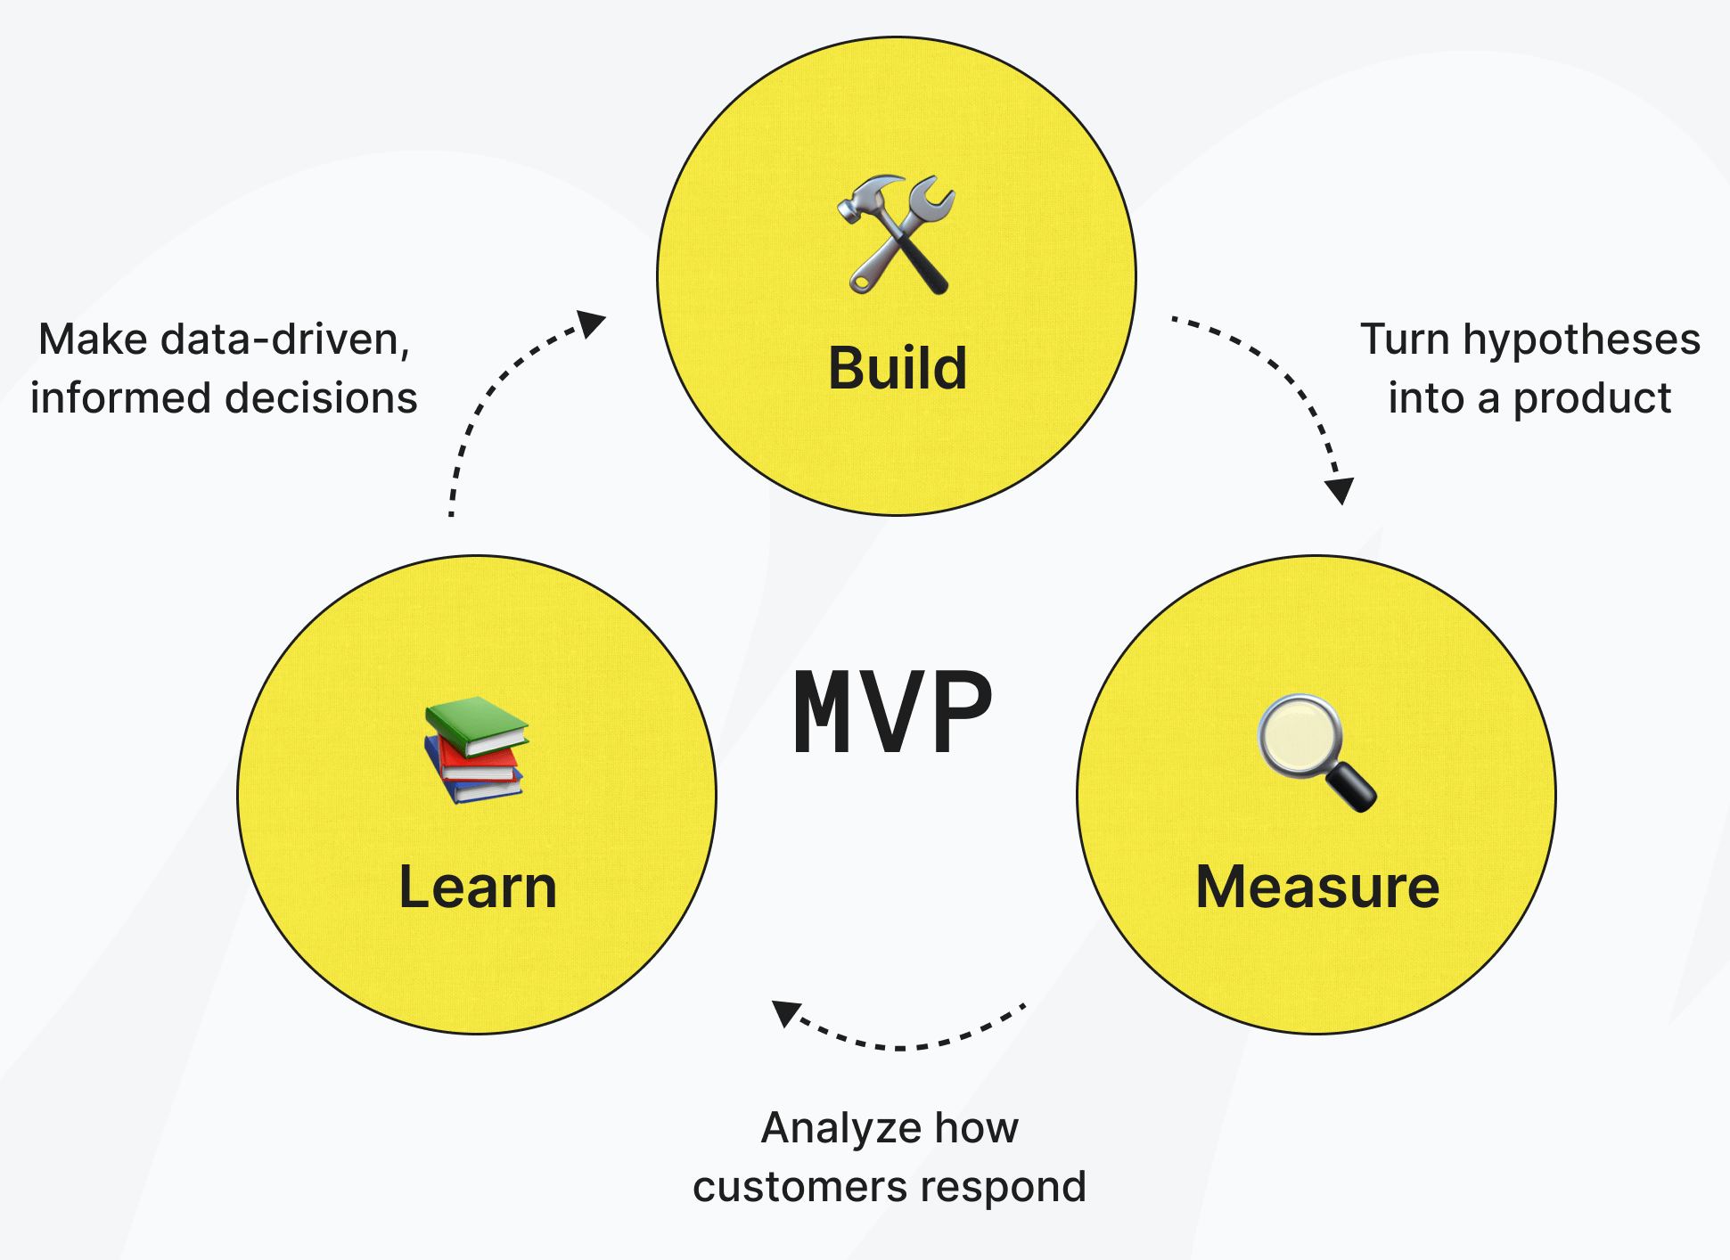
Design Thinking in the Age of AI
From Prototype → Product-Market Fit → Impact
A prototype is not the goal → learning is the goal
Success comes from continuous iteration, not one solution
Modern PMF Metrics:
Activation rate ……Did users start?
Retention rate ….. Did they stay?
Engagement (DAU/MAU) …Do they use it often/love it?
Net Promoter Score (NPS) …Do they recommend it?
Cohort analysis…Is the product improving over time?
Key Insight: “The best ideas don’t win — the best tested ideas do.”

Slide 44
Conclusion:
Find the Right Fit for Your Product
When you achieve product-market fit, your job will become much easier because your customers and other interested parties will become a significant part of your marketing effort. They might even share their own stories with others so you can focus on the work of creating the same great experience for everyone who interacts with your company.

Slide 45
In This Lecture: Design Thinking
Wrap up
v
Prototyping
Benefits of prototyping
Prototyping techniques
Storyboards
Types of storyboards
Product - Market fit
Prototyping
Storyboard
Product-market fit

Slide 46



Thank You

