Slide 1



Lean Canvas model
Prepared by Dr. Mohamed Soliman
ENT624
Entrepreneurial Strategy
Lecture 9

Slide 2



Learning Objectives
1. Discuss the Lean Canvas: Its Origins, difference from Business plan, difference from Business Canvas Model, and Its Blocks.
2. How to conduct a Lean Canvas Model.
3. Explore some case studies to deepen the concepts.

Slide 3
Lean Canvas
This method was created in 2009 primarily to work with SaaS startups. Nowadays many universities and educational institutions all over the world teach this approach as a part of the program of well-known startup accelerators. Lean Canvas is also practiced in many large companies. The author of this approach, Ash Maurya has admitted that he did not expect such popularity.
Lean Canvas is an efficient approach to developing a one-page business plan for deconstructing your business idea into key assumptions for better analysis.
It is a strategic document that helps managers to assemble hypotheses of a particular business model for launching any start up.
It will provide you with an actionable and entrepreneur-focused business plan.
The document is designed to be focused on problems and solutions, key metrics, competitive advantages and other important issues that will be described below in this article.
Lean Canvas is quite similar to the Business Model Canvas structure, but it has some essential differences.
The key advantages of Lean Canvas in comparison with a business plan are:
- Business plan takes too long to write (and actually not everyone will read it)
- Lean Canvas is designed to help creating a quick visualization of any idea, to share it and get a feedback.

Slide 4
Lean Canvas vs Business Plan
Canvas Model Approach : Visual, Dynamic, Action oriented and Focus on Key Activities. Based on an idea, innovation, entrepreneur facility etc.
A Business Plan conveys the organizational structure of your business, including titles of directors or officers and their individual duties. It also acts as a management tool that can be referred to regularly to ensure the business is on course with meeting goals, sales targets or operational milestones.
«Daily business operations and decisions should be aligned to long term company objectives and strategies, which are detailed in the business plan»
Not only for use by third-parties, but for internal use!

Slide 5


Business Model Canvas vs Lean Business Model
Business Model Canvas : by OSTERWALDER
- Outlines several prescriptions which form the building blocks for the activities
- A strategic management and lean startup template for developing new or documenting existing business models.
- A visual chart with elements describing a firm's or product's value proposition, infrastructure, customers, and finances.
Lean Canvas : (why → Answer is here...)
- Outlines a more problem focused approach and it majorly targets entrepreneurs and startup businesses
- Adaptation of Business Model Canvas which Ash Maurya created in the Lean Startup spirit (Fast, Concise and Effective startup).
- Lean Canvas promises an actionable and entrepreneur-focused business plan.
- Focuses on problems, solutions, key metrics and competitive advantages.

Slide 6
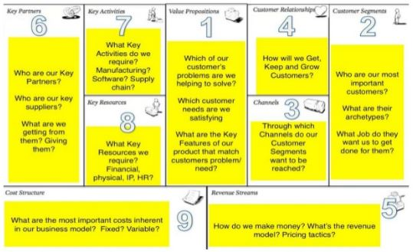
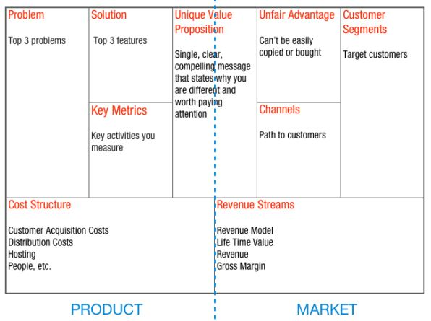
OSTERWALDER (Business Model Canvas)
2
9
1
4
3
5
8
MAURYA (Lean Business Model)
7
6

Slide 7
Element | Business Model Canvas | Lean Canvas
Target | New and existing businesses | Startup businesses purely
Focus | Customers, Investors, Entrepreneurs, Consultants, Advisors | Entrepreneurs purely
Customers | Lays emphasis on customer segments, channels and customer relationships for all businesses | Does not lay much emphasis on customer segments because startups have no known or tested products to sell
Approach | It lays down the infrastructure, lists the nature and sources of financing and the anticipated revenue streams of the business | It begins with the problem, a proposed solution, the channels to achieving the solution, costs involved and the anticipated revenue streams
Competition | It focuses on value proposition in quantitative and qualitative terms as way to stay smart in the market | It assesses whether the business has an unfair advantage over the rest and how to capitalize on it for better grounding
Application | It fosters creativity, discussion and constructive analysis | It is a simple problem-solution oriented approach which enables the entrepreneur to develop step-by-step

Slide 8
Lean Canvas template is a simple one-page business plan that helps deconstruct their ideas into the key assumptions using 9 special blocks/ cells.
Here is a short explanation of each Lean Canvas block:
1) Problem
All customer segments have separate sets of problems that they need to solve. This block is designed right for these problems. Here one, two, three or more problems can be placed. It's better to list up to 3 problems with higher priority.
Identify your real pain. Try to understand the key customers needs and challenges. You may try user interviews, tests, surveys or questionnaires to understand your problems better.
2) Solution
When you recognized the problem, the next thing is to find a solution for it.
Interview your customers, ask them questions and get feedback. Any Lean Startup is validated learning through a continual cycle Build — Measure — Learn.
How can your product solve the problems? Define the main features your product or service offers to solve customers’ problems. Think about the strengths and flaws of each feature.

Slide 9
3) Key Metrics
Key Metrics allow evaluating the success of business processes. Any business needs specific metrics for monitoring performance.
Fill in this Lean Canvas section with the most appropriate metrics for you.
A good idea is to visualize a funnel top down. One of the best model to help with this is AARRR (Pirate Metrics).
4) Customer Segments (CS)
Customer segments are one of the most important blocks. It describes the community of customers or businesses that you are aiming to sell your product.
Customers can be segmented into the groups based on their needs, behaviors and other traits.
They can be defined by demographics (age, gender, ethnicity, profession, etc) or psychographic factors (behavior, interests, and motivations).
5) Unique Value Proposition (UVP)
UVP is a promise of value that should be delivered. It's about why you are different and why your CS should buy or invest time in you.

Slide 10
6) Channels
Channels are the ways to reach your customers' segments.
Think about the channels that will give you enough access to your CS and enough learning: social media, emailing, ads, blogs, TV and radio, trade shows, webinars etc.
Do not use all of them, just where your CS is.
7) Revenue Streams
People often pay not enough attention to the cost structure and revenue. However, these are also the key points that are worth doing.
How you price your business will depend on the type of a model.
8) Cost Structure
In this box, all the operational costs for taking the product/ service to market should be listed.
Consider all your costs of doing business and make sure your customer lifetime value exceeds your acquisition cost.
9) Unfair Advantage
Think about what makes you stand out and what puts you ahead of your competitors.
For example, a great team, insider data, personal authority, getting expert endorsements, reputation, etc.
Just think about something you have that no one can buy.

Slide 11
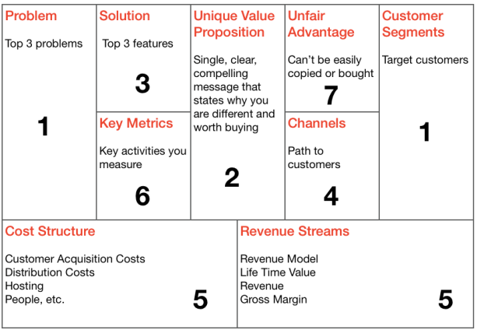
What is Lean Canvas Template?

Slide 12
HOW TO CREATE YOUR LEAN CANVAS
Capture your business model in a portable 1-page diagram.
The Lean Canvas is the perfect format for brainstorming possible business models, prioritizing where to start, and tracking ongoing learning.
Brainstorm Possible
Customers Sketch Multiple Lean Canvases
Prioritize Where to Start
The best way to illustrate the use of the canvas is through an example.

Slide 13
1. Brainstorm Possible Customers
You most likely already have an inkling of the problem, solution, and customer in mind. Start by brainstorming the list of possible customers you envision using your product.
1. Distinguish between customers and users
If you have multiple user roles in your product, identify customers.
A customer is a someone that pays for your product.
2. Split broad customer segments into smaller ones
You can’t effectively build, design, and position a product for everyone.
While you might be aiming to build a mainstream product, you need to start with a specific customer in mind. Even Facebook, with it’s now 500 million+ users started with a specific user in mind - Harvard college students.
3. Sketch a Lean Canvas for each customer segment
As you’ll find shortly, the elements of your business model can and will vary greatly by customer segment.
I recommend starting with the top 2-3 customer segments you feel you understand the best or find most promising.

Slide 14
2. HOW TO CREATE YOUR LEAN CANVAS
Case-study: Lean Canvas
Background
In the course of applying Customer Development and Lean Startup principles to my products, I inevitably needed to document my business model hypotheses. I started with the worksheets at the end of Steve Blank’s book: “The Four Steps to the Epiphany”.
While this was a great exercise, the output was a collection of documents and spreadsheets that become hard to manage and share with other team members over time. I then ran into Alex Osterwalder’s work on Business Model Canvas. While I really liked the portability and clarity of a 1-page business model, I found some of his canvas elements too general and started toying with an adaptation that eventually became the Lean Canvas. The scope of the problems I was addressing also grew from just documenting hypotheses, to measuring and communicating progress over time.
When I started, I envisioned the Lean Canvas being a replacement for worksheets and business plans which led to the following “possible customers” brainstorm list:
Really broad category: Anyone that uses a business plan today

Slide 15
More Specific Possible Customers:
1. Startup founders (bootstrapped, funded)
2. Startup accelerators
3. Investors (Angels, VC)
4. Large companies
Since this was a “scratch my own itch” kind of problem, I decided to build my first Lean Canvas for startup founders.
Sketch Multiple Lean Canvases
In this section, I’ll outline the process for sketching a Lean Canvas.
1. Sketch a canvas in one sitting
While a business plan can take weeks or months to write, your initial canvas should be sketched quickly.
2. It’s okay to leave sections blank
Rather than trying to research or debate the “right” answers, put something down quickly or leave it blank and come back to it later. Some elements like “Unfair Advantage” take time to figure out. The canvas is meant to be an organic document that evolves over time and it’s okay to say “I don’t know”.

Slide 16
3. Think in the present
Business plans try too hard to predict the future which is impossible. Instead, write your canvas with a “getting things done” attitude. Based on your current stage and what you know right now, what are the next set of hypotheses you need to test to move your product forward?
4. Use a customer-centric approach
While Alex Osterwalder discusses several alternative approaches to sketching an initial canvas in his book, I prefer using a customer-centric approach. I start with the Customer Segment and follow a prescribed order to filling out a canvas:

Slide 17
Problem and Customer Segments
I find that the “Problem-Customer” pair usually drives the rest of the canvas which is why I tackle them together:
1. List top 3 problems
For the customer segment you are working with, describe the top 1-3 problems they need solved.
2. List existing alternatives
Then document how you think your early adopters address these problems today. Unless you are solving a brand new problem (unlikely), most problems have existing solutions. Many times these may not be a readily obvious competitor.
As an example, the biggest alternative to most online collaboration tools is not another collaboration tool, but email. Doing nothing could also be a viable alternative for a customer if the pain is not acute enough.

Slide 18
3. Identify other user roles
Next identify any other user roles that will interact with this customer.
Examples:
1. In a blogging platform, the customer is the blog author while the user is a reader.
2. In a photo sharing service, the customer is the sharer, while users are viewers (family and friends).
4. Hone in on possible early adopters
With these problems in mind, get more specific on the customer segment.
Narrow down the distinguishing characteristics of your prototypical customer.
Your objective is to define an early adopter - not a mainstream customer.
As an example, my last product, CloudFire, was a photo and video sharing service targeted at parents. Further refinement got me to define my early adopters as “first-time moms with kids under the age of three”.

Slide 19
Case Study: Lean Canvas - Problem and Customer Segments
Customer Segment: Startup Founder
1. Top 3 problems
Problem 1: Business Models need to be more portable
Business Plans are too static and don’t get read or updated enough. A lot of entrepreneurs skip this step altogether which is NOT the solution.
Problem 2: Measuring progress is hard work
Customer Discovery is a qualitative process and requires a lot of work (documenting interviews, aggregating results, etc.) to yield actionable insights.
Problem 3: Communicating learning is critical
The biggest mind shift when practicing a Lean Startup methodology is being objective and instilling a culture of continuous learning and improvement by holding ourselves accountable to internal and external stakeholders.

Slide 20
2. Existing Alternatives
Intuition, business plans, worksheets/spreadsheets.
3. User Roles:
Creators (Startup Founders):
Responsible for documenting hypotheses and communicating progress.
Collaborators (Advisors/Investors) :
Help the founders by providing advice and holding them accountable.
4. Early Adopter
Since the Lean Canvas was a product of synthesizing Customer Development, Lean Startups, and the Business Model Canvas, I believe an early adopter would be someone who has had some familiarity with at least one and ideally all of the above.

Slide 21
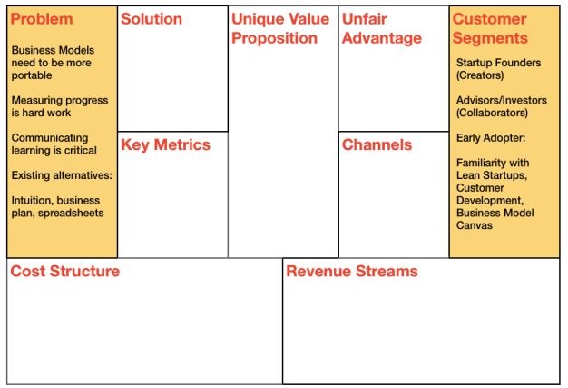

Slide 22
Unique Value Proposition
Dead-center in the Lean Canvas is a box for your Unique Value Proposition (UVP). This is one of the most important boxes on the canvas and also the hardest to get right.
“Unique Value Proposition: A single, clear compelling message that states why you are different and worth buying.”
- Steve Blank
The Four Steps to the Epiphany
The UVP is hard to get right because you have to distill the essence of your product in a few words that can fit in the headline of your landing page. Additionally, your UVP also needs to be different and that difference needs to matter.
First-time visitors spend 8 seconds on average on a landing page. Your UVP is their first interaction with your product - craft a good UVP and they might stay and view the rest of your site. Otherwise, they’ll simply leave.
The good news is you don’t have to get this perfect right away. Like everything on the canvas, you start with a best guess and then iterate from there.

Slide 23
How to Craft a Unique Value Proposition
I highly recommend getting a copy of the classic book on marketing by Al Ries and Jack Trout: “Positioning: The Battle For Your Mind”. Ries and Trout are considered the fathers of modern advertising. This is an “easyread” and the best crash course on marketing I’ve ever come across.
Be different, but make sure your difference matters
The key to unlocking what’s different about your product is deriving your UVP directly from the #1 problem you are solving. If that problem is indeed worth solving, you’re more than halfway there already.
Target early adopters
Too many marketers try to target the “middle” in the hopes of reaching mainstream customers and in the process water down their message. Your product is not ready for mainstream customers yet. Your sole job should be finding and targeting early adopters which requires bold, clear, and specific messaging.
Focus on finished story benefits
You’ve probably heard about the importance of highlighting benefits over features. But benefits still require your customers to translate them to their worldview. A good UVP gets inside the head of your customers and focusses on the benefits your customers derive after using your product.
So for instance if you are building a résumé-building service:
- a feature might be “professionally designed templates”
- the benefit would be an “eye-catching résumé that stands out”
- but the finished story benefit would be “landing your dream job”.

Slide 24
Pick your words carefully and own them
Words are key to any great marketing and branding campaign. Look at how the top luxury car brands have used a single word to define themselves:
Performance: BMW Design: Audi Prestige: Mercedes
Picking a few “key” words that you consistently use also drives your SEO ranking.
Answer: What, Who, and Why
A good UVP needs to clearly answer the first 2 questions - what is your product and who is the customer. The “Why” is sometimes hard to fit in the same statement and I’ll frequently use a sub-heading for that.
Here are example UVPs I have used in products:
CloudFire - Photo and Video Sharing for Busy Parents.
Get back to the more important things in your life.
USERcycle - Lifecycle Marketing Software.
Turn your users into passionate customers.
Study other good UVPs
The best way to craft a good UVP is to study the UVPs of the brands you admire. Visit their landing pages and deconstruct how and why their messaging works.

Slide 25
Create a high-concept pitch
Another useful exercise is to create a high-concept pitch popularized by Venture Hacks in their e-book “Pitching Hacks”.
A high-concept pitch usually builds on other familiar concepts to quickly get an idea across and make it easily spreadable.
Unlike a UVP, a high-concept pitch is best used in conjunction with something else that sets the right context such as an elevator pitch.
Examples:
- YouTube: “Flickr for video”
- Aliens (movie): “Jaws in space”
- Dogster: “Friendster for dogs”

Slide 26
Case Study: Lean Canvas - Unique Value Proposition
In the case of startups and business models, while Lean Canvas might provide an immediate benefit of offering a better process for testing business models, the finished story benefit is finding a business model that works and eventually building a successful product.
Unique Value Proposition:
Lean Canvas - Business Model Validation Software
Help startups raise their odds for building successful products
I also jot down a few high-level concepts:
- Github Meets Weight-watchers for Business Models
- The Startup Report Card

Slide 27
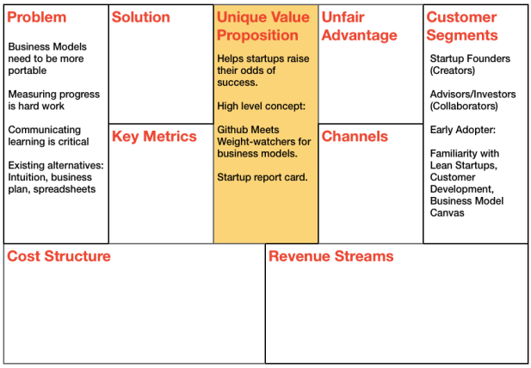

Slide 28
Solution
You are now ready to tackle solution possibilities.
As all you have are untested hypotheses, I don’t recommend getting carried away with fully defining a solution just yet. Rather simply sketch out the top features or capabilities next to each problem.
Bind a solution to your problem as late as possible.
Case Study: Lean Canvas - Solution
For each of the problems outlined earlier, here is a feature or capability that solves the problem:
Problem: Business Models need to be more portable
Solution: Use the Lean Canvas format for capturing hypotheses on 1 page
Problem: Measuring progress is hard work
Solution: Provide a simple way to “dashboard” experiments
Problem: Communicating learning is critical
Solution: Need a sharing feature to facilitate sharing lessons learned

Slide 29
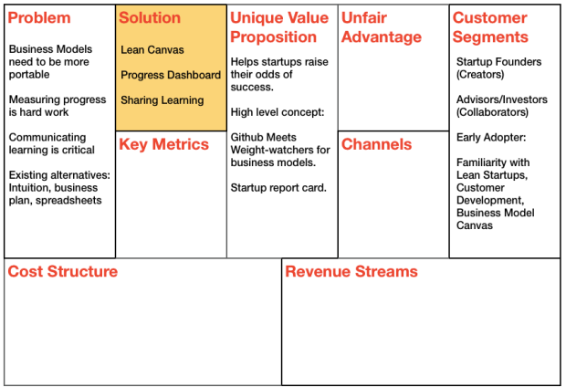

Slide 30
Channels
The good news is that following a “Customer Discovery/Interview” process forces you to build a path to customers early. Unfortunately, unless you are in a direct sales business, that path may not scale beyond Problem/Solution Fit.
In addition to defining the right product to build, it’s just as critical to start finding, building and testing a significant path to your customers from day one.
While there are a plethora of channel options available, some channels may be outright inapplicable to your startup, while others may be more viable during later stages of your startup.
I typically look for the following characteristics in my early channels:
FREE’er versus PAID
First of all there is no such thing as a free channel. Channels we normally associate as being free like SEO, social media, and blogging, have a nonzero human capital cost associated with them. Calculating their ROI is complicated because unlike a paid channel which is used up after you pay for it, these channels keep working for you over time.
A commonly cited paid channel is search engine marketing. Eric Ries has written about how he tested his early product on $5 a day using Google Adwords - driving 100 clicks at a CPC of 5 cents. If you can pull this off
today, by all means use it, but unfortunately those days are long gone for most products. Keyword competition is so fierce now that you need to either out-spend or out-wit your competition. Both of these activities are better suited after product/market fit when your focus shifts to optimization versus learning.

Slide 31
Inbound versus Outbound
Inbound channels use “pull messaging” to let customers find you organically while outbound channels rely on “push messaging” for reaching customers.
- Example inbound channels: Blogs, SEO, E-books, white papers, webinars.
- Example outbound channels: SEM, print/TV ads, trade shows, cold calling.
When you don’t yet have a tested value proposition, it’s hard to justify spending marketing dollars or effort on outbound messaging. Getting “techcrunched” or seeking other forms of PR before then is a form of waste. Now might be the time to start building inroads to influencers but you are not ready to “get covered”.
Direct versus Automated
As a scalable channel, direct sales only make sense in businesses where the aggregate lifetime value of the customers exceeds the total compensation of your direct salespeople - such as in certain B2B and Enterprise products.
But as a learning channel, direct sales is one of the most effective since you interact face-to-face with the customer. The Customer Discovery process we’ll cover in a little bit is direct selling repurposed for accelerating learning from customers.
First sell manually, then automate.

Slide 32
Direct versus Indirect
Another area where startups waste energy is prematurely trying to establish strategic partnerships. The idea is to partner with a larger company to leverage their channels and credibility. The problem is that until you have a proven product, you won’t get the right level of attention from the bigger company’s sales reps to make this work. Given the choice of selling what you know or an unproven product to make your quota, which would you choose?
First sell yourself, then let others do it.
The same principle allow applies to hiring external salespeople. While a salesperson can probably outsell you on the execution of a sales plan, they can’t create that plan.
Retention before Referral
Many startups are obsessed with building virality and referral/affiliate programs into their product from day 1. While referral programs can be very effective in spreading the word about your product, you need to have a product worth spreading first.
“Build a remark-able product.”
- Seth Godin
Purple Cow

Slide 33
Building the ideal early channel
An early channel I recommend building that delivers on all the points above is Content Marketing.
Content Marketing uses a combination of Content, Search Engine Optimization (SEO), and Social Media to work.
Rather than crafting the “perfect outbound message”, you instead incrementally test various aspects of your Problem/Solution using inbound channels like blogs, white papers, and webinars.
SEO and Social Media serve to further enhance the reach of your content.
Content Marketing isn’t free, takes time to build, and does cost time.
But when it starts to work, “Content Marketing” turns from an expense into an asset. It could even become your “Unfair Advantage”.

Slide 34
Case Study: Lean Canvas - Channels
While the problems I outlined above were based on my own experiences, I witnessed other startup founders recount similar stories in the workshops I was teaching. That prompted me to write about Lean Canvas on my blog and also test it in a presentation I gave at Capital Factory’s Demo Day in Austin to a mostly investor audience. Both were well received which pushed me towards incorporating Lean Canvas in my workshops. Lean Canvas was tested and refined in these presentations and workshops before it ever became an online tool.
My blog, workshops, and book are natural early channels to reach other startup founders interested in Lean Startup/Customer Development.

Slide 35
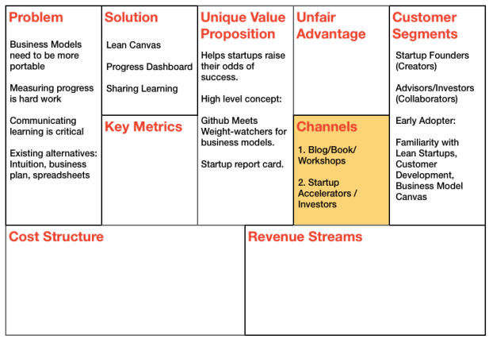

Slide 36
Revenue Streams and Cost Structure
A lot of startups choose to defer the “pricing question” because they don’t think their product is ready. Something I hear a lot is that a minimum viable product is by definition embarrassingly minimal. How can you possibly charge for it?
First, a minimum viable product is not synonymous with a half-baked or buggy product. Your MVP should address the top problems customers have identified as important to them. By that definition, it should deliver enough value to justify charging.
But, there is another line of reasoning frequently cited for deferring pricing - to accelerate initial learning. The argument goes that pricing creates unnecessary friction that should be avoided early on.
While this strategy may work (especially if you are already funded), I find that it delays testing one of the riskier and critical parts of your business model. Furthermore, I have found that you don’t need a lot of users to support learning. You need just a few good customers.
I believe that if you intend to charge for your product, it’s better to be upfront about it. It sets the right expectations, raises customer commitment, starts generating cash flow, and lets you start tackling one of the riskier parts of your business model early.

Slide 37
What you charge for your product is simultaneously one of the most complicated and most important things to get right. Not only does your pricing model keep you in business, it also signals your branding and positioning. It determines your customers.
Your price is part of your product.
Although there is a lot of science around pricing, pricing is more art than science. For a great primer, I highly recommend getting a copy of Neil Davidson’s free e-book on software pricing: “Don’t Just Roll the Dice”.
Pricing is not unlike any other business model hypothesis and should be tested using the same criteria we covered earlier when building validated learning loops - create a testable hypothesis, time-box the experiment, and validate qualitatively, then verify quantitatively.
The strategy I’ve found that meets all these criteria is starting with a single “Free Trial” pricing plan.
Let’s see why.

Slide 38
Start with a single pricing plan
Starting with multiple plans that cover everyone under the sun is a form of waste. I’ve seen startups launch with plan options targeting 1 person startups to 1000+ person enterprises.
Not only does supporting multiple plans require you to write more code to support plan/feature segmentation, but the return on learning is diluted when you attempt to target multiple customer segments all at once. In the example above, the business models and tactics vary greatly when selling to startups than to enterprises.
The bigger point here though is that when you’re starting out, you don’t yet have enough information to know how to correctly price or segment the feature set into multiple plans.
Use a “Free Trial” plan
Time-based trials help time-box your pricing experiments so you can force a conversion decision which allows you to learn and iterate faster.

Slide 39
Pick a price to test
Existing alternatives create “reference points” in the minds of customers that they will use to rank your solution so it’s important to understand and position your price against them.
In the rare case you are actually solving a brand new problem or don’t have clear reference points (more common in Enterprise based products), you might have to pick a starting price out of thin air and refine from there.
“Pricing is all about setting the right perception.”
- Neil Davidson
Don’t Just Roll the Dice
Take your costs into account
The ultimate goal is finding a scalable business model so it should go without saying that you also need to keep an eye on what it would cost you to deliver your solution and ensure you have a healthy margin built in.
One rule of thumb for building a successful business is ensuring the lifetime value of your customers exceeds the cost of customer acquisition by at least a factor of three.
It’s hard to accurately calculate these at this stage so instead do a back-ofthe-envelope calculation based on your people/hardware costs and subscription revenue to find your break-even point.

Slide 40
What about Freemium?
Freemium is a popular model used by numerous web applications. It was first popularized by Fred Wilson on his blog where he described it as:
"Give your service away for free, possibly ad supported but maybe not, acquire a lot of customers very efficiently through word of mouth, referral networks, organic search marketing, etc., then offer premium priced value added services or an enhanced version of your service to your customer base."
- Fred Wilson
AVC Blog
On the surface, Freemium seems like the best of both worlds: Get users to try your service without having to worry about price, then up-sell them into the right premium plan later. But the reality is quite different.
First, I believe that unless you are deriving monetary value from free users, the Freemium model is less of a business model and more of a marketing tactic to fill your pipeline with potential prospects.
Second, I believe pricing is one of the riskiest (and most critical) parts of the business model and should be tested early. Freemium delays this learning.
While I agree Freemium can be a highly effective model, I don’t advocate starting with it.

Slide 41
The Problem with Freemium
Low or no conversions
Many services make the mistake of giving away too much under their free plans, which leads to very low or no conversions. One reason for this is that creatives (artists, musicians, developers) are especially known to undervalue their own work and are really bad at setting price.
Pricing should be set with the buyer in mind, not the seller.
But the main reason is something we covered in the last section. You don’t yet have enough usage data to correctly define the FREE plan so that users naturally outgrow it at some predictable time in the future.
Long validation cycle
Even the best Freemium services report conversion rates in the 0.5-5.0% range which leads to long validation cycles. Time is the most valuable resource for a startup and you can’t afford such long learning cycles on something as critical as price.
Focus shifts to the wrong metric
Because “FREE” can be irrationally appealing, Freemium has a tendency to cause a premature shift in focus from user retention to user acquisition (sign-ups). Unless you have built the right product, getting more sign-ups is waste. You don’t need a lot of traffic to build the right product - just the right initial customers.
Your free users are not your customers (yet).

Slide 42
Low signal-to-noise ratio
When you have a lot of free users, it’s hard to focus your attention on the right feedback.
Given the opportunity, everyone can be a critic.
Free Users aren’t “free”
Even though the operational costs of carrying a free user may seem low, they aren’t zero. Other than server bandwidth/hosting costs, there are support, feature, and learning costs (like the ones described above) that need to be taken into account.
Lincoln Murphy described a quid pro quo test in his paper: “The Reality of Freemium in SaaS” for valuing free users. Unless free users are adding participatory value (as found in services with high network effects like Linked In, Facebook, and twitter), they are an expense.
Jason Cohen, who writes the popular “A Smart Bear” blog, even advocates accounting for free users as a “marketing expense” on your balance sheet much like you would an ad-buy, or trade show expense.

Slide 43
How to Approach Freemium
Start with the premium part of Freemium first
Once you recognize Freemium as a marketing tactic and make a conscious decision to shorten the validation cycle, it makes sense to start with the premium part of Freemium first and use a single pricing plan your customers will bear.
Since your eventual goal is to charge for your product anyway, why not start there? Pick features and a plan based on what customers will pay for today and sign them on as your first customers. Not only is this simpler to build but it’s also simpler to measure.
Then, once you have learned how your customers are using your product, you can always offer a Free plan if you want to. You would have collected valuable usage data along the way which puts you in the best position to design multiple upstream and downstream plans.
Case Study: Mailchimp
Mailchimp is frequently cited as one of the Freemium model success stories, but too often people fail to recognize that Mailchimp didn’t start with a free plan. In fact they spent years building a powerful, affordable (but not free), profitable product first, with years of pricing experimentation, before backing into a free plan.

Slide 44
What is a good Free plan?
A good Free plan should ideally behave similarly to a Free Trial. The difference is that while a Free Trial is time-based, Freemium is usage-based.
If you understand the usage pattern of your product, you should be able to design the Free plan so that a user naturally outgrows it at some point X in the future that you can reasonably predict.
At that point the difference between Freemium and Free Trial is the perception of offering something FREE which is a big enough difference to warrant the use of Freemium for certain types of products.
When to use Freemium versus Free Trials?
Once you’ve built the right product, Freemium can be a powerful user acquisition strategy for consumer facing products that naturally tend to be more “FREE” driven.
Businesses, on the other hand have come to expect time-based trials and the added complexity of tracking and carrying free users may not be warranted here.

Slide 45
Case Study: Lean Canvas - Revenue Streams and Cost Structure
Revenue Streams
Lean Canvas pricing will be largely determined by who will ultimately be the customer - bootstrapped founders, funded founders, larger companies, investors, etc.
For the case of startup founders, they tend to be quite price sensitive and given the fact that their existing alternatives are all free, I decide to start with the following:
“A 30-day Free Trial plan priced at $14/mo that lets them create 1 canvas and invite up to 3 collaborators.”
Cost Structure
In my blog post on Lean Canvas, I made a public call for help building out this tool and got a dozen responses from developers around the world. I selected 3 people from this list and am currently building Lean Canvas with them - Lukas Fittl (Austria), Ross Hale (Santa Barbara), and Andrew Elliott (Santa Barbara). They are all seasoned entrepreneurs in their own right and have a passion for Lean Startups.
We came to an agreement to spend just enough effort to get the Minimum Viable Product built over 2 weeks and evaluate how we move forward after that. We agreed not to pay ourselves till the service had positive cash flow.
That said, I still used the following analysis to figure out the opportunity cost for building and testing the MVP and more importantly determine my break-even point.

Slide 46
Costs
Problem/Solution Fit:
2 interviewers * (50 interviews * 30 min per interview) = 50 hours
Effort to get ready for interviews (mockups, scripts, etc.) = 40 hours
Build MVP:
2 developers * 2 weeks * 20 hours per week = 80 hours
Cost to launch = 170 hours * $65/hr = $11K
Ongoing People costs = 4 ppl * 10 hours per week * $65/hr = $10,400/mo
Hosting costs currently $0 (thank you heroku)
Revenue
Break-even point @$14/mo = $10,400K / $14/mo = 743 paying customers
Break-even point @$24/mo = $10,400K / $24/month = 434 paying customers

Slide 47
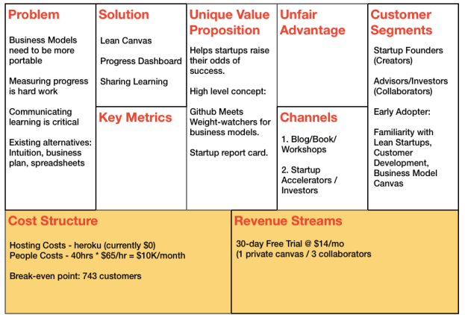

Slide 48
Key Metrics
“Find the key number that tells you how your business is doing in real time, before you get the sales report.”
- Norm Brodsky and Bo Burlingham
The Knack
Startups are inherently chaotic, but fortunately, there are only a handful of key metrics that drive a web startup. We’ll cover five key startup metrics (Dave McClure’s Pirate Metrics) a little later but for right now document the one or two key activities you think will drive usage of your product.
So for example, if you are a blogging platform writing a blog post would be the key activity.
Case Study: Lean Canvas
Creating a lean canvas is the first key activity users would complete but using the tool to track running experiments is the ongoing key activity that will drive use of the tool.

Slide 49
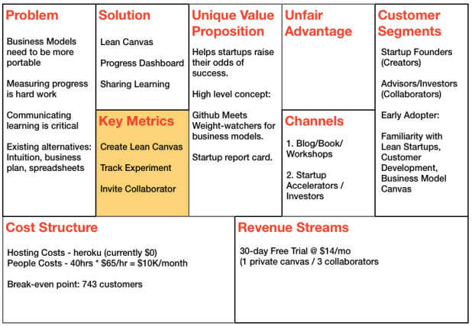

Slide 50
Unfair Advantage
This is usually the hardest section to fill which is why I leave it for last.
Most founders list things as competitive advantages that really aren’t. An interesting perspective, via Jason Cohen, to keep in mind is that anything worth copying will be copied. So imagine your co-founder steals your source code, sets up shop in Costa Rica, and slashes prices. Do you still have a business?
You have to be able to build a successful business in spite of that which leads to the following definition:
“A real unfair advantage is something that cannot be easily copied or bought.” -
Jason Cohen
A Smart Bear
You may initially have to leave this box blank but it’s here to have you really think about how you can make yourself different and make your difference matter. Some examples of unfair advantages - insider information, the right “expert” endorsements, personal authority.
Case Study: Lean Canvas
In the course of writing my blog and book, I have been able to attract a growing and active audience of readers and “experts” interested in Lean Startups which has taken me over a year to build. Only time will tell if this “reputation” and channel proves to be an unfair advantage.

Slide 51
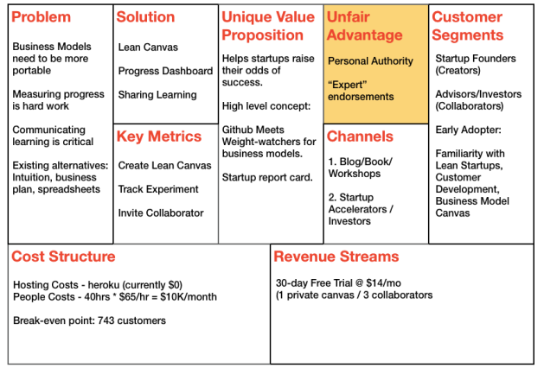

Slide 52
3. Prioritize Where to Start
Once you have your Lean Canvases sketched for each customer segment, lay them side by side and select the best business model to start with.
Your objective is to find a big enough market you can reach with customers who need your product that will pay a price you can build a business around.
Here is the weighting order I use (ranked from highest to lowest):
1. Customer pain level
Pick customer segments that need your product the most. The goal is to have one or more of your top three problems as must-haves for them.
2. Ease of reach
Building a path to customers is one of the harder aspects of building a successful product. If you have an easier path to one segment of customers over others, take that into consideration. It doesn’t guarantee you’ll find a problem worth solving or a viable business model, but it will get you out of building faster and speed up your learning.

Slide 53
3. Price
What you can charge for your product is largely driven by the customer segment.
Pick a customer segment that allows you to maximize on price.
The more you can charge, the fewer customers you need to reach breakeven (assuming your gross margins don’t change).
4. Market Size
Lastly, you need to pick customers that represent a big enough market, or are a stepping stone to a big enough market, that you can build a business around.
Case Study: Lean Canvas
I created other canvases for my different segments (not shown here) and while I could potentially derive higher pricing with other customer segments, I decided to start testing the “Startup Founder” segment because it was the one I best understood and easily reach.

Slide 54
Case Studies

Slide 55
Facebook
• Harvard University’s online network is very limited in functionality and not fun
• Students want a solution to communicate online
Online communication for Harvard students with the possibility to connect with Friends (share,photos,interests), chat and other stuff.
Harvard
Student-oriented communication platform
• Person to person interaction
• Friends’ activities push other friends to use the network
• Invention of a new website type – social network with social features
• College students
• Students of other colleges and universities
• MySpace
• His
• Friendster
DAU/MAU
North star netric
Frienster for college students
• Referral among Havard students society
• Cross-Friends students in other colleges
Harvard university students
• Hosting
• Development
• Payroll
• Investment
• Advertising revenue
Lean Canvas is adapted from The Business Model Canvas (www.businessmodelgeneration.com/canvas). PowerPoint implementation by: Neos Chronos Limited (https://neoschronos.com). License: CC BY-SA 3.0

Slide 56
Airbnb
Hard to find cheap//affordable accommodation options when travelling
Staying in hotels travellers cannot get authentic experiences of a location
It’s not easy for a homeowner to monetize vacant areas on a day-by-day basic
An online service where travelers can rent an affordable local apartment, and homeowners can earn extra money by renting out vacant areas on a day-by-day basic
Travelers can get authentic experience of local area
Extra monetization of vacant areas for homeowners
Travelers can get authentic experience of local area
Trust building: bi-directional rating system of hosts and visitors
Insurance by default for hosts
Travellers Looking for an adequate accommodation experience for a low price
People having some accommodation options to become a host
Booking.com
Hotels.com
Number of view-to-bookings per host
Number of hosts applied
NPS
DAU/MAU
Everyone can become a host
Sharing economy
Referrals
Recommendations
Advertising(both online an offline)
People ready to share their residence and earn money as hosts
Development
Marketing
Insurance
Hosting
Payroll
Photography
Fees for travellers
Lean Canvas is adapted from The Business Model Canvas (www.businessmodelgeneration.com/canvas). PowerPoint implementation by: Neos Chronos Limited (https://neoschronos.com). License: CC BY-SA 3.0

Slide 57
Amazon
Lack of online bookstores
Hard to select book in offline stores (no resting recommendations, hard to find a book, etc.)
Build an online bookstore with millions of titles
Buy books using a PC from home/office (without vising several local stores to find a particular book)
Lower price (less employment and other costs)
No competition for online booksellers
Book readers
Interloc (future Alibris)
Local booksellers
Barnes and Noble
Website traffic
CAC
ROI (sales conversion rate, revenue per visitor, percentage of shopping cart abandoned rate, etc.)
Earth’s biggest bookstore (company’s original tagline)
Affiliates
Resellers
Customers Searching for rare and specialized books
Hosting
Website Development
Operational costs (rent cost, storage, Facilities, Delivery)
Direct sales
Lean Canvas is adapted from The Business Model Canvas (www.businessmodelgeneration.com/canvas). PowerPoint implementation by: Neos Chronos Limited (https://neoschronos.com). License: CC BY-SA 3.0

Slide 58
Google
Hard to find what you are searching for.
Irrelevant search results of existing search engines
Develop a tech that would allow users to search a find relevant content.
Single, clear and compelling message that states why you are different and worth buying
Innovation. Google PageRank tech ( combined citation – ranking system )
All web users
Excite
Yahoo
AltaVista
Number of search req uests
Percentage of users who end their search on the first page.
Fast web search based on the relevancy of web pages
User references
Stanford students
Hosting
Development
Advertising revenue
Investment
Lean Canvas is adapted from The Business Model Canvas (www.businessmodelgeneration.com/canvas). PowerPoint implementation by: Neos Chronos Limited (https://neoschronos.com). License: CC BY-SA 3.0

Slide 59
Uber
Expensive Taxi Service
Availability of cards
Lack of Driver Profile
Know who you drive
Part – time job opportunity
Cheaper Ride
Wide Car Network
Driver / Passengers Ratings
Flexible Work Schedule
All Services in One App , which Allows you to find a Safe Ride 24/7/365
Work on your Own Schedule and Revenue, Navigate the Route Through the App.
Low Prices Rides at the Push of a Button
Passengers
Drivers
Public Transport
Classic Taxi Service
Number of Users
Number of Rides
Income
Uber is like a Taxi but Cheaper, safer and More Flexible
Word of Mouth
PR
User Referrals
Public Transport
Classic Taxi Service
Product development
Marketing Expenses
Salaries
25% of the Pay for Each Ride
Lean Canvas is adapted from The Business Model Canvas (www.businessmodelgeneration.com/canvas). PowerPoint implementation by: Neos Chronos Limited (https://neoschronos.com). License: CC BY-SA 3.0

Slide 60
Startup Name
Name1, Name2, …
DD/MM/YYYY
X.Y
Top 3 problems
Top 3 features
Single, clear and compelling message that states why you are different and worth buying
Can’t be easily copied or bought
Target Customers
List how these problems are solved today.
Key activities you measure
List your X for Y analogy
(e.g. YouTube = Flickr for videos)
Path to customers
List the characteristics of your ideal customers.
List your fixed and variable costs.
Customer acquisition costs
Distribution costs
Hosting
People
Etc.
List your sources of revenue.
Revenue Model
Life Time Value
Revenue
Gross Margin

Slide 61
Recap
Lean Canvas and Its 9 Blocks
Difference between Lean Canvas and Business plan
Difference Lean Canvas and Business Canvas Model
How to conduct a Lean Canvas Model.
Case studies

Slide 62
Summary
Lean Canvas can be repurposed and revised to suit your specific needs. It helps to drive organizational focus down to the right solution, metrics, marketing, design and development efforts.

Slide 63



Thank You

