Slide 1


Project Monitoring
Lecture 10
PMG 333
Outsourcing: Managing
Interorganizational
Relations
Prepared by
Dr. Mohammed Mustafa

Slide 2

Lecture
Learning Objectives
10
Understand the advantages and disadvantages of outsourcing project work.
Describe the basic elements of a Request for Proposal (RFP).
Identify best practices for outsourcing project work.
Practice principled negotiation.
Describe the met-expectations model of customer satisfaction and its implications for working with customers on projects.
www.midocean.km

Slide 3

Lecture
Outlines
10
Outsourcing Project Work.
Request for Proposal (RFP).
Best Practices in Outsourcing Project Work.
The Art of Negotiating.
A Note on Managing Customer Relation
www.midocean.ae

Slide 4

10.1 Outsourcing Project Work
The term outsourcing has traditionally been applied to the transferring of business functions or processes (e.g., customer support, IT, accounting) to other, often foreign companies.
For example, when you call your Internet provider to solve a technical problem you are likely to talk to a technician in Bangalore, India, or Bucharest, Romania.

Slide 5

10.1 Outsourcing Project Work – Cont.
Outsourcing is now being applied to contracting significant chunks of project work.
For example, Apple and Motorola work closely with manufacturers in China to develop next-generation smartphones.
Toyota and DaimlerChrysler collaborate with suppliers to develop new automobile platforms.

Slide 6

10.1 Outsourcing Project Work – Cont.
The shift toward outsourcing is readily apparent in the film industry.
During the golden era of Hollywood, huge, vertically integrated corporations made movies.
Studios such as MGM, Warner Brothers, and 20th Century–Fox owned large movie lots and employed thousands of full-time specialists—set designers, camera people, film editors, and directors.
Star actors like Humphrey Bogart and Marilyn Monroe were signed to exclusive studio contracts for a set number of films (e.g., six films over three years).

Slide 7

10.1 Outsourcing Project Work – Cont.
Today, most movies are made by a collection of individuals and small companies who come together to make films project-by-project.
This structure allows each project to be staffed with the talent most suited to its demands rather than choosing from only those people the studio employs.
This same approach is being applied to the creation of new products and services. For example, see Figure (next slide).

Slide 8
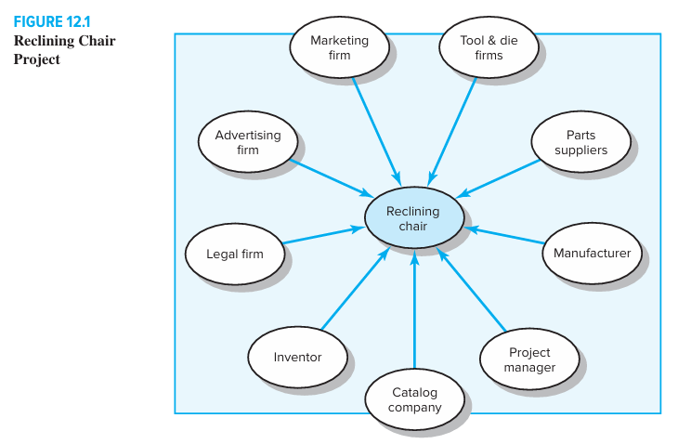
Figure: Reclining Chair Project

Slide 9
10.1 Outsourcing Project Work – Cont.
Figure.1 depicts a situation in which a zero-gravity reclining chair is being developed.
The genesis for the chair comes from a mechanical engineer who developed the idea in her garage.
The inventor negotiates a contract with a catalog firm to develop and manufacture the chair.
The catalog company in turn creates a project team of manufacturers, suppliers, and marketing firms to create the new chair.
Each participant adds requisite expertise to the project.
www.midocean.ae

Slide 10
10.1 Outsourcing Project Work – Cont.
The catalog firm brings its brand name and distribution channels to the project.
Tool and die firms provide customized parts which are delivered to a manufacturing firm that will produce the chair.
Marketing firms refine the design, develop packaging, and test market potential names.
A project manager is assigned by the catalog firm to work with the inventor and the other parties to complete the project.

Slide 11
10.1 Outsourcing Project Work – Cont.
Many outsourced projects operate in a virtual environment in which people are linked by computers, faxes, computer-aided design systems, and video teleconferencing.
They rarely, if ever, see one another face-to-face.
On other projects, participants from different organizations work closely together,
for example, at a construction site or in shared office space.

Slide 12
10.1 Outsourcing Project Work – Cont.
In either case, people come and go as services are needed, much as in a matrix structure, but they are not formal members of one organization, just technical experts who form a temporary alliance with an organization, fulfill their contractual obligations, and then move on to the next project.

Slide 13
The advantages of outsourcing project work:
1. Cost reduction:
Companies can secure competitive prices for contracted services, especially if the work can be outsourced offshore.
Furthermore, overhead costs are dramatically cut since the company no longer has to internally maintain the contracted services.

Slide 14
The advantages of outsourcing project work:
2. Faster project completion:
Not only can work be done more cheaply, but it can also be done faster.
Competitive pricing means more resources for the dollar.
For example, you can hire three Indian software engineers for the price of one American software engineer. Furthermore, outsourcing can provide access to equipment that can accelerate completion of project tasks.
For example, by contracting a backhoe operator you are able to accomplish in four hours what it would take a landscaping crew four days to complete.

Slide 15
The advantages of outsourcing project work:
3. High level of expertise:
A high level of expertise and technology can be brought to bear on the project.
A company no longer has to keep up with technological advances. Instead, it can focus on developing its core competencies and hire firms with the know-how to work on relevant segments of the project.

Slide 16
The advantages of outsourcing project work:
4. Flexibility:
Organizations are no longer constrained by their own resources but can pursue a wide range of projects by combining their resources with talents of other companies.
Small companies can instantly go global by working with foreign partners.

Slide 17
The disadvantages of outsourcing project work:
Coordination breakdowns:
Coordination of professionals from different organizations can be challenging, especially if the project work requires close collaboration and mutual adjustment.
Breakdowns are exacerbated by physical separation with people working in different buildings, different cities, if not different countries.

Slide 18
The disadvantages of outsourcing project work:
2. Loss of control:
There is potential loss of control over the project.
The core team depends on other organizations that they have no direct authority over.
While long term survival of participating organizations depends on performance, a project may falter when one partner fails to deliver.

Slide 19
The disadvantages of outsourcing project work:
3. Conflict:
Projects are more prone to interpersonal conflict since the different participants do not share the same values, priorities, and culture.
Trust, which is essential to project success, can be difficult to forge when interactions are limited and people come from different organizations.

Slide 20
The disadvantages of outsourcing project work:
4. Security issues:
Depending on the nature of the project, trade and business secrets may be revealed.
This can be problematic if the contractor also works for your competitor.
Confidentiality is another concern and companies have to be very careful when outsourcing processes like payroll, medical transcriptions, and insurance information.

Slide 21
The disadvantages of outsourcing project work:
5. Political hot potato:
Foreign outsourcing of work is perceived as a major cause of underemployment and U.S. companies are under increased pressure to keep jobs local.
Furthermore, companies like Apple have been criticized for the oppressive labor practices of some of their suppliers in China.

Slide 22

10.2 Request for Proposal (RFP)
Once an organization decides to outsource project work, the customer or project man ager is frequently responsible for developing a Request for Proposal (RFP).
The responsible project manager will require input from all stakeholders connected to the activities covered in the RFP.
The RFP will be announced to external contractors/ vendors with adequate experience to implement the project.
www.midocean.ae

Slide 23
10.2 Request for Proposal (RFP)
For example, government projects frequently advertise with a “request for proposal” to outside contractors for roads, buildings, airports, military hardware, space vehicles.
Similarly, businesses use RFPs to solicit bids for building a clean room, developing a new manufacturing process, delivering software for insurance billing, conducting a market survey.
In all of these examples, requirements and features should be in enough detail that contractors have a clear description of the final deliverable that will meet the customer’s needs.
www.midocean.ae

Slide 24
10.2 Request for Proposal (RFP)
RFPs are important. In practice, the most common error is to offer an RFP that lacks sufficient detail.
This lack of detail typically results in conflict issues, misunderstandings, often legal claims between the contractor and owner, and, ultimately, a dissatisfied customer.
All RFPs are different, but the outline in Figure 2 is a good starting point for the development of a detailed RFP.
Each step is briefly described next.
www.midocean.ae

Slide 25
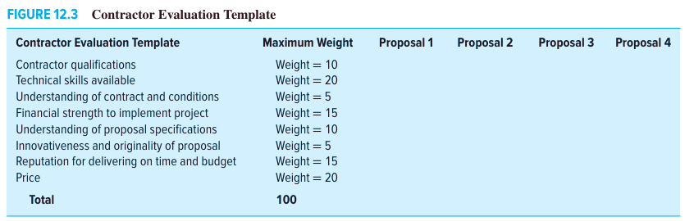

Slide 26
10.2 Request for Proposal (RFP)
Summary of needs and request for action:
The background and a simple description of the final project deliverable are given first.
For example, through simulated war games, the U.S. Navy has found their giant warships of the past are too vulnerable against today’s technology (an example is the Silkworm antiship missiles).
In addition, the Navy’s mission has shifted to supporting ground forces and peace keeping missions, which require getting closer to shore.
www.midocean.ae

Slide 27
10.2 Request for Proposal (RFP)
As a result, the Navy is revamping ships for near-shore duty.
The Navy will select three designs for further refinement from the responses to its RFP.
In general, it is expected that the new ship will be capable of at least 55 knots, measure between 80 and 250 feet in length, and be fitted with radar absorbing panels to thwart guided missiles.
www.midocean.ae

Slide 28
10.2 Request for Proposal (RFP)
2. Statement of work (SOW) detailing the scope and major deliverables:
For example, if the project involves a market research survey, the major deliverables could be design, data collection, data analysis, and providing recommendations by February 21, 2014, for a cost not to exceed $300,000.
www.midocean.ae

Slide 29
10.2 Request for Proposal (RFP)
3. Deliverable specifications/requirements, features, and tasks:
This step should be very comprehensive so bid proposals from contractors can be validated and later used for control.
Typical specifications cover physical features such as size, quantity, materials, speed, and color.
For example, an IT project might specify requirements for hardware, software, and training in great detail.
Tasks required to complete deliverables can be included if they are known.
www.midocean.ae

Slide 30
10.2 Request for Proposal (RFP)
4. Responsibilities—vendor and customer:
Failing to spell out the responsibilities for both parties is notorious for leading to serious problems when the contractor implements the project.
For example, who pays for what? (If the contractor is to be on site, will the contractor be required to pay for office space?) What are the limits and exclusions for the contractor? (For example, who will supply test equipment?) What communication plan will be used by the contractor and owner? If escalation of an issue becomes necessary, what process will be used? How will progress be evaluated? Well-defined responsibilities will avoid many unforeseen problems later.
www.midocean.ae

Slide 31
10.2 Request for Proposal (RFP)
5. Project schedule:
This step is concerned with getting a “hard” schedule which can be used for control and evaluating progress.
Owners are usually very demanding in meeting the project schedule.
In today’s business environment, time-to-market is a major “hot button” that influences market share, costs, and profits.
The schedule should spell out what, who, and when.
www.midocean.ae

Slide 32
10.2 Request for Proposal (RFP)
6. Costs and payment schedule:
The RFP needs to set out very clearly how, when, and the process for determining costs and conditions for progress payments.
7. Type of contract:
Essentially there are two types of contracts—fixed-price and cost-plus.
Fixed-price contracts agree on a price or lump sum in advance, and it remains as long as there are no changes to the scope provisions of the agreement.
This type is preferred in projects that are well defined with predictable costs and minimal risks.
www.midocean.ae

Slide 33
10.2 Request for Proposal (RFP)
The contractor must exercise care estimating cost because any under estimating of costs will cause the contractor’s profit to be reduced.
In cost-plus contracts the contractor is reimbursed for all or some of the expenses incurred during performance of the contract.
This fee is negotiated in advance and usually involves a percent of total costs.
“Time and materials” plus a profit factor are typical of cost-plus contracts.
www.midocean.ae

Slide 34
10.2 Request for Proposal (RFP)
Both types of contracts can include incentive clauses for superior performance in time and cost, or in some cases, penalties—for example, missing the opening date of a new sports stadium.
8. Experience and staffing:
ability of the contractor to implement the project may depend on specific skills; this necessary experience should be specified, along with assurance such staff will be available for this project.
www.midocean.ae

Slide 35
10.2 Request for Proposal (RFP)
9. Evaluation criteria:
The criteria for evaluating and awarding the project contract should be specified.
For example, selection criteria frequently include methodology, price, schedule, and experience; in some cases these criteria are weighted.
Use of the outline in Figure 2 will help to ensure key items in the proposal are not omitted.
A well-prepared RFP will provide contractors with sufficient guidelines to prepare a proposal that clearly meets the project and customer’s needs.
www.midocean.ae

Slide 36
10.2 Request for Proposal (RFP)
Selection of Contractor from Bid Proposals:
Interested contractors respond to project RFPs with a written bid proposal.
It is likely that several contractors will submit bid proposals to the customer.
The final step in the RFP process is to select the contractor who best meets the requirements requested in the RFP.
The selection criteria given in the RFP are used to evaluate which contractor is awarded the contract to implement the project.
www.midocean.ae

Slide 37
10.2 Request for Proposal (RFP)
Losing contractors:
Should be given an explanation of the key factors that led to the selection of the winning contractor/vendor; appreciation for their participation and effort should be acknowledged.
www.midocean.ae

Slide 38
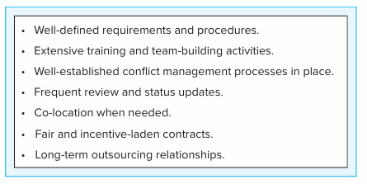

10.3 Best Practices in Outsourcing Project Work
www.midocean.ae

Slide 39
10.3 Best Practices in Outsourcing Project Work
Long-Term Outsourcing Relationships:
Many companies recognize that major benefits can be enjoyed when outsourcing arrangements extend across multiple projects and are long term.
For example, Corning and Toyota are among the many firms that have forged a network of long-term strategic partnerships with their suppliers.
The average large corporation is involved in around 30 alliances today versus fewer than 3 in the early 1990s. Among the many advantages for establishing a long-term partnership are the following:
www.midocean.ae

Slide 40
10.3 Best Practices in Outsourcing Project Work – Cont.
Reduced administrative costs—The costs associated with bidding and selecting a contractor are eliminated.
Contract administration costs are reduced as partners become knowledgeable of their counterpart’s legal concerns.
More efficient utilization of resources—Contractors have a known forecast of work while owners are able to concentrate their workforce on core businesses and avoid the demanding swings of project support.
Improved communication—As partners gain experience with each other, they develop a common language and perspective, which reduces misunderstanding and enhances collaboration.
www.midocean.ae

Slide 41
10.3 Best Practices in Outsourcing Project Work – Cont.
Improved innovation—The partners are able to discuss innovation and associated risks in a more open manner and share risks and rewards fairly.
Improved performance—Over time partners become more familiar with each other’s standards and expectations and are able to apply lessons learned from previous projects to current projects.
www.midocean.ae

Slide 42
10.4 The Art of Negotiating
Effective negotiating is critical to successful collaboration. All it takes is one key problem to explode to convert a sense of “we” into “us versus them.”
At the same time, negotiating is pervasive through all aspects of project management work.
Project managers must negotiate support and funding from top management.
They must negotiate staff and technical input from functional managers.
www.midocean.ae

Slide 43
10.4 The Art of Negotiating
They must coordinate with other project man agers and negotiate project priorities and commitments.
They must negotiate within their project team to determine assignments, deadlines, standards, and priorities.
Project man agers must negotiate prices and standards with vendors and suppliers.
www.midocean.ae

Slide 44
10.4 The Art of Negotiating
A firm under standing of the negotiating process, skills, and tactics is essential to project success.
Many people approach negotiating as if it is a competitive contest. Each negotiator is out to win as much as he or she can for his or her side.
Success is measured by how much is gained compared with the other party.
www.midocean.ae

Slide 45
10.4 The Art of Negotiating
Separate the people from the problem.
Focus on interests, not positions.
Invent options for mutual gain.
When possible, use objective criteria.
www.midocean.km

Slide 46



Thank You

