Slide 1



IT111 - Introduction to Information Technology
Bachelor of Science in Information Technology
Lecture 5 Operation on Data
Prof. Lamiaa Fattouh Ibrahim
Everyone Smart University
Faculty of Informatics
Spring 2023
1
1
Introduction to Information Technology, Prof. Lamiaa Fattouh Ibrahim, Spring 2022-2023

Slide 2
Objectives
After studying this chapter, the student should be able to:
List the three categories of operations performed on data.
Perform unary and binary logic operations on bit patterns.
Distinguish between logic shift operations and arithmetic
shift operations.
Perform logic shift operations on bit patterns.
Understand some applications of logic and shift operations such
as setting, unsetting, and flipping bits.
Perform arithmetic shift operation on integers whey they are
stored in two’ complement format.

Slide 3
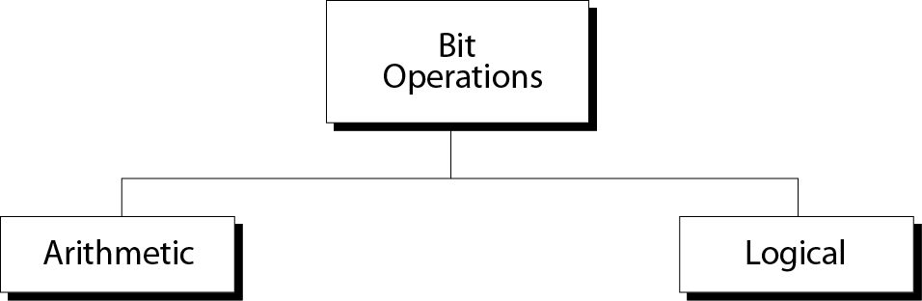
Operations on bits

Slide 4
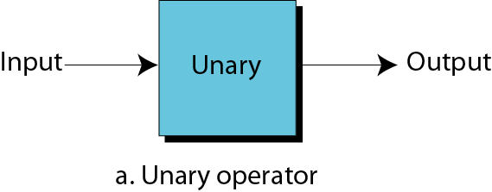
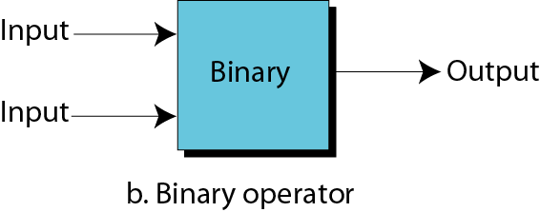
Unary and binary operations

Slide 5
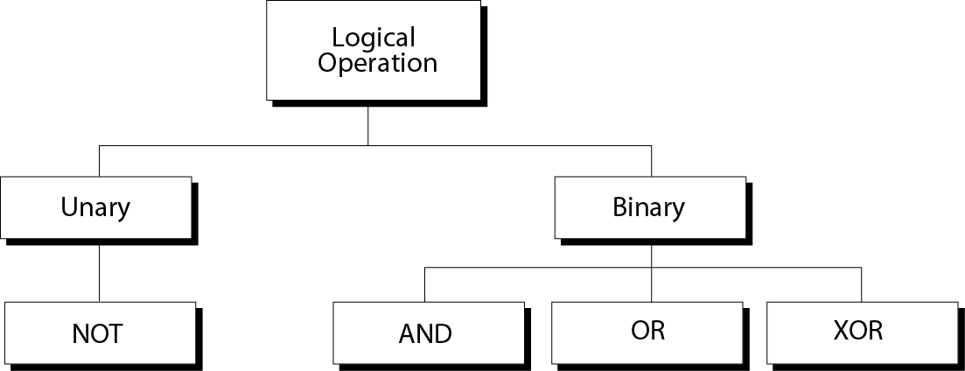
Logical operations

Slide 6
4-1 LOGIC OPERATIONS
In Chapter 3 we discussed the fact that data inside a computer is stored as patterns of bits.
Logic operations refer to those operations that apply the same basic operation on individual bits of a pattern, or on two corresponding bits in two patterns.
This means that we can define logic operations:
at the bit level
at the pattern level

Slide 7
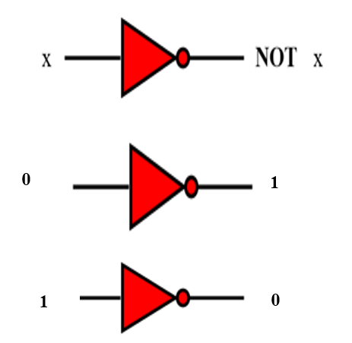
Logic operations at bit level

Slide 8

4.1.2 Logic operations at pattern level
0 1 1 0
4 Logical operation
1 0 0 1
a logic operation at the pattern level is n logic operations, of the same type, at the bit level where n is the number of bits in the pattern.

Slide 9
Logic operations at bit level
A bit can take one of the two values: 0 or 1.
If we interpret 0 as the value false and 1 as the value true, we can apply the operations defined in Boolean algebra to manipulate bits.
Boolean algebra, named in honor of George Boole, belongs to a special field of mathematics called logic.
A Boolean expression is a logical statement that is either TRUE or FALSE.
Boolean algebra and its application to building logic circuits in computers are briefly discussed in Appendix E.

Slide 10
Boolean algebra
Boolean algebra is a branch of algebra. It differs from elementary algebra in two ways.
First, the values of the variables are the truth values true and false, usually denoted 1 and 0, whereas in elementary algebra the values of the variables are numbers.
Second, Boolean algebra uses logical operators such as
conjunction (and) denoted as ∧,
disjunction (or) denoted as ∨,
negation (not) denoted as ¬.
Elementary algebra, on the other hand, uses arithmetic operators such as addition, multiplication, subtraction and division.
Boolean algebra is therefore a formal way of describing logical operations, in the same way that elementary algebra describes numerical operations.

Slide 11
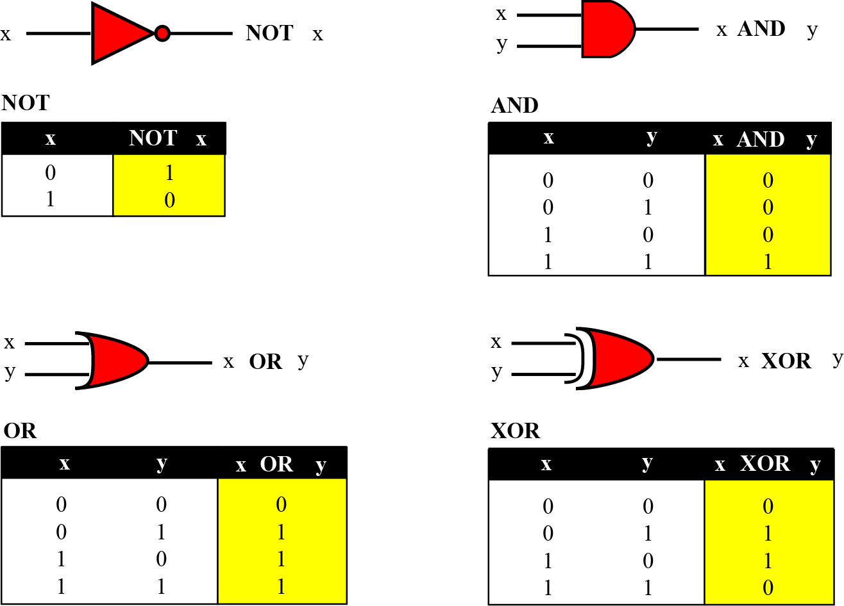
Figure 4.1 Logic operations at the bit level

Slide 12
NOT
The NOT operator is a unary operator: it takes only one input. The output bit is the complement of the input.
AND
The AND operator is a binary operator: it takes two inputs. The output bit is 1 if both inputs are 1s and the output is 0 in the other three cases.
For x = 0 or 1 x AND 0 → 0 0 AND x → 0

Slide 13
OR
The OR operator is a binary operator: it takes two inputs. The output bit is 0 if both inputs are 0s and the output is 1 in other three cases.
For x = 0 or 1 x OR 1 → 1 1 OR x → 1
XOR
The XOR operator is a binary operator like the OR operator, with only one difference: the output is 0 if both inputs are 1 or 0.
For x = 0 or 1 1 XOR x → NOT x 1 XOR x→ NOT x

Slide 14
Example 4.1
In English we use the conjunction “or” sometimes to means an inclusive-or, and sometimes to means an exclusive-or.
The sentence “I wish to have a car or a house” uses “or” in the inclusive sense—I wish a car, a house, or both.
The sentence “Today is either Monday or Tuesday” uses “or” in the exclusive sense—today is either Monday or Tuesday, but it cannot be both.

Slide 15
Example 4.2
The XOR operator is not actually a new operator. We can always simulate it using the other three operators. The following two expressions are equivalent
x XOR y ↔ [x AND (NOT y)] OR [(NOT x) AND y]
The equivalence can be proved if we make the truth table for both.

Slide 16
x XOR y ↔ [x AND (NOT y)] OR [(NOT x) AND y]
x | y | x XOR y | [x AND (NOT y)] OR [(NOT x) AND y]
0 | 0 | 0 | ((0 AND 1)OR(1AND 0))= 0
0 | 1 | 1 | 1
1 | 0 | 1 | 1
1 | 1 | 0 | 0

Slide 17
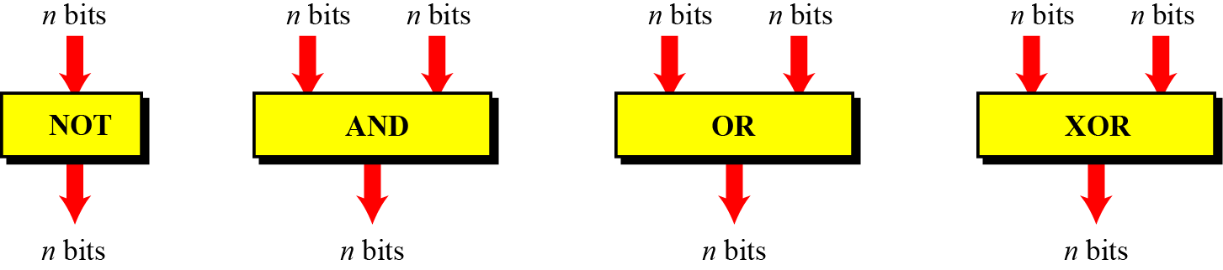
Logic operations at pattern level
The same four operators (NOT, AND, OR, and XOR) can be applied to an n-bit pattern. The effect is the same as applying each operator to each individual bit for NOT and to each corresponding pair of bits for other three operators. Figure 4.2 shows these four operators with input and output patterns.
Figure 4.2 Logic operators applied to bit patterns

Slide 18
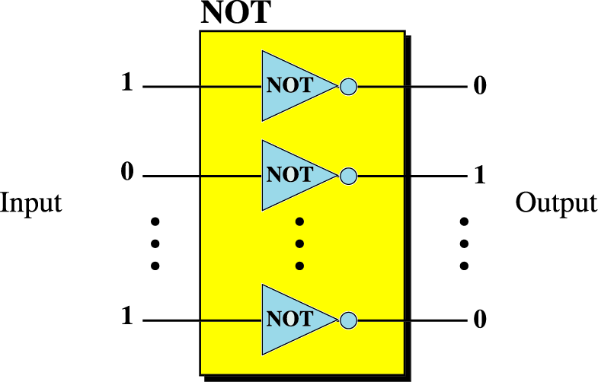

Slide 19
Example 4.3
Use the NOT operator on the bit pattern 10011000.
Solution
The solution is shown below. Note that the NOT operator changes every 0 to 1 and every 1 to 0.

Slide 20
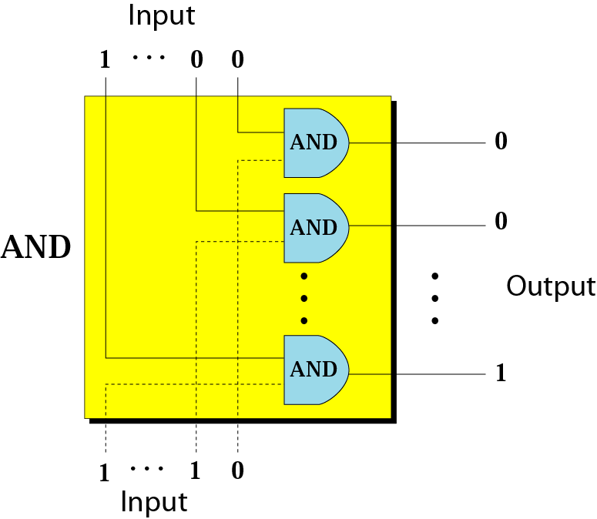

Slide 21
Example 4.4
Use the AND operator on the bit patterns 10011000 and 00101010.
Solution
The solution is shown below. Note that only one bit in the output is 1, where both corresponding inputs are 1s.

Slide 22
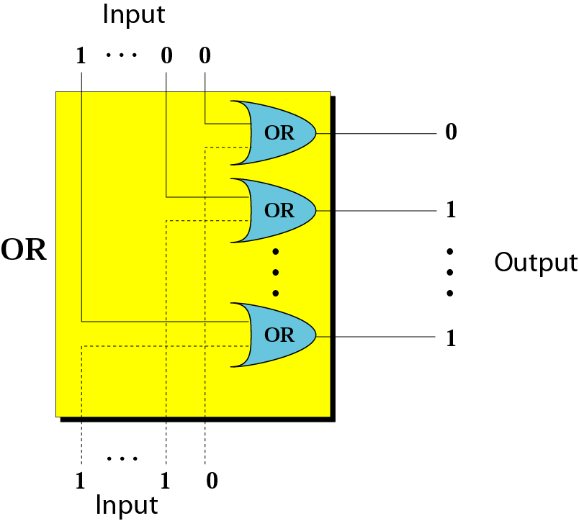

Slide 23
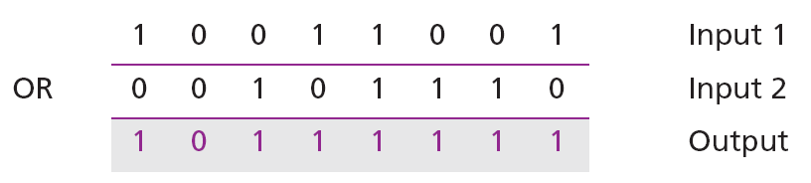
Example 4.5
Use the OR operator on the bit patterns 10011001 and 00101110.
Solution
The solution is shown below. Note that only one bit in the output is 0, where both corresponding inputs are 0s.

Slide 24
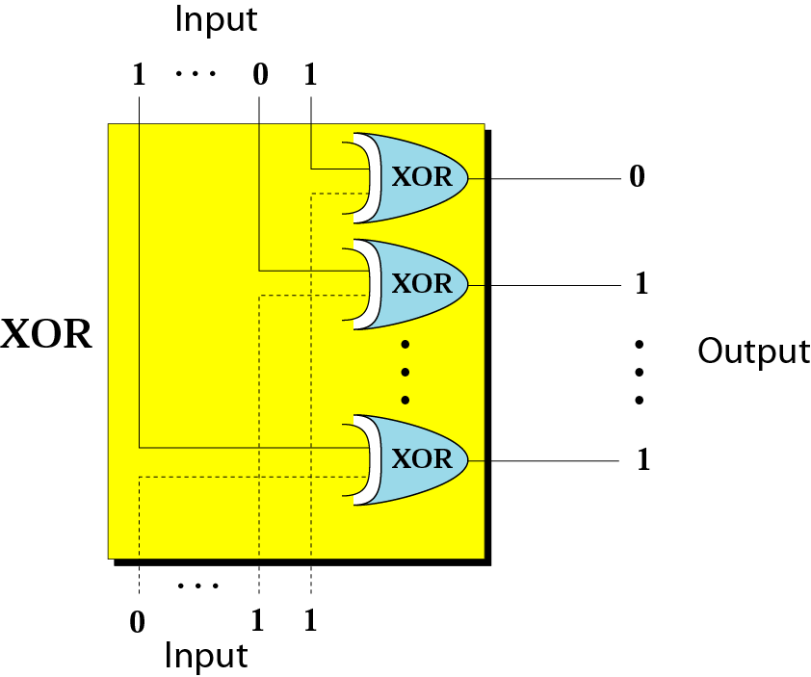

Slide 25
Example 4.6
Use the XOR operator on the bit patterns 10011001 and 00101110.
Solution
The solution is shown below. Compare the output in this example with the one in Example 4.5. The only difference is that when the two inputs are 1s, the result is 0 (the effect of exclusion).

Slide 26
Applications
The four logic operations can be used to modify a bit pattern.
Complementing (NOT)
Unsetting (AND)
Setting (OR)
Flipping (XOR)

Slide 27
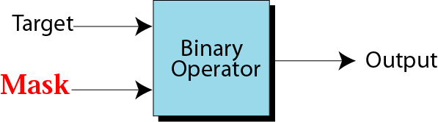
Mask

Slide 28
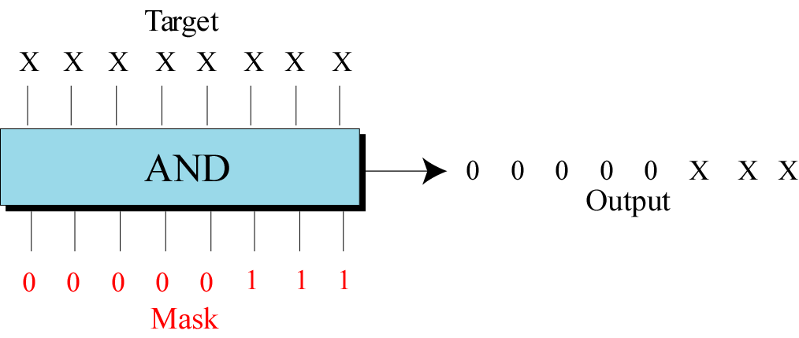
Example of unsetting specific bits

Slide 29
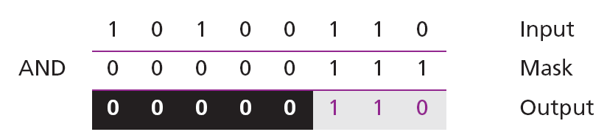
Example 4.7
Use a mask to unset (clear) the five leftmost bits of a pattern. Test the mask with the pattern 10100110.
Solution
The mask is 00000111. The result of applying the mask is:

Slide 30
Application
Imagine a power plant that pumps water to a city using eight pumps. The state of the pumps (on or off) can be represented by an 8-bit pattern. For example, the pattern 11000111 shows that pumps 1 to 3 (from the right), 7 and 8 are on while pumps 4, 5, and 6 are off. Now assume pump 7 shuts down. How can a mask show this situation?
Solution on the next slide.

Slide 31
Solution
Use the mask 10111111 to AND with the target pattern. The only 0 bit (bit 7) in the mask turns off the seventh bit in the target.
Target 1 1 0 0 0 1 1 1 AND
Mask 1 0 1 1 1 1 1 1
------------------
Result 1 0 0 0 0 1 1 1

Slide 32
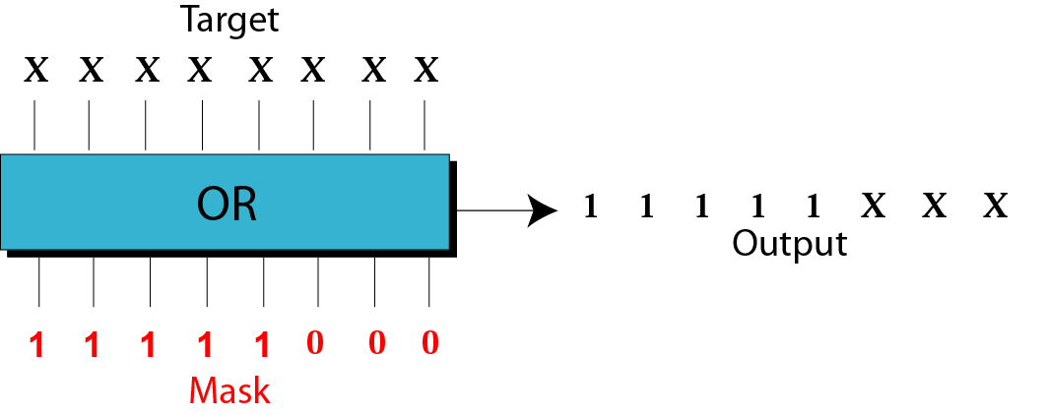
Example of setting specific bits

Slide 33
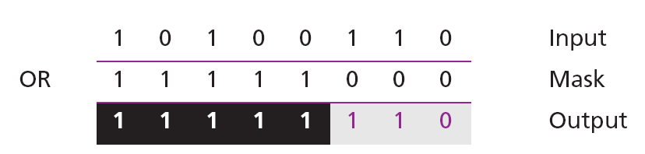
Example 4.8
Use a mask to set the five leftmost bits of a pattern. Test the mask with the pattern 10100110.
Solution
The mask is 11111000. The result of applying the mask is:

Slide 34
Application
Using the power plant example, how can you use a mask to show that pump 6 is now turned on?
Solution
Use the mask 00100000.
Target 1 0 0 0 0 1 1 1 OR
Mask 0 0 1 0 0 0 0 0
------------------
Result 1 0 1 0 0 1 1 1

Slide 35
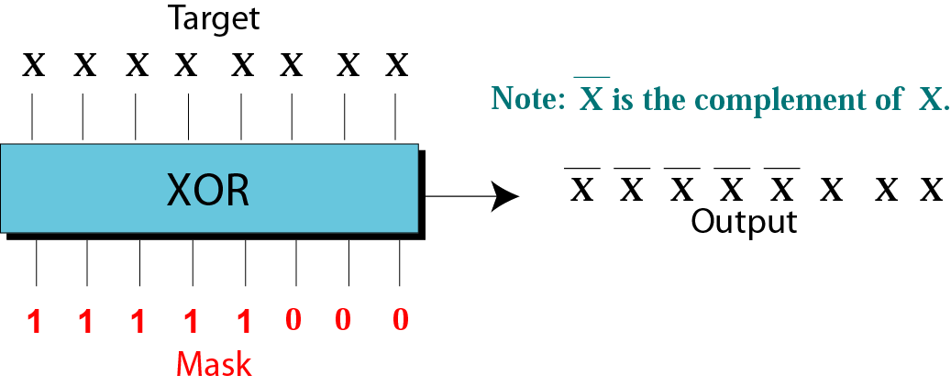
Example of flipping specific bits

Slide 36
Example 4.9
Use a mask to flip the five leftmost bits of a pattern. Test the mask with the pattern 10100110.
Solution
The mask is 11111000. The result of applying the mask is:

Slide 37
4-2 SHIFT OPERATIONS
Shift operations move the bits in a pattern, changing the positions of the bits. They can move bits to the left or to the right. We can divide shift operations into two categories: logical shift operations and arithmetic shift operations.

Slide 38
4.2.1 Logical shift operations
A logical shift operation is applied to a pattern that does not represent a signed number. The reason is that these shift operation may change the sign of the number that is defined by the leftmost bit in the pattern. We distinguishes two types of logical shift operations, as described below:
Logical shift
Logical circular shift (Rotate)

Slide 39
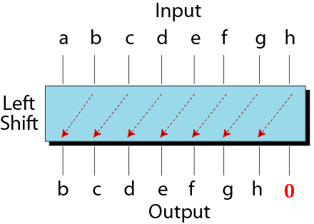
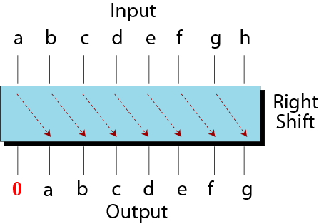
Shift operations

Slide 40
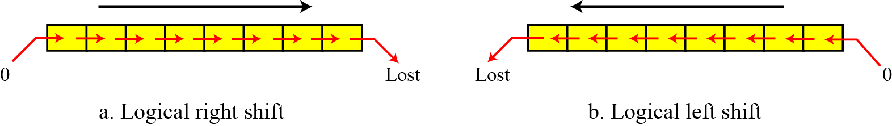
Figure 4.3 Logical shift operations

Slide 41
Example 4.10
Use a logical left shift operation on the bit pattern 10011000.
Solution
The solution is shown below. The leftmost bit is lost and a 0 is inserted as the rightmost bit.
Discarded
Added

Slide 42
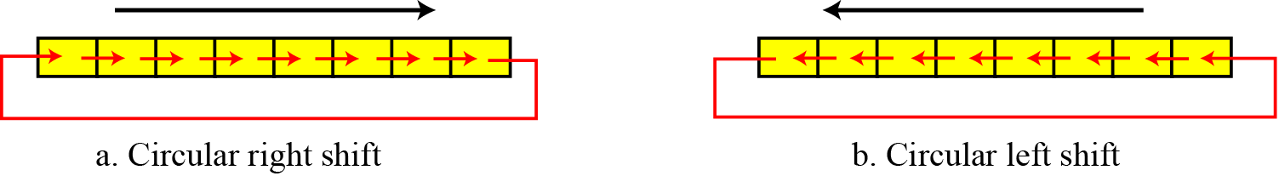
Figure 4.4 Circular shift operations

Slide 43
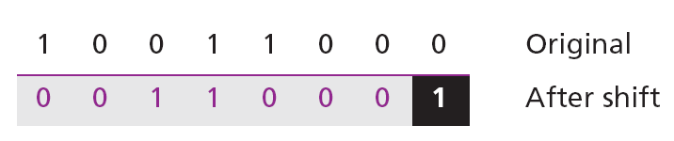
Example 4.11
Use a circular left shift operation on the bit pattern 10011000.
Solution
The solution is shown below. The leftmost bit is circulated and becomes the rightmost bit.

Slide 44
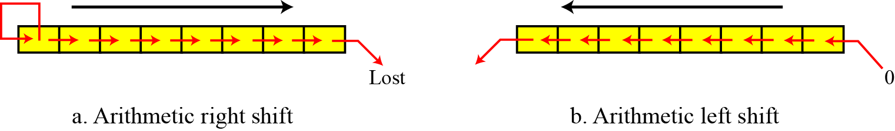
4.2.2 Arithmetic shift operations
Arithmetic shift operations assume that the bit pattern is a signed integer in two’s complement format. Arithmetic right shift is used to divide an integer by two, while arithmetic left shift is used to multiply an integer by two.
Figure 4.5 Arithmetic shift operations

Slide 45
Example 4.12
Use an arithmetic right shift operation on the bit pattern 10011001. The pattern is an integer in two’s complement format.
Solution
The solution is shown below. The leftmost bit is retained and also copied to its right neighbor bit.
The original number was −103 and the new number is −52, which is the result of dividing −103 by 2 truncated to the smaller integer.

Slide 46
Example 4.13
Use an arithmetic left shift operation on the bit pattern 11011001. The pattern is an integer in two’s complement format.
Solution
The solution is shown below. The leftmost bit is lost and a 0 is inserted as the rightmost bit.
The original number was −39 and the new number is −78. The original number is multiplied by two. The operation is valid because no underflow occurred.

Slide 47
Example
Show how you can divide or multiply a number by 2 using shift operations.
Solution
If a bit pattern represents an unsigned number, a right-shift operation divides the number by two. The pattern 00111011 represents 59. When you shift the number to the right, you get 00011101, which is 29. If you shift the original number to the left, you get 01110110, which is 118.

Slide 48
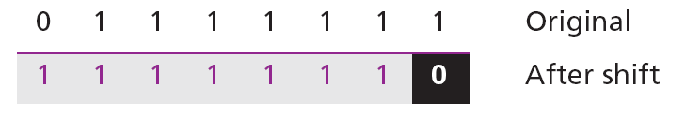
Example 4.14
Use an arithmetic left shift operation on the bit pattern 01111111. The pattern is an integer in two’s complement format.
Solution
The solution is shown below. The leftmost bit is lost and a 0 is inserted as the rightmost bit.
The original number was 127 and the new number is −2. Here the result is not valid because an overflow has occurred. The expected answer 127 × 2 = 254 cannot be represented by an 8-bit pattern.

Slide 49
Example 4.15
Combining logic operations and logical shift operations give us some tools for manipulating bit patterns. Assume that we have a pattern and we need to use the third bit (from the right) of this pattern in a decision-making process. We want to know if this particular bit is 0 or 1. The following shows how we can find out.
We can then test the result: if it is an unsigned integer 1, the target bit was 1, whereas if the result is an unsigned integer 0, the target bit was 0.

Slide 50
Adding bits
Number of 1s
------------
None
One
Two
Three
Result
------------
0
1
0
1
Carry
------------
1
1

Slide 51

Note:
Rule of Adding Integers in
Two’s Complement
Add 2 bits and propagate the carry to the next column. If there is a final carry after the leftmost column addition, discard it.

Slide 52
Add two numbers in two’s complement representation:
(+17) + (+22) ➔ (+39)
Solution
0 64 32 16 8 4 2 1
(+17)= 0 0 0 1 0 0 0 1
(+22)= 0 0 0 1 0 1 1 0

Slide 53
Add two numbers in two’s complement representation:
(+17) + (+22) ➔ (+39)
Solution
Carry 1
0 0 0 1 0 0 0 1 +
0 0 0 1 0 1 1 0
----------------------------------
Result 0 0 1 0 0 1 1 1 ➔ 39

Slide 54
Example
Add two numbers in two’s complement representation:
(+24) + (-17) ➔ (+7)
Solution
0 64 32 16 8 4 2 1
(+24)= 0 0 0 1 1 0 0 0
(+17)= 0 0 0 1 0 0 0 1
(-17)= 1 1 1 0 1 1 1 1

Slide 55
Example
Add two numbers in two’s complement representation: (+24) + (-17) ➔ (+7)
Solution
Carry 1 1 1 1 1
0 0 0 1 1 0 0 0 +
1 1 1 0 1 1 1 1
----------------------------------
Result 0 0 0 0 0 1 1 1 ➔ +7

Slide 56
Example
Add two numbers in two’s complement representation:
(-35) + (+20) ➔ (-15)
Solution
0 64 32 16 8 4 2 1
(+35)= 0 0 1 0 0 0 1 1
(-35)= 1 1 0 1 1 1 0 1
(+20)= 0 0 0 1 0 1 0 0

Slide 57
Example
Add two numbers in two’s complement representation: (-35) + (+20) ➔ (-15)
Solution
Carry 1 1 1
1 1 0 1 1 1 0 1 +
0 0 0 1 0 1 0 0
----------------------------------
Result 1 1 1 1 0 0 0 1 ➔ -15

Slide 58
Example 4
Add two numbers in two’s complement representation: (+127) + (+3) ➔ (+130)
Solution
Carry 1 1 1 1 1 1 1
0 1 1 1 1 1 1 1 +
0 0 0 0 0 0 1 1
----------------------------------
Result 1 0 0 0 0 0 1 0 ➔ -126 (Error)
An overflow has occurred.

Slide 59
Note:
Range of numbers in two’s complement
representation
- (2^{N-1}) ---------- 0 ----------- +(2^{N-1} –1)

Slide 60
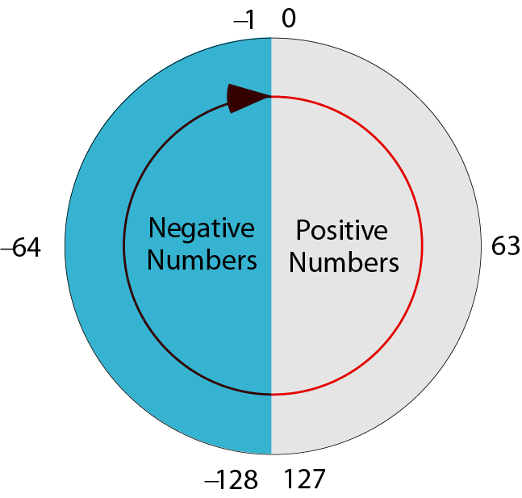
Figure 4-2
Two’s complement numbers visualization

Slide 61
Note:
When you do arithmetic operations on numbers in a computer, remember that each number and the result should be in the range defined by the bit allocation.

Slide 62
Example
Subtract 62 from 101 in two’s complement:
(+101) - (+62) ⬅➔ (+101) + (-62)
Solution
0 64 32 16 8 4 2 1
(+101)= 0 1 1 0 0 1 0 1
(+62)= 0 0 1 1 1 1 1 0
(-62)= 1 1 0 0 0 0 1 0

Slide 63
Example
Subtract 62 from 101 in two’s complement:
(+101) - (+62) ⬅➔ (+101) + (-62)
Solution
Carry 1 1
0 1 1 0 0 1 0 1 +
1 1 0 0 0 0 1 0
----------------------------------
Result 0 0 1 0 0 1 1 1 ➔ 39
The leftmost carry is discarded.

Slide 64
Thank You

