Slide 1
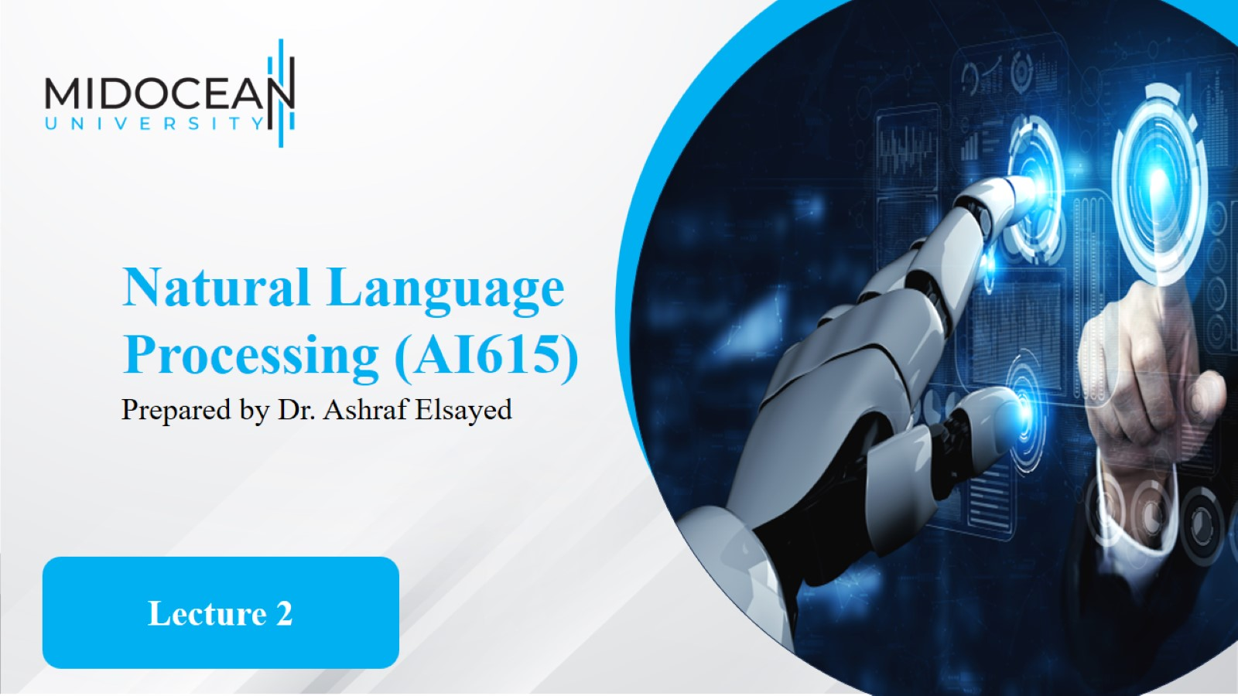

Slide 2
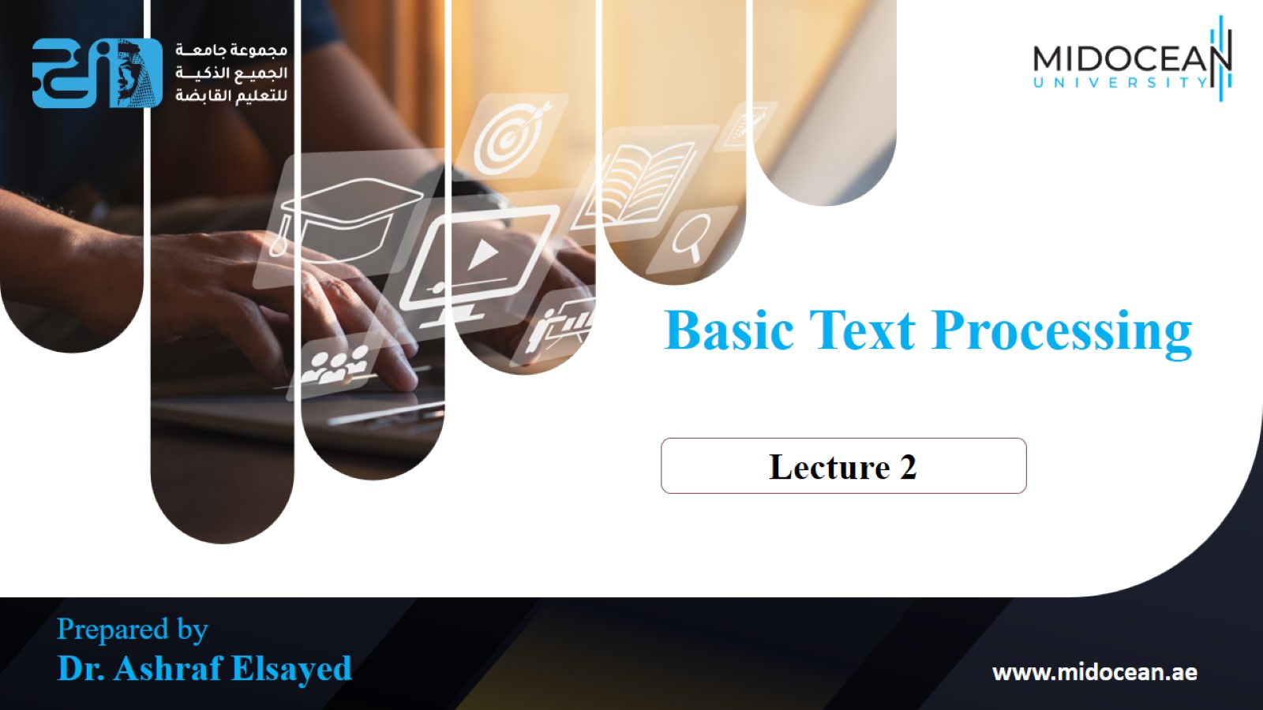

Slide 3
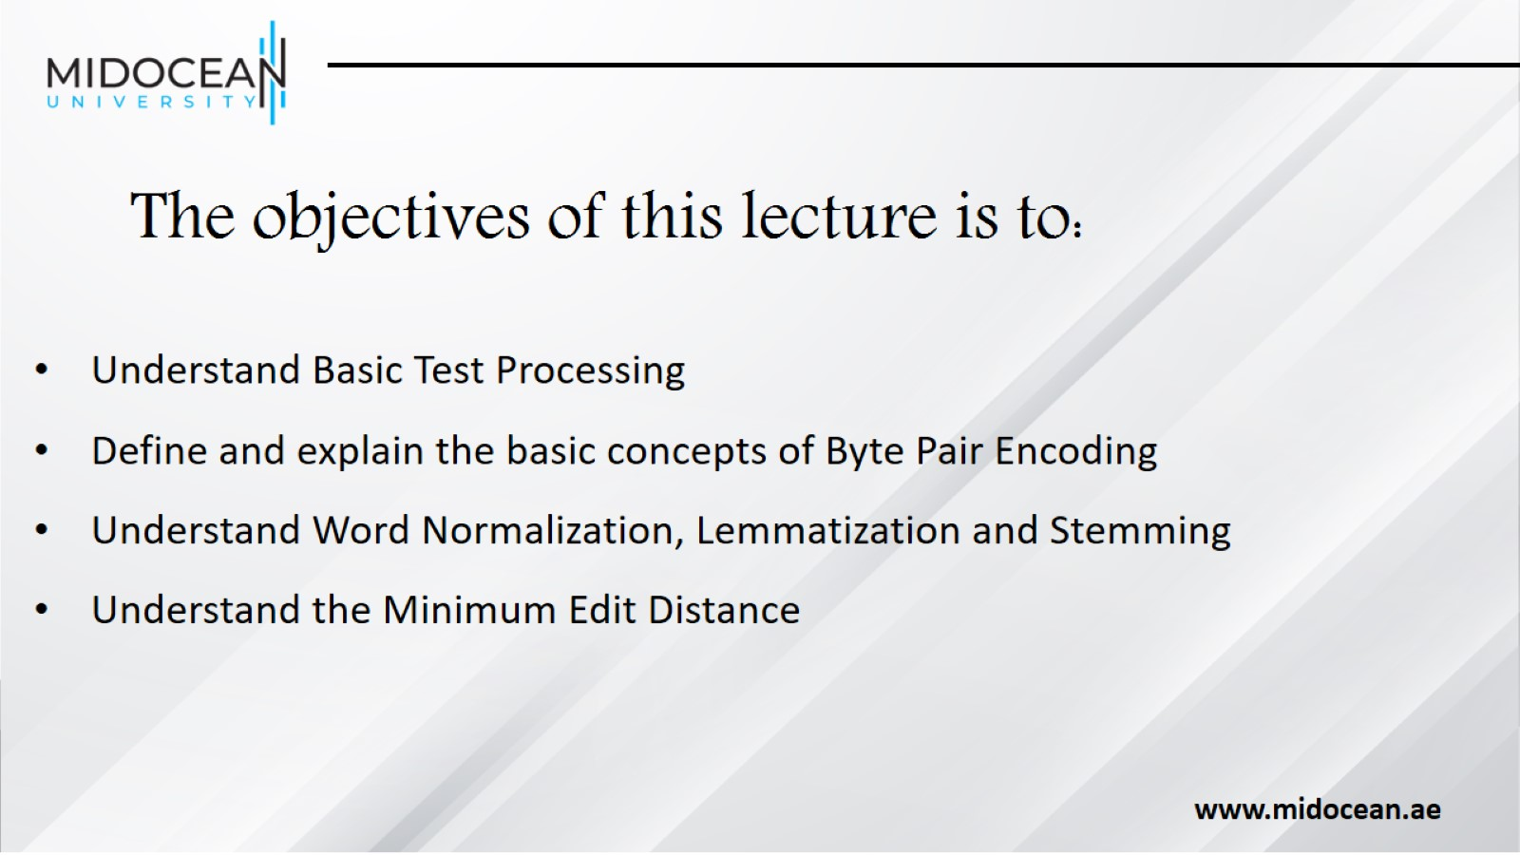
The objectives of this lecture is to:

Slide 4
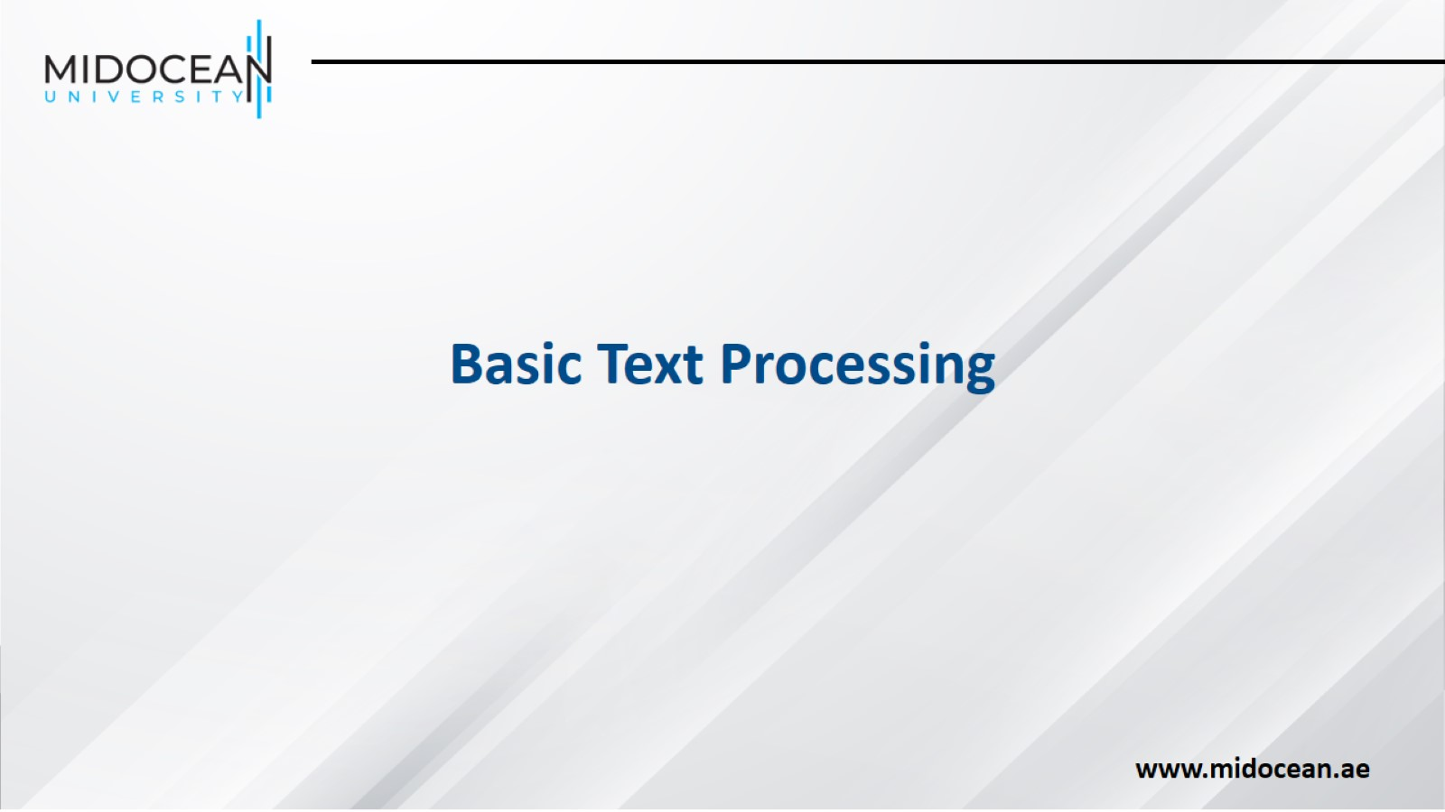

Slide 5
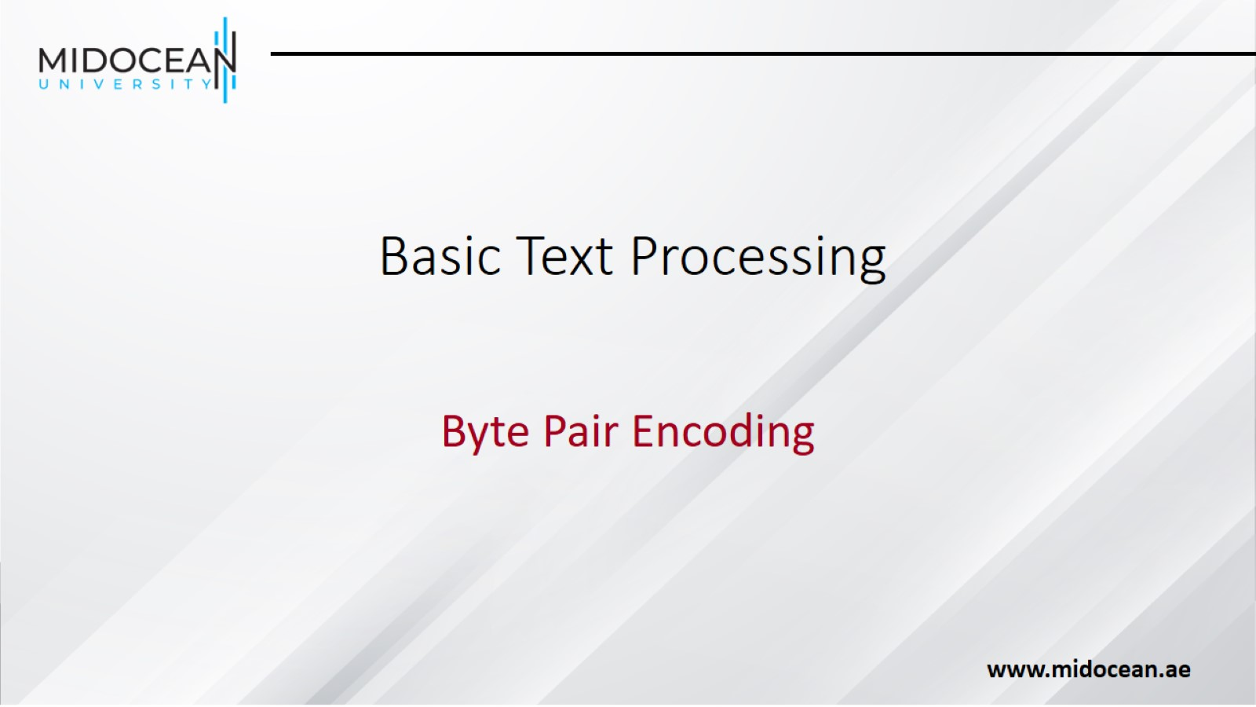
Basic Text Processing

Slide 6
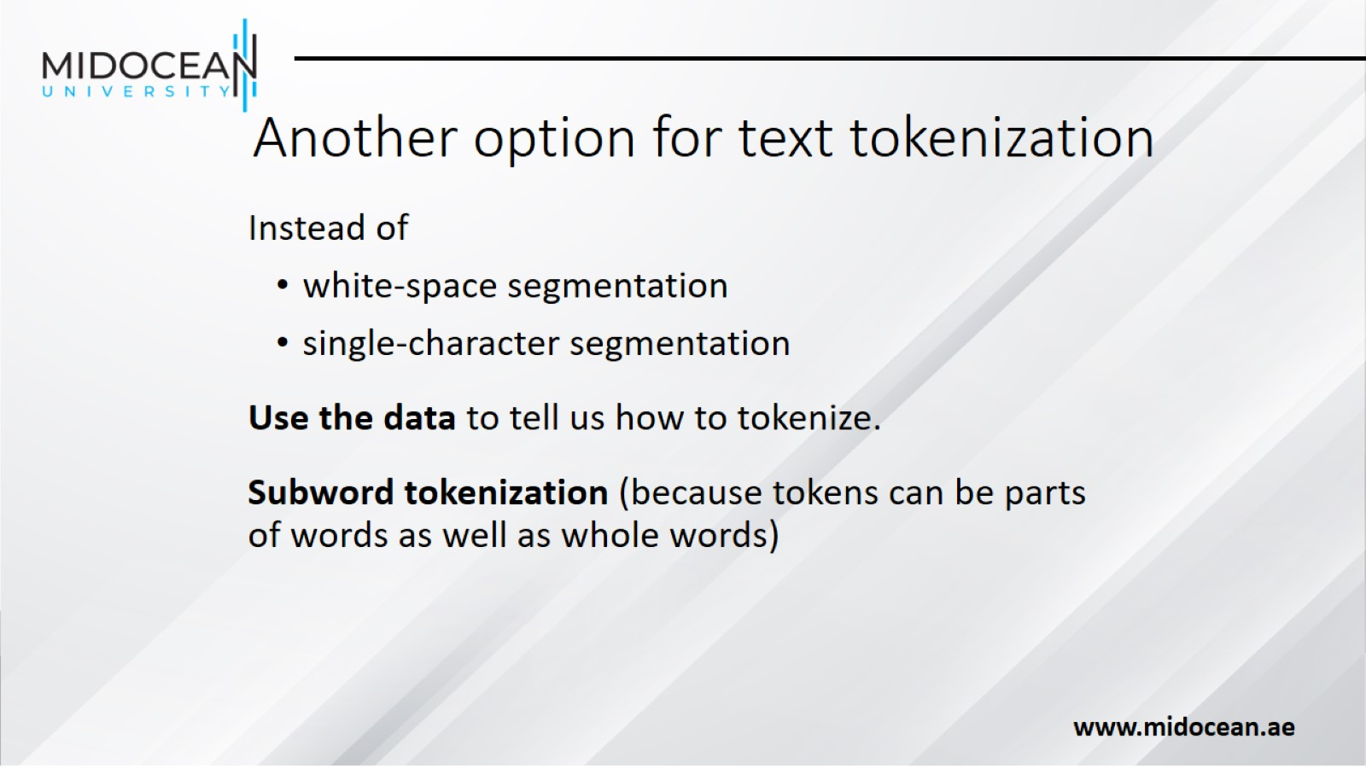
Another option for text tokenization

Slide 7
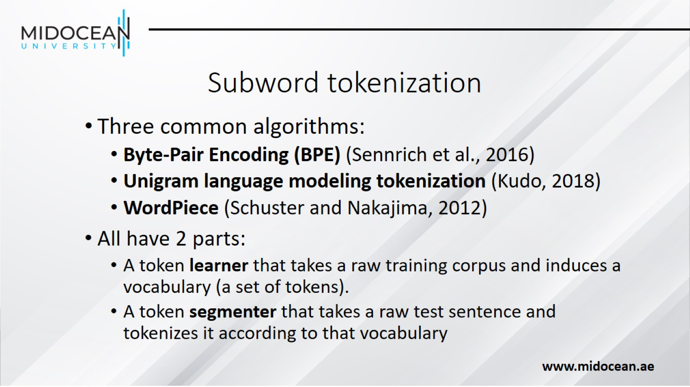
Subword tokenization

Slide 8
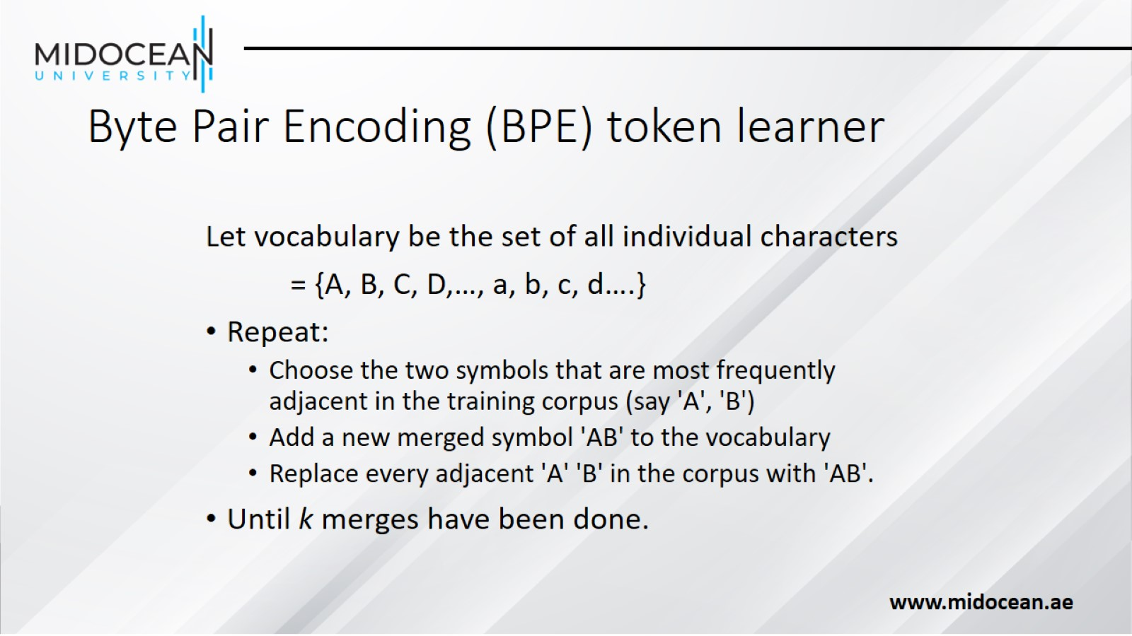
Byte Pair Encoding (BPE) token learner

Slide 9
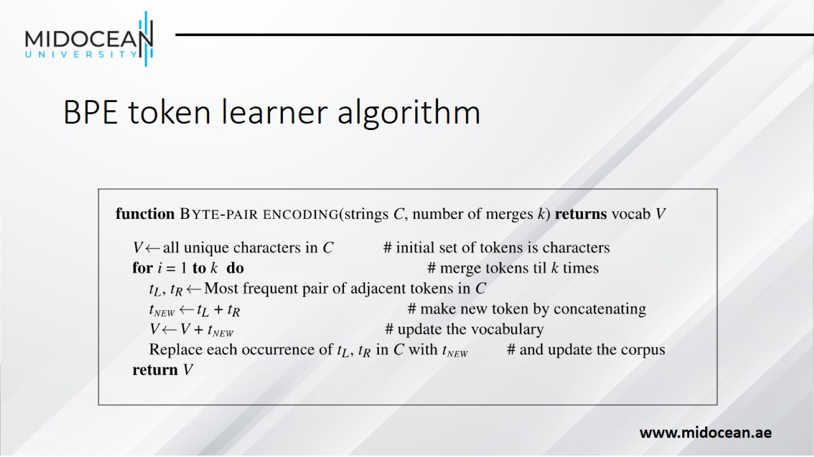
BPE token learner algorithm

Slide 10
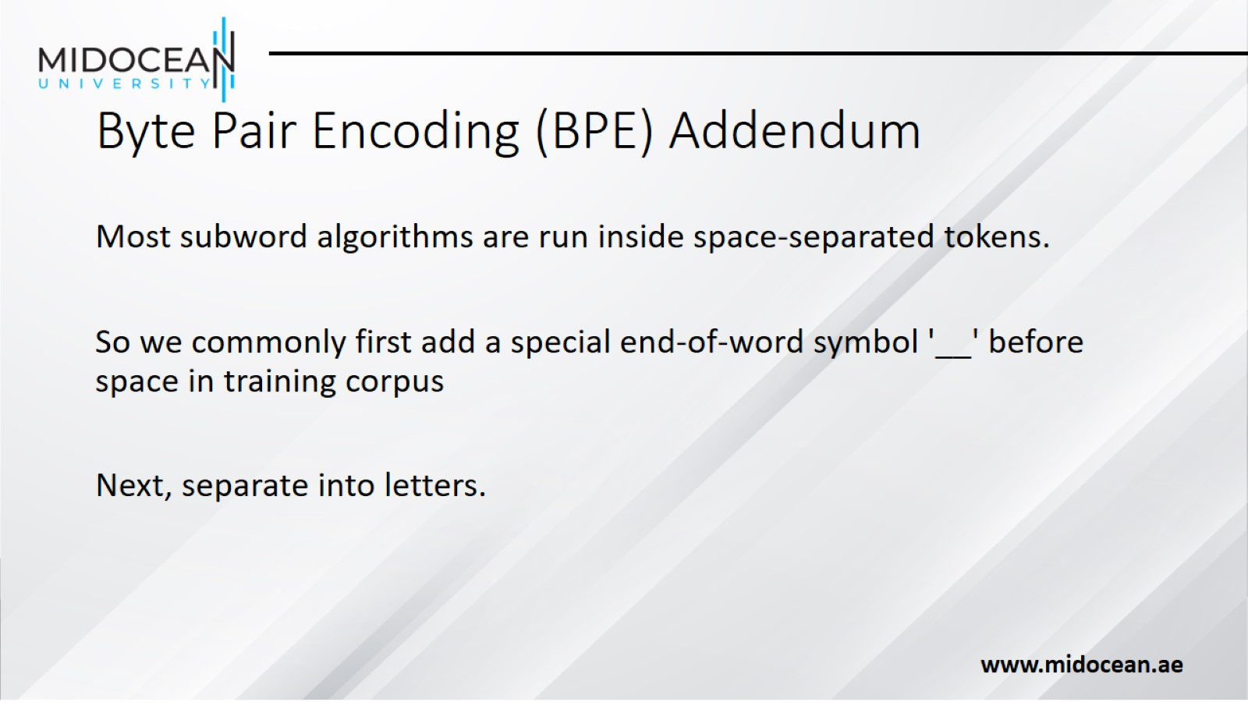
Byte Pair Encoding (BPE) Addendum

Slide 11
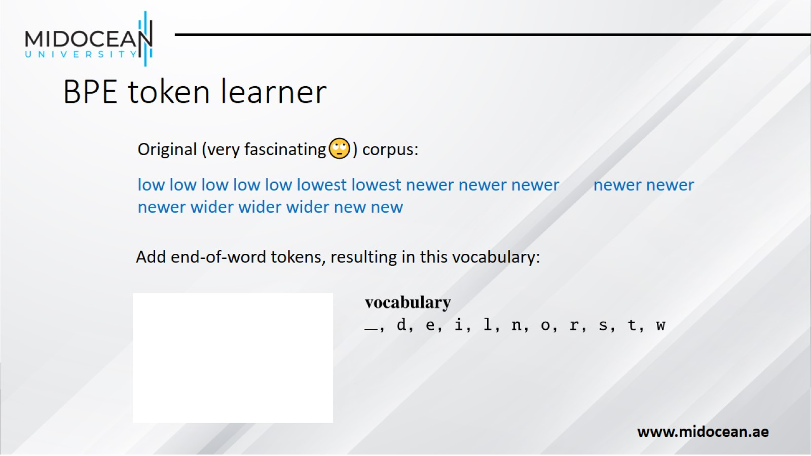
BPE token learner

Slide 12
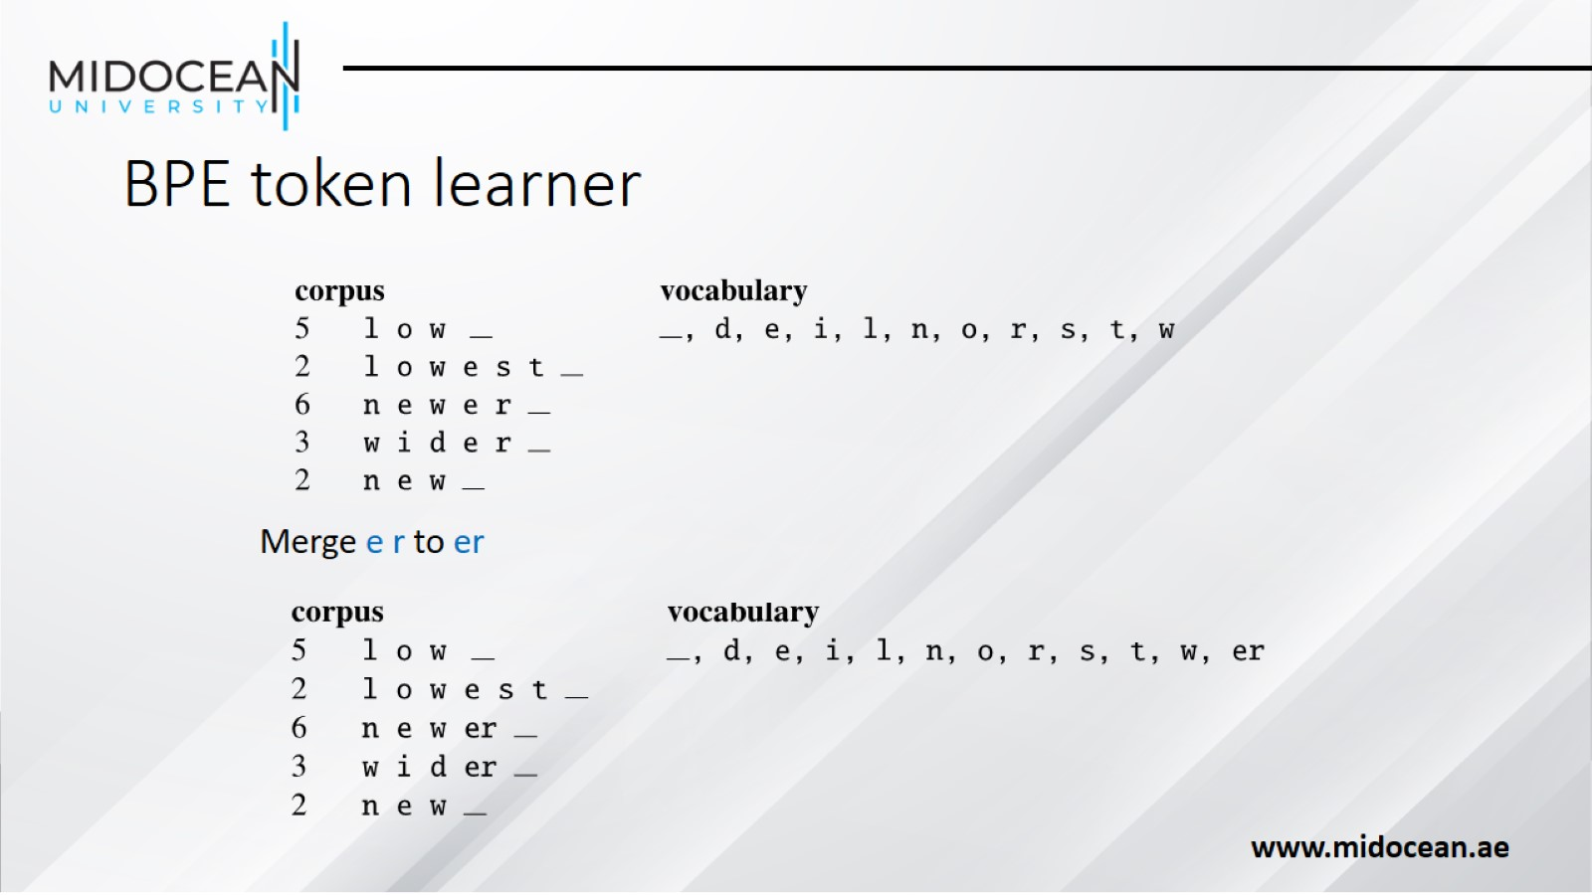
BPE token learner

Slide 13
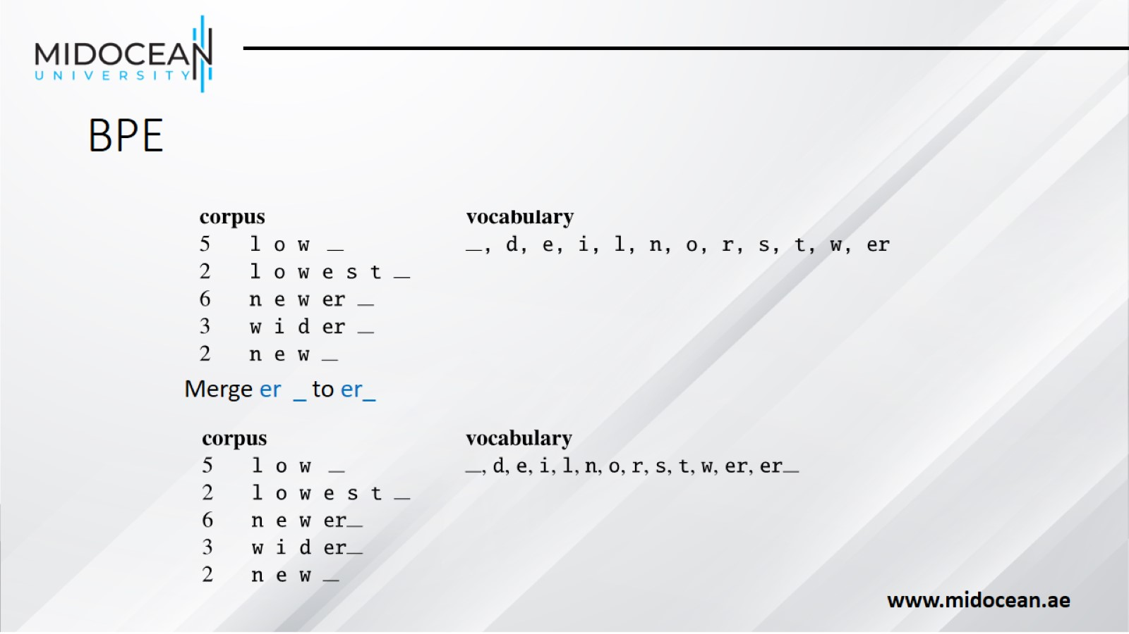
BPE

Slide 14
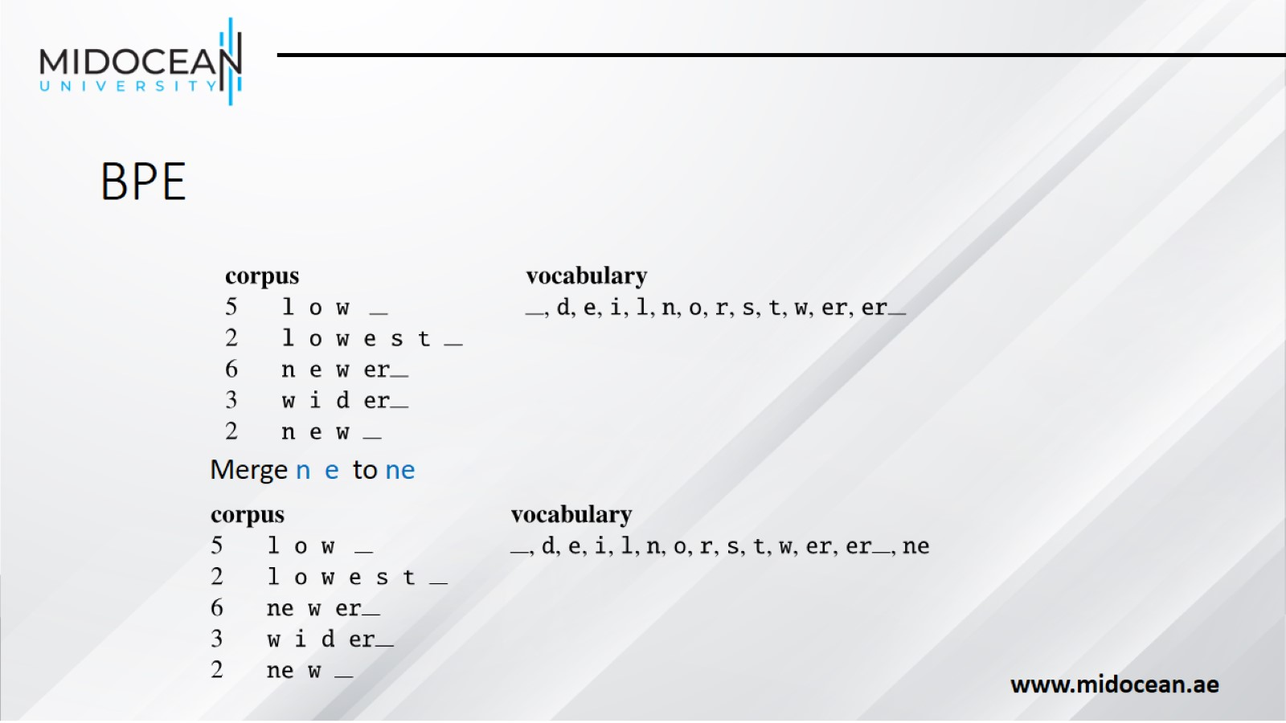
BPE

Slide 15
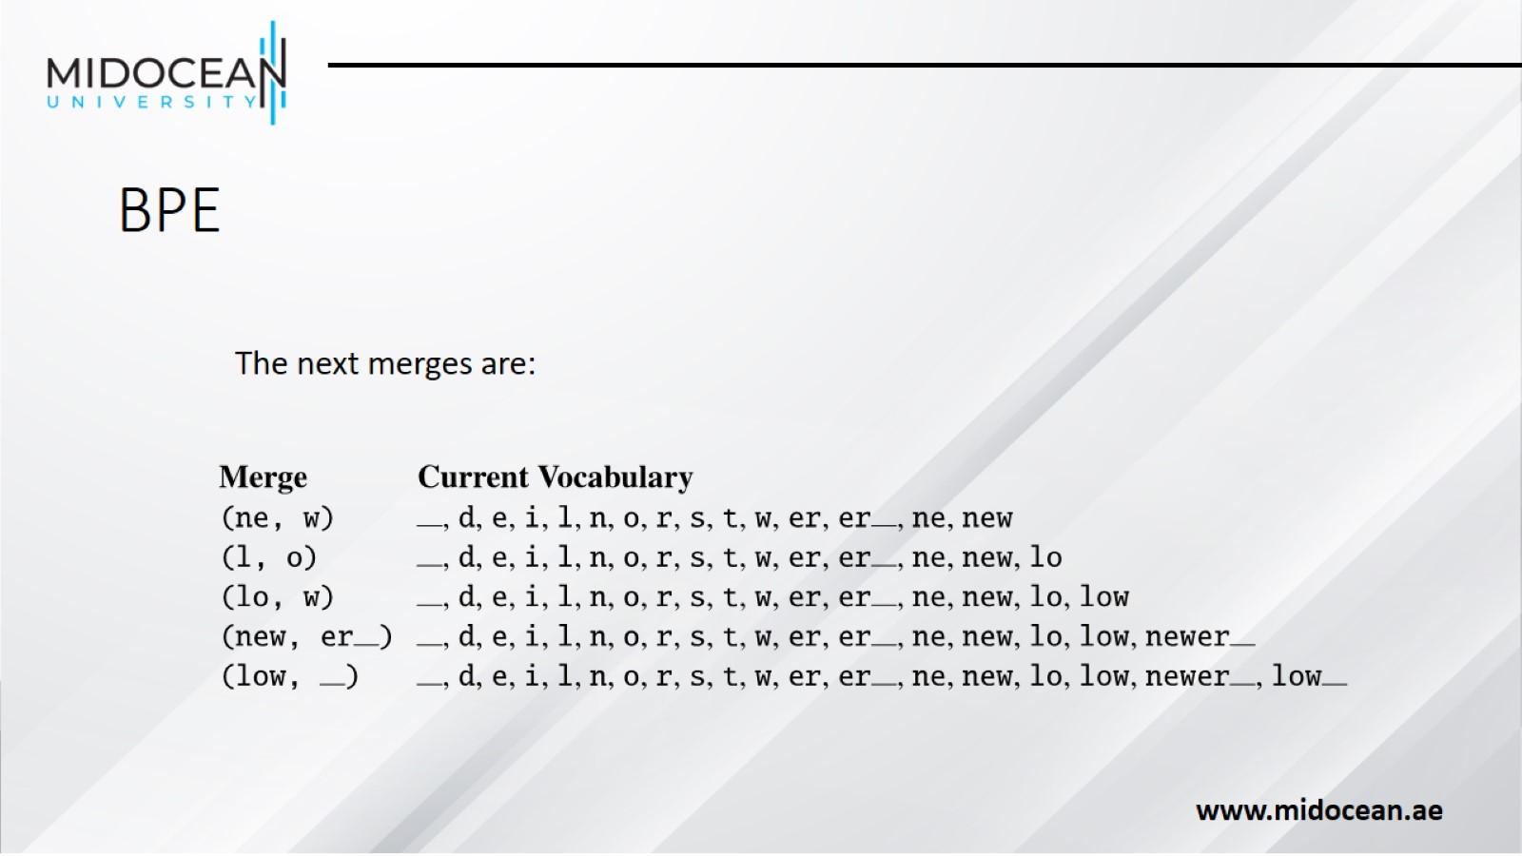
BPE

Slide 16
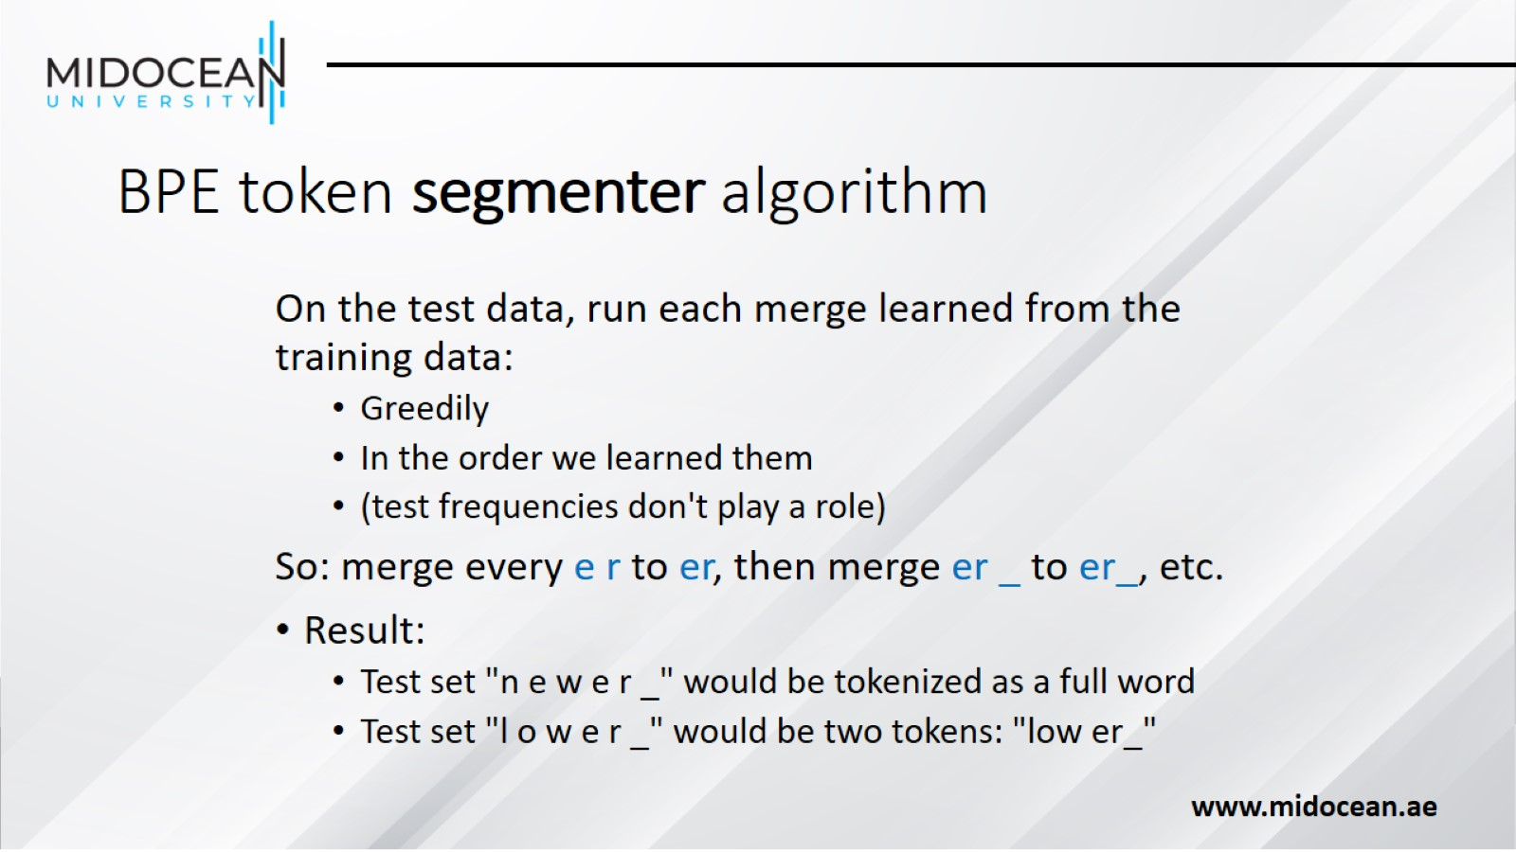
BPE token segmenter algorithm

Slide 17
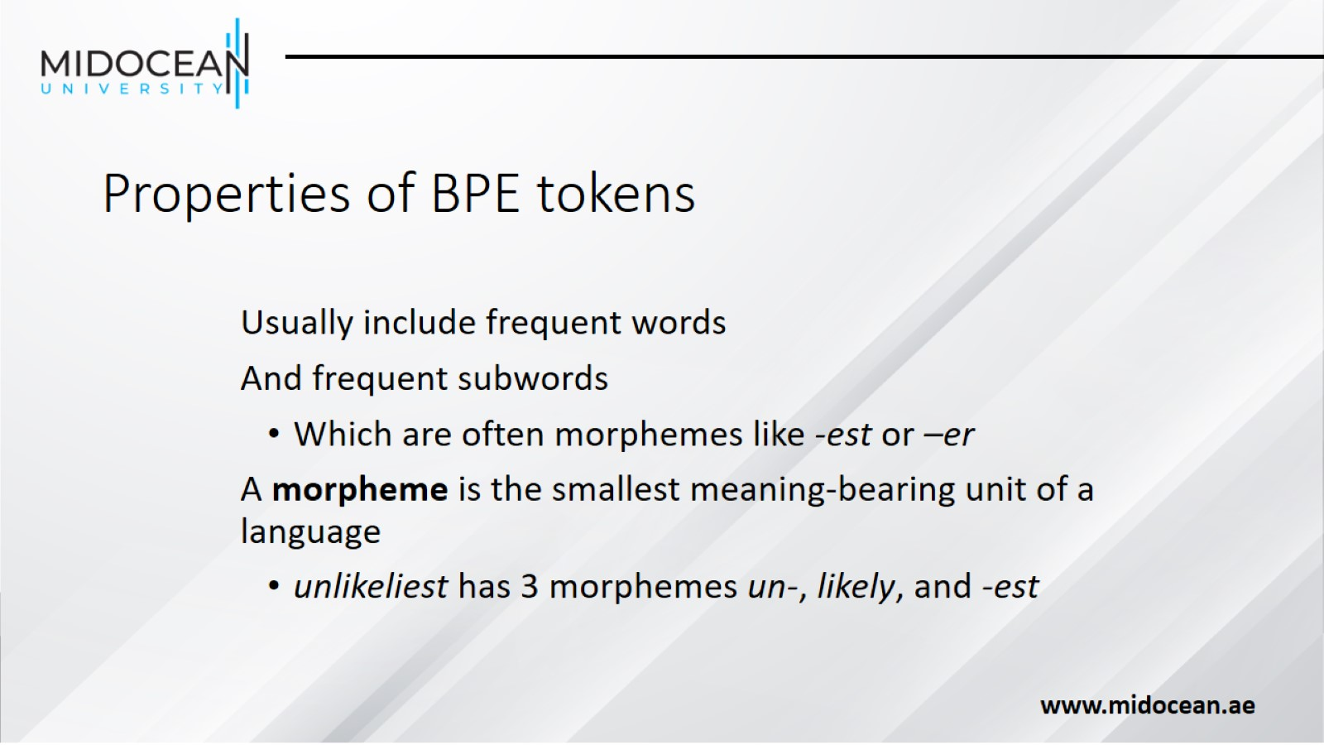
Properties of BPE tokens

Slide 18
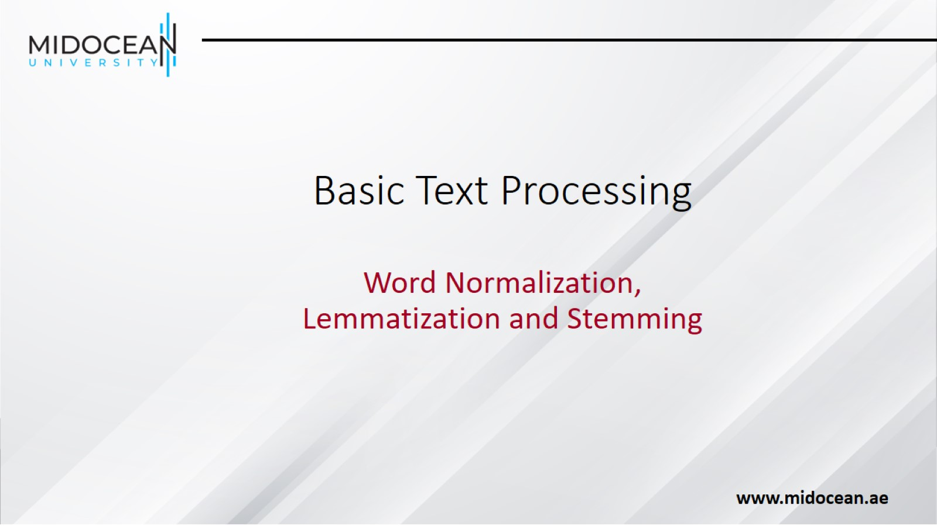
Basic Text Processing

Slide 19
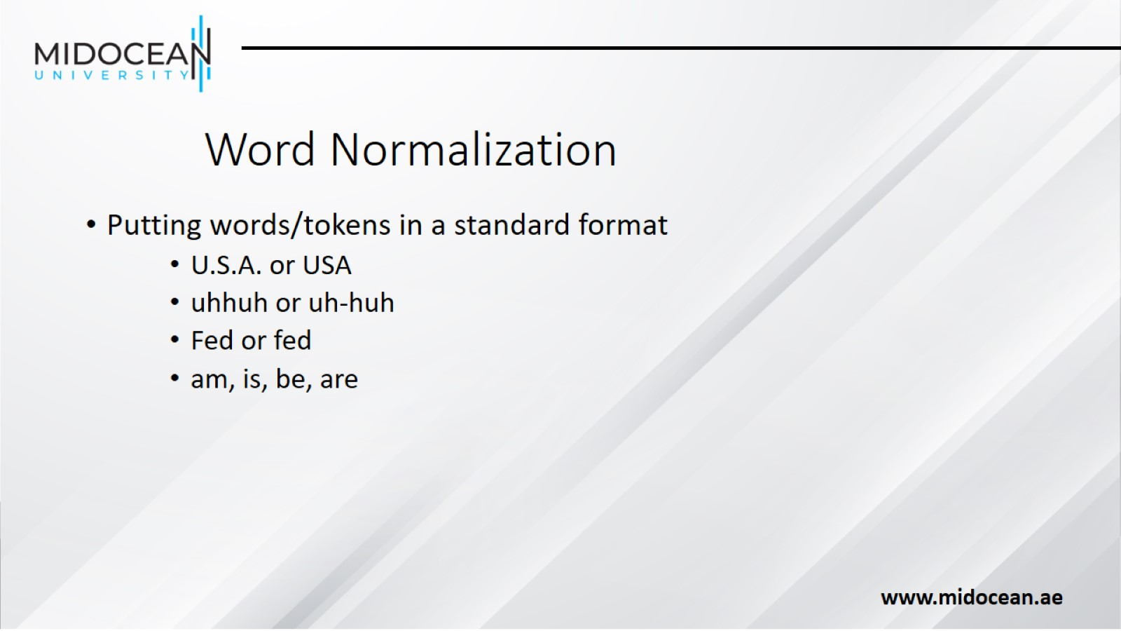
Word Normalization

Slide 20
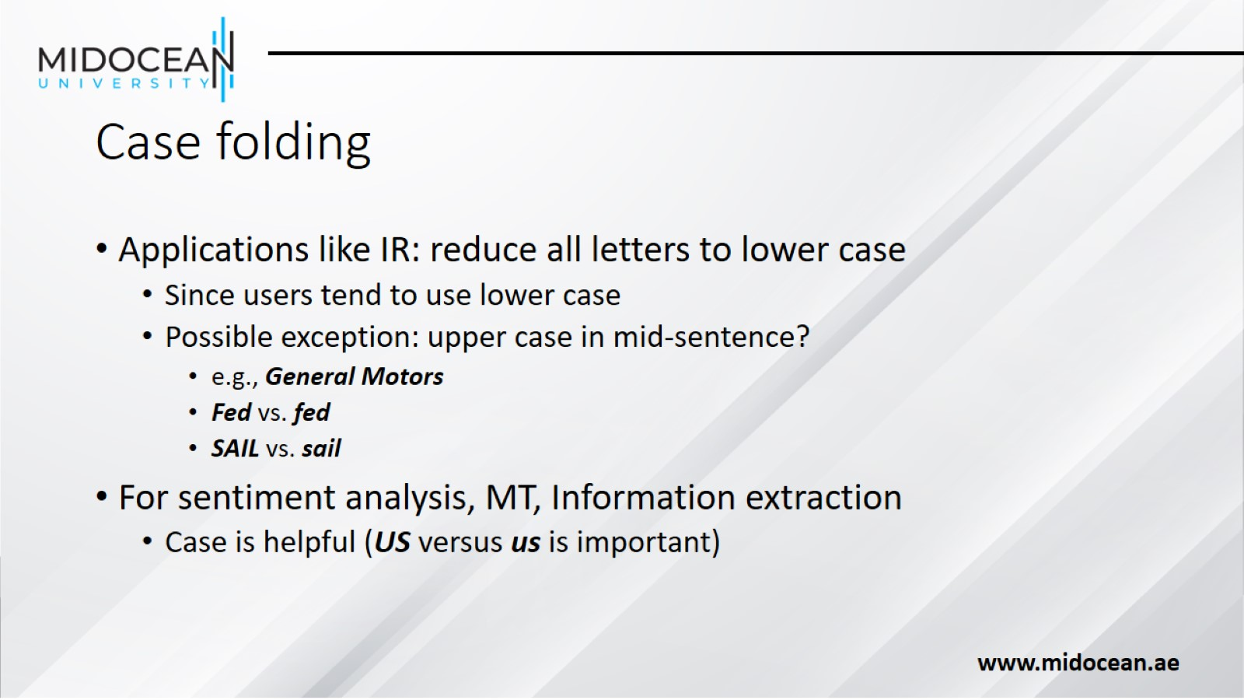
Case folding

Slide 21
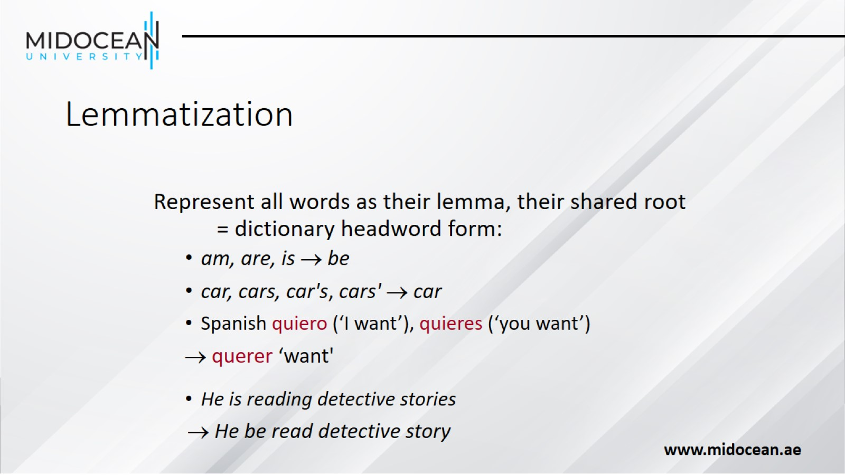
Lemmatization

Slide 22
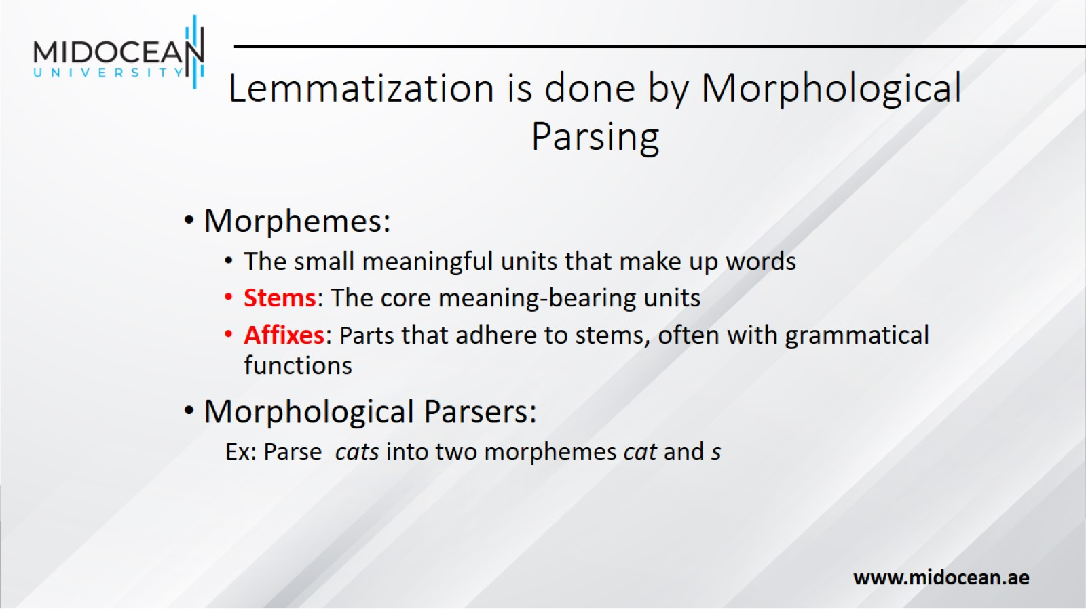
Lemmatization is done by Morphological Parsing

Slide 23
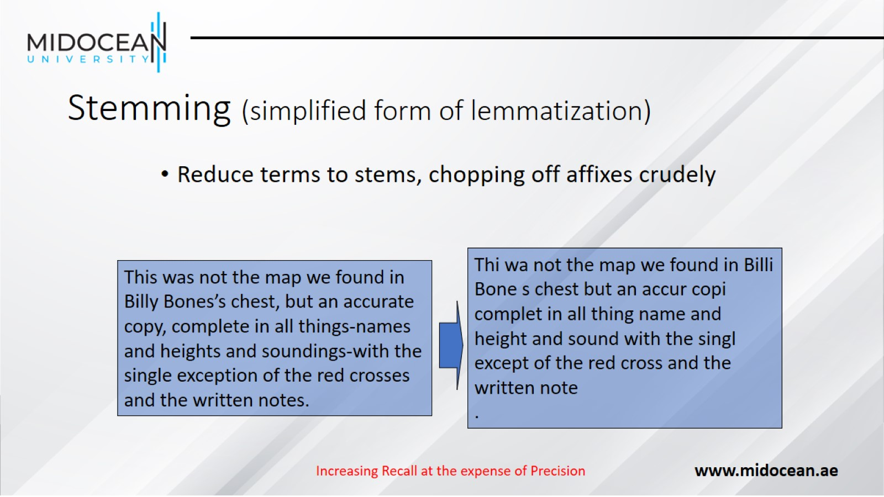
Stemming (simplified form of lemmatization)

Slide 24
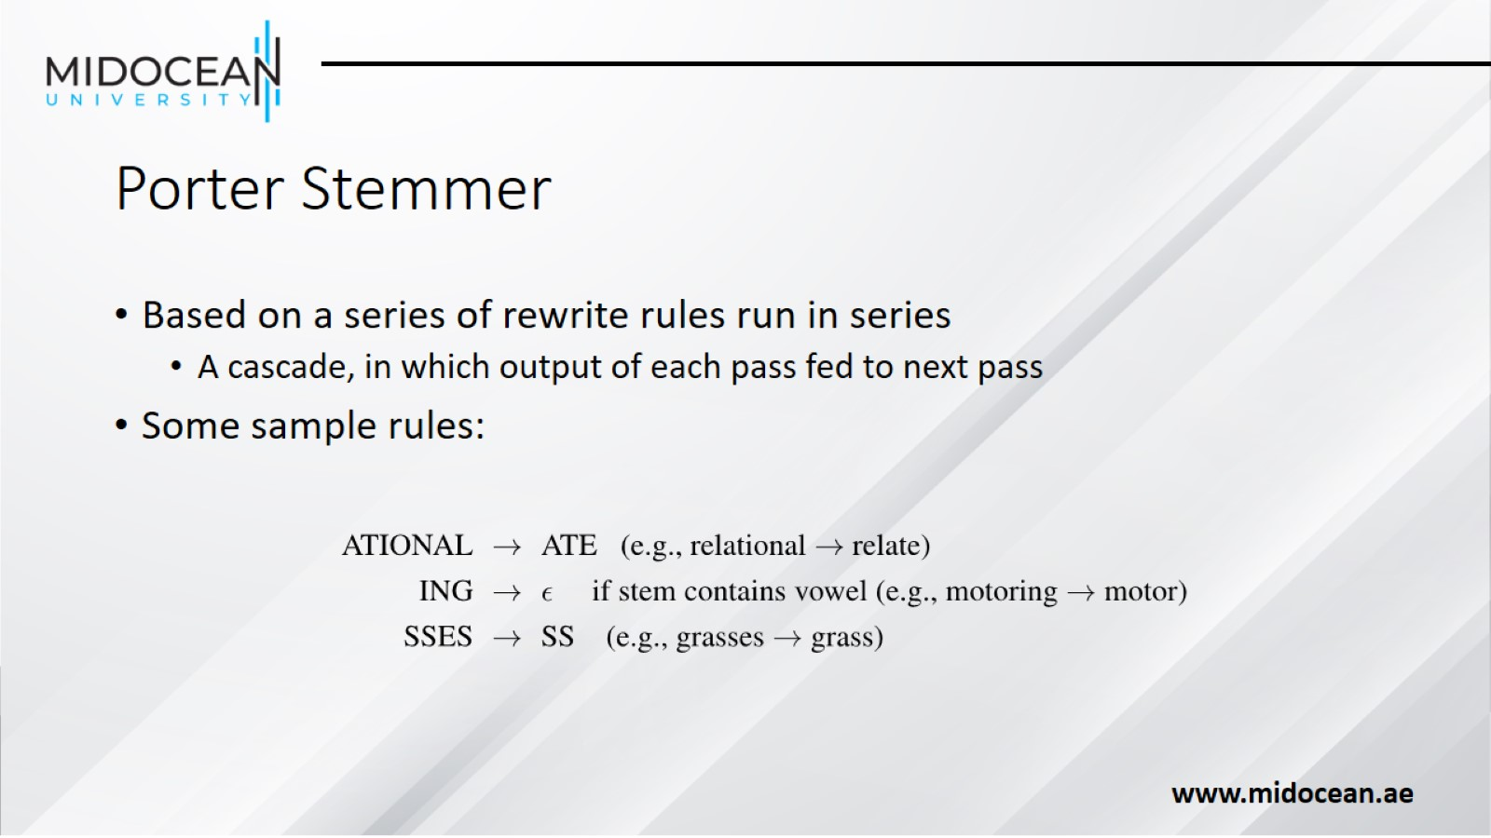
Porter Stemmer

Slide 25
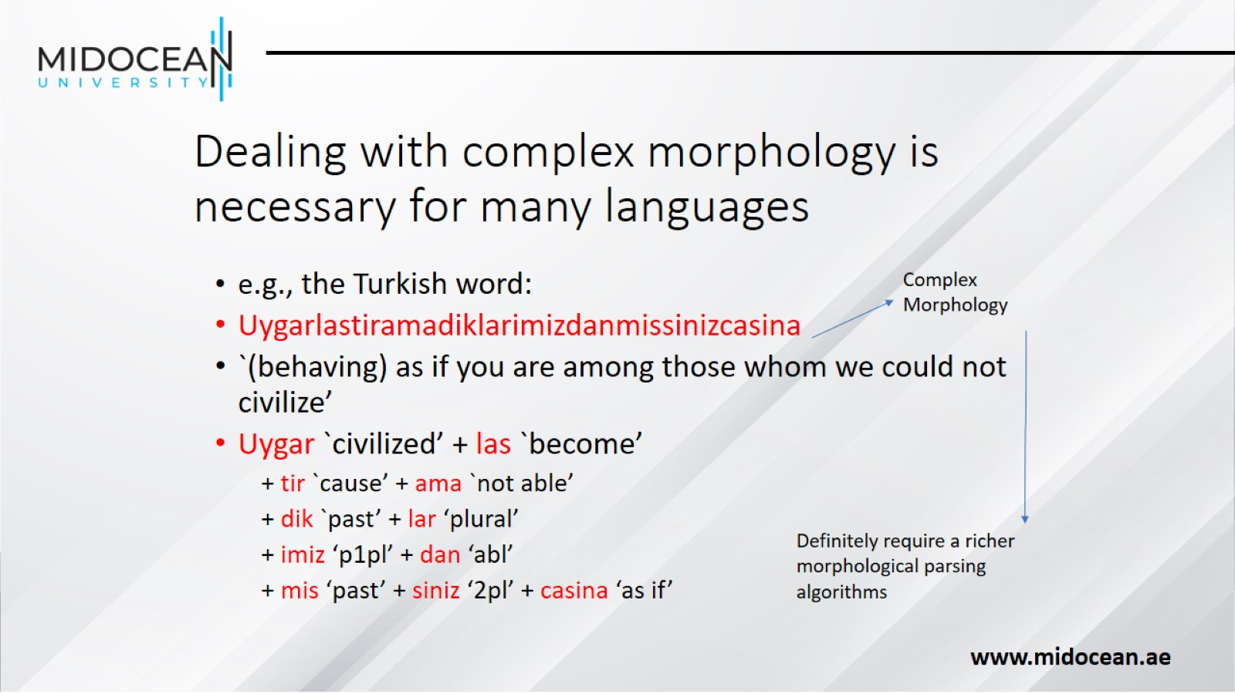
Dealing with complex morphology is necessary for many languages

Slide 26
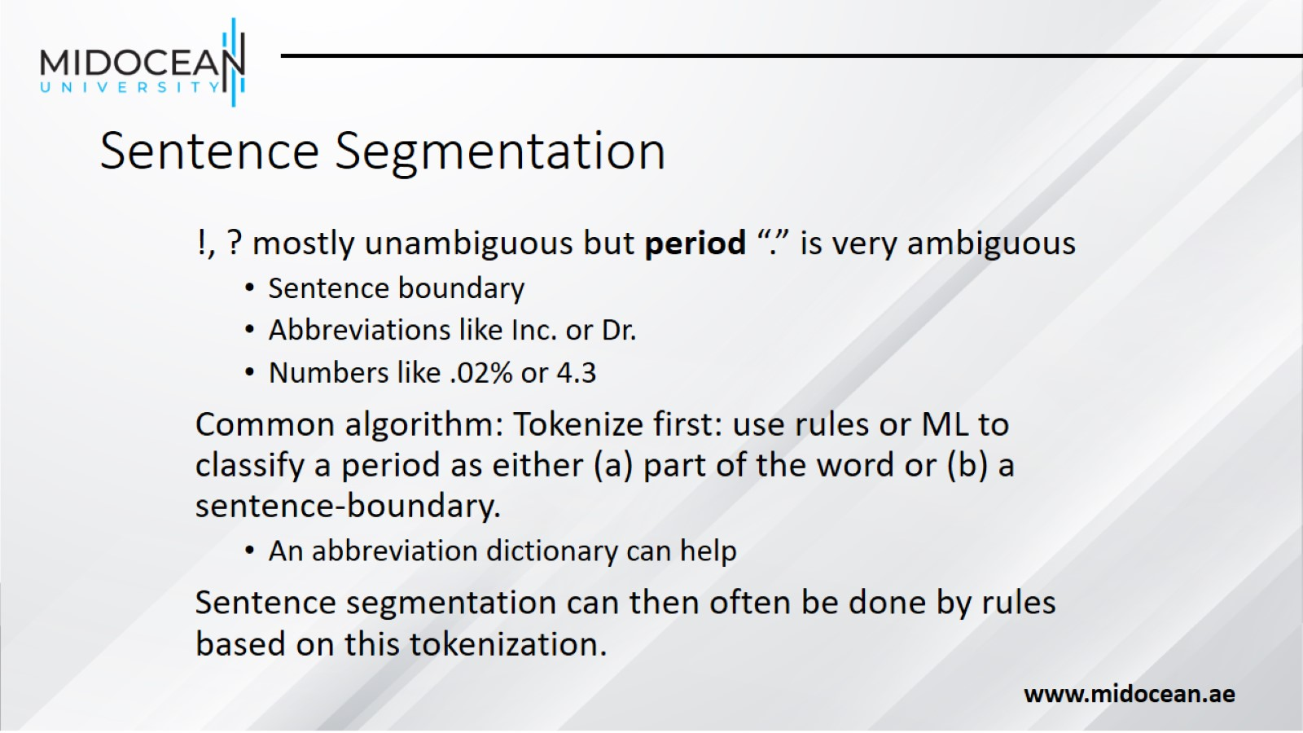
Sentence Segmentation

Slide 27
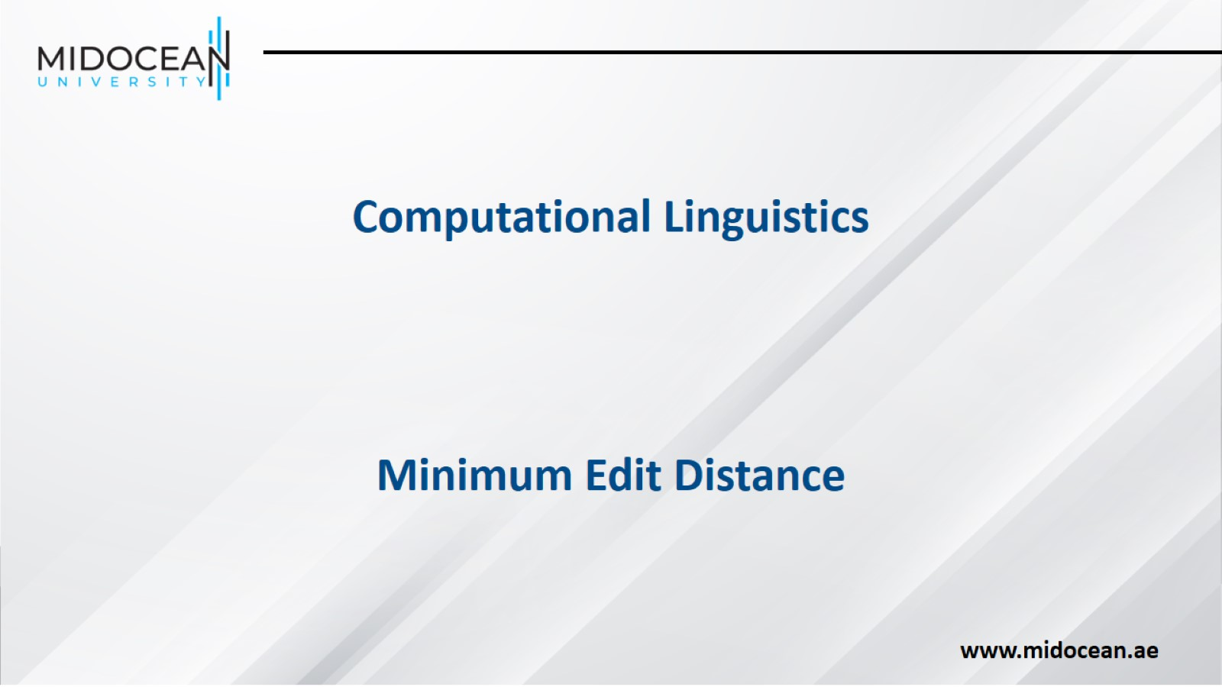

Slide 28

Definition of Minimum Edit Distance

Slide 29
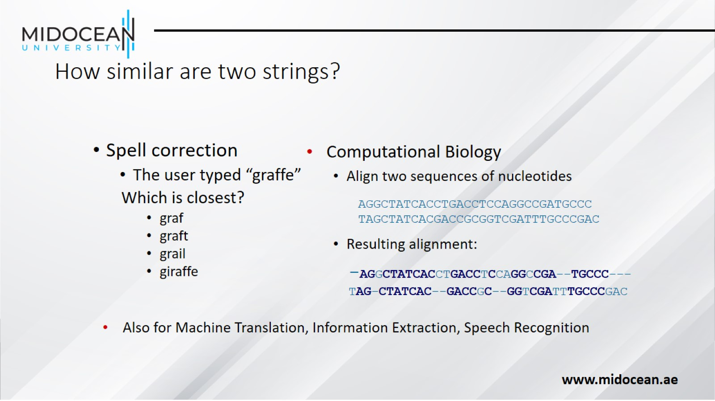
How similar are two strings?

Slide 30
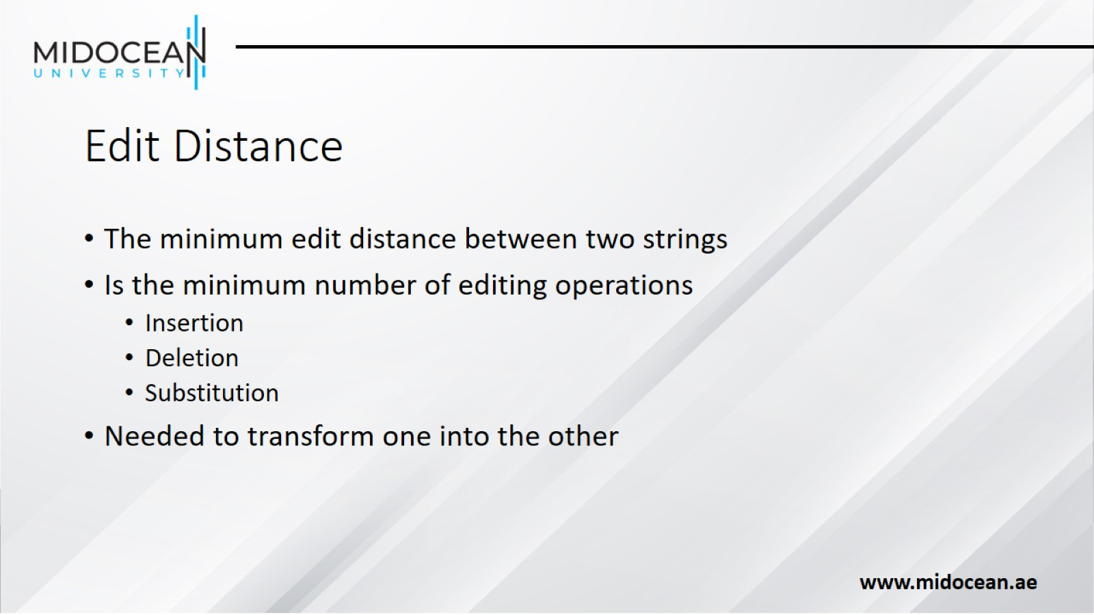
Edit Distance

Slide 31
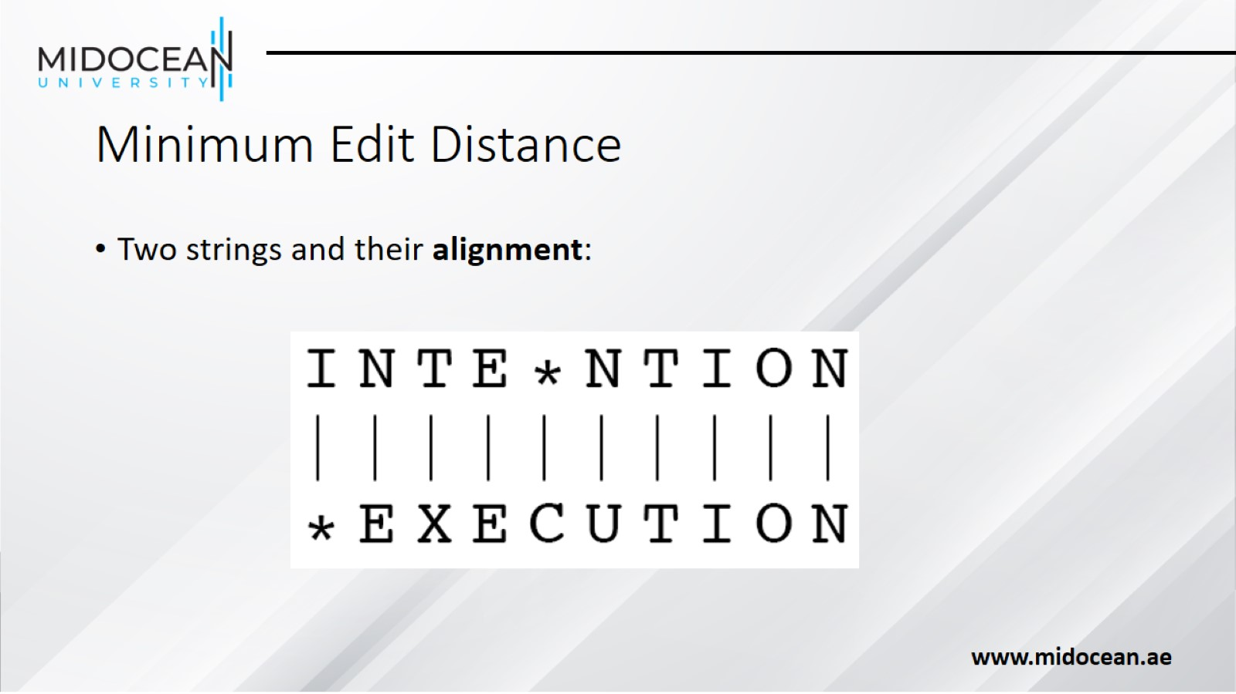
Minimum Edit Distance

Slide 32
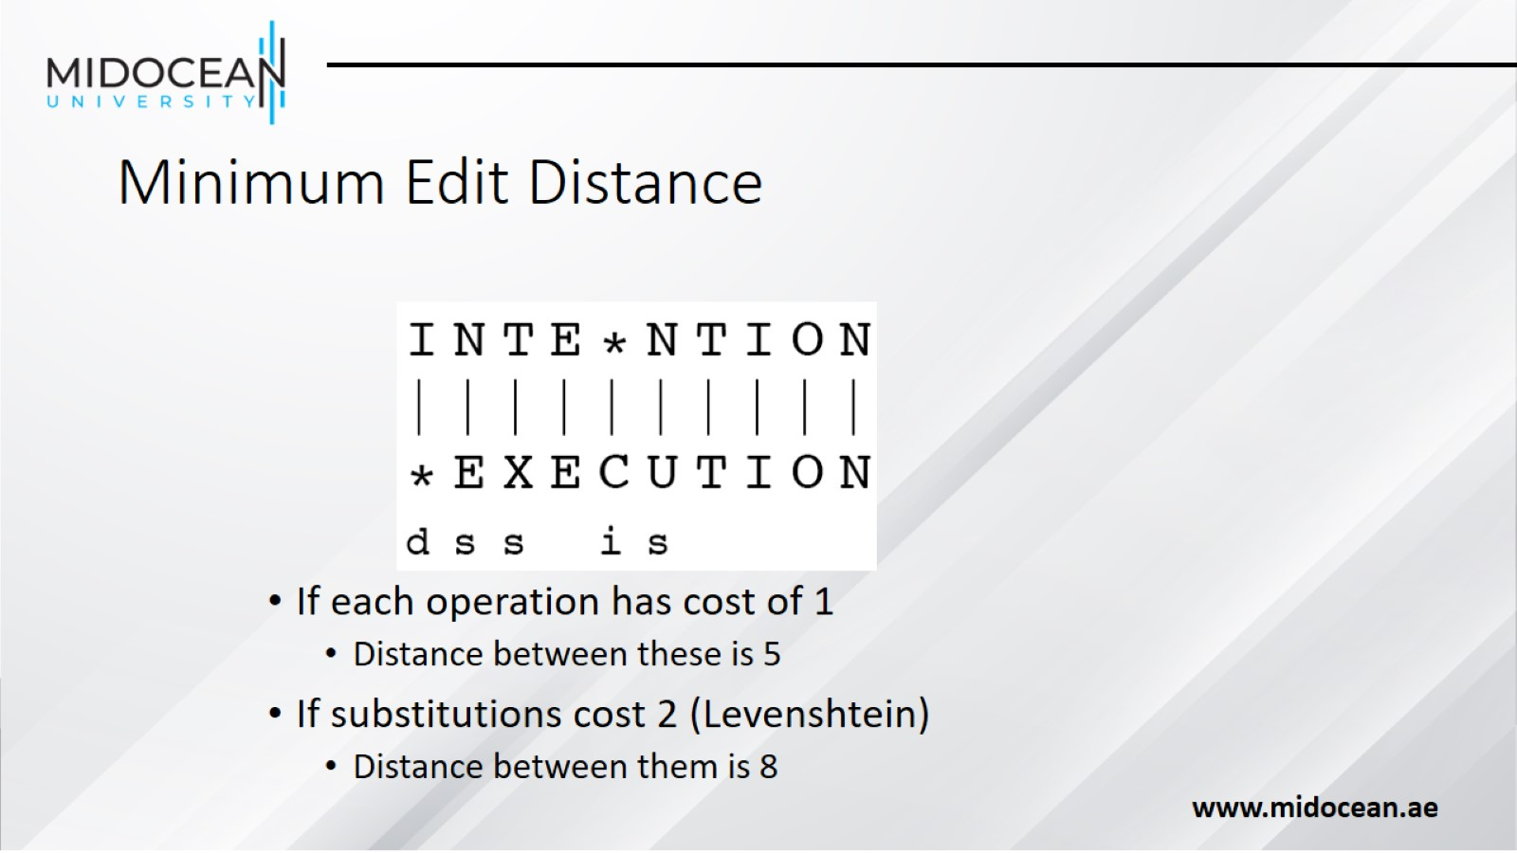
Minimum Edit Distance

Slide 33
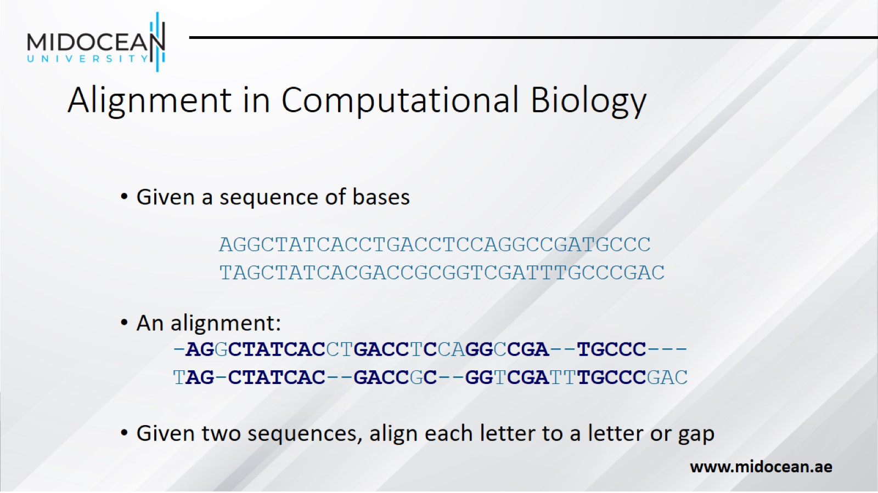
Alignment in Computational Biology

Slide 34
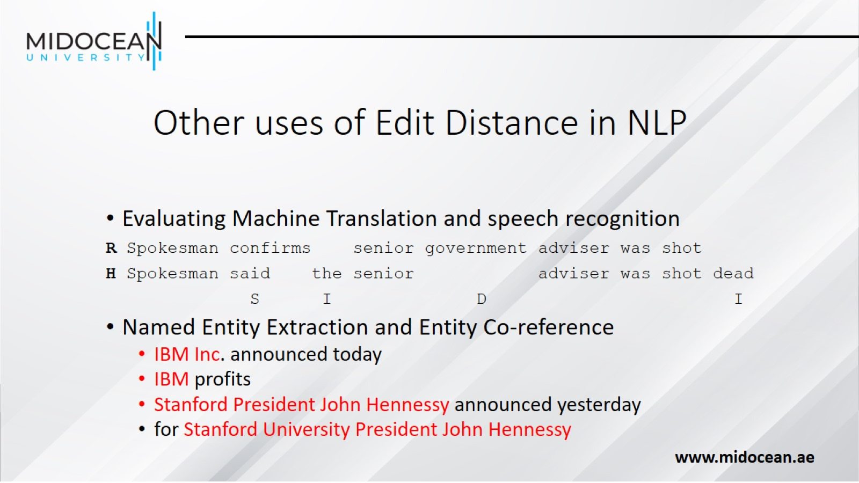
Other uses of Edit Distance in NLP

Slide 35
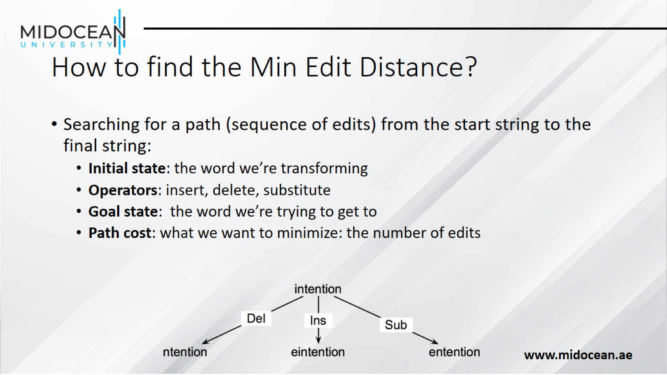
How to find the Min Edit Distance?

Slide 36
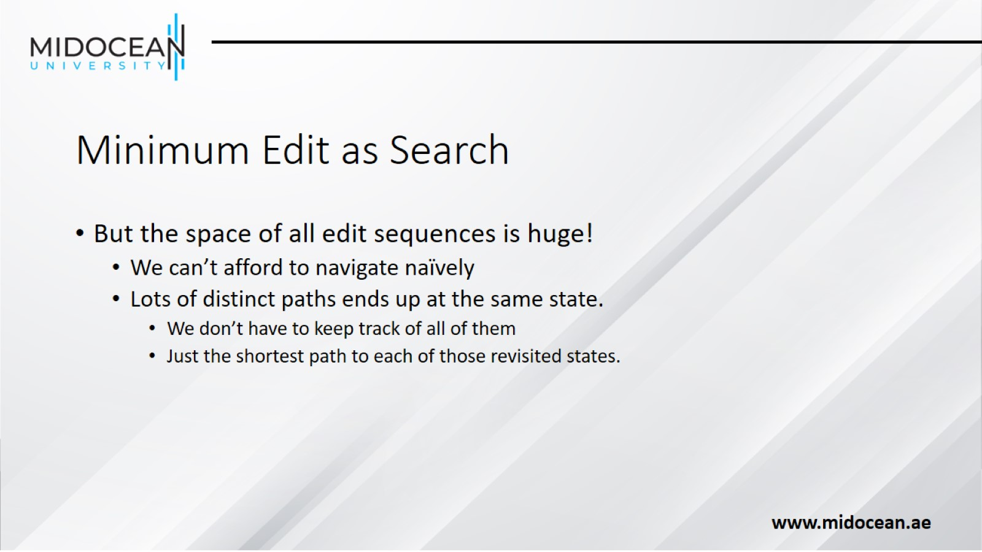
Minimum Edit as Search

Slide 37
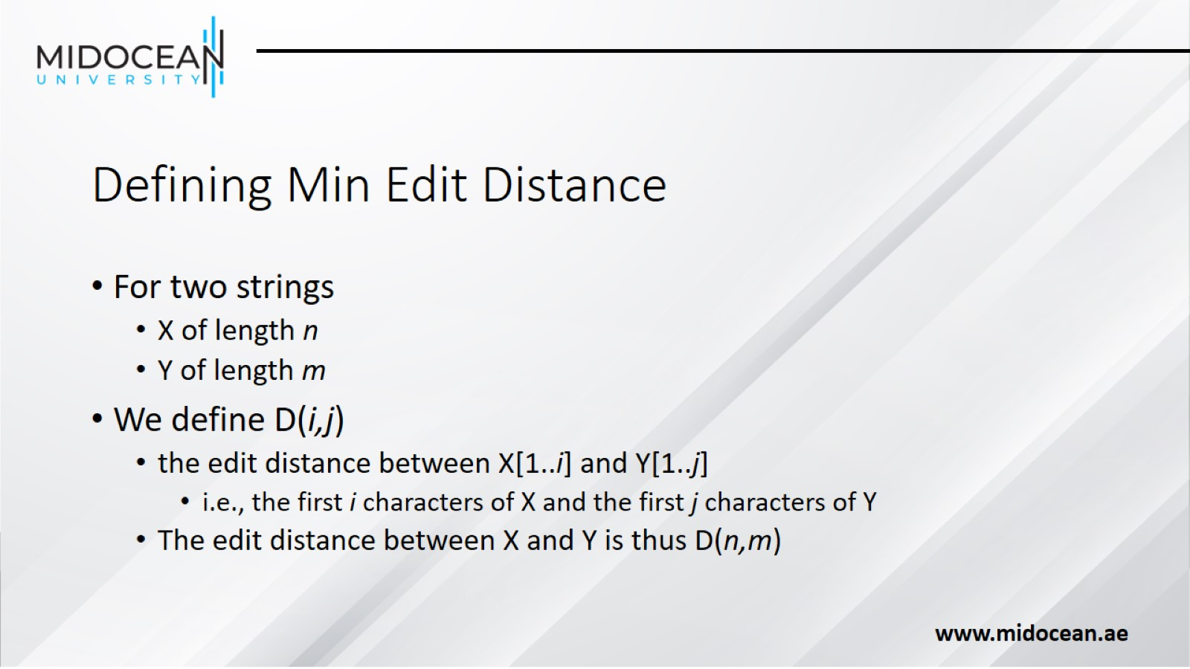
Defining Min Edit Distance

Slide 38
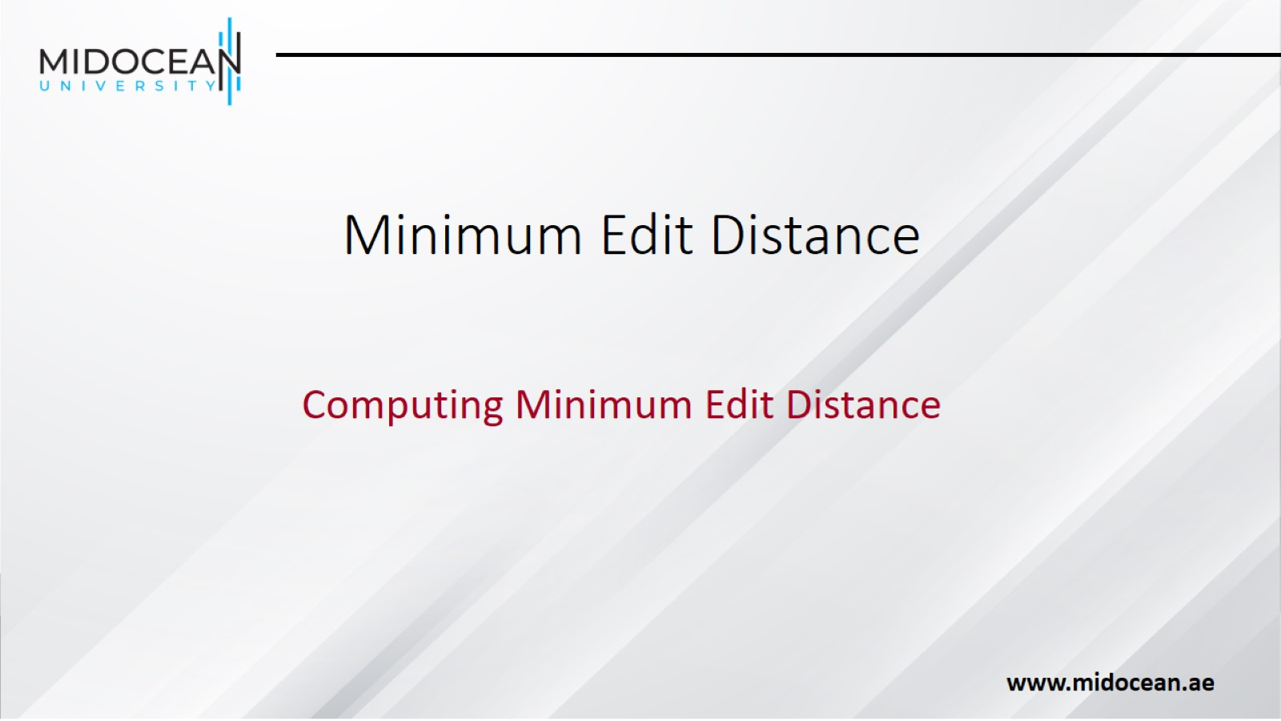
Minimum Edit Distance

Slide 39
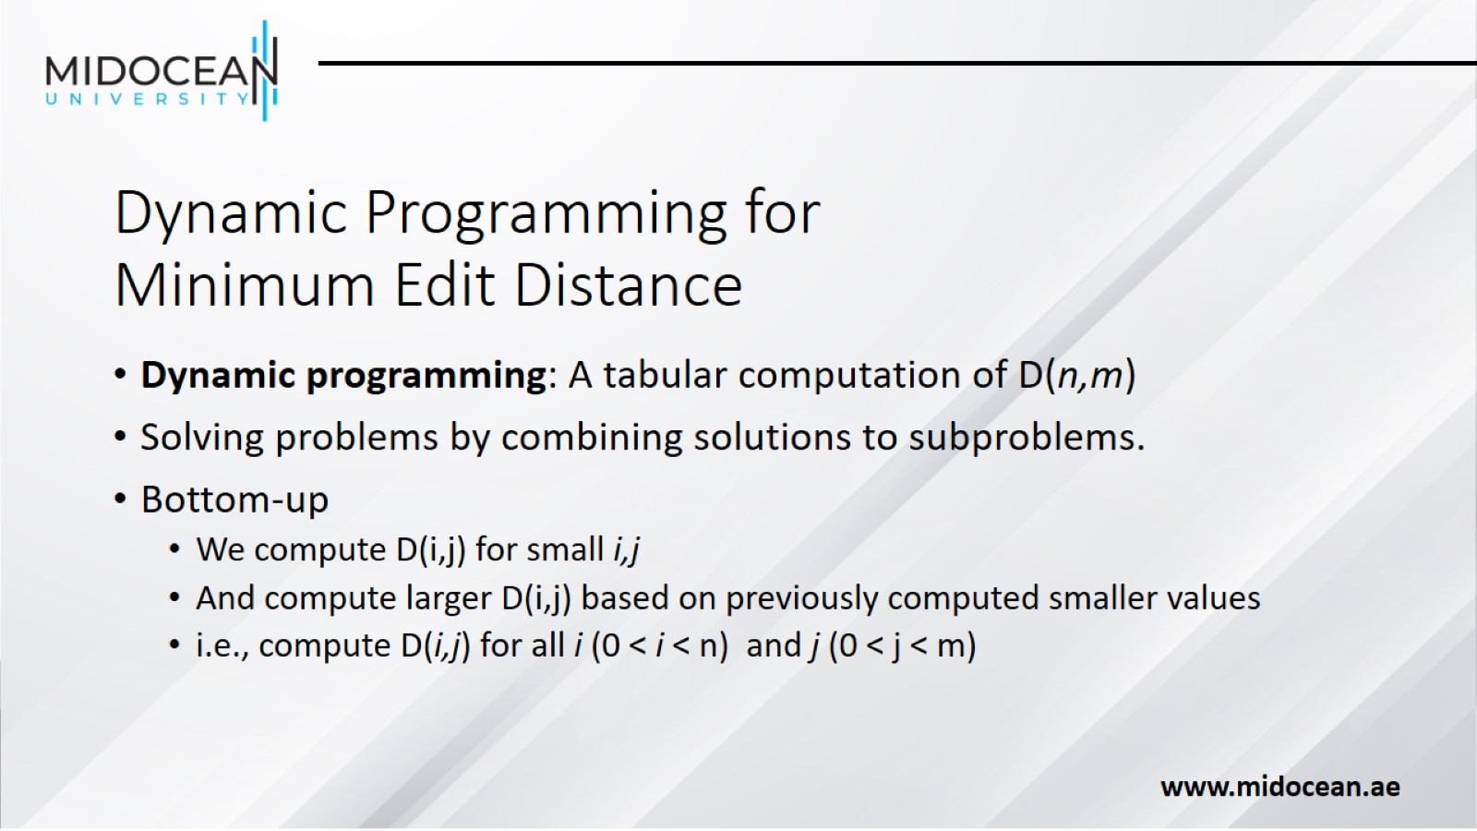
Dynamic Programming for
Minimum Edit Distance

Slide 40
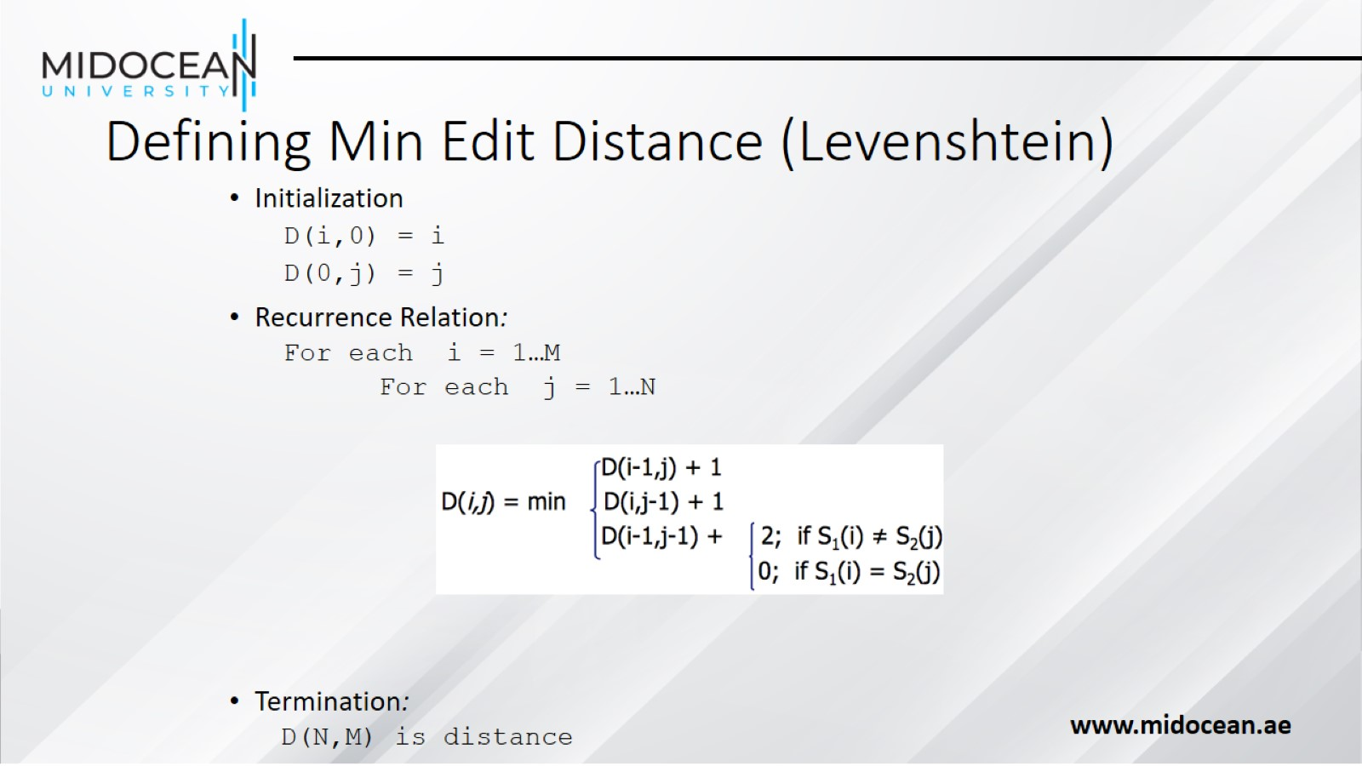
Defining Min Edit Distance (Levenshtein)

Slide 41
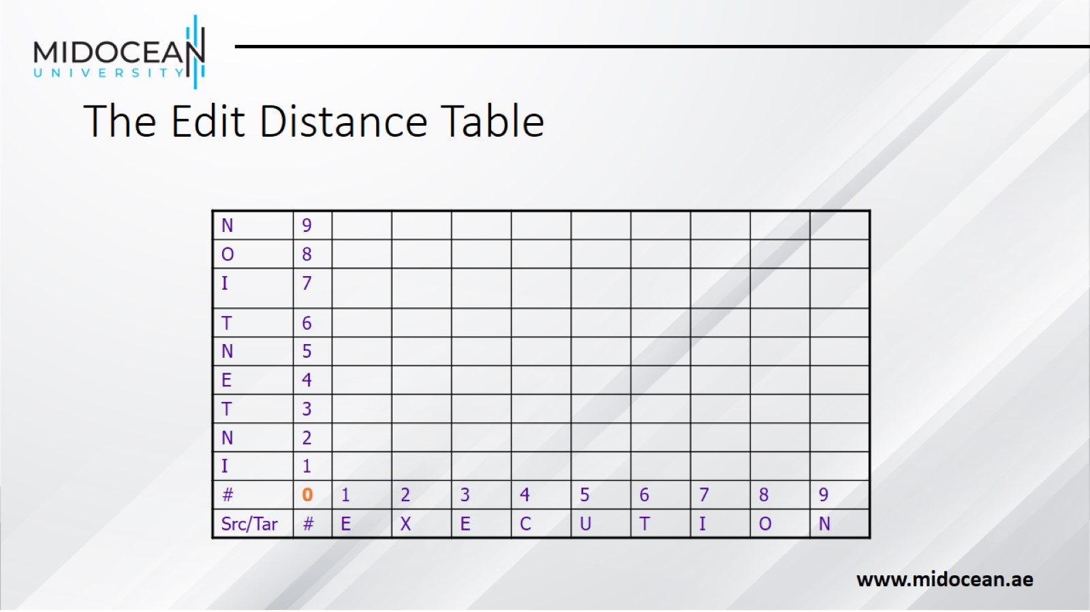
The Edit Distance Table

Slide 42
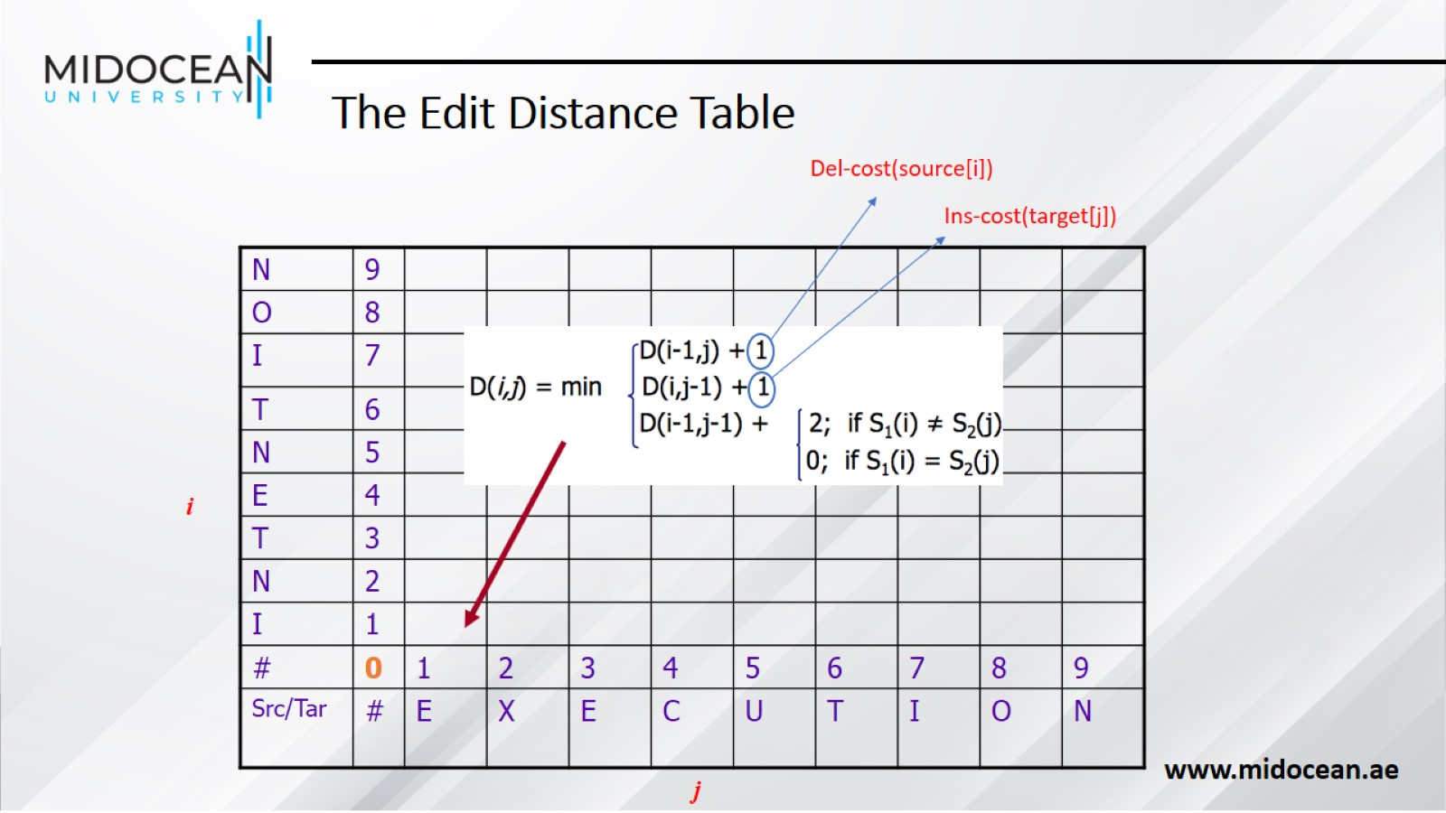

Slide 43
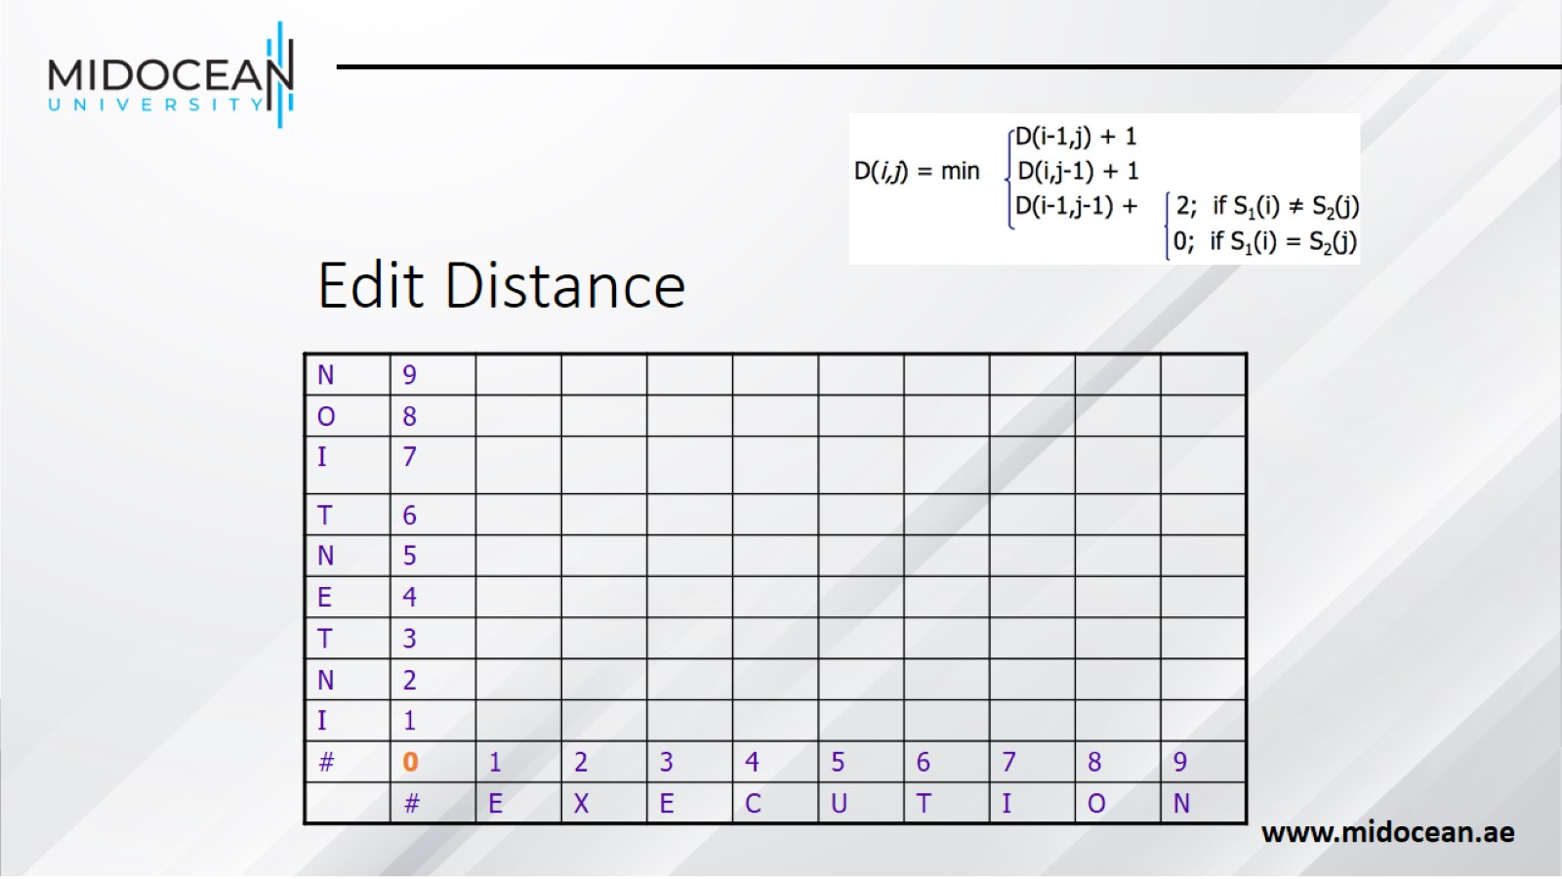
Edit Distance

Slide 44
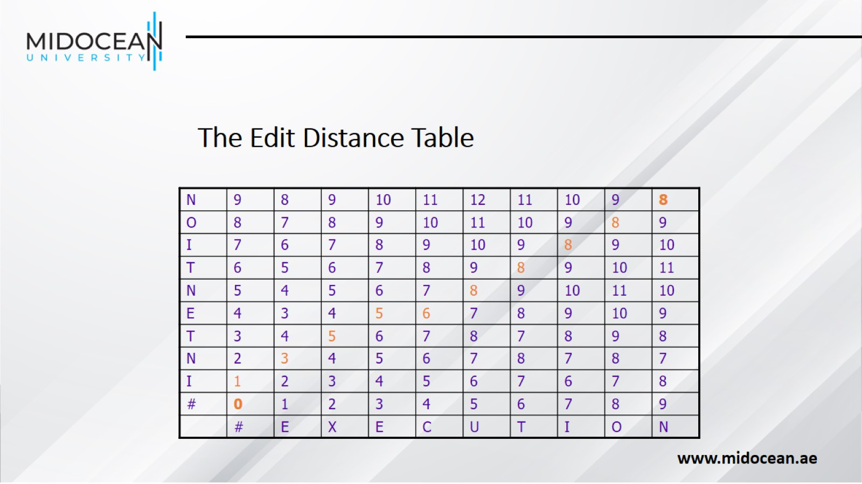

Slide 45
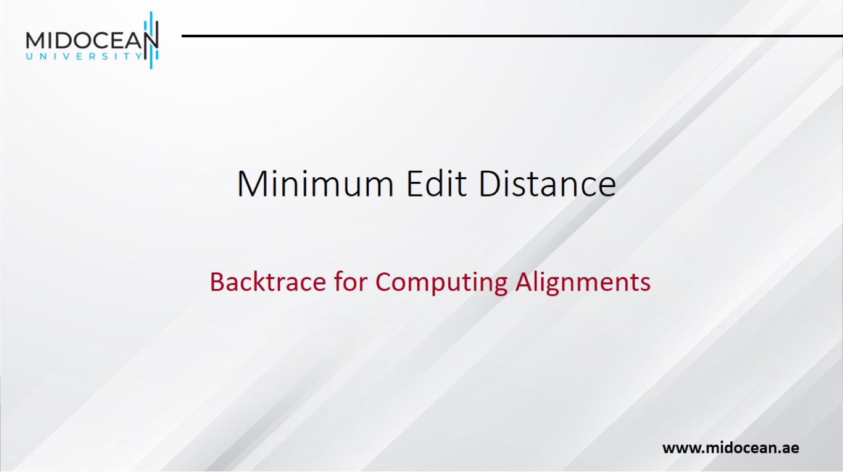
Minimum Edit Distance

Slide 46
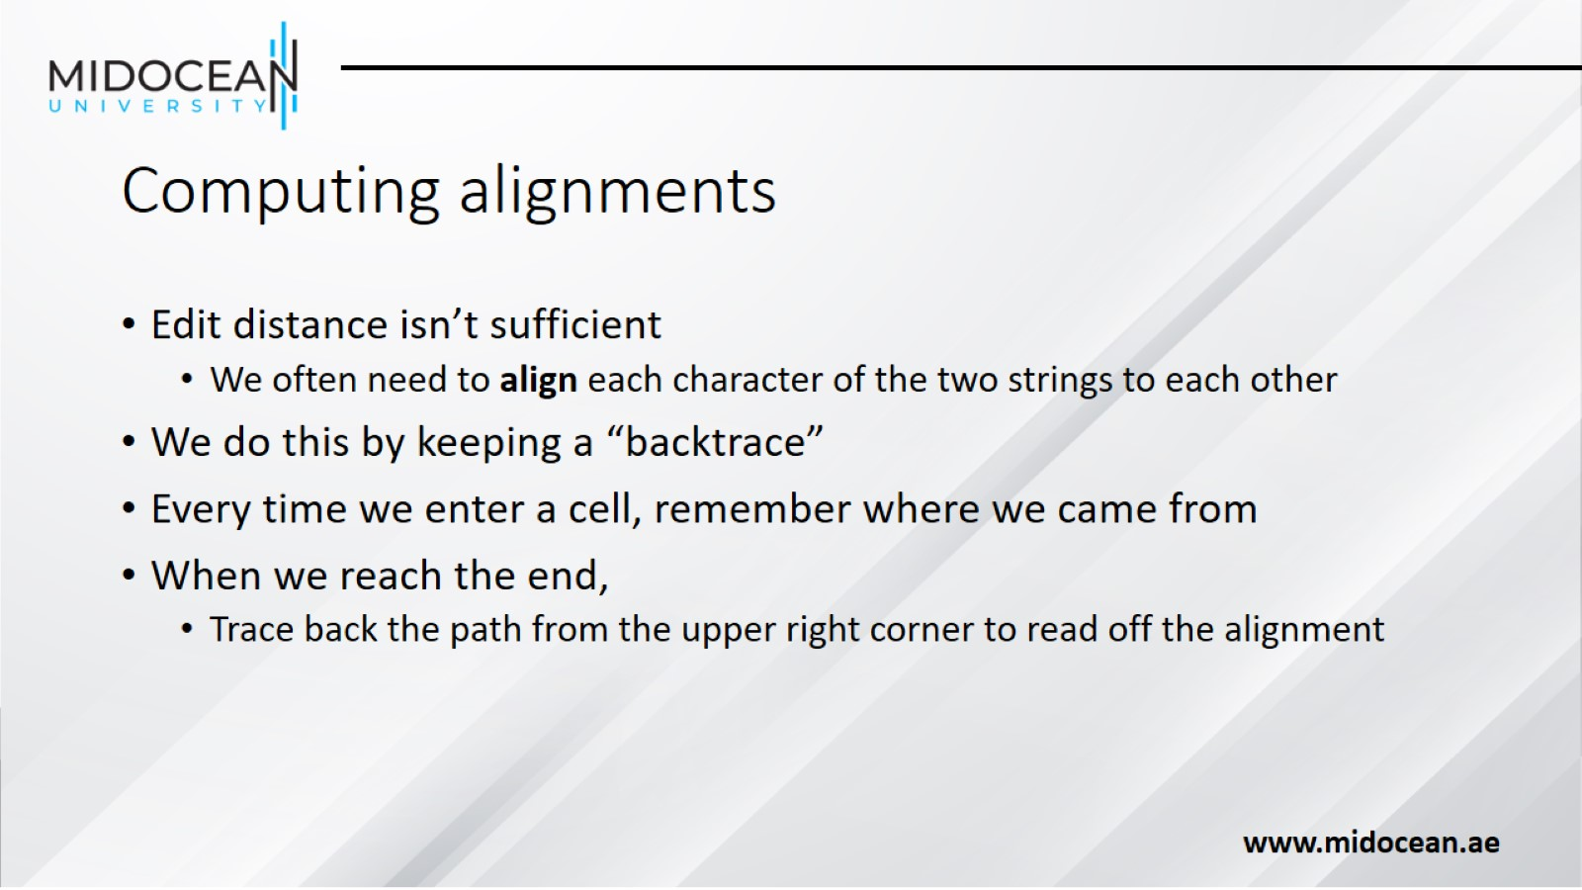
Computing alignments

Slide 47
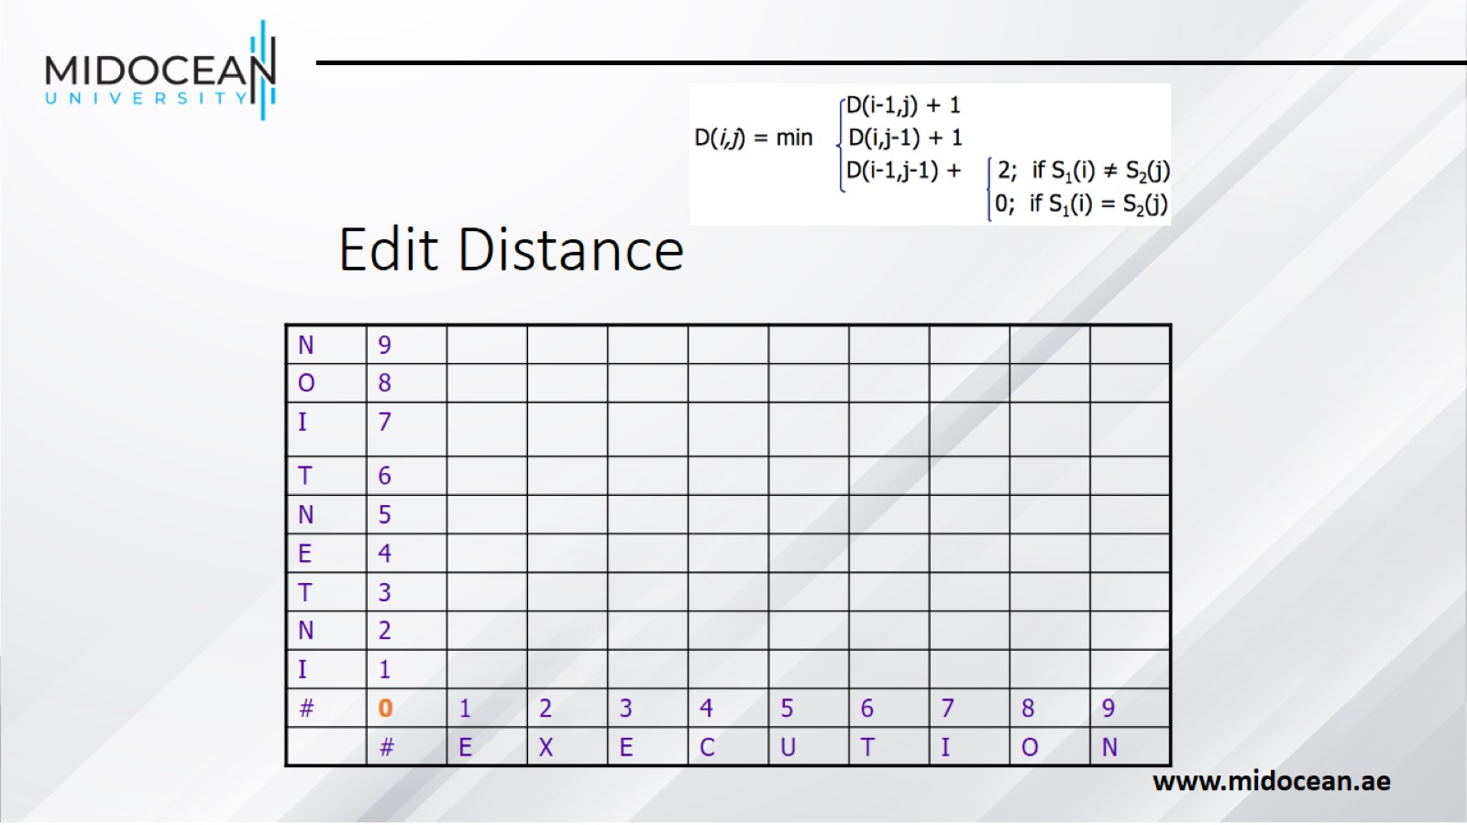
Edit Distance

Slide 48
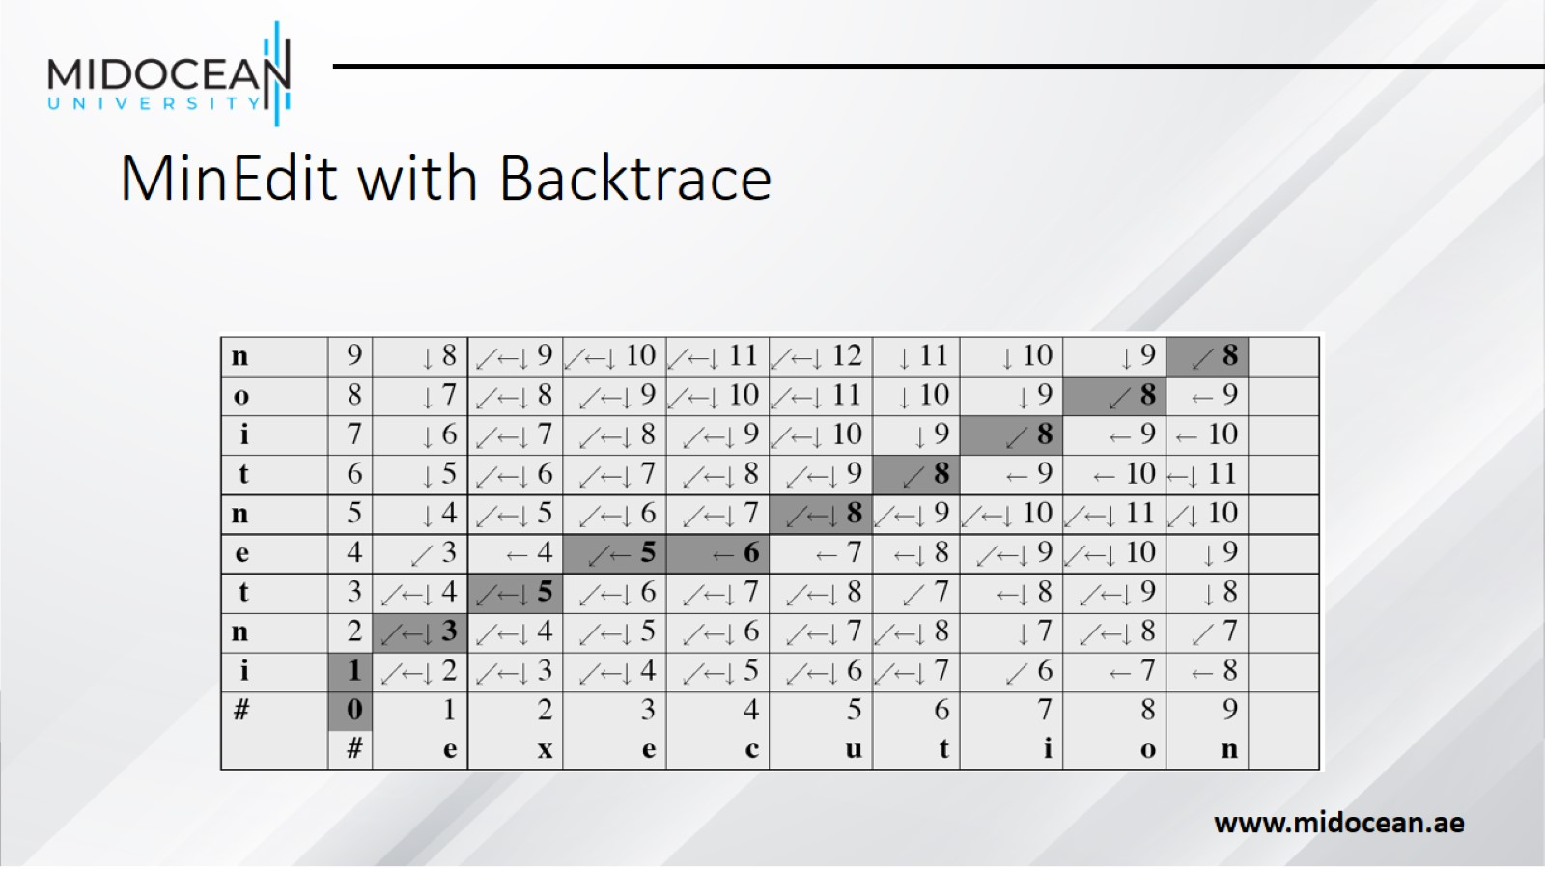
MinEdit with Backtrace

Slide 49
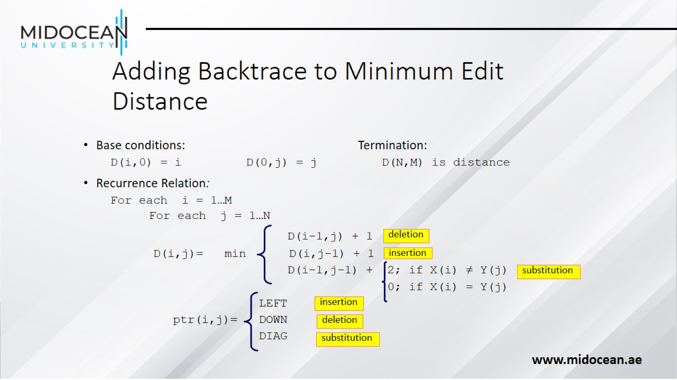
Adding Backtrace to Minimum Edit Distance

Slide 50
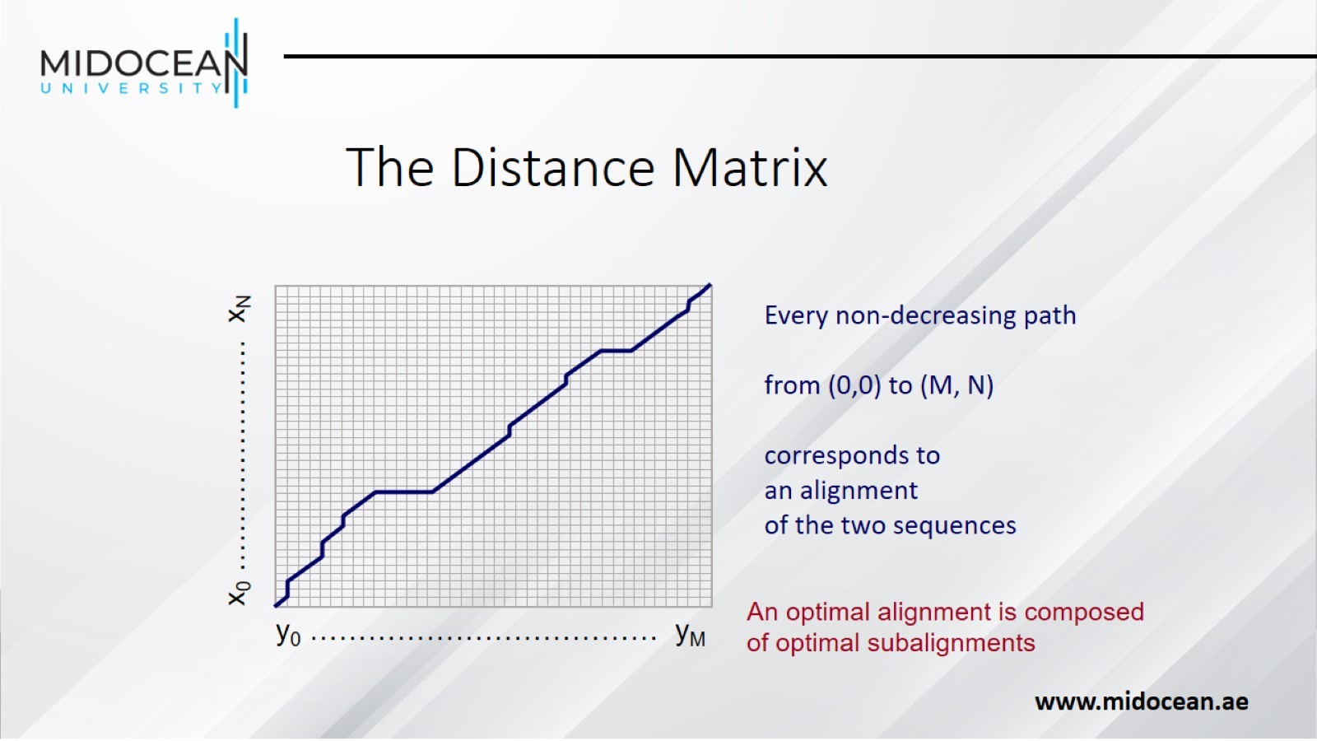
The Distance Matrix

Slide 51
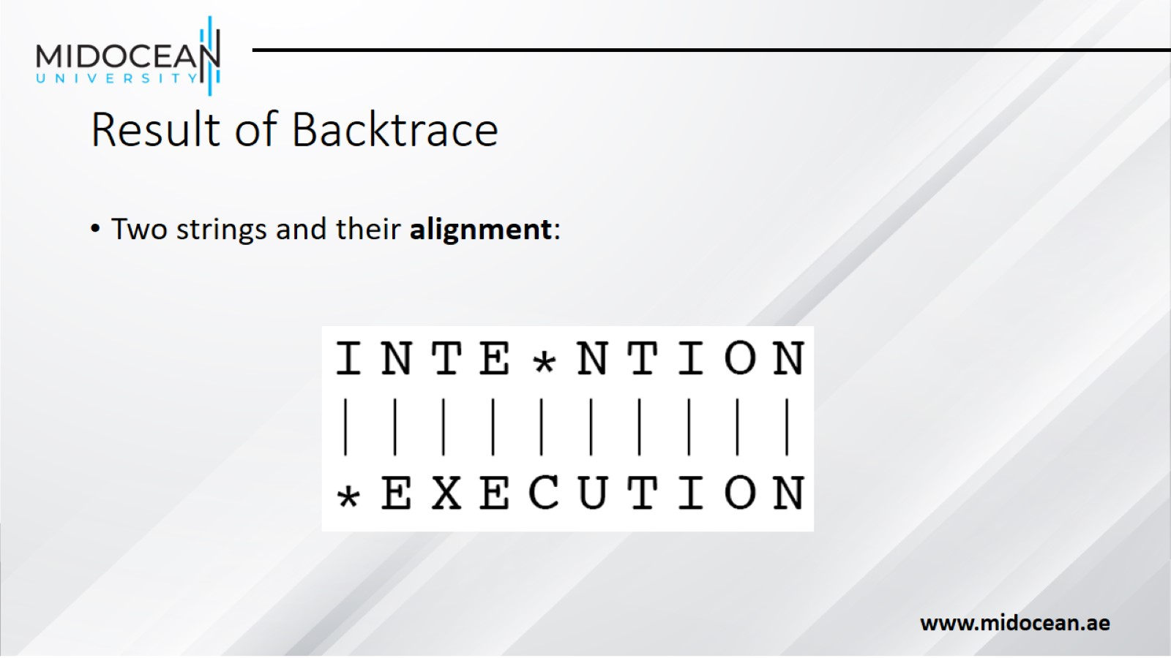
Result of Backtrace

Slide 52

Performance

Slide 53


