Slide 1


Prepared by Dr. Aya Mohamed
ENT 614
New Product Development (Part Two)
Lecture 8

Slide 2

In the previous lecture
Product Portfolio and the Boston Matrix
Topics covered :
What Is a Product Portfolio?
What Should You Include in a Product Portfolio?
What Is the Importance of a Product Portfolio?
How To Build a Product Portfolio?
How To Optimize an Existing Product Portfolio?
Some Examples of Product Portfolios

Slide 3
In this lecture
New product Development Process
Topics covered :
What is a Product Development Process?
The 6 Steps of The New Product Development Process [NPD]
Ideation and Ideation techniques
Idea screening
Concept development & testing

Slide 4
What is a Product Development Process?
A Product Development Process refers to the entire range of activities where a company conceptualizes and realizes a new offering.
A product concept might originate in the marketplace, or in a lab or workspace, or from customer requirements, too.
An innovation process allows teams to innovate and quickly release differentiated products rapidly

Slide 5
Why a Product Development Process?
New product development is the most important strategic activity of any firm
However, it is the most risky venture
Most new products fail!
Only 1 in 9 new product ideas are carried to the commercialization phase
High Failure rate and High Cost

Slide 6
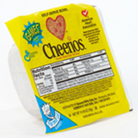
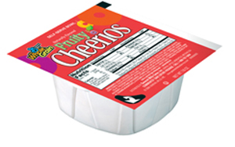


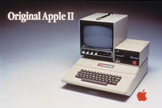
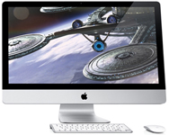
New Products
Product Line Extension
Significant Jump in Innovation
True Innovation

Slide 7
Why new products fail ?
Poor planning and strategy
Market is not attractive
Poor concept
Poor execution
Poor use of research
Poor technology
Poor timing
Changes in tastes/environment
Bad support from channel

Slide 8
Why new products succeed ?
Top-management commitment
Start with the consumer -- not the factory
Intelligent use of research
Find a competitive advantage
Move quickly
Know when to get out
Accept, but manage risk

Slide 9
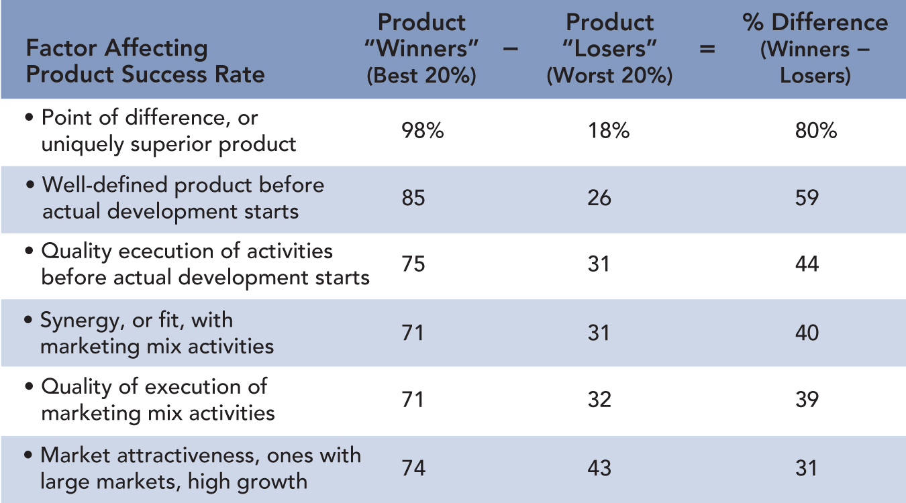
NEW-PRODUCT WINNERS AND LOSERS

Slide 10
Be close to the market
New Product Success Factors
Set a strategic direction
Play to your strengths
Strong organizational support
Speed to market

Slide 11
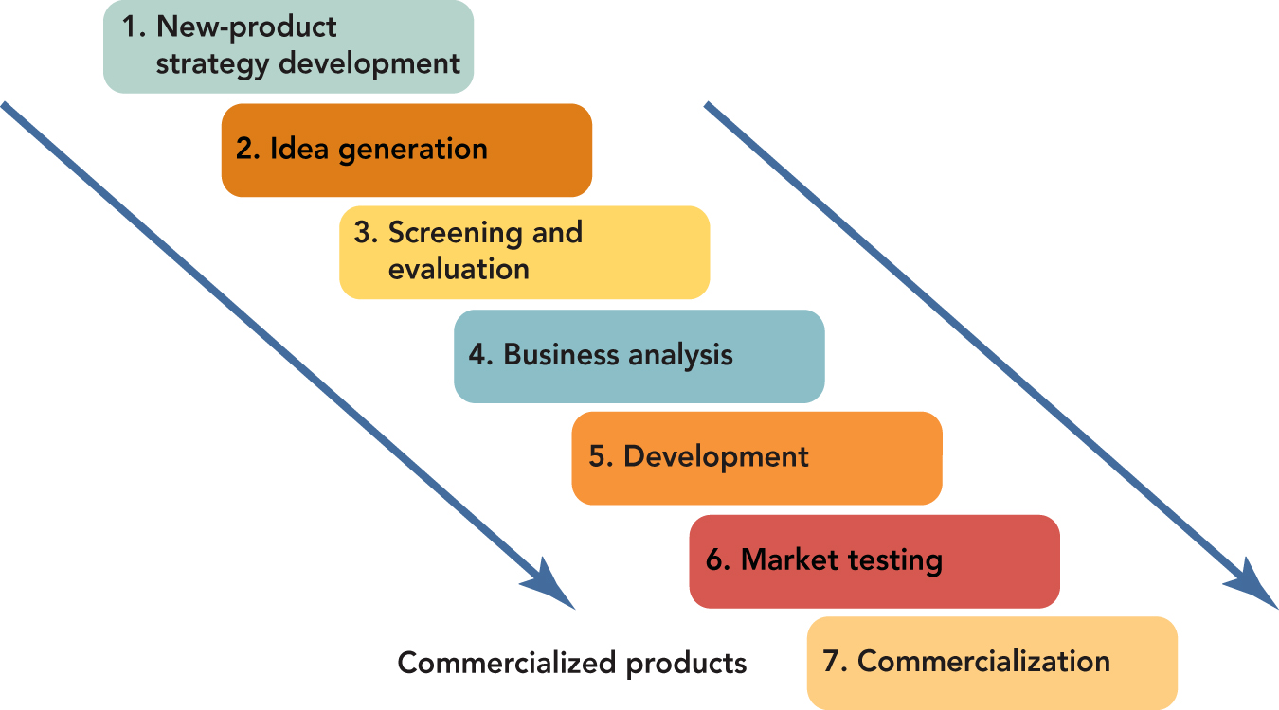
THE SEVEN STAGES IN NEW-PRODUCT DEVELOPMENT

Slide 12
THE NEW-PRODUCT PROCESS
STAGE 1: NEW-PRODUCT STRATEGY DEVELOPMENT
Product Life Cycles and the Product Portfolio
New-Product Process
Stage 1 : New-Product Strategy Development
Type of Strategy to Utilize
SWOT Analysis Conducted
Protocol Defined
Strategic Role Identified

Slide 13
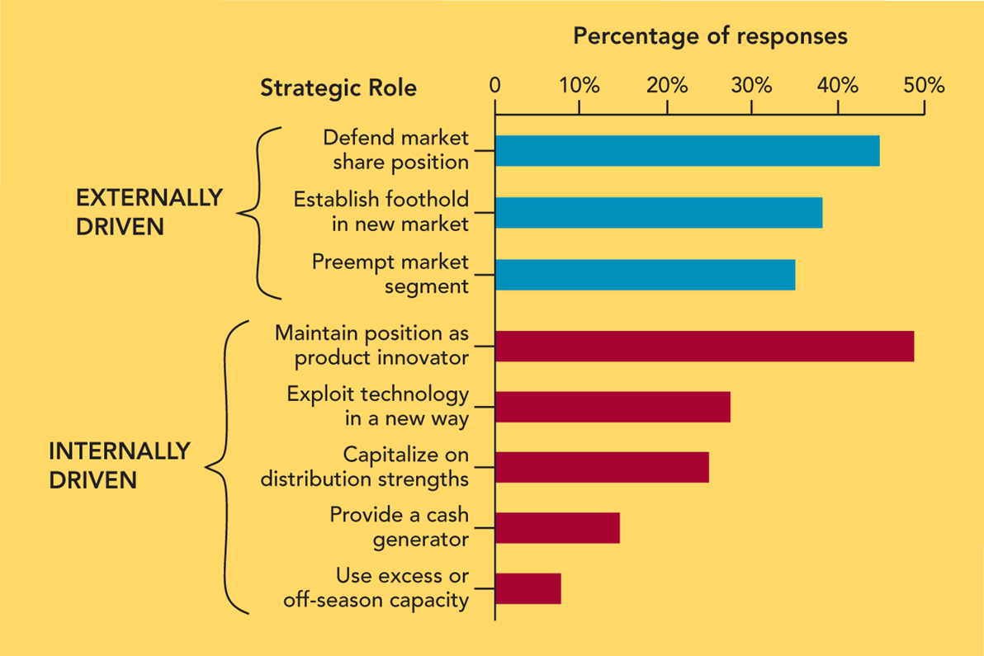
STRATEGIC ROLES OF MOST
SUCCESSFUL NEW PRODUCTS

Slide 14
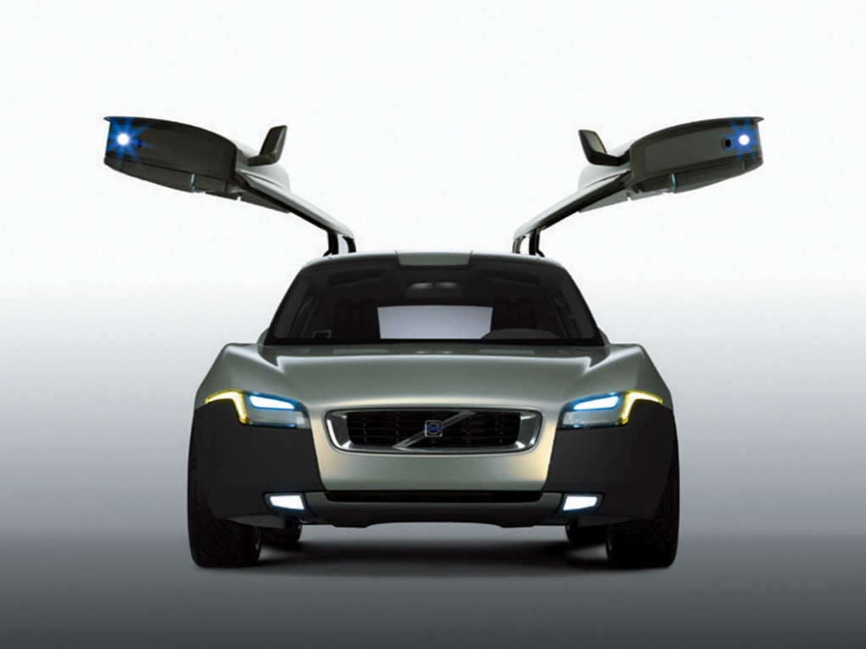
THE NEW-PRODUCT PROCESS
STAGE 2: IDEA GENERATION
Idea Generation
Open Innovation
Customer and Supplier Suggestions
Employee and Co-Worker Suggestions
Research and Development Laboratories
Competitive Products
Universities, Inventors, and Small Tech Firms

Slide 15
IDEATION
(Idea Generation)
Establishing a focal point
Identifying the sources of ideas
  Internal and external
Stimulating idea generation from each source
  Establishing flow lines or mechanisms to solicit ideas
Ideation
(every one’s job & no one’s responsibility )

Slide 16
Sources of Ideas
Internal Sources
Employees
  Across the Functions
    Sales
    Design / R&D
    Production
Methodologies
  Suggestion Schemes
    Possible formats of Suggestion Scheme:
      On-going suggestion scheme
      ‘Idea of the month’ type contests
      Targeted Effort
    Tips for Internal Suggestion Schemes:
      Publicize the scheme widely
  Handling ideas promptly and provide timely feedback to the submitter
      Welcome all ideas
      Provide guidance & assistance
      Offer incentives
      Manage the suggestion scheme

Slide 17

Ideation (Internal sources)
  Group Creativity Methods:
    Brainstorming
      Invite an eclectic group
      Run the session off-site
      Have a pre-session mailing
      Ensure that the ‘rules’ of brainstorming all well understood by everyone
      Have a moderator who runs the session
    Reverse Brainstorming
    Focus Groups
    Attribute Listing etc.
  Scouting Time
  The Idea Bank

Slide 18
Ideation (Idea Generation)
External Sources
Customers
  Group Discussions
  Customer Panels
  Customer Surveys
  Working with Lead Users
Competitors
Trade Shows
Trade Publications
Patents—the universal clearing house
Idea Brokers—the idea middlemen
Suppliers
Trade Partners
Private Inventors
Universities—a brain trust in your back yard

Slide 19

FOUR most powerful Ideation techniques:
Brainstorming:
The first ideation technique, brainstorming, is a way of problem-solving that combines several approaches. It invites people to post or brainstorm ideas at random. It allows the team to express their thoughts openly.
It also generates a slew of new ideas that you can refine into a unique, actionable concept. It allows the crew to express their thoughts openly.

Slide 20
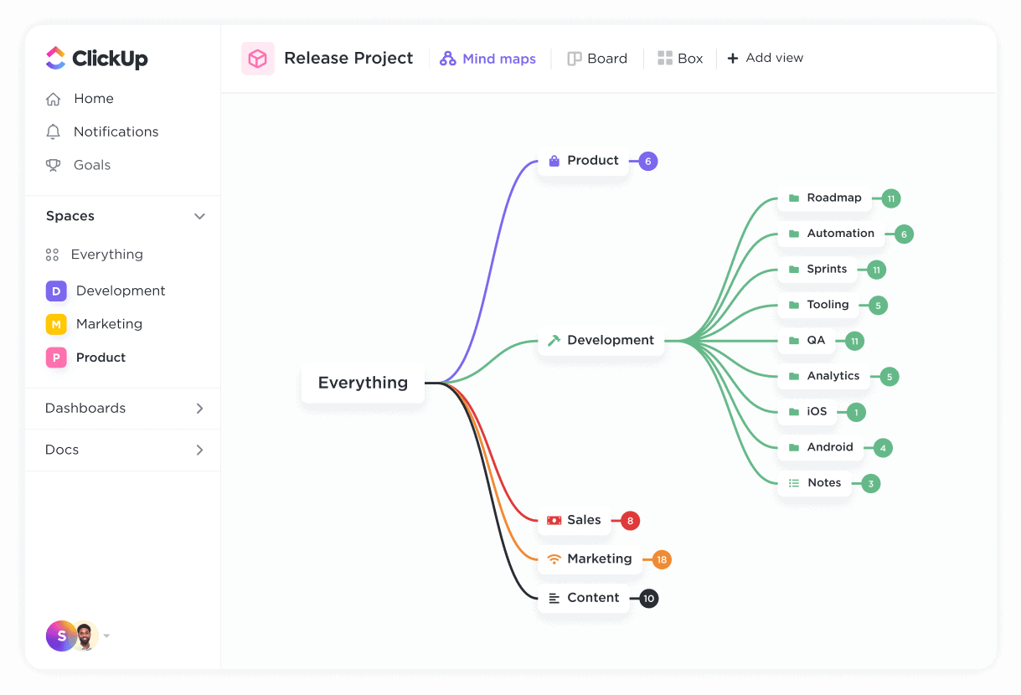
FOUR most powerful Ideation techniques:
Mind Mapping:
The term “mind mapping” refers to a visual depiction of concepts. It is a method of connecting ideas by constructing relationship webs. Here the problem occupies a central position in the minds of the players.
The issue stems from various concepts or themes that link to another solution or idea

Slide 21

FOUR most powerful Ideation techniques:
Sketch Storm:
In the format of diagrams and sketches, Sketch Storm conveys workable solutions. Words alone are insufficient. It allows participants to draw ideas in various shapes appropriate for idea generation.
An idea’s sketch can be straightforward and unrefined but comprehensive enough to indicate the meaning

Slide 22
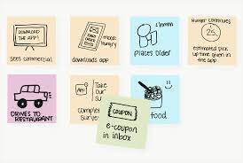
FOUR most powerful Ideation techniques:
Story Board:
The last ideation technique is storyboarding, where participants are encouraged to develop a story based on the issues using storyboarding. It stresses visual storytelling with key characters as design, problem dynamics, and a path to a solution.

Slide 23
Stage 3: IDEA SCREENING
Once you’ve generated plenty of ideas, you’ll need to evaluate them for viability, score them, and decide which ones you’ll want to further investigate.
Objective is to eliminate unsound concepts prior to devoting resources to them
First, you’ll want to establish criteria to
judge each idea against.
Quality
Value
Time
Cost

Slide 24
Stage 3: guidelines for IDEA SCREENING
Alignment with your Product Innovation Strategy
Degree of compatibility with the company’s values & principles (ex: moral, health, environmental)
Market attractiveness / opportunity
Project feasibility
Degree of product advantage over other options
Ability to leverage existing company resources

Slide 25
Stage 3: guidelines for IDEA SCREENING
Does the product represent something completely new and different from anything out there in the marketplace? Would it likely appeal to a specialty/niche segment of people?
Does the idea have a unique design to it, that’ll make it appeal to more people than a comparable product does now?
Will this idea offer a noticeably superior quality in comparison to competitive offerings? If so, can it remain in the same price range as those competitive products?
If it’s a popular item (in terms of category volume), would you be able to noticeably lower its price without affecting its quality?
Is the idea able to offer enough new features to differentiate it from the competition? If so, to what degree would these additional features be of value or seen as advantageous?

Slide 26
Stage 3: guidelines for IDEA SCREENING
For popular products, will your idea enable you to produce and distribute it faster than the competition?
How much longevity does your product idea have? Is it part of an established category of products, a trend, or a fad? Having a grip on this is crucial. I’m not saying some product categories are no-growth, sometimes it depends on the sales channel. But obviously you don’t want to base a lot of business on a me-too product whose lifespan may only last a few years.
How new is this idea compared to existing products in your portfolio or pipeline? Buyers are likely to be approached next season by similar products with the additional features and attributes you’ll be pitching.

Slide 27
Idea Review Session
Personnel from Sales, Marketing, R&D, and PDD (Product Design and Development) are the key attendees to these sessions. Communicate to them the decision-making criteria and the primary aspects of the Product Innovation Strategy.
Create standardized idea forms for presenters to fill-out and distribute. Fields include: product definition, target market, explanation of user benefits, and criteria against which the ideas are judged, and a sketch (if applicable).

Slide 28

Idea Review Session
With a large number of ideas and participants, create voting schemes. This could involve having idea cards/boards set up around the presentation room, and giving every participant a number of votes. Voting by raised hands can work, but perhaps it might be best to give people post-its to place on the ideas they like, then tally the votes. Techniques may vary - the idea is that participation is important.
Once you’ve selected your winning ideas, place them into an idea portfolio.
Any ideas leftover that had some terrific potential, but for some reason couldn’t make the cut, should be stored in an idea bank for future review.

Slide 29

Screening Criteria
 | New Idea Screening Criteria Points
Weightage(100) | C1 | C2 | C3 | C4 | C5
Idea 1
Idea 2
Idea 3
Idea n

Slide 30
Stage 4 : Concept Development & Testing
Concept is A printed or filmed representation of a product or service. It is a promise a product makes to resolve an unmet consumer need, the reason why it will satisfy the need, and a description or portrayal of any key element that will affect the perception of the product.
Effective Product Concept:
A statement of the problem that the product is meant to solve.
A definition of the type of solution that the product requires.
Supporting attributes (physical and communications) that adds credibility to product’s ability to solve the problem.

Slide 31
Stage 4 : Concept Development & Testing
Guidelines for Effective Product Concept:
Need Driven NOT Technology Driven
Use Consumer Language
Keep Statement Clear and Single-Minded
Be Realistic
Avoid Superlatives

Slide 32

From IDEA to CONCEPT
GM’s Electric Car Case
Idea:
An electric car which can go as fast as 80 miles/hr & as far as 90 miles before needing to be re-charged. GM estimates electric car’s operating costs to be about half those of a regular car
The Concept:
An efficient, fun-to-drive, electric powered subcompact car that seats 4; great for shopping trips & visits to friends, costs half as much to operate as similar gasoline-driven cars. Goes up to 80 miles per hour and does not need to be recharged for 90 miles. Priced, fully equipped, at $14,000.

Slide 33
From IDEA to CONCEPT
CONCEPT for a NEW CEREAL
Introducing new Nuggets, the high nutrition cereal that combines three grains - oat, barley and wheat - with the vitamins , minerals and fiber you need to start your day. Simply top with cream or milk, and enjoy. Nuggets can also be served warm, simply by heating in your microwave. New Nuggets, the healthy cereal that gives you the total and balanced nutrition you need.
BETTER CONCEPT for a NEW CEREAL
Introducing new Nuggets, the delicious and nutty-tasting high nutrition cereal that combines the natural sweetness of crunchy oat, barley and wheat - with all the vitamins , minerals and fiber you need to start your day. Simply top with cream or milk, and enjoy. Nuggets can also be served steaming hot, simply by heating in your microwave. With Nuggets, you can have both high nutrition and great taste. New Nuggets. the healthy cereal that really tastes great.

Slide 34

Concept Development and Testing
Written
Simulations
Virtual Reality
Computer aided Design & Manufacturing (CAD/CAM)
Rapid Prototyping / Mock-ups
3-D Animations / Graphics
Conjoint/Trade Off Analysis
Perceptual Maps

Slide 35
Conjoint/Trade Off Analysis
Put the determinant attributes together in combinations or sets.
Respondents rank these sets in order of preference.
Conjoint analysis finds the optimal levels of each attribute.
Measures relative values of attributes jointly rather than separately
Mirrors trade-offs that individuals make in the market place
Attributes can be categorized in 3 elements:
Features
Functions
Benefits
Example: A shampoo may contain pro-v proteins (feature) that coat the hair during shampooing (function), which leads to more shine on the hair (benefit).

Slide 36
Conjoint Analysis Input: Salsa Example
7-36

Slide 37
New Product Development Process
Step 3. Concept Development & Testing
1. Develop Product Ideas into
Alternative
Product Concepts
2. Concept Testing - Test the
Product Concepts with Groups
of Target Customers
3. Choose the Best One

Slide 38
Concept development
Concept 1
Concept 2
Concept 3
  Who
  Why
  when
Category concept
Product concept
Brand concept

Slide 39
Concept Testing
Are the benefits clear?
Does it solve a problem/need?
Does other products solve this need and satisfy the customers?
Is the price reasonable?
Would u definitely/definitely not/ probably /probably not buy this product?
Who would use this product and when and how often the product be used?

Slide 40

Conclusion
New Product Development Process
What is a Product Development Process?
The 6 Steps of The New Product Development Process [NPD]
Ideation and Ideation techniques
Idea screening
Concept development & testing

Slide 41



Thank You

