Slide 1
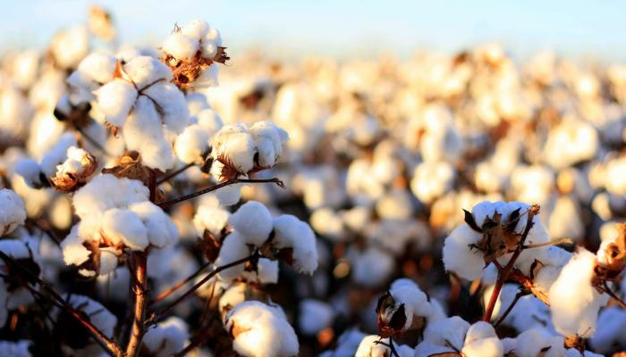

Cotton Disease Detection Using Deep Learning
Prepared by
Youssif Ali Alshalakany
Youssef Abdelmotaleb Saad
Supervised by
PhD. Yasser Abdelhamid
Faculty Member in the Artificial Intelligence Program – MidOcean University
1446/2025

Slide 2
Abstract:-
The research aims to diagnose cotton diseases using deep learning-based image analysis, overcoming the limitations of manual inspection. Convolutional Neural Networks (CNNs) enable precise and rapid disease detection by analyzing cotton leaf images, highlighting affected areas based on disease type. Early detection helps reduce agricultural losses, improve productivity, and enhance sustainability. Since 80-90% of cotton diseases affect leaves, causing significant crop and budget losses, this study explores AI techniques for early detection and prevention.
Key words : Cotton Leaf Disease- Image Analysis - Deep learning plant
Introduction
background
Literature review
References

Slide 3
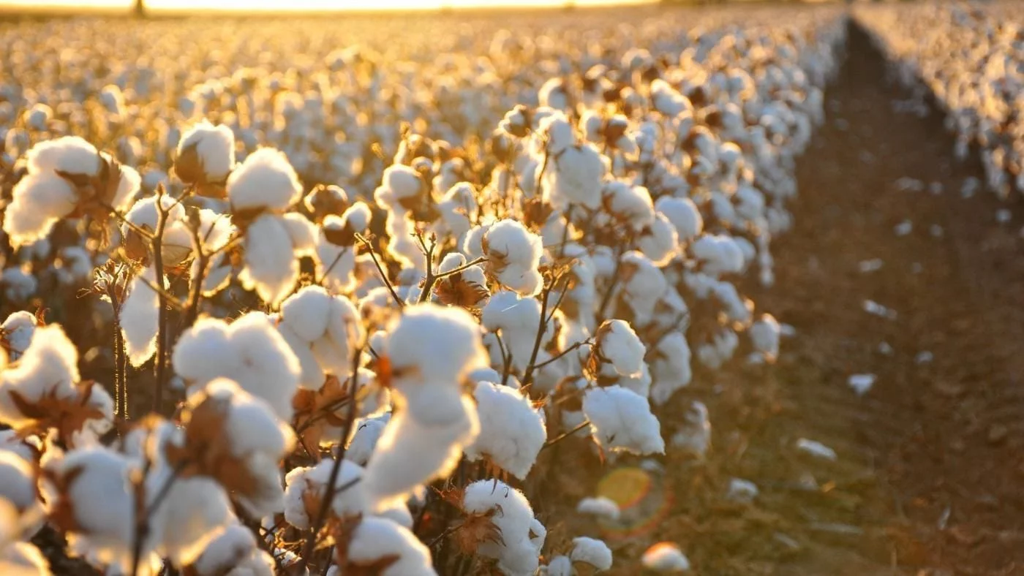
Introduction :-
The Role of AI in Agriculture [1].
Enables large-scale crop data analysis
Helps identify patterns and predict epidemics
Optimizes resource allocation during crises
AI Tools in Cotton Farming [2]
Provides advanced tools for detecting and preventing diseases
Uses data analysis, pattern recognition, and predictive modeling
AI in Agricultural Diagnostics [3]
Quickly and accurately analyzes large datasets
Machine learning examines crop traits and genetic data
Detects early signs of diseases
Genetic Data & Disease Prediction [4]
AI detects mutations linked to agricultural diseases
Assesses disease risks and suggests treatments
Monitors outbreaks using data from various sources

Slide 4
Traditional vs Modern Detection Methods
Conventional methods still used in cotton farming despite large-scale operations[5].
Traditional visual inspection has low accuracy
Advanced technologies have improved disease/pest recognition
Boosts accuracy of actions and crop productivity [6].
Criterion | Traditional Approach | Modern AI-Based Approach | Reference
Diagnosis Method | Visual inspection by experts | Digital imaging + Computer vision | [4], [6]
Accuracy | Moderate, depends on expert skills | High, up to 96% using CNN | [3]
Speed | Slow | Fast diagnosis | [7]
Unman Effort | High | Minimal due to automation | [1], [4]
Tools Used | Lens or manual inspection | Advanced cameras & spectral analysis | [4]
Cost | Low initially, but recurring | Higher initially, more efficient later | [7]
Scalability | Limited for large-scale farms | High due to automation | [3], [5]
Early Detection | After symptoms appear | Pre-symptomatic via image analysis | [4], [6]
Decision Support | Individual, potentially flawed | Data-driven, intelligent analysis | [7]
Focus on Leaf-Based Cotton Disease
Around 80-90% of cotton diseases affect leaves, potentially causing up to 16% budget loss. Without control, losses could range from 30-50%. This research focuses on deep learning for early disease detection

Slide 5
Problem Statement :-
Cotton is sensitive to temperature changes, diseases, and pests
These issues cause significant economic losses
Enhances classification in agricultural tasks
Shows strong potential in analyzing crop data
Diagnosis still relies on traditional visual inspection
Leads to delays and greater crop loss
It’s affected by multiple diseases that threaten productivity
Research Gap :-
There is a research gap owing to the lack of studies regarding Cotton Disease through Image Analysis Using Deep learning. Also, Deep learning method is one of the latest methods that can be used to identify the crops diseases.

Slide 6
Research Questions :-
What is the importance of Cotton Disease ?
What are the most common diseases for the cotton Disease ?
What are the features of deep learning method?
What are the challenges for effective Cotton Disease through Image Analysis Using Deep learning?
What are the requirements for effective Cotton Disease through Image Analysis Using Deep?
Research objectives :-
Clarifying the importance of Cotton Disease .
Identifying the most common diseases for the cotton .
Clarifying the features of deep learning method.
Determining the challenges for effective Cotton Disease through Image Analysis Using Deep learning.
Determining the requirements for effective Cotton Disease through Image Analysis Using Deep.

Slide 7
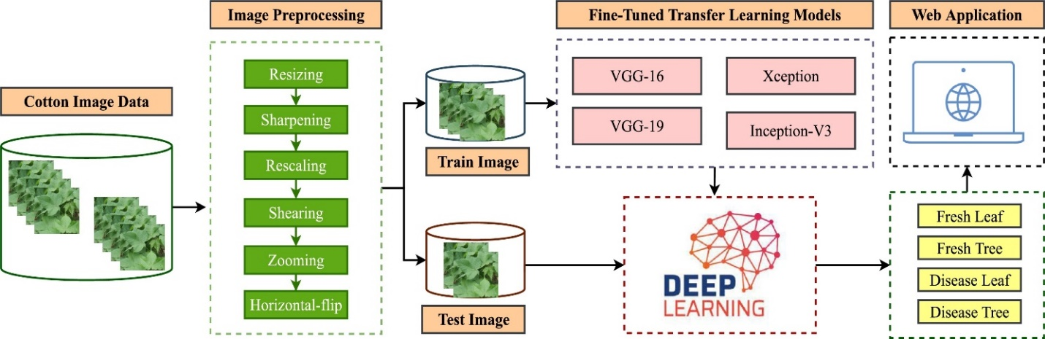
Research Methodology :-
In this research, we will use a cotton disease detection framework using several fine-tuned deep-learning models. The performance of the model will be assessed through several indicators like accuracy and recall [15] .

Slide 8
Dataset :-
Limitations | Size &Samples | Biomarker | Link | Dataset Name
Difficulty in image extraction, features extracted as scalograms more accurately detect each plant condition using DL models | 2432 images | approach combines DL with feature extraction methods such as continuous wavelet transform (CWT) and fast Fourier transform (FFT). | https://www.researchgate.net/publication/382251164_An_ensemble_deep_learning_models_approach_using_image_analysis_for_cotton_crop_classification_in_AI-enabled_smart_agriculture | An ensemble deep learning models approach using image analysis for cotton crop classification in AI-enabled smart agriculture [7]
Large number of images, and the difficulty in image extraction 2170 image | 2170 images | Deep learning method is used to solve the issue because it will perform exceptionally well in image processing and classification problems. The network was built using a combination of the benefits of both the ResNet pre-trained on ImageNet and the Xception component, and this technique outperforms other state-of-the-art techniques | https://iarjset.com/papers/cotton-plant-disease-prediction-using-image-processing-and-transfer-learning/ | Cotton plant disease-prediction using Image processing and Transfer learning [8]
Large number of images, and the difficulty in image extraction 1124 mage | 1124 images | Using a digital camera, I took images of a cotton field for this assignment. In the preprocessing stage, the backdrop is removed from the image using a background removal technique | https://www.researchgate.net/publication/378156934_Cotton_Leaf_Disease_Detection_Using_Image_Processing | Cotton Leaf Disease Detection Using Image Processing [10]

Slide 9
Literature review :-
Sharma et al. (2022) [10]
Comprehensive review of ML and DL methods
Offers insights to improve current techniques
Aggarwal et al. (2023) [11]
Developed a disease prediction system for rice leaves
Used pre-trained models + ML classifiers
Achieved 94% accuracy

Slide 10
Literature review :-
Chander & Upendra Kumar (2022) [12]
Used a manually collected cotton dataset
Trained various models for classification
Reported 96% accuracy with reduced processing time
Kalpana et al. (2023) [13]
Used transfer learning (VGG-16, Inception-V3)
Focused on cotton leaf disease detection
Achieved 96% accuracy

Slide 11
Literature review :-
Reddy et al. (2023) [14]
Built CNN-based deep learning model
Tested on 720 images of cotton leaves
Achieved 89% accuracy

Slide 12
Technique | Description | References
Deep Transfer Learning | Deep transfer learning was applied for improved cotton plant disease detection | [6]
Image Processing Techniques | Image processing techniques used to detect disease based on changes in color and texture | [7]
VGG-16، Inception-V3 (Transfer Learning) | Transfer learning models like VGG-16 and Inception-V3 were used to classify cotton leaf disease images with 96% accuracy | [12]
Convolutional Neural Networks (CNN) | CNN model for cotton disease classification using 720 images with 89% accuracy. | [13]
Manual Dataset + Deep Learning | Manually collected images used to train deep learning models, improving classification accuracy and processing speed | [14]
Fine-tuned Deep Learning Model + Web App | Fine-tuned deep learning model integrated with a smart web application for field-level diagnosis | [15]

Slide 13
Related Work :-
With advancements in AI technologies, it is now possible to develop effective systems for automatic detection and classification of plant diseases with high accuracy, reducing losses. These systems use sensors to capture plant images and analyze them with machine learning algorithms for early disease detection in crops like tomatoes, peppers, potatoes, and cucumbers [1].
Stated that several AI-based techniques exist for early pest detection in plants, such as image processing and computer vision, which use advanced algorithms to analyze images and extract information about plant health. Specialized cameras enhance images to capture changes in color and texture, helping in pest detection.
Computer vision detects diseases faster and more accurately than traditional methods, and machine learning distinguishes between diseased and healthy symptoms. This technique is also effective in detecting fungal diseases like Fusarium [4].
AI is known for its accuracy and speed in detecting plant diseases. Deep learning algorithms analyze agricultural images to quickly identify diseases, saving valuable time for farmers. It reduces costs by minimizing reliance on human experts and offers smart management solutions, enabling farmers to make quick, informed decisions. This enhances disease control strategies, ensures crop sustainability, and improves productivity, ultimately supporting food security [7].

Slide 14
Related Work Summary :-
Traditional cotton disease diagnosis is challenged by limitations in accuracy and time-efficiency. Deep Learning (DL), particularly Convolutional Neural Networks (CNNs), has emerged as a promising solution for efficient and rapid image-based plant disease detection, supported by recent studies and available datasets. However, these datasets remain limited, especially in covering the diversity of cotton and its local conditions. This research aims to develop an effective DL-based diagnostic system tailored to meet specific agricultural needs and address current research gaps in this domain.

Slide 15
Research Plan :-
Data Collection: dataset for Cotton Disease through Image Analysis Using Deep learning, providing a range of data types and information to advance research in these neurodegenerative conditions. Those datasets are available online which makes it easy to use. The first step of our proposal is the collection of data that is necessary to train any deep learning model. In this research, we collect images from well-known data sources.
Data Preprocessing: normalization and dimensionality reduction, are used to prepare the data for classification algorithms, ensuring it is in a suitable format for analysis. This step includes many tasks like image rotating, sharpening, and augmentation. This is necessary to train any deep learning model for classification tasks.
Feature Extraction: extracting relevant features from data sources like AI imaging, and clinical records.
Validation and Testing: The trained models are validated and tested using separate datasets to assess their accuracy and generalization capabilities. This step ensures the model's reliability in early detection.
Predictive Biomarkers: Classification models can identify predictive biomarkers or patterns in the data that are indicative of cotton diseases. These biomarkers aid in the early identification of plants at risk.
Continuous Monitoring: Classification techniques can be applied to monitor changes in cotton lants, allowing for continuous assessment and early intervention as necessary.
Data Collection
Data Preprocessing
Feature Extraction
Validation and Testing
Predictive Biomarkers
Continuous Monitoring

Slide 16
Challenges and Opportunities :-
Lack of Available Data
Variability in Agricultural Conditions
Difficulty in Classifying Similar Symptoms
High Computational Requirements
Challenges in Practical Adoption
Improving Model Performance with Advanced Techniques
Creating Larger Databases Through Research Collaboration
Integrating Deep Learning with IoT for Smart Farming
Supporting Farmers with Smart and Accessible Systems
Challenges
Opportunities

Slide 17
References:-
[1] S. Satraj Sohrab, E. I. Azhar, M. A. Kamal, P. S. Bhattacharya, and D. Rana .(2024). Genetic variability of cotton leaf curl betasatellite in Northern India, Saudi Journal of Biological Sciences, vol. 21, no. 6, pp. 626–631.
[2] S. Kumar, K. M. V. V. Prasad, A. Srilekha, T. Suman, B. Pranav Rao, and J. Naga Vamshi Krishna.(2020) Leaf disease detection and classification based on machine learning, in Proceedings of the 2020 International Conference on Smart Technologies in Computing, Electrical and Electronics.
[3] V. C. Delfosse, M. F. Casse, Y. C. Agrofoglio .(2023)Agroinoculation of a full-length cDNA clone of cotton leafroll dwarf virus (CLRDV) results in systematic infection in cotton and the model plant Nicotiana benthamiana, Virus Research, vol. 175, no. 1, pp. 64–70.
[4] L. Amrao, I. Amin, M. S. Shahid, R. W. Briddon, and S. Mansoor .(2020). Cotton leaf curl disease in resistant cotton is associated with a single begomovirus that lacks an intact transcriptional activator protein, Virus Research, vol. 152, no. 1-2, pp. 153–163.
[5] Muhammad-Farrukh-Shahid, Tariq-Khanzada, Muhammad-Aslam .(2024). An ensemble deep learning models approach using image analysis for cotton crop classification in AI-enabled smart agriculture, DOI:10.1186/s13007-024-01228-w.
6] Vani Rajasekar, Soumya Ranjan Jena .(2021). Detection of Cotton Plant Diseases Using Deep Transfer Learning, DOI:10.13052/jmm1550-4646.1828.
[7] Sushreeta Tripathy. (2021). Detection of Cotton Leaf Disease Using Image Processing Techniques, CCIEA Journal of Physics: Conference Series 2062 (2021) 012009, doi:10.1088/1742-6596/2062/1/012009.
[8] Sankarsan Panda & Dr Vikas Somani .(2021). Cotton Leaf Disease Detection Using Image Processing, Webology 18(6):3786
[9] Ahmed M, Mukhtar M, Ahmad M, Adnan M, Afzal MN, Bilal M.(2022). Deep learning and machine vision for smart agriculture and food production: A review. J King Saud Univ - Comput Inf Sci. 2022; 34(7): 2729-2750.: https://doi.org/10.1016/j.atech.
[10] Sharma, R. Mittal, N. Goyal .(2022). An assessment of machine learning and deep learning techniques with applications, ECS Transactions, 107 (1), p. 8979.
[11] Aggarwal, V. Khullar, N. Goyal, A. Singh, A. Tolba, E.B. Thompson, S. Kumar .(2023). Pre-trained deep neural network-based features selection supported machine learning for rice leaf disease classification Agriculture, 13 (5), p. 936.
[12] Chander, M. Upendra Kumar.(2022). Comparative analysis on deep learning models for detection of anomalies and leaf disease prediction in cotton plant data, Congress on intelligent systems, Springer, pp. 263-273.
[13] Kalpana, R. Thamilselvan, T. Saravanan, M. Pyingkodi, S. Nandhakumar, V. Priyanka, M. Sowndharya.(2023). An imagebased classification and prediction of diseases on cotton leaves using deep learning techniques, international conference on computer communication and informatics (ICCCI), IEEE (2023), pp. 1-6.
[14] Reddy, N.M.V.S. Daswanth, S.K. Pusuluri, D. Komalchowdary, P.S. Rambabu, A. Gopi .(2023). Predicting the cotton leaf disease using convolution neural networks, international conference on sustainable computing and data communication systems (ICSCDS), IEEE (2023), pp. 452-455.
[15] Islam, M. M., Talukder, M. A., Sarker, M. R. A., Uddin, M. A., Akhter, A., Sharmin, S., Al Mamun, M. S., & Debnath, S. K. (2023). A deep learning model for cotton disease prediction using fine-tuning with smart web application in agriculture. ScienceDirect. https://doi.org/10.1016/j.iswa.2023.200278

