Slide 1



HCIA-AI Huawei
Lecture 12
Cutting Edge AI Applications
Prepared by
Eng. Eman Elgallad
www.midocean.ae

Slide 2

Lecture
Content:
12
Reinforcement Learning
GAN
Knowledge Graph
Intelligent Driving
Transformers
www.midocean.ae

Slide 3
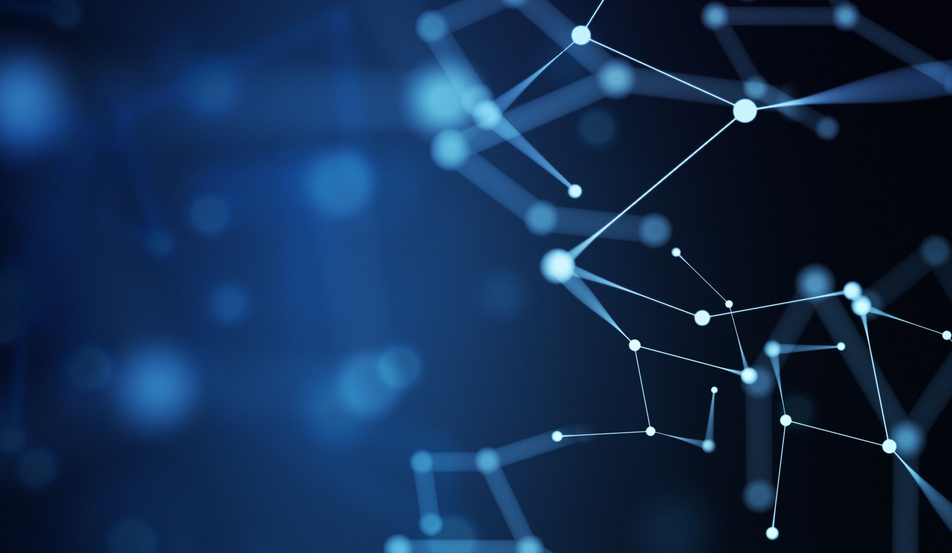
Reinforcement Learning

Slide 4
Reinforcement Learning
Lecture
12
AI
Machine Learning
Reinforcement Learning
Reinforcement learning (RL) is a branch of machine learning that emphasizes how to act based on the environment in order to maximize the expected benefits.
www.midocean.ae
Notes:
The idea of reinforcement learning stems from the study of behavioral psychology. In 1911, Thorndike proposed the Law of Effect: The behavior that makes animals feel comfortable in a certain situation is closely connected to the situation. When the situation reappears, the behavior of animals is more likely to reappear. On the contrary, the behavior that makes an animal feel uncomfortable weakens the connection with the situation, which will be difficult to reproduce when the situation reappears. In other words, behavior will be remembered depending on the utility of that behavior. For example, when the owner throws out the Frisbee, the dog takes the Frisbee back to the owner and obtains a flesh bone, which will reinforce the connection between the behavior of "taking back the thrown Frisbee" and the situation of "the owner throwing out the Frisbee". The utility of "getting flesh bones" will make the dog remember the behavior of "taking back the thrown Frisbee".
In a given situation, the rewarded behavior will be "reinforced" and the punished behavior will be "weakened". Such a bio-intelligent model allows animals to learn from rewards or penalties for different behavior attempts and choose the behavior that the trainer expects most in that situation. This is the core mechanism of reinforcement learning: trial-and-error, which is used to learn to choose the most appropriate behavior in a given situation. Sutton defines reinforcement learning as how to best match states and actions through trial-and-error learning and obtain the maximum rewards.
Reinforcement learning directly imitates the intelligent mode of biological learning. Unlike most other machine learning methods where agents need to be told which action to choose, reinforcement learning enables agents to try different actions, autonomously discover and choose actions that generate the maximum rewards. As Tesauro describes, reinforcement learning enables agents to learn autonomously based on their own experience, without any preparatory knowledge or the help of any external intelligent "teacher".

Slide 5

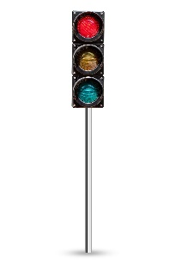
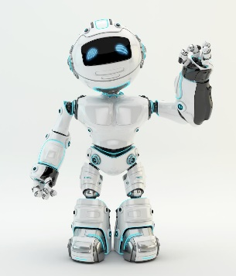
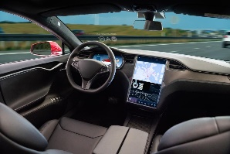
Environment Sensing
Lecture
12
State
–6 points
Reward
Action
Agent
Environment
www.midocean.ae

Slide 6





Reinforcement Learning Model - Go
Lecture
12
AlphaGO
$S_{t}$Status
Agent
$R_{t}$Reward
What is the situation?
Who is winning?
$A_{t}$Action
Where to place the go?
$R_{t+1}$Reward
Environment
$S_{t+1}$Status
www.midocean.ae

Slide 7
Basic Concepts in Reinforcement Learning
Lecture
12
Two objects:
  Agent
  Environment
Main elements:
  Action: performed at the current moment based on the status.
  Policy: makes decisions based on the status and controls the agent to perform actions.
  Reward: provided by the environment based on the current action.
  Return: sum of rewards at all moments.
www.midocean.ae

Slide 8
GAN

Slide 9
Generative Adversarial Network (GAN)
Lecture
12
A GAN is a class of frameworks that trains generator G and discriminator D to compete in a game. The game between the two makes the discriminator D unable to distinguish whether the sample is a fake sample or a real sample.
  The generator G generates "fake" images that look like the images for training.
  The discriminator D determines whether the images output by the generator are real images or fake images.
GANs are used in scenarios such as image generation, text generation, speech enhancement, and image super-resolution.
www.midocean.ae
Notes:
Generator G: Input "noise" z (z complies with a selected prior probability distribution, such as uniform distribution and Gaussian distribution). Multi-layer perceptrons with the maximum likelihood prediction (MLP) parameters are used to represent the derivative mapping G(z) and map the input space to the sample space.
Discriminator D: Input real sample x and fake sample G(z) with labels "real" and "fake", respectively. The discriminator network uses the multi-layer perceptions with the MLP parameters to output the probability D(G(z)) for determining whether a sample is a real sample.

Slide 10
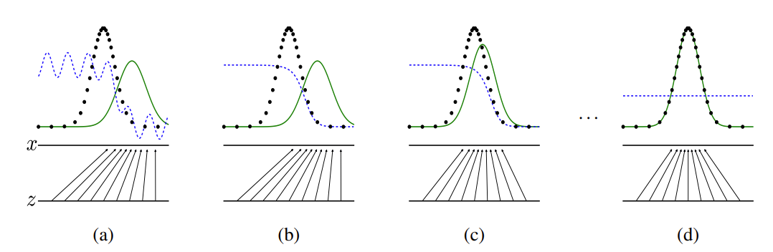
GAN Training Process
Lecture
12
www.midocean.ae
Notes:
In the preceding figure, the blue dotted line indicates the discriminator, the black dotted line indicates the real data distribution, the green solid line indicates the false data distribution generated by the generator, z indicates the implicit vector, and x indicates the generated fake image G(z).
At the beginning of the training, the quality of the generator and discriminator is poor. The generator randomly generates a data distribution.
The discriminator optimizes the network by calculating the gradient and loss function. The data close to the real data distribution is determined as 1, and the data close to the data distribution generated by the generator is determined as 0.
The generator generates data that is closer to the actual data distribution through optimization.
The data generated by the generator reaches the same distribution as the real data. In this case, the output of the discriminator is 1/2.

Slide 11
GAN Application
Lecture
12
Image dataset generation
Image-to-image conversion
Resolution enhancement, making photos clearer
Text-to-image conversion
www.midocean.ae
Notes:
AI training requires a large number of datasets, but manual data collection and labeling is expensive. GAN can automatically generate some datasets to provide low-cost training data.
Converting one image into another one is like adding a filter: converting a photo into an oil painting.

Slide 12
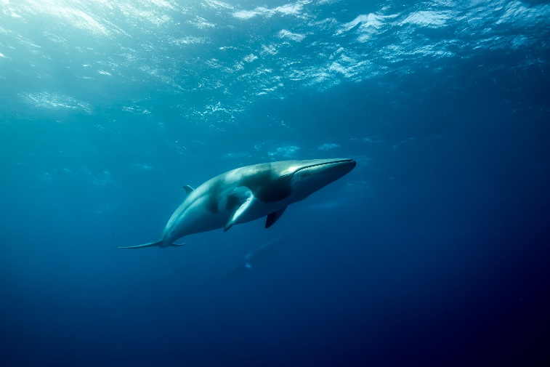
GAN - Photo Repair
Lecture
12
If an area in a photo is faulty (for example, colored or erased), GAN can repair the area and restore it to its original state.
www.midocean.ae

Slide 13
Knowledge Graph

Slide 14
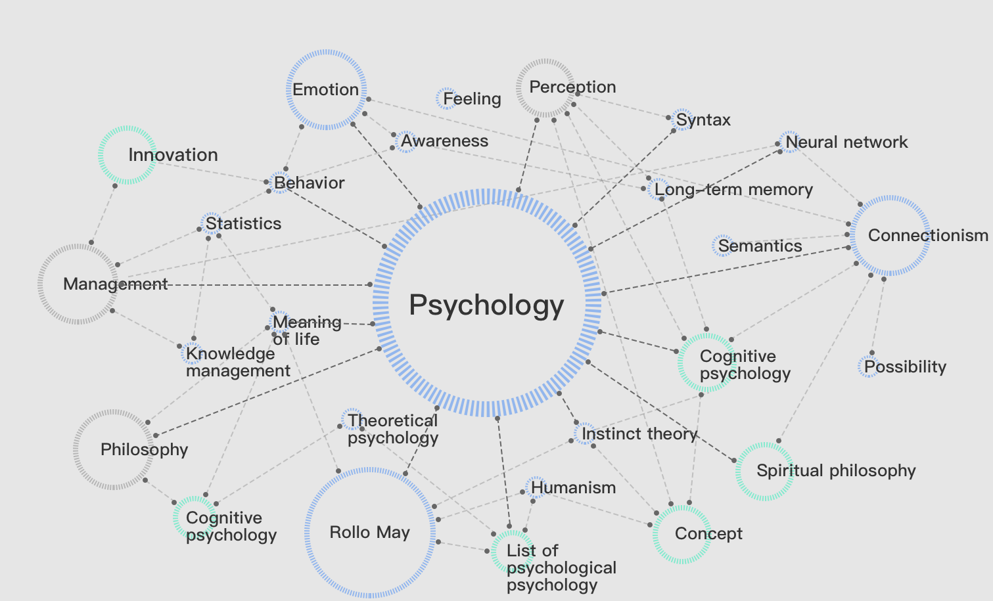
Basic Concepts
Lecture
12
Knowledge graph is essentially a knowledge base of the semantic network. It describes various concepts, entities, and relationships in the real world in a structured manner to form a huge semantic network. Nodes in the network are entities, and each edge represents a property of entities or the relationship between entities.
Entity: an object that exists in the real world and can be distinguished from other objects.
Property: The nature and relationship of a specific object are called the properties of the object.
Concept: a set of entities with the same features.
Ontology: a set of abstract concepts used to describe the common features of all the things in a domain and the relationships between them.
www.midocean.ae
Notes:
Semantic network, proposed in the 1960s, is a structured way to express knowledge with graphs. A knowledge graph consists of interconnected nodes and edges. A node indicates a concept or object, and an edge indicates a relationship between them.
The concept of knowledge base comes from two different fields, one is artificial intelligence and its branch—knowledge engineering, and the other is the traditional database field. It is an organic combination of artificial intelligence and database technologies. The knowledge base is a knowledge-based intelligent system.
https://www.huaweicloud.com/product/nlpkg.html
An example is as follows:
Concept: Country
Entity: China, Russia...
Property: Capital – Connected entity (the capital of China is): Beijing – (Entity) Property of Beijing: latitude, longitude... -- Data: longitude: E 116°20'; latitude: N 38°56'
The basic unit of knowledge graph is a triplet of entity-relationship-entity.
Ontology is a set of concepts.

Slide 15
History of Knowledge Graph
Lecture
12
Knowledge graph is a relatively mature application "fruit" of knowledge engineering in the current stage of AI development.
Five phases of knowledge engineering:
  Pre-knowledge engineering period (1950s–1970s)
  Expert system period (1970s–1990s)
  World Wide Web 1.0 period (1990s–early 21st century)
  Swarm intelligence period (2000–2006)
  Knowledge graph period (2006–present)
In the knowledge graph period, the vigorous development of large-scale structured encyclopedia websites and the continuous progress of text information technology provide conditions for obtaining large-scale knowledge.
Google took the lead in applying knowledge graphs to search engines in 2012, successfully improving users' search quality and experience.
www.midocean.ae
Notes:
For details about the development history, see pages 3–5 in Artificial Intelligence - Knowledge Graph.

Slide 16
Process for Constructing a Knowledge Graph
Lecture
12
The general knowledge graph construction process is as follows:
Determining the domain
Information extraction
Knowledge mapping and fusion
Knowledge processing and reasoning
Property Extraction
Relationship extraction
Entity extraction
Data acquisition
Structured data
Semi-structured data
Unstructured data
Understanding the domain
Determine the target domain of the knowledge graph.
Fully understand the target domain of the knowledge graph.
Knowledge system construction
Knowledge mapping
Knowledge fusion
Knowledge graph application
www.midocean.ae
Notes:
Determine the domain: A good knowledge graph should be domain-specific.
Knowledge mapping: Knowledge mapping is to establish the mapping between the structured information extracted from basic data and the knowledge graph ontology, for example, the mapping between the extracted structured information about movies and the graph ontology. In other words, two data models are established, and the elements of models are linked to form a mesh structure by using related languages or technologies. For example, you can introduce graph database knowledge by mapping from a relational database to a graph (or a non-relational database, such as a graph database).
Knowledge fusion: Data processing and entity disambiguation are performed when data overlaps or is inconsistent.
For more information, please visit https://support.huaweicloud.com/productdesc-kg/kg_02_0004.html#kg_02_0004__fig895816278185.

Slide 17
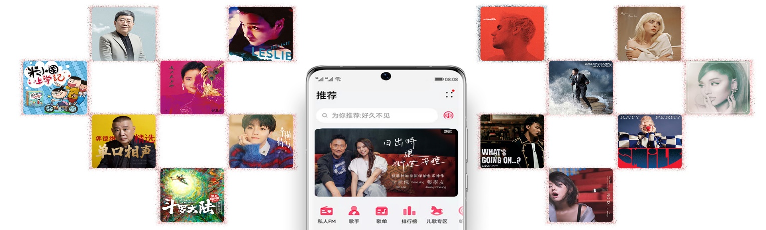
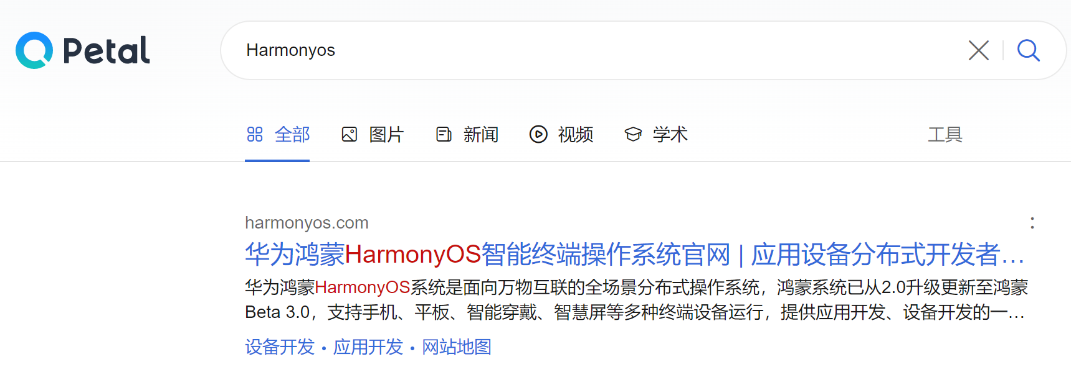
Knowledge Graph Application Scenario (1)
Lecture
12
The common application scenarios are as follows:
Precise recommendation
Music apps accurately recommend songs that you like to listen to.
Semantic search
Intelligent Q&A
Huawei Xiaoyi
Apple Siri
Microsoft Cortana Baidu Xiaodu
Retrieval technology
Knowledge graph
Deep learning
Exact keyword matching by the Petal search engine
The graph technology applies to the intelligent Q&A robots of major vendors.
Notes:
https://consumer.huawei.com/cn/mobileservices/music/
Precise recommendation: The recommendation system works with the knowledge graph to generate user profiles for precise recommendation.
Semantic search: Huawei Petal and other search engines can accurately match the knowledge you search for.
Intelligent Q&A: Siri, Xiaodu, Cortana...

Slide 18
Knowledge Graph Application Scenario (2)
Lecture
12
Oil and Gas Knowledge Computing
Straight well
Well
Pattern layer (Ontology)
Block
Concept
Oil well
Item | Value
Measured horizontal coordinate | 3.81980698645996E7
Name | Pool 155
Borehole depth | 2710.0
Measured vertical coordinate | 5883120.49477415
Kelly bushing elevation | 1571.779
Measured borehole depth | 2710.0
Entity
Long 6 block
Location - Located in
Pool 21
Relationship
Long layer 9
Management - Belong to
Pool 11
Layer - Drilling catching
Data layer
Layer - Drilling catching
www.midocean.ae
Notes:
An example graph in the oil field shows entity types such as oil wells, reservoirs, and blocks. Oil wells have their own property information.
By constructing such a unified knowledge graph, you can provide a unified knowledge base entry, providing functions such as semantic search and Q&A, and use it in models of other scenarios based on graph representation.

Slide 19
Intelligent Driving

Slide 20

Intelligent Driving Will Lift Society to New Heights
Lecture
12
About 1.2 million people die from traffic accidents every year.
In 2019, more than 60,000 people died from traffic accidents in China.
90% of traffic accidents are caused by human error.
Huge reductions in road accidents
Third living space
Convenient and
efficient travel
"Mobile third space": Intelligent vehicles automate driving, to give drivers and passengers a multi-functional space for new entertainment, social networking, and retail scenarios.
With an emphasis on passenger experience, consumer demand will concern industries such as media, entertainment, retail, and health. Its reported 63% of people use the time traveling to socialize, and nearly 25% want to spend the time on fitness.
Intelligent driving enables special groups to drive on roads.
China - 75% of roads in major cities suffer from traffic jams during peak hours, with an average traffic delay of one hour.
Vehicle-road collaboration using an intelligent transportation system (ITS) can greatly improve traffic efficiency.
University of Michigan estimates one shared autonomous vehicle can replace 9.34 conventional vehicles.
Intelligent driving
www.midocean.ae
Notes:
Continuous iteration for zero accident and zero casualty: More than 90% of accidents are caused by human errors and drunk driving. Convenient travel: Intelligent driving improves traffic efficiency, reduces driving and parking time, and enables the elderly, disabled, and children to travel conveniently. The third living space: Passengers are completely free during travel and can rest, work, and entertain in vehicles.
Image source: http://3ms.huawei.com/multimedia/docMaintain/mmMaintain.do?method=showMMDetail&f_id=img202008150653

Slide 21
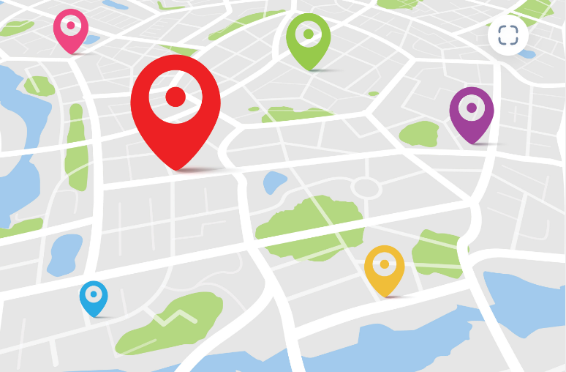
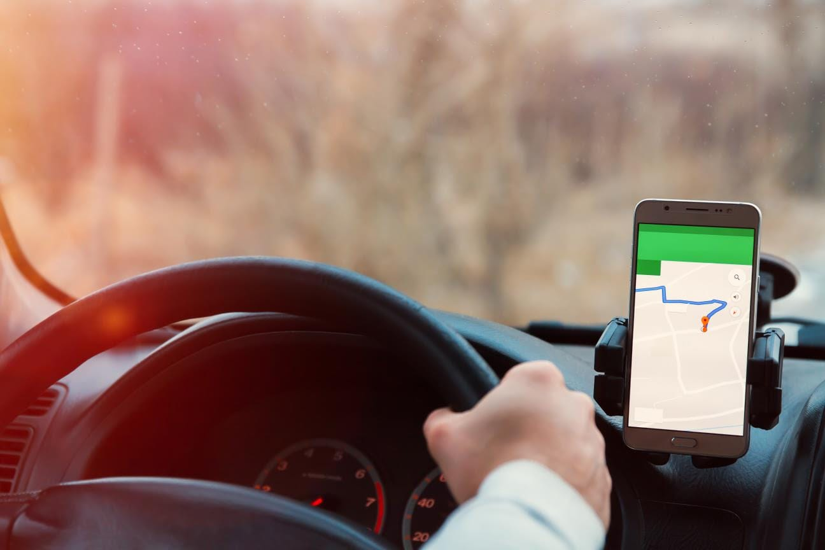
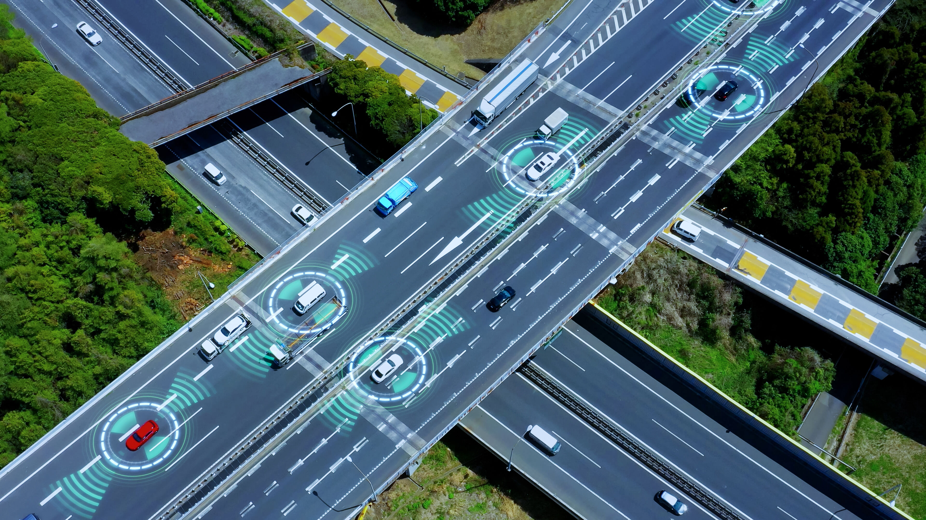
Manual Driving vs. Intelligent Driving
Lecture
Lecture
12
12
How do I get there?
Sensing, positioning, map, and planning and control (PnC)
Where am I?
Sensing, positioning, and mapping
Where am I going?
Navigation and map
Sensing & positioning
Eyes & ears
Cameras & radars
Decision-making & planning
Brain
Central control unit
Control
Hands & feet
Steering wheel & pedals
www.midocean.ae
Notes:
Left: http://3ms.huawei.com/km/static/image/detail.html?fid=63381
Middle: smartvi
Right: http://3ms.huawei.com/km/static/image/detail.html?fid=61786

Slide 22
Three Subsystems of Intelligent Driving
Lecture
Lecture
12
12
Sensing
Thinking
Acting
Ultrasonic radar
Millimeter-wave radar
Camera
Lidar
5G/Vehicle-to-everything (V2X)
......
Sensing
Convergence
Positioning
Planning
Prediction
Decision-making
Control
......
Drive system
Braking system
Steering system
Drive train
Security system
Comfort system
.......
www.midocean.ae

Slide 23

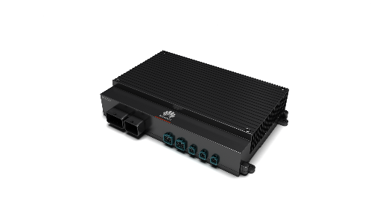

Huawei MDC: Leading Intelligent Driving Computing Platform
Lecture
Lecture
12
12
Personal travel
Long-distance transportation
RoboTaxi
Campus commute
Street cleaning
Logistics
Freight transportation
Third-party scenario-specific algorithms
(from partners)
MDC Intelligent driving computing platform
Huawei hardware (CPU/AI processor) + Software (vehicle control OS platform) + Tool chain
Camera
Millimeter-wave/
ultrasonic radar
Lidar
T-BOX
GPS
Chassis-by-wire
Sensors/X-by-wire
(from partners)
www.midocean.ae
Notes:
Huawei MDC intelligent driving computing platform accelerates commercial launch of intelligent driving vehicles through a "platform + ecosystem" approach.
Huawei MDC consists of the hardware platform, software platform, and tool chain. The software platform is compatible with AUTOSAR.
The hardware platform can be interconnected with products of multiple sensor and X-by-wire partners; the software platform supports application algorithms of different partners, such as sensing, convergence, positioning, decision-making, planning, and control. These algorithms enable various intelligent driving scenarios, such as long-distance transportation and campus commute.
Huawei MDC leverages the power of the platform and ecosystem to reduce costs and quickly implement scenario-based intelligent driving.

Slide 24
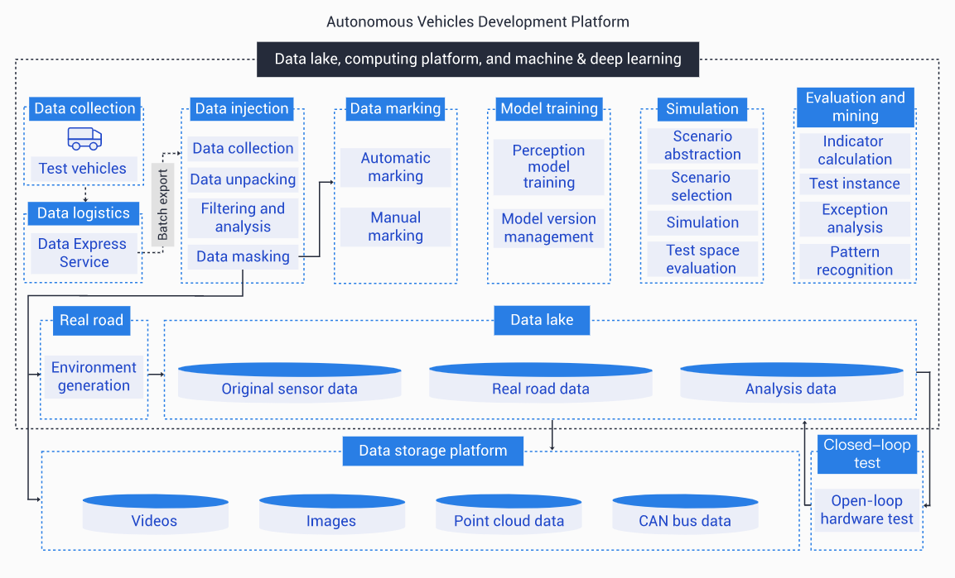
Autonomous Driving Cloud Service: One-Stop Development Platform for Autonomous Vehicles
Lecture
12
Data services:
  Data storage management, processing pipeline, overview, and playback, as well as an annotation platform
Training services:
  Training tasks, algorithm and model management, algorithm iteration, and model evaluation
Simulation services:
  Simulated scenarios, online simulations, task management, and simulation algorithms
Competitive advantages:
  Annotation platform
  Model training
  Parallel simulation
www.midocean.ae
Notes:
Data service: Data services of Huawei Octopus provide automatic processing of raw data collected by autonomous vehicles, facilitating data management, KPI statistics collection, and problem point playback and locating. In addition, Octopus can create new training datasets through the annotation platform.
Data storage: PB-level massive data storage supports data import from OBS and physical drives.
Data processing pipeline: The pipeline provides automatic RosBag data parsing, playback transcoding, and statistics analysis.
Data overview: The takeover dashboard and data overview dashboard allow you to quickly view fleet data and track overview.
Data playback: Playbacks contain detailed image information about sensor data during drive tests.
Annotation platform: Online annotation includes manual labeling and automatic labeling, improving labeling efficiency.
Data management: Major data sets in the industry, such as Pascal VOC, can be generated, imported, and managed.

Slide 25
Transformers

Slide 26

Lecture
12
Transformer Model :
transformer model is a neural network that learns context and thus meaning by tracking relationships in sequential data like the words in this sentence.
Transformer models apply an evolving set of mathematical techniques, called attention or self-attention, to detect subtle ways even distant data elements in a series influence and depend on each other.
They're called "transformers" because they transform one piece of information into another.
www.midocean.ae

Slide 27
Lecture
12
Transformer Model :
Simply translating word by word in the order of appearance may result in an output that a human Japanese speaker would consider ungrammatical. For instance, in Japanese the verbs are placed at the end of the utterance, whereas this never happens in English. One of the main questions in sequence transduction is the learning of representations for both the input and output sequences in a robust manner, so that no distortions are introduced. You do not want to mistranslate an important message.
The magic of machine translation works thanks to two components in the architecture: the encoder and decoder. The former is the element that receives each component of the input sequence, encoding (hence the name) it into a vector carrying the context information about the whole sequence. This is sent to the decoder whose job is to understand the context and resolve the output meaningfully.
www.midocean.ae

Slide 28
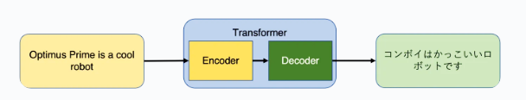
Lecture
12
Transformer Model :
As we can see, "memory" alone in the model (such as in an LSTM) may not be enough. We need "attention" to help further improve tasks such as machine translation be. Let us take a look at what attention does.
In a sequence-to-sequence model the encoder passes only the last hidden state as the context to the decoder. When attention is used, the encoder passes not only the last hidden state, but actually all of them. This means that the decoder may have a bit more work to do than before. This extra processing is needed as now every hidden state received is associated with a given part of the input sequence. In our sample sentence "Optimus Prime is a cool robot" the first hidden state is related to the word "Optimus", the second to the word "Prime", the third one to "is" and so on. In this way, the decoder gets to do more, but also receives much more information.
www.midocean.ae

Slide 29
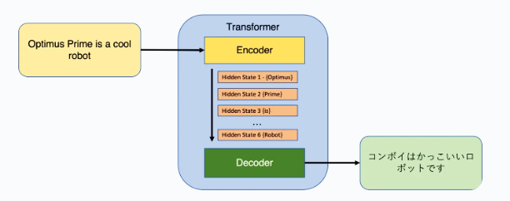
Lecture
12
Transformer Model :
The job of the decoder is now to calculate the weight for each hidden state received by the encoder. This is done with the decoder's own hidden state, in other words, the output of the previous time step in the model. The aim is to provide greater importance to hidden states with higher weight values, and this is our new context vector. We can then use this context as input to the decoder’s feed forward neural net to obtain the output sequence we are after. In turn the output sequence is used as the hidden state of the decoder that is sued in the calculation of weights in the next time step.
www.midocean.ae

Slide 30
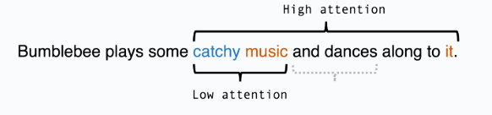
Lecture
12
Transformer Model :
Attention is Key: At the heart of transformers is something called "attention." Imagine you're reading a sentence, and you want to understand it. Your brain doesn't treat each word equally; it pays more attention to important words. Transformers do the same thing with data.
Self-Attention: Transformers use "self-attention" to decide which parts of the input data are most important. For example, in a sentence like "The cat chased the mouse," self-attention helps the model focus on "cat" when trying to understand the word "chased."
www.midocean.ae

Slide 31
Lecture
12
Transformer Model :
No Recurrence: Unlike traditional recurrent neural networks (RNNs) that process data in order, transformers can process all parts of the data at the same time. This makes them very fast and good at understanding long-range relationships in data.
Layers and Stacking: Transformers have many layers, each with its own attention mechanism. These layers work together, with each layer adding more understanding and context to the data. It's like solving a puzzle piece by piece.
Applications: Transformers have been used in many applications, from language translation (like Google Translate) to chatbots, image recognition, and more. They're especially great at handling sequences, like sentences in natural language.
www.midocean.ae

Slide 32

Thank You
eman.elgalad@esu.ac.ae
www.midocean.ae

