Slide 1



IT111 - Introduction to Information Technology
Bachelor of Science in Information Technology
Lecture 8 Computer Organization (Continue)
Prof. Lamiaa Fattouh Ibrahim
Everyone Smart University
Faculty of Informatics
Spring 2023
1
Introduction to Information Technology, Prof. Lamiaa Fattouh Ibrahim, Spring 2022-2023

Slide 2
Objectives
After studying this chapter, the student should be able to:
Simple Computer
Distinguish the two major trends in the design of computers.
Understand how computer throughput can be improved
using pipelining and parallel processing.

Slide 3
5-8 A SIMPLE COMPUTER
To explain the architecture of computers as well as their instruction processing, we introduce a simple (unrealistic) computer. Our simple computer has three components: CPU, memory, and an input/output subsystem.

Slide 4
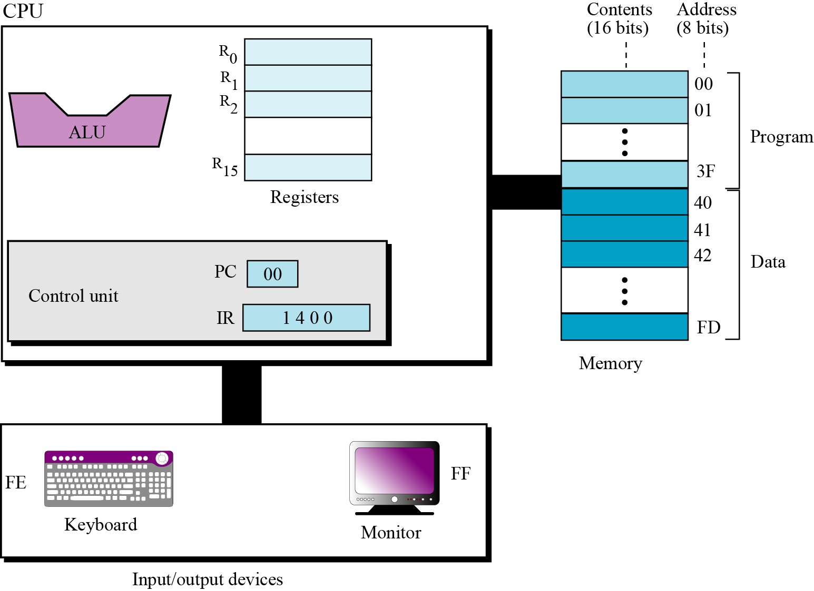
The Components of a Simple Computer
0 | 1 | 1 | 0 | 1 | 1 | 0 | 0 | 0 | 1 | 0 | 1 | 0 | 1 | 0 | 1
One Register (16 bits)

Slide 5
Instruction set
Our simple computer is capable of having a set of sixteen instructions, although we are using only fourteen of these instructions. Each computer instruction consists of two parts: the operation code (opcode) and the operand (s). The opcode specifies the type of operation to be performed on the operand (s). Each instruction consists of sixteen bits divided into four 4-bit fields. The leftmost field contains the opcode and the other three fields contains the operand or address of operand (s), as shown in Figure 5.31.

Slide 6
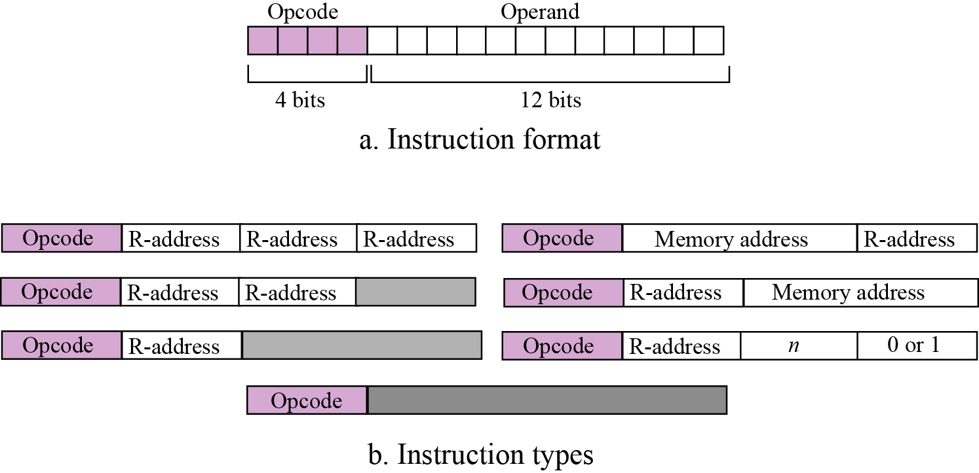
Figure 5.31 Format and different instruction types

Slide 7
5.8.5 Processing the instructions
Our simple computer, like most computers, uses machine cycles. A cycle is made of three phases: fetch, decode, and execute. During the fetch phase, the instruction whose address is determined by the PC is obtained from the memory and loaded into the IR. The PC is then incremented to point to the next instruction. During the decode phase, the instruction in IR is decoded and the required operands are fetched from the register or from memory. During the execute phase, the instruction is executed, and the results are placed in the appropriate memory location or the register. Once the third phase is completed, the control unit starts the cycle again, but now the PC is pointing to the next instruction. The process continues until the CPU reaches a HALT instruction.

Slide 9
An example
Let us show how our simple computer can add two integers A and B and create the result as C. We assume that integers are in two’s complement format. Mathematically, we show this operation as:
We assume that the first two integers are stored in memory locations (40)₁₆ and (41)₁₆ and the result should be stored in
memory location (42)₁₆. To do the simple addition needs five instructions, as shown next:

Slide 10
In the language of our simple computer, these five instructions are encoded as:

Slide 11

5.8.6 Storing program and data
We can store the five-line program in memory starting from location (00)₁₆ to (04)₁₆. We already know that the data needs to be stored in memory locations (40)₁₆, (41)₁₆, and (42)₁₆.
0000 | 40
0000 | 41
0000 | 42

Slide 12
5.8.7 Cycles
Our computer uses one cycle per instruction. If we have a small program with five instructions, we need five cycles. We also know that each cycle is normally made up of three steps: fetch, decode, execute. Assume for the moment that we need to add 161 + 254 = 415. The numbers are shown in memory in hexadecimal is, (00A1)₁₆, (00FE)₁₆, and (019F)₁₆.
00A1 | 40
00FE | 41
019F | 42

Slide 13
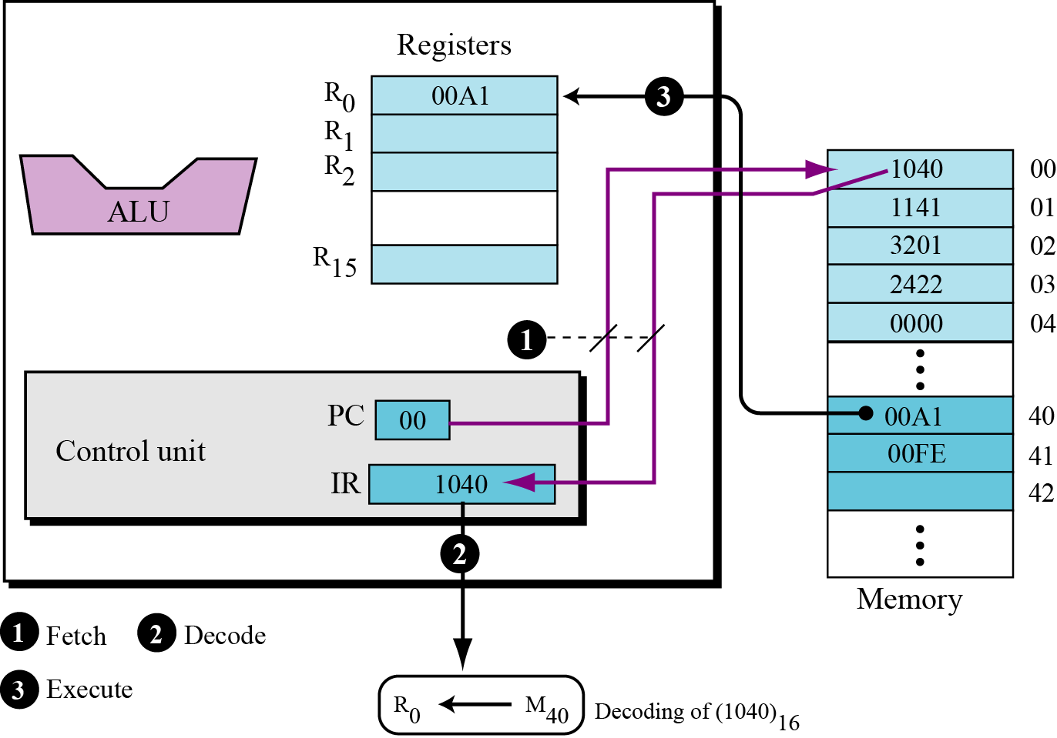
Figure 5.32 Status of cycle 1

Slide 14
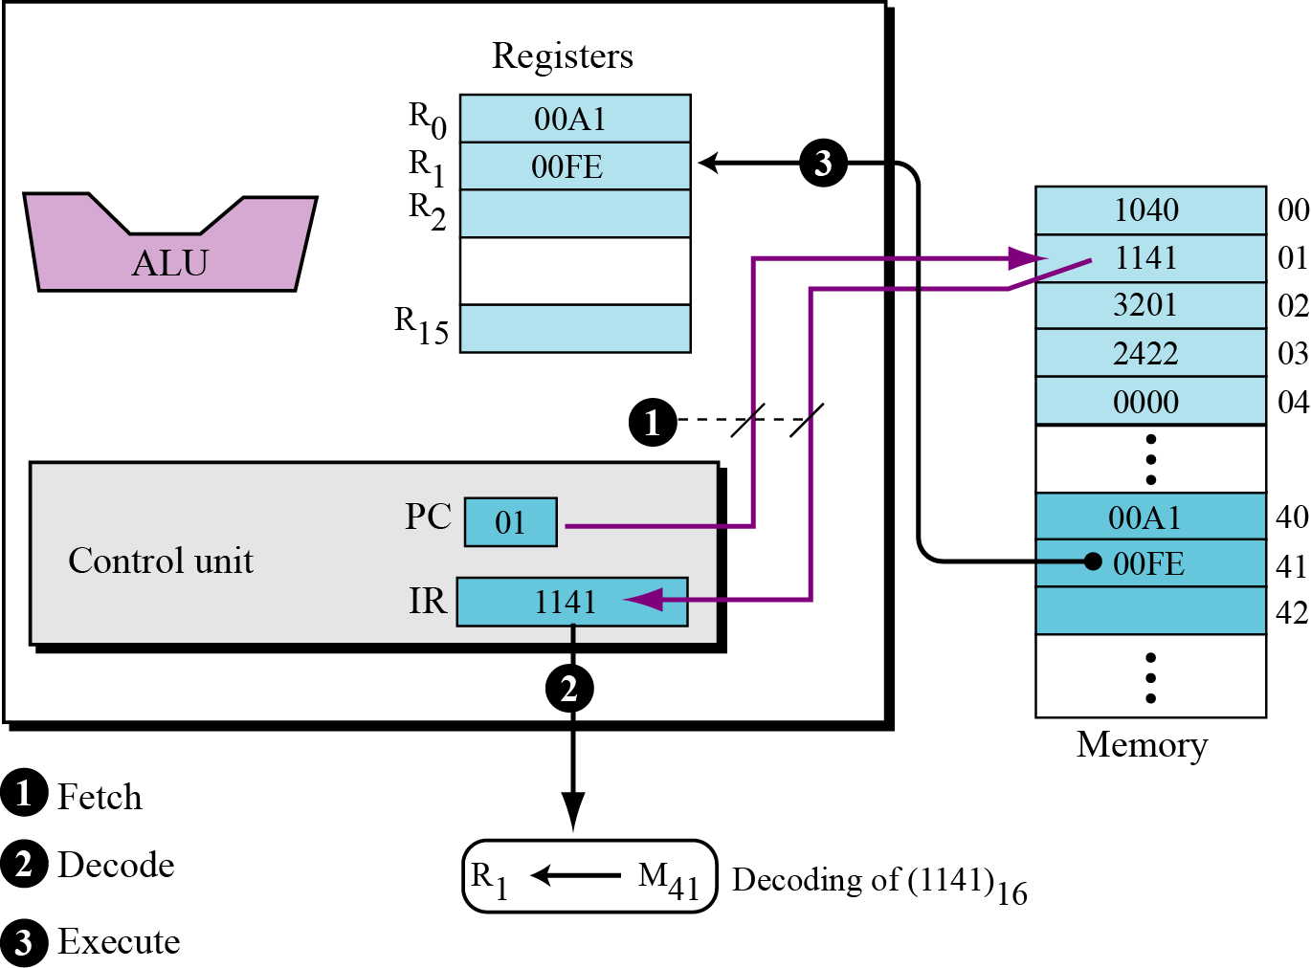
Figure 5.33 Status of cycle 2

Slide 15
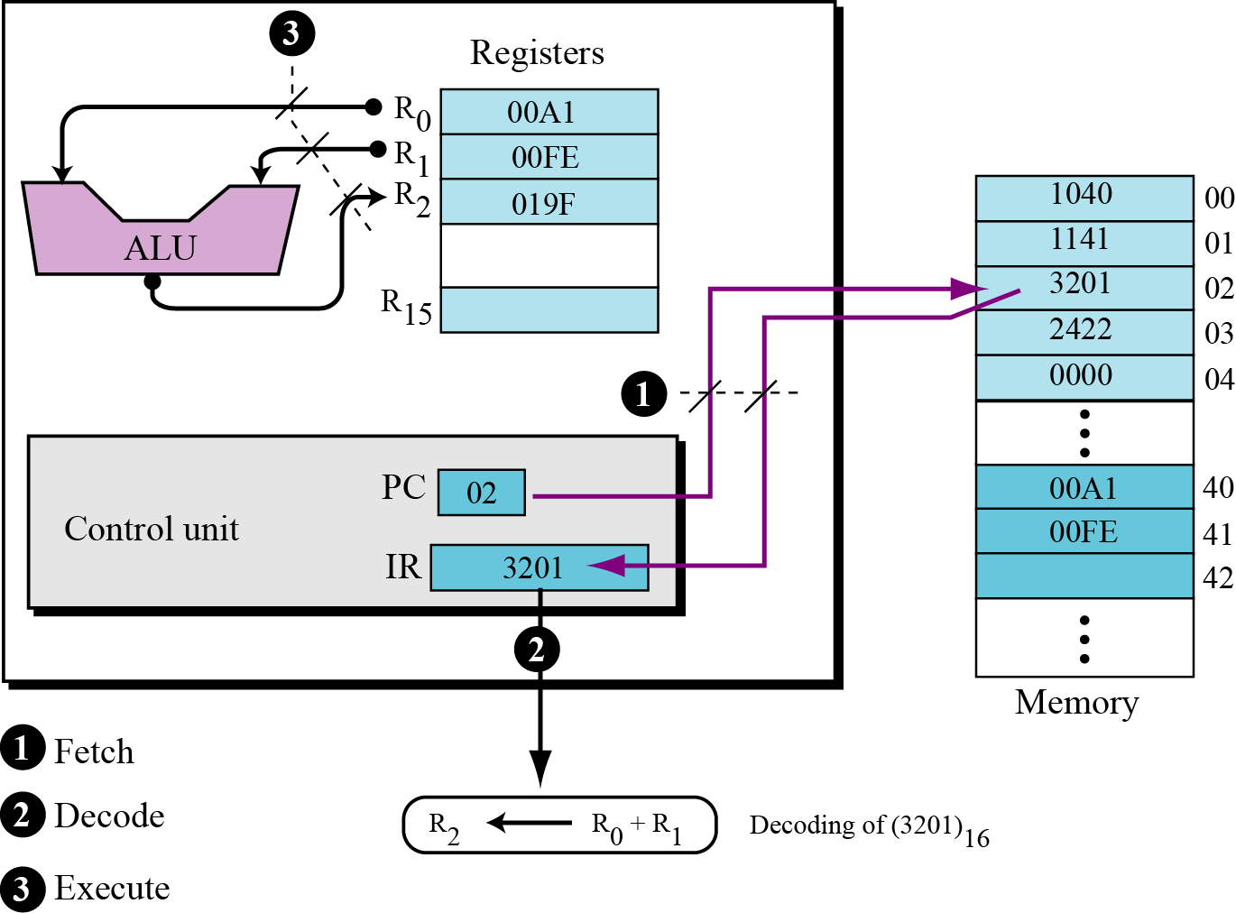
Figure 5.34 Status of cycle 3

Slide 16
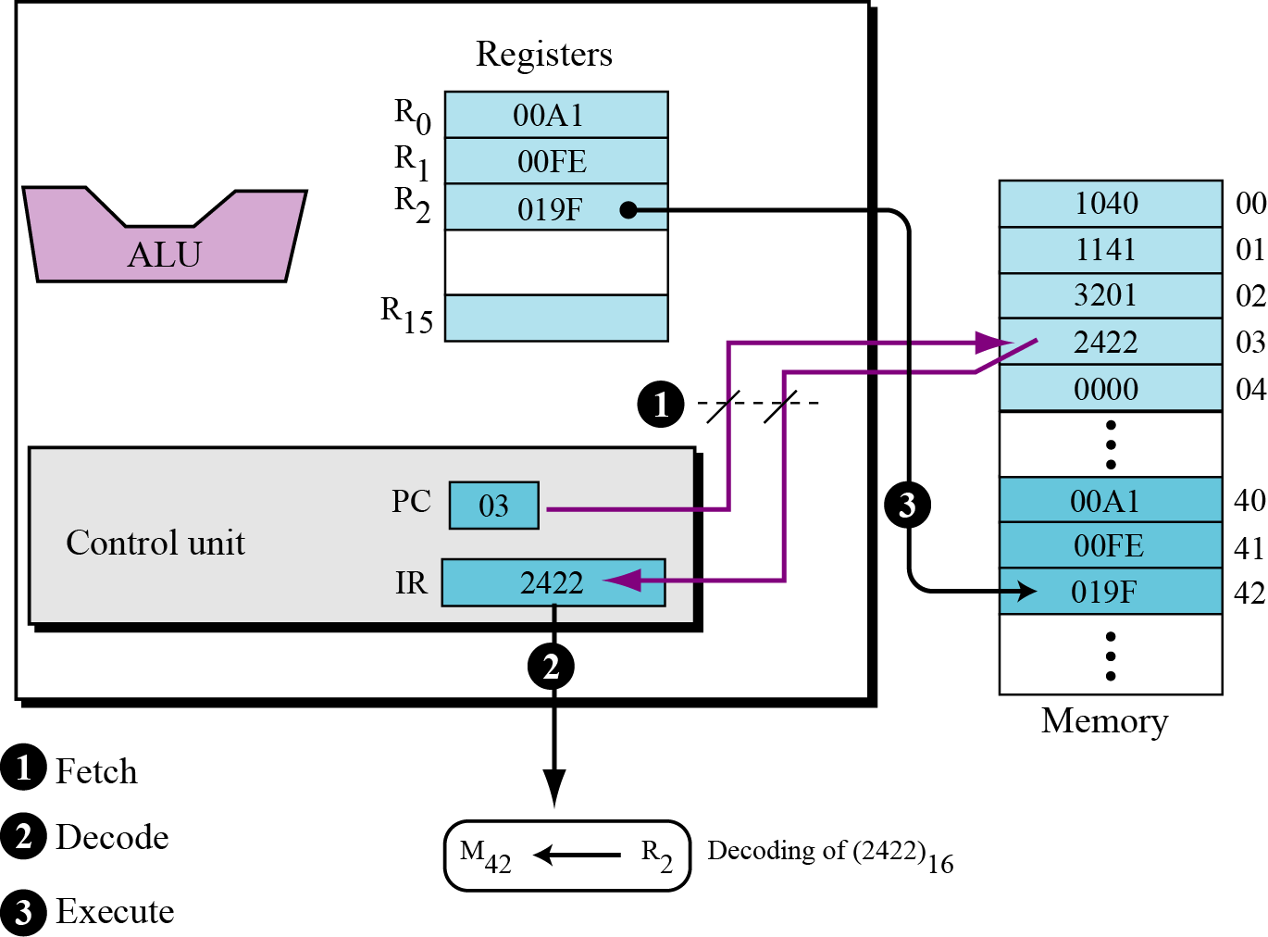
Figure 5.35 Status of cycle 4

Slide 17
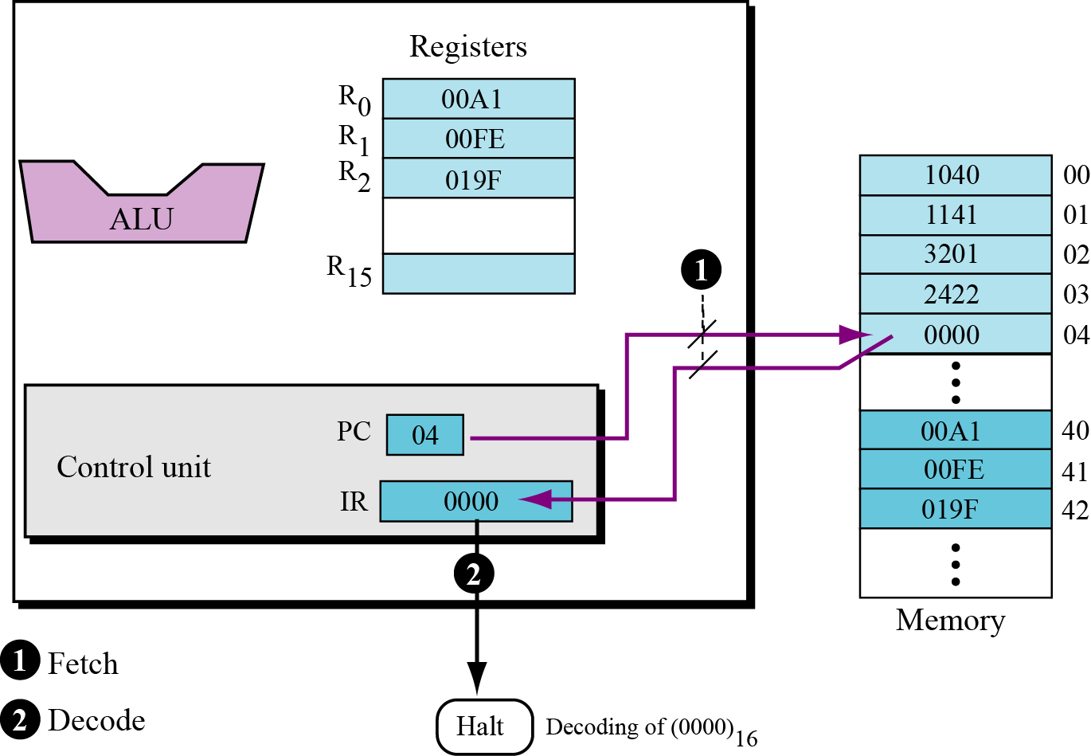
Figure 5.36 Status of cycle 5

Slide 18
5.8.8 Another example
In the previous example we assumed that the two integers to be added were already in memory. We also assume that the result of addition will be held in memory. You may ask how we can store the two integers we want to add in memory, or how we use the result when it is stored in the memory. In a real situation, we enter the first two integers into memory using an input device such as keyboard, and we display the third integer through an output device such as a monitor. Getting data via an input device is normally called a read operation, while sending data to an output device is normally called a write operation. To make our previous program more practical, we need modify it as follows:

Slide 19
In our computer we can simulate read and write operations using the LOAD and STORE instruction. Furthermore, LOAD and STORE read data input to the CPU and write data from the CPU. We need two instructions to read data into memory or write data out of memory. The read operation is:

Slide 20
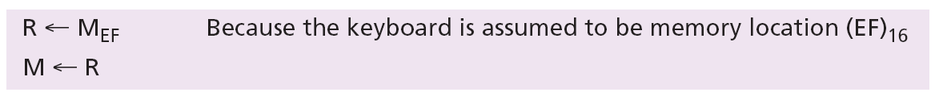

The write operation is:
i
The input operation must always read data from an input device into memory: the output operation must always write data from memory to an output device.

Slide 21
The program is coded as:
Operations 1 to 4 are for input and operations 9 and 10 are for output. When we run this program, it waits for the user to input two integers on the keyboard and press the enter key. The program then calculates the sum and displays the result on the monitor.

Slide 22
5-7 DIFFERENT ARCHITECTURES
The architecture and organization of computers has gone through many changes in recent decades. In this section we discuss some common architectures and organization that differ from the simple computer architecture we discussed earlier.

Slide 23
5.7.1 CISC
CISC (pronounced sisk) stands for complex instruction set computer (CISC). The strategy behind CISC architectures is to have a large set of instructions, including complex ones. Programming CISC-based computers is easier than in other designs because there is a single instruction for both simple and complex tasks. Programmers therefore do not have to write a set of instructions to do a complex task.

Slide 24
5.7.2 RISC
RISC (pronounced risk) stands for reduced instruction set computer. The strategy behind RISC architecture is to have a small set of instructions that do a minimum number of simple operations. Complex instructions are simulated using a subset of simple instructions. Programming in RISC is more difficult and time-consuming than in the other design because most of the complex instructions are simulated using simple instructions.

Slide 25
5.7.3 Pipelining
We have learned that a computer uses three phases of fetch, decode, and execute for each instruction. In early computers, these three phases needed to be done in series for each instruction. In other words, instruction n needs to finish all of these phases before the instruction n + 1 can start its own phases. Modern computers use a technique called pipelining to improve the throughput (the total number of instructions performed in each period of time). The idea is that if the control unit can do two or three of these phases simultaneously, the next instruction can start before the previous one is finished.

Slide 26
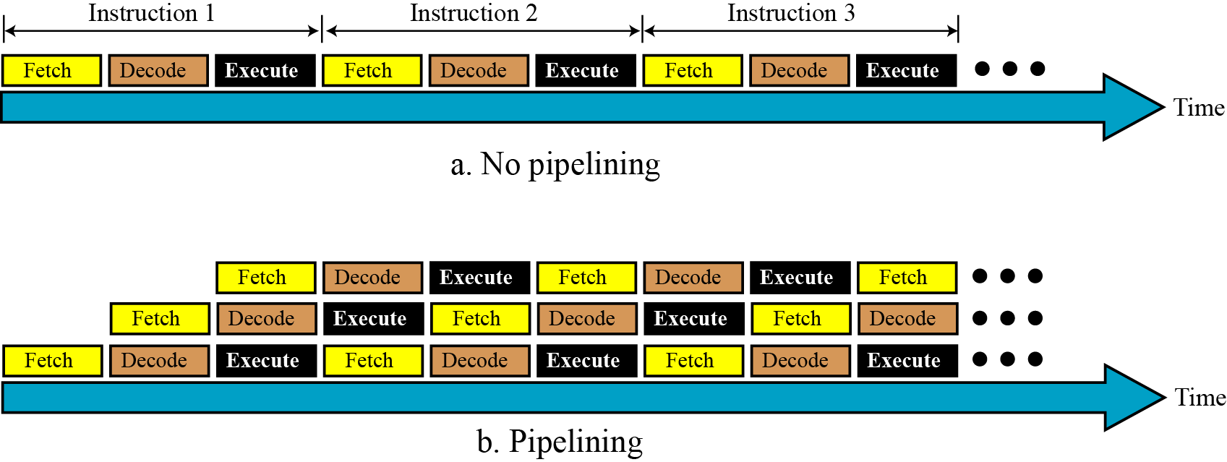
Figure 5.24 Pipelining

Slide 27
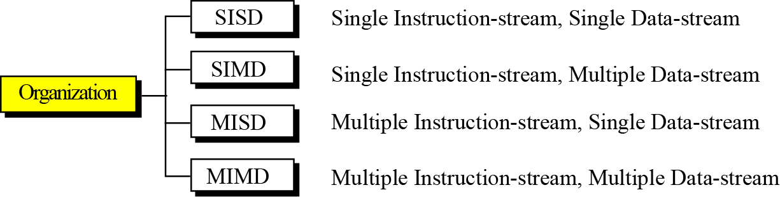
5.7.4 Parallel processing
Traditionally a computer had a single control unit, a single arithmetic logic unit, and a single memory unit. With the evolution in technology and the drop in the cost of computer hardware, today we can have a single computer with multiple control units, multiple arithmetic logic units and multiple memory units. This idea is referred to as parallel processing. Like pipelining, parallel processing can improve
throughput.
Figure 5.24 A taxonomy of computer organization

Slide 28
SISD organization
A single instruction-stream, single data-stream (SISD) organization represents a computer that has one control unit, one arithmetic logic unit, and one multiple memory units. The instructions are executed sequentially, and each instruction may access one or more data items in the data stream. Our simple computer introduced earlier in the chapter is an example of SISD organization.

Slide 29
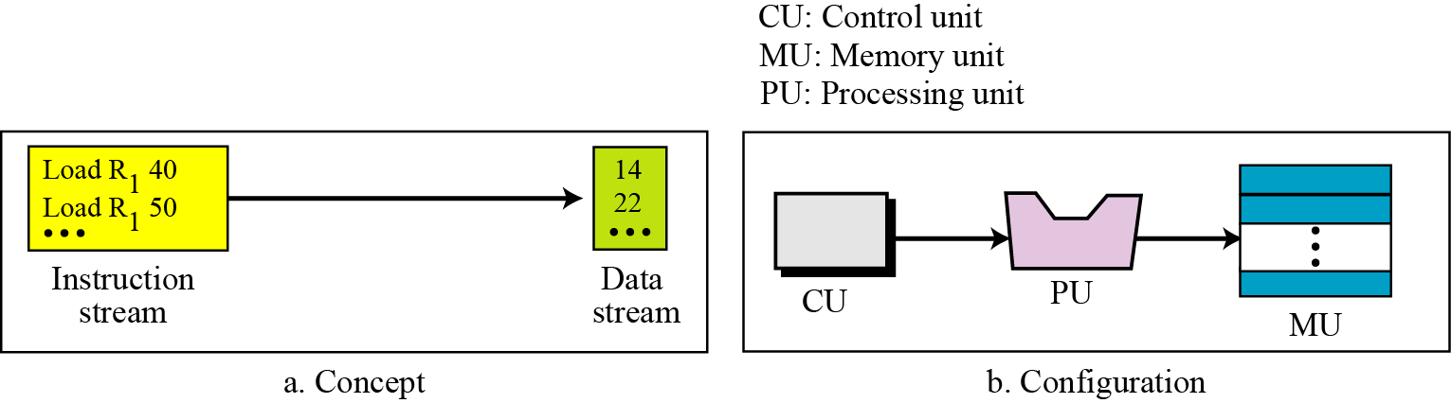
Figure 5.26 SISD organization

Slide 30
SIMD organization
A Single Instruction-stream, Multiple Data-stream (SIMD) organization represents a computer that has one control unit, multiple processing units, and multiple memory units. All processor units receive the same instruction from the control unit but operate on different items of data. An array processor that simultaneously operates on an array of data belongs to this category.

Slide 31
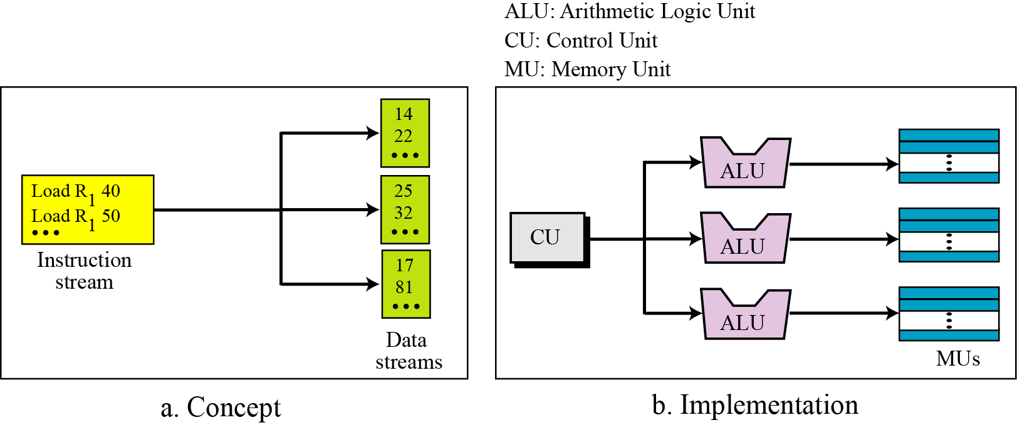
Figure 5.27 SIMD organization

Slide 32
MISD organization
A multiple instruction-stream, single data-stream (MISD) architecture is one in which several instructions belonging to several instruction streams simultaneously operate on the same data stream.

Slide 33
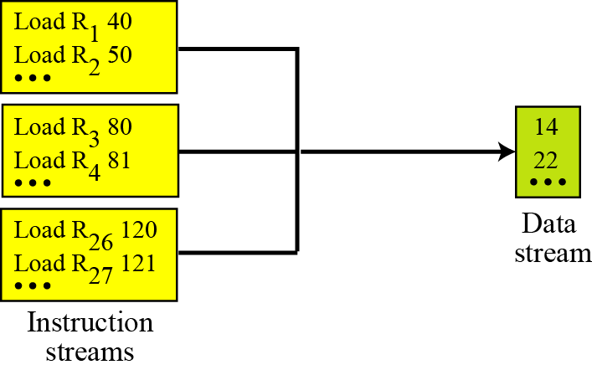
Figure 5.28 MISD organization

Slide 34
MIMD organization
A multiple instruction-stream, multiple data-stream (MIMD) architecture is one in which several instructions belonging to several instruction streams simultaneously operate on several data streams (each instruction on one data stream). MIMD organization is considered as a true parallel processing architecture by some experts. In this architecture several tasks can be performed simultaneously. The architecture can use a single shared memory or multiple memory sections.

Slide 35
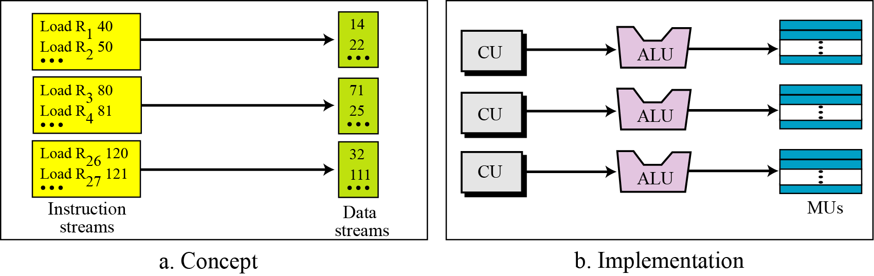
Figure 5.29 MIMD organization

Slide 36
Example
An imaginary computer has 16 data registers (R0 to R15), 1024 words in memory, and 16 different instructions (add, subtract, and so on).
a) What is the minimum size of an add instruction in bits if a typical instruction uses the following format: add M R2.
b) If the computer uses the same size of word for data and instructions, what is the size of each data register?
c) What is the size of the instruction register in the computer? What is the size of the program counter in the computer?
Solution:
minimum size of an add instruction in bits = 4 + 10 + 4 = 18 bits
what is the size of each data register = 18 bits
the size of the instruction register in the computer = 18
the size of the program counter in the computer = 10

Slide 37
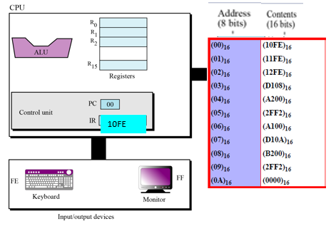
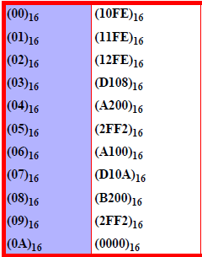
Example
What is the output if we input 3 integer: 1, 2, 3
Solution:
Output = 2

Slide 38
Summary
Simple Computer
Distinguish the two major trends in the design of computers.
Understand how computer throughput can be improved
using pipelining and parallel processing.

Slide 39
Thank You

