Slide 1

MGM 112
Introduction to Economics
Prepared by Dr. Maryem ZORGUI
Chapter 5
The Theory of the Firm

Slide 2


Slide 3
Syllabus
I- The Firm Theory
III- THE Costs
IV- The Revenue
II- Production Function
V- The Profit

Slide 4
I- The Firm Theory
I- 1- Context of the Theory of the Firm
I-2- The Production Theory
I-3- The Theory of the Firm
I-4- The Short Run versus the Long Run

Slide 5
I- The Firm Theory
I- 1- Context of the Theory of the Firm
Neoclassical Economics abandoned the production approach of the classicals to reconstruct economics as a mathematical science of behavior and markets expressing the interplay of demand and supply based on theories of marginal utility, marginal productivity, and universal scarcity.
The most famous of this approach are Alfred Marshall, William Stanley Jevons, Léon Walras…..
This approach is based on the Production Theory

Slide 6
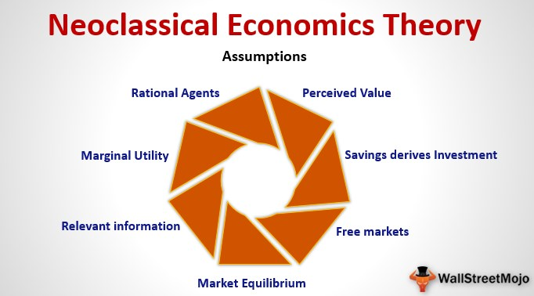
I- The Firm Theory

Slide 7
I- The Firm Theory
I-2- The Production Theory
Production theory forms the foundation for the theory of supply.
Production is the process by which factor inputs are transformed into output.
Production involves transformation of inputs such as capital, equipment, labor, and land into output - goods and servicesIn this production process, the manager is concerned with efficiency in the use of the inputs- technical vs. economical efficiency.

Slide 8
I- The Firm Theory
The production function can thus answer a variety of questions. It can, for example, measure the marginal productivity of a particular factor of production (i.e., the change in output from one additional unit of that factor).
It can also be used to determine the cheapest combination of productive factors that can be used to produce a given output.

Slide 9
I- The Firm Theory
The Production Decisions of a Firm
The production decisions of firms are analogous to the purchasing decisions of consumers, and can likewise be understood in three steps:
1. Production Technology
2. Cost Constraints
3. Input Choices
Factors of production are Inputs into the production process (e.g., labor, capital, and materials)

Slide 10
I- The Firm Theory
I-3- The Theory of the Firm
The Theory of the Firm describes how a firm makes costminimizing production decisions and how the firm’s resulting cost varies with its output
Managerial decision making involves four types of production decisions:
1. Whether to produce or to shut down
2. How much output to produce
3. What input combination to use
4. What type of technology to use

Slide 11
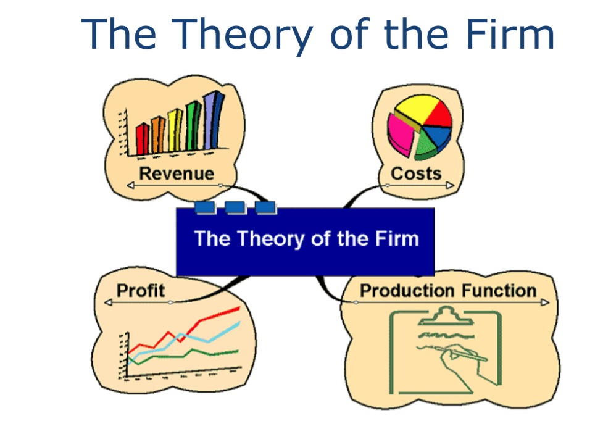
I- The Firm Theory

Slide 12
The Short Run versus the Long Run
I-4- The Short Run versus the Long Run
I-4-1- The short run
Short run is a period of time in which quantities of one or more production factors cannot be changed.
Fixed input Production factor that cannot be varied.
In the short run some inputs are fixed and some variable
.

Slide 13
The Short Run versus the Long Run
In the short run at least one factor fixed in supply but all other factors capable of being changed.
• It reflects ways in which firms respond to changes in output (demand).
• It Can increase or decrease output using more or less of some factors but some likely to be easier to change than others

Slide 14
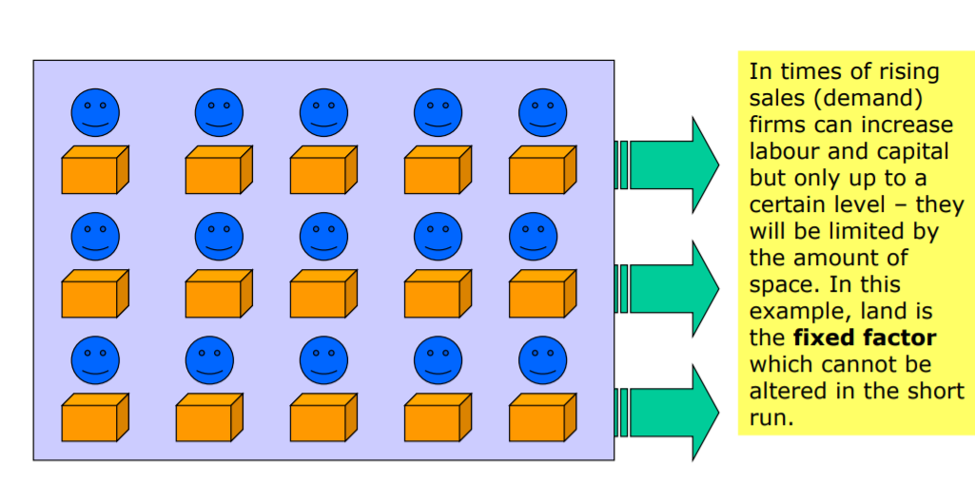
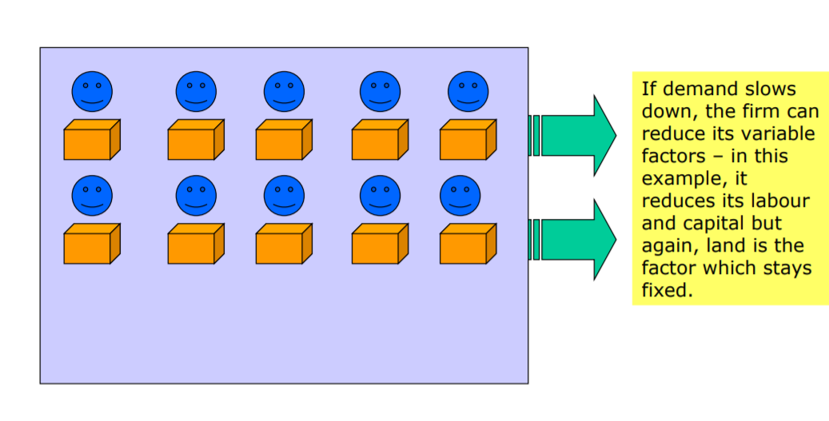
The Short Run versus the Long Run

Slide 15
The Short Run versus the Long Run
I-4-2- The long run
It is defined as the period of time taken to vary all factors of production
– By doing this, the firm is able to increase its total capacity
– not just short term capacity
– Associated with a change in the scale of production
– The period of time varies according to the firm and the industry – In electricity supply, the time taken to build new capacity could be many years; for a market stall holder, the ‘long run’ could be as little as a few weeks or months!

Slide 16
The Short Run versus the Long Run
In the long run all inputs become variable
The long run is the period in which a firm can adjust all inputs to changed conditions in the long run we can talk about returns to scale (compare latter with economies of scale, which is a cost related concept).

Slide 17
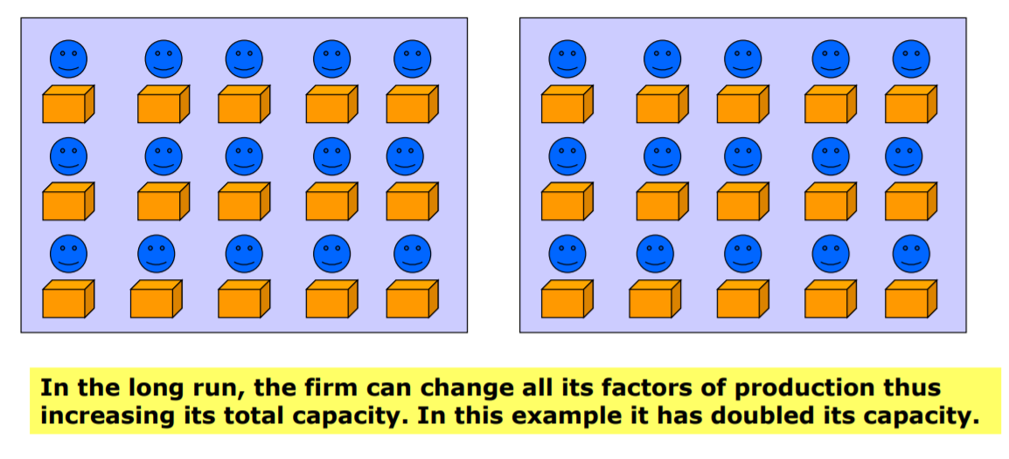
The Short Run versus the Long Run

Slide 18
The Short Run versus the Long Run
Short-Run Changes in Production Factor Productivity
How much does the quantity of Q change, when the quantity of L is increased?
Long-Run Changes in Production Returns to Scale
How much does the quantity of Q change, when the quantity of both L and K is increased?

Slide 19
II- Production Function
II-1- Definition
II-2- Determinants
II-3- The Production formula
II-4- The Production Table
II- 5- The Efficiency

Slide 20
II- Production Function
II-1- Definition
Production function, in Economics, is an equation that expresses the relationship between the quantities of productive factors (such as labour and capital) used and the amount of product obtained.
It states the amount of product that can be obtained from every combination of factors, assuming that the most efficient available methods of production are used.
It states the relationship between inputs and outputs

Slide 21
II- Production Function
The Producers Theory is concerned with the behavior of firms in hiring and combining productive inputs to supply commodities at appropriate prices.
Two sets of issues are involved in this process:
one is the technical constraints, which limit the range of feasible productive processes,
while the other is the institutional context such as the characteristics of the market where commodities and inputs are purchased and sold.

Slide 22
II- Production Function
II-2- Determinants
The determinants of the Production Function are the Inputs.
These inputs are classified as Land, Labour and Capital.
Land
all natural resources of the earth
* Price paid to acquire land = Rent

Slide 23
II- Production Function
Labour
all physical and mental human effort involved in production
* Price paid to labour = Wages
Capital
buildings, machinery and equipment not used for its own sake but for the contribution it makes to production
* Price paid for capital = Interest

Slide 24
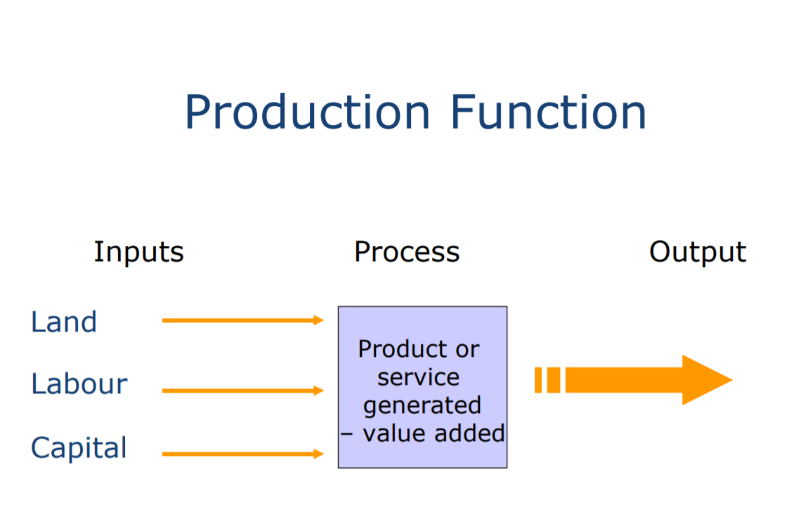
II- Production Function

Slide 25
II- Production Function
II-3- The Production formula
Mathematical representation of the linear Production Function
Q = f(X1, X2, …, Xk)
where * Q = output
* X1, …, Xk = inputs
If we will take 3 inputs (capital, land and labour), the output (Q) will be dependent upon the amount of capital (K), Land (L) and Labour (La) used Q = f (K, L, La)

Slide 26
II- Production Function
For our current analysis, we will reduce the input:
  capital (K)
  labour (L) Q = f(L, K)

Slide 27
II- Production Function
II-4- The Production Table
The production function can also be a table showing the maximum amount of output that can be produced from any specified set of inputs, given the existing technology
Same Q can be produced with different combinations of inputs.

Slide 28
II- Production Function
II- 5- The Efficiency
All of these outputs are assumed to be technically efficient
But which one is economically efficient?
Economic Efficiency: occurs when the cost of producing a given output is as low as possible
Technological efficiency: occurs when it is not possible to increase output without increasing inputs
The objective of efficiency will provide us with some basic rules about the manner in which firms should utilize inputs to produce goods and services.

Slide 29
II- Production Function
To maximize the output attainable with a given level of cost.
You will see that basic production theory is simply an application of constrained optimization:
the firm attempts either to minimize the cost of producing a given level of output or to maximize the output attainable with a given level of cost.
Both optimization problems lead to same rule for the allocation of inputs and choice of technology

Slide 30
III- THE Costs

Slide 31
III- THE Costs
In buying factor inputs, the firm will incur costs.
Costs are classified as:
– Fixed costs (FC): costs that are not related directly to production such as rent, rates, insurance costs, admin costs.
They can change but not in relation to output
– Variable Costs (VC): costs directly related to variations in output. Raw materials primarily

Slide 32
III- THE Costs
The Total Cost: the sum of all costs incurred in production
TC = FC + VC
• Average Cost: the cost per unit of output
AC = TC/Output
• Marginal Cost: the cost of one more or one fewer units of production
MC = TCn – TCn-1 units

Slide 33
III- THE COSTS
Short run: Diminishing marginal returns results from adding successive quantities of variable factors to a fixed factor.
Short-Run Changes in Production Factor Productivity
How much does the quantity of Q change, when the quantity of L is increased?
Long run: Increases in capacity can lead to increasing, decreasing or constant returns to scale.
Long-Run Changes in Production Returns to Scale
How much does the quantity of Q change, when the quantity of both L and K is increased?

Slide 34
IV- The Revenue

Slide 35
IV- The Revenue
Revenue is the income a firm retains from selling its products once it has paid indirect tax, such as VAT.
Revenue provides the income which a firm needs to enable it to cover its costs of production, and from which it can derive a profit.
Profit can be distributed to the owners, or shareholders, or retained in the business to purchase new capital assets or upgrade the firm’s technology.
Revenue is measured in three ways:

Slide 36
IV- The Revenue
• Total revenue:
the total amount received from selling a given output
TR = Σ (Px x Qx )
• Average Revenue:
the average amount received from selling each unit
AR = TR / Q
• Marginal revenue:
the amount received from selling one extra unit of output
MR = TRn – TR n-1 units

Slide 37
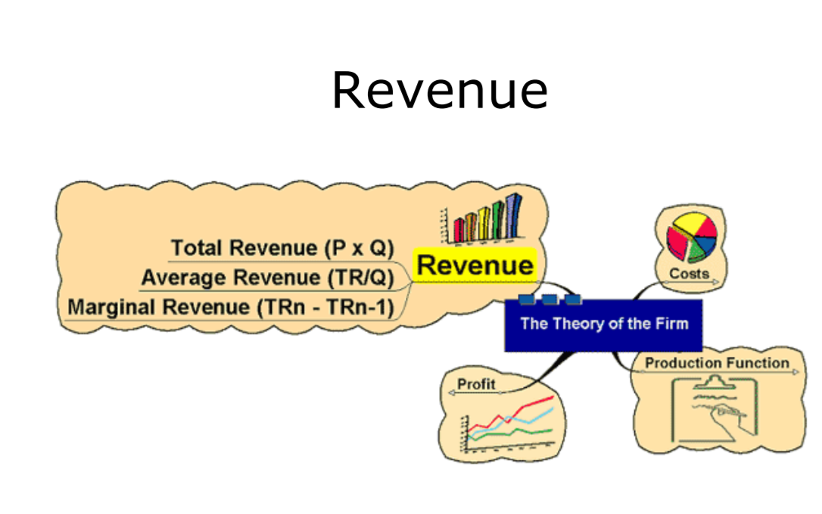
IV- The Revenue

Slide 38
V- The Profit

Slide 39
V- The Profit
Profit describes the financial benefit realized when revenue generated from a business activity exceeds the expenses, costs, and taxes involved in sustaining the activity in question.
Any profits earned funnel back to business owners, who choose to either pocket the cash or reinvest it back into the business.
Profit is calculated as total revenue less total expenses.

Slide 40
V- The Profit
Profit = TR – TC
The reward for enterprise
Profits help in the process of directing resources to alternative uses in free markets
Relating price to costs helps a firm to assess profitability in production

Slide 41
V- The Profit
Normal Profit:
The minimum amount required to keep a firm in its current line of production
• Abnormal or Supernormal profit:
profit made over and above normal profit
Abnormal profit may exist in situations where firms have market power
Abnormal profits may indicate the existence of welfare losses
Could be taxed away without altering resource allocation

Slide 42
V- The Profit
Sub-normal Profit:
profit below normal profit
Firms may not exit the market even if sub-normal profits made if they are able to cover variable costs
Cost of exit may be high
Sub-normal profit may be temporary (or perceived as such!)

Slide 43
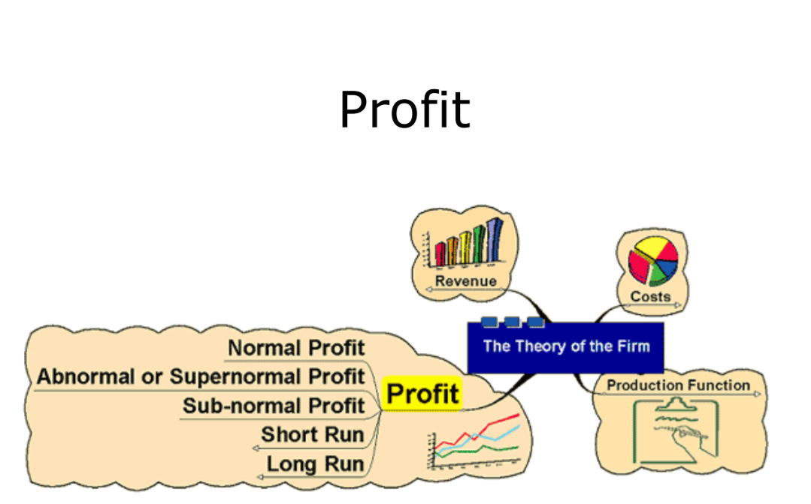
V- The Profit

Slide 44


Slide 45
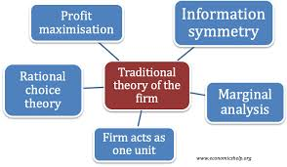

Slide 46
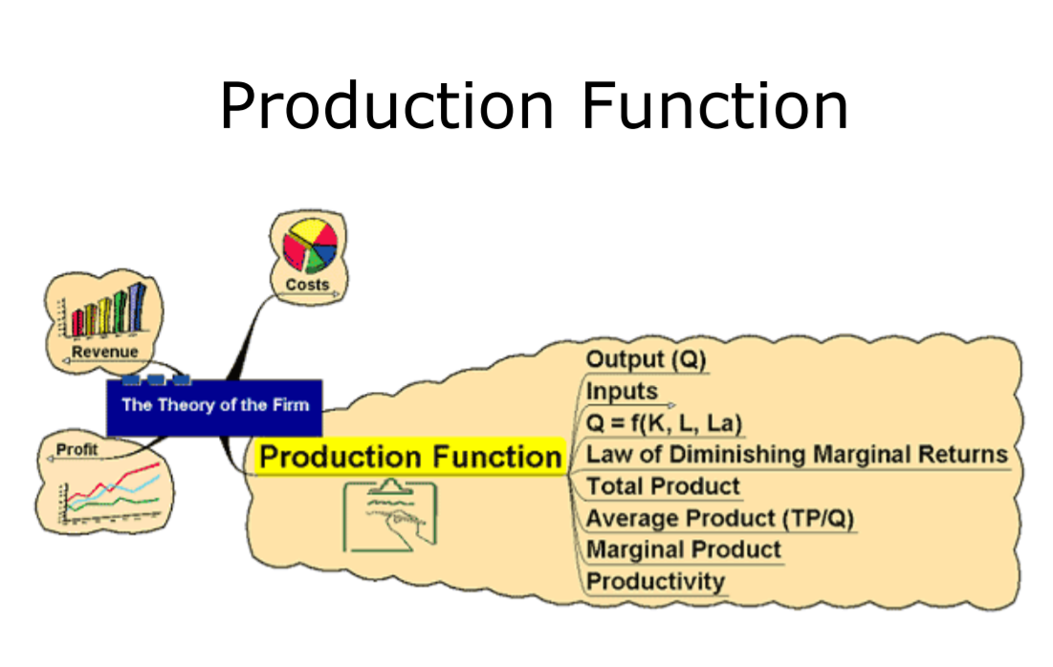
Production Function
Factor Costs:
• Labour wages/salaries
• Land rent
• Capital interest

Slide 47
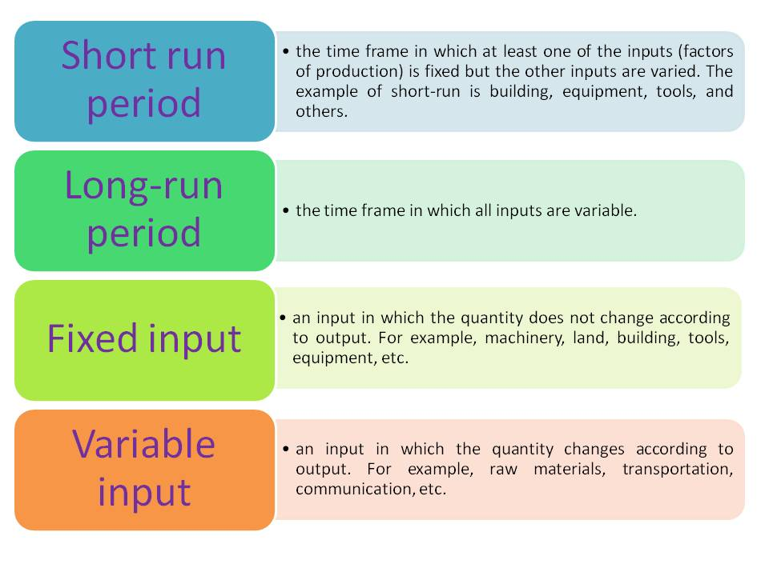
Production Function

Slide 48
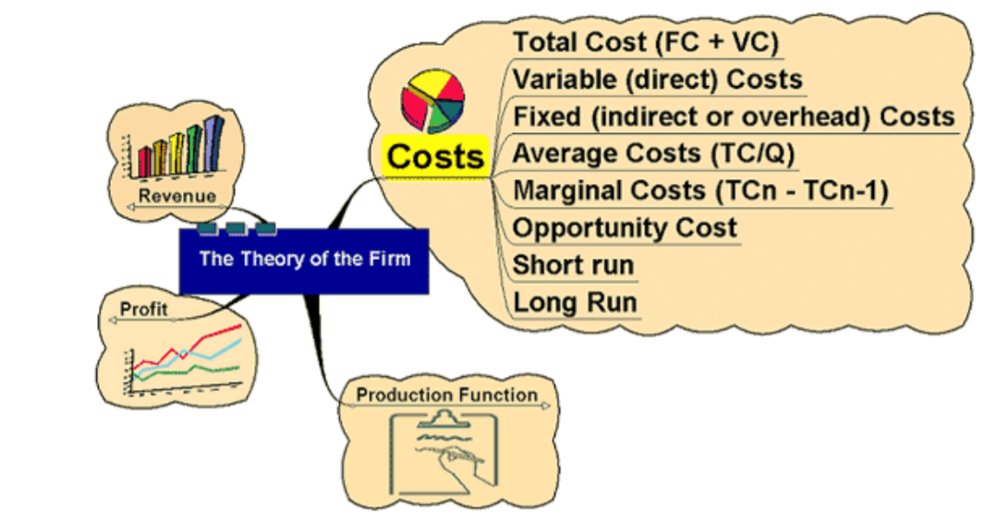
The Costs
Total Cost is the sum of all costs
( fixed, variable and semi-fixed)
• Fixed Costs do NOT depend on quantity produced: Rent, Rates, Insurance, etc.
• Variable Costs vary directly with the amount produced – raw materials •

Slide 49
The Revenue
Revenue:
amount received from the sale of goods or services
TR = P x Q

Slide 50
The Profit
Profit:
Difference between Revenue and Cost Π = TR - TC

Slide 51


